Slide 1
Study of the Elementary Reaction
Pete Markowitz
Florida International University

Slide 2
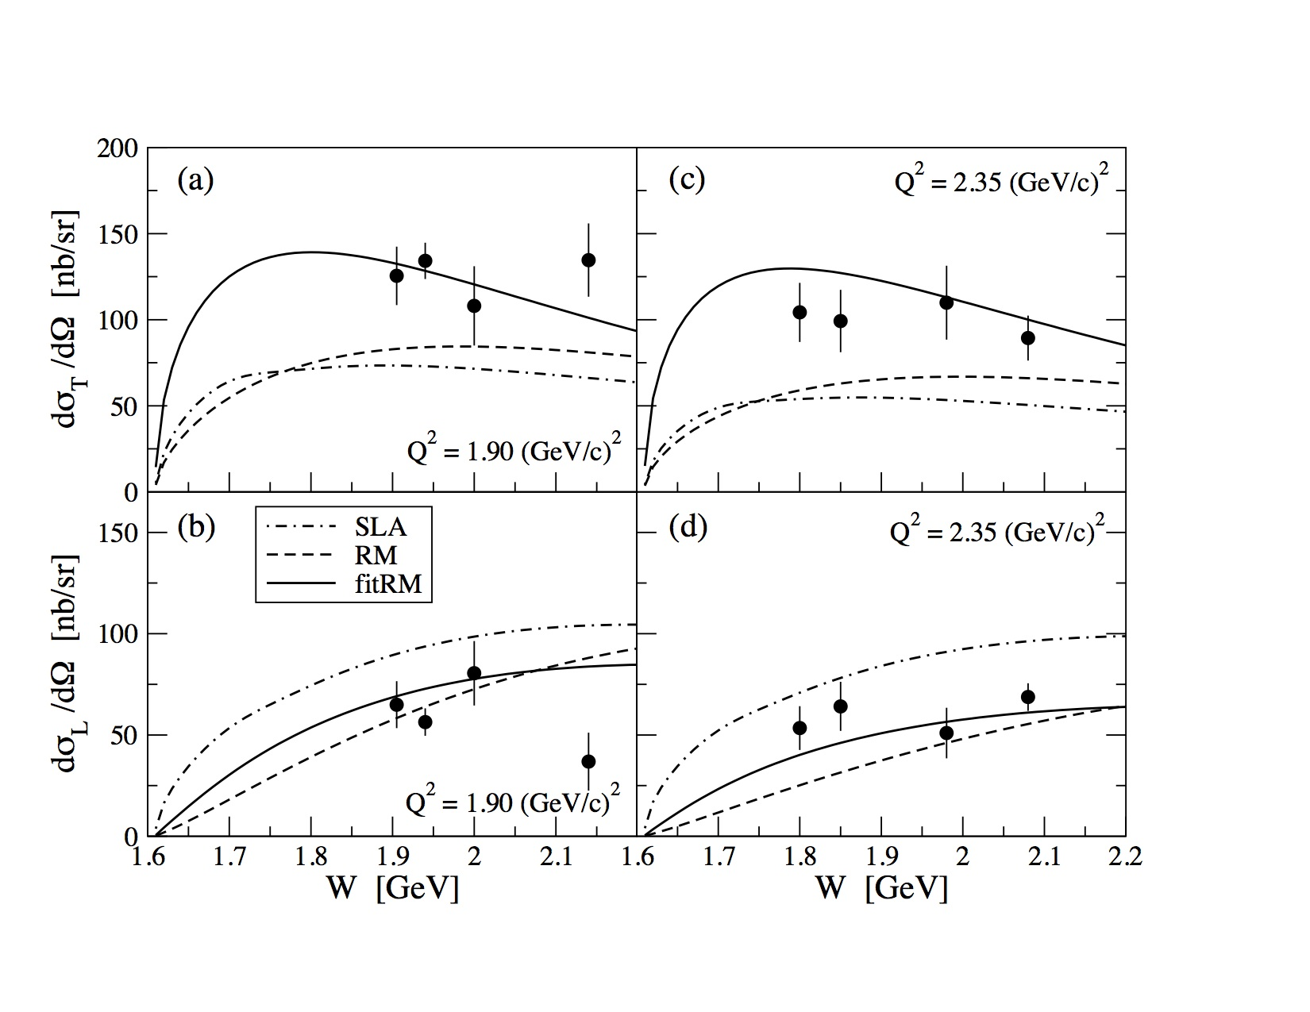
The Program in Halls A & C to date:
High Q² at large (“normal”) angles
Longitudinal and Transverse Structure Function Separation
Utilized standard cryotargets, spectrometers (HRS, HMS, SOS)
Required addition of Kaon PID (aerogel counters)
Showed sizable longitudinal response
Aimed at form factors, reaction mechanism, appropriate degrees of freedom (Regge models, isobar models,
To be continued in Hall C at 12 GeV (E12-09-011)

Slide 3
The Hypernuclear Program to date:
Low Q² at small angles
Same kinematics as hypernuclear spectroscopy
Elementary reaction is an ingredient of hypernuclear calculation
Typically start w/ photoproduction and extend to electroproduction
Intrinsically interesting however:
θ dependence at small angles not previously measured
W dependence still open
Ratio of Λ:Σ⁰ could reveal isospin of diquarks
Hypernuclear setup
Utilized cryogenic, waterfall or CH2 targets
Very clean spectra with low backgrounds
➔ Luminosity well understood but acceptances take work
Precise cross sections obtained
Odd piece of phase space
Critical for interpreting hypernuclear measurements
Almost real photons but …
Possible to do very limited Q² (slope?)

Slide 4
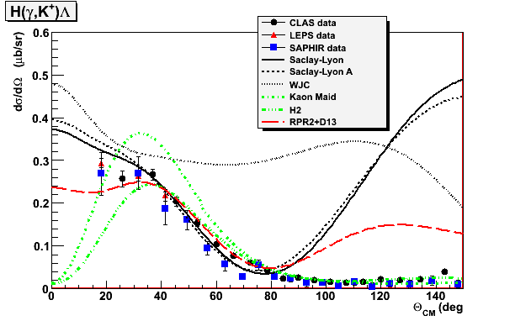
H target – The elementary process ¹H(e,e’K)Λ
JLab hypernuclear experiments detect K⁺ at small angles & low Q² (close to photon-point).
Region not covered existing photo- and electroproduction data CLAS, SAPHIR, and LEPS.
Lack forward angle data
Models differ at very forward angles.
Also makes interpretation of obtained hypernuclear spectra difficult.

Slide 5
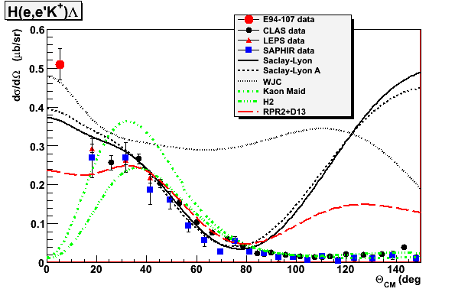
Results on H target – Angular distribution
None of the models is able to describe the data over the entire range
E94-107 data is electroproduction – could longitudinal amplitudes play a role?

Slide 6
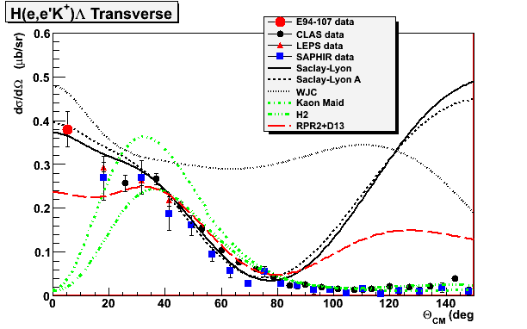
Results on H target – Transverse estimate
Estimate of purely transverse amplitudes
Still greater than most models predict

Slide 7
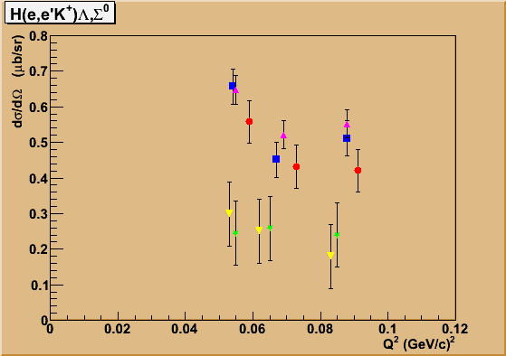
Λ {
Λ drops with increasing Q²
Σ⁰ essentially flat with Q²
Σ⁰ {

Slide 8
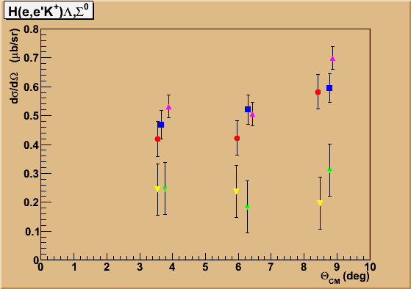
Λ drops with increasing Q²
Σ⁰ essentially flat with Q²
Λ slight rise with increasing Θ_{CM} ?
Σ⁰ essentially flat with Θ_{CM}
Λ {
Λ drops with increasing Q²
Σ⁰ essentially flat with Q²
Σ⁰ {

Slide 9
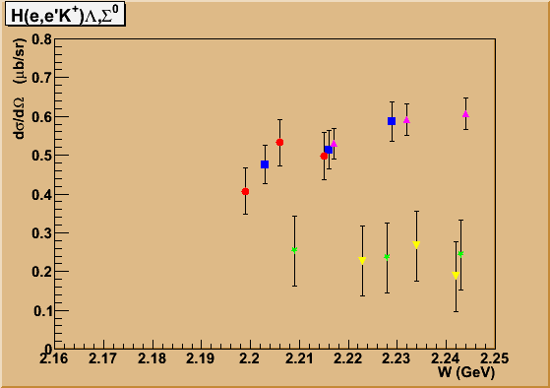
Λ {
Λ slight rise with increasing Θ_{CM} ?
Σ⁰ essentially flat with Θ_{CM}
Λ drops with increasing Q²
Σ⁰ essentially flat with Q²
Σ⁰ {
Λ, Σ⁰ essentially flat with W,
as expected from photoproduction

Slide 10
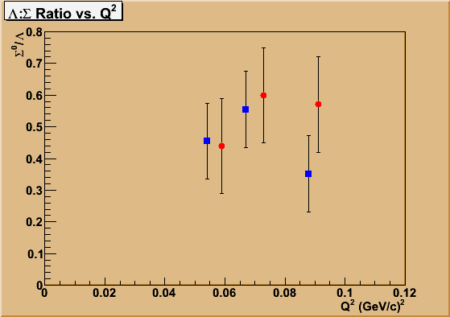
Λ {
Λ slight rise with increasing Θ_{CM} ?
Σ⁰ essentially flat with Θ_{CM}
Λ drops with increasing Q²
Σ⁰ essentially flat with Q²
Σ⁰ {
Λ, Σ⁰ essentially flat with W,
as expected from photoproduction
Σ^{0/}Λ ratio essentially flat with Q², ~0.5

Slide 11
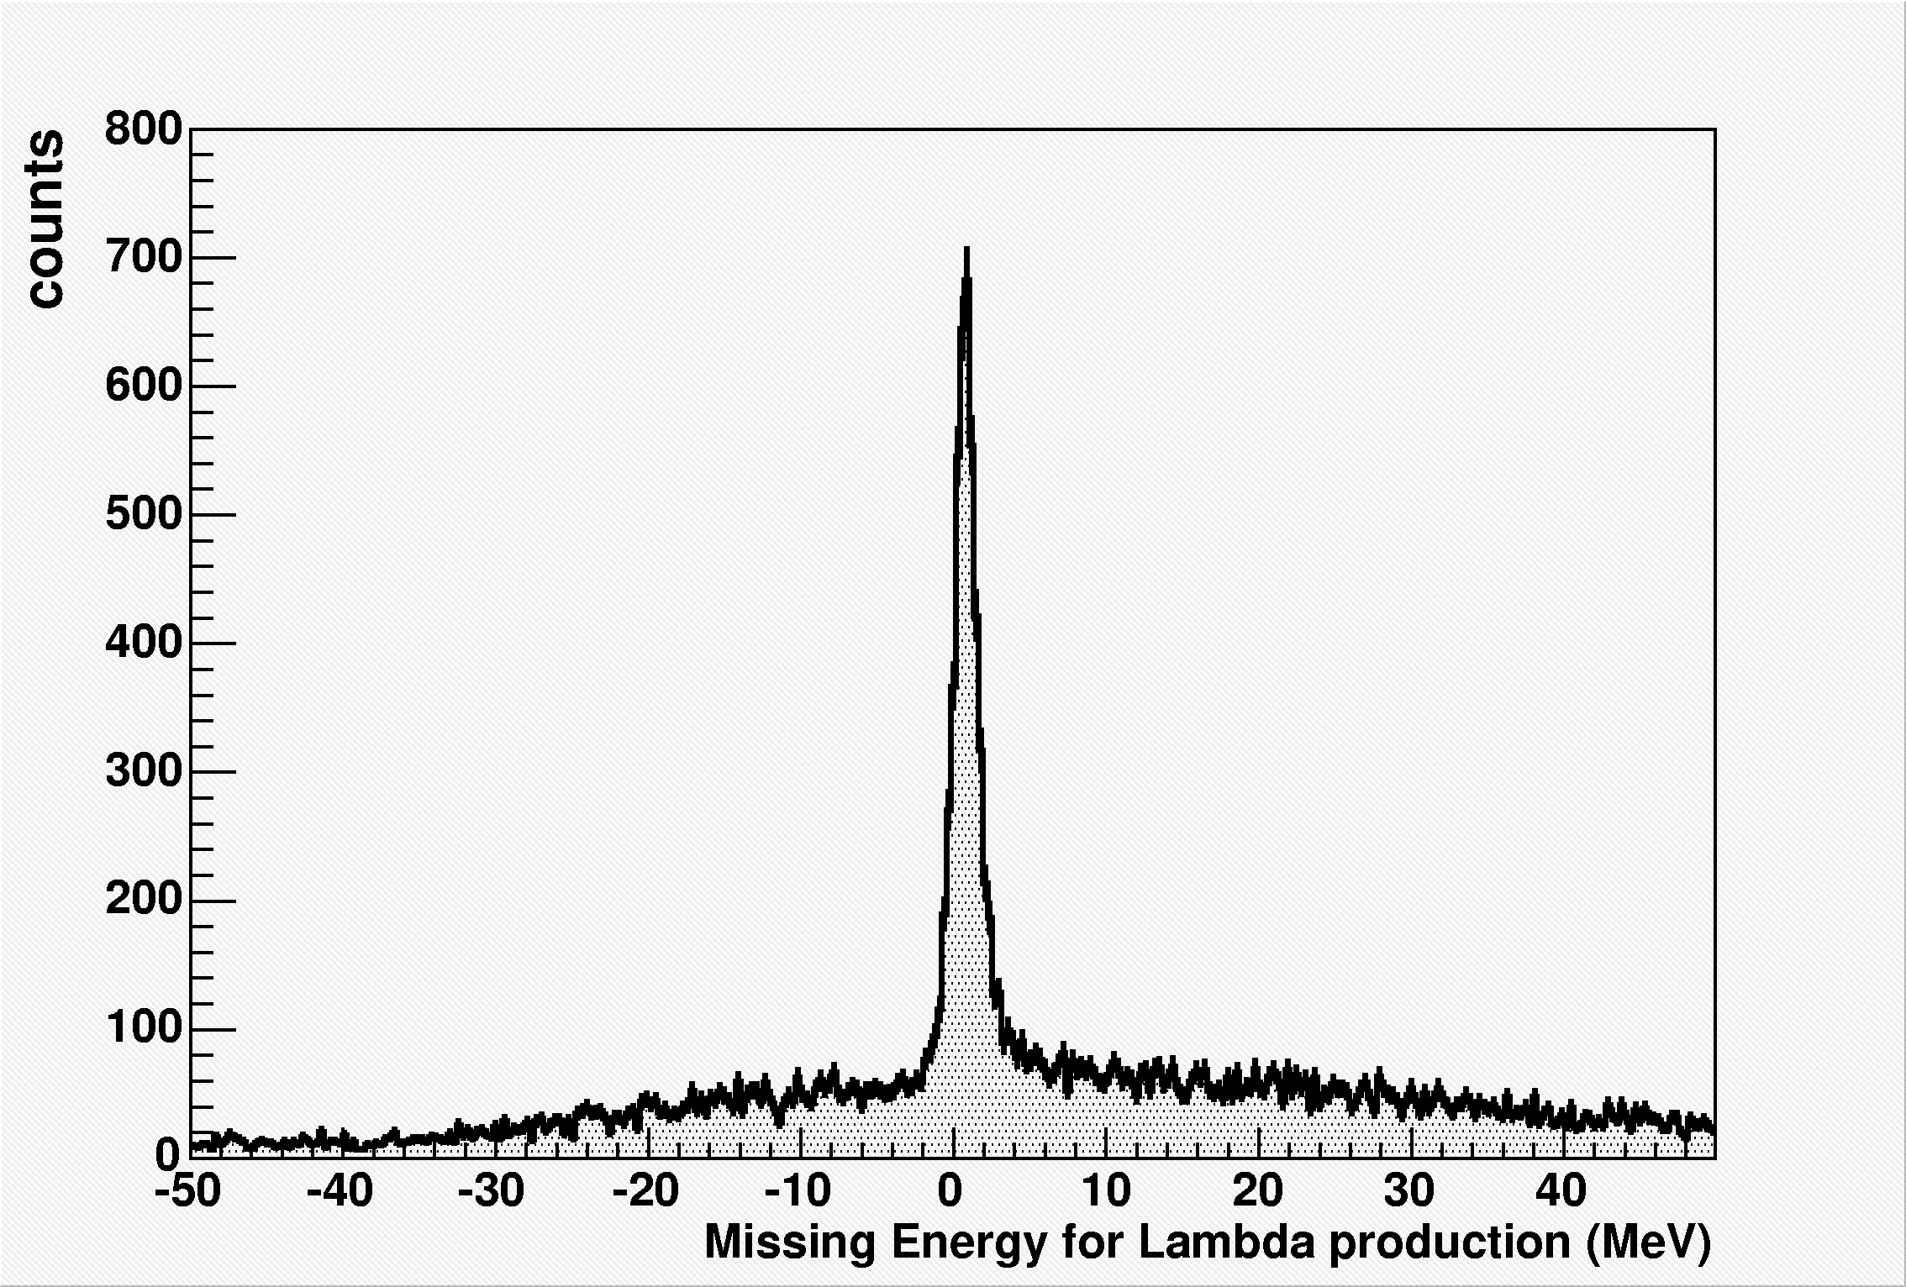
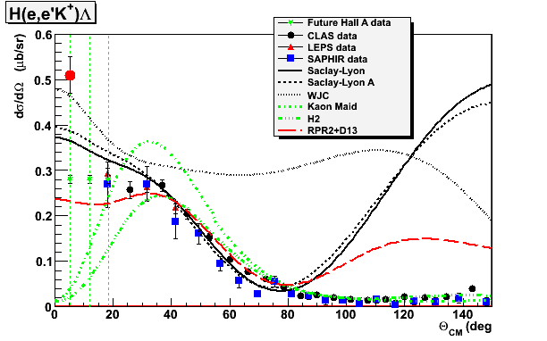
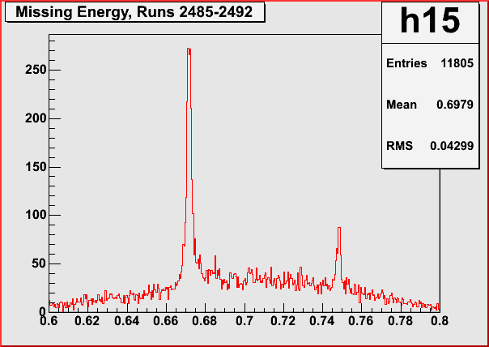
Results on H target – The p(e,e’K)Λ Cross Section
p(e,e'K⁺)Λ on Waterfall
Production run
p(e,e'K⁺)Λ on LH₂ Cryo Target
Calibration run
Expected data from E07-012,
Never ran
(but we could get similar data)

Slide 12
Proposed Kinematics
E | 4.5328 GeV
Q² | .218 (GeV/c)²
W | 1.89 GeV
t (φ=π) | -.113 GeV²
e’ | 7° (±1.5° H, 2.5° V)
 | 3.0296 GeV (±4.5%)
P_{k} | 1.2 GeV/c (±12.5%)
 | 16° (±12.5°)

Slide 13
Summary Thoughts
Low hanging fruit:
Important to make sense of hypernuclear data
Funny corner of phase space
Extremely forward kaon angle
Possible W-dependence (~1.7 – 2.2 GeV)?
Minimal amount of beam time (few days total)
May not be strong enough motivation to sell the entire program
Complementary to other measurements
Could use H2O target instead of LH2
What might be unique to Jlab?
Energy allows W-scan
Independent septa/HKS could allow angular scan

Slide 14
Not Discussed
Existence of Σ hypernuclei: ⁴_{Σ-}He (Tamura yesterday)
CSB: ⁴_{Λ}H (Achenbach & Nakamura yesterday)
Sign of spin-spin term: polarized target, polarized beam
Lifetimes: ³_{Λ}H

Slide 15
Backup Slides

