Slide 1
Hypernuclear photoproduction and test of elementary amplitudes
Toshio MOTOBA （Osaka E-C)
Hypernuclear Workshop
May 27 - 29, 2014 Jefferson Lab

Slide 2
CONTENTS
1. Introduction / Basic Motivation
2. Characteristics utilized for electro/photo-production with a typical target
²⁸Si (γ, K⁺)_{Λ}²⁸Al cf. new exp. report
3. Extend the approach to produce heavier hypernuclei around A=40-52
4. Hyperon s.p.e (²⁰⁸Pb(γ, K⁺)_{Λ}²⁰⁸Al)
5. Two suggestions : (a) hyperon-rotation coupling , (b) 4He(γ,K+)
6. Summary

Slide 3
1. Basic motivations to go to medium-heavy hypernuclei
Success of JLab experiments (Hall A & C)
on p-shell targets with high resolution
Theoretical framework confirmed:
(DWIA, elementary amplitudes, microscopic, )
Unique properties of the reaction process

Slide 4
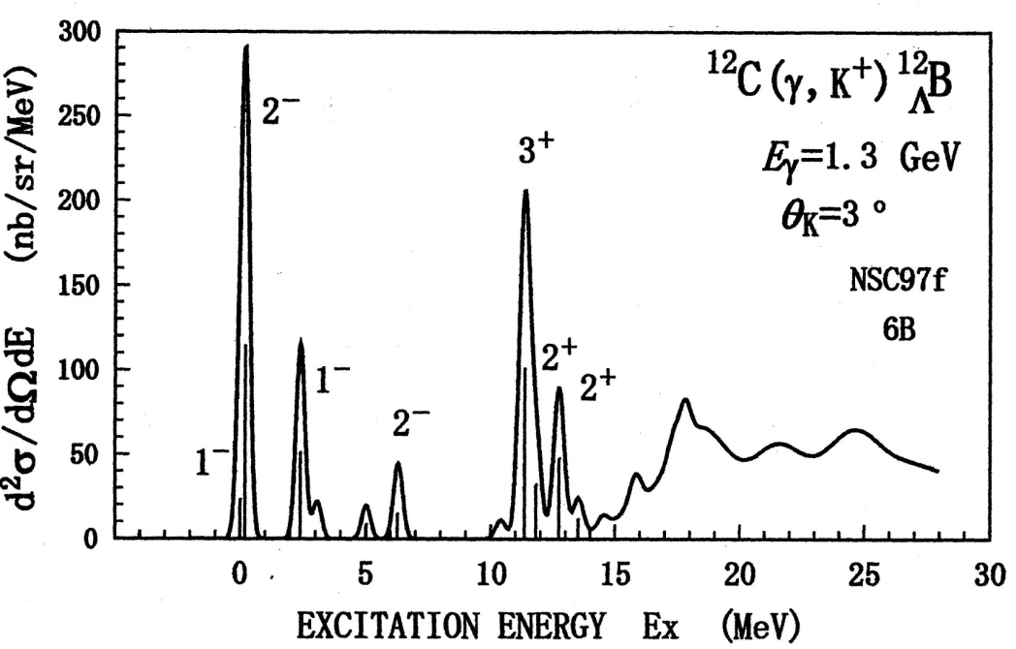
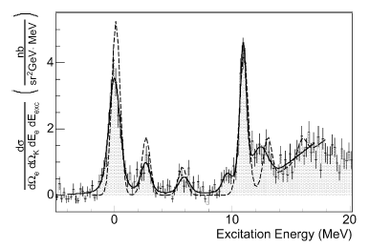
Theor. prediction vs. (e,e’K⁺) experiments
Theory
Motoba. Sotona, Itonaga,
Prog.Theor.Phys.Sup.117 (1994) T.M. Mesons & Light Nuclei (2000) updated w/NSC97f.
----------------------------------------------→
Hall C (up) T. Miyoshi et al.
P.R.L.90 (2003) 232502. Γ=0.75keV
Hall A (bottom), J.J. LeRose et al.
N.P. A804 (2008) 116. Γ=0.67keV

Slide 5
Hyperon recoil momentum and the transition operator determine the reaction characteristics
q_{Λ}=350-420 MeV/c at Eγ=1.3 GeV

Slide 6
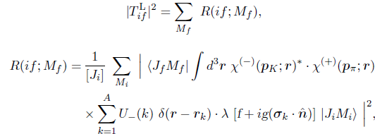
Microscopic treatment based on the
elementary transition amplitudes (π,K) case
(π,K) case
Elementary amplitude N → Y
f = spin-nonflip, g= spin-flip , σ= baryon spin

Slide 7
Lab dσ/dΩ photoproduction case (2Lab)
(γ,K+) case

Slide 8
Elementary amplitudes (complex and momentum dependent)

Slide 9
These characteristic merits of the γp → Λ K⁺ process(ability to excite high-spin unnatural-parity states) should be realized better in heavier systems involving large j_{p} and large j_{Λ}
(e,e’K⁺) d³σ/dE_{e} dΩ_{e} dΩ_{K} = Γ x dσ/dΩ_{K}
Γ : virtual photon flux (kinematics)
Hereafter we discuss dσ/dΩ_{K} for ^{A}Z (γ,K+)_{Λ}^{A}Z’

Slide 10
A typical example of medium-heavy target :²⁸Si: (d_{5/2})⁶ and (sd)^{6P}(sd)^{6N} to show characteristics of the (γ,K⁺) reaction with DDHF w.f. Spin-orbit splitting: consistent with _{Λ}⁷Li, ⁹Be,¹³C, ⁸⁹Y
2. Medium-heavy nuclear
targets (1) Summary of A=28

Slide 11
Theor. x-section for (d_{5/2})⁶ (γ,K⁺)[ｊ_{h}-ｊ_{Λ}]J

Slide 12
proton-state fragmentations should be taken into account to be realistic

Slide 13
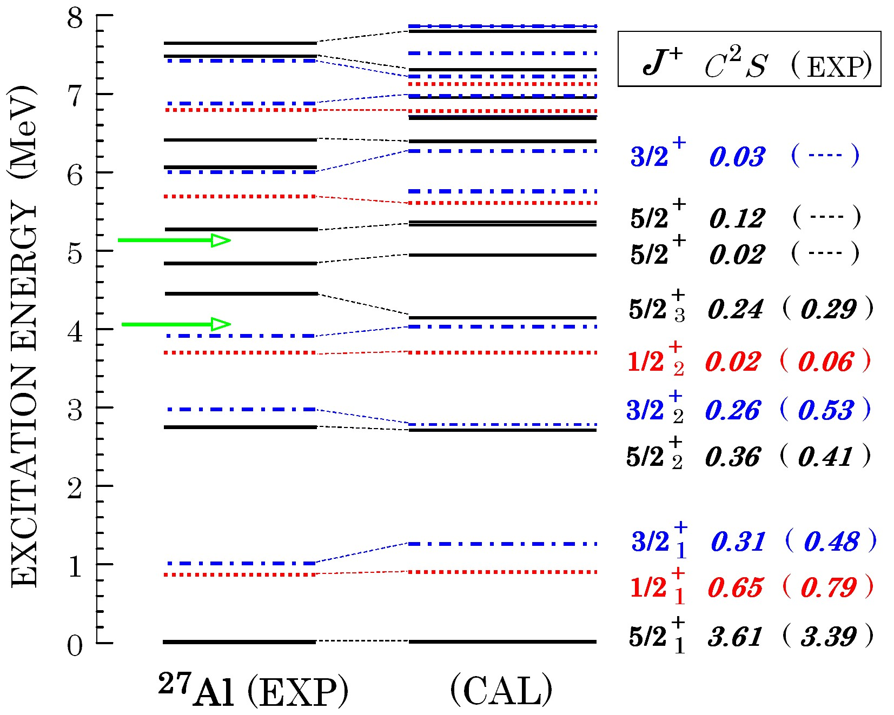
Proton pickup from ²⁸Si(0⁺):(sd)⁶ =(d_{5/2})^{4.1}(1s_{1/2})^{0.9}(d_{3/2})^{1.0}
13

Slide 14
Peaks can be classified by the characters

Slide 15
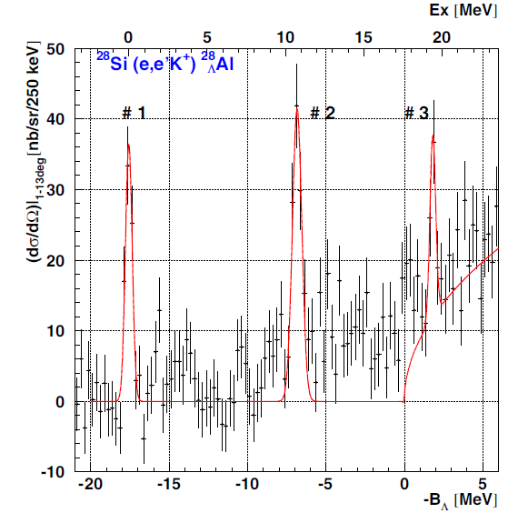
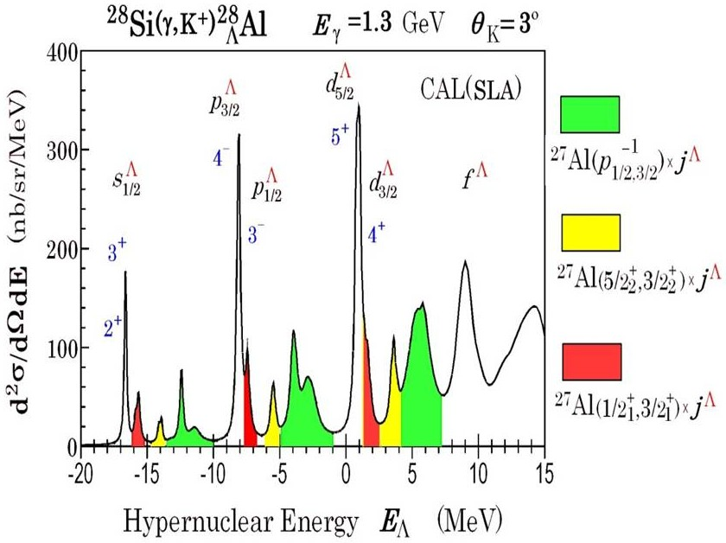
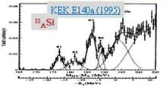
Preliminary
Exp. data: Fujii et al, Proc. SNP12 workshop (2012)
Seems promising, (waiting for the finalization of analysis)

Slide 16
3. Extend to heavier nuclear Targets (2)
⁵²Cr: (f_{7/2})⁴ assumed
⁴⁰Ca: (sd-shell LS-closed)

Slide 17
⁵²Cr ( j> dominant target case) typical unnatural-parity high-spin states

Slide 18
JLab E05-115 data is coming, but not finalized yet (Nakamura)
-B_{Λ}=-21.8 MeV
B.E. should be
extracted from
Experiment.

Slide 19
Theory side has a “flexibility”
(uncertainty)
Density dependence
of Nijmegen NSC97f model
(YNG-type eff.
interaction at
⁸⁹Y region.)

Slide 20
Nijmegen B-B interaction model improved by taking account of hypernuclear data

Slide 22
⁴⁰Ca ( LS-closed shell case): high-spin states with natural-parity (2⁺,3⁻,4⁺)

Slide 23
Proton pickup reaction on ⁴⁰Ca
1s1/2-hole
d3/2-hole

Slide 24
Well-separated series of peaks due to large q and spin-flip dominance: j>=l+1/2, j<=l-1/2

Slide 25
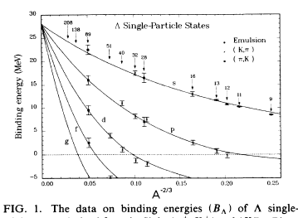
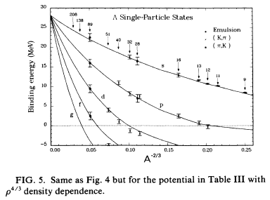
4. Systematics of Λ s.p.e.
Taken from: Millener-Dover-Gal, PRC18 (1988)
Woods-Saxon pot. D=28MeV
r_0= 1.128+0.439A^(-2/3)
Skyrme HF with ρ^(4/3)
Density dependent

Slide 26
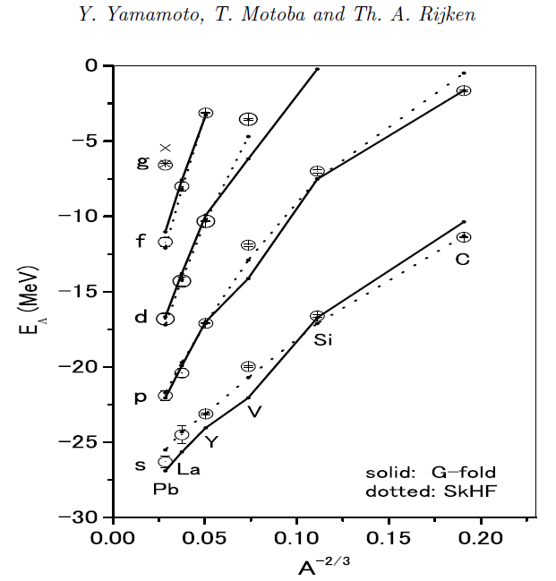
Single-particle energies of Λ G-matrix（ESC08ｃ） results vs. experiments (Y. Yamamoto et al.: PTP. S.185 (2010) 72 and priv. commun. )
High resolution
exp. data over wide A are necessary.
sd, fp-shell and
heavier data are quite Important to extract the Λ behavior in nuclear matter.

Slide 27
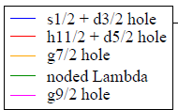
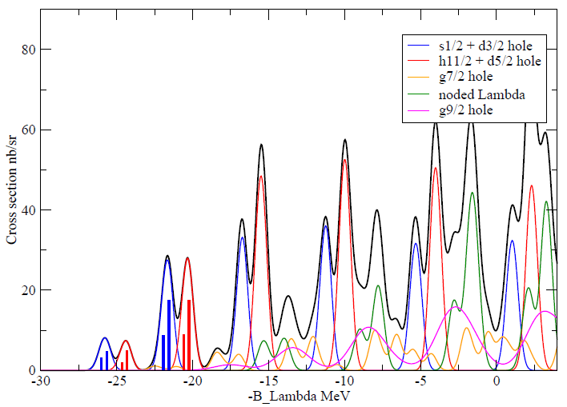
²⁰⁸Pb(γ,K+) ²⁰⁸_{Λ}Tl
6 proton-hole states
2s_{1/2}
1d_{3/2}
0h_{11/2}
0d_{5/2}
0g_{7/2}
0g_{9/2}
with Λ (s, p, sd, fp, sdg, fph shells)
f
d
g
p
s
We have an opportunity to observe a series of Lambda orbits ?

Slide 28
Candidate targets in medium and heavy regions
Odd-Z and even-N cases (100%) chosen
²³₁₁Na, ²⁷₁₃Al , ³⁹₁₉K ,
⁴⁵₂₁Sc , ⁵¹₂₃V , ( ⁵²₂₄Cr 83.8%), ⁵⁹₂₇Co,
⁷⁵₃₃As , ⁸⁹₃₉Y , ⁹³₄₁Nb , ¹⁰³₄₅Rh

Slide 29
5. Two interesting subjects by making use of (e,e’K+) reaction (A) Study of coupling scheme of Λ with nuclear collective motions
As a promising candidate to observe it in
the fp-shell region, we propose to use ⁵⁹Co(γ, K⁺) ⁵⁹_{Λ}Fe (speculation)

Slide 30
One suggestion (personal view): Use ⁵⁹Co as a typical target in this mass region
Reasons are rather simple:
It has many protons in f_{7/2} orbit.
Cross sections are comparable to ⁵²Cr
2) Proton pickup S-factors look promising .
3) Study coupling features between p- &
d-state Λ and the ground rotational motion,
as in Λ⁹Be, Λ¹³C, Λ²¹Ne, Λ²⁷Mg.

Slide 31
⁵⁹Co (γ,K⁺) ⁵⁹_{Λ}Fe
f
d
p
s

Slide 32
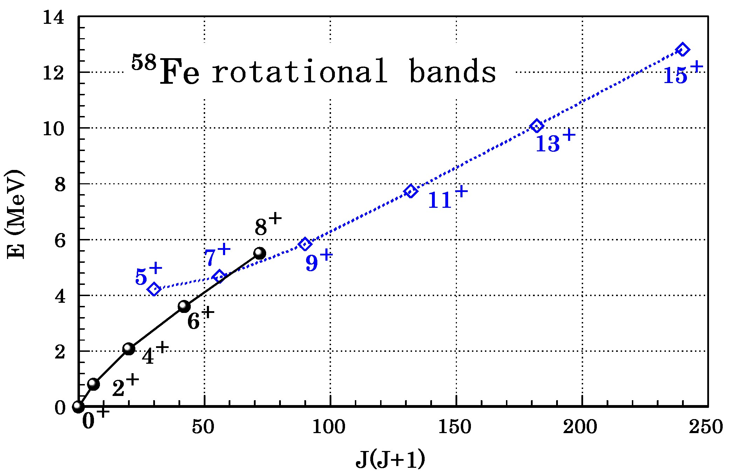
⁵⁹Co(γ,K⁺)⁵⁹_{Λ}Fe
( just preparing CAL )
Interesting to see
dynamical coupling of Λ in p-/d-state with Gnd
rotation (free from the Pauli principle)

Slide 33
Proton-pickup experiment N.Miwano, T.Ishimatsu, R. Asano, T.Suehiro, M.Tanaka, N.P.A377 (1982) 148.
6₂⁺
8₁⁺
2₁⁺
8₂⁺
6₁⁺
4₁⁺
0₁⁺
4₂⁺
2₂⁺

Slide 35
Natural extension from α+α+Λ case

Slide 36
weak coupling with Λ(s), strong coupling with Λ(p),

Slide 38
T.Yamada, K. Ikeda, H. Bando, and T.Motoba, PRC38 (1988)

Slide 39
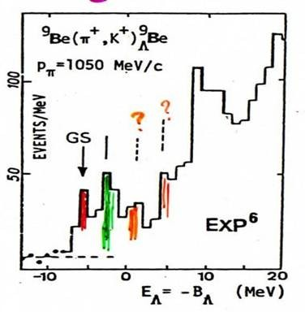
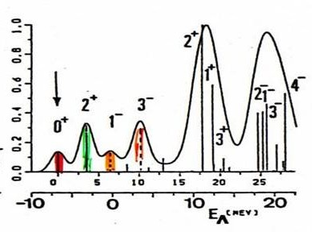
All the existing exp.data can be explained. Genuine hypernucear states confirmed !
(π+,K+) @ q=350MeV/c
(K-,π-) recoilless

Slide 40
²⁷Al (γ,K⁺) ²⁷_{Λ}Mg (5 protons in d5/2 ) offers a similar opportunity to study coupling of Λ hyperon (p- & d-orbit) with ground rotational motion (SD states might be difficult to excite?)

Slide 41
(B) Level energy measurement by ⁴Η(γ,Κ⁺) + π−decay
Calculated X-S
(nb/sr)
Excitation energy can be
reliably deduced by the modern technique.

Slide 42
SUMMARY
Based on the elementary amplitudes, the microscopic theoretical framework for several hypernuclear production XS are discussed.
2) Among others the predictions for ²⁸_{Λ}Al and
⁵²Cr are well compared with the recent expt. ⁴⁰Ca and ²⁰⁸Pb also demonstrated
In addition to the Λ s.p.e., dynamical coupling
of Λ with collective nuclear motion is emphasized.

Slide 44
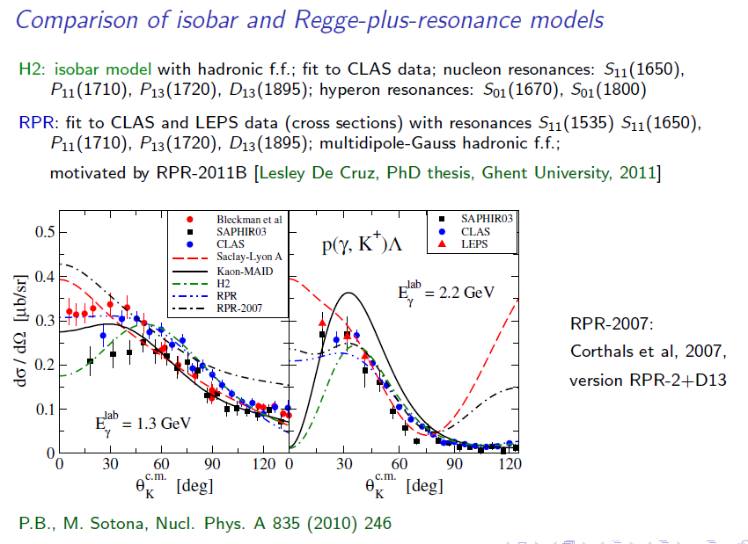
Possible test of γp->ΛΚ ampl.
(From P. Bydzovsky )

