Slide 1
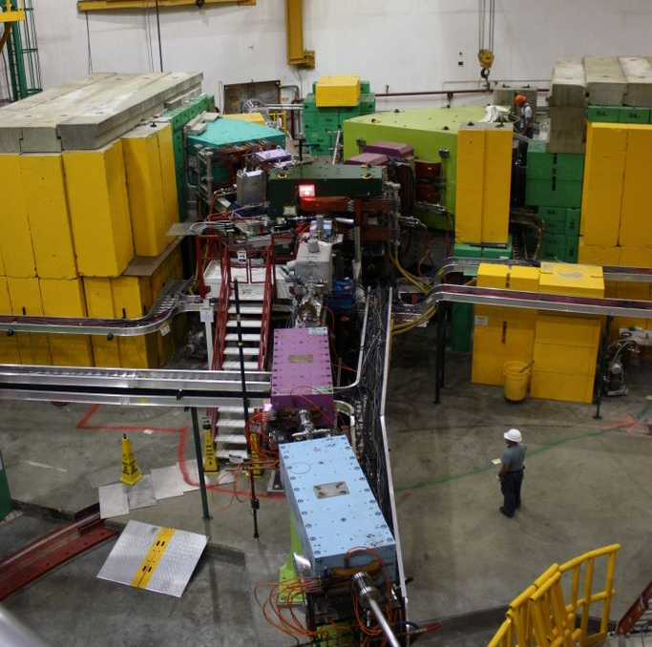
JLab Hypernuclear Workshop 27th May 2014
Satoshi N Nakamura, Tohoku University
Perspectives at Jefferson Lab
Medium mass hypernuclei
HES
HKS
Notes:
Including discussion 30min

Slide 2
Study of hypernuclei
Λ in nuclear medium
Single particle nature of Λ in nuclear medium
A dependence of Λ potential
ls force vs. core-config. Mixing
Inputs for mean-field theories
High quality
medium heavy
hypernuclear
spectroscopy
Λ as a probe
Λ as an impurity
Collective motion of core nucleus
Tri-axial deformation of core nucleus
Modify nature of core
Energy level inversion
Glue like role of Λ

Slide 3
Objectives --- Hypernuclear Physics
1
20
50
200
10⁵⁷
A
Medium
Heavy
Hypernuclei
Elementary Process
Strangeness electro-production
Neutron/Hyperon star,
Strangeness matter
Light Hypernuclei (s,p shell)
Hyperonization →
Softening of EOS ?
Extend Nuclear Force to
Baryon Interaction
CSB, ΛΣ coupling in large isospin hypernuclei
Medium - Heavy hypernuclei
Use Λ as a probe to
see deep inside of nucleus
Single-particle potential
Distinguishability of a Λ hyperon
U₀(r), m_{Λ}*(r), V_{ΛNN}, ...

Slide 4
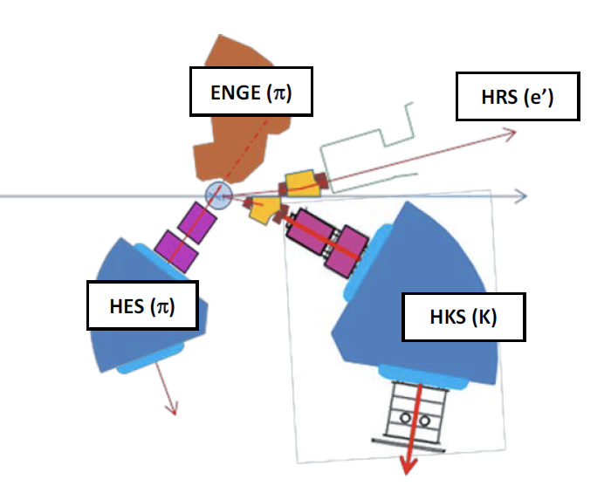
Proposing Setup at JLab 12
K(HKS) x HRS (e’) + K(HKS) x {ENGE (π) + HRS (π)}

Slide 5
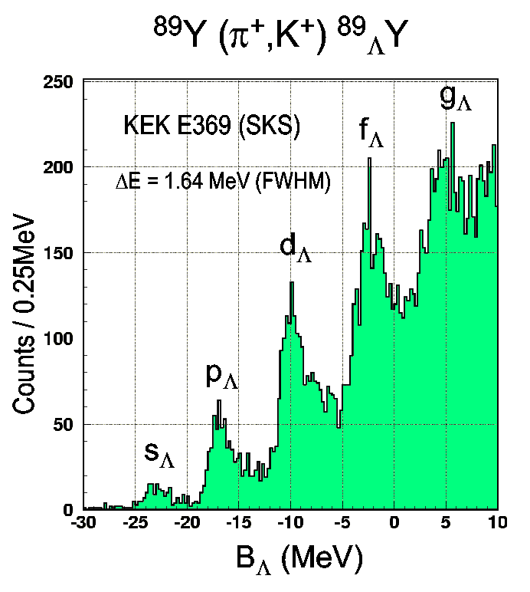
Precise spectroscopy of HY
Single Particle Model is OK to some extent
Hadron keeps its identities
Hypernuclei
Single Particle Model
Baryon
Constitute Quark Model

Slide 6
Precise spectroscopy of HY
Nucleon
Hypernuclei
Valence quarks
Lambda particle
Nuclear medium
Core’s properties, density
QCD vacuum
Sea quarks, gluons
Baryon Interaction
Light Hypernuclei
Modification of core
Heavy Hypernuclei
Lambda’s behavior in nucleus

Slide 7
Proposed Programs
1. Elementary Λ, Σ⁰
Reliable data ¹H(e,e’K⁺)Λ, Σ⁰ in low Q²
2. Few-body
²D(e,e’K⁺) [ΛN] Exotic bound state, ΛN int.
⁴He(e,e’K⁺)⁴_{Λ}Η ΛN CSB
^{6,7}Li(e,e’K)⁶_{Λ}He, ⁷_{Λ}He
³t(e,e’K)[nnΛ]
3. Medium-heavy
^{40,44,48}Ca(e,e’K⁺) ^{40,44,48}_{Λ}K Λ’s S.E., iso-spin
²⁷Al(e,e’K⁺) ²⁷_{Λ}Mg Tri-axial deformation
⁴⁸Ti(e,e’K⁺) ⁴⁸_{Λ}Sc Level inv. due to Λ
¹⁹F(e,e’K)¹⁹_{Λ}O
4. Heavy
²⁰⁸Pb(e,e’K⁺) ²⁰⁸_{Λ}Tl Λ in heaviest nucleus
5. Decay π
Weak decay of light hyper-fragments

Slide 8
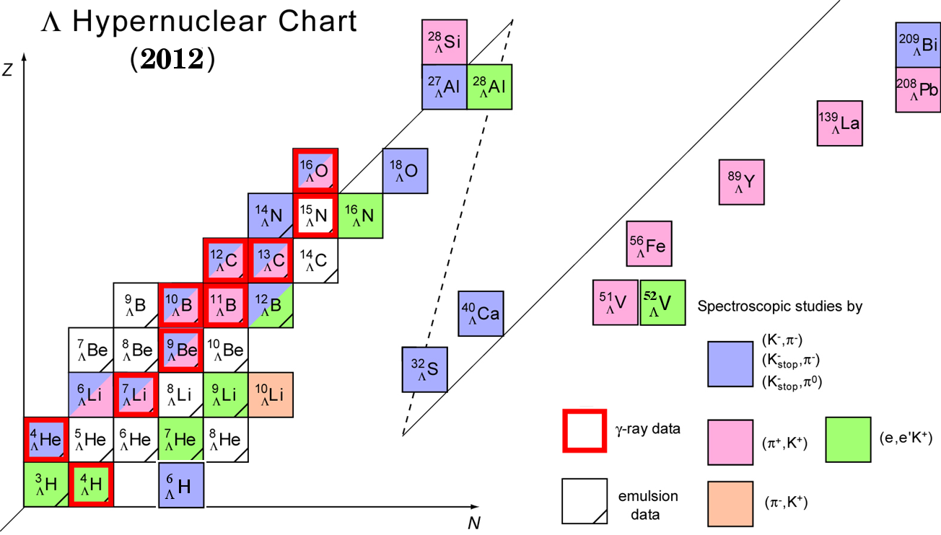
Hypernuclear Chart
²⁷
_{Λ}
_{Λ}
Tl
Mg
²⁰⁸
¹⁹
_{Λ}
O
¹²
_{Λ}
B
⁴⁰
_{Λ}
⁴⁰
_{Λ}
⁴⁴
_{Λ}
⁴⁸
K
_{Λ}
K
K
K
_{Λ}
⁴
H
[ΛΝ]
Λ

Slide 9
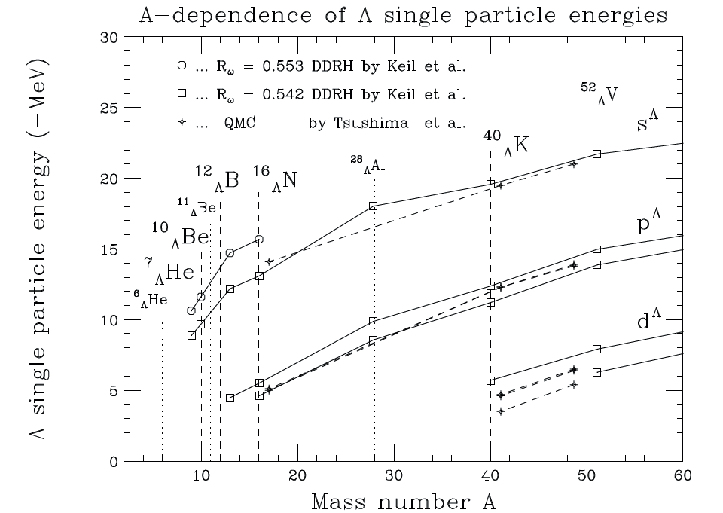
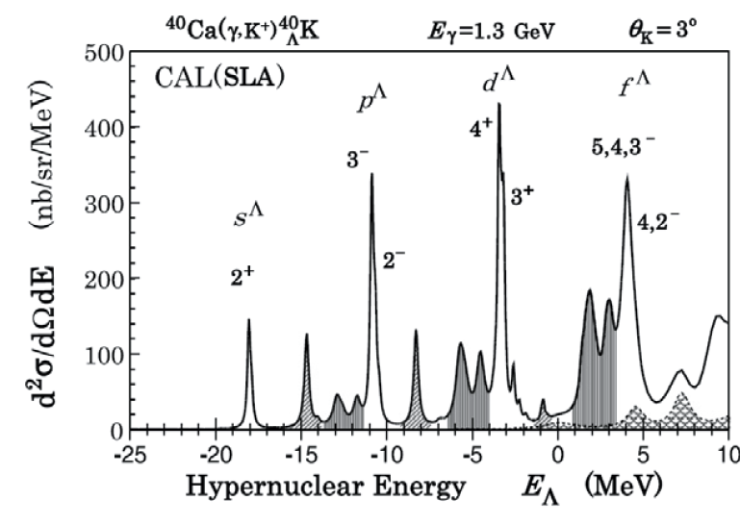
1. Ca (e,e’K⁺) _{Λ}K
P.Bydzovsky et al. NPA881 (2012)199.
Clean Spectrum
Missing in (e,e’K) data
Complete A dependence of Λ S.P.Energy
Doubly LS closed ⁴⁰Ca target
isotope effect of core nuclei: ⁴⁰Ca, ⁴⁴Ca , ⁴⁸Ca targets

Slide 10
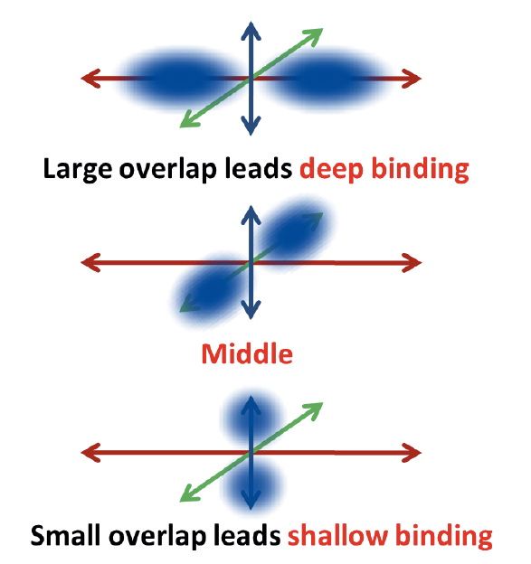
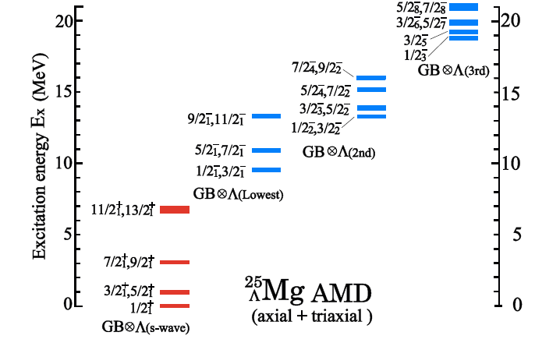
2. ²⁷Al (e,e’K⁺) ²⁷_{Λ}Mg
⁹_{Λ}Be = α + α + Λ
Genuine hypernuclear state
M.Isaka Yesterday’s talk
Tri-axially deformed ²⁶Mg core + Λ in p-shell
Totally new method to search shape of nucleus with Λ!

Slide 11
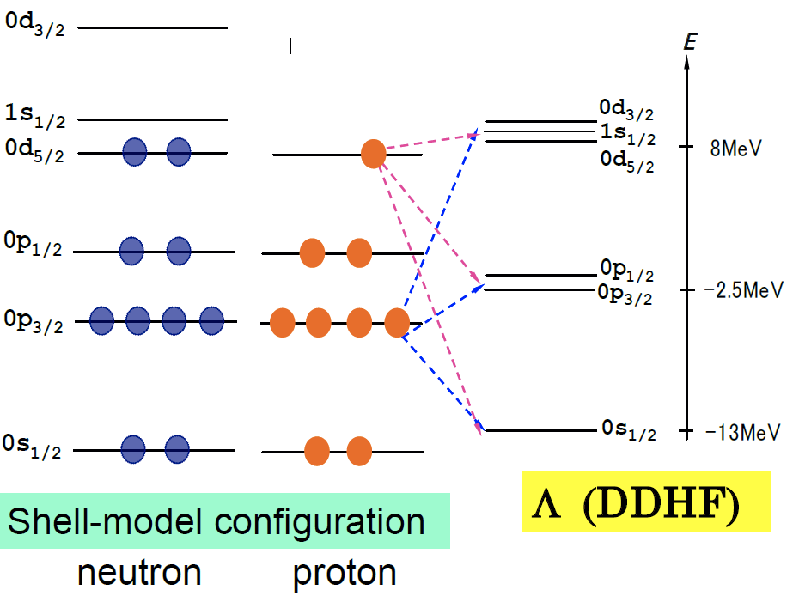
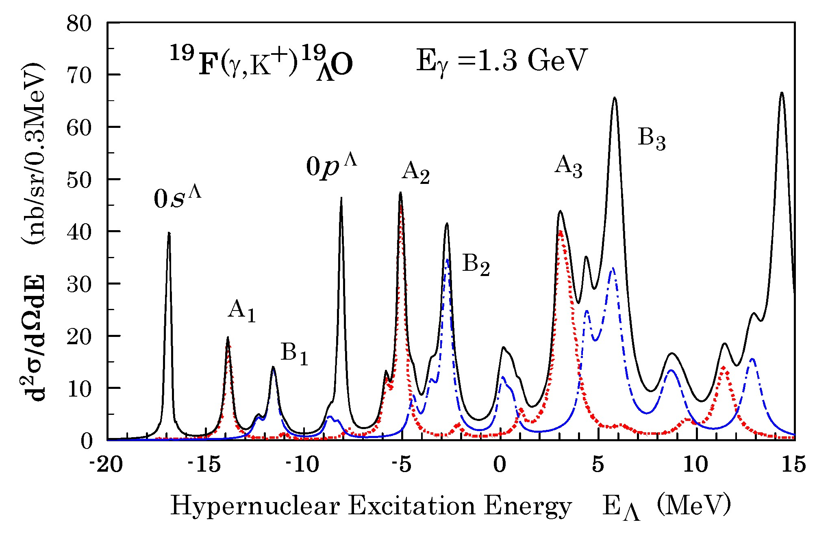
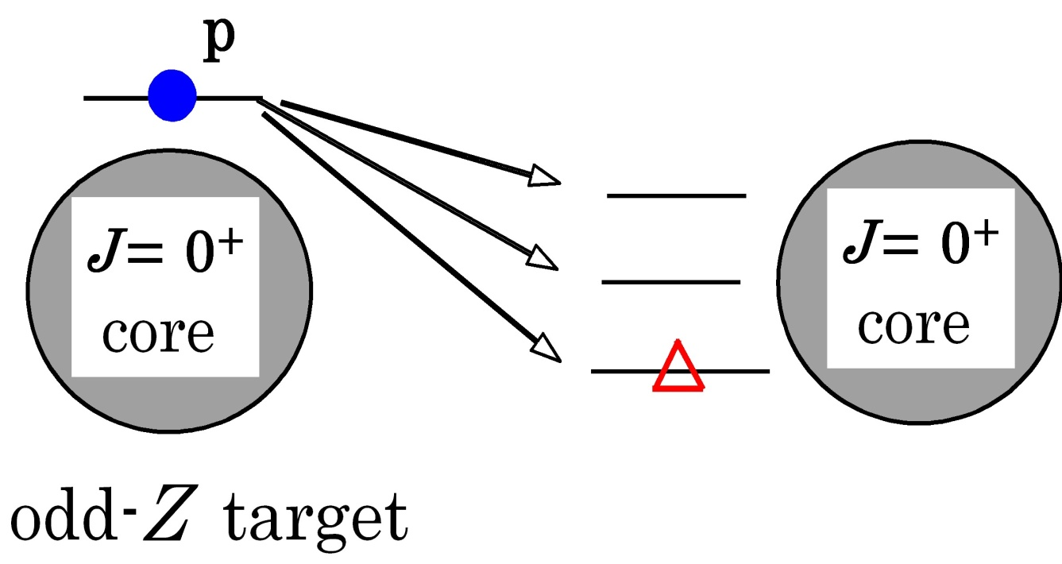
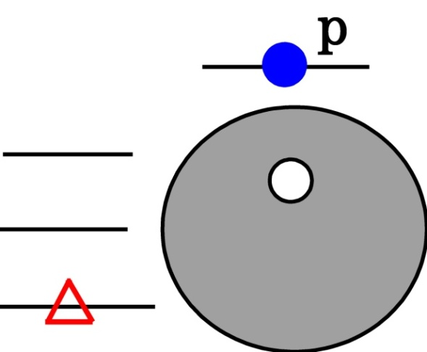
3. ¹⁹F target : simplest sd-shell
T. Motoba, C2C WS Barcelona (2012)
A’s: p1/2-hole series, B’s: p3/2-hole series
Study of core-dynamics

Slide 12
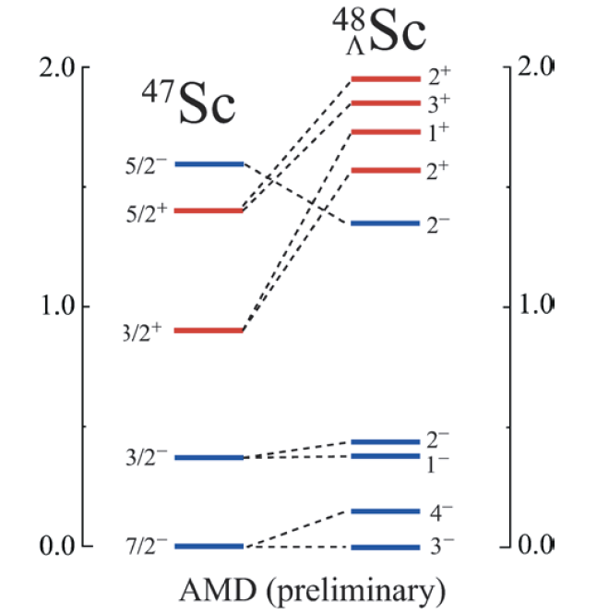
3. ⁴⁸Ti (e,e’K⁺) ⁴⁸_{Λ}Sc
Isaka Hyper-AMD
Positive
Energy surface
Negative
Λ impurity causes energy level inversion !
Feasibility should be re-checked with cross section est.

Slide 13
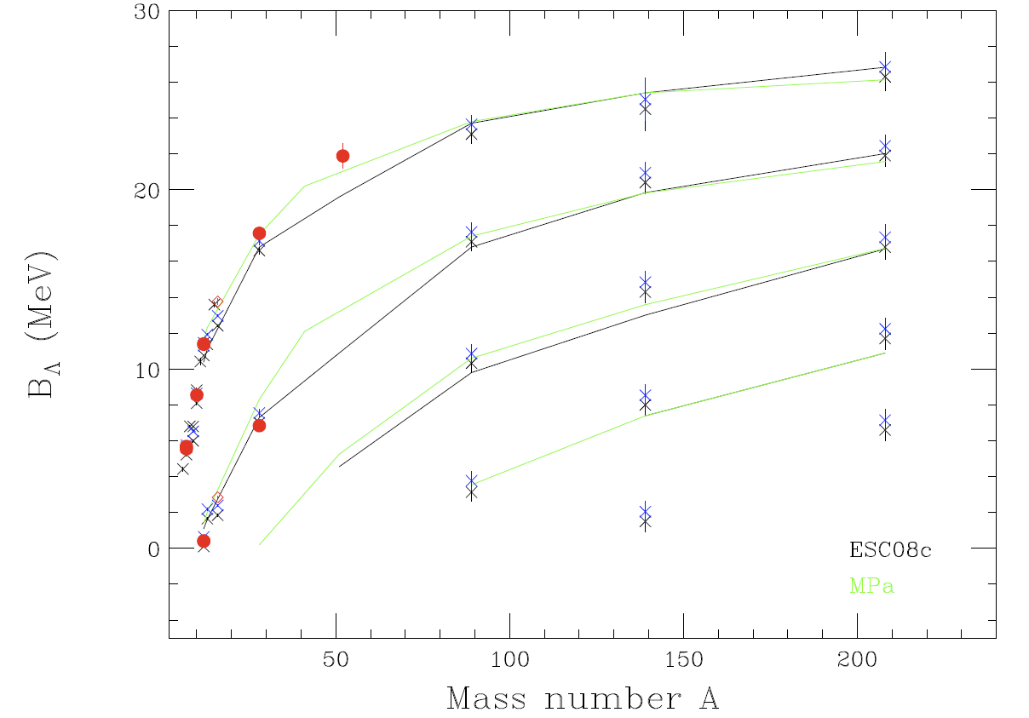
Measured hypernuclei & expected A dependence
¹³⁹La
²⁰⁸Pb
_{Λ}¹⁹O
_{Λ}⁴⁰K
⁸⁹Y
E05-115
_{Λ}²⁷Mg
Λ in medium
Interaction
Characteristics of Core

Slide 14
Few-body physics with strangeness
1. ⁶Li (e,e’K⁺) ⁶_{Λ}He
Λ
α
n
Three-layer structure
r.m.s α-Λ 2.8 fm
α-n 5.0 fm
Larger than ⁶He
E.Hiyama : Yesterday’s talk

Slide 15
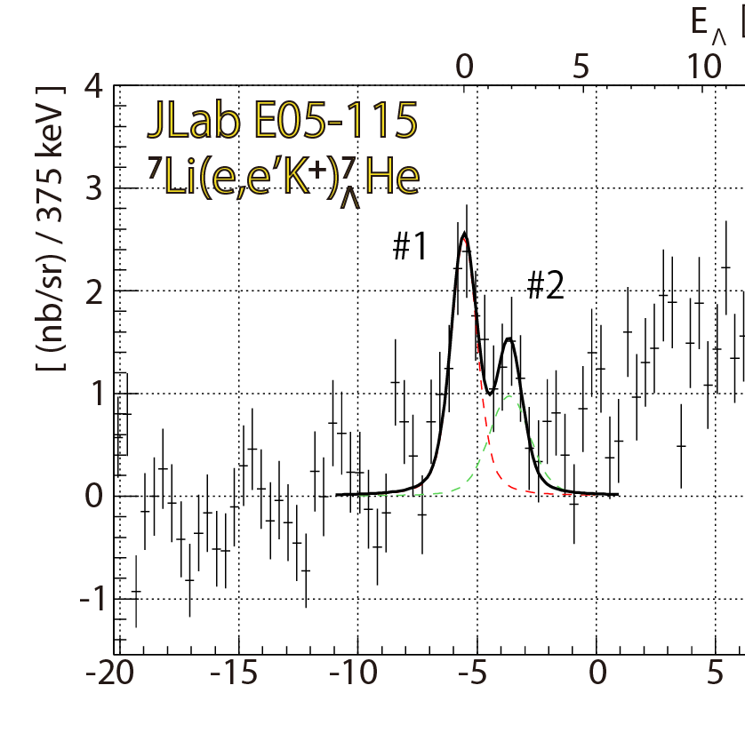
2. ⁷Li (e,e’K⁺) ⁷_{Λ}He
Γ＝12.1 ±1.1 MeV
(2⁺,1⁻,0⁺)?
Λ
⁷He
2⁺
2+
1.797 MeV
Λ
Γ=113 ±20 keV
0 MeV
α+Λ+n+n
0 MeV
α+n+n
5/2⁺
-1.88 Γ=0.7 MeV
-0.98
-2.04, Γ=0.5 MeV
0+
3/2⁺
⁵He+n+n
Λ
-3.12
5/2+
neutron
halo states
⁶He
3/2+
-4.57
Exp.
1/2+
-6.19 MeV
E.Hiyama : Yesterday’s talk

Slide 16
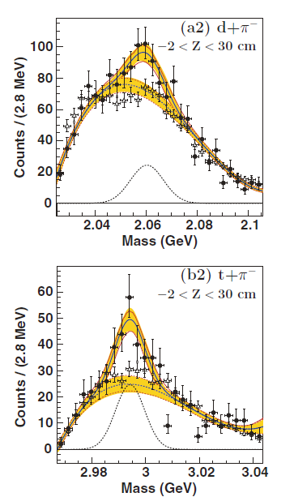
Few-body physics with strangeness
3. Search of [nΛ] bound state and study of n-Λ interaction through FSI.
Established lightest hypernyclei = ³_{Λ}H
Hyp-HI experiment at GSI a structure in d + π⁻ , t + π⁻ invariant mass
C.Rappold et al. PRC88, 041001(R) (2013)
T.R.Saito, NUFRA2011
Indication of a nΛ , nnΛ bound state ?
²d(e,e’K⁺)[nΛ]
³t(e,e’K⁺)[nnΛ]
Direct method to search or set upper limit on this exotic system.

Slide 17
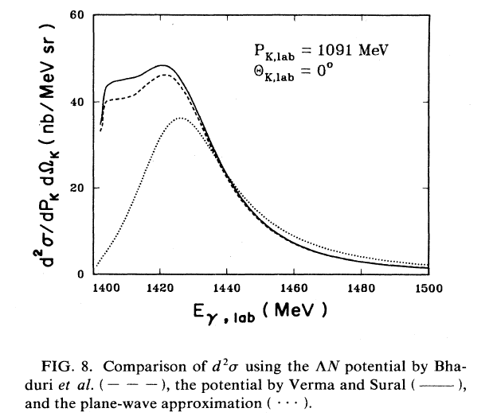
Few-body physics with strangeness
2. Study of n-Λ interaction through FSI.
²d(e,e’K⁺) nΛ
²d(e,e’K⁺) provides also information of n-Λ interaction through FSI.
R.A.Adelseck & L.E.wright
PRC 39(1989) 580.

Slide 18
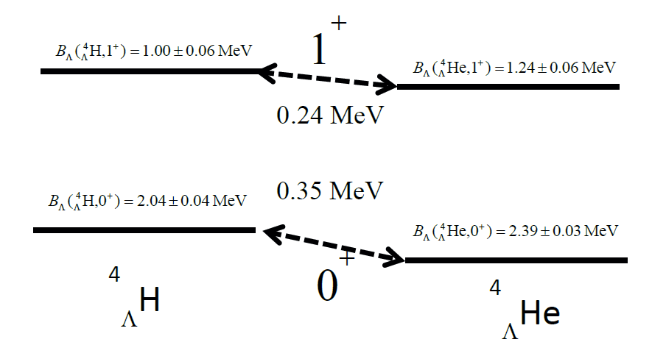
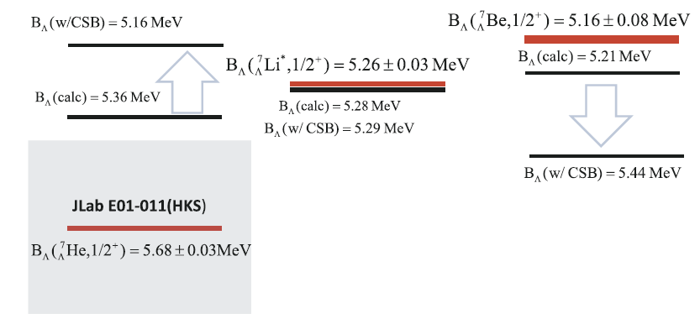
Few-body physics with strangeness
4. Charge Symmetry Breaking of ΛN interaction
⁴He(e,e’K⁺) ⁴_{Λ}H
A=4,iso-doublet hypernuclei
^{E13 @ J-PARC}
Introduced to explain A=4.
Decay π
Phenomenological CSB potential
Re-check of A=4 system
NOT becessary for A=7.
JLab E01-011 (HKS)
Recently measured
at JLab Hall-C
A=7,iso-triplet hypernuclei

Slide 19
Summary
Medium heavy hypernuclear study
Ca targets : ⁴⁰Ca doubly closed, clean, ⁴⁴Ca
²⁷Al target : ²⁷_{Λ}Mg tri-axial deformed
¹⁹F targets: simplest sd-target, excited-core
Few-body hypernuclear study
⁶Li target : ⁶_{Λ}He n-halo hypernucleus
⁷Li target : ⁷_{Λ}He unbound states of ⁶He
d target : Exotic nΛ state, FSI nΛ study
CT_{n} target : Exotic nnΛ state
Other targets : SPE of Λ with <100 keV accuracy

Slide 21
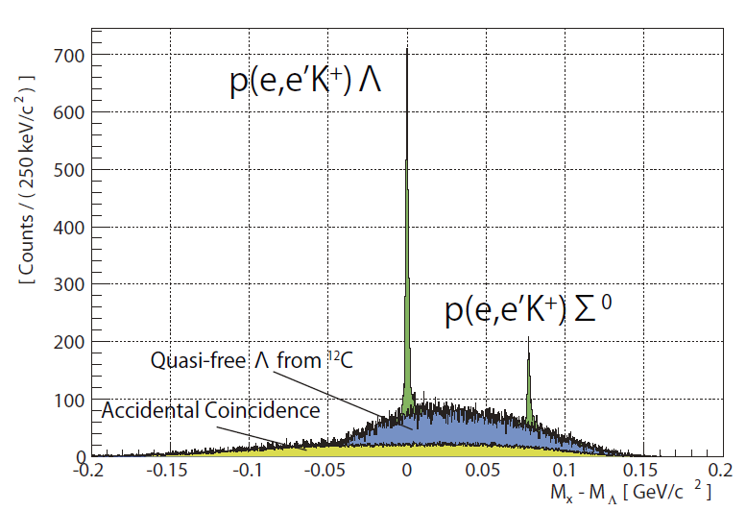
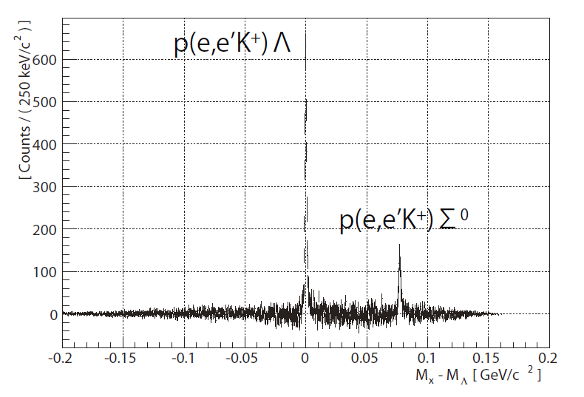
Subtraction of ¹²C effects and Accidental BG

Slide 22
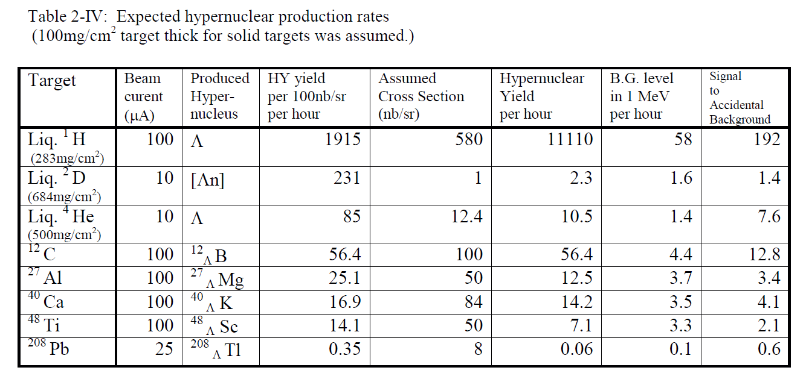
Expected Yields
>5 times more yield than E94-107
Much better S/N than E05-115

Slide 23
Expected Mass Resolution
Calibration for independent K, e’ spectrometers.
Established in E94-107.
Absolute missing mass calibration with Λ,Σ⁰ masses
Established in E05-115.

