Slide 1




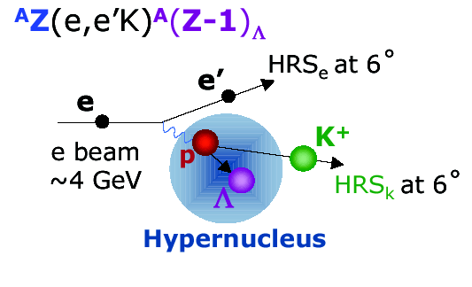
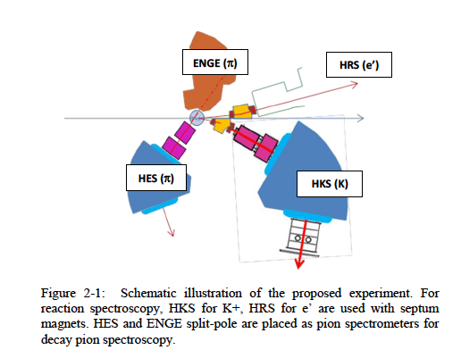
²⁰⁸Pb(e,e’K) ²⁰⁸_{Λ}Ti
Franco Garibaldi – Workshop on perspectives of the hypernuclear Physics at Jefferson Lab – 27-29 May 2014
Tohoku
The physics
Experimental challenges
The proposal: ²⁰⁸Pb
  PID
  Target
  Counting rates
  Summary and conclusions

Slide 2
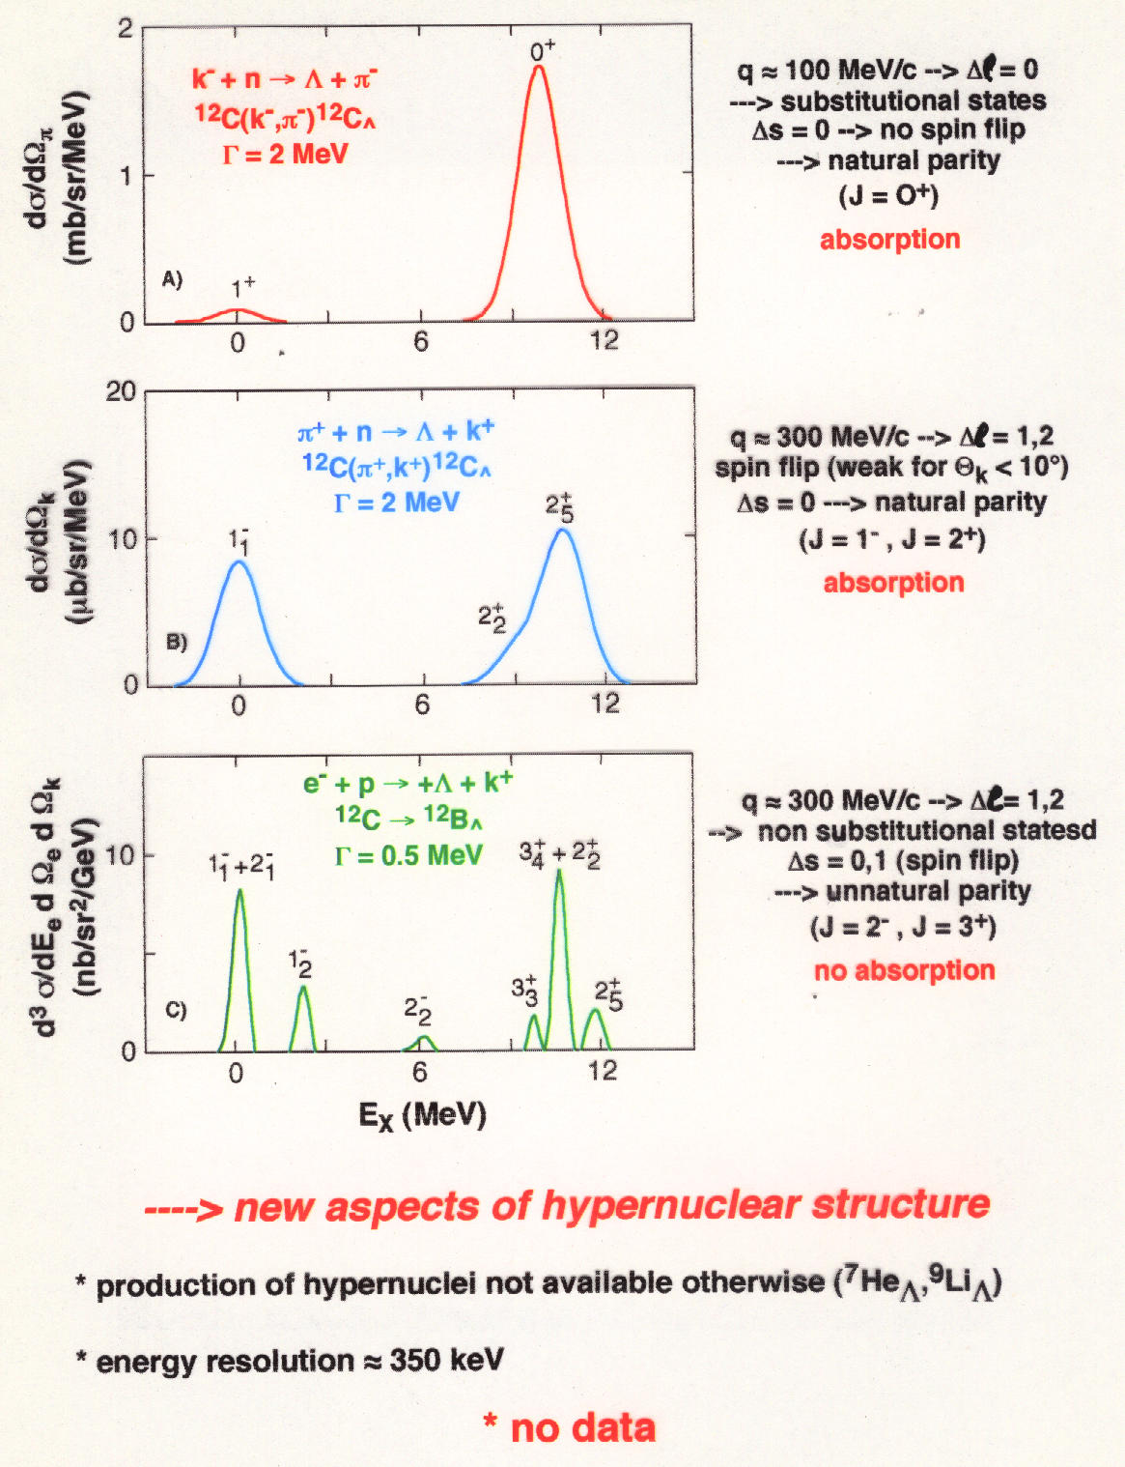
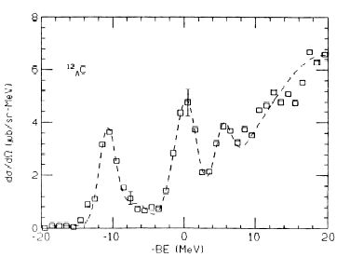
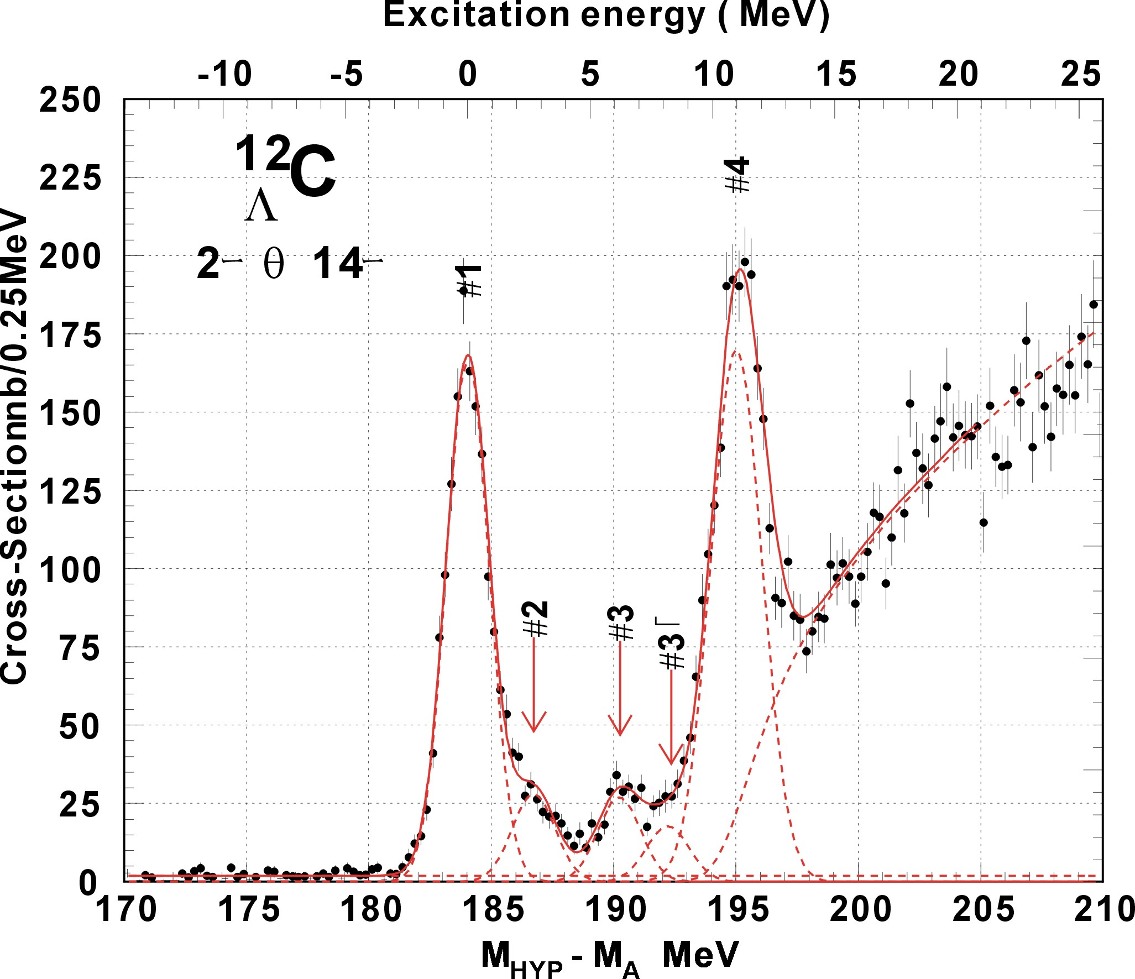
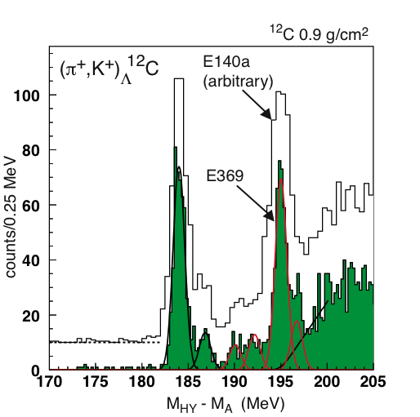
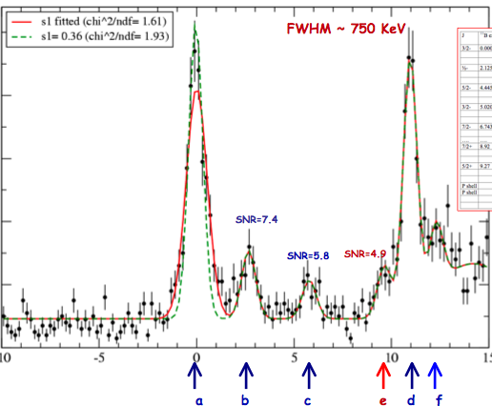
BNL 3 MeV
KEK336 2 MeV
Improving energy resolution
~ 1.5 MeV
and
using electromagnetic probe
635 KeV
635 KeV
new aspects of hyernuclear structure
High resolution, high yield, and systematic study is essential
production of mirror hypernuclei
energy resolution ~ 500 KeV

Slide 3
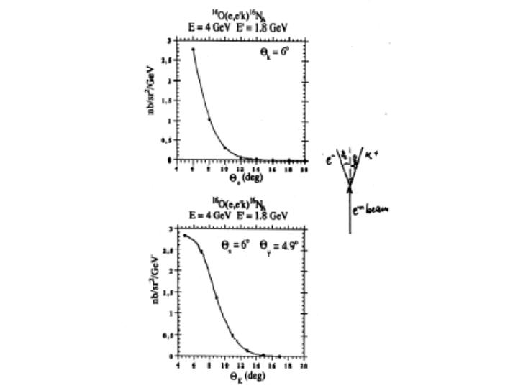
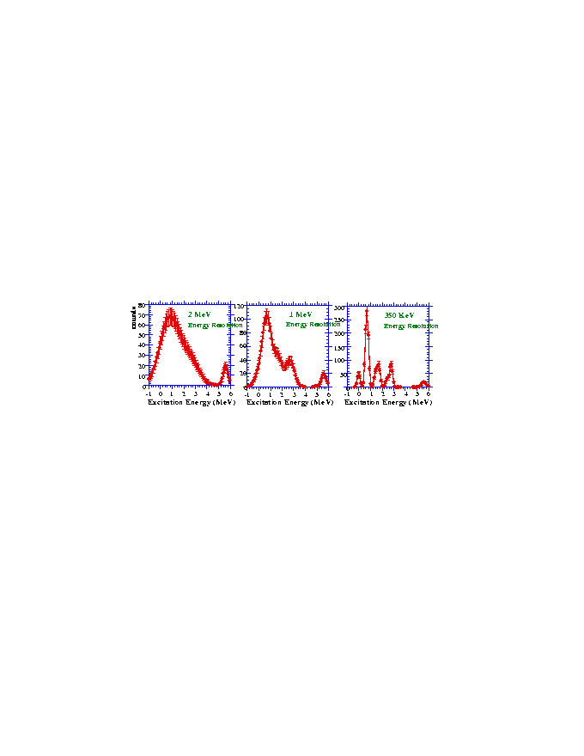
Experimental challenges
reasonable counting rates
good energy resolution
minimize beam energy instability
“background free” spectrum
unambiguous K identification
RICH detector
The target
10 – 25(35) μA on 100 mg/cm² Pb (cryocooling)

Slide 4
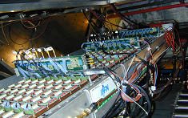
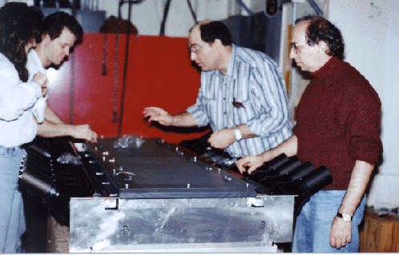
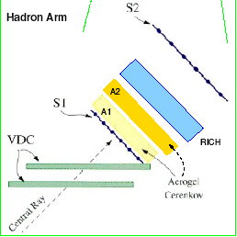
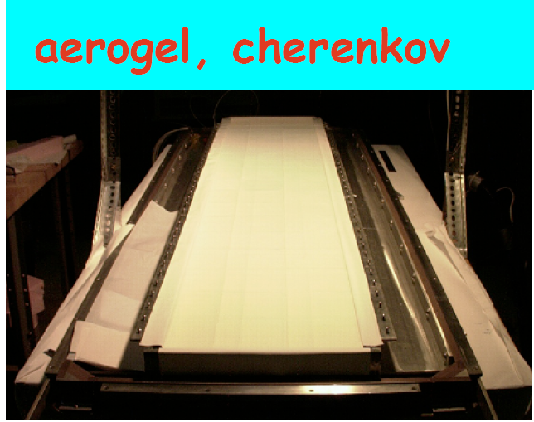
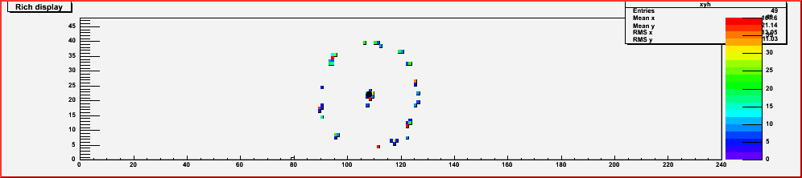
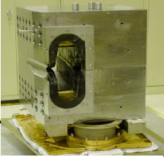
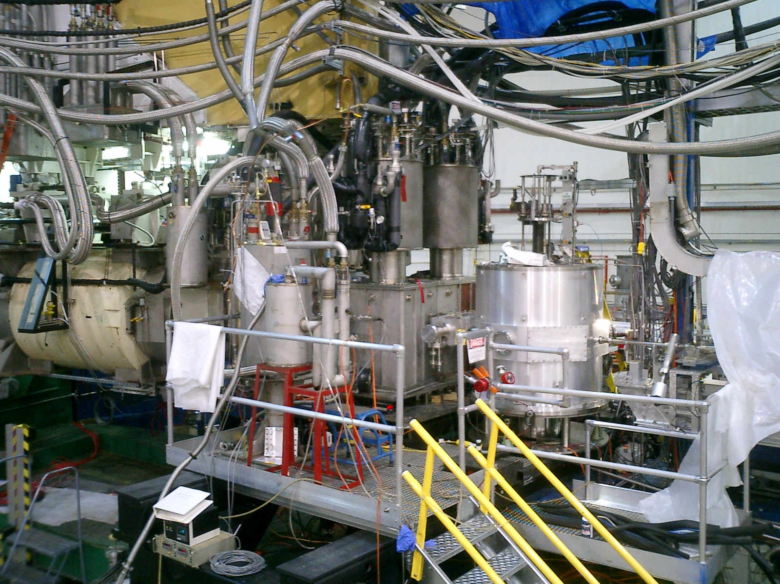
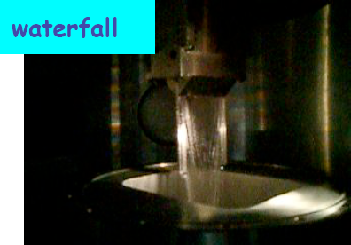
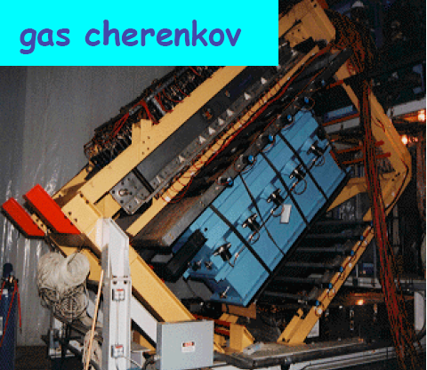
Hall A deector setup
RICH Detector
aerogel first generation
hadron arm
septum magnets
aerogel second generation
electron arm
To be added to do the experiment

Slide 5
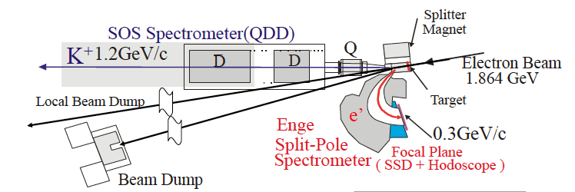
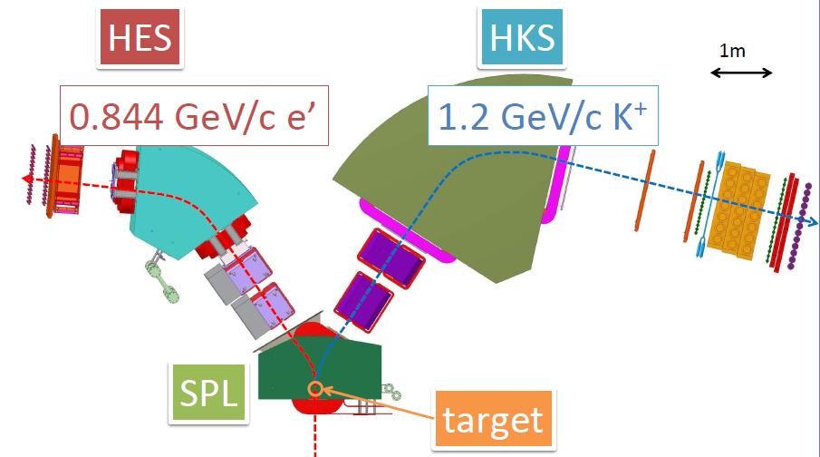
Hall C (HKS, HES, ENGE)

Slide 6
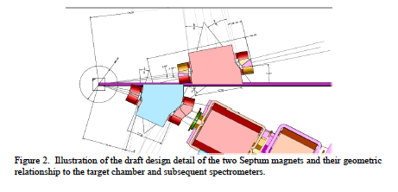
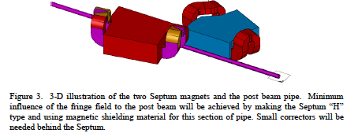
Hall A + Hall C

Slide 7
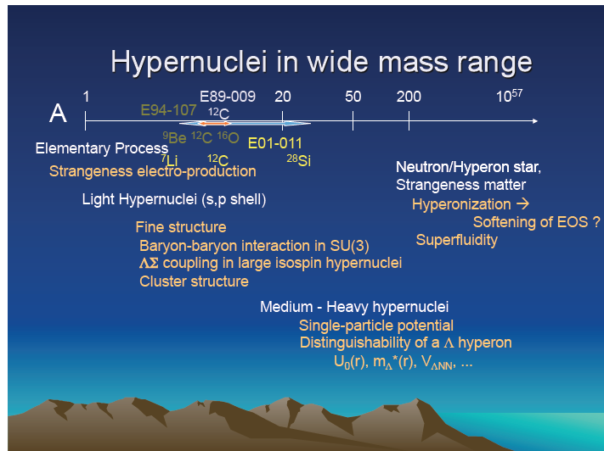
Hypernuclear spectroscopy prospectives at Jlab
Future mass spectroscopy
Decay Pion Spectroscopy to Study ☹-Hypernuclei

Slide 8
Goals
. Elementary kaon electroproduction
. Spectroscopy of light Λ-Hypernuclei
. Spectroscopy of medium-heavy Λ-Hypernuclei
. Spectroscopy of ²⁰⁸Pb
. Pion decay spectroscopy

Slide 9
Medium heavy hypernuclei
• to what extent does a Λ hyperon keep its identity as a baryon inside a nucleus?
• the mean-field approximation and the role that the sub-structure of nucleons plays in the nucleus.
• the existing data from (π+,K+) reactions obtained at KEK, do not resolve the fine structure in the missing mass spectra due to limited energy resolution (a few MeV), and theoretical analyses suffer from those uncertainties
• the improved energy resolution (~ 500 - 800 keV) of (e,e’K) hypernuclear spectroscopy, which is comparable to the spreading widths of the excited hypernuclear states, will provide important information

Slide 10
Λ Hyperon in heavier nuclei – ²⁰⁸(e,e’K+)²⁰⁸_{Λ}Ti
✔ A range of the mass spectroscopy to its extreme
✔ Studied with (π,k) reaction, levels barely visible (poor energy resolution)
(e,e’K) reaction can do much better.
Energy resolution → Much more precise Λ single particle energies. Complementarity with (π,k) reaction
✔ the mass dependence of the binding energy for each shell model orbital will be extended to A = 208, where the ambiguity in the relativistic mean field theories become smaller.
✔ neutron stars structure and dynamics
✔ distinguishability of the hyperon in the nuclear medium

Slide 11
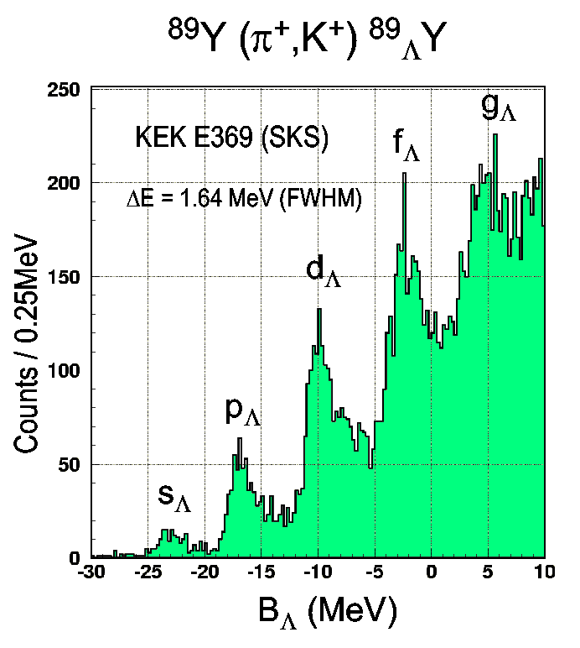
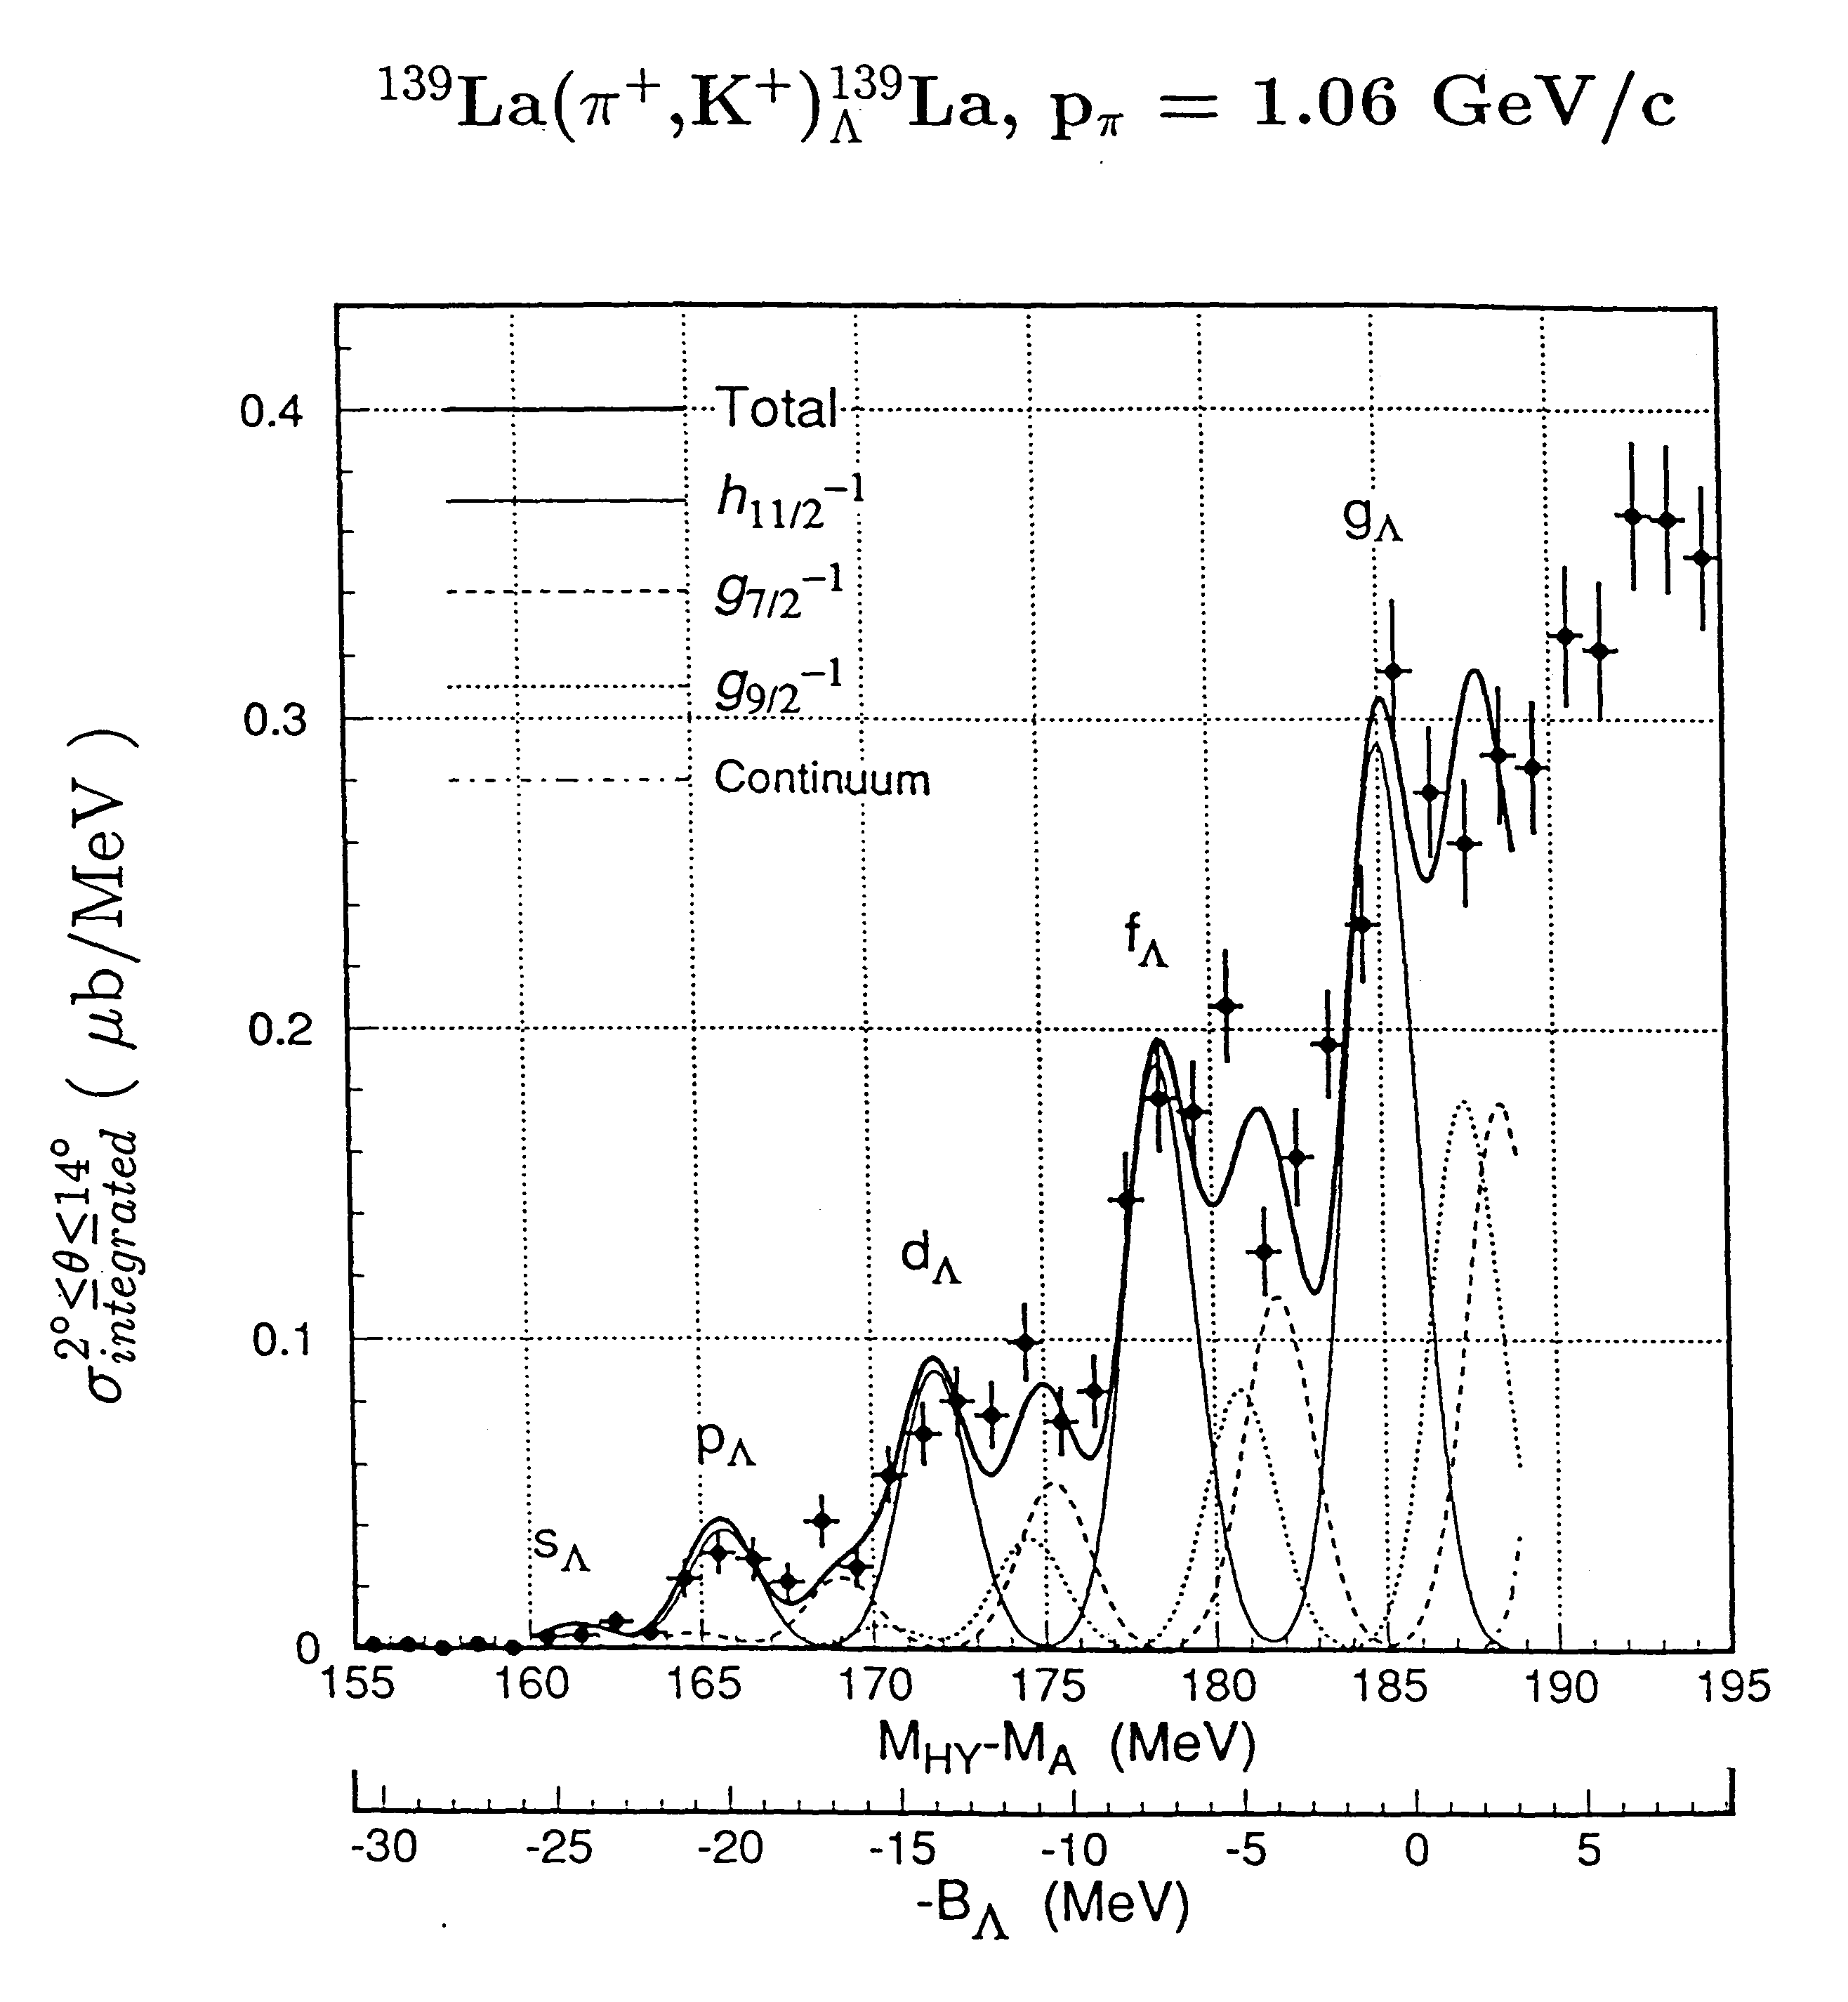
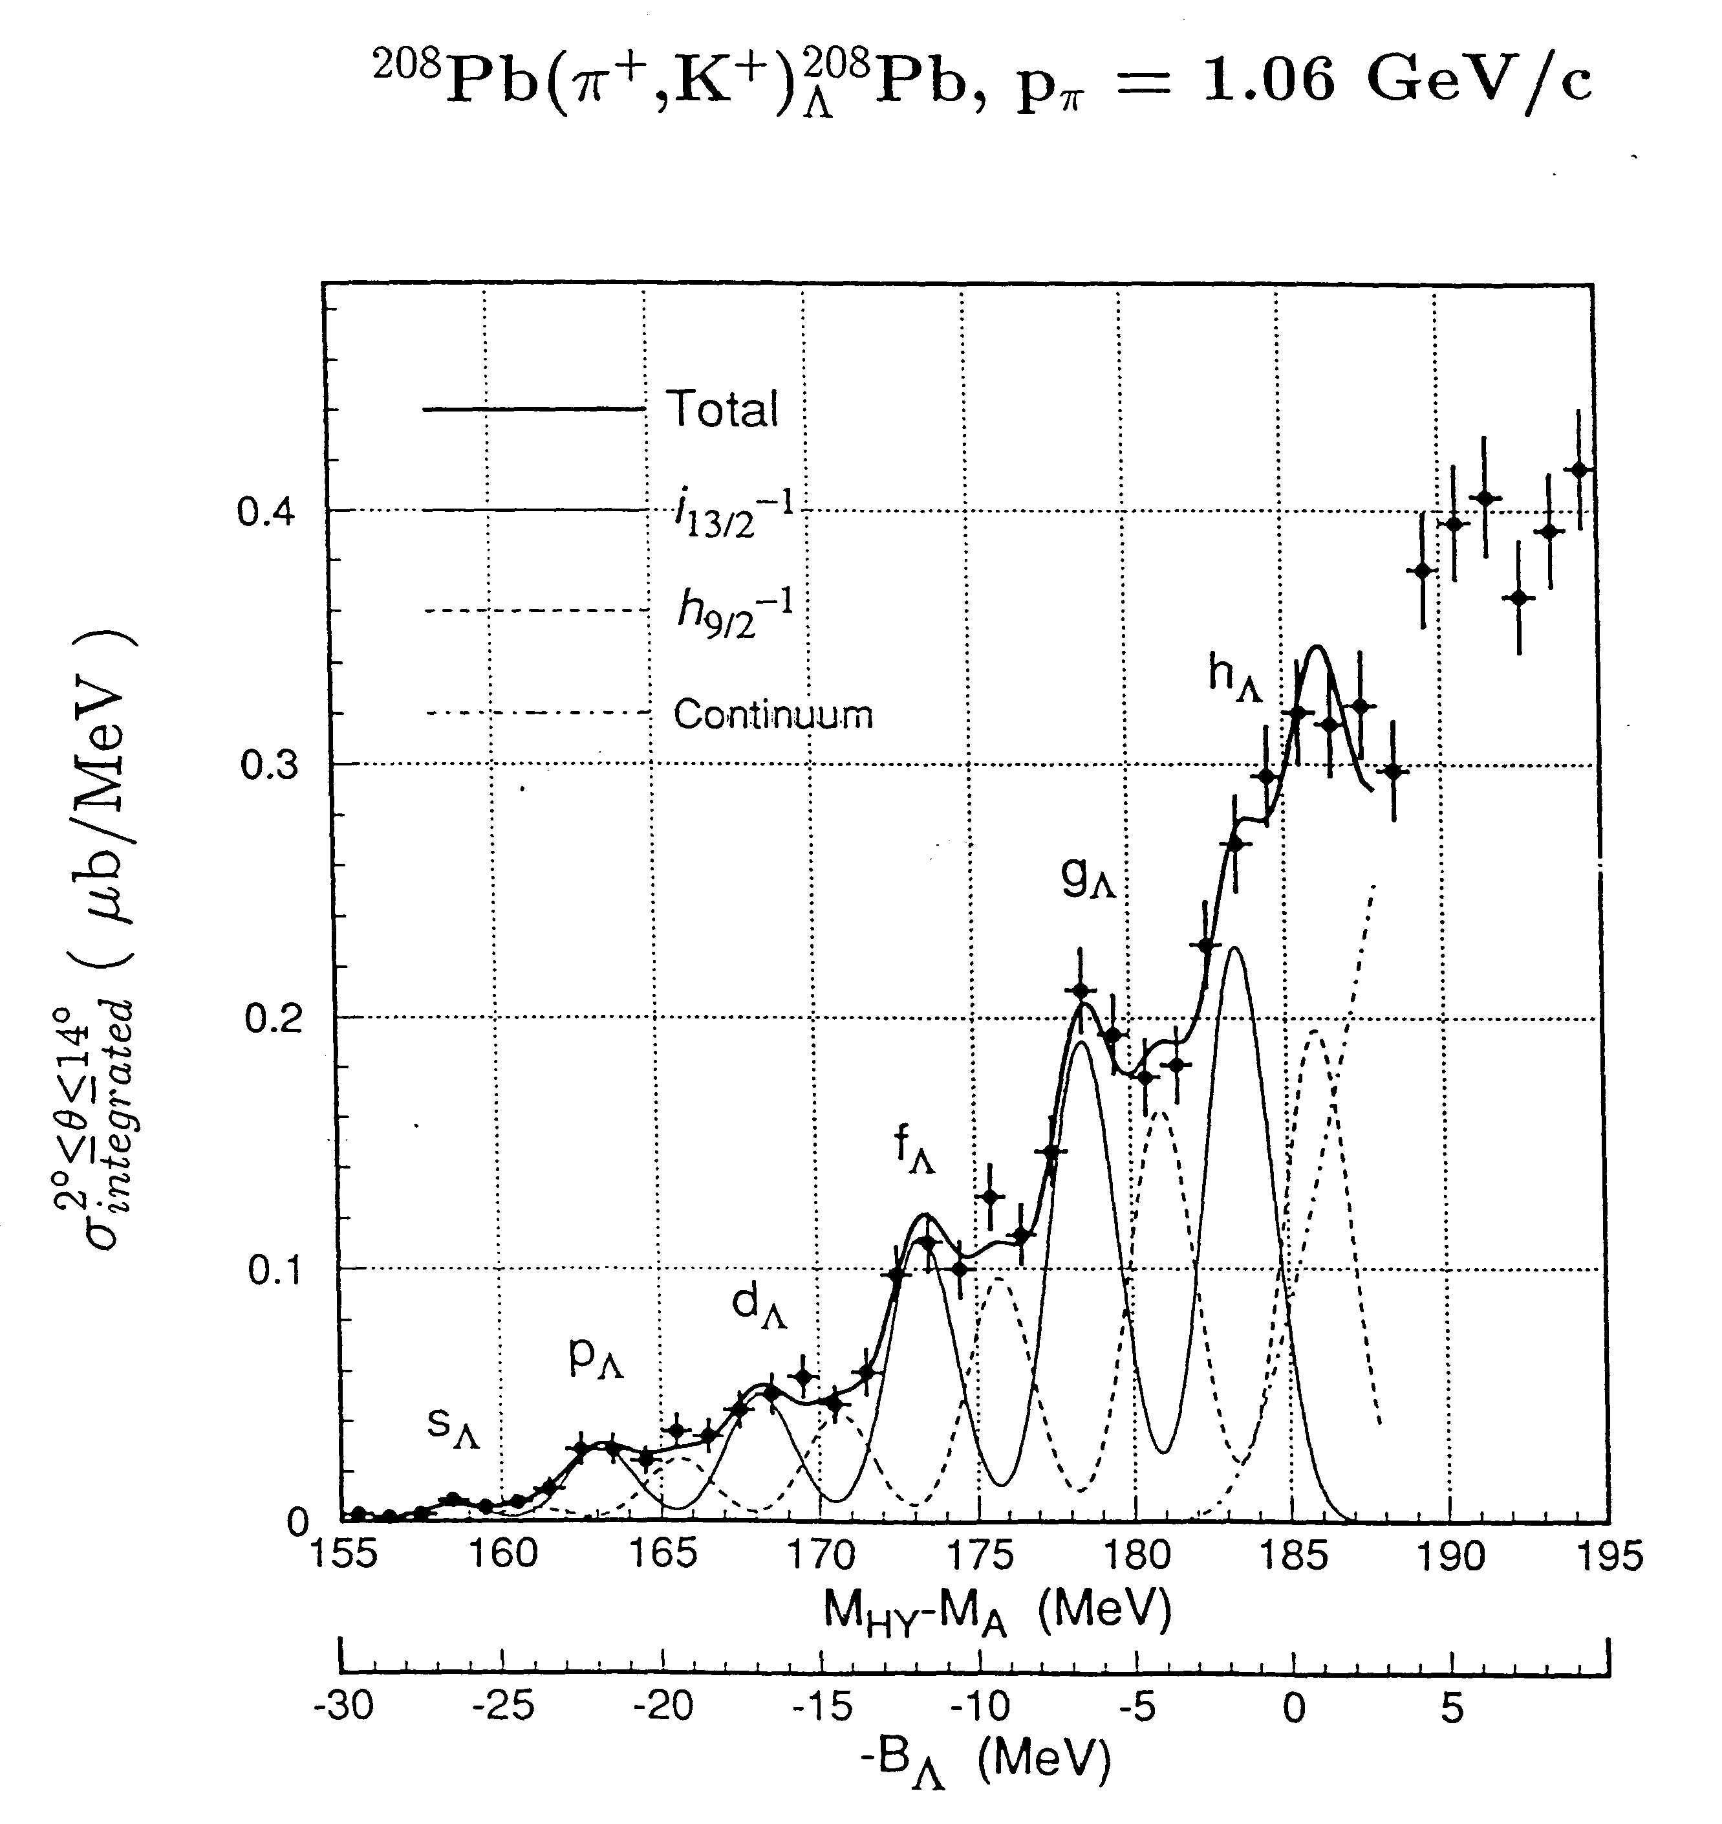
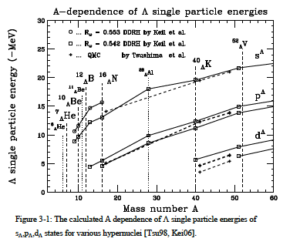
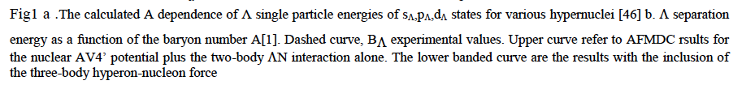
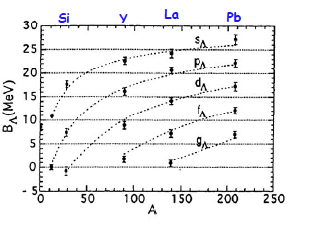
Λ Hyperon in heavy nuclei (π,K)
Hotchi et al., PRC 64 (2001) 044302
Hasegawa et. al., PRC 53 (1996)1210
Measured (π,K)

Slide 12
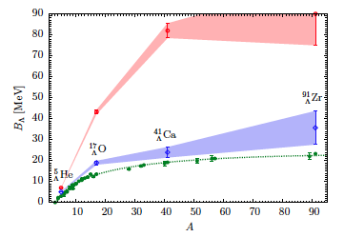
D. Lonardoni et al.
Separation energy as a function of the baryon number A.
Plain green dots [dashed curve] are B_{Λ} experimental values.
Empty red dots [upper banded curve] refer to the AFDMC results for the nuclear AV4' potential plus the two-body ΛN interaction alone.
Empty blue diamonds [lower banded curve] are the results with the inclusion of the three-body hyperon-nucleon force.

Slide 13
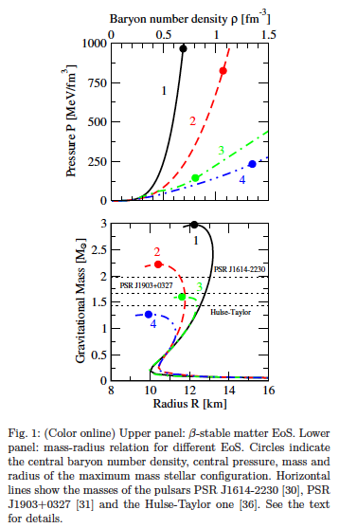
Appearence of hyperons brings the maximum mass of a stable neutron star down to values incompatible with the recent observation of a star of about two solar masses.
It clearly appears that the inclusion of YNN forces (curve 3) leads to a large increase of the maximum mass, although the resulting value is still below the two solar mass line.
A precise knowledge of the level structure can, by constraining the hyperon-nucleon potentials, contribute to more reliable predictions regarding the internal structure of neutrons stars, and in particular their maximum mass
It is a motivation to perform more realistic and sophisticated studies of hyperonic TBF and their effects on the neutron star structure and dynamics, since they have a pivotal role in this issue
It seems that only simultaneous strong repulsion in all relevant channels could significantly raise the maximum mass

Slide 14
Binding energies of the Λ inferred assuming they correspond to the peak centroids of the bumps, altough they may depend on detail of the bump structures.
Spectrum smoother than expected (DWA calculation) and experimental energy resolution.
” Therefore it is of vital importance to perform precision spectroscopy of medium - heavy hypernculei with mass resolution comparable to or better than the energy differences of the core excitation in order to further investigate the structure of the Λ hyperon deeply boud states in heavier nuclei.
(e,e’K) spectroscopy is a very promising approach to this probem ”
(O. Hashimoto and H. Tamura, Progr. N Part. and Nucl. Physic 57 (2006)
“Up to now these data are the best proof ever of quasi particle motion in a strongly interacting system”

Slide 15
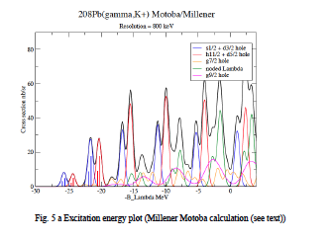
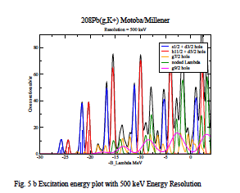
Millener-Motoba calculations
Particle hole calulation, weak-coupling of the Λ hyperon to the hole states of the core (i.e. no residual Λ-N interaction).
Each peak does correspond to more than one proton-hole state
- Interpretation will not be difficult because configuration mixing effects should be small
- Comparison will be made also with many-body calculations using the Auxiliary Field Diffusion Monte Carlo (AFDMC) that include explicitely the three body forces.
- Once the Λ single particle energies are known the AFMDC can be used to try to determine the balance between the spin independent components of the ΛN and ΛNN interactions required to fit Λ single-particle energies across the entire periodic table.

Slide 16
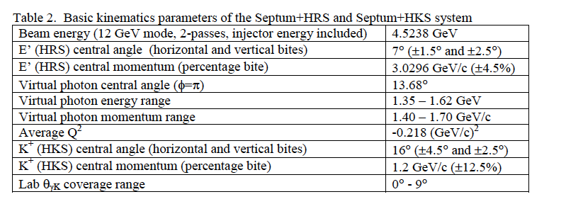
kinematics

Slide 17
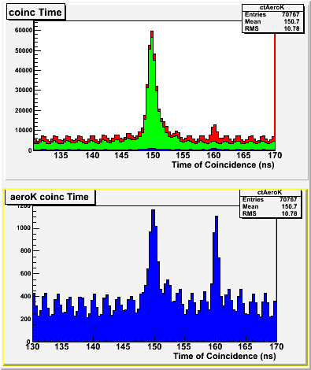
The PID Challenge
Very forward angle ---> high background of p and p
TOF and 2 aerogel in not sufficient for unambiguous K identification !
Kaon Identification through Aerogels
p_{h} = 1.7 : 2.5 GeV/c
p
p
All events
k
k
p
p
AERO1
n=1.015
AERO2
n=1.055
k
Pions = A1•A2
Kaons = A1•A2
Protons = A1•A2

Slide 18
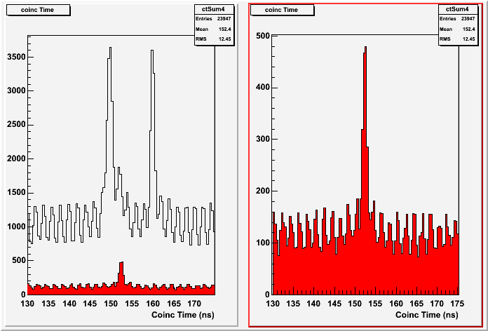
RICH – PID – Effect of ‘Kaon selection
Coincidence Time selecting kaons on Aerogels and on RICH
AERO K
AERO K && RICH K
p
P
K
Pion rejection factor ~ 1000

Slide 19
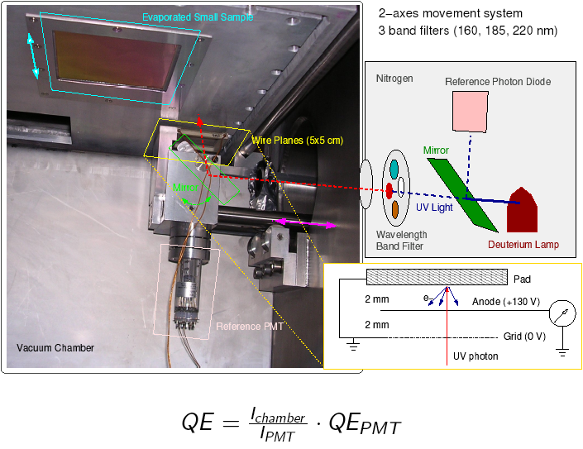
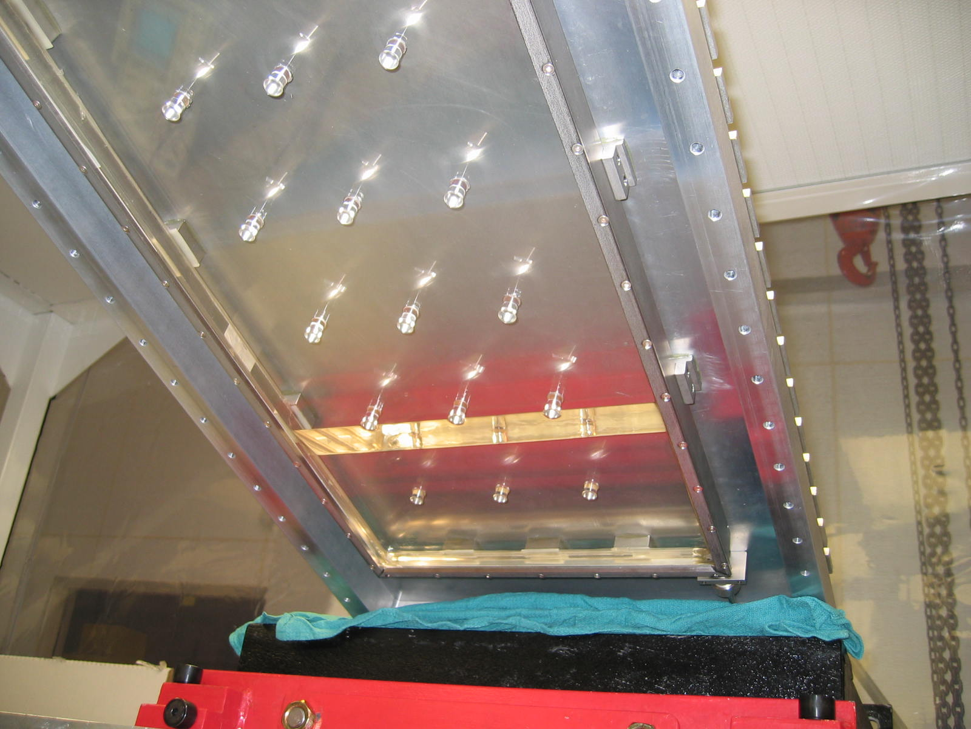
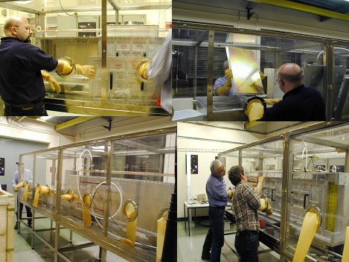
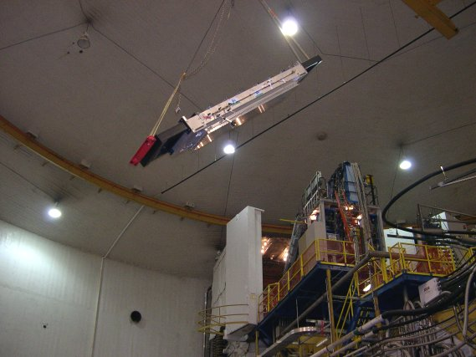
The RICH detector at Jefferson Lab
RICH flying to hunt kaons
into the detector hut

Slide 20
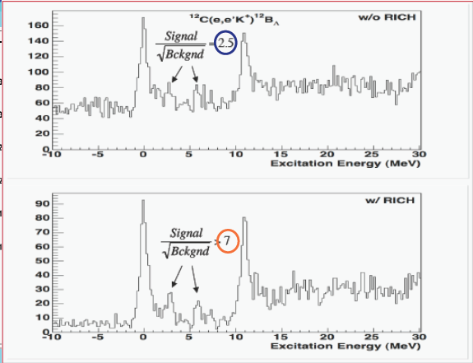
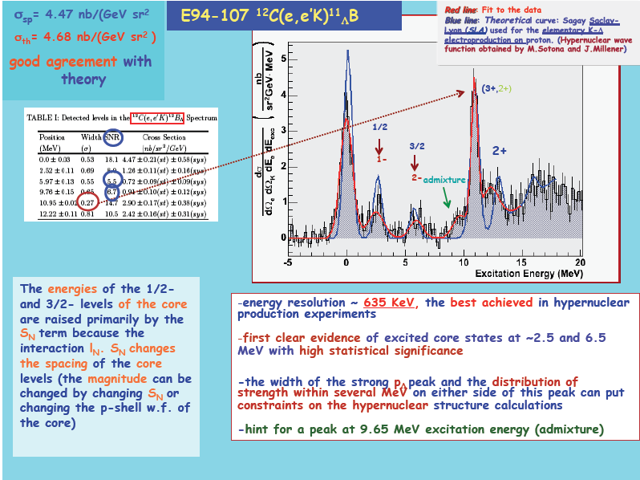
¹²C(e,e’K)¹²B_{L} M.Iodice et al., Phys. Rev. Lett. E052501, 99 (2007)

Slide 21
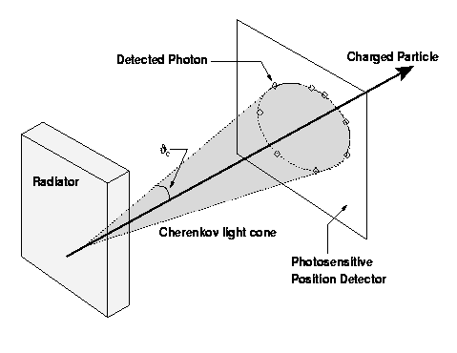
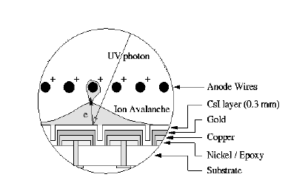
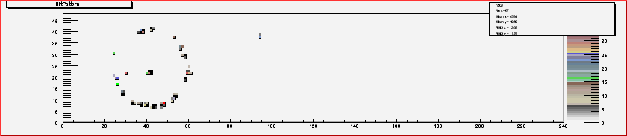

RICH detector – C₆F₁₄/CsI proximity focusing RICH
“MIP”
Cherenkov angle resolution
Separation Power
N. of detected photoelectrons
Performances
- N_{p.e.} # of detected photons(p.e.)
- and  (angular resolution)
maximize
minimize

Slide 22
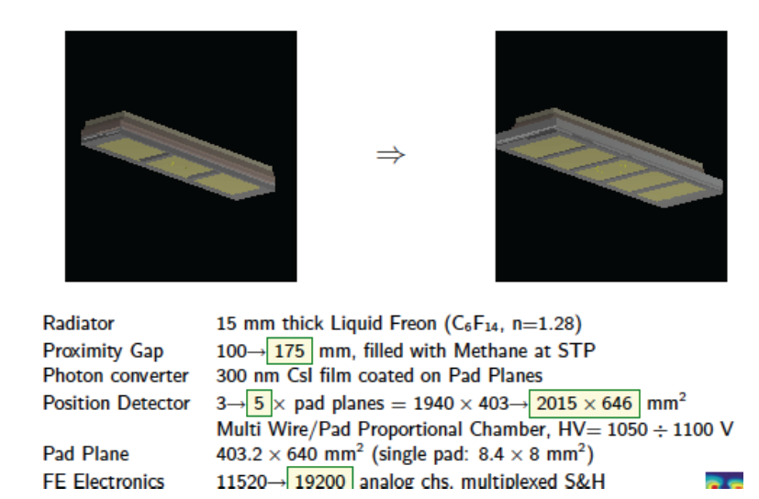
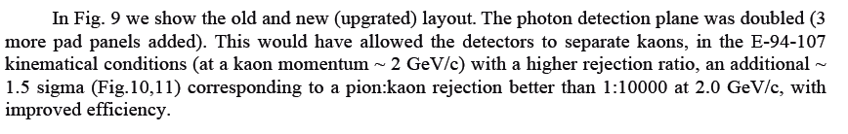
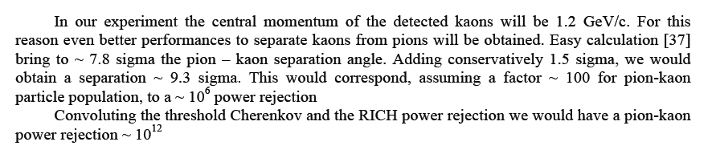
RICH upgrated for Transversity experiment

Slide 23
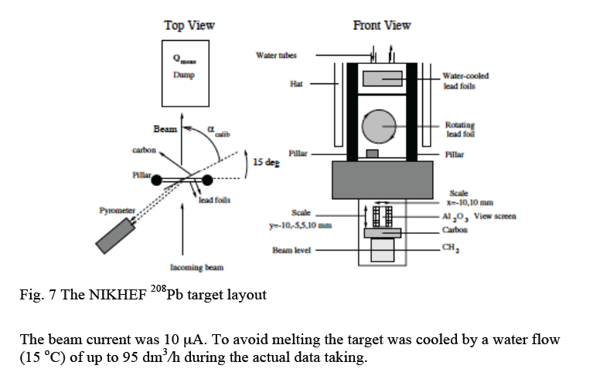
The target
NIKHEF target (C. Marchand, Saclay)

Slide 24
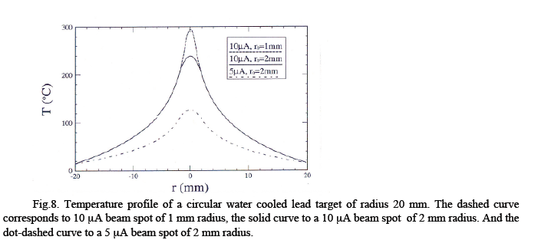

Elastic scattering measurement off Pb-208 to know the actual thickness of the target then monitor continuously by measuring the electron scattering rate as a function of two-dimensional positions by using raster information.

Slide 25


HKS PID
3 TOF, 2 water Cherenkov, three aerogel Cerenkov
Power rejection capability is:
- In the beam p:K:p 10000:1:2000
- in the on-line trigger 90:1:90
- after analysis it is 0.01:1:0.02
- so for π the rejection power is 10⁶
- and for p 10⁵
HKS PID
(gas Cherenkof + shower counter)
e,π rejection 10⁵
RICH Detector
Target
solid cryocooled for Pb
PID π/Κ ∼ 10¹² ^{(threshold + RICH)}
<i> = 25 mA - 100 mg/cm cryocooling
Elastic scattering measurement off Pb-208 to know the actual thickness of the target then monitor continuously by measuring the electron scattering rate as a function of two-dimensional positions by using raster information.

Slide 26

Counting rates

Slide 27
<I> (mA) | Target thickness (mg/cm2) | Peak significance | Peak
10 | 100 | 3.48 | s-shell
10 | 200 | 4.13 | s-shell
10 | 300 | 4.48 | s-shell
10 | 100 | 7.54 | p-shell
10 | 200 | 9.21 | p-shell
10 | 300 | 11.52 | p-shell
20 | 100 | 4.13 | s-shell
20 | 200 | 4.63 | s-shell
20 | 300 | 4.84 | s-shell
25 | 100 | 4.3 | s-shell
25 | 200 | 4.7 | s-shell
25 | 300 | 4.9 | s-shell
25 | 100 | 10.5 | p-shell
25 | 200 | 12.8 | p-shell
25 | 300 | 14.0 | p-shell

Slide 28
Summary and conclusions
The of hypernculear physics is an important part of the modern nuclear and hadronic physics
The (e,e’K) experiments performed at Jlab in the 6 GeV era confirmed the specific, crucial role of this technique in the framework of experiments performed and planned in other facilties.
The importance of the study of the pion decay spectroscopy, the elementary reaction , the few body and medium mass nuclei has been shown in other talks
Interesting comparison betwen different kind of calculations, namely lattice QCD calulations, standard Mcarlo calulation, ab initio Mcarlo calculations possible in the entire A range
The study of (medium and) heavy hypernuclei is an essential part of the series of measurements we propose, fully complementary to what performed and proposed with (e,e’K) reactions and in the framework of experiments performed or planned at other facilities

Slide 29
Important information will be obtained on the limits of the description of hypernculei
and nuclei in terms of shell model/mean field approximation
The role of three body interaction both in hypernuclei and in the structure and dynamics of neutron stars will be shown
Comparison between standard shell/model-mean field calculations and microscopic Mcarlo consistent calculations in the whole A range
The behaviour of Λ binding energy as function of A will be extended at his extreme
Comparison of (e,e’K) with (π,K) results might reveal the limits of the distinguishability
of the hyperon in the dense nuclear medium
Combining the informations from the performed and proposed (e,e’K) experiment will
allow a step forward in the comprehension of the role of the strangeness in our
world.

Slide 30
Backup slides

Slide 31

The mass (A) dependence of the central binding potential depth from the absolute Λ binding energies
Information about the spin-orbit splitting as a function of the core nucleus mass
Self-consistent interaction parameters for non-relativistic Hartree-Fock or relativistic mean-field theories.
    - Access to deformation of the core nucleus, utilizing the Λ as a probe.
    Modify energy levels of a core nucleus by adding a Λ as an impurity.

Slide 32

The curves are the spe from a Woods-Saxon well with V = 30.05 MeV,r = 1.165 fm, a = 0.6 fm.
Spread out the Woods-Saxon spe for large A. This one can do by introducing density dependence an an effective mass in some combination to get a good fit over the full range of A
Fig… shows that a density dependence increases the radius of the potential in a way that is more or less independent of A.
Separation energy as a function of the baryon number A.
Plain green dots [dashed curve] are B_{Λ} experimental values.
Empty red dots [upper banded curve] refer to the AFDMC results for the nuclear AV4' potential plus the two-body ΛN interaction alone.
Empty blue diamonds [lower banded curve] are the results with the inclusion of the three-body hyperon-nucleon force.

Slide 33

The target
<i> = 25 mA - 100 mg/cm²
cryocooling
Target calibration and monitoring
Elastic scattering measurement off Pb-208 to know the actual thickness of the target then monitor continuously by measuring the electron scattering rate as a function of two-dimensional positions by using raster information.
RICH Detector
PID π/Κ ∼ 10¹²
^{(threshold + RICH)}

Slide 34

Λ N vs Σ N
H. J Schulze and T Rjiken, Phys Rev C84, 035801 (2011)
New potential (ESC08) and TBF stiffen the EOS, allowing for higher maximum masses of hyperon stars.
“Therefore is of great importance to carry out accurate theoretical calculations of hypernuclear matter and the corresponding hyperon star structure, as much as possible constrained by independent experimental information on the hyperon-nucleon interactions.”
Massive neutron stars have to be hybrid stars containing a core of nonbaryonic (“quark”) matter, since the possibility of them being nucleonic stars is ruled out by the early appearance of hyperons
Λ appears earlier than Σ

Slide 35

Millener plots

Slide 36

The observation of a very heavy pulsar (M=1.97(4) solar masses, Demorest et al. Nature 467 1081 (2010), severely constraints the equation of state at high densities with implications for possible hypernuclear components.
Further information on contributions of non nucleonic degrees of freedom from experiments are important

Slide 37





✓ p(e,e′K+)Λ/Σ The data suggest that not only do the present models fail to describe the data over the full angular range, but that the cross section rises at the forward angles. The failure of existing models to describe the data suggests the reaction mechanisms may be incomplete.
✓ ⁷Li(e,e’k) ⁷_{Λ}He A clear peak of the ⁷He ground state for the first time. CSB term puzzle experiment and theory worse, (CSB term is essential for A=4 hypernuclei). → understanding of the CSB effect in the Ν Λ interaction potential is still imperfect.
✓ ⁹Be(e,e’K+)⁹_{Λ}Li: Disagreement between the standard model of p-shell hypernculei and the measurements, both for the position of the peaks and for the cross section.
✓ ¹²C(e,e’K+) ¹²_{Λ}B: for the first time a measurable strength with sub-MeV energy resolution has been observed in the core-excited part of the spectrum. The s part of the spectrum is well reproduced by the theory, the p shell part isn’t.
✓.¹⁶O(e,e’K+)¹⁶_{Λ}N: The fourth peak ( in p state) position disagrees with theory. This might be an indication of a large spin-orbit term SΛ. Binding Energy B_{Λ}=13.76±0.16 MeV measured for the first time with this level of accuracy

Slide 38
BNL 3 MeV
KEK336 2 MeV
hadron probe vs e.m. probe
Improving energy resolution
~ 1.5 MeV
- Energy resolution
- Spin flip
and
using electromagnetic probe
670 KeV
635 KeV
High resolution, high yield, and systematic study is essential

Slide 39

Appearence of hyperons brings the maximum mass of a stable neutron star down to values incompatible with the recent observation of a star of about two solar masses.
It clearly appears that the inclusion of YNN forces (curve 3) leads to a large increase of the maximum mass, although the resulting value is still below the two solar mass line.
A precise knowledge of the level structure can, by constraining the hyperon-nucleon potentials, contribute to more reliable predictions regarding the internal structure of neutrons stars, and in particular their maximum mass
It is a motivation to perform more realistic and sophisticated studies of hyperonic TBF and their effects on the neutron star structure and dynamics, since they have a pivotal role in this issue
It seems that only simultaneous strong repulsion in all relevant channels could significantly raise the maximum mass

Slide 40
Goals of the proposal(s)
. Elementary kaon electroproduction
. Spectroscopy of light Λ-Hypernuclei
. Spectroscopy of medium-heavy Λ-Hypernuclei
. Spectroscopy of heavy Λ-Hypernuclei
. Pion decay spectroscopy
They provide invaluable information on
ΛN interaction
Charge Symmetry Breaking (CSB) in the Λ-N interaction
Limits of the mean field description of nuclei and hypernuclei
Λ binding energy as a function of A for different nuclei than those probed with hadrons and structure of tri-axially deformed nucleus using a Λ as a probe.
Energy level modification effects by adding a Λ
- The role of the 3 body ΛNN interaction in Hypernuclei and Neutron Stars

