Slide 1
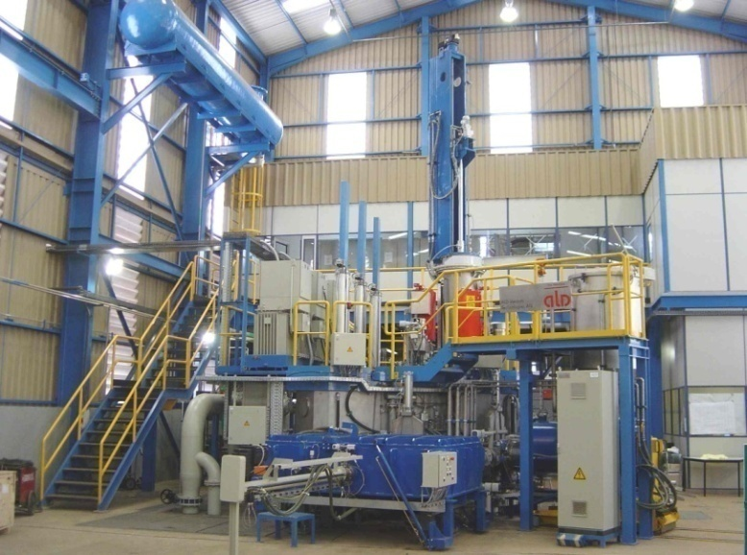
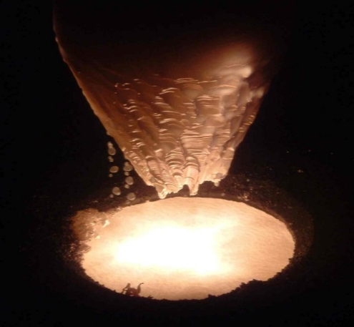
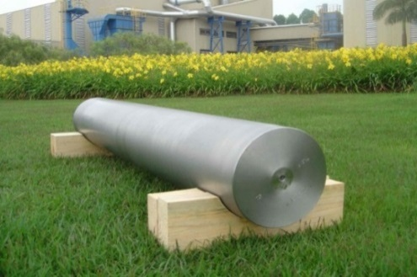

Recent Developments in High Purity Niobium Metal Production at CBMM
CBMM -
Companhia Brasileira de Metalurgia e Mineração
Araxá, Minas Gerais, BRAZIL
Innovate, Respect, Compete

Slide 2
Important Notice
This presentation does not constitute an offer or invitation for the sale or purchase of any securities, businesses and/or assets or any recommendation or commitment by the Company, the Controlling Shareholders or any of their respective advisers. The information in this presentation has not been verified by the Company, the Controlling Shareholders or any of their respective advisers. No representation or warranty, express or implied, is or will be made in relation to, and no responsibility, liability or duty of care is or will be accepted by the Company, the Controlling Shareholders or any of their respective directors, partners, officers, representatives, employees, advisers or agents (together ‘Relevant Persons’) as to, or in relation to, the accuracy, reliability, or completeness of this presentation or any information or any statement in this presentation. Accordingly, none of the Company, the Controlling Shareholders, or any Relevant Persons shall be liable for any direct, indirect or consequential loss or damage suffered by any person as a result of relying on the accuracy of any information or any statement in this presentation or any errors in or omissions from this presentation. No responsibility, liability or duty of care is or will be accepted by the Company, the Controlling Shareholders, or any Relevant Persons for providing the recipient with access to any additional information, updating this presentation or correcting any inaccuracies herein which may become apparent. Nothing herein is intended to exclude any liability for, or remedy in respect of, fraudulent misrepresentation. Neither this presentation nor anything contained herein shall form the basis of any contract or commitment whatsoever.
This presentation is only being made available to interested parties on the basis that: (A) if they are UK persons, they are persons falling within Articles 19 or 49 of the Financial Services and Markets Act 2000 (Financial Promotion) Order 2005; (B) if they are US persons (as defined in Regulation S under the Securities Act of 1933, as amended (the ‘Securities Act’), they are ‘accredited investors’ as defined under Rule 501(a) under the Securities Act who represent that they are participating in the Transaction for their own account for investment purposes only and not with a view to resale, who are willing and able to conduct an independent investigation of the risks of participation in the Transaction and who will be required to represent that they are participating in the Transaction for investment purposes; or (C) they are outside the United Kingdom are not US persons (as defined in regulation S) and are eligible under local law to receive this presentation (all such persons collectively being referred to as ‘Intended Recipients’). Recipients of this presentation in jurisdictions outside the UK who are not US persons should inform themselves about and observe any applicable legal requirements. By attending and/or accepting this presentation you represent and warrant that you are an Intended Recipient. This presentation must not be acted on or relied upon by persons who are not Intended Recipients. Any investment or investment activity to which this presentation relates is available only to Intended Recipients and will be engaged in only with Intended Recipients.
Forward-looking statements - All statements, other than statements of historical fact included in this presentation, are or may be deemed to be forward-looking statements within the meaning of the United States Private Securities Litigation Reform Act of 1995. These statements include statements regarding, among other things, the Company's results of operation, financial condition, liquidity, prospects, growth, strategies and the industry in which Company operates. The use of the words ‘expects’, ‘intends’, ‘anticipates’, ‘estimates’, ‘may’, ‘forecast’, ‘objective’, ‘plan’ or ‘target’, and other similar expressions are intended to identify forward-looking statements. No representation or warranty is given as to the completeness or accuracy of the forward-looking statements contained in this presentation. These forward-looking statements are not guarantees of future performance and are subject to a number of risks and uncertainties. Important factors that could cause actual results to differ materially from those discussed in such forward-looking statements include but are not limited to: adverse trends in the general economy, business conditions or interest rates; the Company’s ability to anticipate customer requirements; the reputation of the Company and its trading names, together with the success of the Company's marketing and promotional programmes; the ability to recruit, train and retain staff; and the suitability and reliability of the Company’s systems and procedures, including its information technology.

Slide 3

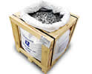

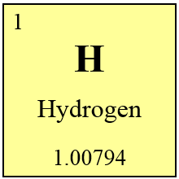
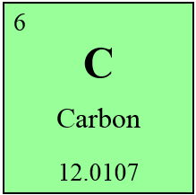
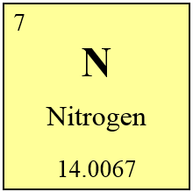
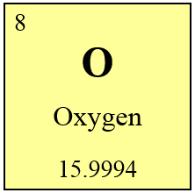

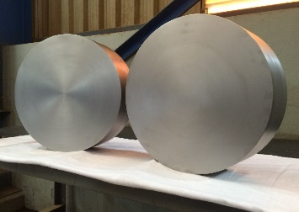
Agenda
CBMM - Products and applications
Niobium Metal refining process
Main Niobium Metal impurities
Slice technology
Large diameter ingot
Innovate, Respect, Compete

Slide 4
Agenda
CBMM - Products and applications
Niobium Metal refining process
Main Niobium Metal impurities
Slice technology
Large diameter ingot
Innovate, Respect, Compete

Slide 5
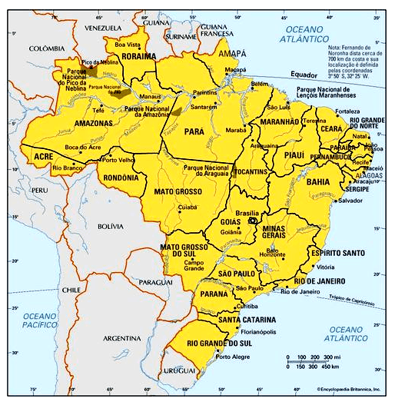
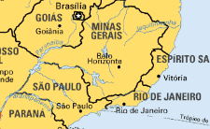
Industrial Facilities - Location
Araxá
600 Km from SP
Araxá
1000 Km from RJ
Innovate, Respect, Compete

Slide 6
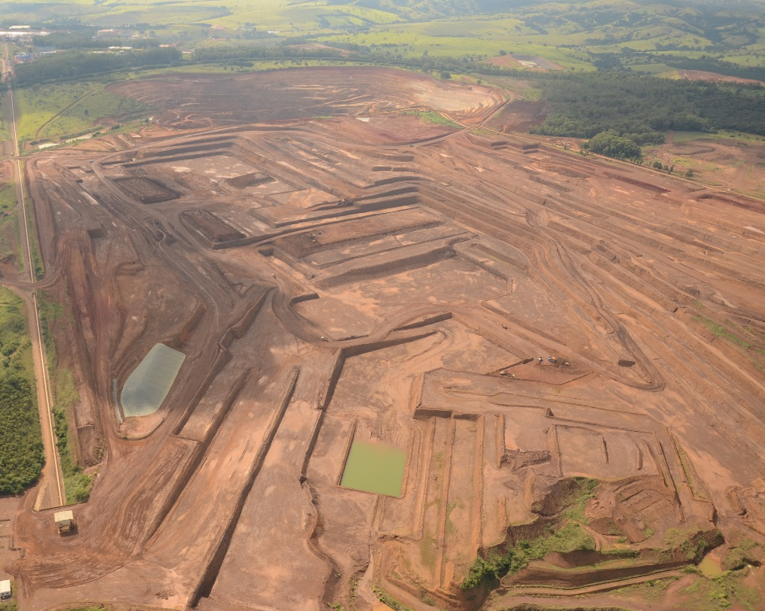
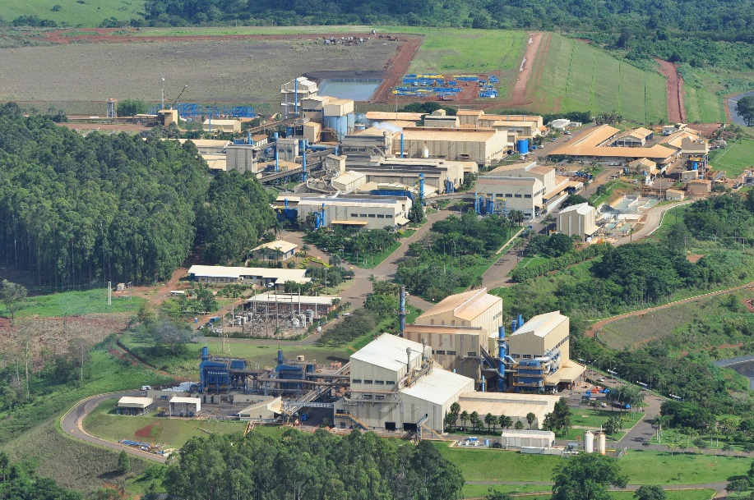
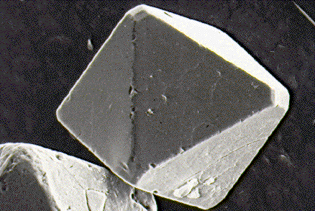
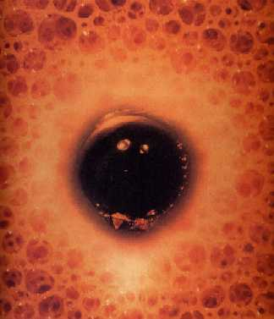
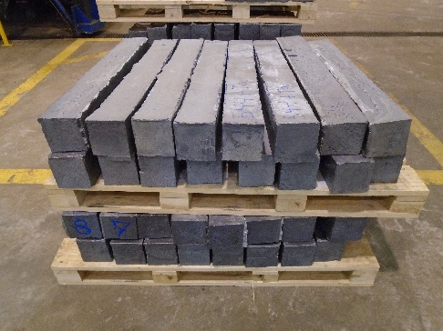
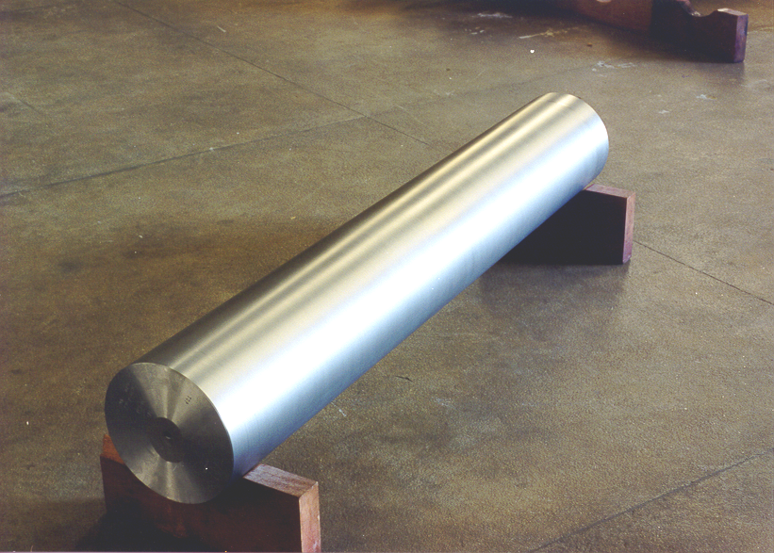
CBMM - Overview
Innovate, Respect, Compete

Slide 7
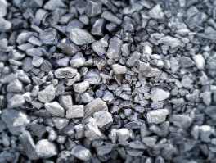
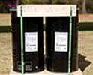
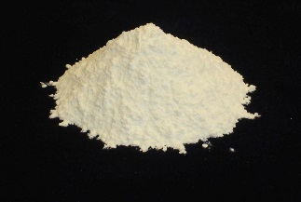
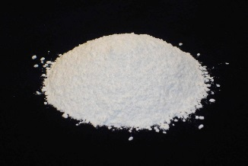
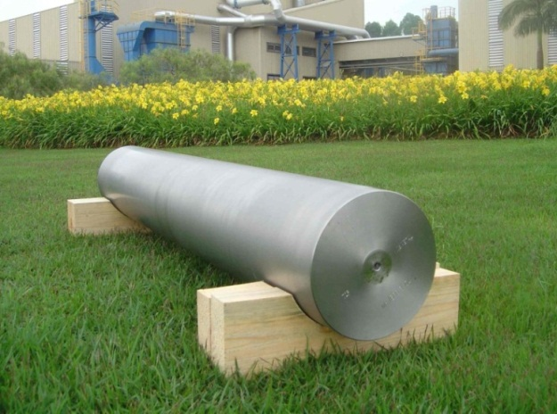
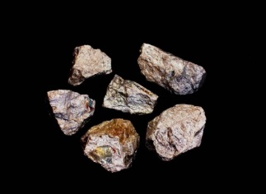
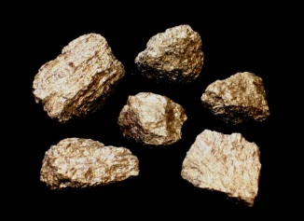
CBMM – Products
Ferroniobium
Niobium Oxide
High Purity
Niobium Oxide
Optical Grade
Ferroniobium
Vacuum Grade
Nickel Niobium
Vacuum Grade
High Purity Niobium Metal
Innovate, Respect, Compete

Slide 8
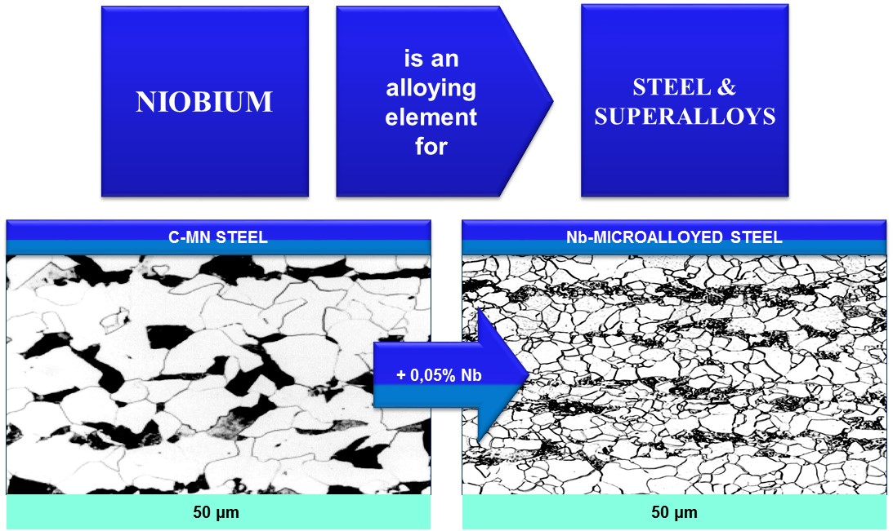
What are the Benefits of Niobium ???
Innovate, Respect, Compete

Slide 9
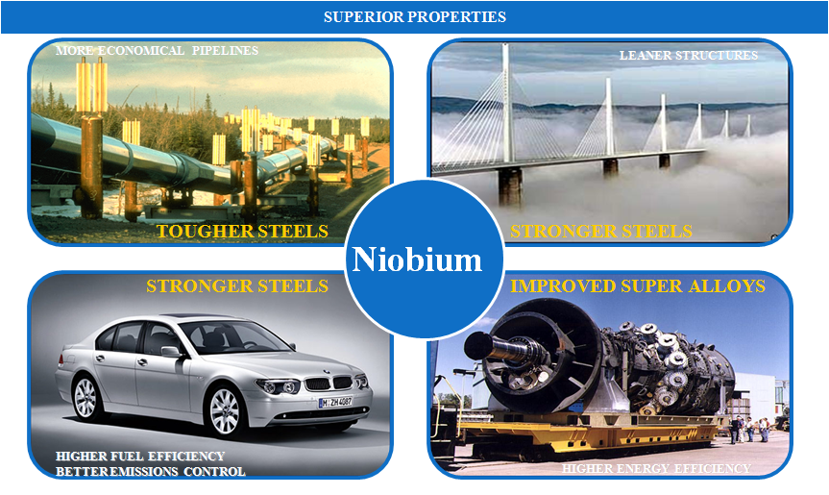
Niobium – Technological Solutions

Slide 10
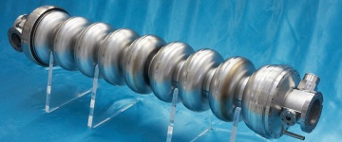
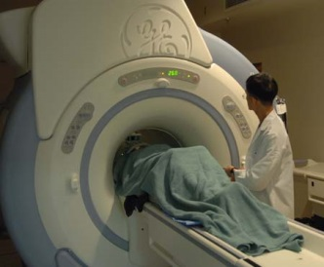
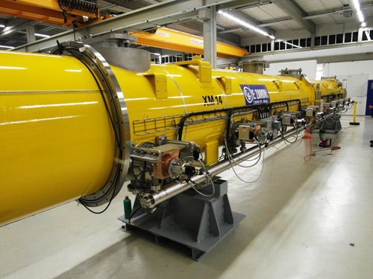
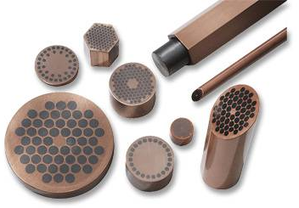
Niobium – Technological Solutions
Pure Niobium Metal Applications
Innovate, Respect, Compete

Slide 11
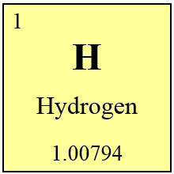
Agenda
CBMM - Products and applications
Niobium Metal refining process
Main Niobium Metal impurities
Slice technology
Large diameter Ingot
Innovate, Respect, Compete

Slide 12
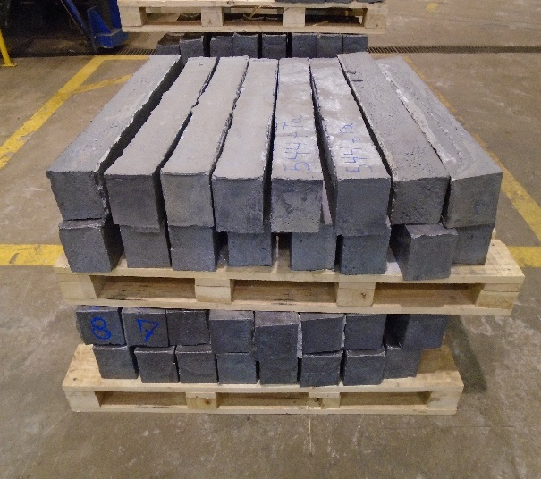
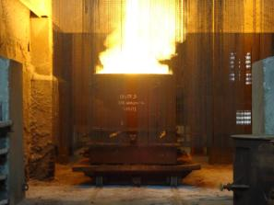
Raw Material
ATR (Aluminothermic Reduction)
3 Nb₂O₅ + 10 Al = 6 Nb + 5 Al₂O₃
Typical ATR Composition
95% Niobium metal
5% Aluminum compounds and ore residual elements
Innovate, Respect, Compete

Slide 13
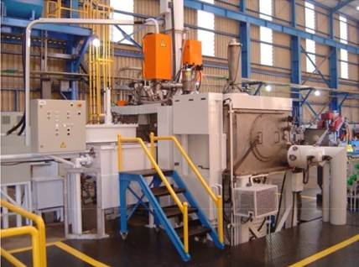
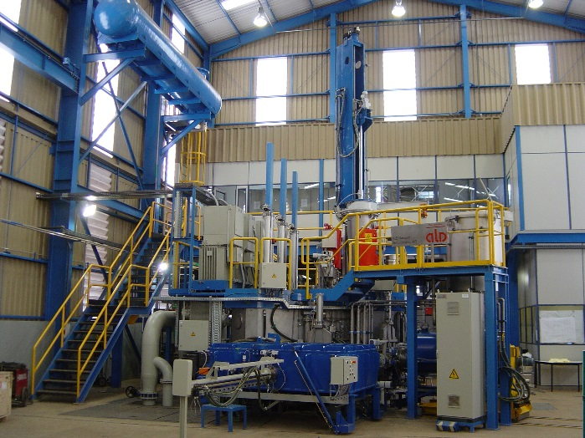
CBMM Electron Beam Furnaces
Leybold
500 kW nominal power
50,000 liter per second pumping capacity
ALD Technologies
1.8 MW nominal power
150,000 liter per second pumping capacity
Innovate, Respect, Compete

Slide 14
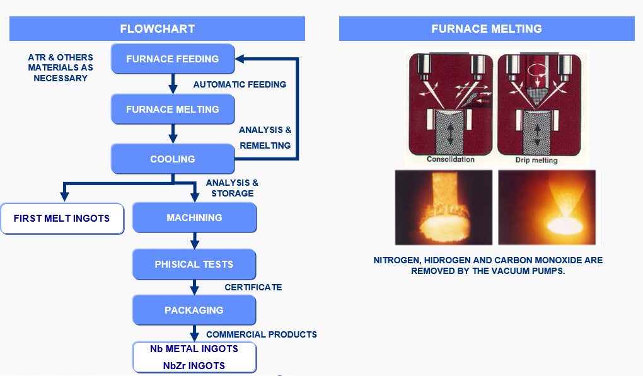
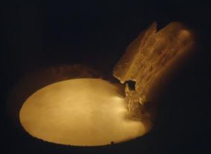



Niobium Metal Refining Process
y
ASTM B391-09
Innovate, Respect, Compete

Slide 15
Agenda
CBMM - Products and applications
Niobium Metal refining process
Main Niobium Metal impurities
Slice technology
Large diameter ingot
Innovate, Respect, Compete

Slide 16



Main Niobium Metal Impurities
(Correlation between interstitial elements and material resistivity)
W. Singer, A. Ermakov, X. Singer. RRR-Measurement Techniques on High Purity Niobium. TTC-Report 2010-02.
Innovate, Respect, Compete

Slide 17
Oxygen in Niobium Metal
(ATR – Reduction Steps)
3 Nb₂O₅ + 2 Al = 6 NbO₂ + Al₂O₃
3 NbO₂ + 2 Al = 3 NbO + Al₂O₃
3 NbO + 2 Al = 3 Nb + Al₂O₃
(ATR bars - Global Reaction)
3 Nb₂O₅ + 10 Al = 6 Nb + 5 Al₂O₃
(Effect of excess of Aluminum in reaction equilibrium)
Yield gain after 1st melting promoted by the use of aluminum in excess at the ATR reaction.
Lower oxygen content after 3rd melting promoted by the use of aluminum in excess at the ATR reaction.
Innovate, Respect, Compete

Slide 18


Nitrogen in Niobium Metal
(Correlation between interstitial elements and material resistivity)
W. Singer, A. Ermakov, X. Singer. RRR-Measurement Techniques on High Purity Niobium. TTC-Report 2010-02.
Nitrogen < 10 ppm in ATR bars
CBMM’s 3rd melt ingot production data in 2015.
Nitrogen results from CBMM’s development in ATR production.
Innovate, Respect, Compete

Slide 19
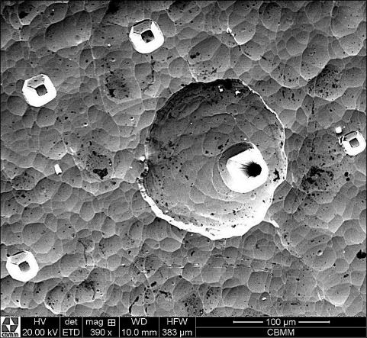
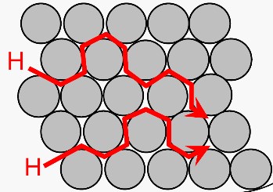
Carbon and Hydrogen in Niobium Metal
Carbon
Hydrogen
Low Carbon content mostly < 10 ppm
Low Hydrogen content mostly < 3 ppm
CBMM’s 3rd melt ingot production data in 2015.
CBMM’s 3rd melt ingot production data in 2015.
Effect of high Carbon content
Hydrogen trapping in material defects
Hydrogen diffusion
Presence of corrosion pits in materials with C segregation
Innovate, Respect, Compete

Slide 20
Agenda
CBMM - Products and applications
Niobium Metal refining process
Main Niobium Metal impurities
Slice technology
Large diameter ingot
Innovate, Respect, Compete

Slide 21
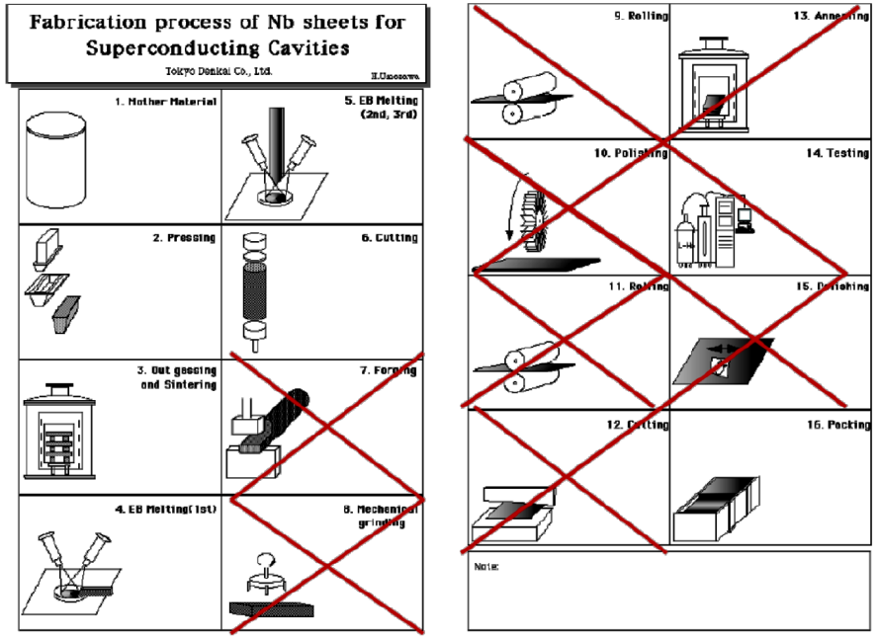
Niobium Ingot Technology
Reduce the overall cost of manufacturing superconducting cavities by reducing the manufacturing steps (currently 16).
Innovate, Respect, Compete

Slide 22
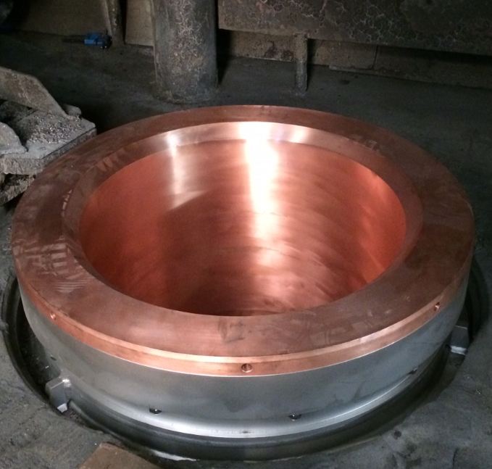
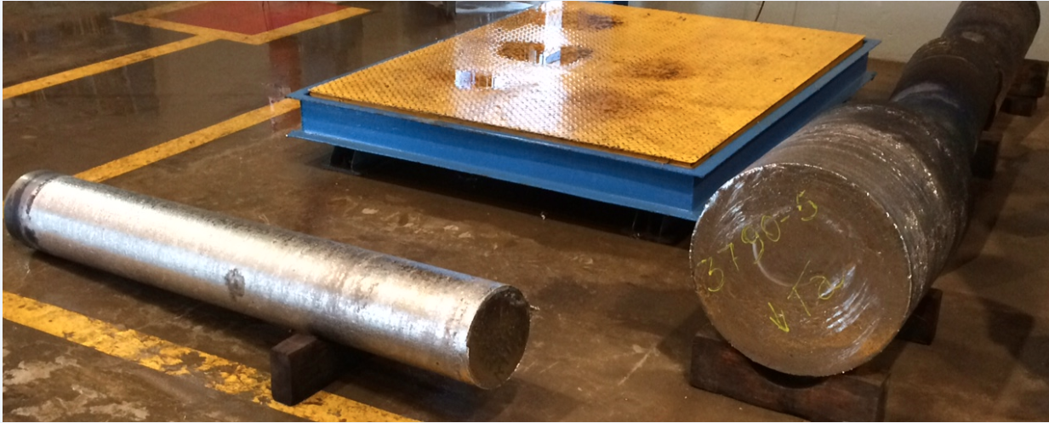
Large Diameter Niobium Ingot
Copper crucible with Ø 535 mm sufficient to produce discs which can be used to fabricate cavities with frequency as low as 650MHz
Ingot with Ø 535 mm (as cast), prepared with special, low-impurity raw materials
Ingot with Ø 250 mm
(as cast)
Innovate, Respect, Compete

Slide 23
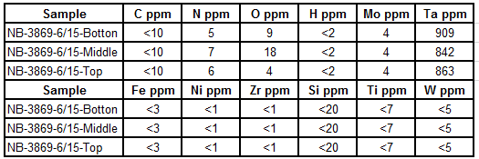

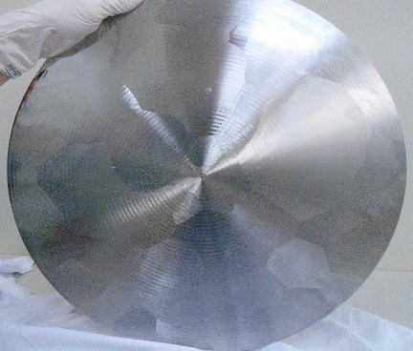
Large Diameter Niobium Ingot
Chemical analysis of 6th melt large diameter ingot
Ta ~ 850 ppm
Machined samples with 480 mm
Presence of large grain
Innovate, Respect, Compete

Slide 24
Large Diameter Niobium Ingot - RRR values
Samples position
High RRR in 6th melt ingot with Ta ~ 850 ppm
Innovate, Respect, Compete

Slide 25
Conclusions
Raw materials with low Oxygen and Nitrogen impurities are crucial to achieve high quality in the final metal.
Hydrogen and Carbon are easily removed in the electron beam refining process.
Ingot Slice Technology can reduce the number of process steps, leading to significant manufacturing cost savings.
The first production test of a large diameter ingot (535 mm) to produce cavities with frequency as low as 650 MHz using slice technology has succeeded.
A sixth-melt, large diameter ingot made using controlled raw materials and Ta content around 850 ppm achieved low gas content and high RRR values ~300.
Innovate, Respect, Compete

Slide 26
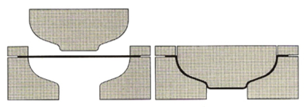
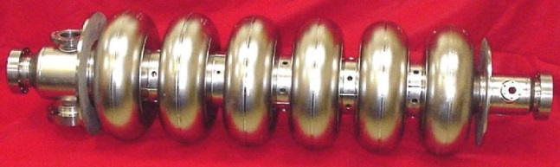
Large Diameter Niobium Ingot - Next Steps
Sliced ingot
Innovate, Respect, Compete

Slide 27
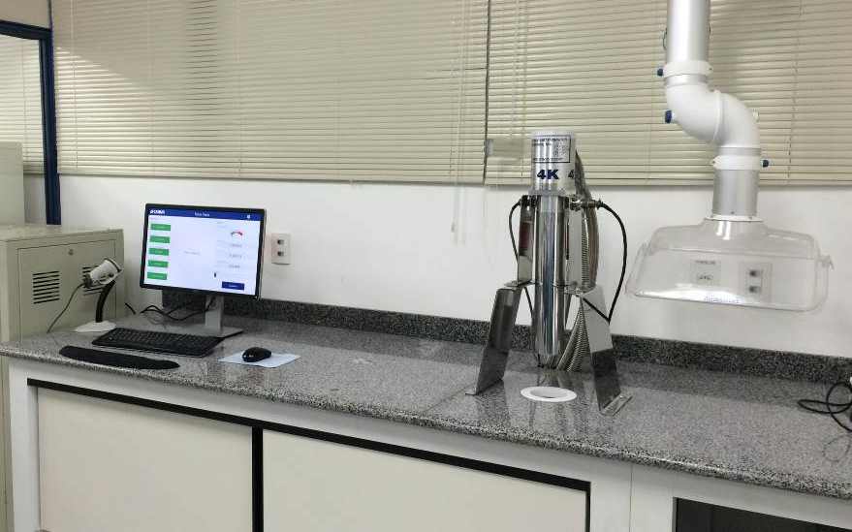
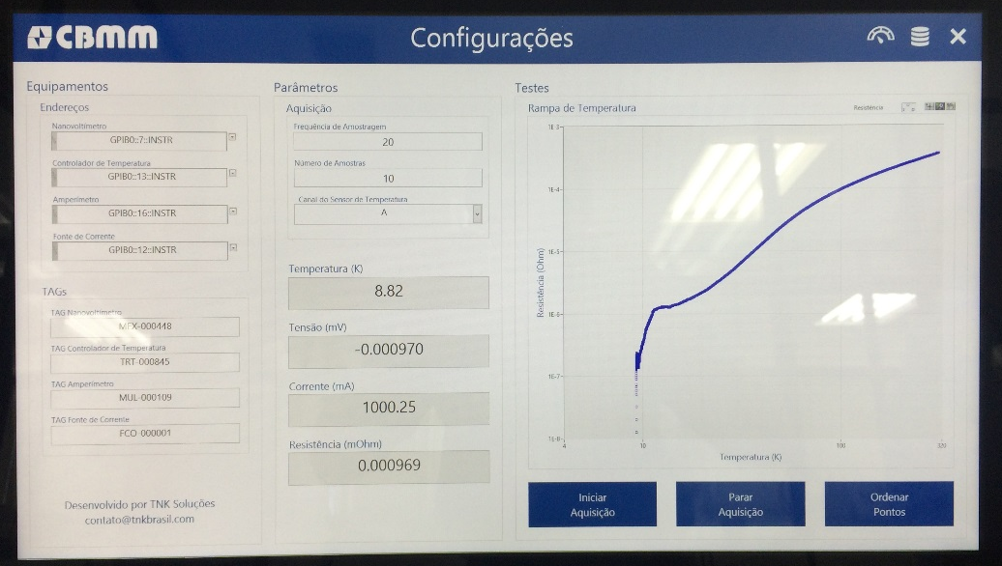

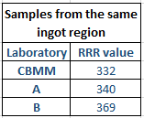


RRR measuring unit at CBMM - Next Steps
Interlaboratory comparison Method Validation
DC method use determined by Tc ~9.3 K (more practically and widely used).
DC method use determined by the extrapolation of the U curve until 4.2 K.
Innovate, Respect, Compete

Slide 28

Thank You!
Gustavo Giovanni Ribeiro Abdo
Gustavo.abdo@cbmm.com.br
+55 (34) 3669 3369
www.cbmm.com.br
Innovate, Respect, Compete

