Slide 1
CBMM Ingot Nb cavities
G. Ciovati, P. Dhakal, P. Kneisel, G. Myneni
Jefferson Lab
Ingot Nb Workshop, Jefferson Lab, Dec. 4th, 2015

Slide 2
Ingots from CBMM
SRF cavities were built at JLab from the following ingots:
Five 13” diameter ingots, labelled A-E received between 2004-2006
RRR ~ 260, Ta content ~800 wt.ppm (~1500 wt.ppm for ingot C)
Seven 13” diameter ingot, labelled A-D, F-H in 2008
RRR between 70-150, Ta content between ~600-1400 wt.ppm

Slide 3
CBMM Ingot Nb SRF cavities
26 single-cell and 11 multi-cell cavities were built at JLab from 2004 from CBMM Ingots
All but 3 cavities were in the 1.3-1.5 GHz frequency range

Slide 4
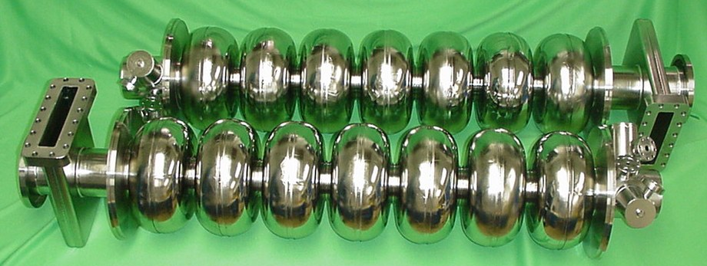
CBMM Ingot Nb SRF cavities

Slide 5
Statistics on cavity performance
Considered cavities made of RRR≥100
Most of the cavities have been tested multiple times, after different treatments (not the same for all cavities).
Compiled a statistic of the highest field achieved for each cavity, and the Q₀-value at 2 K at the maximum field

Slide 6
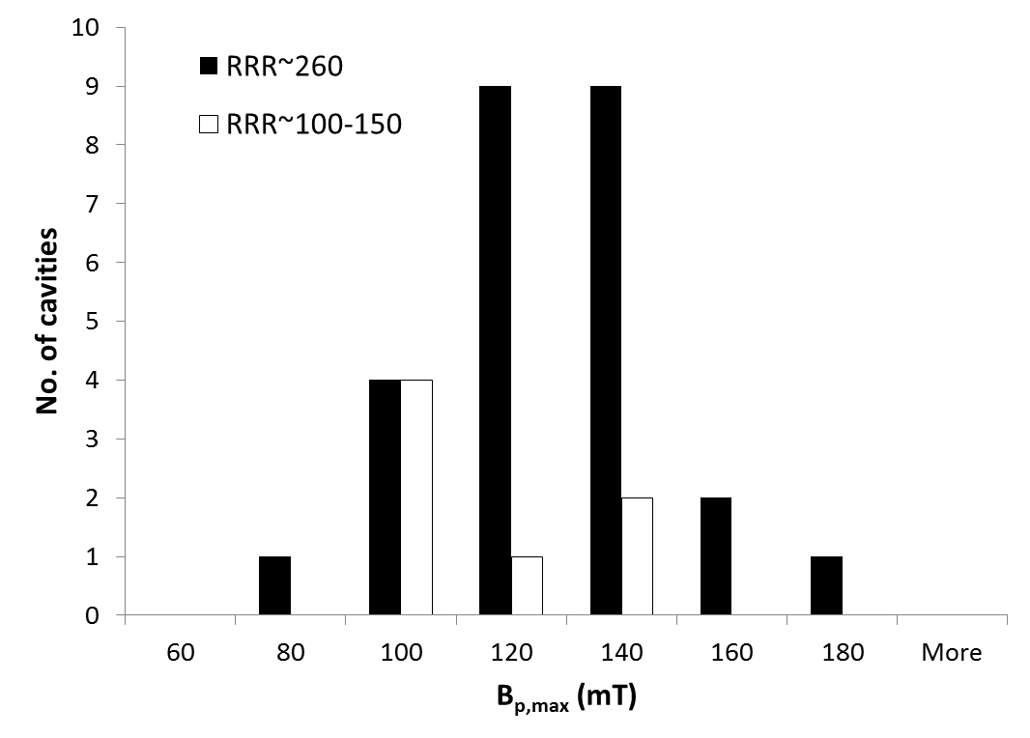
Quench field statistic
RRR~260: <B_{p,max}> = (119 ± 4) mT
RRR~100-150: <B_{p,max}> = (104 ± 8) mT
For a ILC/XFEL cavity shape:
RRR~260: E_{acc} = 28 MV/m
RRR~100-150: E_{acc} = 24 MV/m
Electropolished
Only ~5% of the cavities were treated by EP

Slide 7
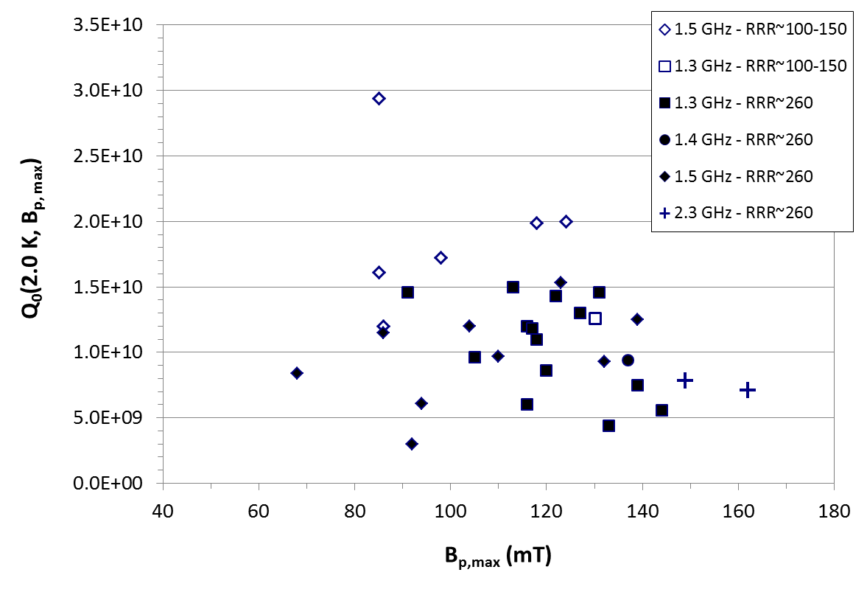
Q₀ statistics
LCLS-II
XFEL
ILC
CEBAF Upgrade
RRR~260: <Q₀> = (1.1 ± 0.1)×10¹⁰
RRR~100-150: <Q₀> = (1.8 ± 0.2)×10¹⁰

Slide 8
Doping with Ti or N
Titanium doping
Nitrogen doping
“Doping” with N or Ti showed the capability of producing a Nb surface for which Q₀ increase with increasing B_{p}. The quench field however is reduced significantly
Similar behavior was found with doping medium-purity ingot Nb cavities.

Slide 9
Lower R_{s} for medium-purity Nb
~20% lower R_{BCS} for RRR ~ 100-150 than for RRR > 300
R_{res} ~ 2-3 nΩ routinely obtained with medium-purity ingot Nb
“Flat” Q₀(E_{acc}) after standard treatments (EP, BCP)

Slide 10
Best case
1.5 GHz Single-cell “F3F4”, ingot Nb of RRR~120
Treatments:
100 μm CBP + 50 μm BCP + 800°C/2h + 20 μm BCP (solid symbols)
120°C/12h bake (empty symbols)
To be published
The equivalent Q₀(2 K) at 1.3 GHz is ~3.8×10¹⁰ with no doping!

Slide 11
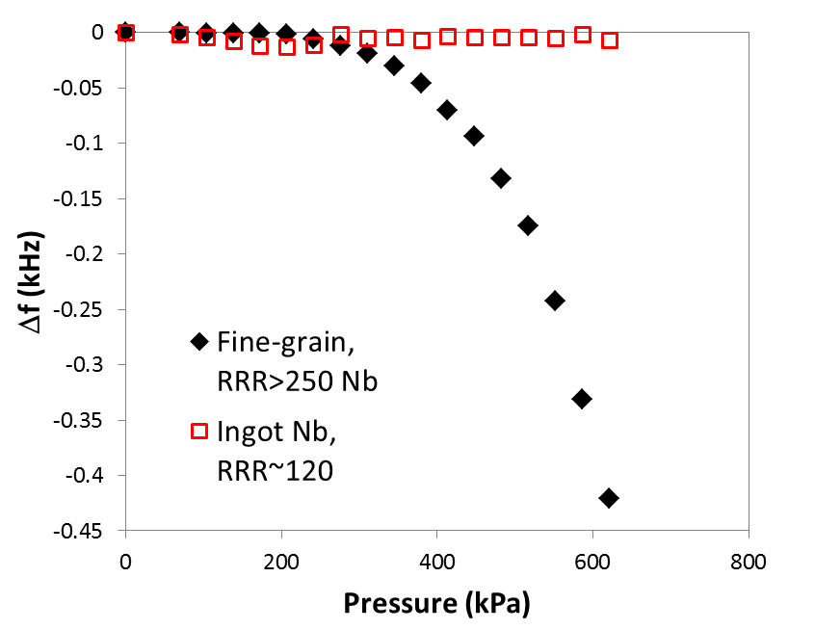
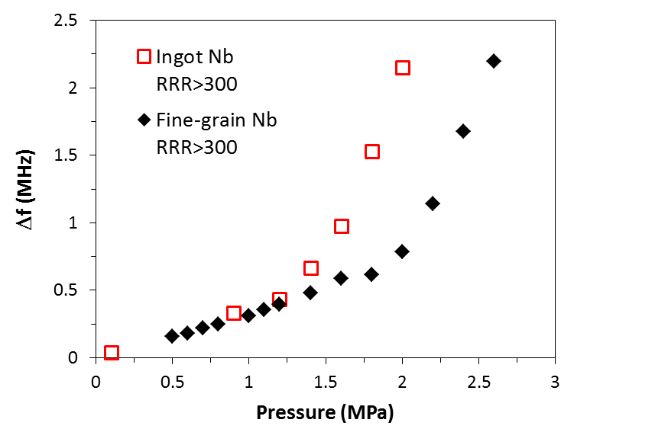
Mechanical properties
Cavities annealed at 800°C/2h
Single-cell
9-cell with He tank
For the same annealing temperature:
Medium-purity ingot Nb cavities: higher yield strength than high-purity fine-grain ones
High-purity ingot Nb cavities: lower yield strength than high-purity, fine-grain ones
G. Ciovati et al., Mat. Sci Eng. A 642 (2015) 117

Slide 12
Conclusions
On average, the performance of cavities made from CBMM ingots is acceptable for many SRF accelerator projects
For the same treatment, higher quench-field can be achieved with high-RRR cavities, compared to medium-RRR
The quench field depends mainly on processing method (EP better than BCP) rather than RRR-value
Higher Q₀-value can be achieved with medium-RRR, instead of high-RRR

