Slide 1


Thomas Jefferson National Accelerator Facility is managed by Jefferson Science Associates, LLC, for the U.S. Department of Energy's Office of Science
Ingot Niobium Workshop
RF Sources
Andrew Kimber
4th December 2015
Notes:
Blue Title Page

Slide 2

Outline
Why are RF sources important?
Current landscape
Future devices/systems
Ingot Niobium Workshop, Jefferson Lab, 4th December 2014
Slide 2/14
Notes:
Blue Interior Page Design 2

Slide 3
RF System anatomy
Ingot Niobium Workshop, Jefferson Lab, 4th December 2014
Slide 3/14
Notes:
Blue Interior Page Design 2

Slide 4
Why is it important?
High capital cost (one time)
Operational costs (ongoing)
Reliability (system downtime)
  “Repairability”
  Maintenance
  Cost of spares (increasing!)
  Availability of spares
  Redundancy (for very high reliability systems)
Performance (getting the most out of the cavity)
The accelerating components from signal generation to cavity should be thought of as a system.
Ingot Niobium Workshop, Jefferson Lab, 4th December 2014
Slide 4/14
Notes:
Blue Interior Page Design 2

Slide 5
System topology
Low Level RF (LLRF) component takes feedback from cavity and keeps the system on resonance
Simple or very sophisticated
RF power distribution (coax, waveguides, circulators, couplers etc.) defined somewhat by topology and power levels
High capital costs means that system topology is ‘locked in’ for the lifetime of the project.
Choose wisely!
Ingot Niobium Workshop, Jefferson Lab, 4th December 2014
Slide 5/14
Notes:
Blue Interior Page Design 2

Slide 6
Operationally ($)
Projected site power consumption of a fully operational 12GeV CEBAF running 3 halls + LERF
(400+ 5,8 and 13kW klystrons)
Total site power draw 31.4 MW
RF contributes 26 % (8.3 MW)
Operational costs increasing year on year!
Data from W. Oren, all numbers in MW
Ingot Niobium Workshop, Jefferson Lab, 4th December 2014
Slide 6/14
Notes:
Blue Interior Page Design 2

Slide 7
Comparison of RF sources
(current landscape)
Information taken from a selection of data sheets during research for RF sources chapter
Ingot Niobium Workshop, Jefferson Lab, 4th December 2014
Slide 7/14
Notes:
Blue Interior Page Design 2

Slide 8
Future RF sources – solid state
Increasingly used in broadcast, telecommunications
Good efficiencies, although including peripherals they match ‘traditional’ amplifiers
Modular and highly configurable
  Higher powers made up from many smaller units
Systems engineering
  Redundancy and high availability can be attained
  Industrial processes (time=$), Accelerator Driven Systems (ADS)…
Ingot Niobium Workshop, Jefferson Lab, 4th December 2014
Slide 8/14
Notes:
Blue Interior Page Design 2

Slide 9
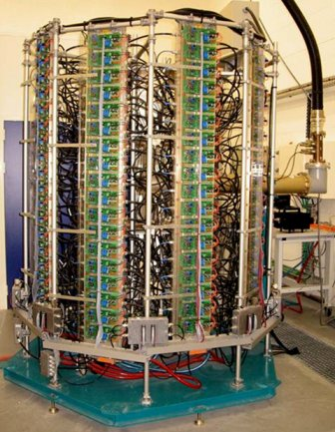


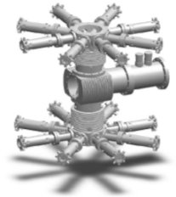
Soleil Booster, 35 kW CW, 352 MHz
330 W CW - 352 MHz amplifier module
600 W - 280V/28V dc power converter
Power combiner(8x8x2)
146 modules of 330 W at 352 MHz roughly 7 years of operation (more than 35 000h) Operational availability ≈ 100% MTBF > 15 000 hours
http://www.synchrotron-soleil.fr/portal/page/portal/SourceAccelerateur/Accelerateurs/RF-system-Booster
Ingot Niobium Workshop, Jefferson Lab, 4th December 2014
Slide 9/14
Notes:
Blue Interior Page Design 2

Slide 10
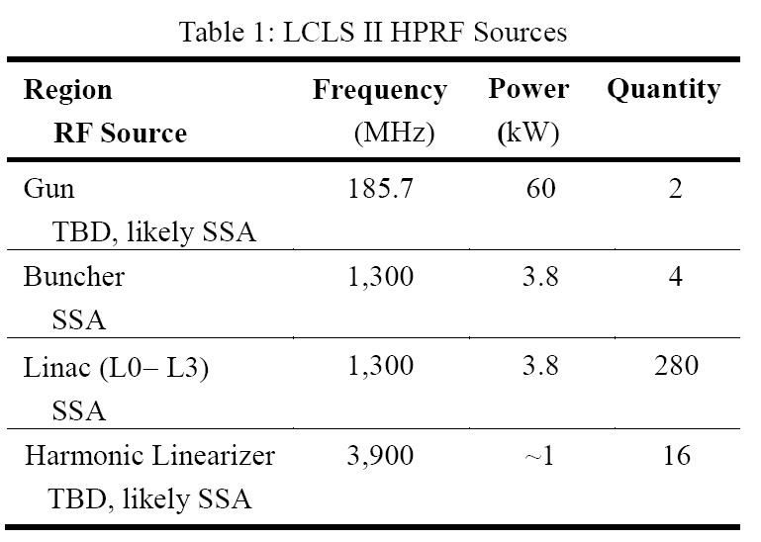
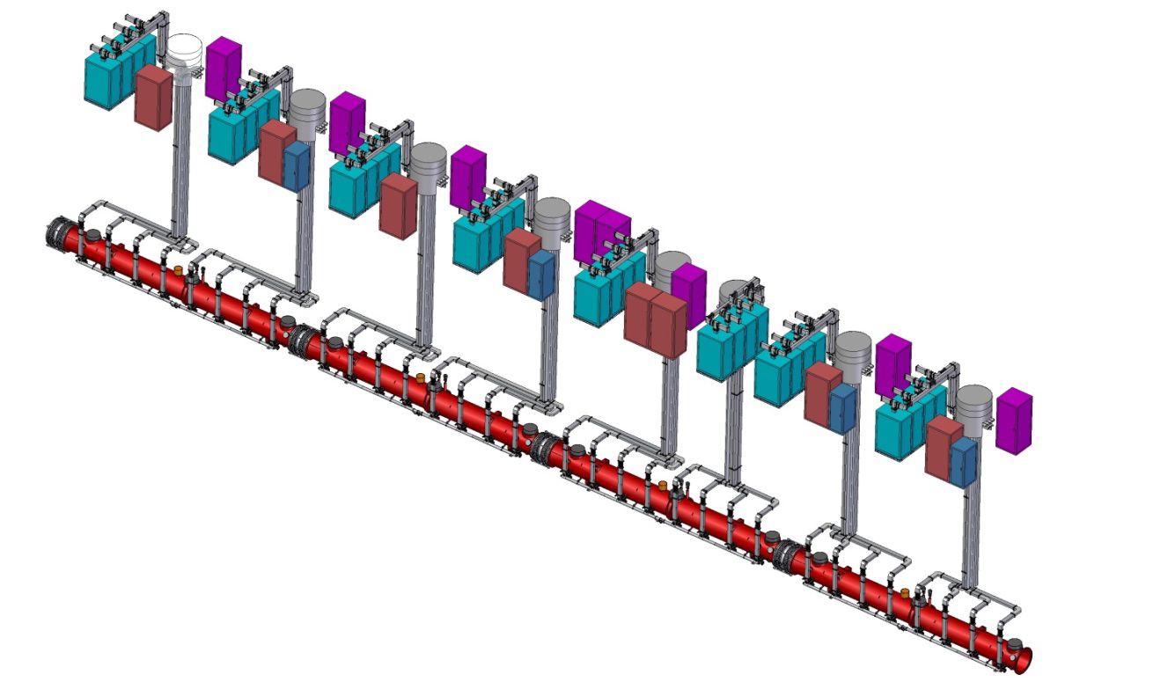
LCLS II, SLAC ~4 kW, 1.3 GHz
LLRF Rack
Penetration shielding
SSA racks
$/W figure better than klystrons
Upgrade path for higher efficiency in ~10 years (keep
infrastructure, replace SSA modules when technology catches up
Reliability?
  MTBF >30,000 hours of major components
  <1% of transistor pallets should fail in 2000 hours (1 every ~3 weeks?)
Efficiency?
  From wall AC to output power >40%
http://slac.stanford.edu/pubs/slacpubs/16250/slac-pub-16408.pdf
Ingot Niobium Workshop, Jefferson Lab, 4th December 2014
Slide 10/14
Notes:
Blue Interior Page Design 2

Slide 11
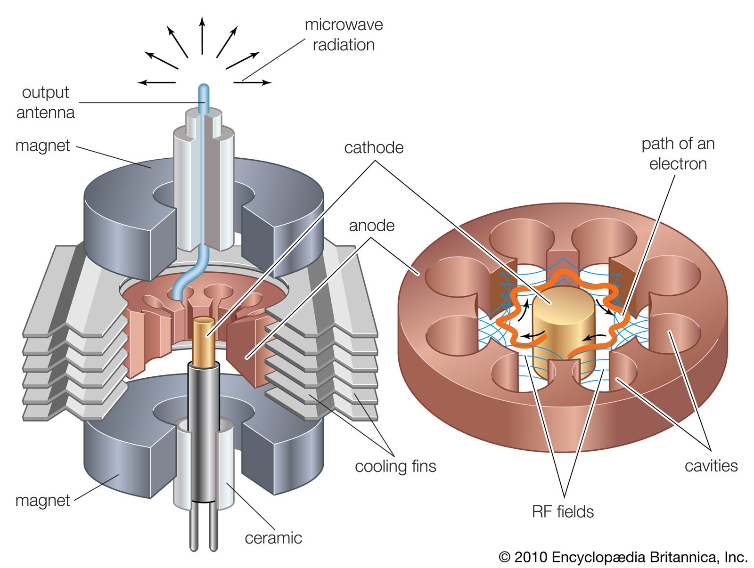
Future RF sources - Magnetrons
Ingot Niobium Workshop, Jefferson Lab, 4th December 2014
Slide 11/14
Notes:
Blue Interior Page Design 2

Slide 12
Future RF sources - Magnetrons
Used in industrial applications (microwave ovens, industrial heating)
Used to a lesser extent in medical/radiotherapy
  Smaller so can be placed on a rotating gantry
High efficiency (>90%)
Smaller size, simple design
  Up to half the capital cost of a similar klystron*
Huge potential!
Problem: control of phase and amplitude independently and simultaneously
  Use an ‘injection locking’ technique
  A few small teams in the US and UK have made some progress, still a long way to go.
*http://journals.aps.org/prstab/abstract/10.1103/PhysRevSTAB.14.032001
Ingot Niobium Workshop, Jefferson Lab, 4th December 2014
Slide 12/14
Notes:
Blue Interior Page Design 2

Slide 13
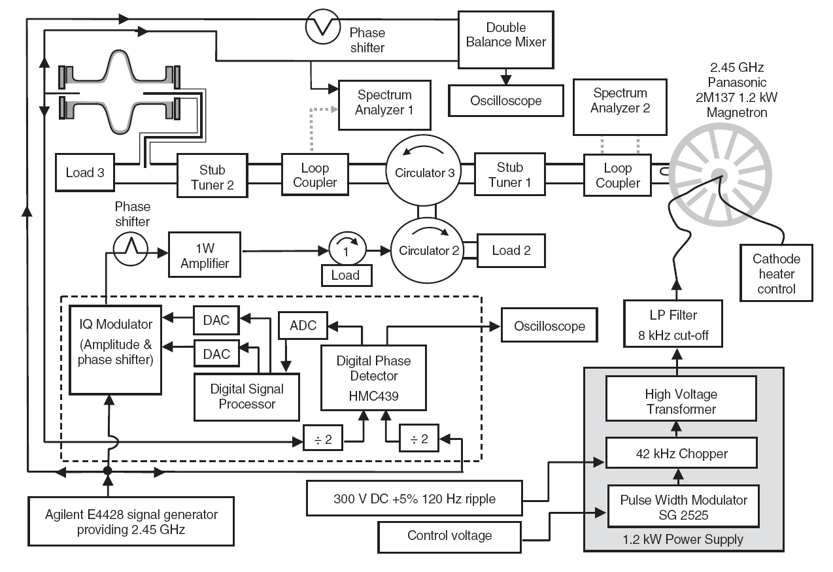
Future RF sources - Magnetrons
LLRF control is not trivial!
http://journals.aps.org/prstab/abstract/10.1103/PhysRevSTAB.14.032001
Ingot Niobium Workshop, Jefferson Lab, 4th December 2014
Slide 13/14
Notes:
Blue Interior Page Design 2

Slide 14
Summary
RF sources are an important part of the RF system
Choice of technology effects
  Capital cost
  Operational costs
  Effort to maintain, amongst others…
Don’t dismiss traditional robust RF sources!
There are alternatives:
  Solid state being adopted quickly
  Magnetrons have potential for the future
Questions/discussion?
Ingot Niobium Workshop, Jefferson Lab, 4th December 2014
Slide 14/14
Notes:
Blue Interior Page Design 2

