Slide 1
CBMM North America – JLab CRADA Historical Remarks
Ganapati Myneni
Ingot Niobium Summary Workshop
Jefferson Lab
December 4, 2015

Slide 2
Overview
Niobium Products Company, Inc. 1995
Foundations of collaboration-RRR measurements
Reference Metals Company, Inc. (RMCI) 2001 – 2005
Informal Tantalum Investigations (DESY, JLab and RMCI)
RMCI 2003 – 2005
RMCI – LANL – UVa – JLab MOU – Niobium Microstructure Control
RMCI-JLab CRADA 2004 – 2015
Evolution of Ingot Niobium Technology

Slide 3
Niobium Products Company, Inc. (1995)
(CBMMNA-JLab CRADA foundation)
90% of the niobium for the CEBAF accelerator originated from Brazil’s CBMM pyrochlore ore
Supplied by Fansteel (70%), Wah Chang (20%)
Fansteel went out of business after fulfilling the CEBAF order
CBMM initiated a niobium sheet development program
Dr. Tadeu Carneiro, GM of NPCI in PA gave JLab a call in August 1995, requesting help with RRR measurements
As received niobium samples RRR ~ 100
1400° C heat treatment improved the RRR to ~ 300
JLab discontinued R&D on niobium properties soon after and SRF lead is taken over by DESY

Slide 4
Sources of Niobium
Niobium is produced from one of two sources:
Columbite/Tantalite is Niobium with Tantalum in similar proportions
Niobium is produced as a by-product of the process of refining the ore to produce Tantalum
Niobium is purified by electron beam refining in a series of “melts”
Successive melts of niobium (>3) mostly reduce the interstitials
Pyrochlore is predominantly Niobium with tantalum as an “impurity”
Successive melts (>3) also mostly reduce the interstitials
Over 90% of the world’s Niobium comes from Pyrochlore ore (CBMM)

Slide 5
Niobium Impurities
Niobium impurities can be categorized in three classes
Tantalum
Other Metallic impurities
Iron, Copper, Tungsten, Titanium etc. behaves similarly
Interstitial impurities
Hydrogen, Carbon, Oxygen, Nitrogen
Residual Resistivity Ratio (RRR) is commonly employed as a measure of Niobium purity
In fact, the RRR is mostly affected by interstitials
M. G. Rao and P. Kneisel, “Mechanical Properties of High RRR Niobium at Cryogenic Temperatures” Advances in Cryogenic Engineering Volume 40, 1994 pp 1383-1390

Slide 6
Metallic Impurities
These are all only trace levels after initial refining
Do not have an impact on performance
Do not affect the RRR
Typical impurity levels in wt. ppm:
There is no major difference in the metallic impurities between Columbite and Pyrochlore Niobium
 | Iron | Copper | Tungsten | Silicon
Columbite | <3 | <1 | <5 | <20
Pyrochlore | <3 | <1 | <5 | <20

Slide 7
New Millennium and New Opportunities for High Tantalum Ingot Niobium
DESY (TESLA) RRR specifications calls for Ta <500 wt. ppm thereby eliminating CBMM Pyrochlore niobium
SNS prototype cavities became soft after 800° C annealing for hydrogen degassing to prevent gross Q disease
Dr. Tadeu Carneiro VP of RMCI proposed a study of tantalum concentration in niobium to provide scientific justification for increasing the tantalum content in SRF Niobium
JLab wise men (Larry Cardman and Ron Sundelin) called for R&D into the thermo-mechanical properties of niobium to improve the scientific understanding of niobium for SRF

Slide 8
Reference Metals Company, Inc. (RMCI) 2001 – 2005 Informal Tantalum Investigations (DESY, JLab and RMCI)
Dr. Carneiro asked JLab to evaluate the influence of tantalum on the thermal conductivity of niobium and provided the samples
The results were to be jointly presented at the SRF 2001 in Japan
JLab investigated the thermal conductivity measurements of niobium for different samples with Ta varying between 150 and 1300 wt. ppm
No significant effect was found
The results were not presented at SRF 2001
Tokyo Denkai produced sheets for DESY with niobium from CBMM
The RRR of these sheets were not as high as required (RRR>300) and DESY did not produce cavities with this material
Finally JLab requested and received these niobium sheets in 2003 from DESY, single cell cavities were fabricated and the results were published at LINAC2004 and PAC2005
There is no adverse influence of tantalum on cavity performance

Slide 9
Tantalum Effect on SRF Cavity Performance
Performance of cavities is unaffected by Tantalum content up to ~1300 wt. ppm
P. Kneisel, G. Myneni, G. Ciovati, D. Proch, W. Singer, T. Carneiro et al in Proceedings of PAC 2005

Slide 10
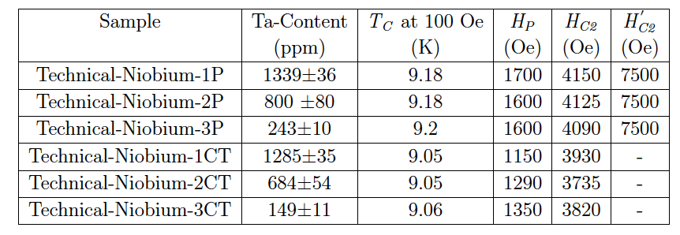
Tantalum
Tantalum content of Columbite Niobium is <500 ppm
This was adopted as specification for SRF cavities
Many studies have demonstrated that this specification is overly restrictive for uniformly distributed Tantalum
Hp is the most important parameter determining Eacc
S. B. Roy, G. Myneni et al Supercond. Sci. Technol. 25 (2012) 115020

Slide 11
RMCI 2003 – 2005 RMCI – LANL – UVa – JLab MOU – Niobium Microstructure Control
SNS prototype cavities (805 MHz) became soft after annealing at 800° C for hydrogen degassing to prevent gross Q disease
The annealing temperature was optimized to eliminate the softening
600° C for 10 hours
Los Alamos National Lab became interested in this issue and a joint MOU was agreed between RMCI, LANL, UVa and JLab for developing microstructure control of niobium sheets
UVa Materials Science Dept. hired a graduate student from China
RMCI sent 2 large ingots to UVa for this work and they were returned to RMCI as UVa was unable to handle such large ingots
The graduate student failed his qualifier and as a result the program died prematurely
However the program confirmed that there was heterogeneous grain growth during high temperature annealing, resulting in micro yielding
JLab in 2004 signed a CRADA with RMCI

Slide 12
RMCI-JLab CRADA 2004 – 2015
The initial CRADA was established in 2004 to study interstitial content via low strain rate stress-strain curves (PLC)
Modification 1 (2005) – Prepare and Study Samples for tensile, PGAA, NIS, DMA, and NRA tests
Modification 2 (2006) – Development of cavities from large/single grain niobium for ILC and ERL’s
Modification 3 (2009) – Reduction of RRR specification from 300 to 200 and increasing Tantalum ~ 1500 wt. ppm
Modification 4 (2010) – Explore the uses of ingot niobium in accelerators and for other technologies including ADS by hosting International Workshops/Symposia/Meetings
The results were published as a review paper in 2015
Review of ingot niobium as a material for superconducting radio frequency accelerating cavities P. Kneisel, G. Ciovati, P. Dhakal, K. Saito, W. Singer, X. Singer, G. R. Myneni in Nuclear Instruments and Methods in Physics Research A774(2015)133–150

Slide 13
Technical specifications of niobium for future SRF linacs*
Material parameter | TESLA/XFEL Pulsed/CW | CW/Pulsed SRF Linac (proposed)
Type | Polycrystalline | Ingot
RRR | > 300 | > 150
Grain Size | ~ 50 μm | > 1 cm
Yield Strength | > 50 N/mm² | > 50 N/mm²
Tensile Strength | > 100 N/mm² | > 100 N/mm²
Elongation | 30% | ≥30%
Contents of the Impurities wt. ppm | Ta ≤ 500 O ≤ 10 N ≤ 10 C ≤ 10 H ≤ 2 | Ta ≤ 1300 O ≤30 N ≤ 30 C ≤ 40 H ≤ 5
Vickers Hardness | ≤ 50 |  55
Note: nominally present low metallic impurities in niobium does not affect the RRR significantly
*G. Myneni, P. Kneisel, G. Ciovati, S. B. Roy, “Ingot niobium material specifications for
continuous wave superconducting radio frequency cavities” JLab-TN-14-009

Slide 14
MS and Ph.D. Theses Supported by the CRADA
1. Zeng Fei, MS Thesis, ‘Ultrasonic Characterization of Nb” August 2004, University of Virginia
2. Asavari Dhavale, Ph. D., “Study of Structures for Linear Accelerators” 2011, Homi Bhabha National Institute, India
3. Prateek Maheswari, Ph. D., “Surface Characterization of Impurities in Superconducting Niobium for Radio Frequency (RF) Cavities Used in Particle Acclerators” 2012, North Carolina State University
4. Saravan Kumar Chandrasekharan, Ph. D. Thesis, “Role of Metallurgy in the Thermal Conductivity of Superconducting Niobium” 2013 Michigan State University
5. Jayanta Mondal, Ph. D., “Studies of niobium and Development of Niobium Resonant RF Cavities for Accelerator Driven System” 2013, Homi Bhabha National Institute, India
6. Ashraf Hassan Farha, Ph D., “Investigation of NbNx Thin Films and Nano Particles Grown by Pulsed Laser Deposition and Thermal Diffusion” 2013, Old Dominion University

Slide 15
ADS&ThU International Workshops
1st International ADS&ThU Workshop 2010
http://www.phys.vt.edu/~kimballton/gem-star/workshop/index.shtml
2nd International ADS&ThU Workshop 2011
http://www.ivsnet.org/ADS/ADS2011/
3rd International ADS&ThU – Oct 14-17, 2014
http://adsthu.org/index.html
4th International ADS&ThU Workshop 2016
Huddersfield University, UK, September 2016

Slide 16
International Symposium On Hydrogen In Matter (ISOHIM) Publications
Hydrogen in Materials and Vacuum Systems AIP CP 671 http://www.virtualjournals.org/dbt/dbt.jsp?KEY=APCPCS&Volume=671&Issue=1
Hydrogen in Matter AIP CP 837 http://www.virtualjournals.org/dbt/dbt.jsp?KEY=APCPCS&Volume=837&Issue=1
Single Crystal Large Grain Niobium AIP CP 927 http://www.virtualjournals.org/dbt/dbt.jsp?KEY=APCPCS&Volume=927&Issue=1
Superconducting Science and Technology of Ingot Niobium AIP CP 1352 http://scitation.aip.org/dbt/dbt.jsp?KEY=APCPCS&Volume=1352&Issue=1
Science and Technology of Ingot Niobium for Superconducting Radio Frequency Applications AIP CP 1687

Slide 17
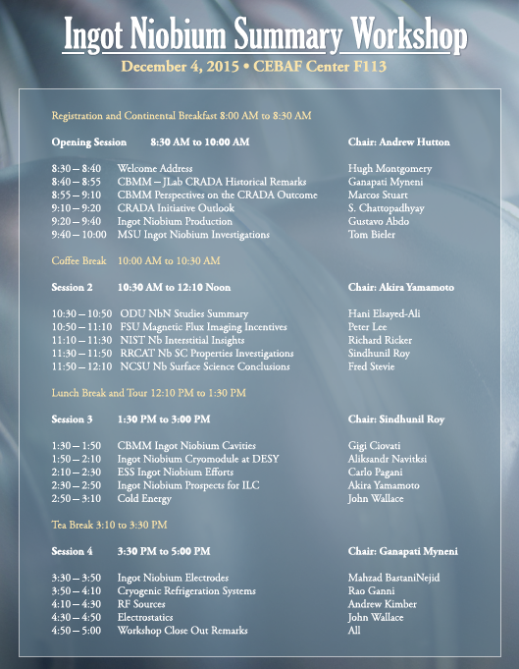
Workshop Program

Slide 18
Acknowledgements
We would like to take this opportunity to sincerely acknowledge all your help, encouragement and support in carrying out the CBMMNA-JLab CRADA so successfully
Thank You!

