Slide 1
Mechanical Properties as Indicator of Interstitial Impurities in Large Grain Nb for Superconducting Accelerator Cavities
Richard E. Ricker, Ph.D.
Manufacturing Program Director
Material Measurement Laboratory
Gaithersburg, MD 20899
email: richard.ricker@nist.gov
Material Measurement Laboratory

Slide 2
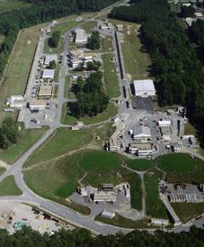
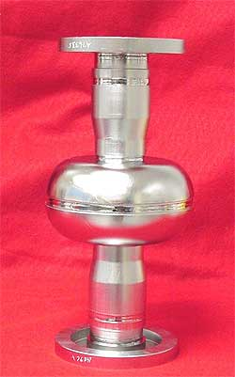
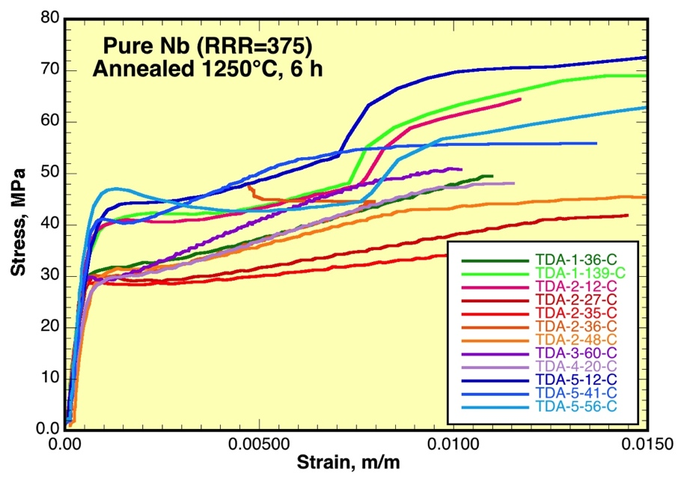
Introduction
Objective:
To explore mechanical properties as a means for detecting and quantifying impurities absorbed during SRF processing.
“White Paper” (lean) Project
Feasibility of funding a real project
Issues, scope, and work statement
Support:
Samples provided by JLab and CBMM.
Tensile tests at JLab
DMA measurements at NIST
Analysis by NIST and JLab
White Paper (lean) Project BCs:
Existing equipment (unmodified)
Existing samples (or data) where possible
Analysis of results, and data, as time, and other projects, allow.

Slide 3
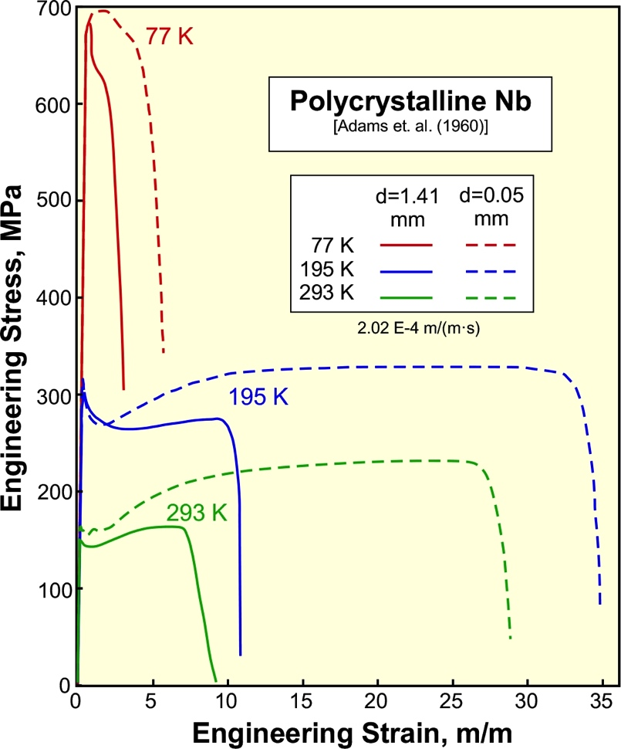
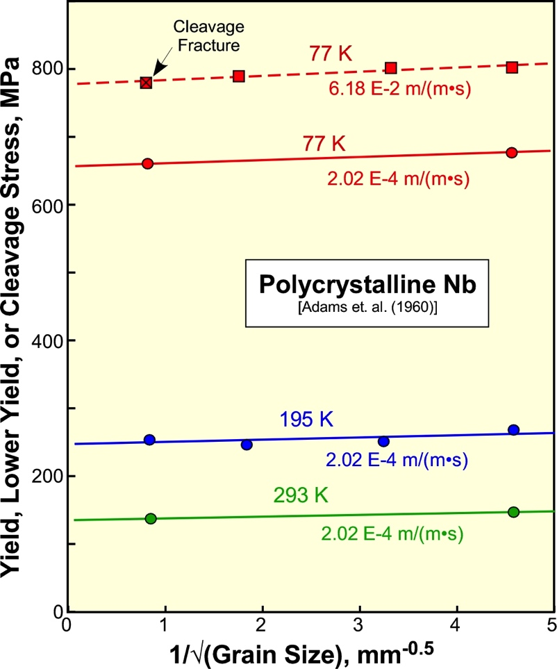
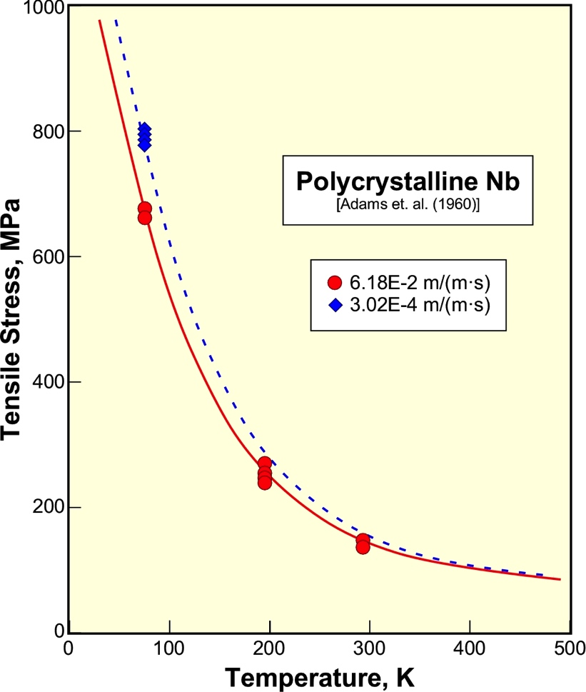
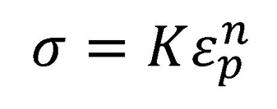
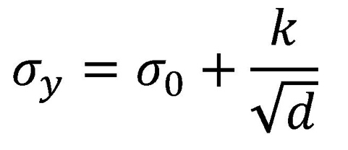
Background (1):
Tensile behavior of polycrystalline Nb - Stress as a function of strain (ε), grain size (d), temperature (T), and strain rate (dε/dt)
Hollomon Equation
Hall-Petch Equation
Thermally Activated Flow Stress
Ludwiks Equation

Slide 4
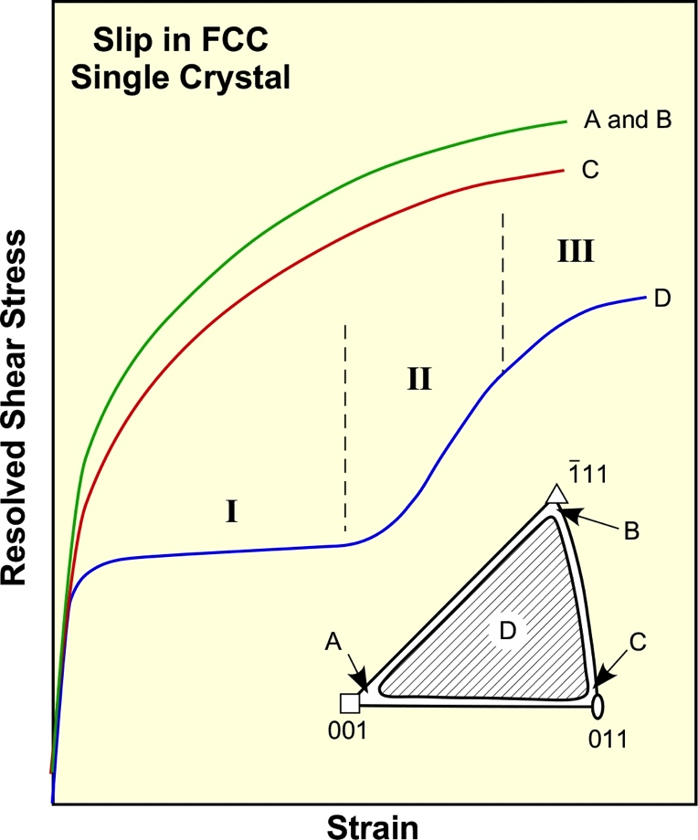
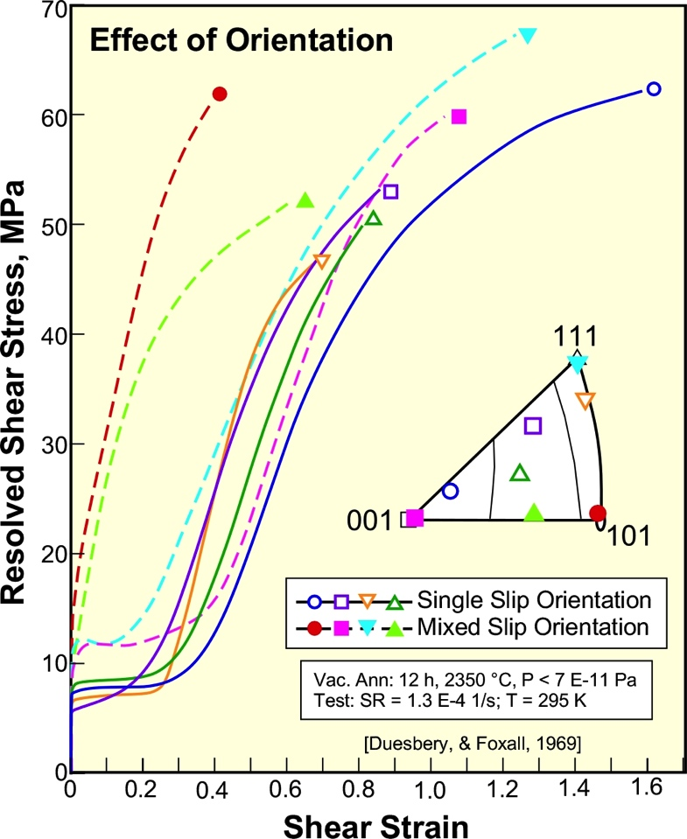
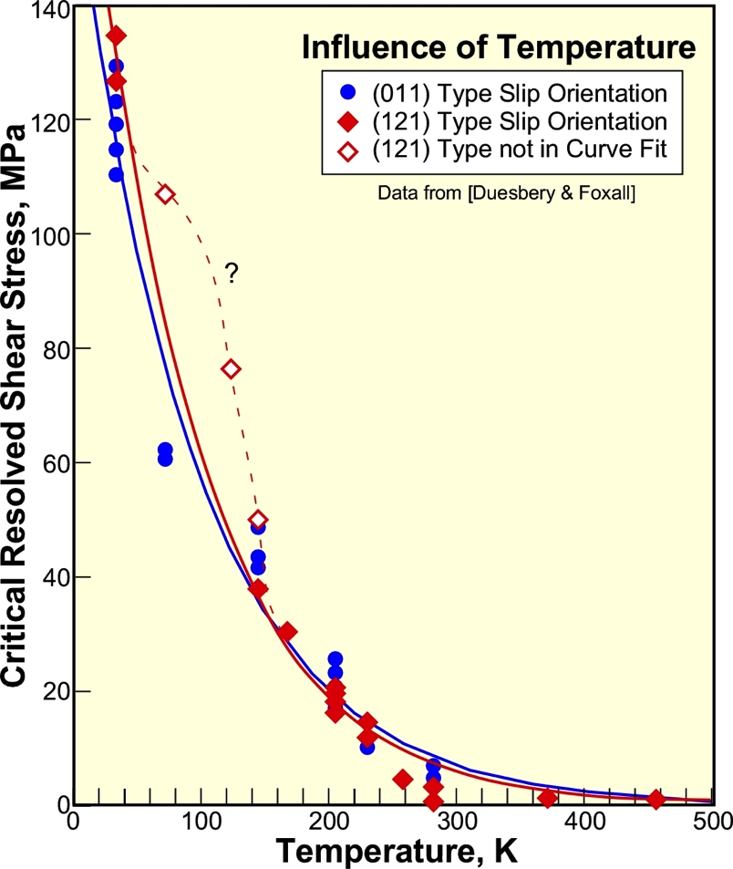
Background (2):
Tensile behavior of Nb single crystals
FCC Crystals
Single slip (curve D)
Mixed Slip (curves A-C)
Curve D shows the classic 3 stages of slip
BCC Niobium
Single (solid lines)
Mixed (dashed lines)
Stereographic triangle
Thermally Activated
Flow Stress
Deviations from theory frequently reported in the literature

Slide 5
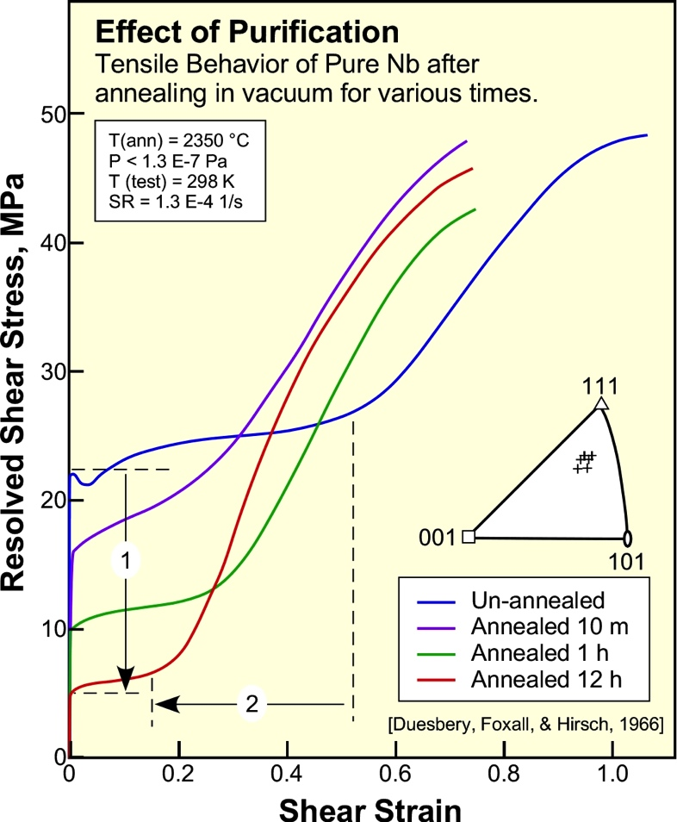
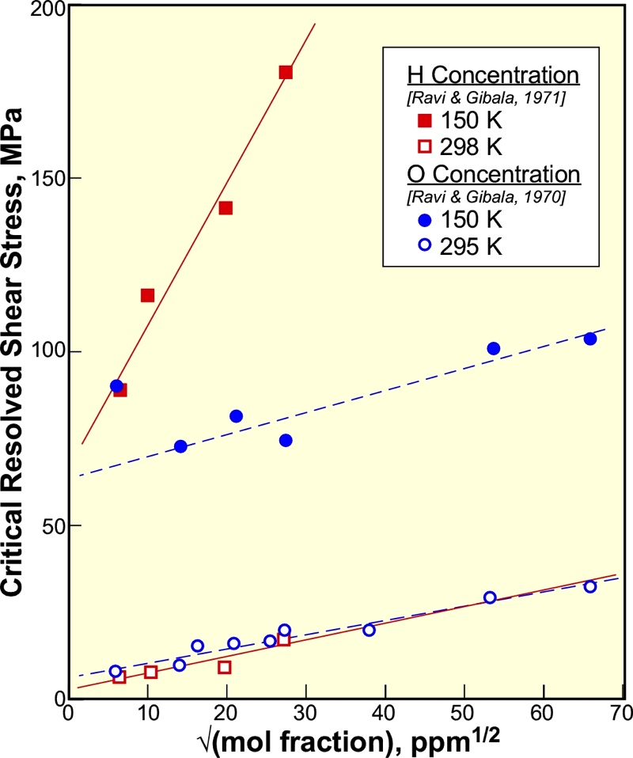
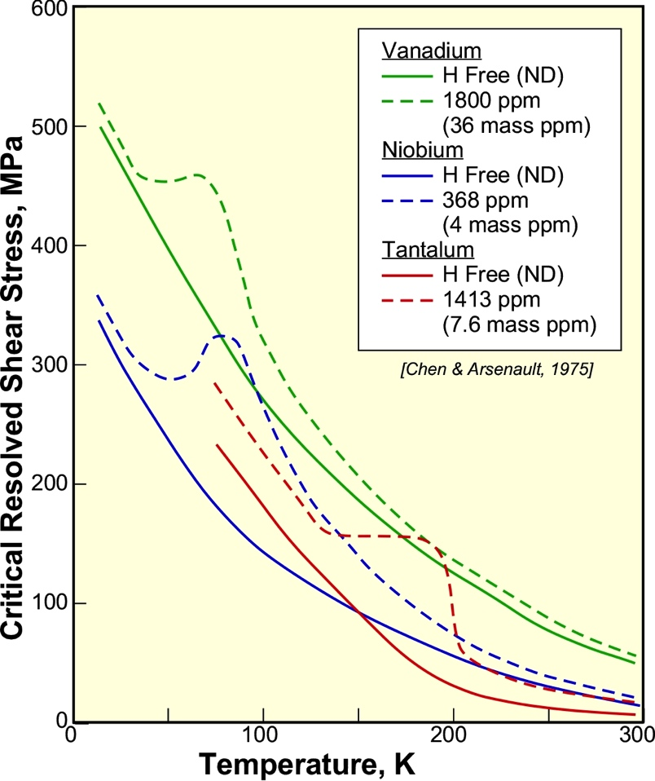
Background (3):
Influence of impurities on single crystal tensile behavior
Purification
Reduces Yield Strength
Reduce stage I/II strain
Increases strain to failure
Interstitial
Strengthening
Fleischer (1964) strength is proportional to the square root of conc.
Thermally Activated
Flow Stress
Similar deviations reported for all Vanadium group metals

Slide 6
Background (4):
Potential sources of interstitial impurities
Ore reduction and Refining
Residual impurities
Atmospheric Air
78% Nitrogen
21% Oxygen
0.04% CO₂
< 0.0001% H₂(gas)
Relative humidity = [H₂O]
Aqueous solutions
Polishing and etching solutions (e.g. BCP with complex forming F⁻ ion)
Abrasive slurries (sometimes used for H charging of passivating metals)
EDM media
Washing and cleaning solutions
Non-aqueous (organic) liquids
Cutting fluids
Lubricants (die)
Degreasing solvents
Heat treatment
Solvation of surface films (O, N, and C)
Absorption of atmospheric constituents

Slide 7
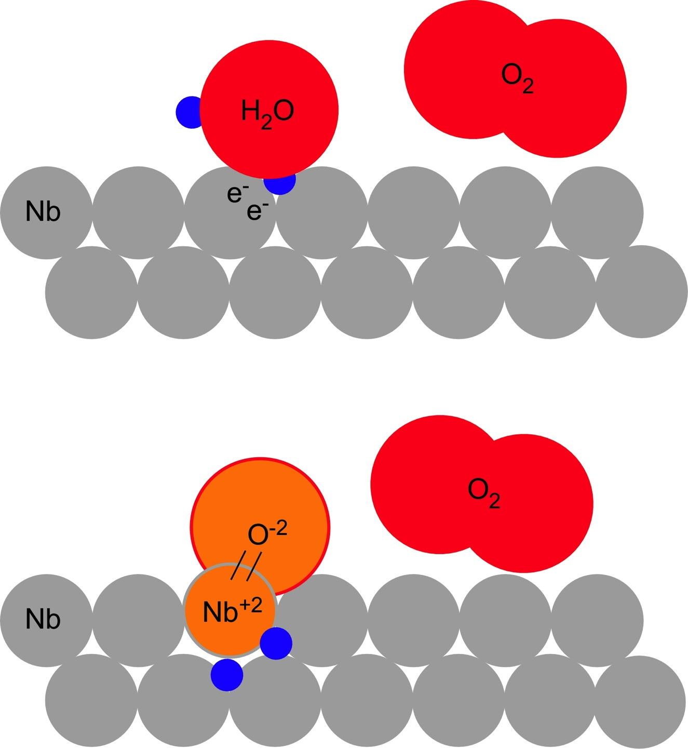
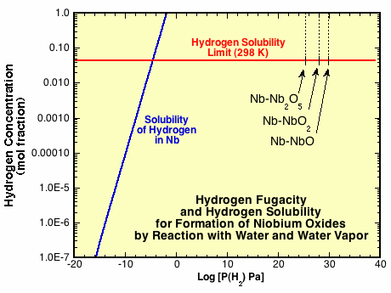
Background (5):
Why Hydrogen?
1. Readily produced in metal surface when Nb is exposed to water or water vapor.
Element | Xtl | Elneg. (χ) | ∆_{f}G°(oxide)¹ kJ/mol
Fe | BCC | 1.83 | -742.2 (Fe₂O₃)
Ni | FCC | 1.91 | -211.7 (NiO)
Cu | FCC | 1.90 | -129.7 (CuO)
Ag | FCC | 1.93 | -11.2 (Ag₂O)
Au | FCC | 2.54 | +163 (Au₂O₃)²
Element | Xtl | Elneg. (χ) | ∆_{f}G°(oxide)¹ kJ/mol
V | BCC | 1.63 | -1,419.5 (V₂O₅)
Nb | BCC | 1.6 | -1,766.0 (Nb₂O₅)
Ta | BCC | 1.5 | -1,911.2 (Ta₂O₅)

Slide 8
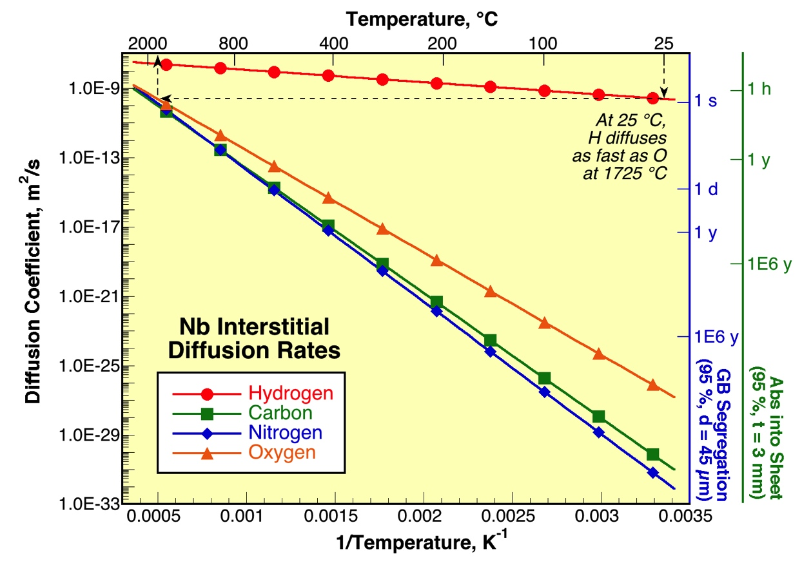
Background (6):
Why Hydrogen?
Rapidly diffuses and segregates to discontinuities
Moves fast enough to dynamically interact with plastic deformation at, or near, room temperatures

Slide 9
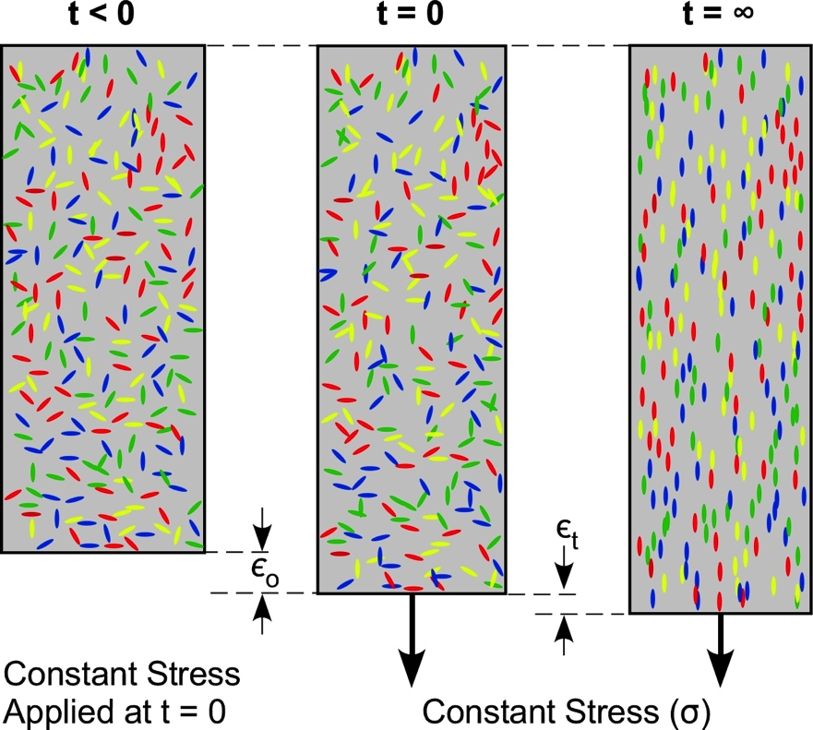
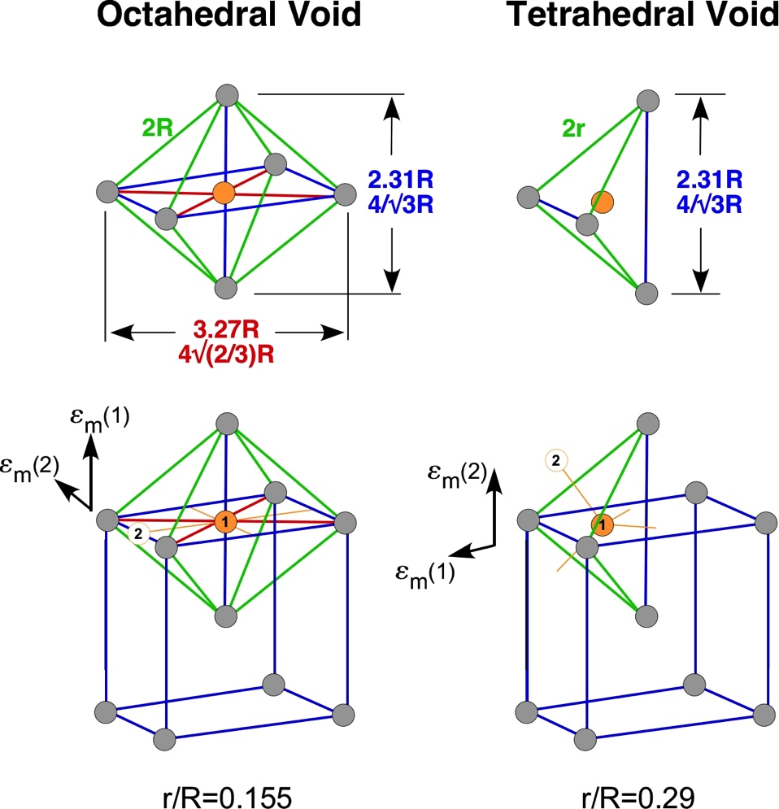
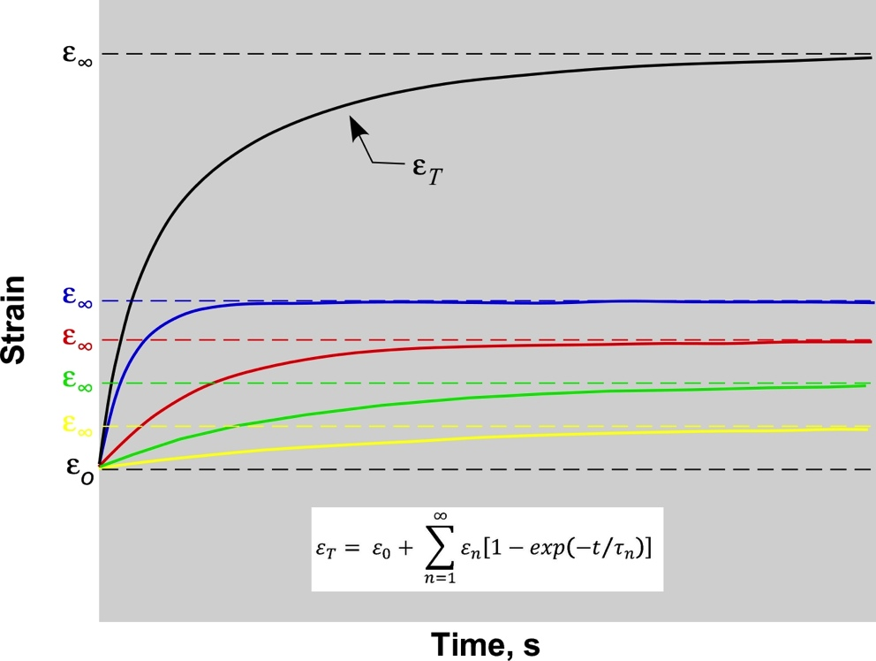
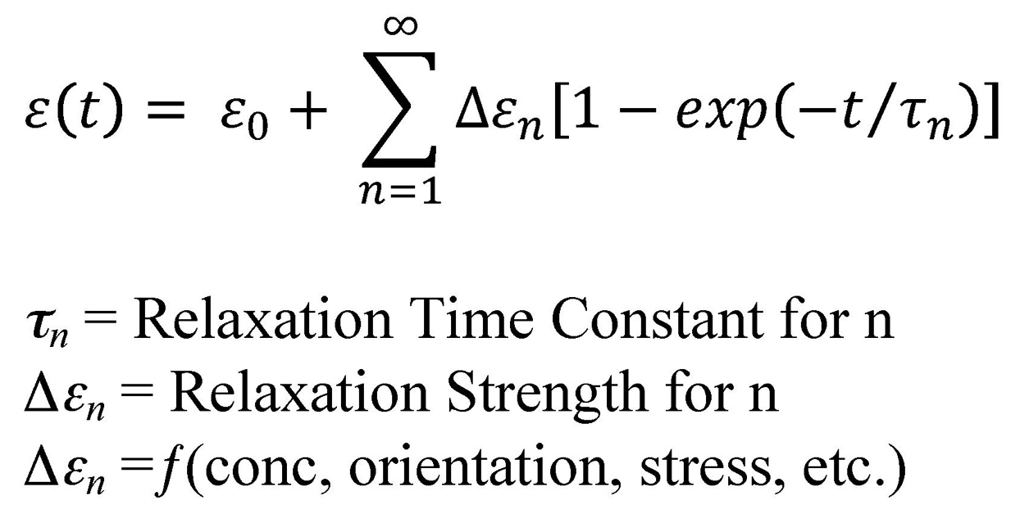
Background (7):
Interstitial Relaxation Mechanisms in BCC Metals

Slide 10
Background (8):
Summary
Interstitials strongly influence mechanical properties
H is the only interstitial with sufficient mobility to dynamically interact with plastic deformation at room temperature.
Theoretically, H can be absorbed from any environment containing water, or water vapor, at sufficient activities to nucleate hydrides.
However, the passive film on Nb may block H entry into the matrix, but it may also block H egress once it is in the metal.
Physical removal of this film (i.e. abrasion) may promote H entry.
Chemical attack of this film (i.e. exposure to F⁻) may promote H entry.
Heat treatments that disrupt the continuity of the passive film, or solvate it, may promote the entry of H and other interstitials.
EDM voltages will breakdown the electrolyte while the current melts a thin surface film increasing interstitial solubility and producing residual stresses at the surface.
Metal dissolution and passive film growth will inject defects into the surface region that may trap interstitials.

Slide 11
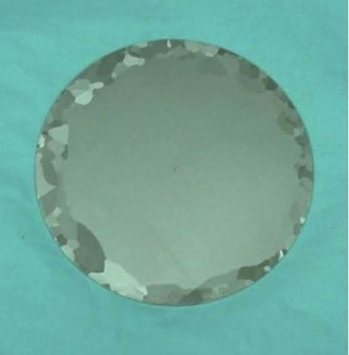
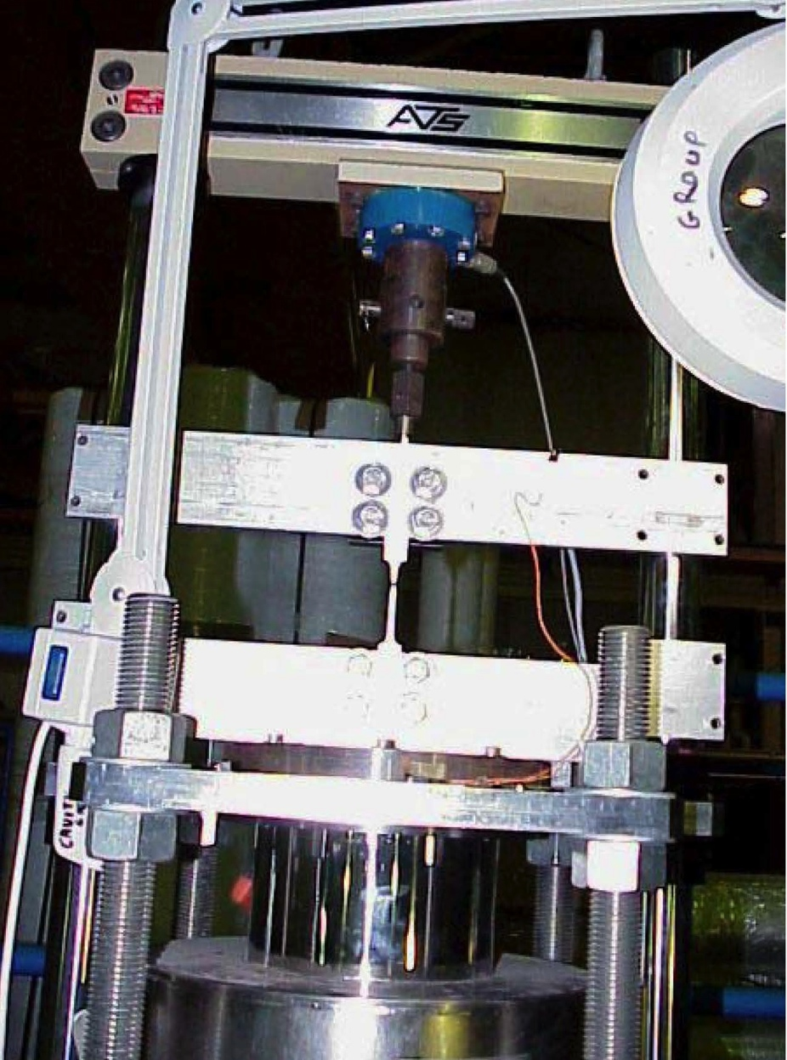
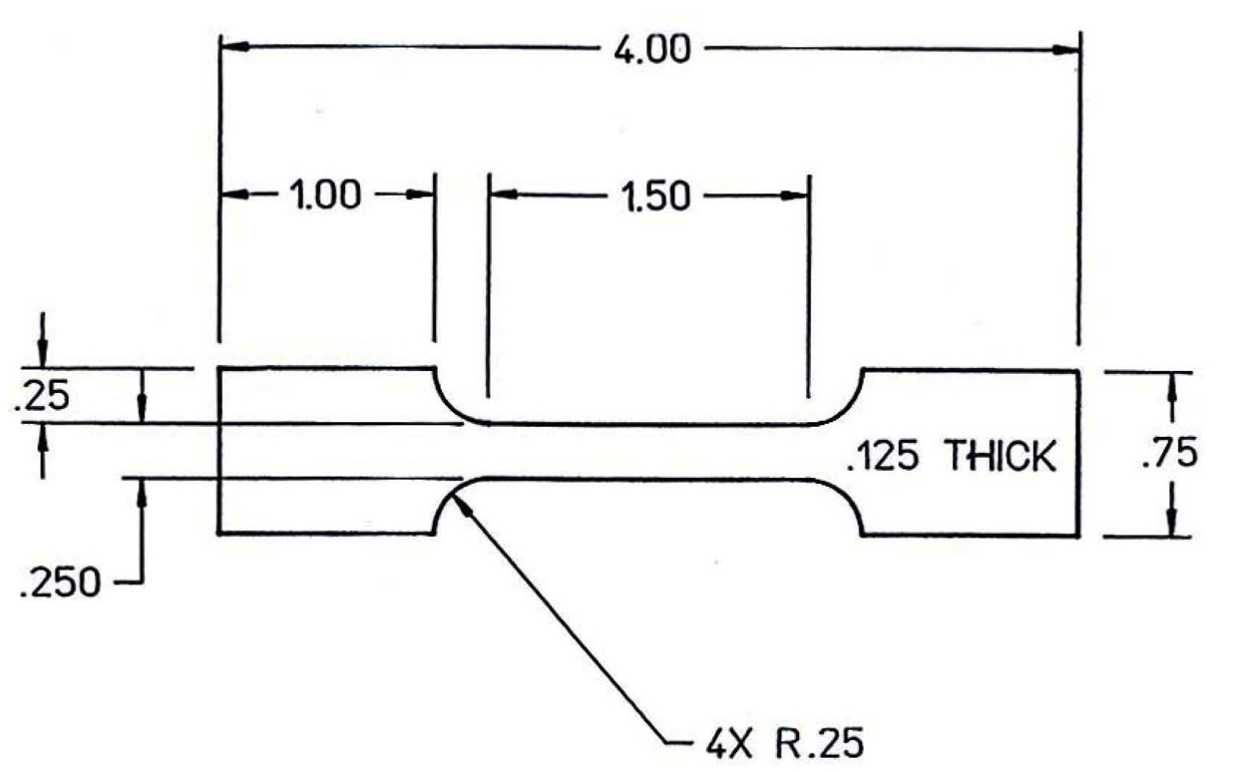
Experimental (1):
Tensile tests and plastic flow curve analysis
Tensile tests at JLab
Samples all cut from same large Nb Grain
Same crystallographic orientation
Strain Rate: 4.0 E-5 s⁻¹
Temperature: ≈ 23 °C (RT)
Three different treatments:
As rcvd, std process, normal slice
As rcvd, std process, EDM sliced
As rcvd, std process, normal slice, interstitial bake-out (Vac. 1,250 °C, with Ti, 3 h)

Slide 12
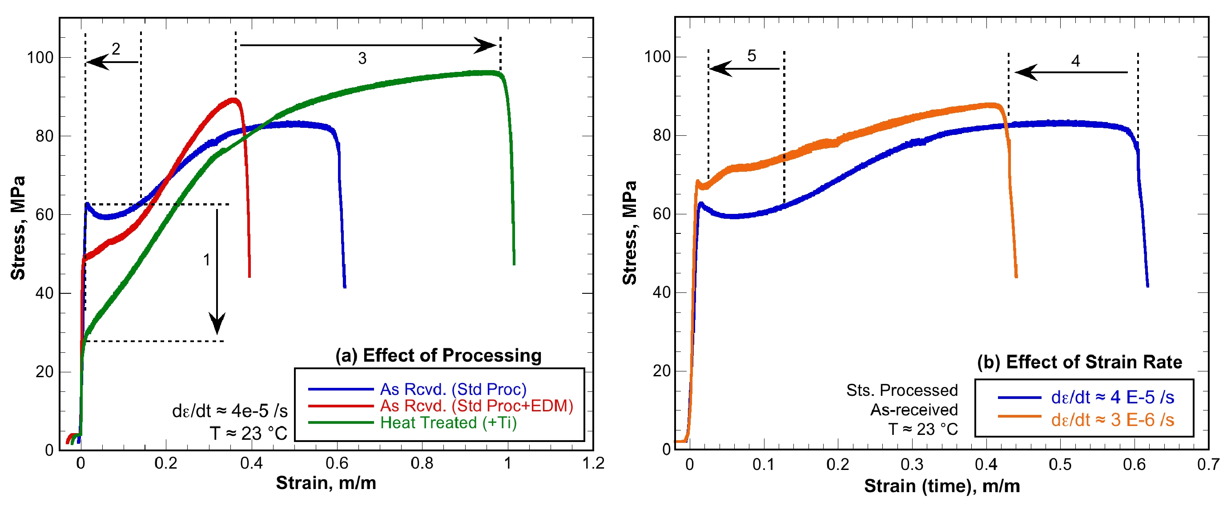
Results (1a):
Tensile flow curves
Yield point shift
Region of low dσ/dε reduced
Strain to UTS and strain to failure increased
Strain to failure reduced when strain rate lowered (typical HE min is 1E-6)
Yield drop reduced and dσ/dε increased by lowering strain rate

Slide 13
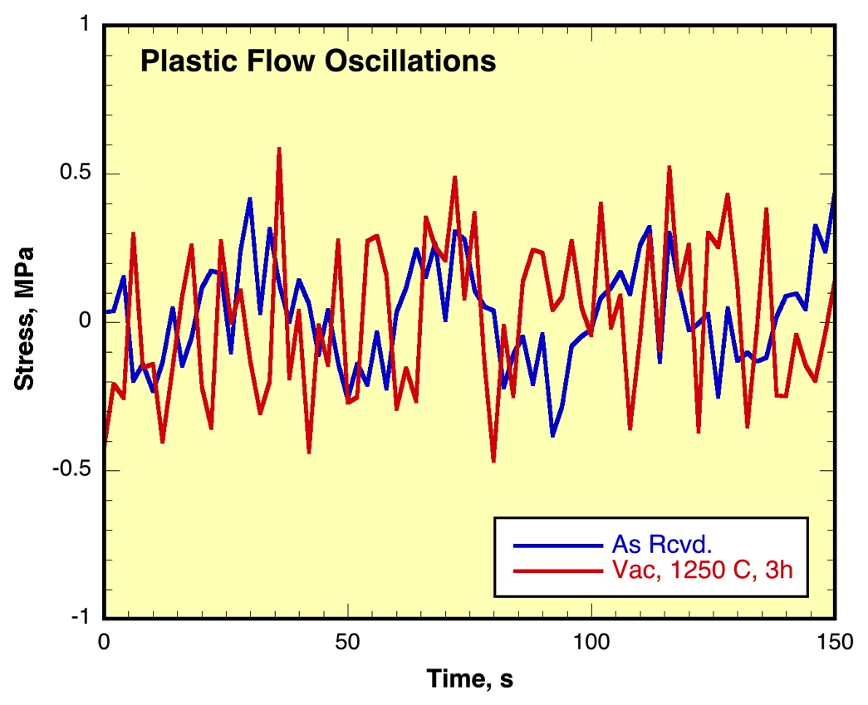
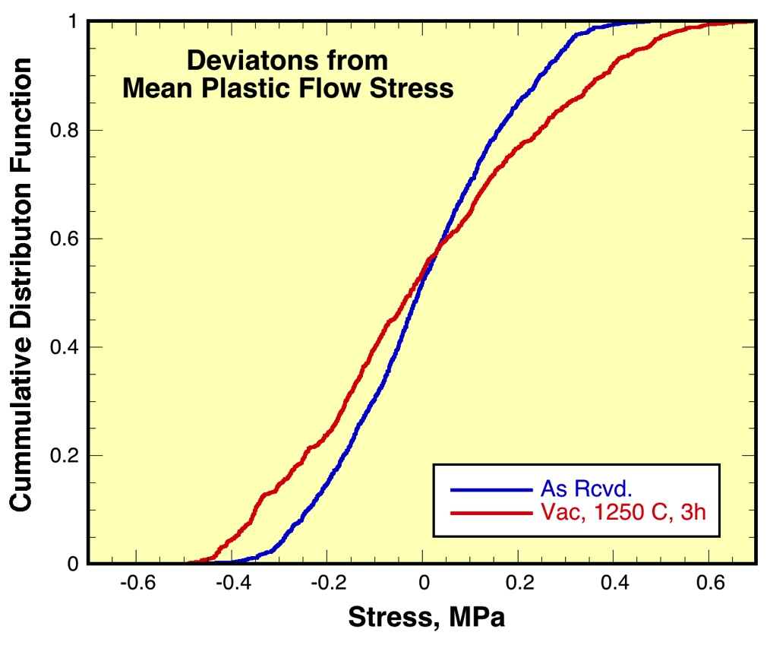
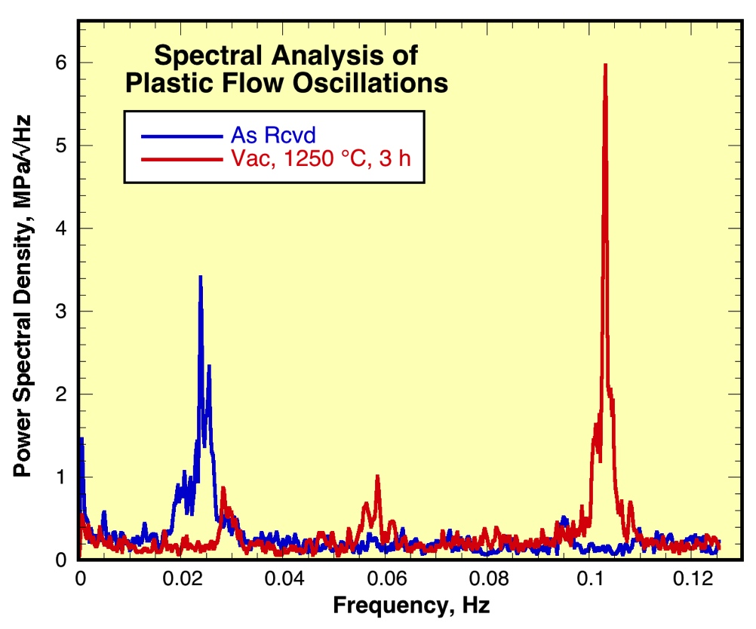
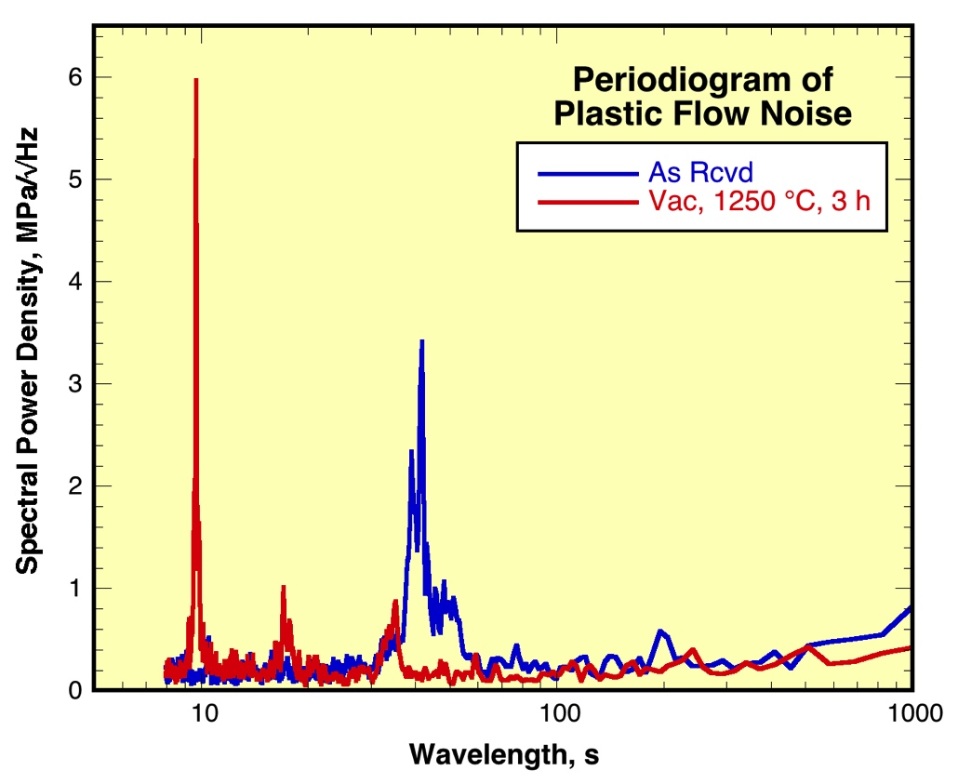
Results (1b):
Stress oscillations during plastic flow

Slide 14
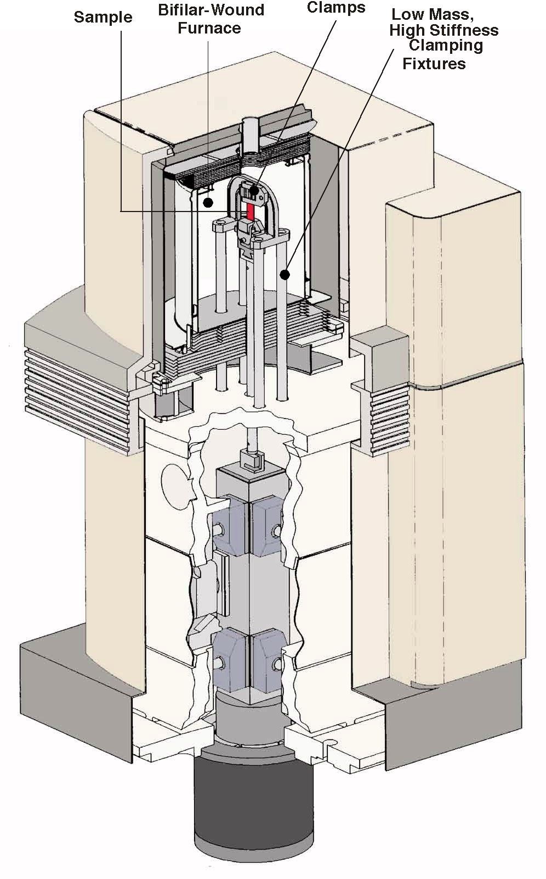
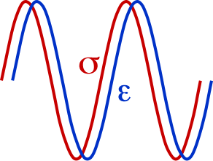
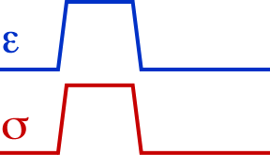
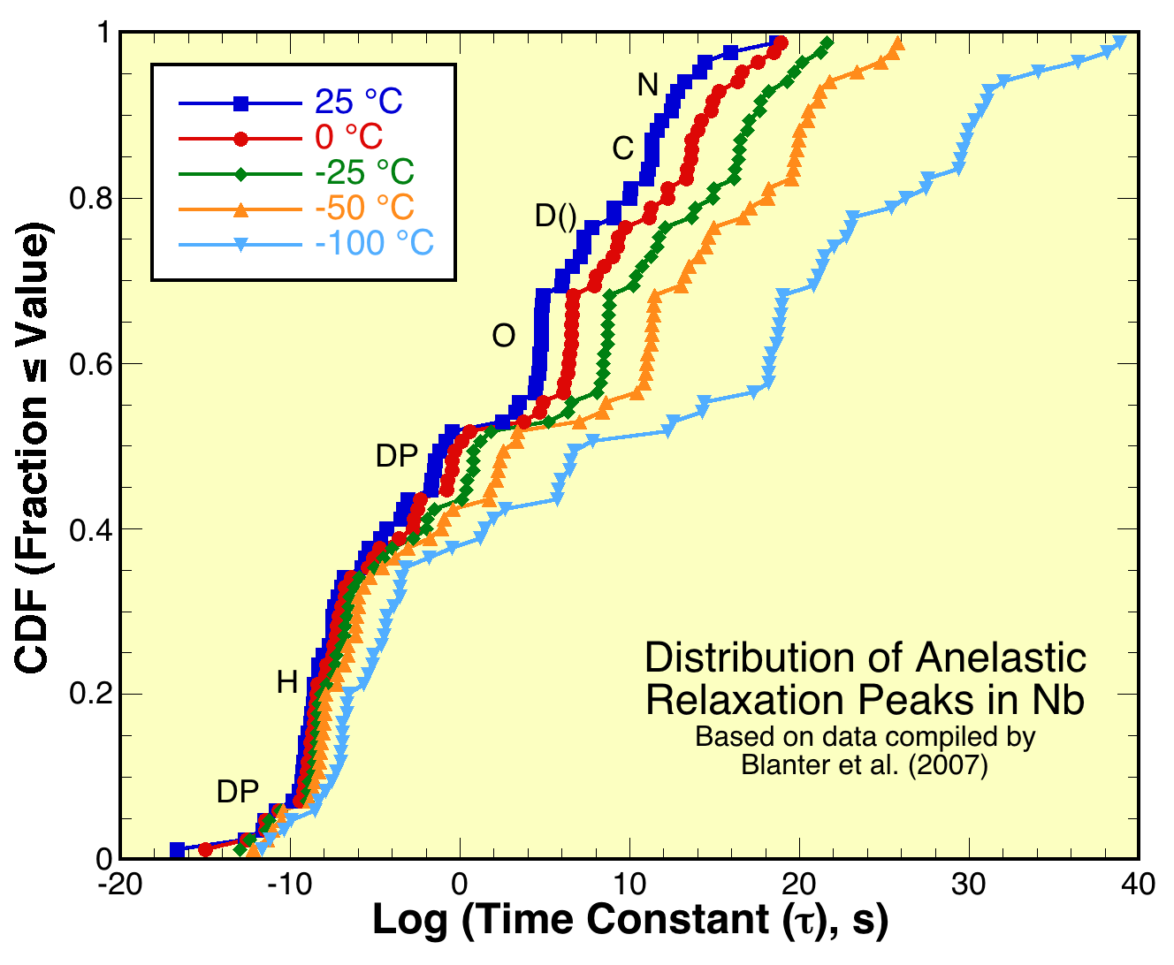
Experimental (2):
Dynamic mechanical analysis at NIST
DMA temperature scans
Samples cut from two ingots of Ta rich SRF Nb
Samples correspond to chemical analyses (below).
Displacement control (∆s=15 µm), 1 Hz, 1.0 °C/m, phase angle measured for each cycle.
Element | Ingot 14887 |  |  | Ingot 15006
 | Top | Half Height | Bottom | Top | Half Height | Bottom
Ta | 776 | 732 | 795 | 776 | 735 | 725
C | < 30 | < 30 | < 30 | < 30 | < 30 | < 30
O | < 30 | < 30 | 31 | < 30 | < 30 | 31
N | < 10 | 10 | < 10 | < 10 | < 10 | < 10
Three point bend (50 mm span)
Samples (1.5x5.5x60) mm
Isothermal relaxation/recovery
Square wave force control (0-40 MPa), 1,200 s/cycle,
Five temperatures (-100, -50, -25, 0, and 25) °C
Four conditions:
As received,
Vac, 120 °C, 24 h
Vac, 600 °C, 10 h, and
Vac, 1250 °C, 3 h

Slide 15
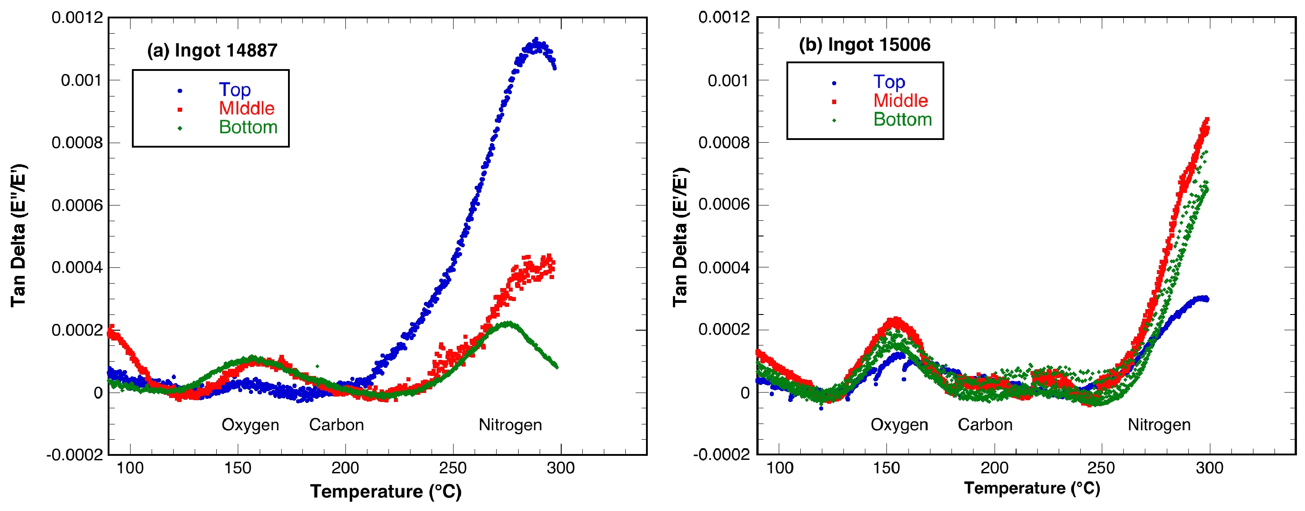
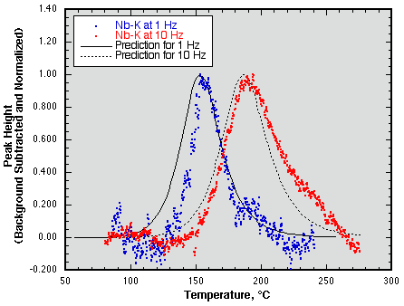
Results (2a):
DMA – Temperatures scans
Element | Ingot 14887 |  |  | Ingot 15006
 | Top | Half Height | Bottom | Top | Half Height | Bottom
Ta | 776 | 732 | 795 | 776 | 735 | 725
C | < 30 | < 30 | < 30 | < 30 | < 30 | < 30
O | < 30 | < 30 | 31 | < 30 | < 30 | 31
N | < 10 | 10 | < 10 | < 10 | < 10 | < 10

Slide 16
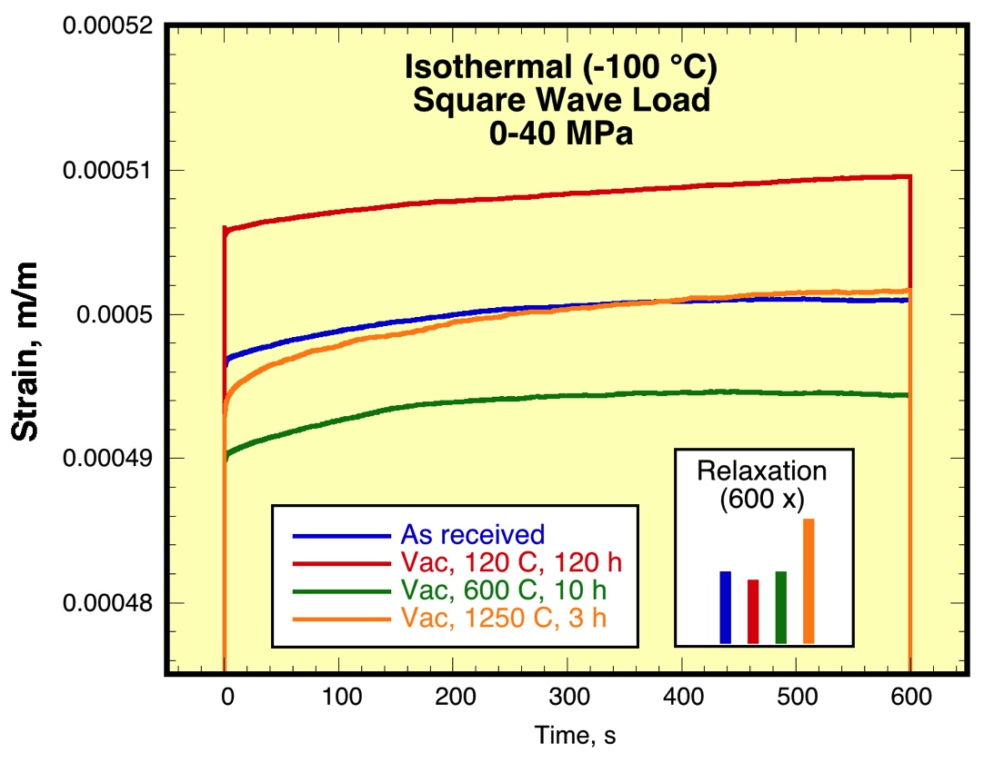
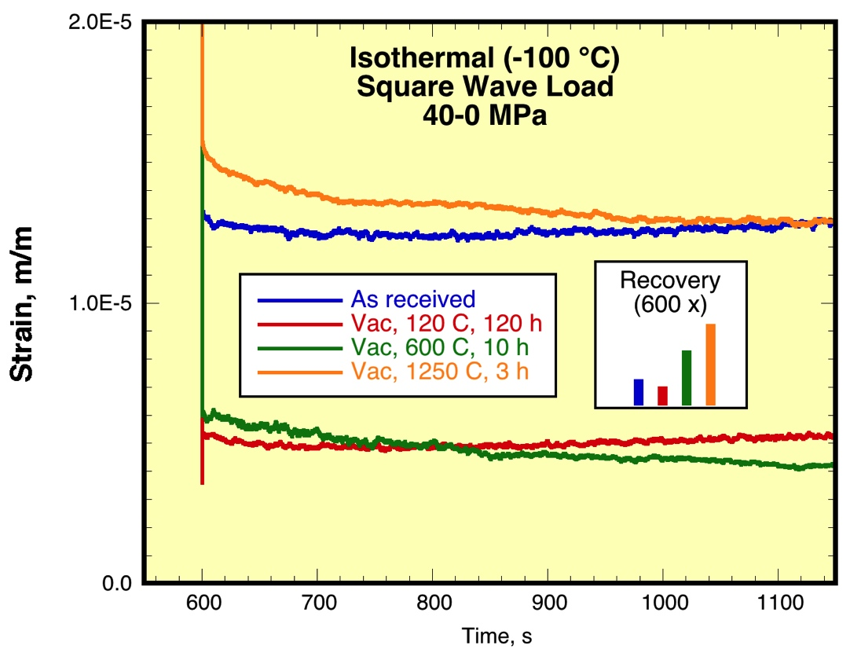
Results (2b):
DMA – Isothermal relaxation/recovery experiments (elastic after effect)
Some overshoot (ringing) observed.
Some drift appears to be present (calibration)
The 1250 °C vacuum anneal resulted in the greatest anelastic strains observed.
The 120 °C vacuum anneal resulted in the least anelastic strains observed.
Complex relaxation mechanisms require greater study

Slide 17
Conclusions:
Mechanical properties can be used to indicate, or measure, interstitial content.
Quantitative measurements, with uncertainties, will require considerably more research beyond the scope of the present study (to understand, and quantify, sensitivity to experimental variables).
Yield points, PLCs, and strain rate effects are clear indicators of the presence of interstitials in tensile tests.
DMA (anelastic or internal friction meas.) can only identify and measure the concentration of interstitials participating in a particular relaxation mechanism. (interstitials bound to defects or other interstitials will have different relaxation kinetics, etc.).
The results demonstrate that interstitial impurities are present in SRF Nb and that these impurities can be removed by heat treatment under the proper conditions.
The results support the hypothesis that H is the interstitial impurity primarily responsible for the observations.

