Slide 1

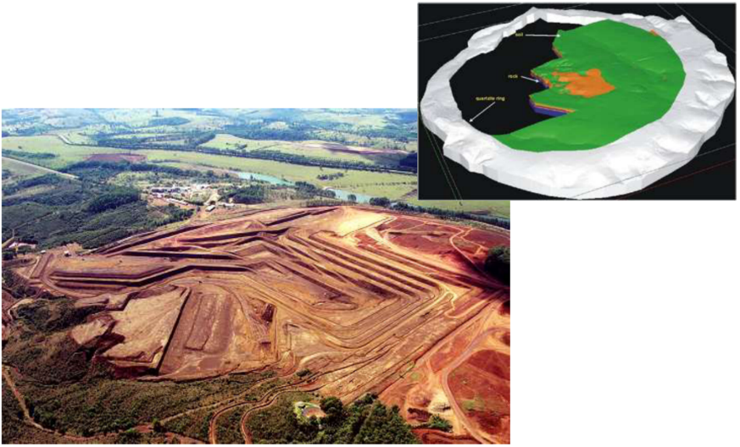
Ingot Niobium
Workshop

Slide 2
CBMM’s Niobium Technology Program:
Adding value to the supply chain
Improve material performance.
Increase product life cycle.
Reduce total cost in the value chain (processes & products).
Enhance perceived value in the market (market value of product).

Slide 3
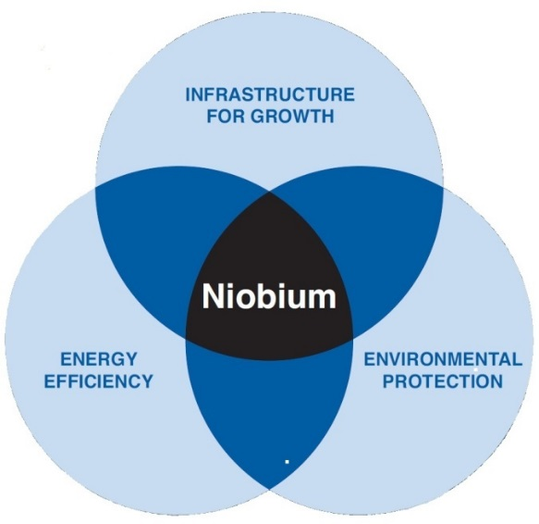
CBMM’s Niobium Technology Program
Components include joint projects, technical support and visits by specialist teams.
Currently over 130 projects are underway around the world with partners such as customers, research centers and universities.

Slide 4
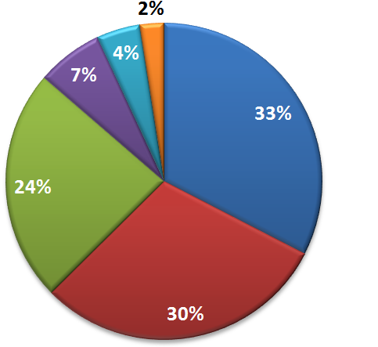
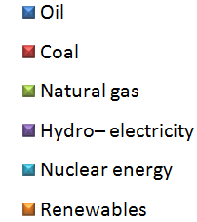
Motivation for JLab Ingot Niobium: Clean energy, reduction of CO2 emissions
World Energy Consumption by Fuel
Source: BP Statistical Review of World Energy 2015 (2014 data)

Slide 5
Energy: The challenge for growth
Electricity Consumption Per Capita
Norway
24.558
Canada
16.020
Sweden
14.510
USA
11.920
Japan
Switzerland
France
Singapore
Netherlands
Germany
Denmark
Spain
United Kingdom
Portugal
kWh/capita
China
Brazil
Source: TSPData.org – 2014

Slide 6
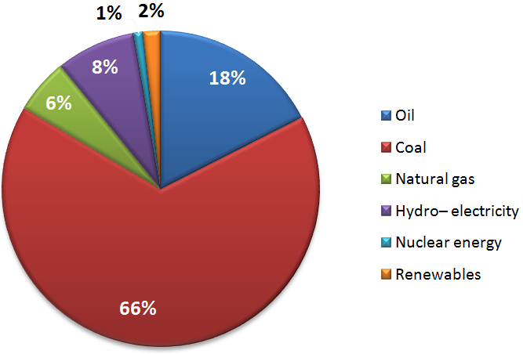
China: 92% of energy sources have high CO₂ emissions
Energy Consumption by Fuel – China
Source: BP Statistical Review of World Energy 2015 (2014 data)

Slide 7
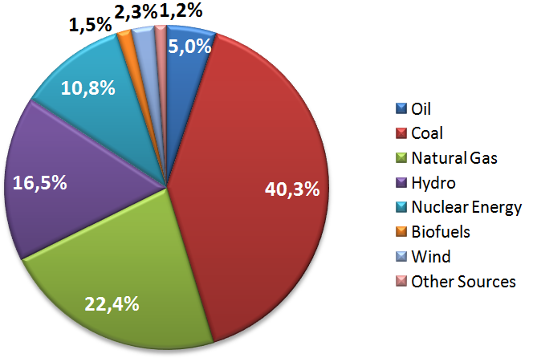
Global electricity
Global Electricity Generation by Fuel
*
Source: International Energy Agency 2012

Slide 8
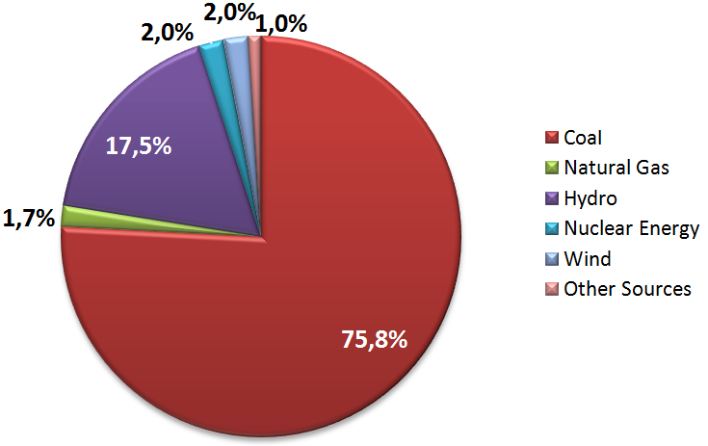
Electricity in China
Electricity Generation by Fuel – China
*
*including oil, bio fuels and waste
Source: International Energy Agency 2012

Slide 9
CO₂ emissions are growing, especially in developing countries
CO₂ emissions from fossil fuel use and cement production, selected countries
China
United States
1990
EU 28
2000
India
2013
Russia
Japan
Germany
South Korea
Canada
Brazil
Million tones of CO₂
Source: EDGAR 4.2FT2010 (JRC/PBL 2012); BP 2014; NBS China 2014; WSA 2014; NOAA 2012.

Slide 10
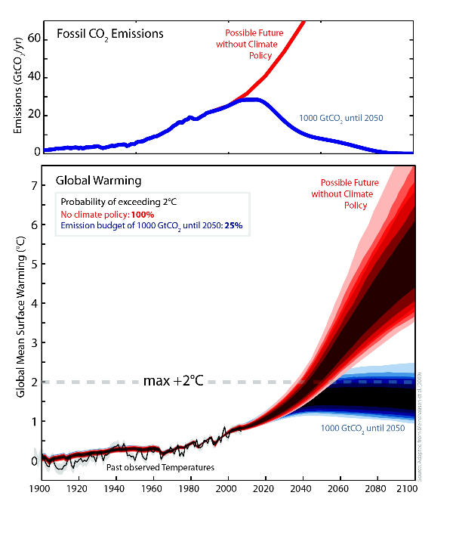
CO₂ emissions must be reduced to prevent global mean surface warming exceeding 2 ºC
https://simpleclimate.wordpress.com/category/co2-calculators/

Slide 11
How to overcome this challenge?
  - Wind energy
  - Solar energy
  - Wave power
  - Geothermal energy
  Bio energy
  Hydro energy
  Nuclear energy
  - Increasing energy efficiency

Slide 12
CRADA
Initial contact was in 1995: Dr. Ganapati was measuring the RRR of niobium while CBMM’s Tadeu Carneiro aimed to develop SRF cavity applications.
In order broaden the use of this technology it was necessary to improve the performance of the SRF technology and reduce operational and construction costs.
Optimized processes and procedures ensure that ingot niobium technology can be used for several SRF applications, including medical/industrial radioisotope production, accelerator driven subcritical systems, energy recovery linacs and circular colliders.
Today’s ingot niobium workshop discusses the work done thus far and identifies areas to further optimize processes and procedures.

Slide 13
CRADA
There is special interest in accelerator driven systems for subcritical reactors using thorium for power generation – no CO₂ emissions.
Thorium (Th-232), unexploited yet, is about four times more abundant than uranium in the Earth’s crust. While most uranium is dissolved in the oceans, thorium is present as mineral deposits, making it an attractive potential energy supply.
In 2015 CBMM held the first trial to produce the world’s largest-diameter niobium ingot (as cast 535 mm) to produce high performance supercavities directly from the ingot. The trial presented excellent RRR results, which will be presented during today’s workshop.
CBMM invested in state-of-the-art technology to measure RRR in our ingots.

Slide 14
Welcome to the 2015 Ingot Niobium Workshop at Jefferson Lab

