Slide 1
Ingot Niobium Summary Workshop December 4, 2015
Jefferson Lab
Swapan Chattopadhyay

Slide 2
A vast body of knowledge informed by fundamental research on Ingot Niobium as a material for microwave superconducting cavities has been generated thanks to the RMCI-JLab CRADA 2004-2015
I consider myself fortunate to have overlapped my tenure at JLab (2001-2007) which initiated and enabled this research via this CRADA, thanks to the outstanding leadership and contributions by JLab SRF scientists and collaborating industrial scientists and technologists
Original leadership in understanding Niobium at the foundation of CEBAF:
Ron Sundelin and Larry Cardman
(Niobium thermo-mechanical properties)
Followed by outstanding scientific contributions by SRF leaders:
P. Kneisel, G. Ciovati, K. Saito, G. Myneni
(Niobium as SRF material)
Visionary support of industrial scientific leaders:
Tadeu Carneiro
(Ingot development)
Other major contributors:
Scientists and scientific leaders from the JLab SRF Institute, Accelerator , Engineering and FEL Divisions

Slide 3
RMCI-JLab CRADA 2004 – 2015
Interstitial content via low strain rate stress-strain curves (PLC)
Modification 1 (2005) – Prepare and Study Samples for tensile, PGAA, NIS, DMA, and NRA tests
Modification 2 (2006) – Development of cavities from large/single grain niobium for ILC and ERL’s
Modification 3 (2009) – Reduction of RRR specification from 300 to 200 and increasing Tantalum ~ 1500 wt. ppm
Modification 4 (2010) – Explore the uses of ingot niobium in accelerators and for other technologies including ADS by hosting International Workshops/Symposia/Meetings
Review of ingot niobium as a material for superconducting radio frequency accelerating cavities P. Kneisel, G. Ciovati, P. Dhakal, K. Saito, W. Singer, X. Singer, G. R. Myneni in Nuclear Instruments and Methods in Physics ResearchA774(2015)133–150

Slide 4
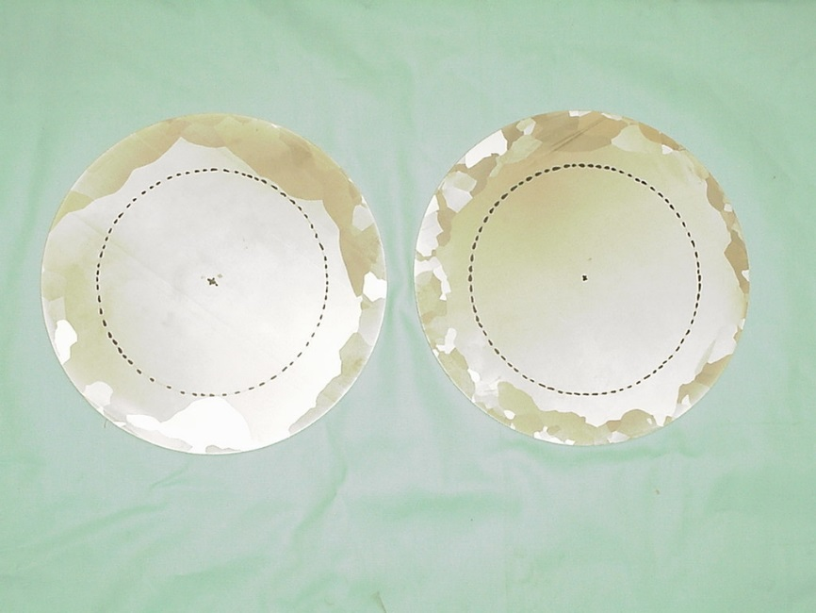
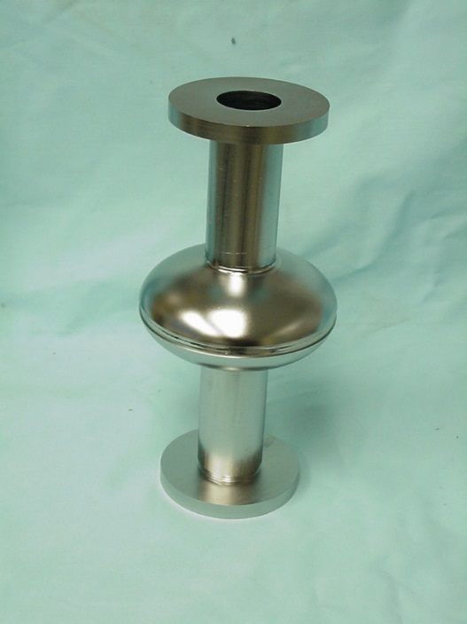
It all started with the Single Crystal Niobium Cavity results which got us all excited back in 2005!!!!
Single Crystal Ingot discs before cavity formation
Achieved Cavity Fields
E_{peak}/E_{acc} = 1.674
H_{peak}/E_{acc} = 4.286 mT/MV/m

Slide 5
Single Crystal Niobium Cavity (7)
Test #2:after baking at 120C, ~44 hrs

Slide 6
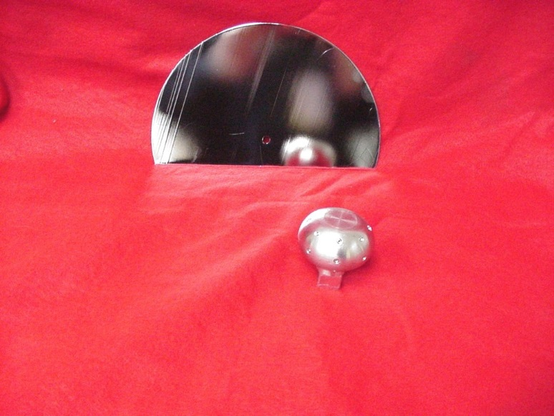
Single Crystal BCP
Provides very smooth surfaces as measured by A.Wu, Jlab
RMS: 1274 nm fine grain bcp
27 nm single crystal bcp
251 nm fine grain ep

Slide 7
Single Crystal Niobium Cavity (10)
Development Program
Material | Cavity/f [MHz] | Status | Results
Single crystal | HG, 2.2 GHz | tested | E_{acc} =38-43 MV/m R_{res} < 1 nW
standard | HG, 2.2 GHz | tested | E_{acc} ~35 MV/m R_{res} < 1 nW
Single Crystal | LL-ILC, 2.3 GHz | Fabricated, H-degassed
Large Grain”A” | HG, 1.5 GHz | tested | E_{acc} =32 MV/m R_{res} ~ 7 nW
Large Grain”B” | HG, 1.5 GHz | tested | E_{acc} =30 MV/m R_{res} ~ 7 nW
Large Grain”A” | 7-cell,HG, 1.5 GHz | In fabrication
Single Crystal | 7-cell,LL_ILC 1.3 GHz | Dies in fab Ingot in proc
Large Grain”A” | HG, 1.5 GHz OC, 1.5 GHz | In fab, Saw cut

Slide 8
→ A vast body of knowledge also gathered on effects of Hydrogen in materials!!
→ Q-disease!
→ Barely saved the CEBAF cavities from hydrogen-induced Q-disease during SRF recovery of CEBAF SRF linacs in the aftermath of the 2003 Hurricane Isabel (CERN Courier article 2004)
→ And today, at Fermilab, we are exploiting Nitrogen-doping in Niobium (A. Grassellino) to improve “Q” of SRF cavities , enhancing cryogenic efficiency
→ Potential energy and cost savings in LCLS SRF linacs where both JLab and Fermilab are involved

Slide 9
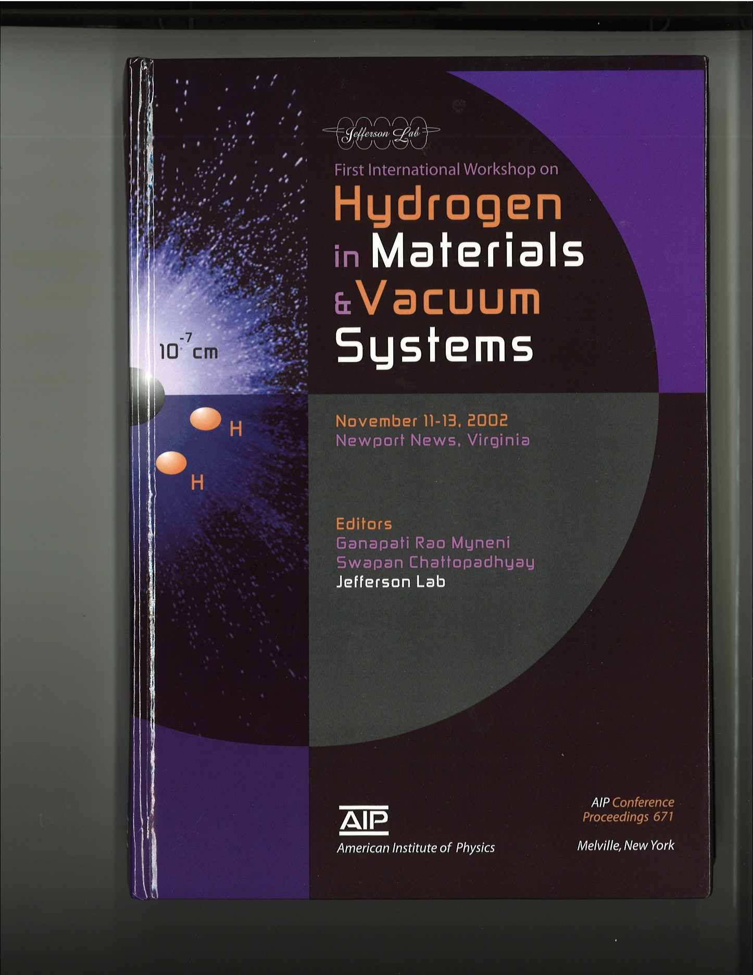

Slide 10
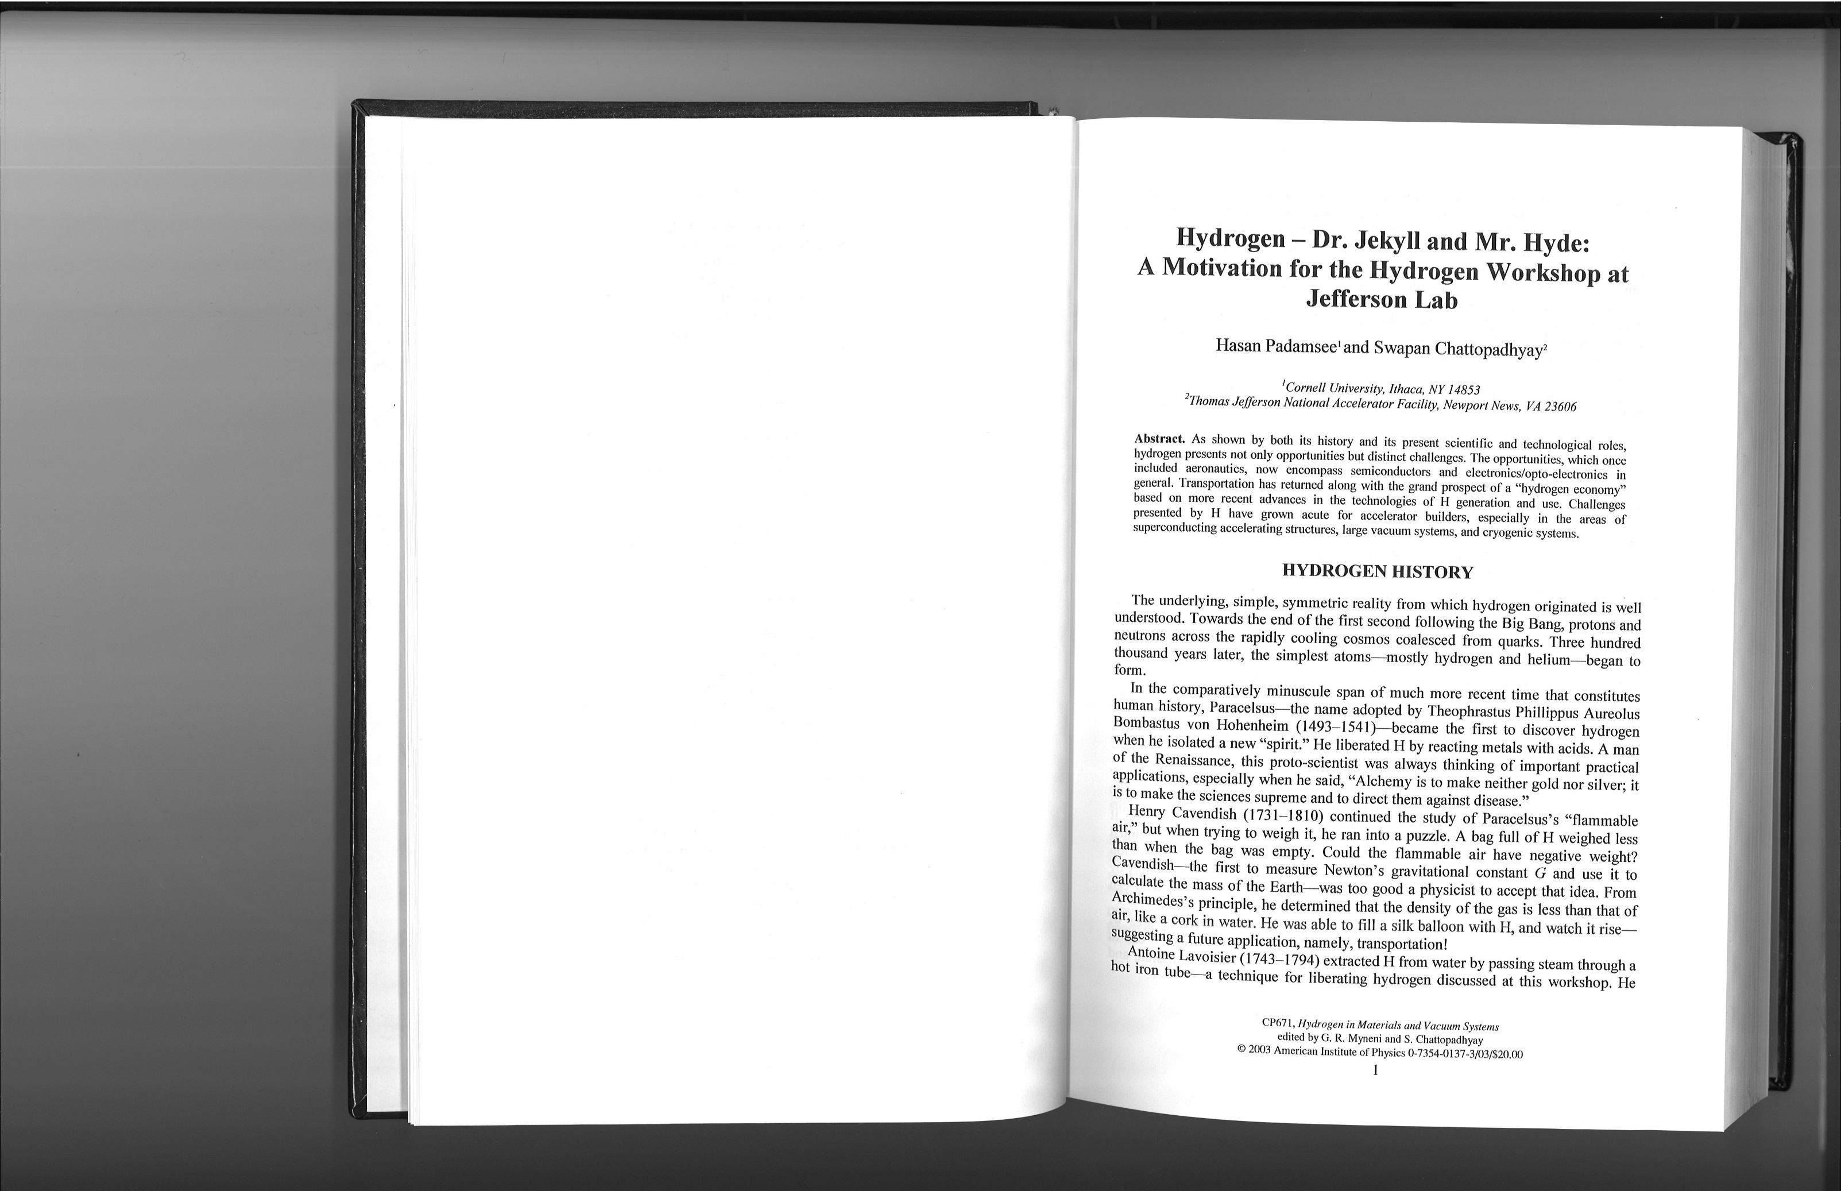

Slide 11
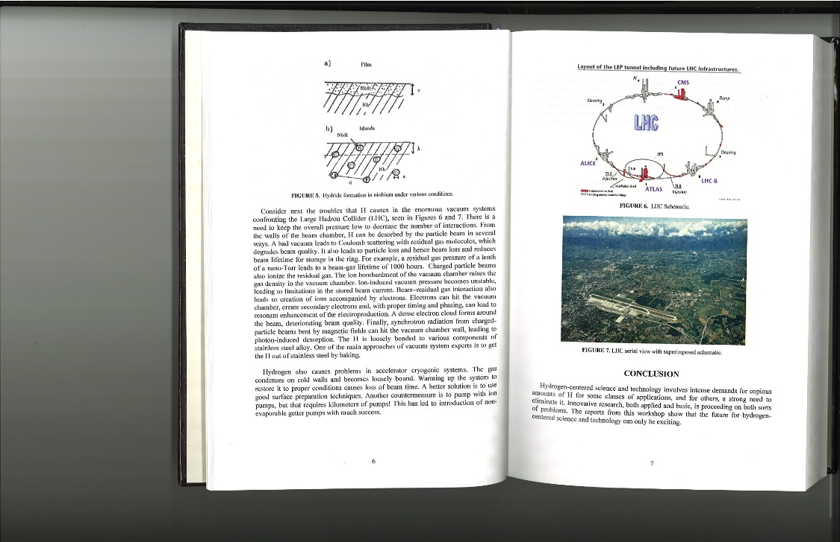

Slide 12
OUTLOOK:
RMCI – JLab CRADA
Evolution of Ingot Niobium technology
Great investment of resources
Accumulated Knowledge summarized in many workshops specializing in:
→ Ingot Niobium
→ SRF
→ Hydrogen in Materials
→ Accelerator Driven Subcritical Reactors
Many PhD students/post-docs and MS and PhD dissertations
International attention (DESY, SNS, ILC!)

Slide 13
THANKS
to
JLab’s leadership
in
Developing Ingot Niobium Technology
for
SRF Applications!!

