Slide 1
Ingot-Nb Based SRF Technology for the
International Linear Collider
Akira Yamamoto, M. Yamanaka (KEK),
and
G. Myneni (Jlab)
to be presented at “Ingot Nobium CARADA Workshop”,
JLab, 4 Dec., 2015

Slide 2
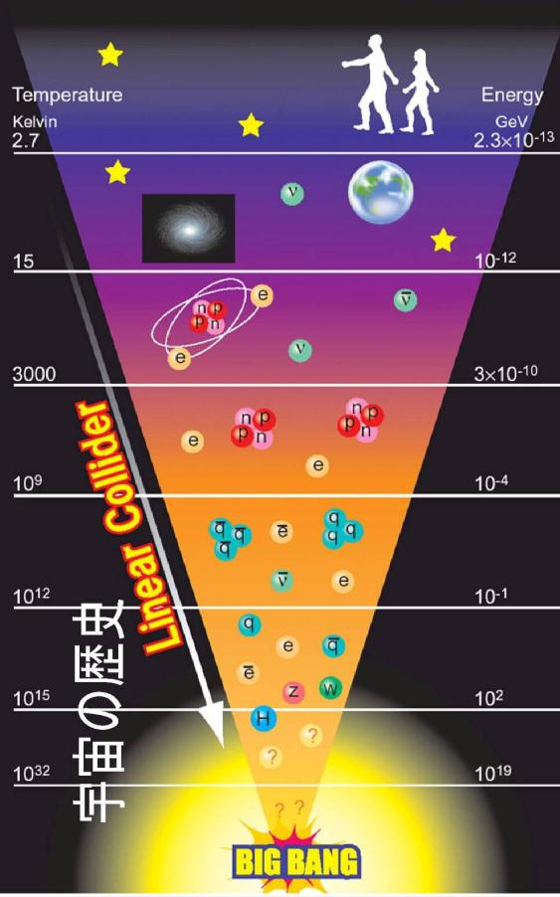





Study of Universe/Cosmos
~ 300 k Years
Limit of optical astronomical observation
Earlier Period
- Elementary particle physics taking
a major role,
Very early universe
~ 10⁻¹⁰ ~ ⁻³⁴ sec,
Particle accelerators play major
role.
Star
10E8 yrs
Atom：
４E5 yrs
Nucleus
3 min.
Proton,
1E-4 sec
History of the Universe
ν
d
Elementary
Particles

Slide 3
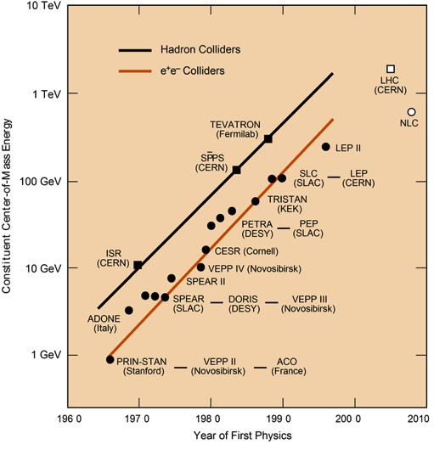
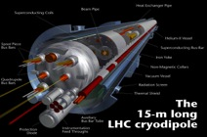
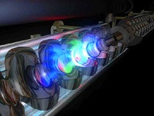
Applied Superconductivy
Particle Acceleratoes
LHC
SC magnet technology
ILC
Proton Acc.
SRF technology
Electron Acc.
Becoming inevitable fundamental technology

Slide 4
A full set of Fundamental Particles
Water
Atom
Nucleus
Proton
Quark
The Standard Model
u
c
t
g
Particles and
Forces
up
charm
top
gluon
Quarks
s
γ
d
b
down
strange
bottom
photon
e
μ
τ
Force Carriers
W
Leptons
electron
muon
tau
W boson
ν_{e}
ν
ν
Z
μ
τ
e-neutrino
μ-neutrino
τ-neutrino
Z boson
I
II
III
Generations of matter
Higgs
Boson?
Discovered at LHC
Nobel prize in 2013
© Brian Foster

Slide 5




Important Energies in ILC
Discovery of a 125 GeV Higgs has reinforced importance of ILC
Integrated Luminosity (ab⁻¹)
K. Kawagoe
(modified)
2
HHZ
Physics confident:
→ Higgs and Top Quark
Learn “everything” about H (125)
Probe dynamics of EWSB
New Physics beyond SM:
Direct or indirect DM searches
Evidence for BSM physics
Hints of a new mass scale
1
HZ
ννH
tt
ttH
E _{cm} (GeV)
200
300
400
500
600

Slide 6
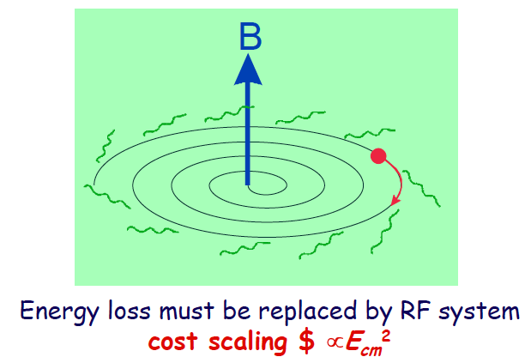
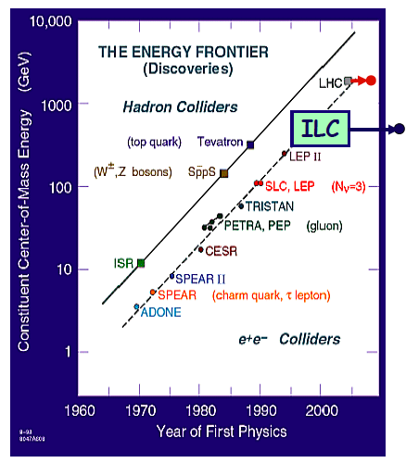
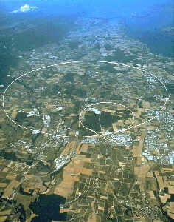
Linear Collider as a next Step for Electron-Positron Collider
e-e+ accelerator
Ring collider
-->> Linear Collider

Slide 7

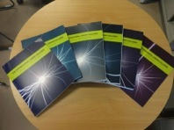
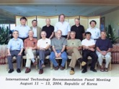
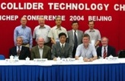


ILC Technical Design Phase
1980’ ~ Basic Study
2005
2006
2007
2008
2009
2010
2011
2012
2013
2014
2004
ILC-GDE
LCC
Ref. Design (RDR)
TDR
Tech. Design：TDP1
TDP 2
TDR completion
LHC
126 GeV
Higgs
discovered
Selection of SC Technology
2012.12.15
2013.6.12

Slide 8
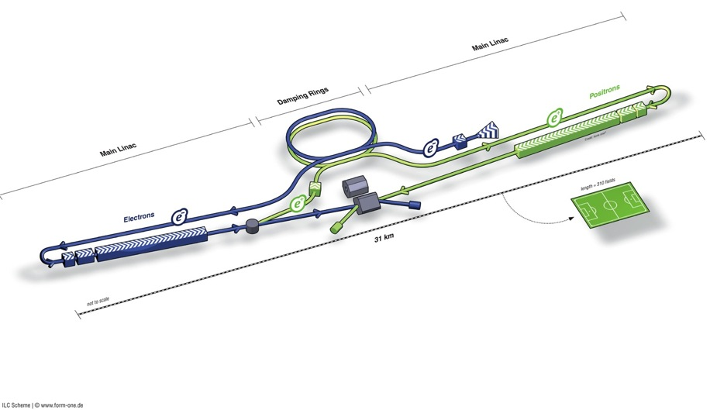
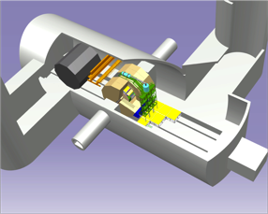
ILC Layout Proposed
Damping Rings
e+ Main Linac
e- source
e- Main Linac
Parameters | Value
C.M. Energy | 500 GeV
Peak luminosity | 1.8 x10³⁴ cm⁻²s⁻¹
Beam Rep. rate | 5 Hz
Pulse duration | 0.73 ms
Average current | 5.8 mA (in pulse)
E gradient in SCRF acc. cavity | 31.5 MV/m +/-20% Q₀ = 1E10
E+ source

Slide 9
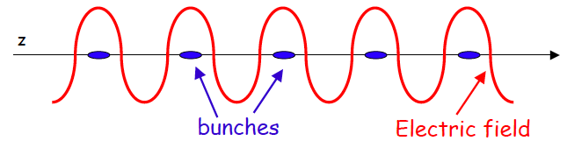
ILC Accelerator: Functional View
e-/e+ Sources
Ultra low-emittance beam
(ultimately parallel)
Final focusing and
Collision
SCRF Main Linac
Linear Acceleration by using
SCRF Cavity Technology
9
Notes:
9

Slide 10

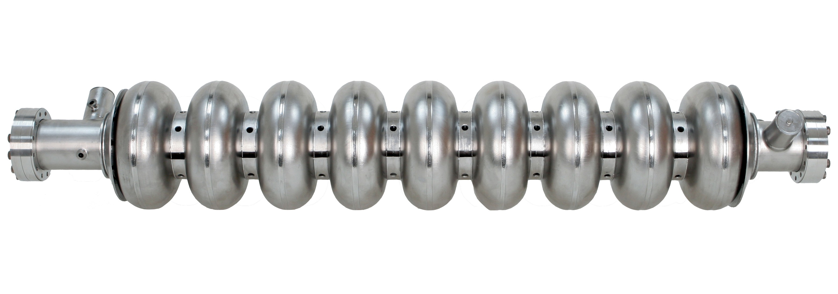
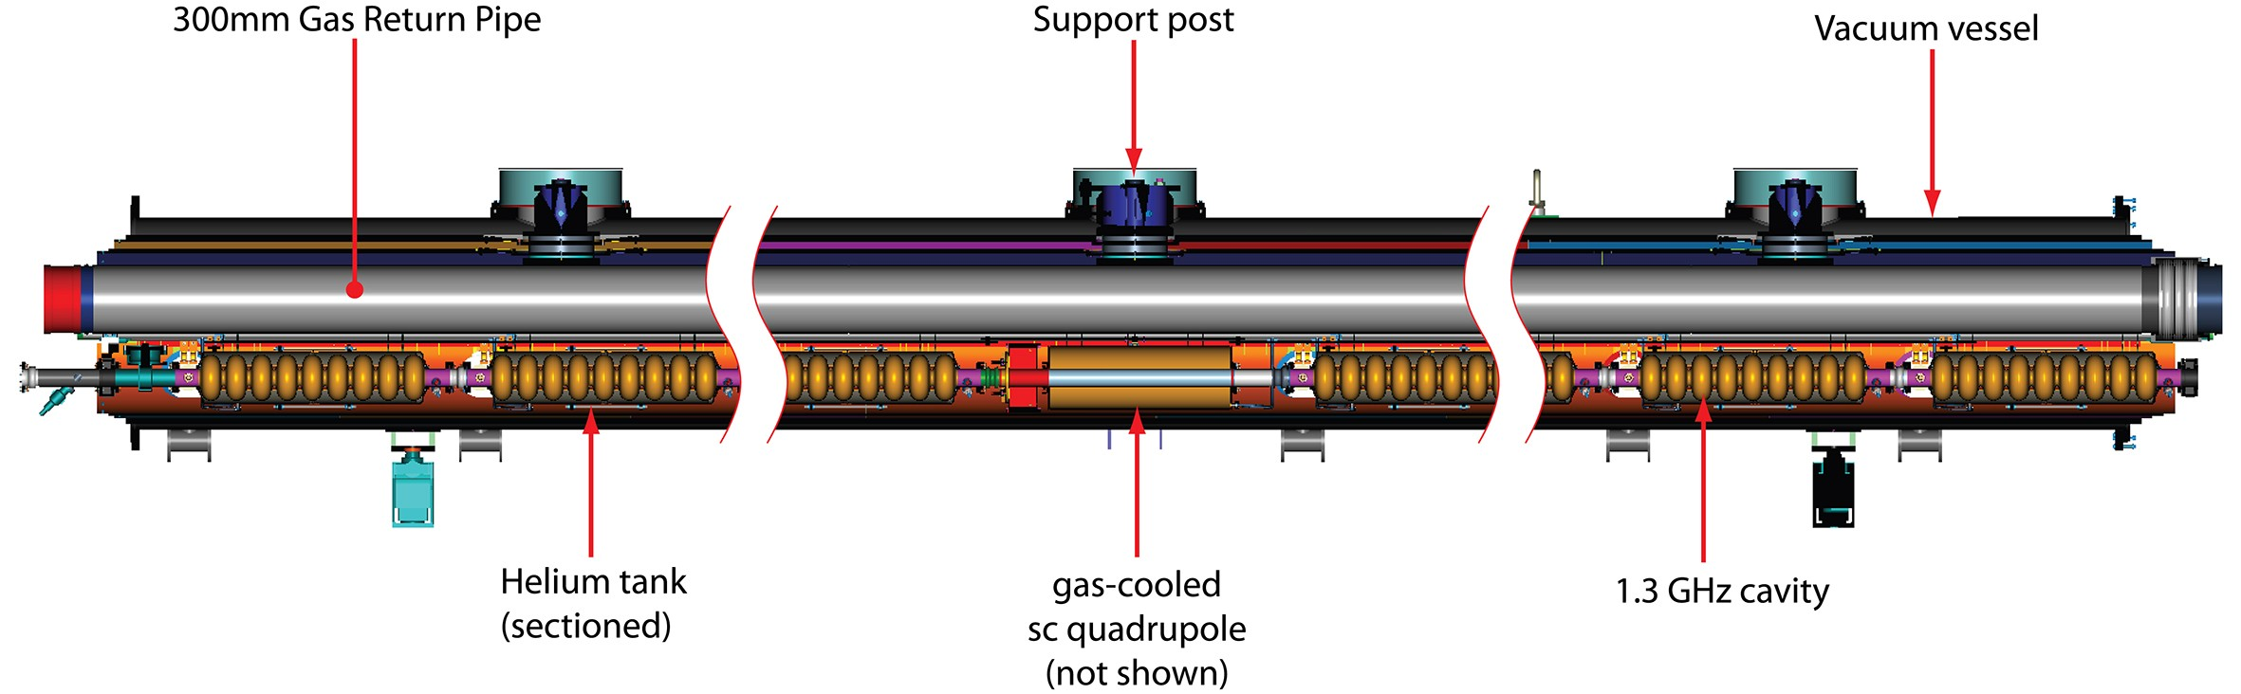
SCRF Industrialization required
Parameters | Value
C.M. Energy | 500 GeV
Peak luminosity | 1.5 x10³⁴ cm⁻²s⁻¹
Beam Rep. rate | 5 Hz
Pulse duration | 0.73 ms
Average current | 5.8 mA (in pulse)
Av. field gradient | 31.5 MV/m +/-20% Q₀ = 1E10
# 9-cell cavity | 16024 (x 1.1)
# cryomodule | 1,855
# Klystron | ~400

Slide 11
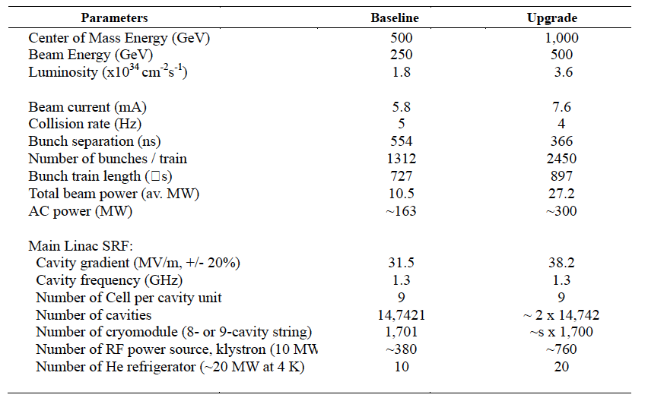
ILC Accelerator Parameters

Slide 12
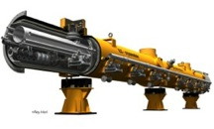

SCRF Procurement/Manufacturing Model
ILC Host-Lab
Technical Coordination
for Lab-Consortium
Regional Hub-Lab:
A
Regional Hub-Lab:
E, & …
World-wide
Industry responsible to
‘Build-to-Print’ manufacturing
Regional Hub-Lab:
B
Regional Hub-Lab:
D
Regional Hub-Lab:
C: responsible to
Hosting System Test and Gradient Performance
Regional hub-laboratories responsible to regional procurements to be open for any world-wide industry participation
: Technical
coordination link
: Procurement link

Slide 13



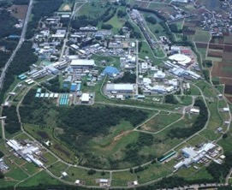
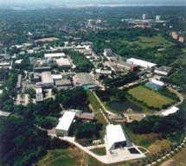

SRF Facilities anticipated for Hub/Consortium
DESY, INFN, E-XFEL
FNAL/ASTA, ANL
IHEP, PKU
Cornell
CEA-Saclay, LAL-Orsay
JLAB
KEK
SLAC, LCLS-II
IUAC, RRCAT
AMTF @DESY/E-XFEL, CEA,
STF-CFF @ KEK
ASTA @ FNAL, TEDF @ JLab

Slide 14

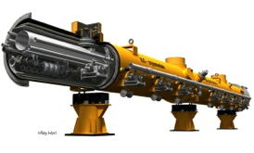
Cavity/Cryomodule Fabrication
Purchasing Material/Sub-component
Manufacturing Cavity：
Processing Surface
Assembling LHe-Tank ：
Qualifying Cavity, 100 %：
Cavity String Assembly：
Cryomodule Assembly:: CM 組立
Qualifying CMs, 33 + 5 %：

Slide 15
Courtesy: R. Geng
ILC is inevitable
next machine!

Slide 16
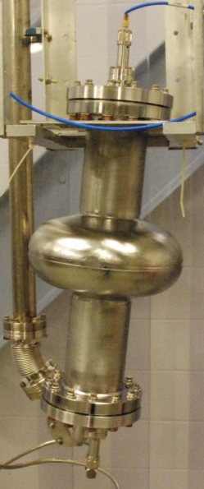
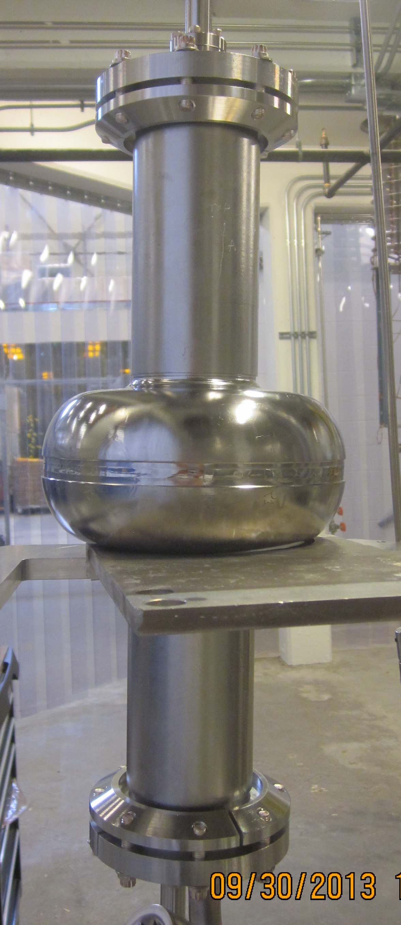
Courtesy: R. Geng
FG Single + EP
FG End-single + EP
Bright future
FG 9-cell + EP
LG single + BCP
LG 9-cell + BCP
G2 1.8K
PJ1-2 1.8K
1 TeV ILC
Goal set in TDR
ILC baseline (2.0K)
F. Furuta et al., International Symp. On Supercond. Sci. & Tech. of Ingot Niobium, Sept. 22-24, 2010.

Slide 17
Optimization for Mass-production in the ILC Preparation Stage
Seeking for the best cost-effective production technology for Nb disk/sheet
  Very clean surface
    Important for gradient stability
  Optimum (could be lower) residual resistance ratio
    to be optimized with RRR of ~ 150 +/- 50
  Optimum (medium) grain size
  Hoping, to slice with better mechanically stability.
    optimum solution anticipated

Slide 18
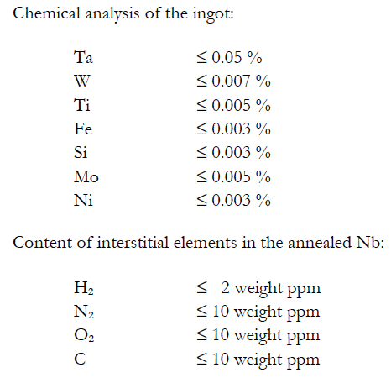
Technical Specification for Nb Sheet
Chemical contents: Example
Electrical Properties
  RRR: > 300 (to be furher optimized)
Chemical contents
  see table
Microstructure
  Re-crystalized 100 %
  Grain-size: ASTM 6 or finer (to be further optimized)
  Local grain size: ASTM 4-5
Mechanical Properties
  Ultimate strength: > 140 N/mm2, RT
  Yield strength: TBD (> xx N/mm2, RT)
  Elogation; > 30 %
  Hardness: ≤ 60
Shape/size: TBD
  Rect. Sheet : ~ 300 mm sq. or
  Circular sheet: ~280 mm dia. with a center-hole
    Possibility of Blanking (in consortium: to be discussed)
  Thickness : 2.8 mm +/- 0.1 mm
  Flatness: 2 % or better
  Surface roughness: < 15 mm (RF side)

Slide 19
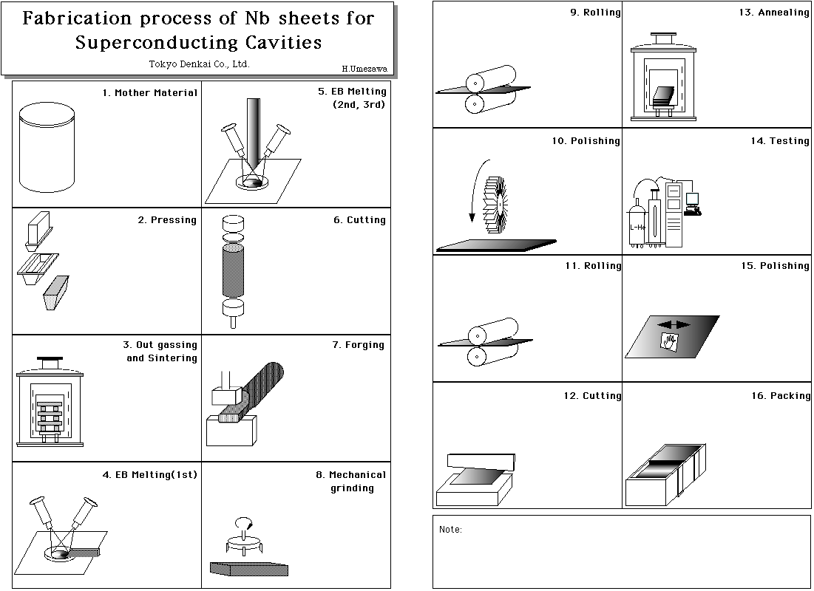
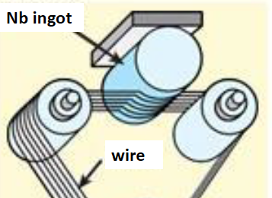
FG-Nb rolled or LG-Nb sliced from Ingot
Courtesy: G. Myneni
Cleaness to be highy
secured
Foreign materials could be rolled in

Slide 20
A Direction to be Investigated for the Nb disk Mass-production
Clean surface from the beginning of Nb sheets
  Direct slicing from Nb Ingot (having high purity)
    Proposed and patentend in the US, by G. Myneni, P. Kneisel (Jlab) and T. Carneiro (CBMM)
    (Patented in Japan and in Europe, by KEK, Tokyo-Denkai, and others)
  Keep clean surface w/ directly sliced Nb-sheets
    w/o additional rolling causing contamination and defects
On the other hand,
  necessary mechanical uniformity and stability for press-work with tighter tolerance in assembly.

Slide 21
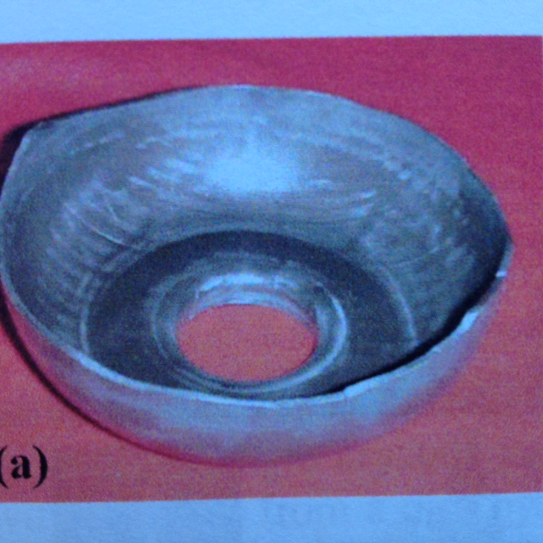
A Direction to be Investigated for the Nb disk Mass-production
Clean surface from the beginning of Nb sheets
  Direct slicing from Nb Ingot (having high purity)
    Proposed and patentend in the US, by G. Myneni, P. Kneisel (Jlab) and T. Carneiro (CBMM)
    (Patented in Japan and in Europe, by KEK, Tokyo-Denkai, and others)
  Keep clean surface w/ directly sliced Nb-sheets
    w/o additional rolling causing contamination and defects
On the other hand,
  necessary mechanical uniformity and stability for press-work with tighter tolerance in assembly.

Slide 22
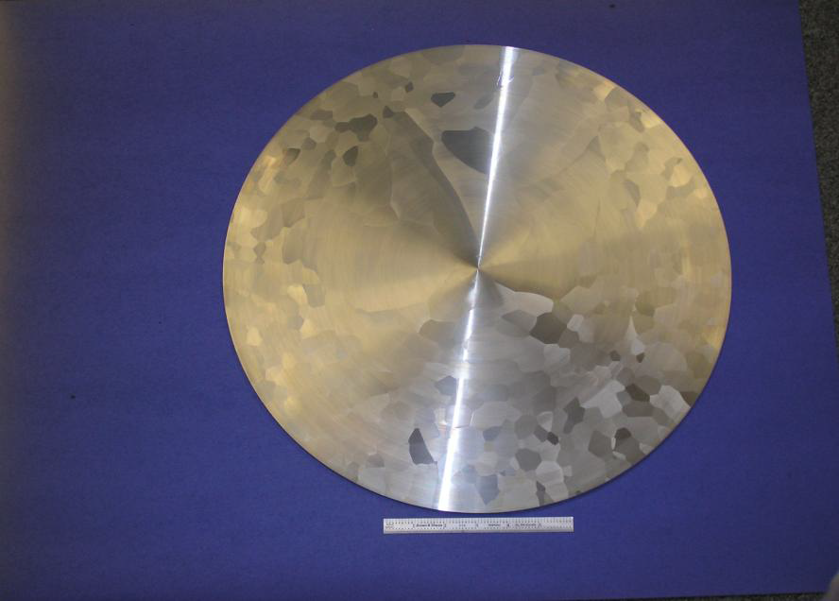
Nb Sheet directly cut out anticipated with medium grain size
RRR: ~ 200
Grain size : < ~ 1 cm
  To be optimized for press-work,
Size: > 260 mm
Thickness: ~ 2.8 mm
Cleanness:
  Min. surface work
  No rolling

Slide 23

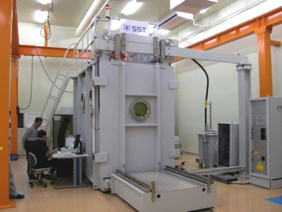
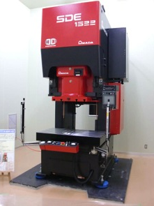
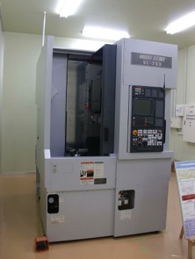
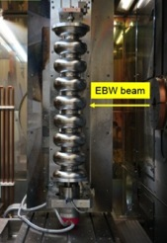
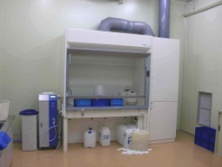
Efforts for Self Learning at KEK
EBW
Press
Trim
SST EBOCAM KS-110 – G150KM
Chamber (St. St. chamber)
AMADA digital-survo-press SDE1522
150t, 50stroke/min, 225mmstroke
MORI VKL-253
Vertical CNC lathe
Chemical
process

Slide 24

Fabrication and evaluation of low-RRR, LG single cell cavity
Mechanical Engineering Center, KEK
Masashi YAMANAKA
Presented at TTC Meeting @SLAC, 2 December, 2015

Slide 25
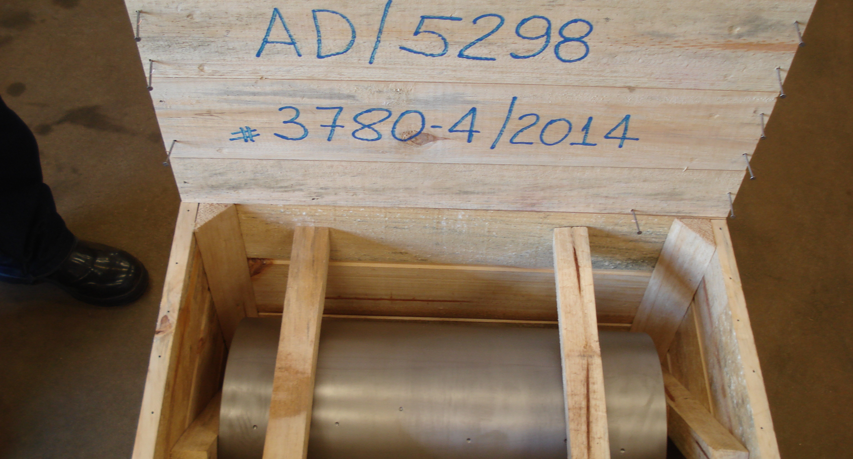

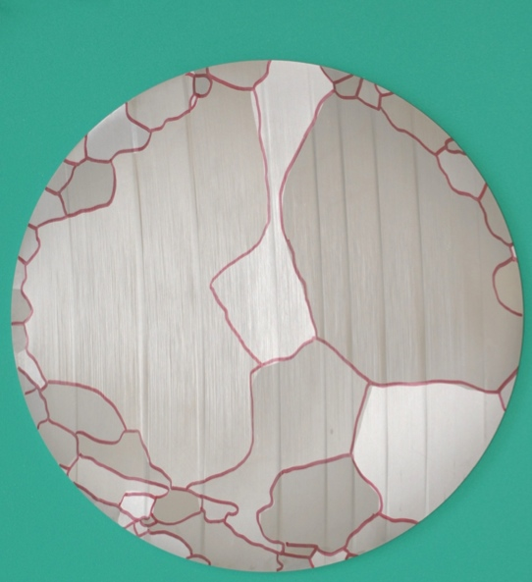
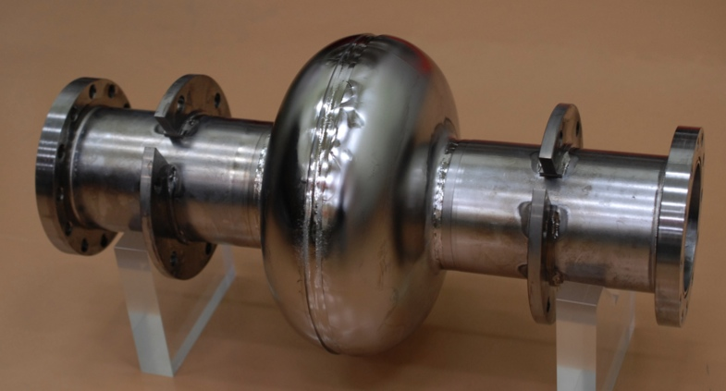
Objectives
Courtesy: M. Yamanaka
Motivation
Reduce the niobium material cost
Approach
Use low RRR cheap niobium
Use sliced ingot sheet
Objectives
Manufacture a single cell cavity
Evaluate the performance
Chemical compositions (unit: ppm) and RRR
H | C | O | N | Fe | Si | Ta | RRR
< 10 | < 30 | < 30 | 10 | 3 | 20 | 1034 | 100
50 mm
Sliced ingot niobium（φ260）
Boundary was traced by felt pen
Ingot Nb kindly contributed by CBMM
1.3 GHz single cell cavity
fabricated by KEK-CFF
TESLA-like (end cell)

Slide 26
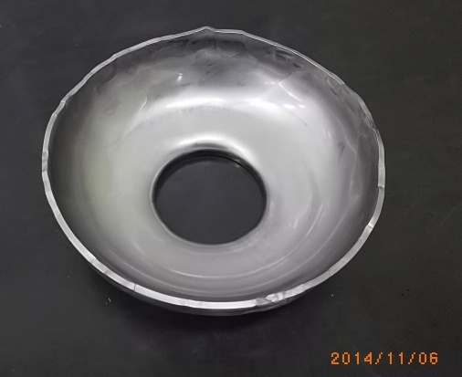
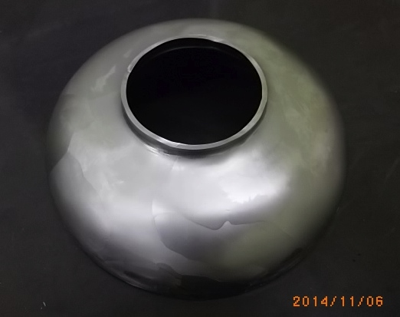
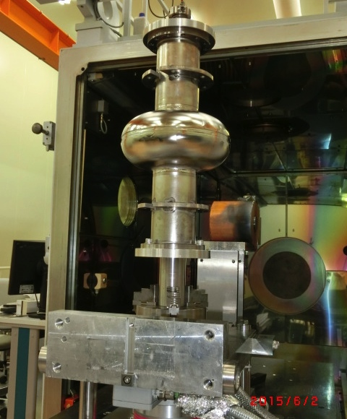
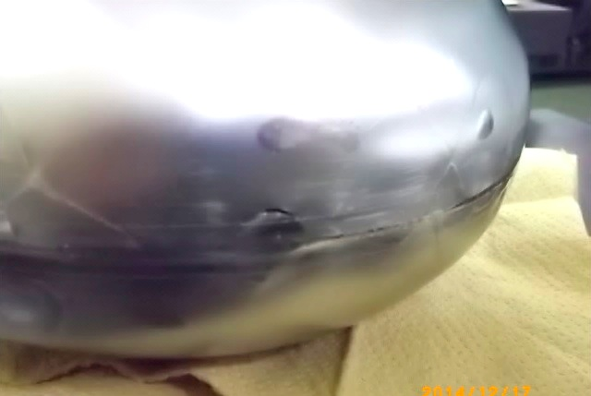

Fabrication
Courtesy: M. Yamanaka
Deformation is not uniform due to anisotropy
It is difficult to keep circularity at edge (equator)
Press forming for cells（Same way to ordinary process）
Crack occurred
Just at surface, no leak
Welding bead across the boundary is smooth (not affected)
Leak check was achieved before trimming edge
EBW test (plate)
EB welding for equator part

Slide 27
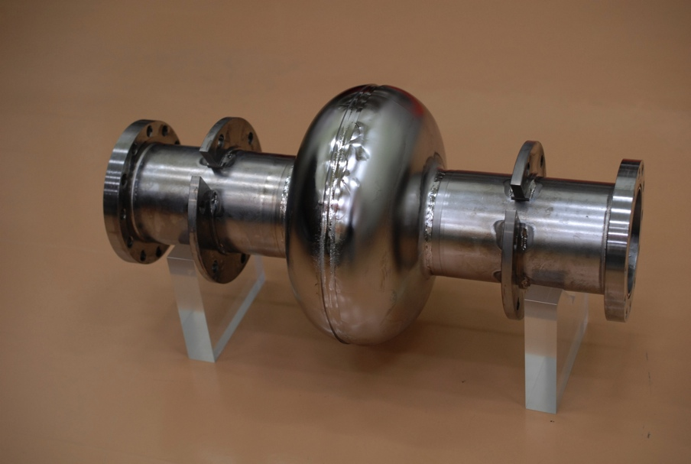
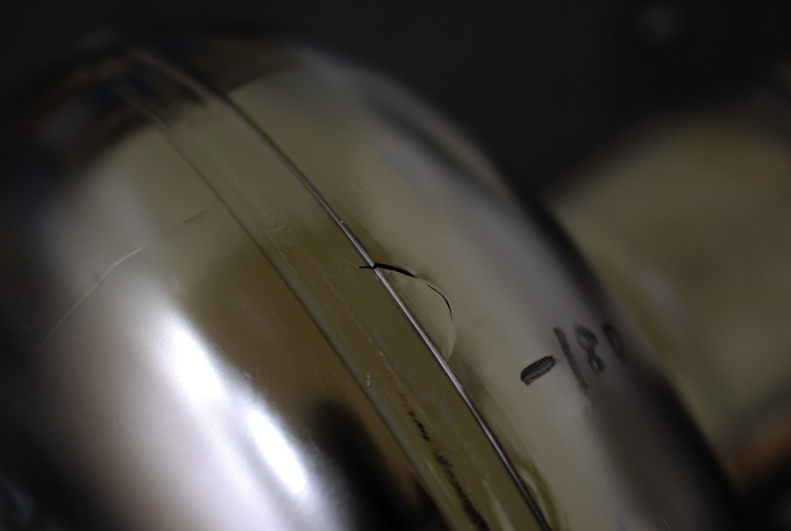
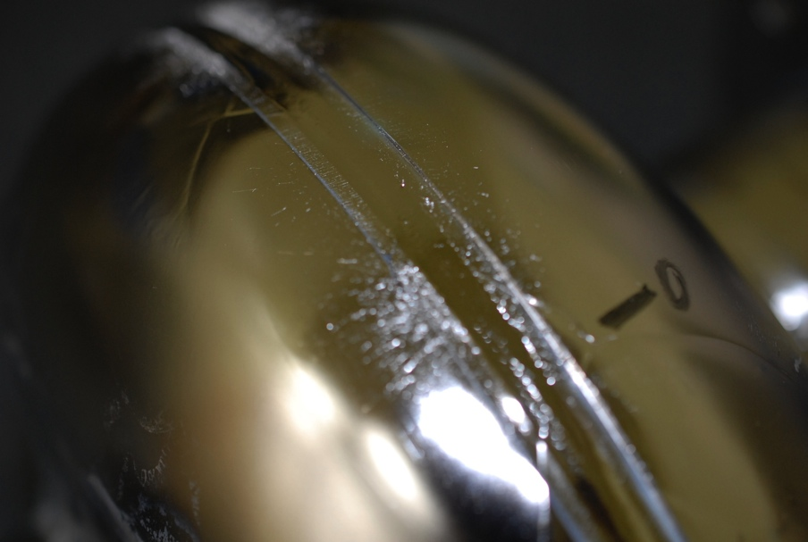
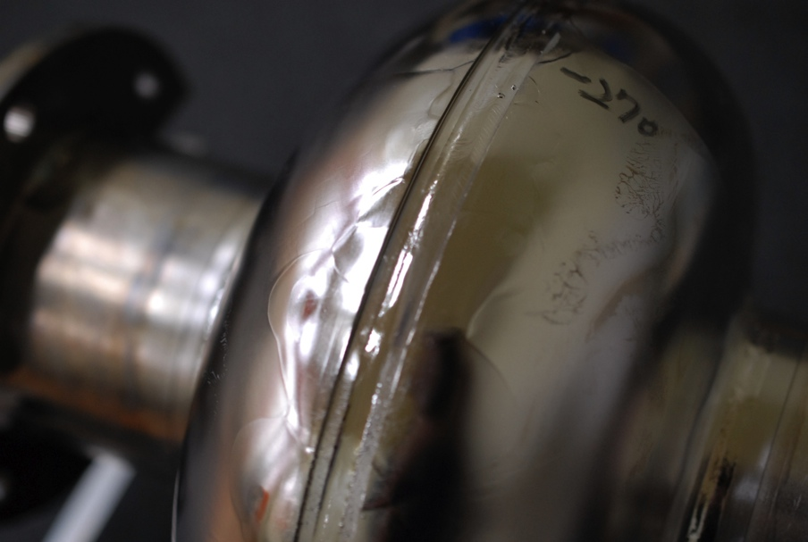
Single-Cell cavity Fabricated
Courtesy: M. Yamanaka
Crack
Sputter
Bead is not uniform
LG takes time to fabricate a cavity comparing with FG

Slide 28
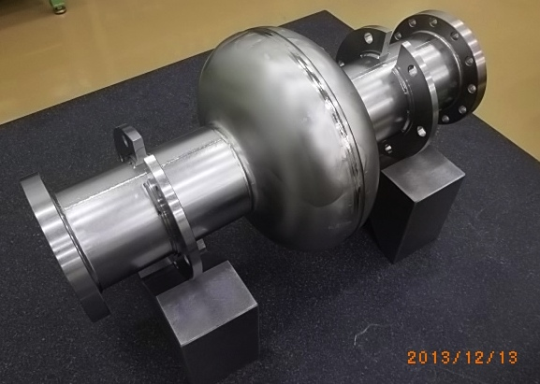
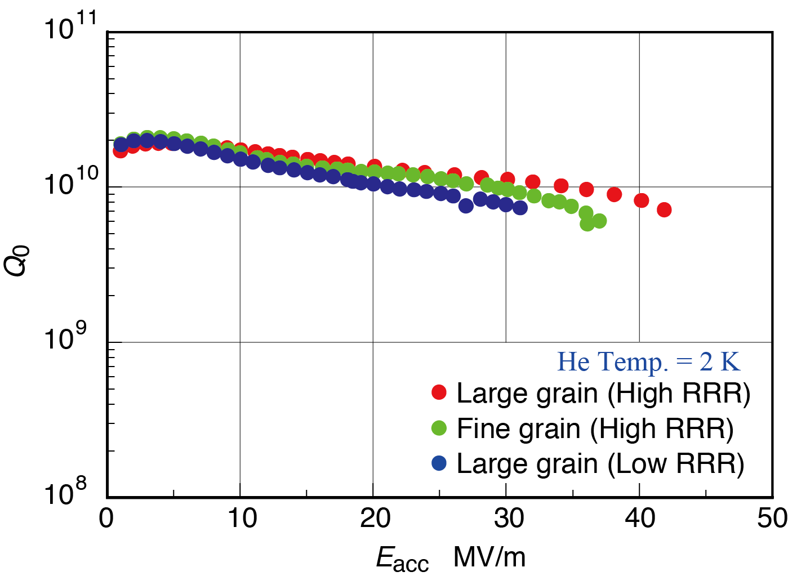
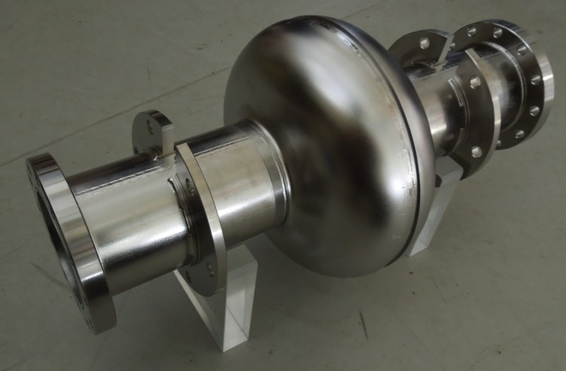
Comparisons with high RRR Nb
 | H | C | O | N | Fe | Si | Ta | RRR
LG (TD) | < 5 | < 10 | < 10 | < 10 | < 10 | < 10 | 80 | 390*
FG (TD) | < 10 | 40 | 100 | 40 | 20 | 20 | 700 | 258**
LG (CBMM) | < 10 | < 30 | < 30 | 10 | 3 | 20 | 1034 | 100*
Measurement RRR: * by KEK, ** by TD
Large grain (TD)
31
42
36
Fine grain (TD)
The effect of low RRR and high Ta not seen on Q0.

Slide 29
Progress and Comments
A single cell cavity using low RRR large grain niobium was fabricated and evaluated.
The maxim gradient reached 31 MV/m.
Multiple repairing/inspection and tests required to reach the high gradient. LG requires moretime in fabrication, compared with FG. . It causes higher cost.
Smaller grain size would be an important issue for mass production.
φ260×500 niobium ingot was provided by CBMM

Slide 30
Key Issues to be Settled
Fabrication of Nb sheets
  Size: 260 mm diameter, ~ 3 mm thick
  Quantity: ~ 18,000 x 20 = 360,000 disks (~1.2 kg/disk)
  Purity, Residual Resistance Ratio
    RRR: 150 ~ 200 to be investigated (currently > 300 )
  Mechanical uniformity
    Grain-size : to be optimized (with a level of thickness?)
    How it can be made with cost-effective process?
      Adding specific, controlled impurities, contolling environment?
Best cost effective solution anticipated
  Nb Ingot with medium grain-size to be optimized

Slide 31
Acknowledgments
I would thank CBMM (specially for Mr. R. Ribas, and Mr. G. Abdo) for their kindest cooperation for the R&D effort to seek for the most optimum properties for the ILC and furher applications.
I would thank Dr. G Myneni for his kindest guidance to realize the optimum Ingot-Nb material for future, various SRF applications.

