Slide 1

Overview of ERL MEIC
Cooler Design Studies
S.V. Benson, Y. Derbenev, D.R. Douglas, F. Hannon,
F. Marhauser, R. A Rimmer, C.D. Tennant, H. Zhang,
H. Wang, and Y. Zhang
October 6, 2015

Slide 2
Outline
Cooler specifications
Statement of the problem
Can we bend the beam?
Can we not bend the beam?
Where do we go from here?

Slide 3
Cooler Specifications
Energy 20-55 MeV
Charge 420 pC
Repetition rate 476(952) MHz
rms Bunch length 70 psec (24°)
rms emittance 30 mm-mrad
rms Energy spread (uncorr.)* 3x10⁻⁴
Energy spread (p-p corr.)* <2x10⁻³
Solenoid field 2 T
Solenoid length 30 m
Injector Magnetized!!

Slide 4
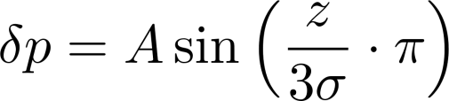
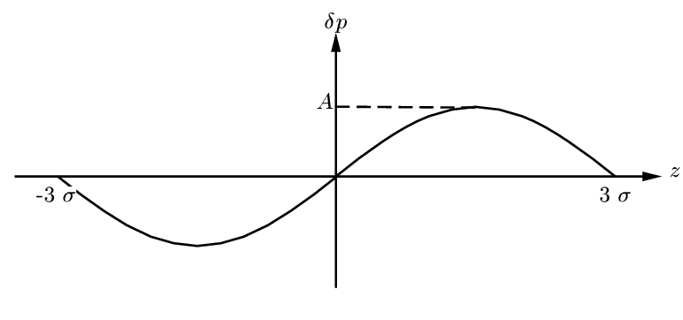
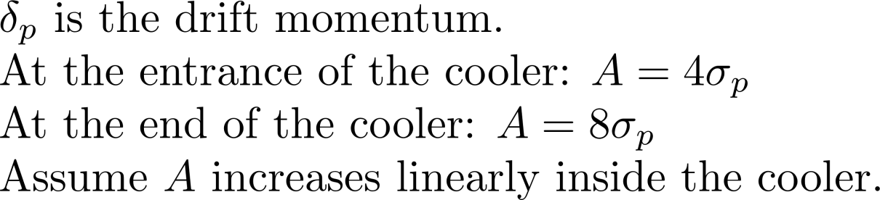
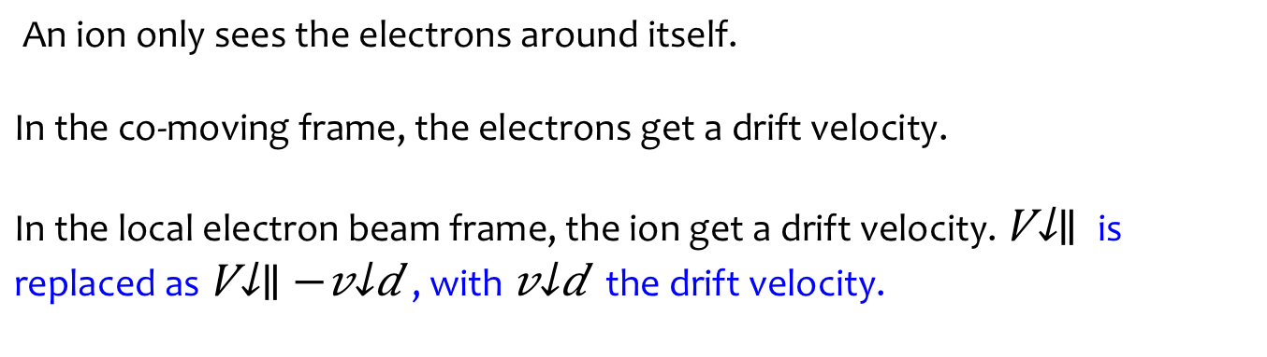
Model of the Correlated Electron Beam
An ion only sees the electrons around itself.
In the co-moving frame, the electrons get a drift velocity.
In the local electron beam frame, the ion get a drift velocity. $V_{∥}$ is replaced as $V_{∥}−v_{d}$, with $v_{d}$ the drift velocity.

Slide 5
Cooling Rate vs. Momentum Spread
Monte Carlo model.
Enough samples to make sure the result is stable till the third effective digit .
δ_{p} |  | Uncorrelated |  |  | Correlated
⁻⁴ | eV |  | R_{y} | R_{z} | R_{x}(×10⁻³) | R_{y}(×10⁻³) | R_{z}(×10⁻²)
1 | 0.0051 | 1.59 | 1.59 | 1.66 | 1.53 | 1.53 | 1.22
2 | 0.0204 | 1.54 | 1.54 | 1.50 | 1.33 | 1.33 | 0.66
3 | 0.0460 | 1.48 | 1.48 | 1.34 | 1.14 | 1.14 | 0.39
4 | 0.0818 | 1.41 | 1.41 | 1.19 | 0.99 | 0.99 | 0.25
5 | 0.1278 | 1.34 | 1.34 | 1.06 | 0.87 | 0.87 | 0.17
Cooling rate is severely reduced, especially in the longitudinal direction.

Slide 6
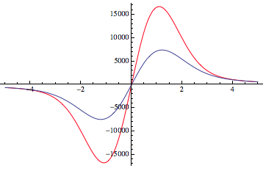
LSC-induced Energy Change Accumulated in the Linac (8m) and the Following Matching Section (4m)
parameters
Drift Length
Here is an under-estimated result:

Slide 7
So What is So Hard about This?
Have to run very high current (200 mA)
  Must have energy recovery or cost is too high
  Need SRF cavities (at least in the linac)
  No magnetic fields in the linac cavities.
The current varies with position in the micro-bunch so space charge forces vary and cannot be perfectly compensated.
Any realistic design must bend the beam with discreet magnet elements.
No micro-pulsed high current source has been demonstrated
Bunch is very long in the cooler solenoid.

Slide 8
Architecture: Traditional ERL
Same-cell energy recovery in SRF cavities
Dechirper and chirper before and after solenoid
Bends
Possible R2F/F2R with space charge
Dump energy

Slide 9
Can We Bend the Beam?
We can transport beams and keep them “calm” if we use solenoids to focus and n=1/2 dipoles to bend the beam. This is all for a DC beam. What about for a pulsed beam?

Slide 10
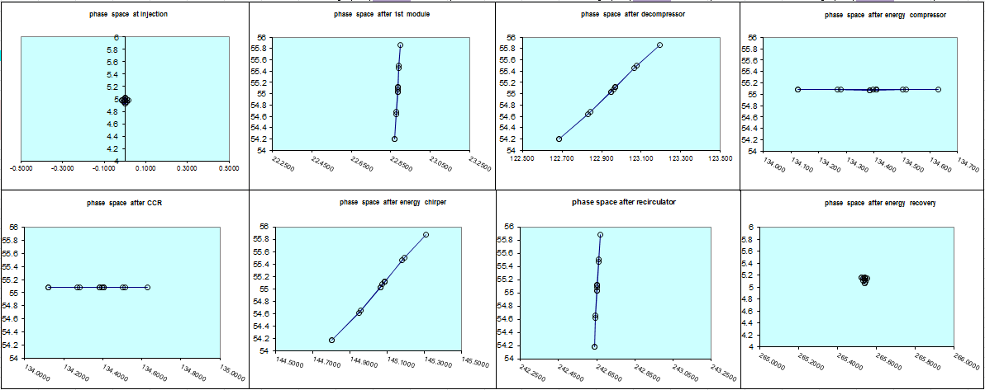
Longitudinal Match
Accelerate off-crest, decompress, energy compress → cooling channel
(courtesy D. Douglas)

Slide 11
Lattice for Study
Schematic of modules for the round beam
linac
180° arc
solenoid
Match from linac to arc
Match from arc to solenoid

Slide 12
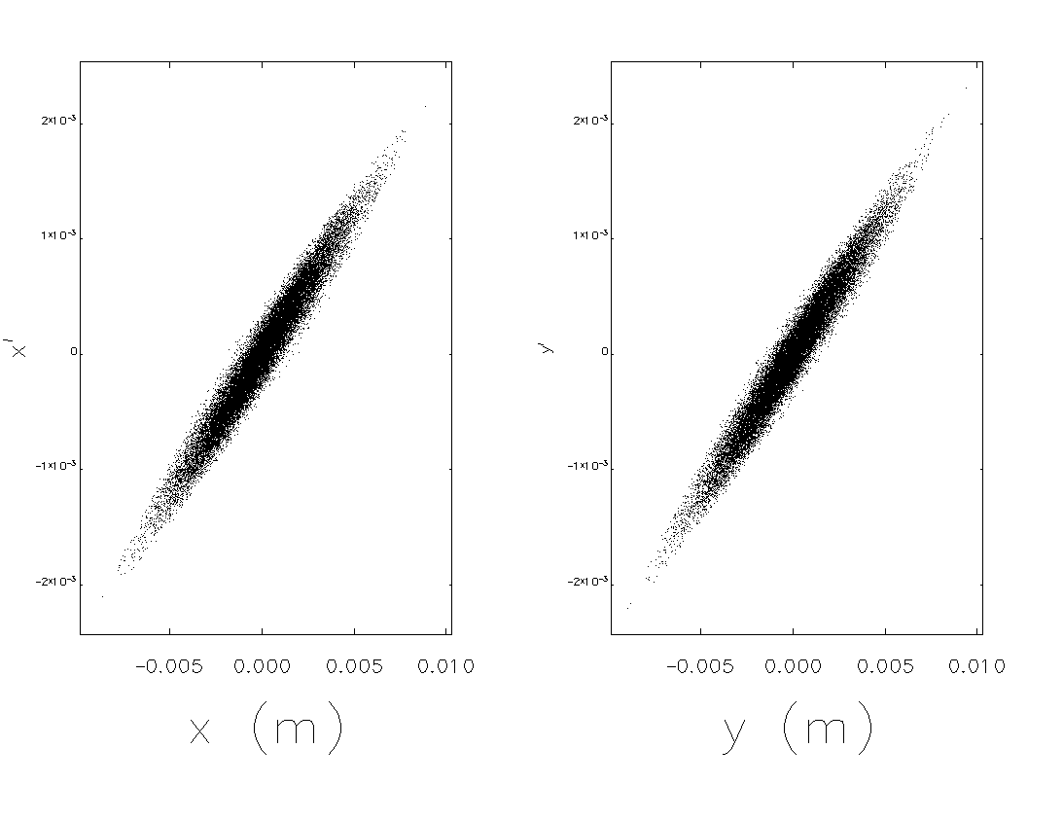
Linac Exit: Round Beam
Modeled in TStep with space charge effects (420 pC)
  Acceleration 20° before crest
Input transverse match: β_{x=y} = 6.0 m, α_{x=y} = -2.0
β_{x} = 17.57 m
α_{x} = -4.33
ε_{x} = 30.3 mm-mrad
β_{x} = 17.60 m
α_{x} = -4.34
ε_{x} = 30.3 mm-mrad

Slide 13
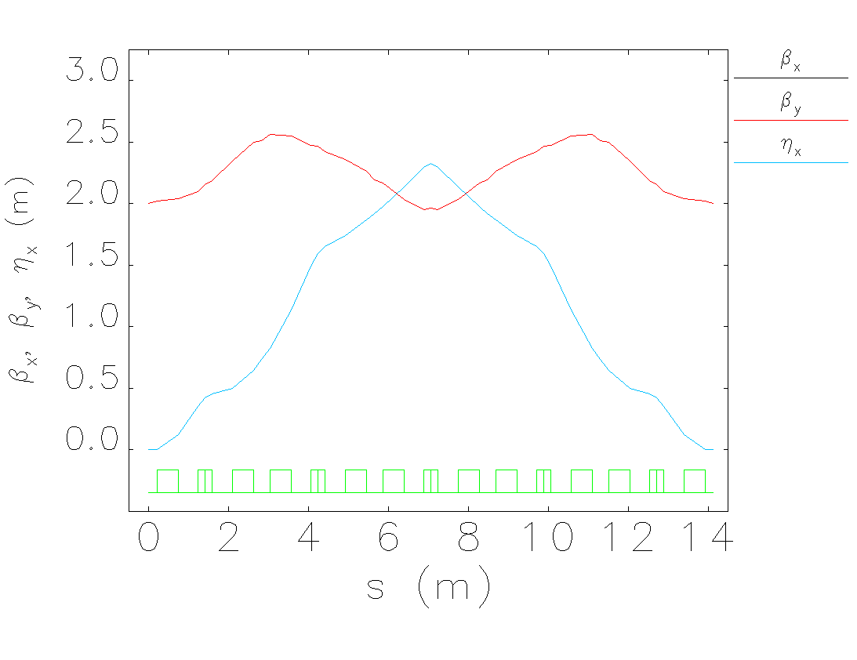
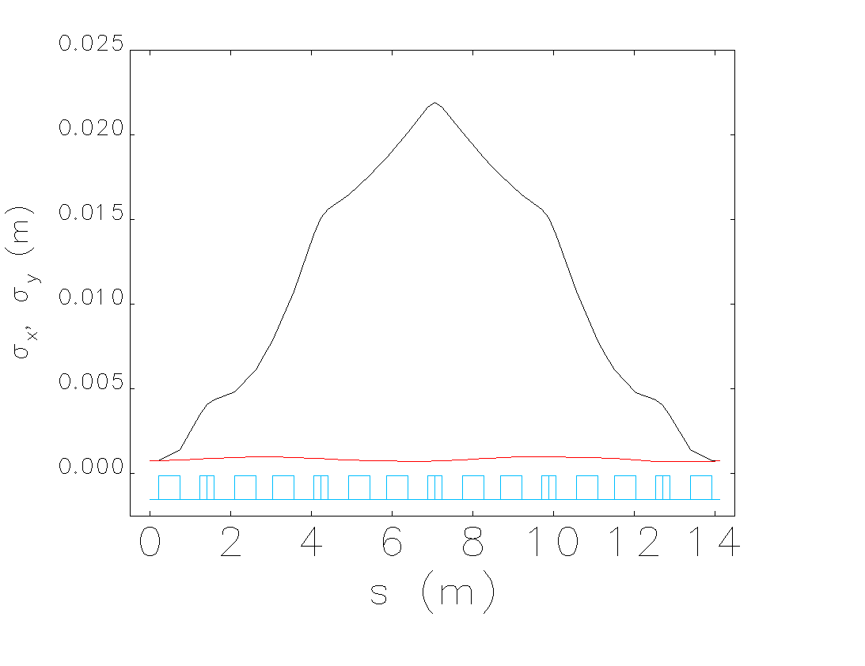
Recirculation Arc
Utilize indexed dipoles to provide azimuthally symmetric focusing
Three bend achromats with reversed center bend to increase the focusing per unit bending
5th-integer (tune of 0.2) in both planes
(design by D. Douglas)

Slide 14
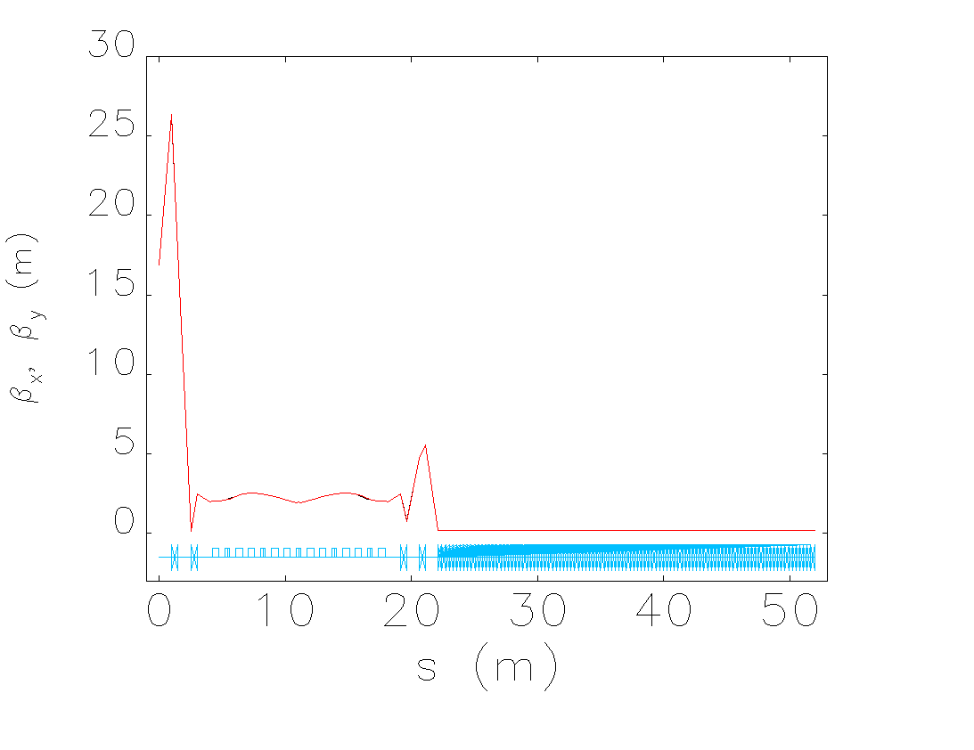
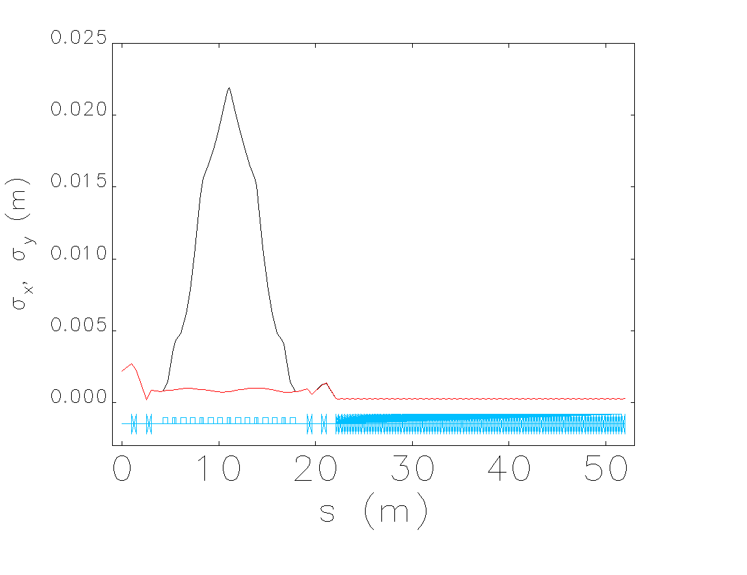
Lattice
From the exit of the linac to the exit of a 30 m solenoid (B=2T)

Slide 15
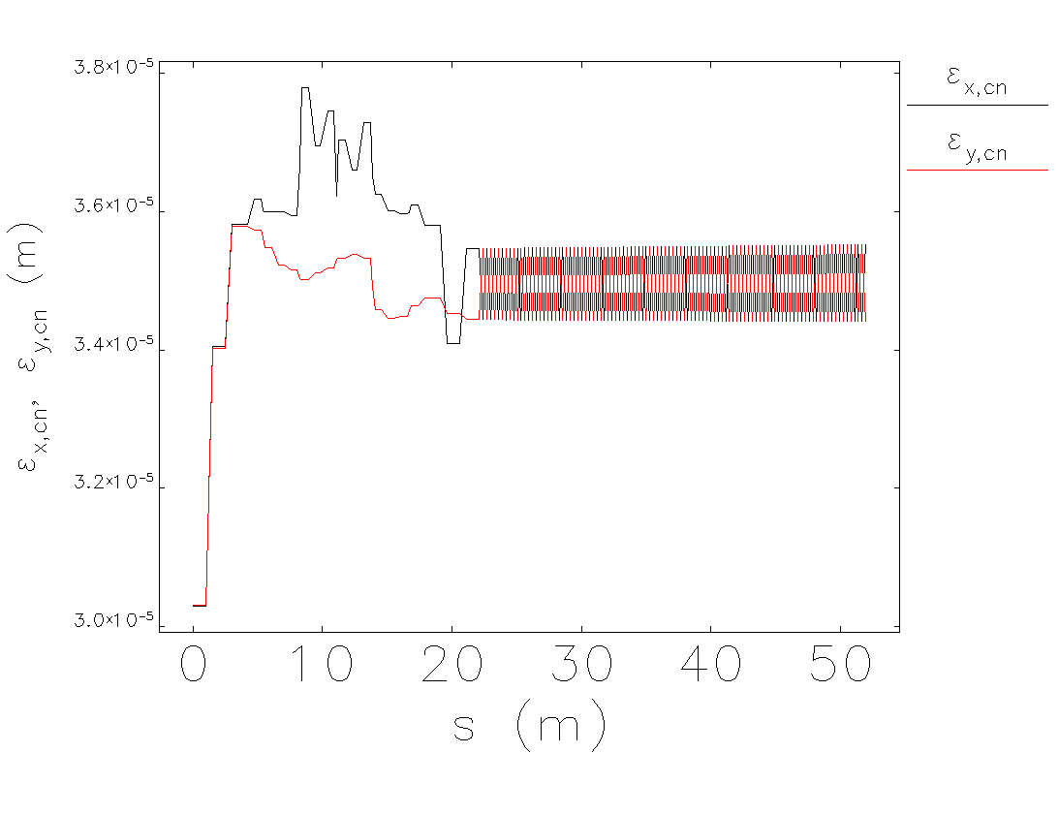
Lattice: Emittance Evolution

Slide 16
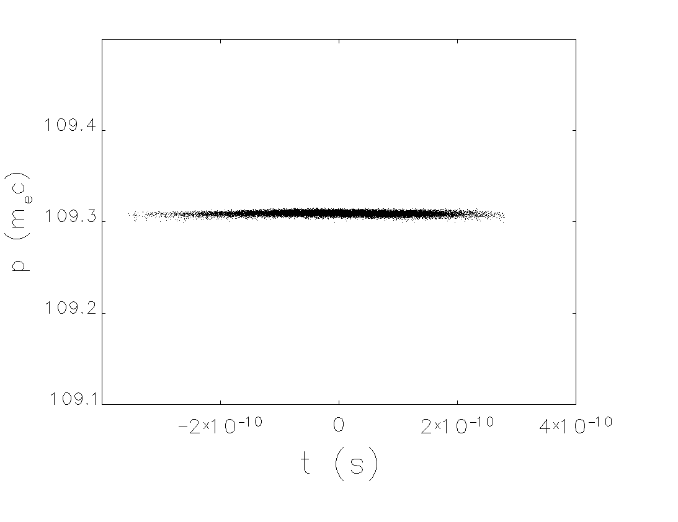
Lattice: (t,p) Phase Space
Longitudinal phase space at entrance to cooling solenoid
  Note: energy spread actually order of magnitude smaller than spec

Slide 17
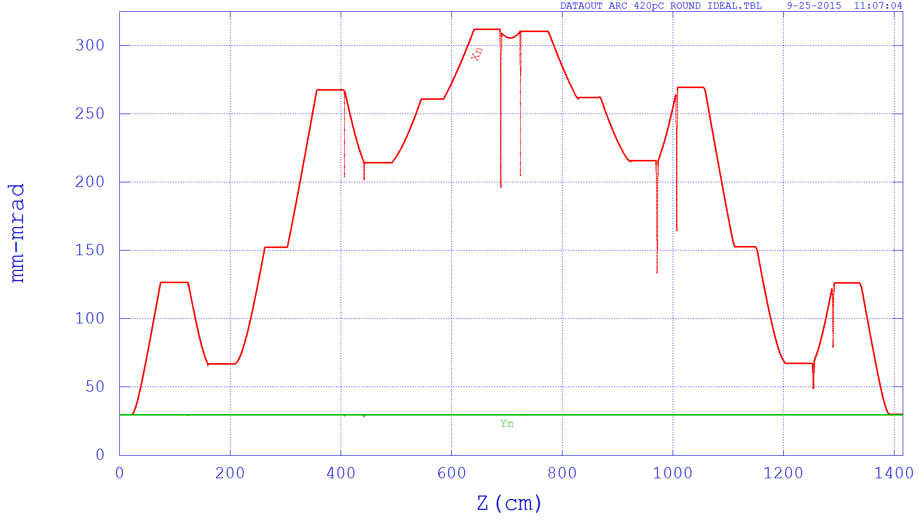
TStep Output
Normalized emittance of an ideal, round beam through a 180 deg. arc with 420 pC (space charge on)

Slide 18
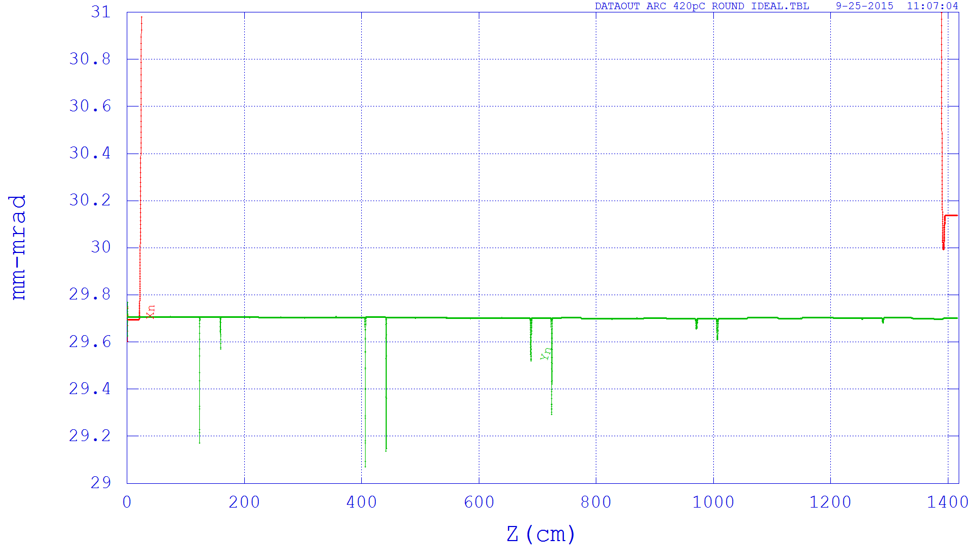
TStep Output
Zoomed in
Normalized emittance of an ideal, round beam through a 180 deg. arc with 420 pC (space charge on)

Slide 19
But We Have Cheated
Elegant simulations have no space charge.
Tstep Started with ideal distribution.
The de-chirper was just a mathematical construct rather than a real RF cavity.
Have not demonstrated cathode to cooler transport

Slide 20
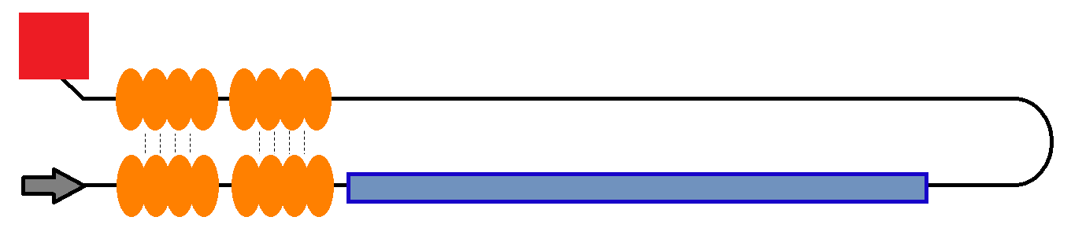
Architecture: Linac to Linac ER
No merger
Up and down are linked in the same way as traditional ERL
Bend happens after the cooling solenoid
May need bends for bunch stretcher
Cavity phasing and positioning important

Slide 21
Possible Dual Axis Design

Slide 22
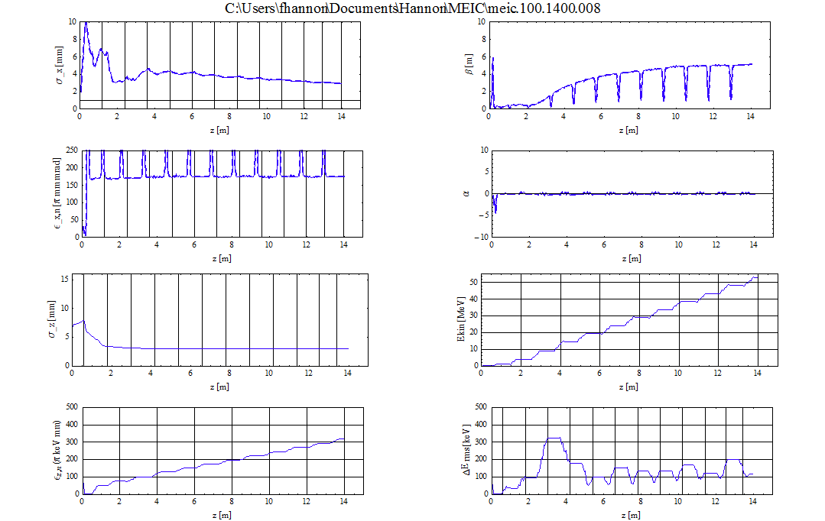
Linac to Linac ER
Solenoids

Slide 23
Where Do We Go From Here?
Need Gun Design (see Riad Suleiman’s talk)
Need to understand how arbitrary bunch profile causes emittance growth.
Need Merger Design for traditional ERL layout.
Down select single cell or dual cell architecture
Need to incorporate realistic de-chirper and chirper
Consider non-linear effects (see Rui Li’s talk)
Do Start to End (cathode to dump)
Look at lower energy

Slide 24
Conclusions
We now have a longitudinal solution for 952 MHz acceleration.
We can bend an ideal magnetized beam 180° without transverse emittance growth.
With no space charge the longitudinal emittance looks good.
Still lots of work to do!

Slide 25
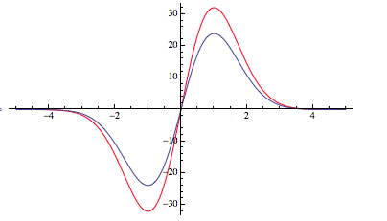
LSC-induced Energy Change accumulated in the Cooling Channel
parameters
Drift Length

