Slide 1
ODU Activities on Crabbing/Deflecting Cavities
MEIC Collaboration
JLab, 5-7 October 2015

Slide 2
Cast of Characters
Subashini De Silva
  PhD ODU 2014 : “Investigation and optimization of a new compact superconducting cavity for deflecting and crabbing applications” (2015 IEEE PAST Award, 2015 ODU College of Science Lee Entsminger Outstanding PhD Dissertation Award)
  Post-doc at ODU
  RF separator for 12 GeV upgrade
  Crabbing system for LHC High Luminosity Upgrade
Alejandro Castilla
  PhD ODU later this year, now at CERN
  Crabbing system for electron-ion colliders (first place at JLab Users Annual Meeting student poster competition)
HyeKyoung Park
  JLab Engineer and ODU PhD Physics Student
  Superconducting RF separator for 12 GeV upgrade
  Crabbing system for LHC High Luminosity Upgrade
Rocio Olave
  ODU Post-doc, now part-time

Slide 3
Sources of Support for deflecting/crabbing cavities
JLAB
  RF separator for 12 GeV upgrade (ARRA $2.7M, completed)
ODU
  4 Phase I STTRs with Niowave Inc ($50k each, completed, DOE NP and HEP)
    Development of a 499 MHz Superconducting RF Deflecting Cavity
    Development of a 400 MHz Superconducting RF Crabbing Cavity
    Development of an SRF Deflecting/Crabbing System for Fermilab’s Project X
    Development of an SRF Crabbing Cavity for an Electron-Ion Collider
  2 Phase II STTRs with Niowave Inc ($375k each, completed, DOE NP and HEP)
    Development of a 400 MHz Superconducting RF Crabbing Cavity
    Development of an SRF Crabbing Cavity for an Electron-Ion Collider
  Spreader for LCLS II
    SLAC, $54k
  Development of a crabbing system for the LHC High-Luminosity upgrade
    Ongoing since 2010
    DOE HEP LARP, $709k to date, $250k for FY16
  1 Phase I/II SBIR with Niowave Inc, (DOE HEP, $550k, just starting)
    Development of HOM couplers for the LHC superconducting crab cavities

Slide 4
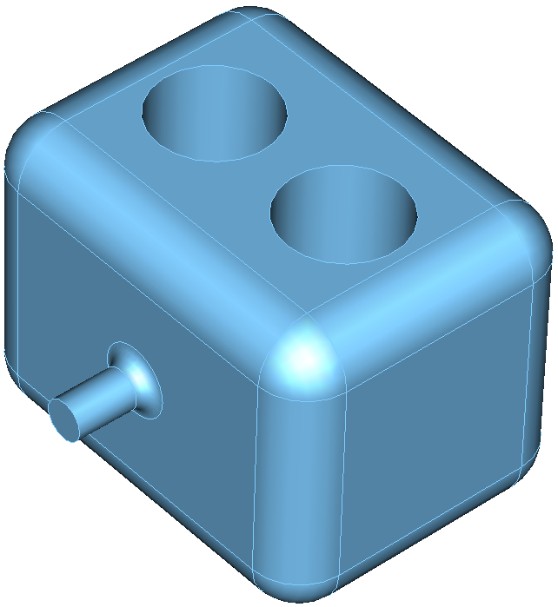
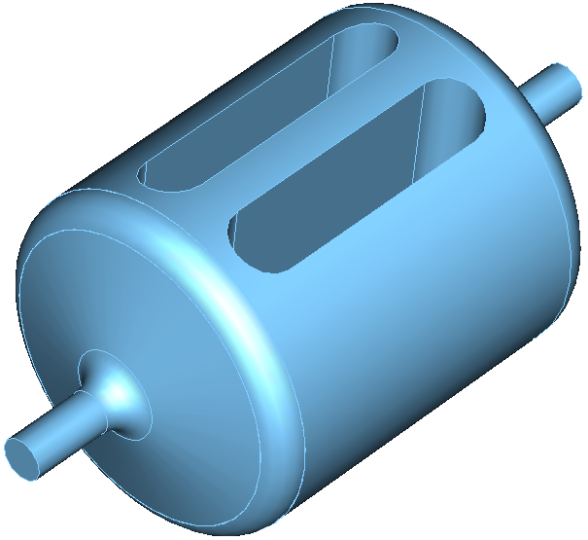
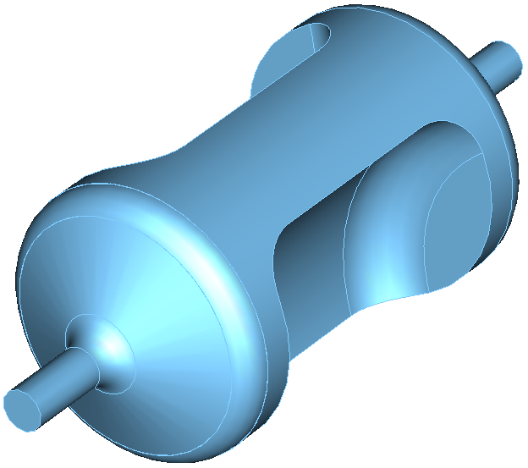
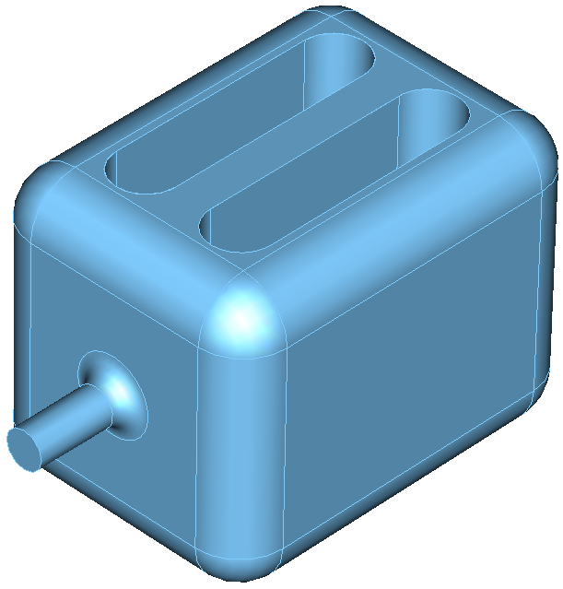
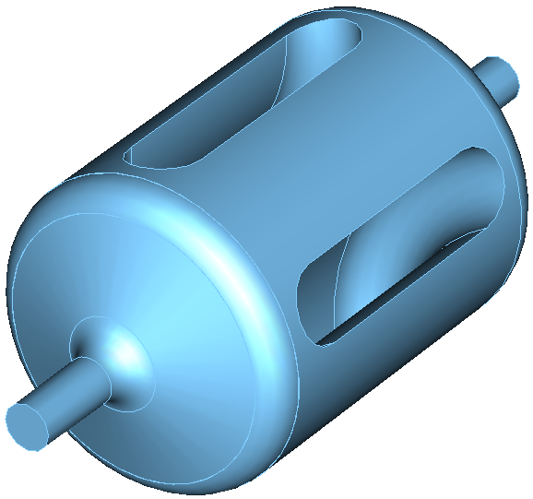
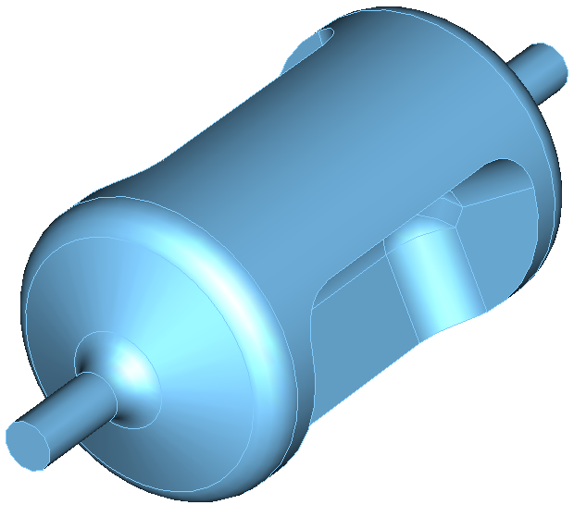
Evolution: From Parallel-bar to RF Dipole Cavity
Aspects of optimization
  Lower and balanced peak surface fields
  Stability of the design
    Cylindrical shape is preferred to reduce flat surfaces
  Cavity processing
    Curved end plates for cleaning the cavity
  Wider separation in Higher Order Mode (HOM) spectrum
  Multipacting
S. U De Silva and J. R. Delayen, “Design evolution and properties of superconducting parallel-bar rf-dipole deflecting and crabbing cavities, PRSTAB 16, 012004 (2013)
S. U. De Silva, PhD thesis, ODU 2014

Slide 5
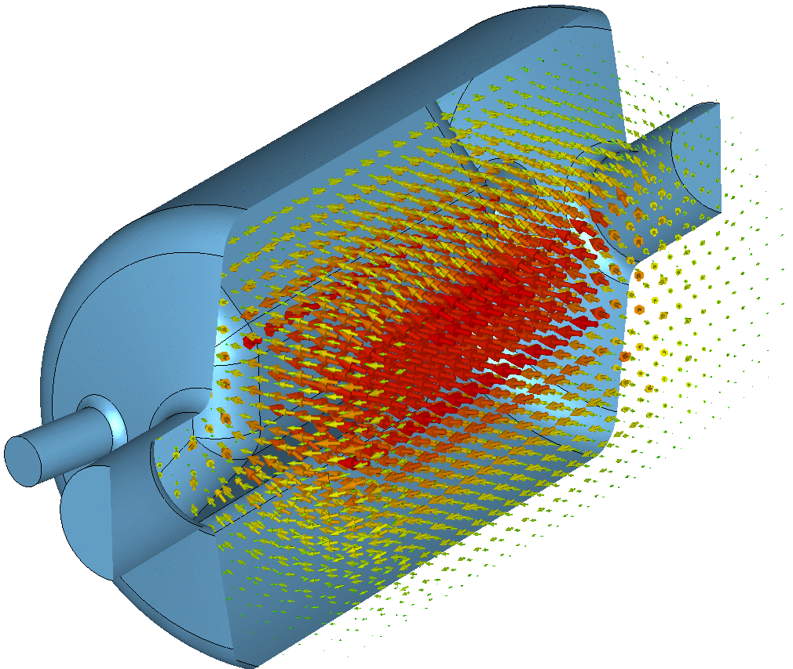
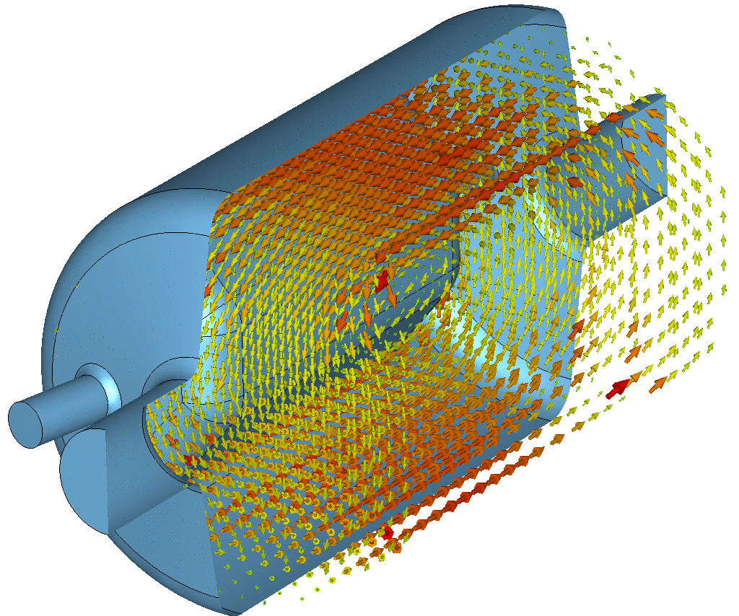
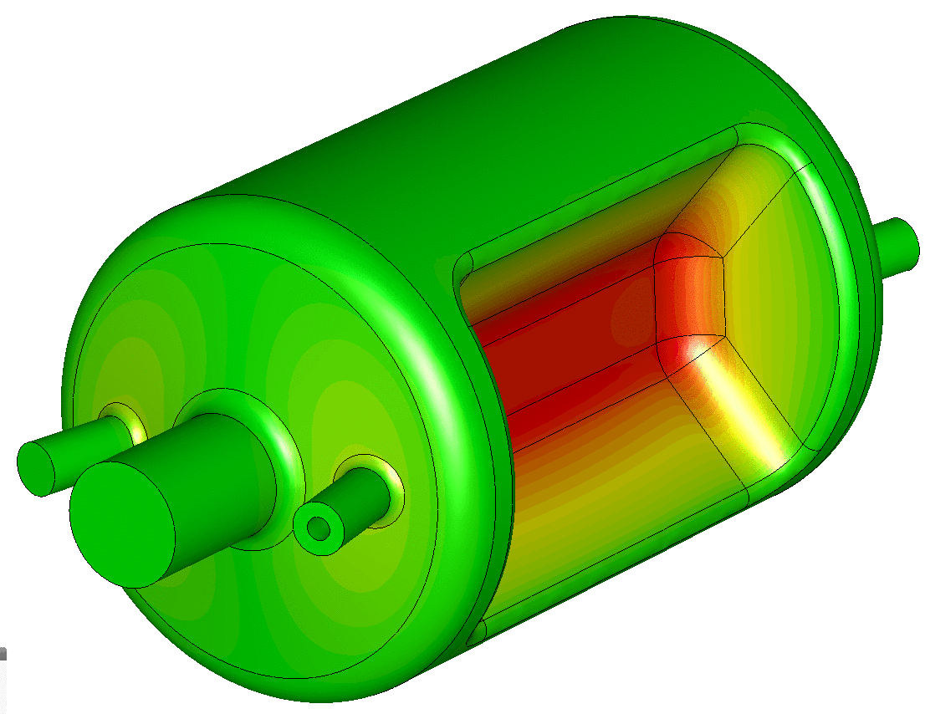
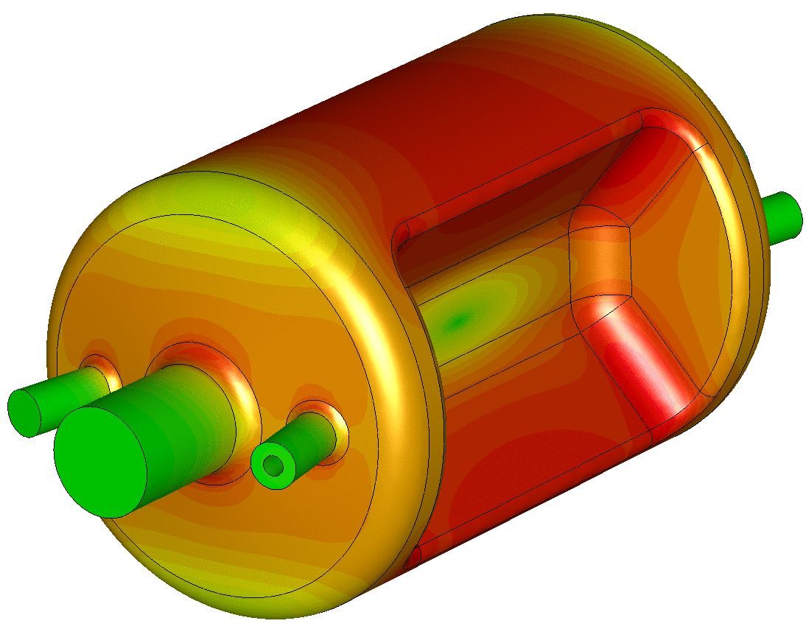
RF Field Profile of RF Dipole Cavity
B Field
E Field
Surface E Field
Surface B Field

Slide 6
RF Dipole Cavity Properties
Compact design
  Supports low frequencies
Fundamental deflecting/crabbing mode has the lowest frequency
  No LOMs, no need for notch filter in HOM coupler
  Nearest HOM widely separated ( ~ 1.5 fundamental)
Low surface fields and high shunt impedance
Good balance between peak surface electric and magnetic field
Good uniformity of deflecting field due to high degree symmetry
Many degrees of freedom to tailor design to application

Slide 7
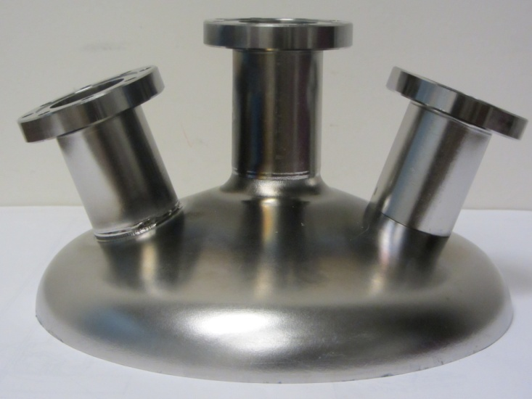
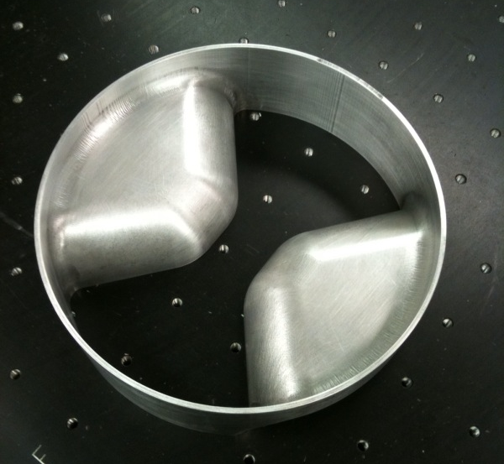
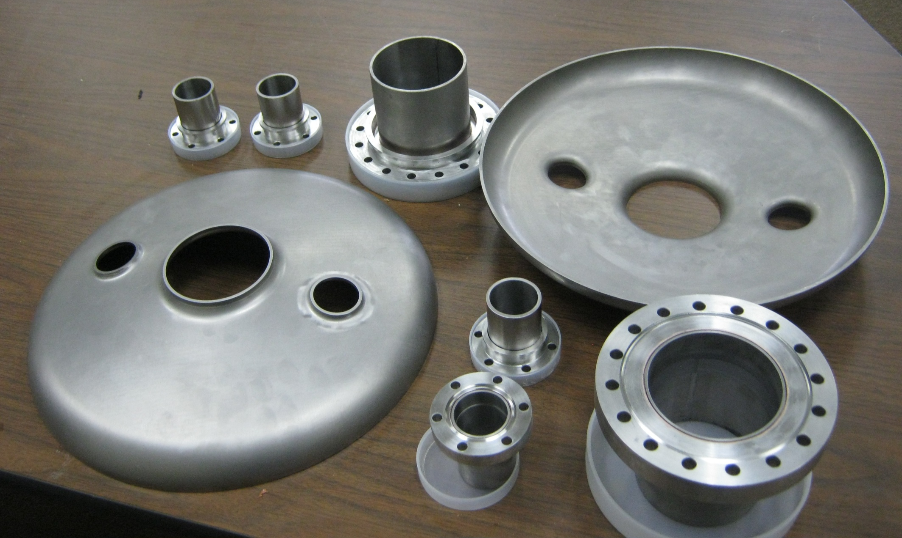
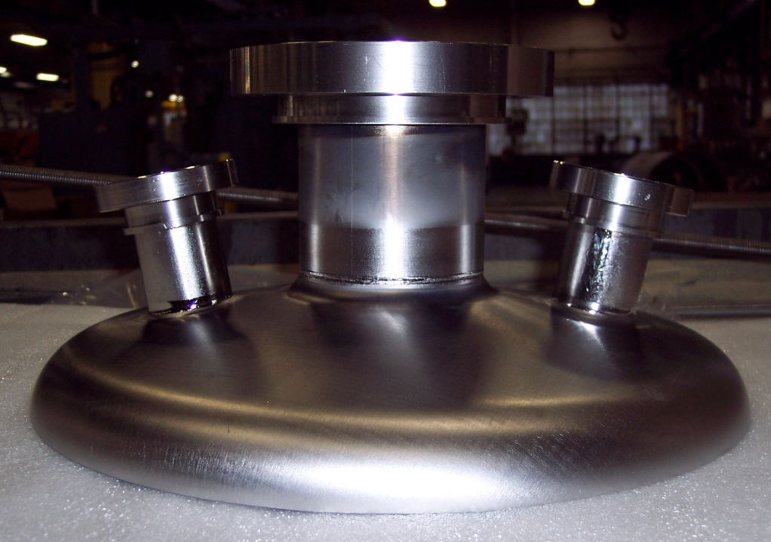
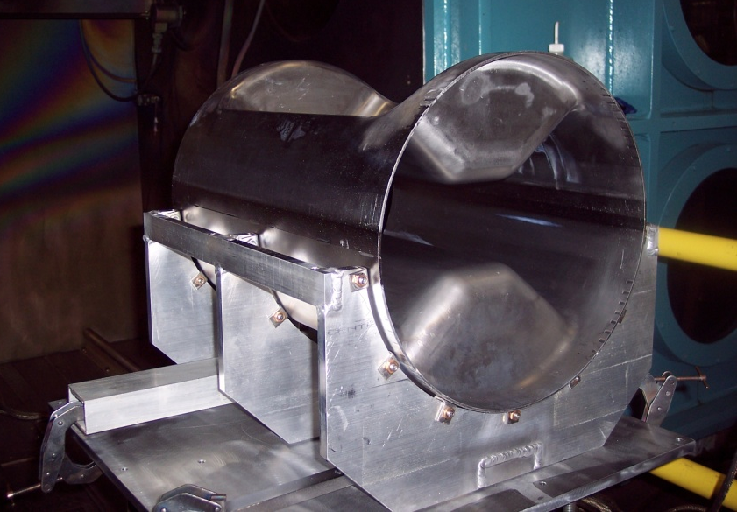
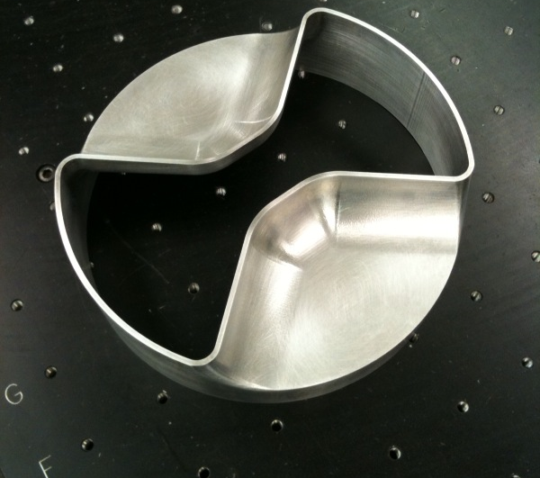
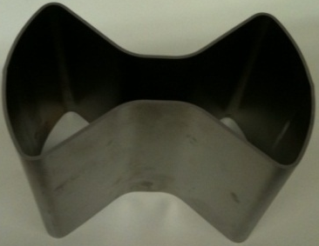
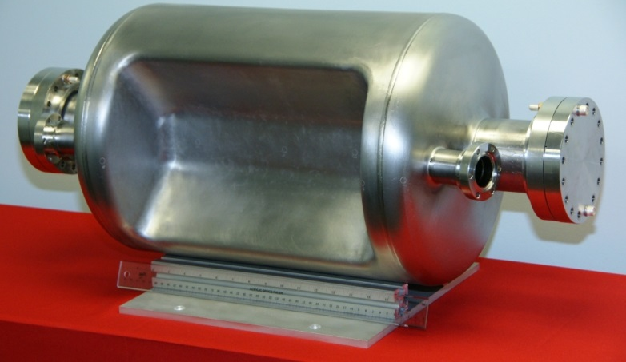
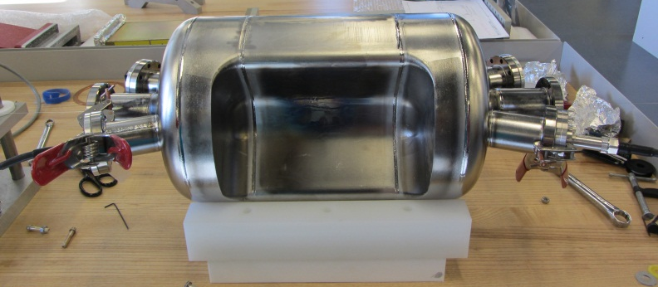
Fabrication
499 MHz Deflecting Cavity
Fabricated at Jefferson Lab
400 MHz Crabbing Cavity
Fabricated at Niowave Inc.

Slide 8

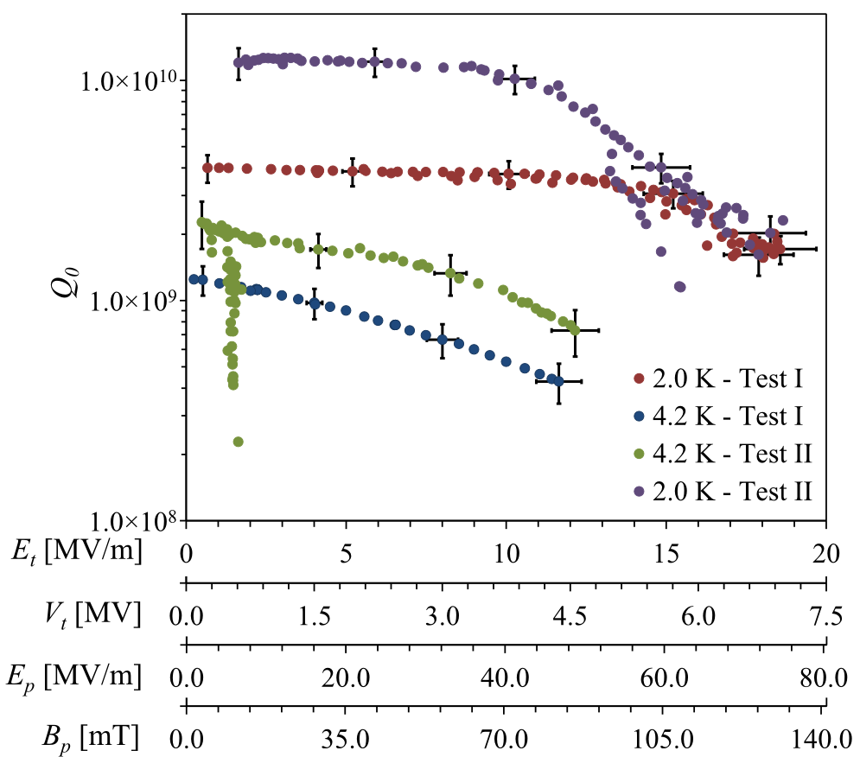
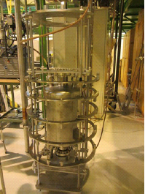
400 MHz Proof-of-Principle Cavity Test
Cavity reached a V_{T} of 7.0 MV
Test II →
  Cavity was retested with Nb coated flanges provided by CERN
  Q₀ increased by a factor of 3 from 4×10⁹ to 1.2×10¹⁰
Multipacting was processed easily and did not reoccur
Results were confirmed by CERN
3.4 MV
5.0 MV

Slide 9
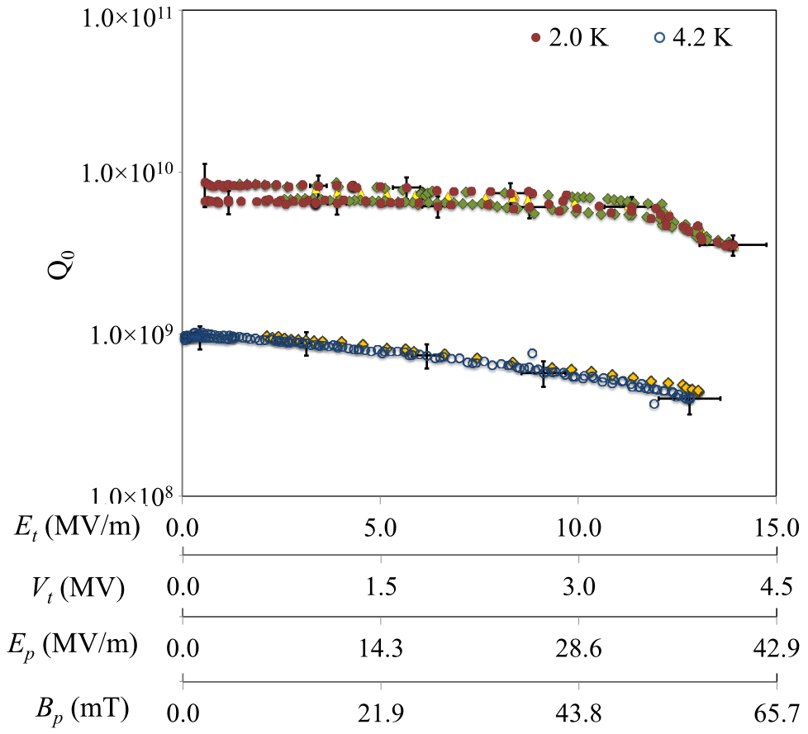
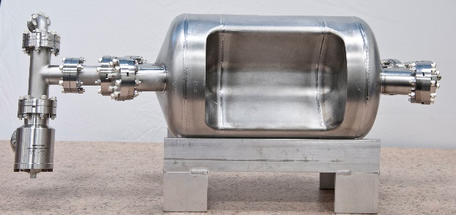
499 MHz Deflecting Cavity
Frequency | 499.0 | MHz
Aperture Diameter (d) | 40.0 | mm
Nearest HOM | 777.0 | MHz
E_{p}* | 2.86 | MV/m
B_{p}* | 4.38 | mT
B_{p}*/E_{p}* | 1.53 | mT/ (MV/m)
[R/Q]_{T} | 982.5 | Ω
Geometrical Factor (G) | 105.9 | Ω
R_{T}R_{S} | 1.0×10⁵ | Ω²
At E_{T}* = 1 MV/m
Quench
3.3
4.2

Slide 10
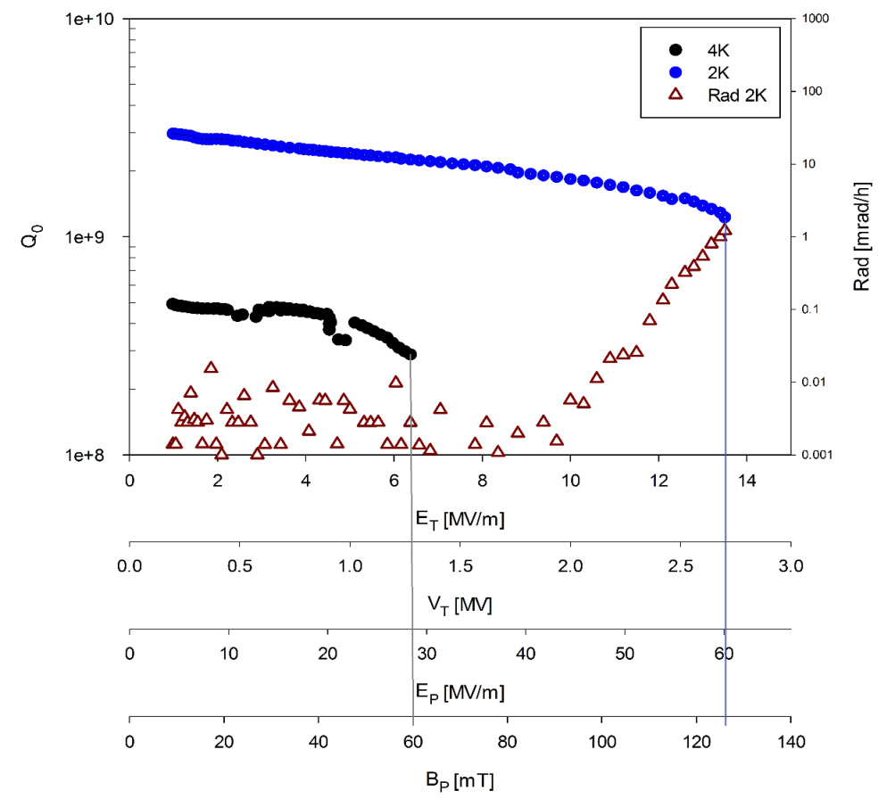
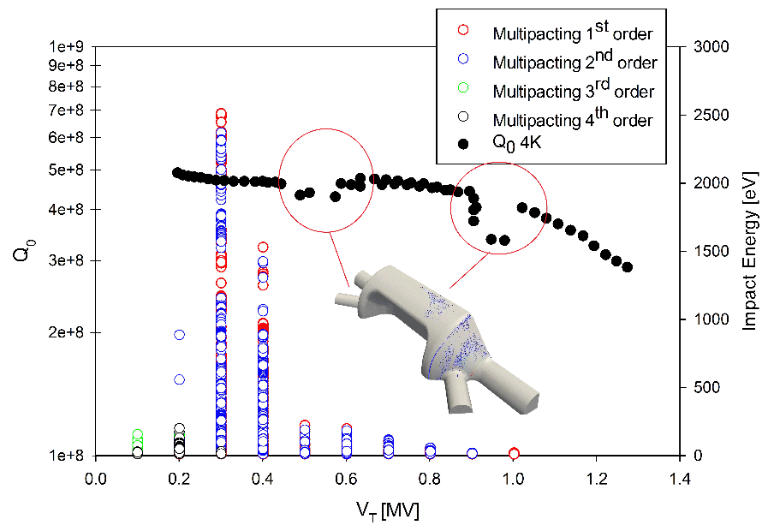
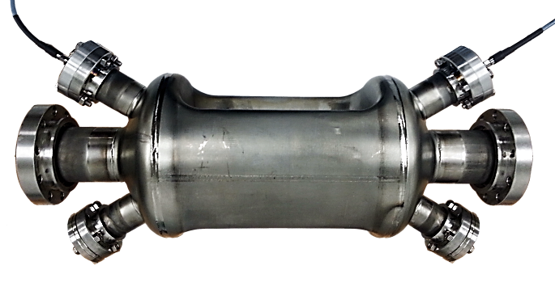
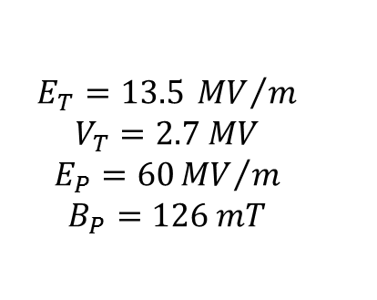
750 MHz Crabbing Cavity
Multipacting
Cryogenic Tests
$$E_{T}=13.5 {MV}/m$$
$$V_{T}=2.7 MV$$
$$E_{P}=60{MV}/m$$
$$B_{P}=126 mT$$

Slide 11
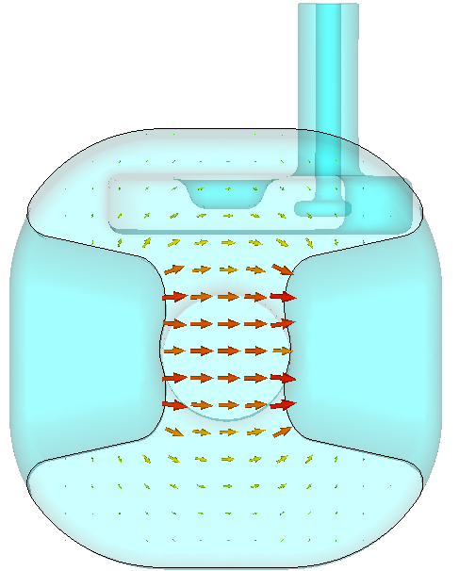
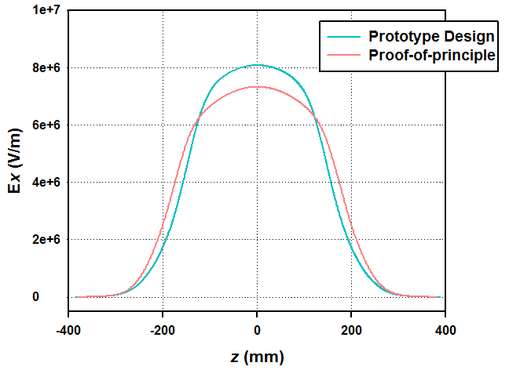
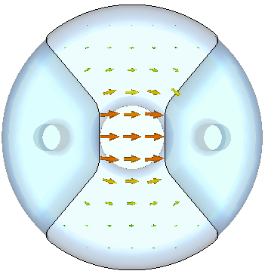
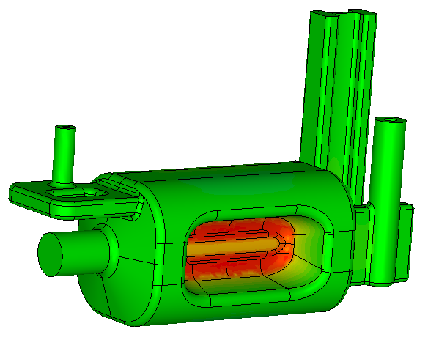
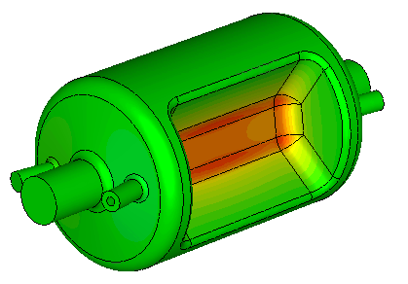
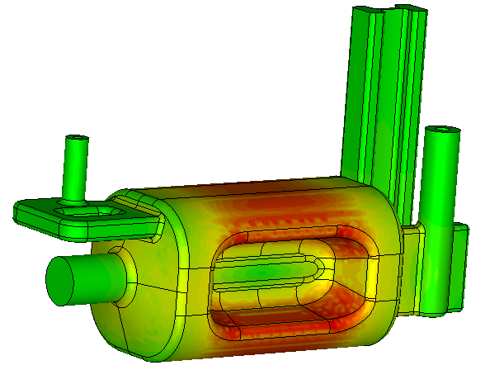
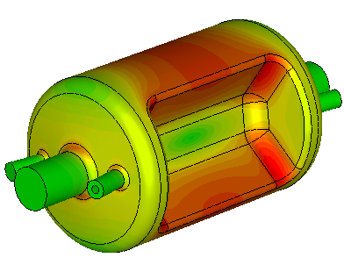
Prototype Design vs. Proof-of-Principle
Transverse
Electric Field
* At energy content of 1 J
Surface Electric Field
Surface Magnetic Field

Slide 12
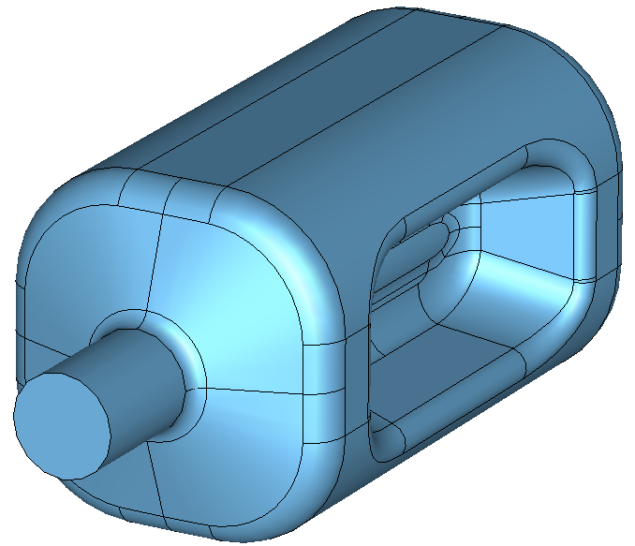
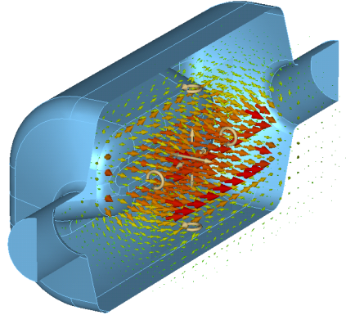
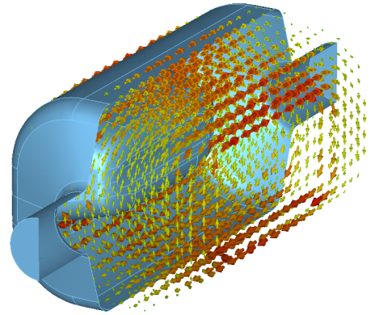
Prototype RF Dipole Design
Prototype design has improved rf-properties
Parameters | Prototype | P-o-P | Units
Frequency of fundamental | 400 | 400 | MHz
Frequency of 1st HOM | 632 | 590 | MHz
Deflecting Voltage (V_{T}*) | 0.375 | 0.375 | MV
Peak Electric Field (E_{p}*) | 3.65 | 4.02 | MV/m
Peak Magnetic Field (B_{p}*) | 6.22 | 7.06 | mT
Peak Electric Field (E_{p}**) | 32.6 | 35.9 | MV/m
Peak Magnetic Field (B_{p}**) | 55.6 | 63.1 | mT
B_{p}/E_{p} | 1.71 | 1.76 | mT/(MV/m)
Stored Energy (U*) | 0.13 | 0.195 | J
[R/Q]_{T} | 427.4 | 287.0 | Ω
Geometrical Factor (G) | 106.7 | 140.9 | Ω
R_{T}R_{S} | 4.6×10⁴ | 4.0×10⁴ | Ω²
*At E_{T} = 1 MV/m ** At V_{T} = 3.35 MV
28.1 cm
54 cm
E Field
B Field

Slide 13
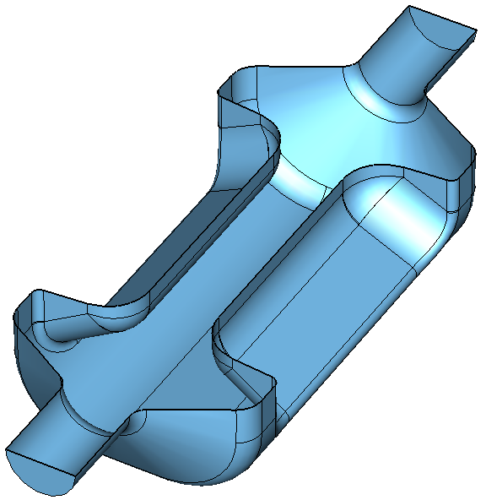
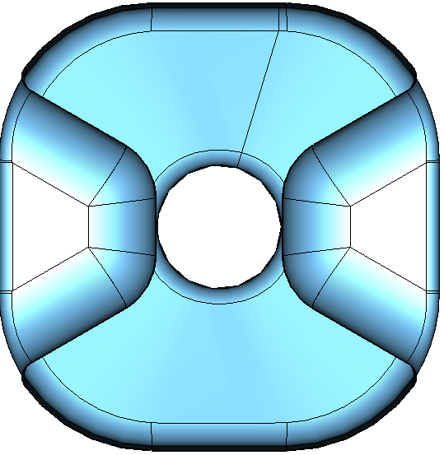
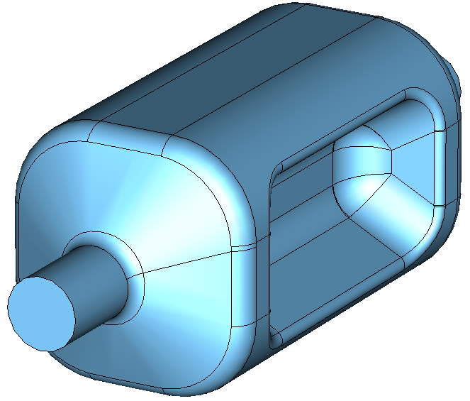
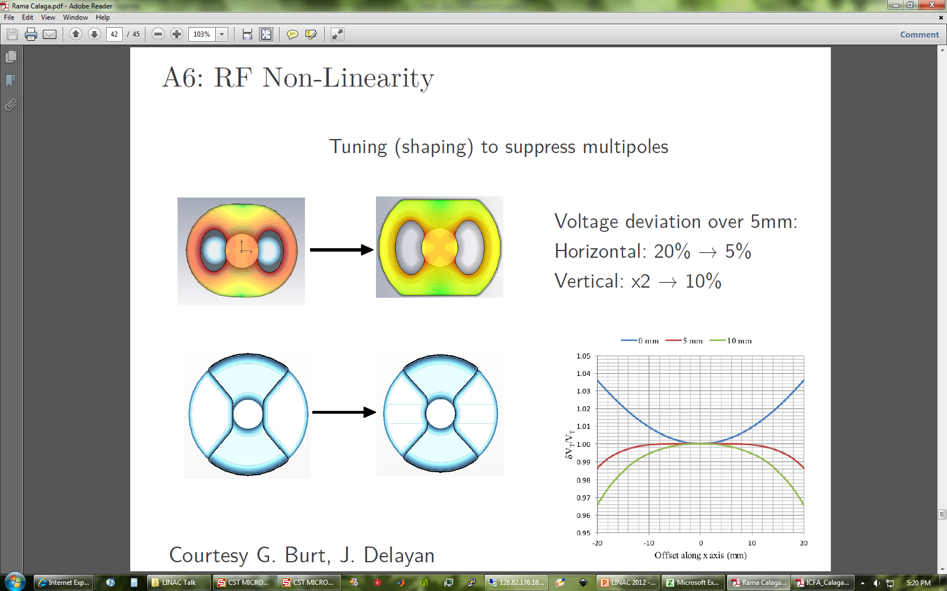
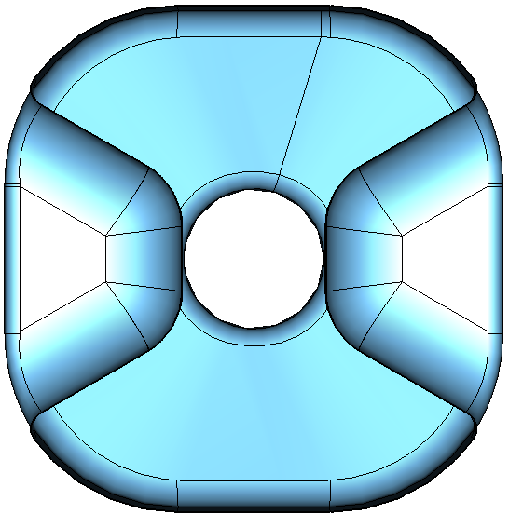
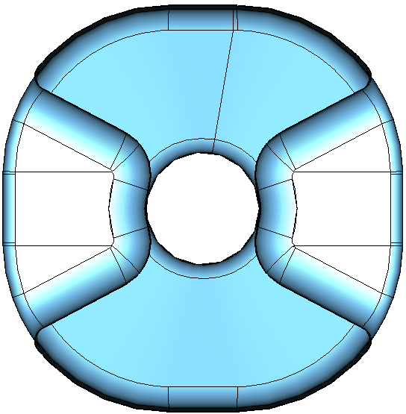
RF-Dipole Square Cavity Options
Square-type rf-dipole cavity to further reduce the transverse dimensions
  Frequency is adjusted by curving radius of the edges
RF-dipole cavity with modified curved loading elements across the beam aperture to reduce field non-uniformity
Voltage deviation at 20 mm
  Horizontal: 5.0% → 0.2%
  Vertical: 5.5% → 2.4%
400 MHz Crabbing Cavity
(A)
y
Height and Width
< 145 mm
(B)
x

Slide 14
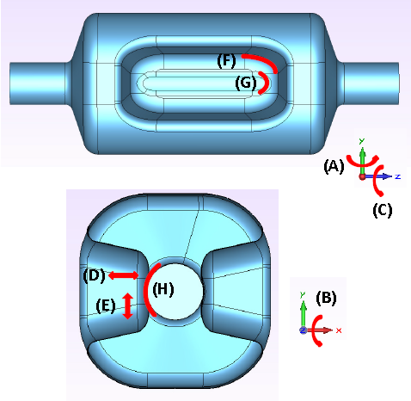
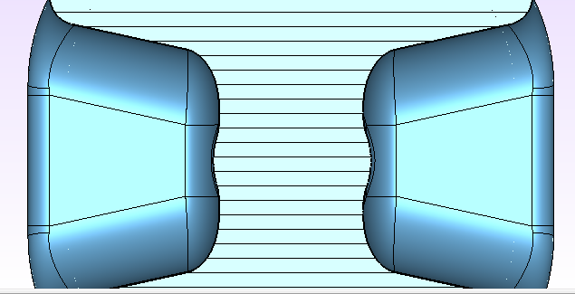
Prototype RF Dipole Design
Multipole analysis
Small individual imperfections (~1 mm) have negligible effects on the multipole components, but may shift the electrical center and operating frequency.
(A) Yaw (rotation about y-axis) of one pole.
(B) Pitch (rotation about x-axis) of one pole.
(C) Roll (rotation about z-axis) of one pole.
(D) Horizontal displacement of one pole.
(E) Vertical displacement of one pole.
(F) Blending radius along depth of one pole.
(G) Blending radius of the feather-like structure near the beam line of one pole.
(H) Aperture radius in one pole.
(I) Blending radius at the outer corner of one pole
(J) Width of pole (uneven) at beamline
(K) Width of pole (uneven) at outer conductor
(L) Aperture displacement at beamline
(I)
(J)
(K)
(L)
Strength of the multipole components is mainly determined by the aperture region of the poles near the beamline.
Analysis focused on individual imperfections of the ideal cavity poles due to fabrication or welding errors (no deformations due to tuning processes considered).
Aperture reduction
The largest frequency shift observed is produced by the horizontal aperture reduction (or displacement) of a pole → loss of field uniformity across aperture

Slide 15
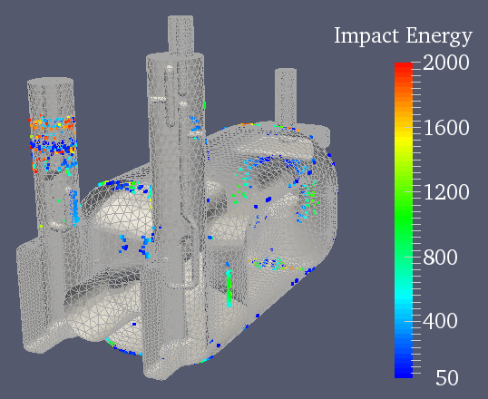
Multipacting
Extensive simulations of multipacting have been performed using the SLAC ACE3P suite of codes
Multipacting occurred in the proof-of-principle cavities where predicted, was easily processed, and did not reoccur

Slide 16
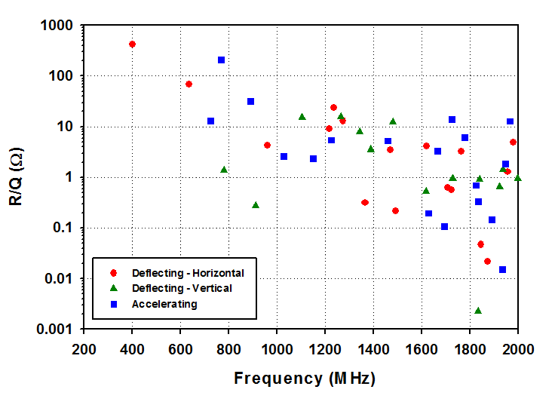
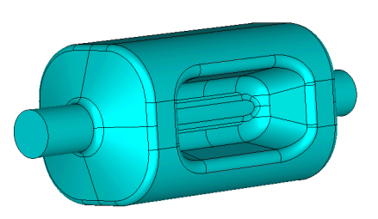
HOM Damping
No lower-order mode
Frequency of first HOM is about 1.5 that of fundamental deflecting mode
Nearest cavity mode
~230 MHz away

Slide 17
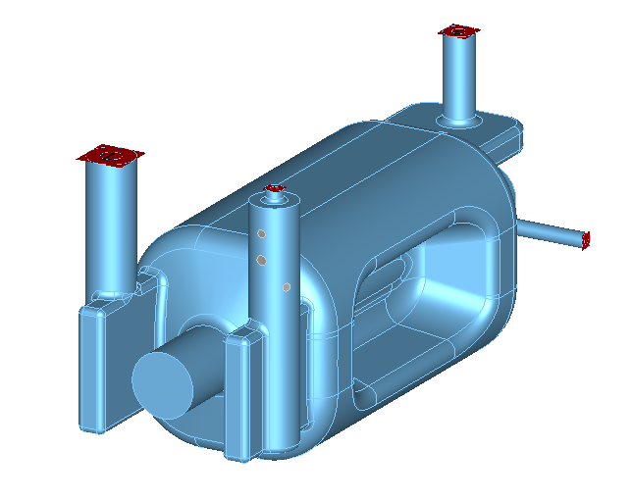
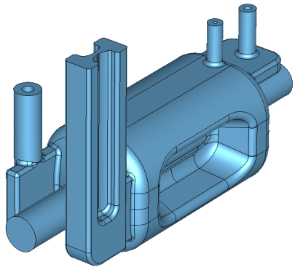
HOM Damping
2 HOM ports
  1 port does not couple to the fundamental mode
    Does not perturb the symmetry
    No need for filtering the fundamental mode
  1 port couples to the fundamental mode
    Aperture symmetrical to aperture for fundamental power coupler
    2 options for filter
      Waveguide with cut-off frequency between fundamental and HOM
      Lumped element

Slide 18

FPC and HOM Coupler Designs
V-HOM
(selective coupling)
FPC
H-HOM
(Hi-pass filter)
Coupler at locations of low field region on cavity body
  Minimizes RF heating on the coupler components
Location preserves field symmetry
  Electrical center moved by 50 microns
Selective coupling (V-coupler) to reduce the number of filters
FPC/HOM ports oriented to keep clearance for the second beam pipe

Slide 19



FPC and HOM Couplers
FPC
Outer diameter – 62 mm
Inner diameter – 27 mm
Interface to LHC main coupler design
Q_{L} = 5.0×10⁵
Hook shaped coupler reduced RF heating → 69 W
FPC
Coupling Hook
V-HOM Coupler
V_HOM
Doesn’t couple to fundamental mode
  No filter necessary
Damps vertical dipole modes and some accelerating modes
H-HOM Coupler
H-HOM High Pass Filter
H_HOM
Horizontal HOM high pass filter to cut off fundamental mode
Couples to horizontal dipole modes and accelerating modes
Both options damp adequately to meet impedance requirements

Slide 20



HHOM – High Pass Filter
High pass filter
  Simple filter design
  Damps horizontal deflecting and accelerating modes
  Demountable coupler
  Low fields in the filter
50 Ω probe (Cu)
T (Nb)
Rejection of operating mode
V-HOM
Hook (Nb)
FPC
H-HOM
High pass filter transmission
Dimensions
  Center rod diameter: 14 mm
  Larger cylinder diameter: 74 mm
  50 ohm port: 14mm/32.2mm
S₂₁ [dB]
Frequency [GHz]

Slide 21


HOM Manufacturing Tolerance
  Deviations introduced during manufacturing and also the most crucial GD&T for performance
  gap_bar
  rot_about_z
Introduced during manufacturing, easily controlled or large allowable tolerance
  tank_radius
  bar_radius
  gap_top
  rot_about_x
Introduced during assembly but with large tolerance
  y_tip
  gap_probe
gap_top
gap_bar
gap_probe
rot_about_x
(+)
rot_about_z
(+)
bar_radius
ytip
tank_radius

Slide 22

Cavity Tolerances
Roll – Rotation around z axis of one pole → ± 1.0 deg
Pitch – Rotation around x axis of one pole → ± 1.0 deg
Yaw – Rotation around y axis of one pole → ± 1.0 deg
X offset → ± 0.5 mm
Y offset → ± 0.5 mm
Z offset → ± 0.5 mm

Slide 23





Improved HOM Damping
Horizontal HOM Coupler
Coupling hook optimized
30 degree hook orientation
No change in filter elements
30deg
Vertical HOM Coupler
7 mm offset incorporated into the pickup tip to enhance coupling to the dipole modes at around 2GHz
Small RF power leakage through the coupler, ~1.5W, due to asymmetry

Slide 24





Coupler Design
FPC
Vertical HOM Feedthrough
Same feedthru design from H-HOM coupler with different flange size and probe configuration
Horizontal HOM Coupler

Slide 25







Cavity Fabrication
CERN requested extension of beam pipe 7 mm each side to have space for magnetic shielding.

Slide 26

Engineering Activities
SPS Cavities under production by DOE LARP
HOM prototyping to be launched (JLAB or CERN); production for SPS will be done by CERN
Helium vessel designed by CERN and will be produced by LARP
Tuning system will be produced by CERN
Magnetic shielding to be finalized by STFC

Slide 27



Magnetic Shielding and Helium Tank

Slide 28


Tuner Engineering

Slide 29

Cryostat Engineering
Cryo Jumper
Tuning System
HOM Couplers
Fundamental Power Coupler

Slide 30

SPS Test (2016-2017?)

Slide 31



Aperture-dependent Properties
Electromagnetic properties of “TE” cavities are quite sensitive to beamline aperture (separation between the poles)

Slide 32


Impact of Beam Aperture (84 → 100 mm)
Aperture | 84 | 100 | mm
Frequency | 400 |  | MHz
Nearest HOM | 633.5 | 630.0 | MHz
E_{p}* | 3.6 | 4.2 | MV/m
B_{p}* | 6.2 | 6.9 | mT
B_{p}*/E_{p}* | 1.71 | 1.66 | mT/ (MV/m)
[R/Q]_{T} | 429.7 | 277.7 | Ω
Geometrical Factor (G) | 106.7 | 112.2 | Ω
R_{T}R_{S} | 4.6×10⁵ | 3.1×10⁴ | Ω²
At E_{T}* = 1 MV/m
Preliminary design looks promising
  Still room for further optimization
Remains to be done
  HOM damping
  Multipole components
  Multipacting analysis

Slide 33
Crabbing System for MEIC
Proof-of-principle cavities have been successfully demonstrated at 400 MHz, 499 MHz, 750 MHz
  In all cases performance exceeded specifications
  Multipacting never was an issue
A prototype 400 MHz cavity and cryomodule are under development for LHC upgrade
  Cavity is quite different from PoP
  Much work taking place on ancillary systems and cryomodule design
A fully developed crabbing system for MEIC will look substantially different from the proof of principle
  Incorporate beam properties in cavity design
    Higher order modes
    Multipole components
  Need requirements

Slide 34
Crabbing System for MEIC
Frequency choice (476 MHz or 952 MHz)
  Both can be made to work but the optimal choice (performance vs. cost) is not obvious
  If all dimensions can be scaled by the same factor
    The number of cavities will be the same at 476 MHz and 952 MHz
    Cryogenic load will be higher at 952 MHz
  At constant beam aperture (dictated by beam properties and impedance requirements) a 952 MHz cavity will have lower properties
    Higher surface fields
    Lower shunt impedance
    Higher number of cavities
    Increased cryogenic load

Slide 35
Plans for Crabbing System for MEIC
Phase 1: Thorough evaluation of both frequency options
  6 to 9 months
  Smallest beam aperture compatible with beam physics requirements
  Define the beam physics requirements
    Voltage
    Impedance
    Multipoles
    HOM
  Size, rf power, cryogenics, integration with interaction point…
  Crabbing at “arbitrary angle” ?
    Include horizontal and vertical crabbing cavities
  Close interaction and iteration between beam physics and cavity design
  Risk: Beam physics requirements would lead to inefficient cavity geometry, or challenging engineering

Slide 36
Plans for Crabbing System for MEIC
Phase 2: Design and prototyping after frequency down-select
  12 to 18 months, starting half-way through Phase 1
  Cavity prototype design (driven by beam physics)
    Aperture
    Impedances (HOM damping requirement)
    Nonlinearities and instabilities (Multipole components, quenches, …)
    Multipacting simulations
  Cavity prototype fabrication, and testing
  Design, prototyping, and testing of ancillary components
    Tuner, Couplers, Cryostat, LLRF, …..
    Only if substantially different from state of the art
  Risk:
    Beam physics requirements would lead to inefficient cavity geometry, or challenging engineering
    Unknown unknown

