Slide 1
MEIC R&D
Some Facts & some thoughts
Y. Derbenev for the design participants
MEIC Collaboration meeting
October 5-7, 2015
JLab

Slide 2
Outline
EIC@JLab catechism
Ion Magnets
Ion Components
Electron Collider Ring
Synchronization
Beam Cooling
IonTest Stand & Studies /a proposition/
2
Notes:
2

Slide 3
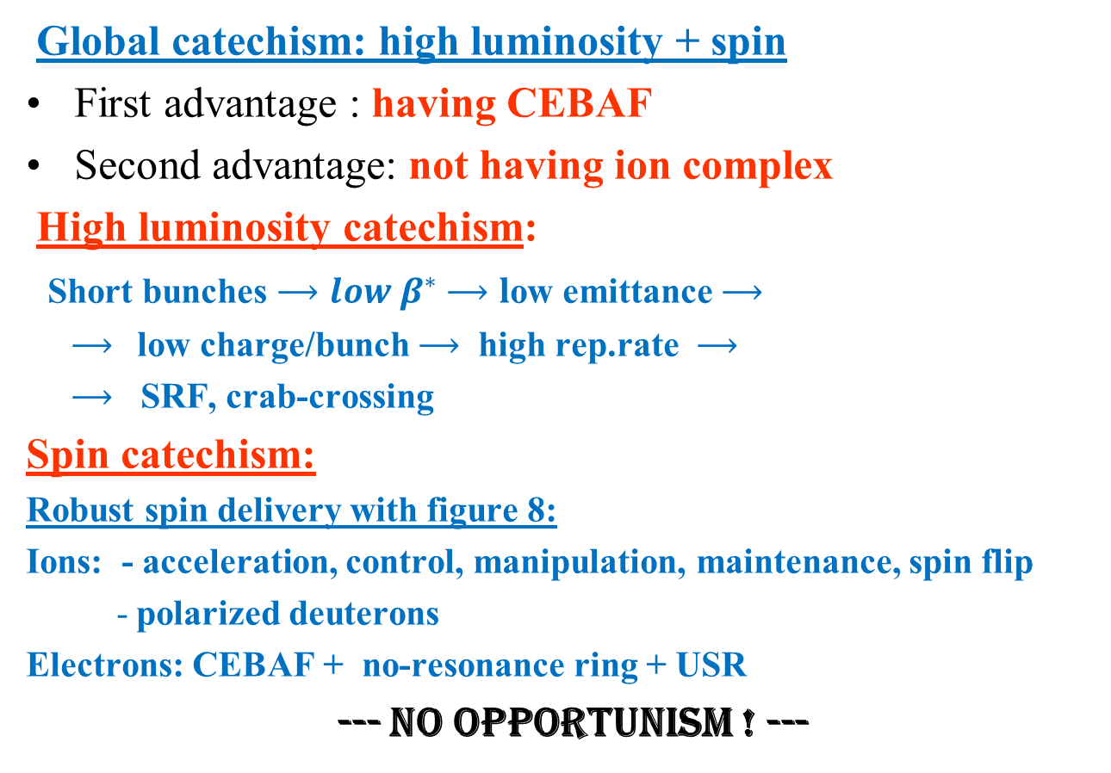
EIC@JLab catechism
Global catechism: high luminosity + spin
First advantage : having CEBAF
Second advantage: not having ion complex
High luminosity catechism:
Short bunches $⟶low β^{∗}$ $⟶l$ow emittance $⟶$
$⟶$low charge/bunch $⟶$ high rep.rate $⟶$
$⟶$ SRF, crab-crossing
Spin catechism:
Robust spin delivery with figure 8:
Ions: - acceleration, control, manipulation, maintenance, spin flip
- polarized deuterons
Electrons: CEBAF + no-resonance ring + USR
--- No opportunism ! ---

Slide 4
Ion Magnets
SF: baseline or R&D ?
Explore the achieved and explored SC sin-technology level
1) cable (fast ramp & efficient operation)
2) bent dipoles
Expand expert consultant and collaborations:
Exchange visits & collaborate JINR/GSI

Slide 5
A sight on Ion Components
100 MeV ion linac + 2 boosters injector for Collider ring
100 MeV linac suggests about 90 M$ cost reduction (!)
Pre-booster: Design a (reasonably) shortest 3 GeV racetrack booster (warm or SF). Advantages:
- reduction of Sp. Ch. Impact by a factor about 2.5 (better emittance
or higher accumulated current)
- two times shorter SC solenoid for proton spin
Large Booster:
Use E-collider ring as large ion booster
Alternative (V. Morozov): Design separate SF LB ring (400 M circumference)
6

Slide 6
Electron Collider Ring
Need small emittance !!!
Investigate a modest advanced lattice concept:
PEPII dipoles + SC quads
Ultimate lattice concept: short dipoles + SC quads
Are sextupoles absolutely needed in arcs?
Place them in CCB ?/ gaining reduction of the 2nd order chromatic tune?/

Slide 7
Synchronization
Gear instability is a holloing ghost ,
not more than that !
Gear switch vision
1. In my anticipation, gear switch will be shown allowed (i.e. it seems not to present a dynamical problem). In case, necessary stabilizing measures will be implemented.
2. To be noted that, N-physicists want to use gear for averaging over bunch to-bunch collisions.
3. Move magnets (drastic easier with gear switch!) is a baseline for today, anyway

Slide 8
Gear impacts an cure
Kink instability (which is an actual reduction of the gear dynamics, as to me) will be suppressed by Landau damping: collective dipole excitation of ion beam (as well as the electron one) happens in the non-linear field of the encountering beam with its fundamental non-linear tune spread. This tune spread exceeds the kink increment by one order of value for i-beam and two orders for e-beam. Similar picture should be actual in the longitudinal direction.
Gear + Gaps effect vision
Gear with gaps lead to stochastic incoherent dynamics in, again,
non-linear beam-beam field. Potential heat mechanism for ion
beam. However, my estimations show that it can be suppressed by
electron cooling.
I think we are able to develop an analytical study based on dynamics
modeling with Vlasov + Liapunov + Landau stability equations.
We should invite for cooperation Alexei Burov and Davresh Khasanyan.
Of course, gear dynamics must be simulated in an adequate code way.
No question for me, gear switch is allowed.
4

Slide 9


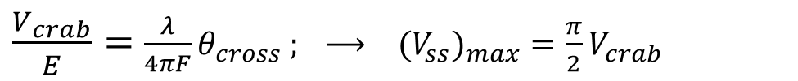



Scanning Synchronization idea
We consider a scheme of the crab-crossing colliding beams with collision point moved periodically by a small scanning the beam directions in real time. For very most of the e-i bunch pairs, this scanning compensates for time delay of ion arrival at the nominal (central) Interaction Point (IP). The direction tilt of bunches is produced by RF deflecting resonators with amplitude and phase control of the RF voltage $V_{ss}$.
ions
h
e⁻
In case that shift of the collision point (CP) is shared equally with the ion beam, the bypass parameters for each of two beams are reduced by a factor of 2, together with the similar reduction of the CP deviation.
$h_{max}$ = ± $\frac{\text{λ}}{8}$ $θ_{cross}$ = $±α_{max}F ; ⟶$
$${(V}_{ss})_{max}{=α}_{max} E$$
Compare with $V_{crab}$ :
$\frac{V_{crab}}{E}=$ $\frac{λ}{4πF}θ_{cross} ; ⟶ {{(V}_{ss})_{max}=\frac{π}{2}V}_{crab}$
$$\tan{φ_{0}=\frac{V_{ss}}{V_{crab}}}$$
Crabbing and scanning voltages could be combined in one cavity:
Notes:
h

Slide 10
ScSyn cycles
A cycle of the RF voltage control implies two tact: the collisions tact (CT) and the switching tact (ST).
In CT, RF amplitude (including sign) changes linearly with time (according to the diagram of Fig. 2).
During ST, the kicking RF voltage is supposed to be quickly returned to its initial amplitude and phase to start the next cycle.
The cycle duration will be equal to the two inverse differences in the bunch repetition rates of two beams.
Minimum duration of a cycle is equal 2 periods of beam revolution
(14 mcs at 2.1. KM of circumference, i.e. 70 KHz rep. rate)
ions
e⁻
Notes:
ScS cycle rep. rate for 2.1 KM circuference is 70 KHz

Slide 11
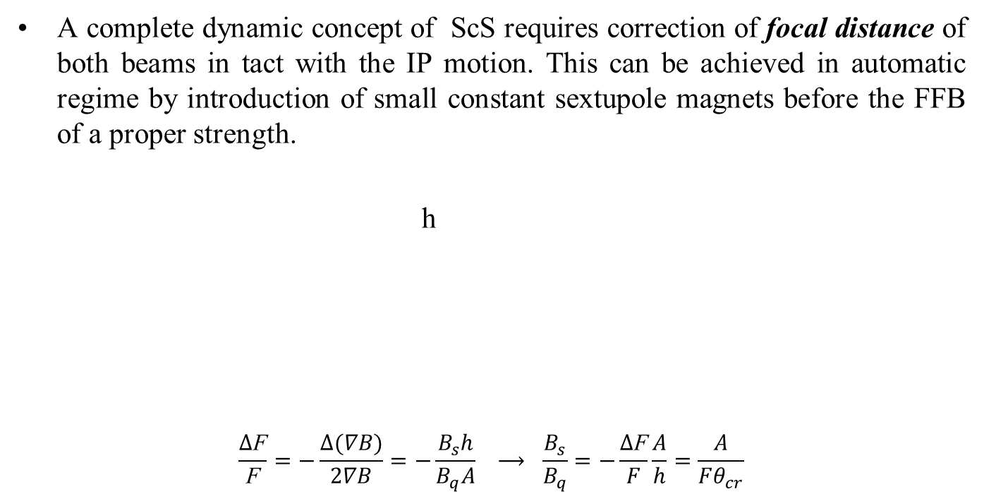
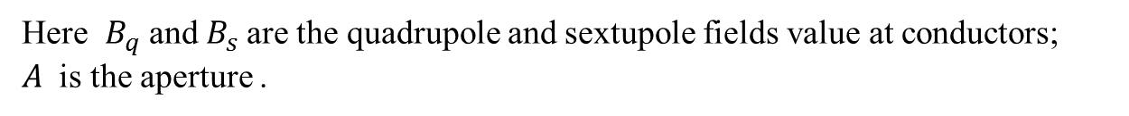
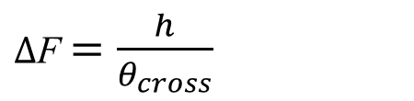
Adjustment of beam focusing at ScS
A complete dynamic concept of ScS requires correction of focal distance of both beams in tact with the IP motion. This can be achieved in automatic regime by introduction of small constant sextupole magnets before the FFB of a proper strength.
h
$$\frac{∆\text{F}}{\text{F}}=−\frac{∆(∇B)}{2∇B}=−\frac{B_{s}h}{B_{q}A} ⟶ \frac{B_{s}}{B_{q}}=−\frac{∆\text{F}}{F}\frac{A}{h}=\frac{A}{Fθ_{cr}}$$
ions
e⁻
$∆$F $=\frac{h}{θ_{cross}}$
Here $B_{q}$and $B_{s}$are the quadrupole and sextupole fields value at conductors;
$A$ is the aperture .
Notes:
Here are the quadrupole and sextupole fields at conductors

Slide 12
Estimations of ScSyn parameters
Electrons
$λ=30 cm ⟶ ∆F=±3.75 cm$;
${θ_{cr}=50 mr ⟶ h}_{max}$= $±$2 mm
$F_{e}=4m ⟶ α_{e}=0.5 mrad;$
$A=3 cm$ $⟶ \frac{B_{s}}{B_{q}}=0.15$
$E_{e}=$ 10 GeV $⟶ { Σ V}_{sse}=5 MV$
SRF power $≅10 KWt$
Protons
$F_{p}=7m$ $⟶$ $α_{p}=0.3 mrad$; $\frac{B_{s}}{B_{q}}=0.085$
$E_{p}=$ 100 GeV $⟶ { ΣV}_{ssp}=30 MV$
SRF power $≅60 KWt$

Slide 13
Transmitters with the frequency-locked magnetrons for digital control of ScSyn (G.Kazakevich / Muons, Inc.)
A wide-band phase and amplitude control of magnetrons via phase-modulated injection-locking signal had been demonstrated at FNAL “ NIM A 760, (2014)
The injection (frequency)-locked magnetrons keeping precisely-stable carrier frequency are available for a wide-band phase modulation almost like klystrons and IOTs, [http://arxiv.org/abs/1407.0304].
The RF transmitters based on the frequency-locked controlled magnetrons can compete with traditional amplifiers (klystrons, IOTs and solid-state amplifiers) in feeding of RF cavities of accelerators requiring controlled manipulations in phase and power.
However, the magnetrons are much more cost-effective RF sources. Cost of 1 W power from high-power magnetron RF sources is ~ $1, while cost of 1 W from klystrons is ~ $5, cost of 1 W from IOT is ~$10 and cost of 1 W from solid-state high-power amplifiers is ~$16.
Magnetrons are most efficient RF sources. Efficiency of high-power CW commercial magnetrons is ~85%, while efficiency of the traditional high-power RF amplifiers does not reach 60%.
Thus utilization of magnetrons in high-energy intensity-frontier accelerators can save very significant capital and maintenance costs in comparison with application of the traditional RF sources.
Transmitter with the frequency-locked magnetrons can be applied for digitally controlled Scanning Synchronization.
The transmitter can provide a fast phase flip (~200 ns) for energy recovery by beats and a controlled ramp of the deflecting voltage. At the ramp duration of >10 mcs one can expect nonlinearity < 1%. I guess that for cycle with duration of 14 mcs the nonlinearity may be ~ 0.1%. Duration of the linear ramps is limited by bandwidth of the phase control and for shortest ramps, (~ 1 mcs) one can expect nonlinearity ~ a few %.

Slide 14
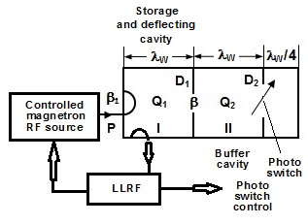
ScSyn Electro-dynamical concept
(Y. Derbenev, V. Popov (JLab); G.Kazakevich (Muons, Inc)
Modeling of energy transfer into the buffer cavity
Conceptual scheme
A novel method of energy recovery in the deflecting cavities, based on a fast transfer by beats of the stored energy in coupled high Q-factor cavities has been proposed and considered for use at ScS.
Need a precise phase and amplitude control
Need a superfast switch !
7
G. Kazakevich
7.30.2015

Slide 15
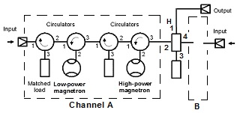
Controlled Magnetron RF Source for ScS (G. Kazakevich)
The magnetron transmitter providing a wideband phase and power control
The proposed RF energy recovery method using efficient transmitters based on magnetrons frequency-locked by phase-modulated wide-band signal will be cost-effective and will allow a significant decrease of the RF power required for the deflecting cavities at the scanning synchronization.
8
G. Kazakevich
7.30.2015

Slide 16
Superfast Switch for ScS (V. Popov)
Photoconductive Semiconductor Switch (PCSS) for use
in “MEIC Scanning Synchronization”.
The PCSS switch was proposed as an advanced alternative to the PIN diode microwave switching circuit for control the energy transfer process in coupled resonators-cavities (see. G. Kazakevitch Conceptual scheme).
The PCSS switch is a very fast photo-electrical switch-device with a lot of potential applications including sub-nanosecond fast microwave switching. However, for use in the MEIC Scanning Synchronization the microwave circuit with embedded one or more optically controlled PCSS devices has to be designed, simulated and tested. Some PCSS models and semiconductor raw material dedicated for application in PCSS are available from the market (Kyma Technologies).
List of questions which need to be answered:
1. What type of semiconductor is preferred
2. On/Off timing and ratio.
3. Insertion loss
4. Long term stability
5. Operation inside of high strength microwave field.
A possible microwave circuit and light pulse control system also must be designed and tested.
V. Popov
9
Notes:
V. Popov

Slide 17
Electron Cooling
Circulator-cooler ring, overall issues
Fast SRF kicker
Beam-beam kicker
Electron Storage Ring-Cooler
Circular Modes Ion Transport

Slide 18
Superfast Kickers
SRF multi-harmonic kicker
Beam-beam kicker

Slide 19

Beam-beam Kicker
Ejection/injection of cooling bunches in the horizontal plane by kicks in x-direction
Both beams magnetized
Both beams should be flattened in the kick sections to have a small horizontal size while relatively large the vertical sizes
A short (1~ 3 cm) target electron bunch passes through a long (10 - 20 cm) low-energy flat bunch at a very close distance, receiving a transverse kick :
Coherence conditions:
F
surface charge density
v≈c
D
h
σ_{c}
kicking beam
v₀
L
Circulating beam energy | MeV | 33
Kicking beam energy | MeV | ~0.3
Repetition frequency | MHz | 5 -15
Kicking angle | mrad | 0.7
K- bunch length | cm | 15-30
K- bunch width | cm | 0.5
K-bunch charge | nC | 2

Slide 20
ERL storage ring as Cooler
Y.Zhang, V. Morozov, Jiquan Guo
Cooling section
ion bunch
E
electron bunch
Full energy injector
solenoid
E
cooling ring
Energy compensation
ERL
Energy compensation
± ΔE
~100 MeV
E+ΔE
E+ΔE
Damping ring
Multiple damping wigglers
Notes:
Red Interior Page Design 2

Slide 21
Circular Modes (CM) optics for Ion Beam
By the way, there is the following serious issue of the MEIC design:
Space charge of short ion bunches of MEIC does limit luminosity of the collider in the “low” energies region
Observation of features of a magnetized e-beam transport
(CM optics!)
provokes a question:
CM optics for Ion Beam?

Slide 22
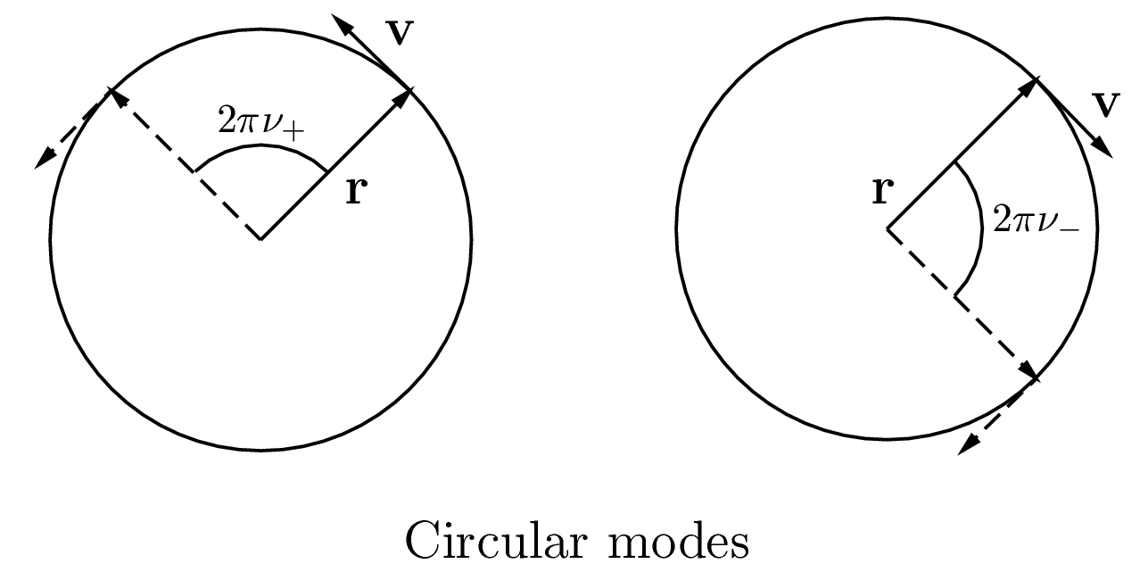
Circular Modes Transport (CMT) & Rings (CMR)
Design beam transport around a ring creating two circular modes (CM) of two naturally opposite helicities.
Each of two individual CMs will look at a point of the orbit as a round (more generally, elliptical) turn by turn rotating pencil beam with some phase advance.
CMs may occupy all the beam transport (ring or line)
but also:
CMs can be created from (annihilated to) planar modes in a region of a ring or line applying round to flat transformations (RFT)
CMs can be magnetized by cooling solenoid

Slide 23

Ion space charge with CMs
Laslett detune of two CM modes is intrinsic-equate:
$∆ν_{1}=∆ν_{2}=\frac{∆ψ}{2π}=\frac{I_{peak}}{I_{A}}\frac{Zm_{e}}{Am_{p}}\frac{Π}{4πγ^{2}β_{L}{(ε}_{1}+ε_{2})}$ ; ($I_{A}≡17 KA; β_{L}$ $≡\frac{v}{c}$ )
Similar to magnetized e-beam, beam space charge can be “settled” just into one of two CMs, leaving other “empty” i.e. having a very low emittance:
$ε_{1}⟹\frac{Zm_{e}}{Am_{p}}\frac{Π_{i}}{4πγ^{2}β_{L}∆ν_{i}}$ ; ${ ε}_{2} ≪$ ${ ε}_{1}$
On the background of large CM, the small one manifests in a low “temperature” of the round-rotating beam
Notes:
Small mode will manifest in a low “temperature” of the round-rotating beam

Slide 24
Beam Cooling with CMs
Cooling of small CM will not be stopped by the SpCh
Applicable to stochastic cooling
What about electron cooling?
Applicable to EC in principle as well, but cooling rate can be limited by rotation of the “large” CM
Can we eliminate this rotation in cooling section?
Yes, we can

Slide 25
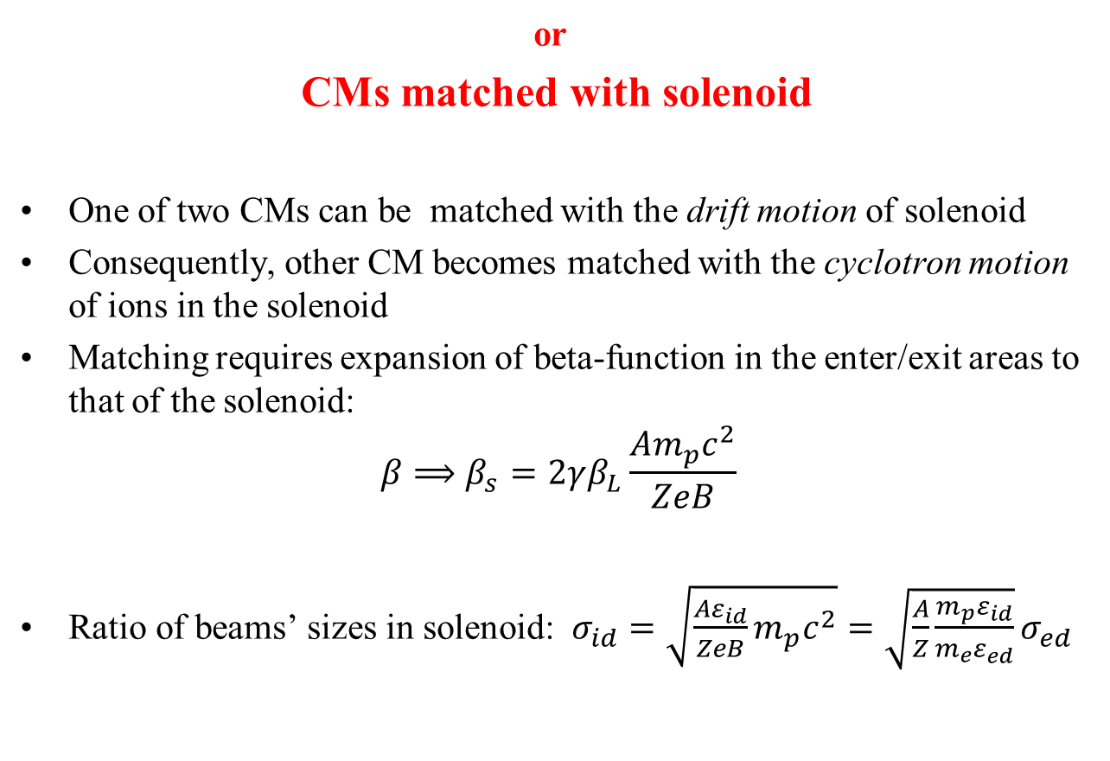
“Magnetized” Ion Beam
or
CMs matched with solenoid
One of two CMs can be matched with the drift motion of solenoid
Consequently, other CM becomes matched with the cyclotron motion of ions in the solenoid
Matching requires expansion of beta-function in the enter/exit areas to that of the solenoid:
$${β⟹β}_{s}=2γβ_{L}\frac{Am_{p}c^{2}}{ZeB}$$
Ratio of beams’ sizes in solenoid:$σ_{id}=\sqrt{\frac{Aε_{id}}{ZeB}m_{p}c^{2}}=\sqrt{\frac{A}{Z}\frac{m_{p}ε_{id}}{m_{e}ε_{ed}}}σ_{ed}$

Slide 26
Cyclotron and Longitudinal cooling
In a homogeneous e-beam one can cool the CyM and energy spread
However, ion beam size may exceed the e-beam size (at least for initial ion beam)
Scanning e-beam is solution for this issue

Slide 27
Dispersive cooling of the drift mode
To attain the drift cooling, introduce dispersion of appropriate magnitude and sign for both beams in solenoid
Comment on organizing i-beam dispersion:
while zooming the ion beta-function to match solenoid, one can avoid undesirable growth of the dispersion, by a specific design of the dipole/quadruple lattice of the zooming section
Possible alternative to e-dispersion:
- Make scanning of e-beam gradient-inhomogeneous

Slide 28
IBS in CM rings
Cyclotron cooling can be stopped by IBS in ion beam around the CM ring
Below the transition energy (TE) (approximately…), IBS heating is due to alteration of beam focusing
Above TE, IBS heating is mainly due to the “negative longitudinal mass”

Slide 29
Use of CM and Matched EC

Slide 30
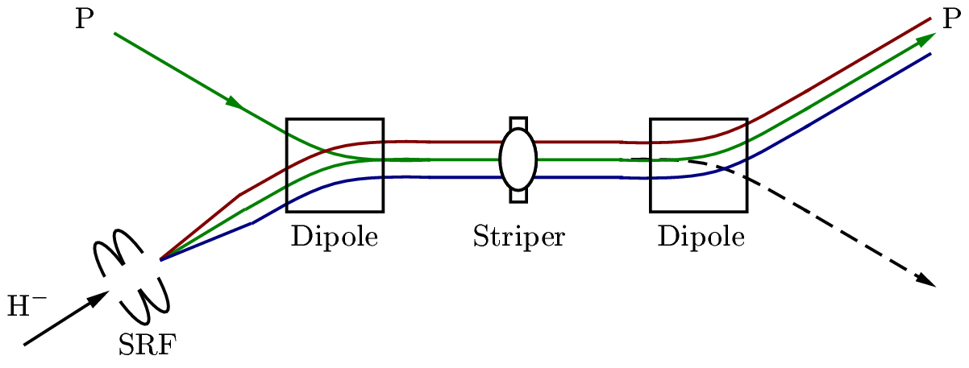
RF-painting for stacking in one CM

Slide 31
Shortening the initial cooling time
At optimal organization of EC (including the dispersive cooling), cooling time is determined by the 6D normalized emittance of ion beam (beam extension is not necessary but can be applied when advantageous)
So, when having one CM emittance small, one receives a significant reduction of the cooling time (cooling after injection to collider ring; and initial cooling at top energy)

Slide 32
Potential to overcome the SpCh limitation of EIC luminosity
While maintaining a round-rotating cooled beam state around the ring, one can transform round beam to flat to the IP (since the e-beam is flat), in this way gaining luminosity over the SC limit of the ring.

Slide 33
Easing the IR design
Having flat or one-CM-round beam in IR is easing significantly the achromatic IR design
Allows one to reduce limitations of dynamical aperture due to the non-linear fields of achromatic IR

Slide 34
Low energy ion front-end Test Facility (ITF)
Polarized ion source, universal
RFQ and DTL 10 MeV
Small booster-synchrotron 200 MeV with DC EC
-Coupled optics (circular modes)
-Space charge with Circular Modes
-Matched El. Cool. for low 4D emittance
-Polarimetry tests
-Study spin resonance, natural and RF (figure 8 ring)
13

Slide 35
Conclusion
Goals of R&D beyond the baseline:
--- Maintain the conceptual superiority of the EIC@JLab
in capabilities, efficiency and operation cost ---
Thank you for your attention and interest!

