Slide 1




The US-based Electron-Ion Collider: Status of the New NSAC Long-Range Plan
Rolf Ent
Jefferson Lab
?
+
=
2007 Long-Range Plan
2014 EIC White Paper
2015 Long-Range Plan
MEIC Collaboration Meeting @ JLab
05-07 October 2015

Slide 2
Status of the New NSAC Long-Range Plan
EIC: Science introduction and requirements
The Science of the EIC White Paper
  Imaging the Gluons and Quark Sea of Nucleons and Nuclei
The NSAC Long-Range Planning process in the US – status (NSAC = Nuclear Science Advisory Committee)
Ongoing and next steps
Notes:
2
Note BSM not included in project

Slide 3


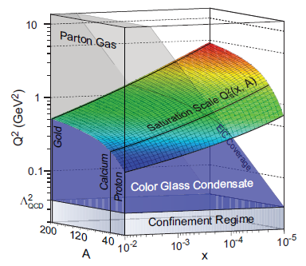
The Structure of the Proton
Naïve Quark Model: proton = uud (valence quarks)
QCD: proton = uud + uu + dd + ss + …
The proton sea has a non-trivial structure: u ≠ d
& gluons are abundant
=
gluon dynamics
Non-trivial sea structure
The proton is far more than just its up + up + down (valence) quark structure
Gluon photon:
Radiates
and recombines:

Slide 4
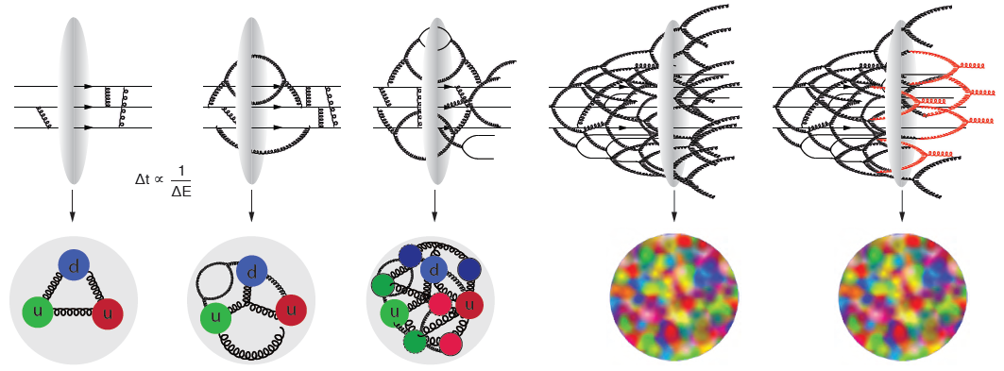
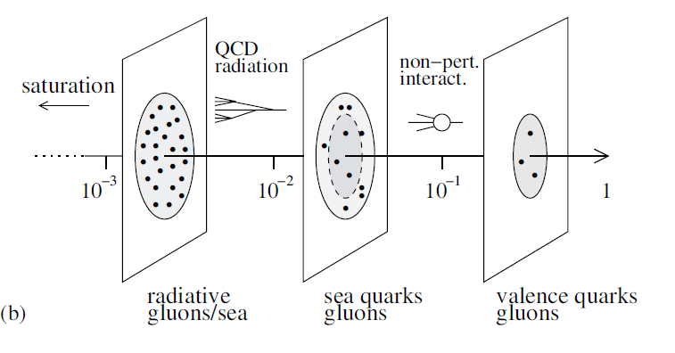
The Evolution of a Proton – Deep into the Sea
Resolution
=
>
Saturation

Slide 5



Gluons and the EIC – US Coverage
Scientific American
May 2015
Notes:
5
Note BSM not included in project

Slide 6
The Electron Ion Collider
For e-N collisions at the EIC:
Polarized beams: e, p, d/³He
e beam 3-10(20) GeV
Luminosity L_{ep} ~ 10³³⁻³⁴ cm⁻²sec⁻¹
  100-1000 times HERA
20-~100 (140) GeV Variable CoM
1212.1701.v3
A. Accardi et al
For e-A collisions at the EIC:
Wide range in nuclei
Luminosity per nucleon same as e-p
Variable center of mass energy
World’s first
Polarized electron-proton/light ion
and electron-Nucleus collider
Two proposals for realization of the science case -
both designs use DOE’s significant investments in infrastructure
Notes:
6
Note BSM not included in project

Slide 7
EIC – World’s First Polarized eN Collider
A spin factory of polarized electrons and polarized protons/light nuclei:
imaging the quarks and gluons
How are the gluons and sea quarks, and their intrinsic spins distributed in space & momentum inside protons and neutrons?
What is the role of sea quark and gluon orbital angular momentum?
How do gluons and sea quarks contribute to the nucleon-nucleon force?
Notes:
7
Note BSM not included in project

Slide 8

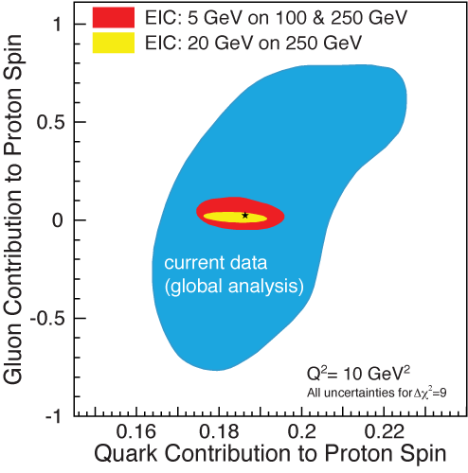
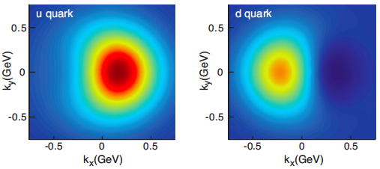
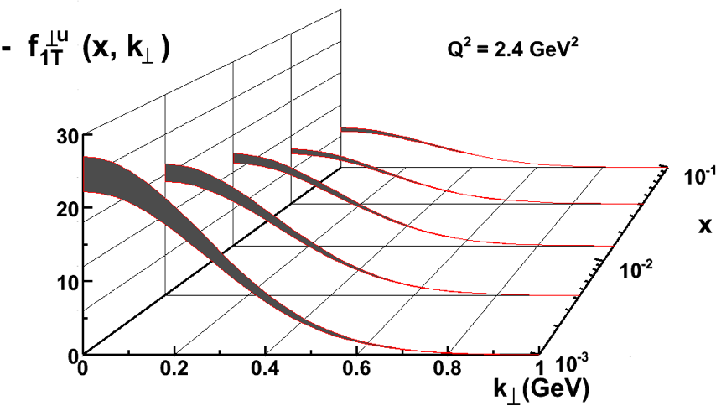
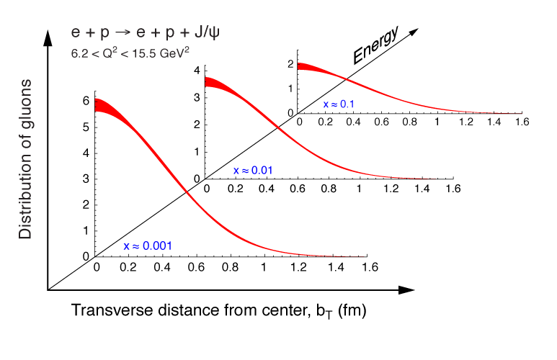
2+1 D partonic image of the proton
Spatial distance from origin X Transverse Momentum → Orbital Angular Momentum
Helicity Distributions: ΔG and ΔΣ
Transverse Momentum Distributions
Transverse Position Distributions
Notes:
8
Note BSM not included in project

Slide 9
EIC – World’s First eA Collider
The Nucleus:
A laboratory for QCD
What do we know about the gluons in nuclei? Very little!
Does the gluon density saturate? Does this produce a unique and universal state of matter?
How do color charges propagate through and interact with the nuclear medium?
Notes:
9
Note BSM not included in project

Slide 10
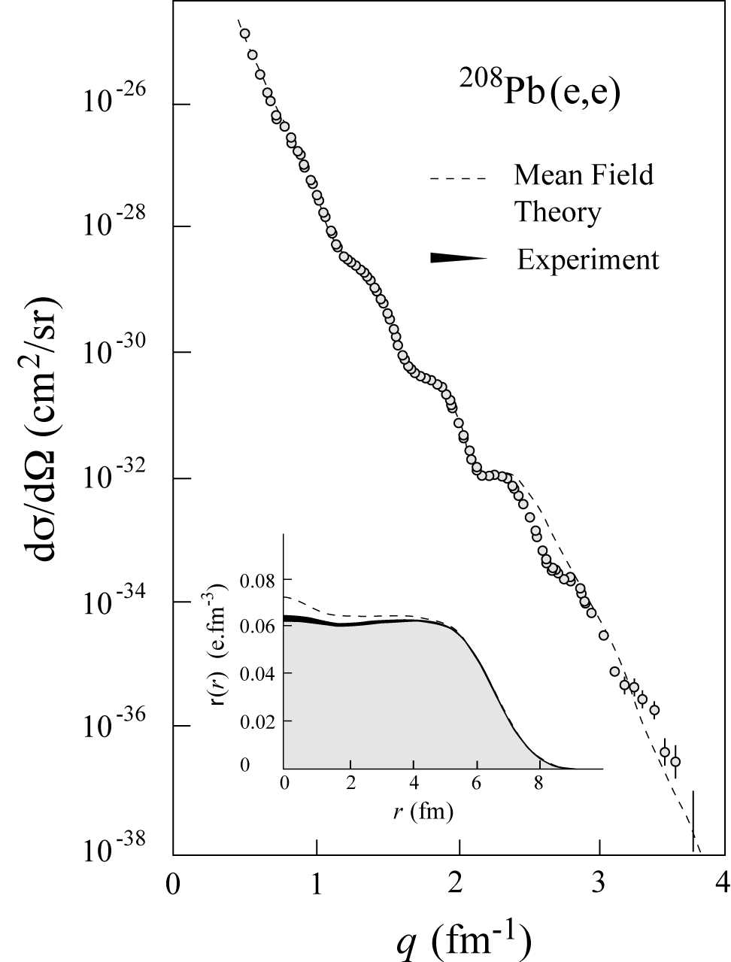
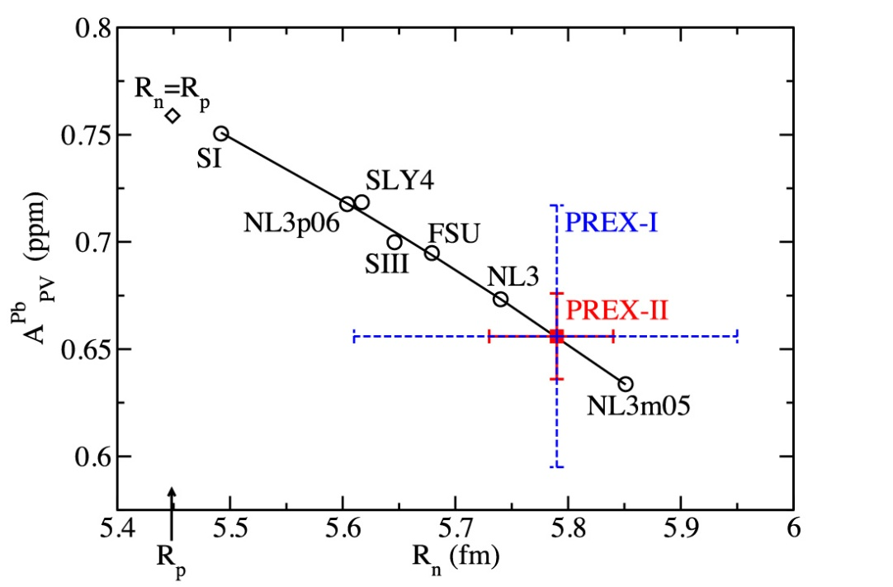
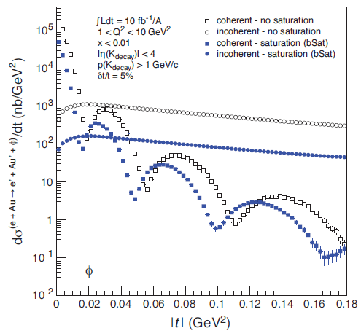
Exposing different layers of the nuclear landscape with electron scattering
History:
Electromagnetic
Elastic electron-nucleus scattering → charge distribution of nuclei
Present/Near-future:
Electroweak
Parity-violating elastic electron-nucleus scattering (or hadronic reactions e.g. at FRIB) → neutron skin
Future:
Color dipole
φ Production in coherent electron-nucleus scattering → gluon spatial distribution of nuclei
Fourier transform gives unprecedented info on gluon spatial distribution, including impact of gluon saturation
Notes:
Added collaborators

Slide 11
The US Nuclear Science Long-Range Planning Process
Notes:
11
Note BSM not included in project

Slide 12

Nuclear Science Long-Range Planning
Every 5-7 years the Nuclear Science community produces a Long-Range Planning (LRP) Document
Previous versions: 1979, 1983, 1989, 1996, 2002, 2007
The final document includes a small set of recommendations for the field of Nuclear Science for the next decade
For instance, 12 GeV construction was the highest recommendation of the 2007 plan.
How does it work:
The Division of Nuclear Physics of the American Physical Society organizes a series of Town Meetings, where the community provides input in the form of presentations and in the form of contributed “White Papers”
Each Town Meeting produces a set of recommendations and a summary “White Paper”
The Nuclear Science Advisory Committee, extended to about 60 people into a Long-Range Plan Working Group, then comes together for a week and decides on a final set of recommendations and produces a LRP document

Slide 13
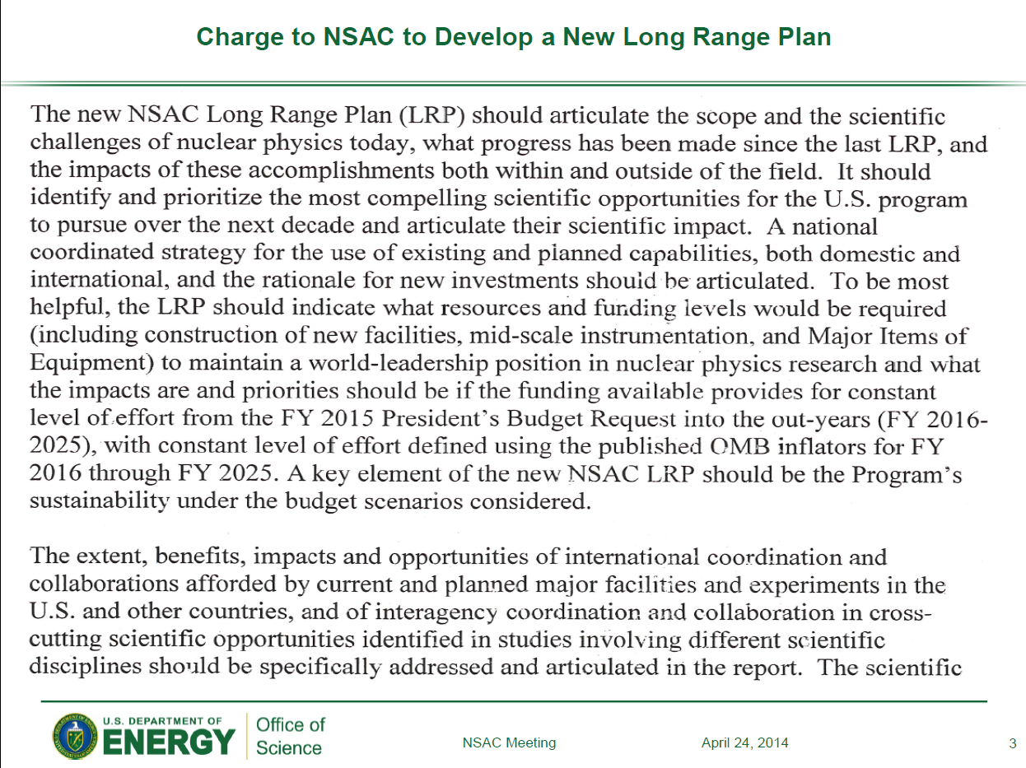
Budget Assumptions
“Discussion of Budgets in light of priorities and recommendations”

Slide 14
DNP Town Meetings – Programs
Town Meeting on Computational Nuclear Physics
SURA, Washington DC, 14-15 July, 2014
https://www.jlab.org/conferences/cnp2014/
Town Meeting on Education and Innovation
Michigan State University, East Lansing, 7-8 August 2014
http://meetings.nscl.msu.edu/Education-Innovation-2014/program.htm
Town Meeting on Nuclear Structure and Nuclear Astrophysics
Texas A&M University, College Station, 21-23 August 2014
http://www.lecmeeting.org/program.htm
Town Meeting on QCD and Hadronic Physics
Town Meeting on Phases of QCD Matter
        (One Day Joint)
Temple University, Philadelphia, 13-15 September 2014 https://indico.bnl.gov/conferenceTimeTable.py/pdf?view=standard&confId=857
Town Meeting on Fundamental Symmetries and Neutrinos
Chicago, 28-29 September 2014
https://fsnutown.phy.ornl.gov/fsnuweb/

Slide 15
QCD Town Meetings
QCD and Hadron Physics – “Cool QCD” Town Meeting Resolutions:
2. A high luminosity, high-energy polarized Electron Ion Collider (EIC) is the highest priority of the U.S. NP QCD community for future new construction after FRIB. (voted jointly with Phases of QCD community)
Phases of QCD Matter – “Hot QCD” Town Meeting Resolutions:
2. A high luminosity, high-energy polarized Electron Ion Collider (EIC) is the U.S. QCD Community’s highest priority for future new construction after FRIB.
From mail from Abhay Deshpande, Rolf Ent, Richard Milner and Thomas Ullrich, in collaboration with BNL and JLab management, recently sent to mailing list of potential EIC-interested institutions, and also to the general RHIC and CEBAF user mailing lists:
“In the 2015 long range planning (LRP) activity of the US Nuclear Science Community the joint Town Meetings on QCD unanimously and enthusiastically endorsed the Electron-Ion Collider (EIC) as the highest priority for new facility construction in the US. The view of the broader US nuclear science community, to be expressed in the NSAC Long Range Plan, will be released in October of this year. We hence think it is timely for the US and the international users of a future US-based EIC to organize more formally with the goal of giving the future users community a stronger and more visible role in the process leading to the creation of an EIC.”

Slide 16
Nuclear Science Long-Range Planning
    Adapted from Don Geesaman (ANL, NSAC Chair) presentation
    See: http://science.energy.gov/np/nsac/meetings/agenda20141117/
LRP Schedule
Charge delivered at 24 April 2014 NSAC Meeting
LRP Working Group formed in early June of ~60 members
- NuPECC (Europe) and ANPhA (Asia) observers included
Community organization this Summer
DNP Town Meetings in the July/September time frame
Joint APS-DNP-JPS Meeting Oct. 7-11, Wednesday afternoon discussion
Working Group organizational meeting Nov. 16 in Rockville, MD
Time for more community meetings in November-January
(Community) White Papers by end of January to have greatest impact
Cost review of EIC by February
Most of text of report assembled by April 10
Resolution meeting of Long Range Plan working group April 16-20, 2015
Draft report reviewed by external wise women and men
LRP final report due October 2015
(Formally voted upon and accepted at NSAC meeting mid October)

Slide 17
Ongoing and next steps
Notes:
17
Note BSM not included in project

Slide 18
Some EIC Events (since ~ May 2014)
Event | Date
Presentation on EIC & LHeC to INFN Long-Term Strategy Meeting | May 2014
EIC users meeting – about 180 participants | Jun. 2014
POETIC V @ Yale | Sep. 2014
Joint DNP/JPS Workshop on Future Directions in High-Energy QCD | Oct. 2014
Revision of EIC White Paper – v2 & v3 | Dec. 2014
NSAC cost review | Jan. 2015
Joint (w. users, BNL) preparation of EIC talk for the LRP process | Jan.-Mar.15
Joint (w. users, BNL) Meeting at SURA to prepare for LRP | Mar. 2015
Letter from Asia (China, India, Japan, Korea) showing interest in EIC to NSAC chair | Apr. 2015
NSAC LRP Working Group | Apr. 2015
Scientific American article on Gluons | May 2015
Participation in LHeC meeting | June 2015
Presentation on EIC at U Torino and at INFN Headquarters | June 2015
Discussion with Orsay & Saclay on French involvement in EIC | July 2015
POETIC VI @ Palaiseau | Sep. 2015
NSAC meeting to formally approve 2015 LRP document | Oct. 2015
Notes:
Added collaborators

Slide 19
What’s next: EIC Users Meeting
Dear Friends and Colleagues,
We are happy to announce that the next meeting of the EIC
collaborators and enthusiasts will be held at U. of California at Berkeley (UCB).
The dates of the meeting are: January 6-9, 2016. — Please mark your
calendars. Web pages with information about logistical and scientific
planning are being setup. Please stay tuned.
We look forward to seeing you at UCB.
Sincerely,
Abhay Deshpande, also for:
Elke Aschenauer, Rolf Ent, Barbara Jacak, Robert McKeown,
Richard Milner, Berndt Mueller & Thomas Ullrich
Notes:
19
Note BSM not included in project

Slide 20
EIC Realization Imagined
Assuming a formal NSAC/LRP recommendation, what can we speculate about any EIC timeline?
It seems unlikely that a CD0 (US Mission Need statement) will be awarded without a National Academy of Sciences study
EIC accelerator R&D questions will not be completely answered until ~2017
EIC construction has to start after FRIB completion, with FRIB construction
anticipated to start ramping down near or in FY20
Most optimistic scenario would have EIC construction start (CD3) in FY20
Best guess for EIC completion assuming formal NSAC/LRP recommendation would be 2025-2030 timeframe
Notes:
20
Note BSM not included in project

Slide 21
Conclusion
The EIC will profoundly impact our understanding of the structure of nucleons and nuclei in terms of sea quarks & gluons. → Can we provide a bridge between sea quarks/gluons and nuclei?
EIC will enable IMAGES of yet unexplored regions of phase spaces in QCD with its high luminosity/energy, nuclei & beam polarization → There is high potential for discovery
Outstanding questions raised both by the science at RHIC/LHC and at HERMES/COMPASS/Jefferson Lab, have naturally led to the science and design parameters of the EIC
There exists world wide interest in collaborating on the EIC
EIC realization will require strong collaboration both within the US and abroad
The future of nuclear science demands an Electron Ion Collider
Notes:
21
Note BSM not included in project

Slide 22
Backup
Notes:
22
Note BSM not included in project

Slide 23

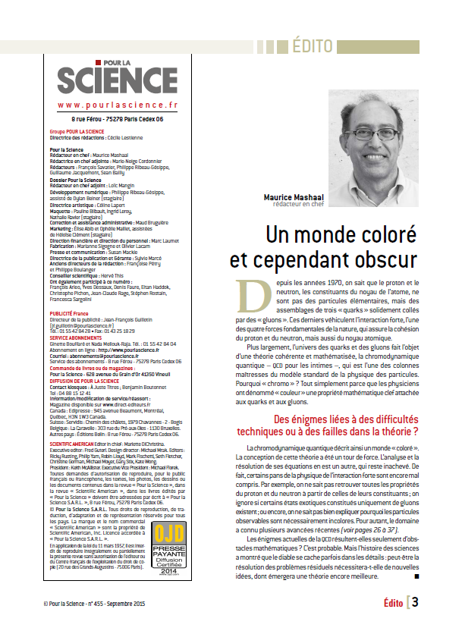
Gluons and the EIC – France Coverage
Pour La Science - September 2015
Notes:
23
Note BSM not included in project

Slide 24
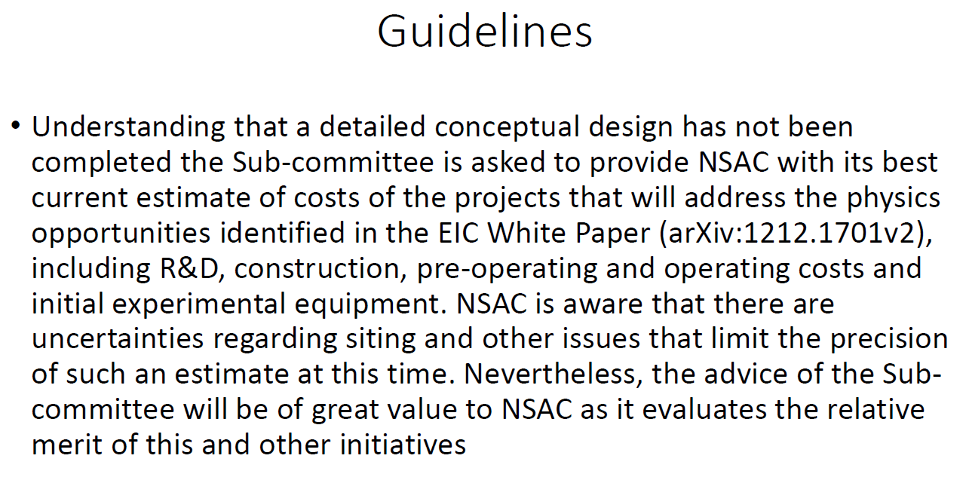
NSAC EIC Cost Review – Jan 26-28
From Ed Temple’s presentation to NSAC, publicly available on the web
NSAC’s Sub-Committee review of the EIC (Electron Ion Collider) Cost Estimates
L. Edward Temple, Jr., Chairman

Slide 25
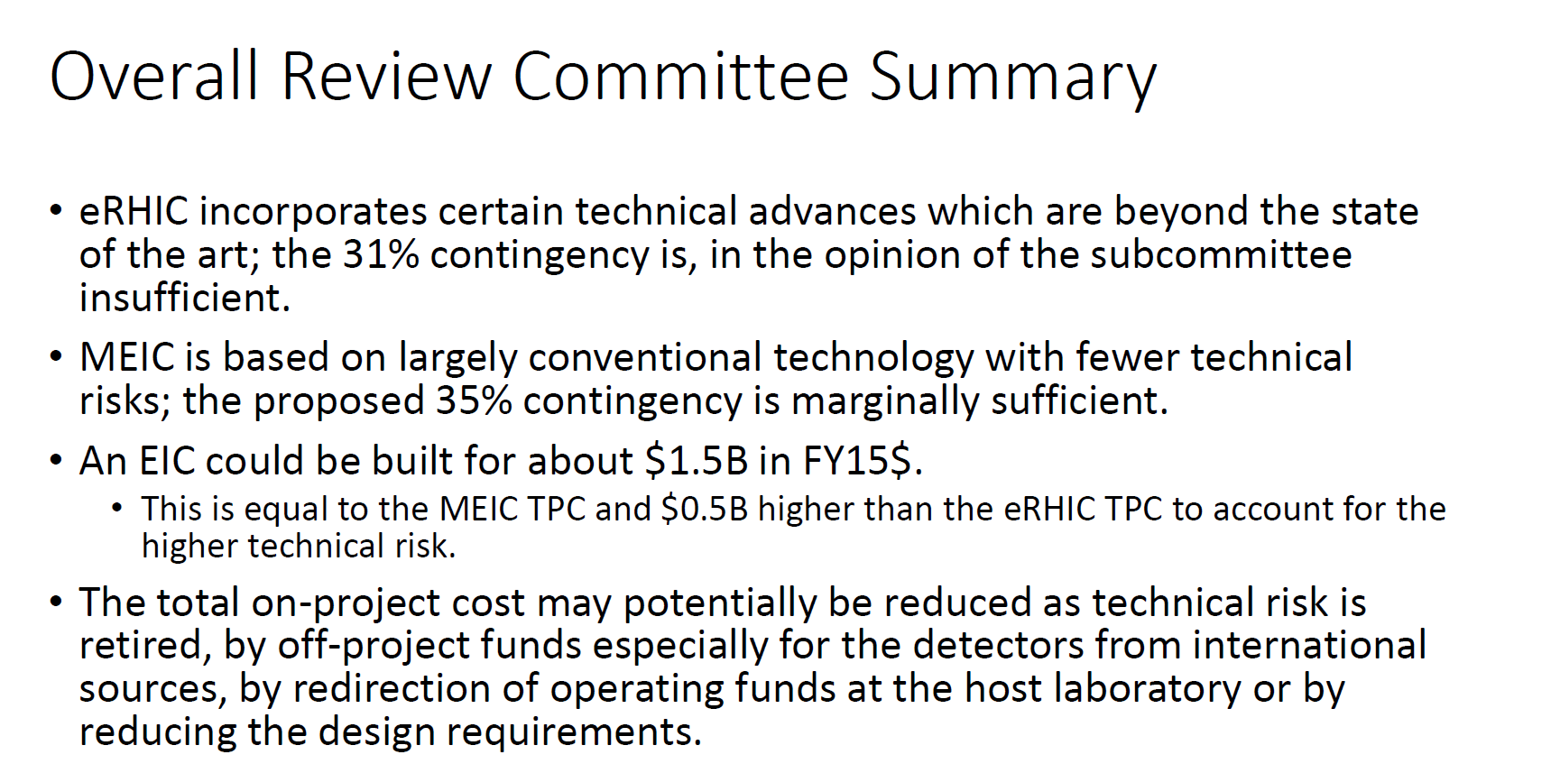
Cost Review Presentation to NSAC
From Ed Temple’s presentation to NSAC, publicly available on the web

Slide 26
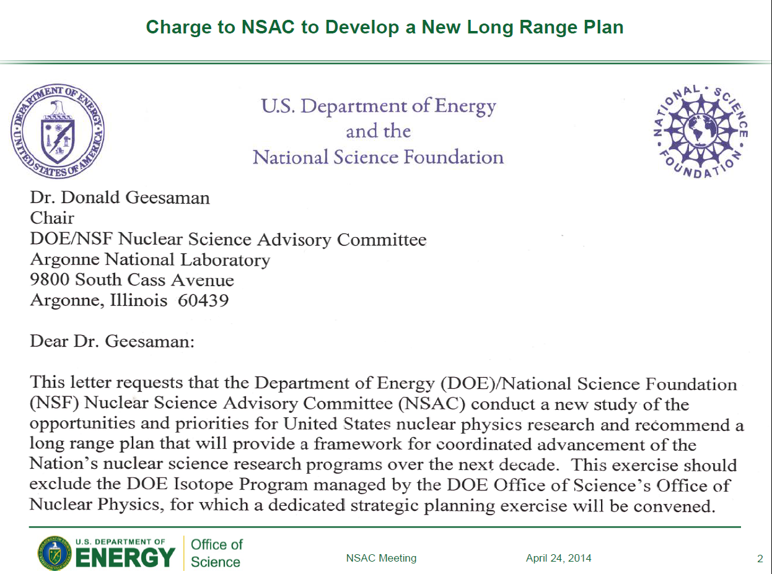

Slide 28
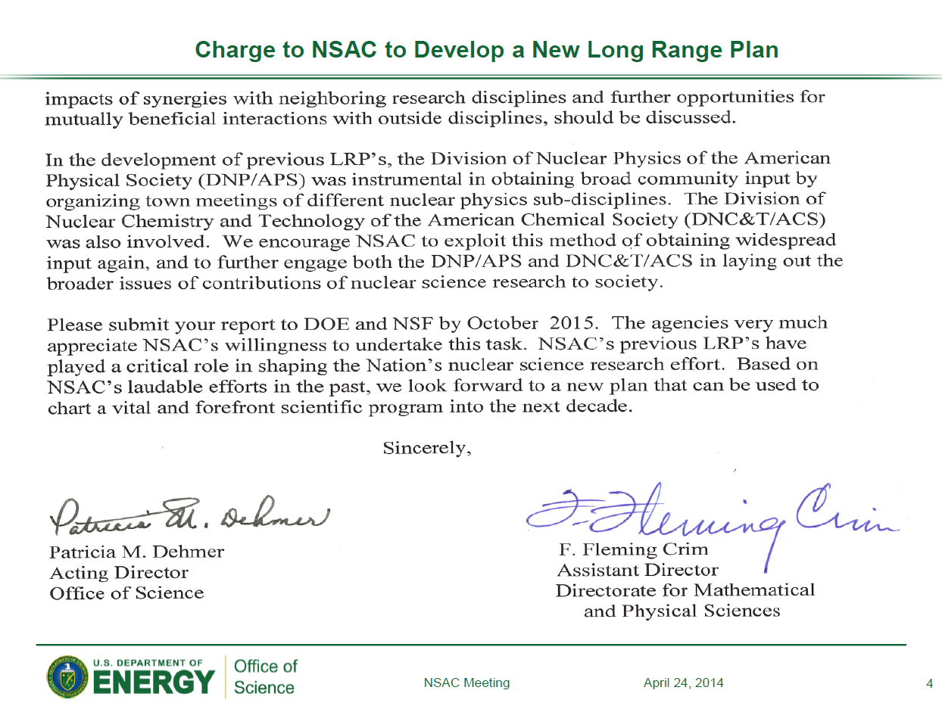

Slide 29
QCD and Hadron Physics – Cool QCD
With highest priority, we recommend both completion of construction and full operation of the 12 GeV CEBAF at the Thomas Jefferson National Accelerator Facility, along with targeted instrumentation investments such as the MOLLER and SoLID projects.
A high luminosity, high-energy polarized Electron Ion Collider (EIC) is the highest priority of the U.S. NP QCD community for future new construction after FRIB. (voted jointly with Phases of QCD community)
We recommend strong support for other existing facilities, such as the polarized proton facility at RHIC, university-based laboratories, and the scientists involved in these efforts. …
We recommend that support for the theory program be increased, in a balanced manner and in proportion to new and continuing investment in experiment. …

Slide 30
Phases of QCD Matter – Hot QCD
As our highest priority we recommend a program to complete the search for the critical point in the QCD phase diagram and to exploit the newly realized potential of exploring the QGP’s structure at multiple length scales with jets at RHIC and LHC energies. This requires implementation of new capabilities of the RHIC facility (a state-of-the-art jet detector such as sPHENIX and luminosity upgrades for running at low energies) needed to complete its scientific mission, continued strong U.S. participation in the LHC heavy-ion program, and strong investment in a broad range of theoretical efforts employing various analytical and computational methods.
A high luminosity, high-energy polarized Electron Ion Collider (EIC) is the U.S. QCD Community’s highest priority for future new construction after FRIB.
We endorse the new initiatives and investments proposed in the Recommendation and Request received from the Computational Nuclear Physics Town Meeting, at a level to be determined by the requested NSAC subcommittee. In addition, we recommend new funding to expand the successful “Topical Collaborations in Nuclear Theory” program initiated in the last Long Range Plan of 2007, to a level of at least one new Topical Collaboration per year

Slide 31
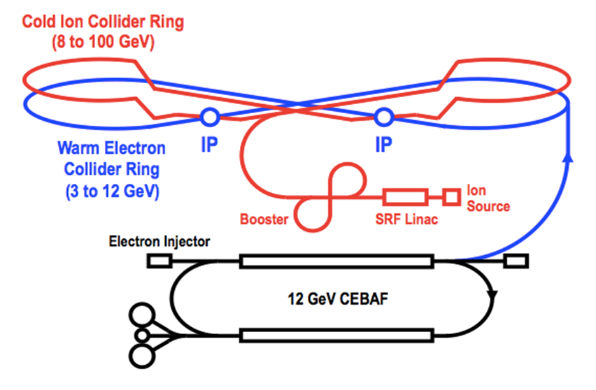
MEIC Baseline Design
arXiv:1209.0757 (Sept. 2012)
arXiv:1504.07961 (April 2015)
Features:
Collider ring circumference: ~2100 m
Electron collider ring and transfer lines : PEP-II magnets, RF (476 MHz) and vacuum chambers
Ion collider ring: super-ferric magnets
Booster ring: super-ferric magnets
SRF ion linac
Goals:
Balance of civil construction versus
magnet costs and risks
Aim overall for low technical risks
Collaborators:
ANL, Fermilab, SLAC
Texas A&M
Notes:
Added collaborators

Slide 32
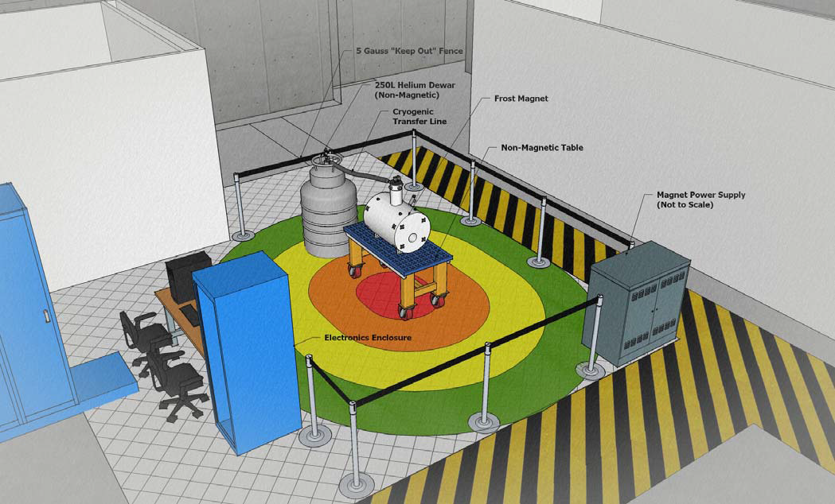
Ongoing: Generic EIC-related detector R&D
An active Generic Detector R&D Program for EIC currently underway, (supported by DOE, administered by BNL):
  ~140 physicists, 31 institutes (5 Labs, 22 Universities, 9 Non-US Institutions) 15+ detector consortia exploring novel technologies for tracking, particle ID, calorimetry at the EIC:
  Weekly meetings, workshops and test beam activities already underway
  Many R&D proposals are collaborative (BNL/JLab/users)
  https://wiki.bnl.gov/conferences/index.php/EIC_R%25D
JLab active partner to provide support for staff and users in this Generic EIC Detector R&D program
  Provide organization for users
  Assist in proposal preparation
  Provide infrastructure for R&D topics, e.g. 5T sensor test facility re-using existing magnets
  Often synergy with 12-GeV related work (like SiPMs, DIRC, PbWO4 crystals)
High-B-field sensor test facility at JLab (utilizes FROST magnet)
Notes:
Added collaborators

Slide 33
What’s next: EIC User Organization
Mail from Abhay Deshpande, Rolf Ent, Richard Milner and Thomas Ullrich, in collaboration with BNL and JLab management, recently sent to mailing list of potential EIC-interested institutions, and also to the general RHIC and CEBAF user mailing lists.
Dear X,
In the 2015 long range planning (LRP) activity of the US Nuclear Science Community the joint Town Meetings on QCD unanimously and enthusiastically endorsed the Electron-Ion Collider (EIC) as the highest priority for new facility construction in the US. The view of the broader US nuclear science community, to be expressed in the NSAC Long Range Plan, will be released in October of this year. We hence think it is timely for the US and the international users of a future US-based EIC to organize more formally with the goal of giving the future users community a stronger and more visible role in the process leading to the creation of an EIC.
We are writing to invite you and colleagues at your Institution to join in the international Electron-Ion Collider Users Group (EICUG) with the aim of realizing the EIC in the United States. Currently there are two designs of the US EIC under consideration, one at Brookhaven National Laboratory based on RHIC and the other at Jefferson Laboratory based on the 12-GeV CEBAF facility. The EICUG will work together, across these efforts, to …
We request all users group members to designate a representative from their home institution to be a member of the EICUG’s Steering Committee (SC).
…
Notes:
33
Note BSM not included in project

Slide 34
The Evolution of a Proton – Deep into the Sea
Resolution
=
>
Saturation

