Slide 1
MEIC Electron Ring Injection from CEBAF
Jiquan Guo
for the MEIC design study team
Oct. 5, 2015

Slide 2
Outline
Overview of the MEIC electron complex and collider ring injection
Synchronization between the CEBAF and the electron collider ring
Time structure of the injected bunch train
Synchronization with varying ring frequency
Maximizing the CEBAF extracted beam current
Bunch train time structure in CEBAF
Gradient droop
Estimated injection time

Slide 3
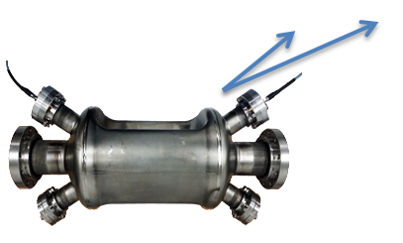
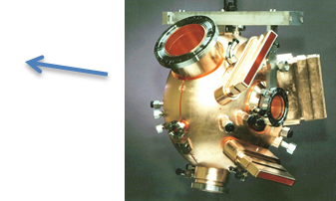
Overview of the MEIC Electron Complex
Stage I
CEBAF as full-energy e⁻/e⁺ injector
Ring energy 3-10 GeV e⁻/e⁺
Collider ring uses PEP-II 476MHz RF system (cavities, klystrons, and distribution components)
Stage II
Upgrade to 952MHz SRF system in the e-ring
12-20GeV e⁻/e⁺
MEIC Electron Collider Ring
(e-ring)
Crab
IP
e-RF
e-RF
Crab
Future IP
Electron Injector
Hall D
12 GeV CEBAF
Halls A, B, C

Slide 4
Overview: MEIC e-ring
Figure-8 shape to preserve spin polarization in ion ring
3-10 GeV, up to 3 A, up to 10 MW synchrotron radiation power
Re-use PEP-II RF system, frequency 476 MHz (1/6 of 2856 MHz from SLAC linac)
Transverse damping time τ_{d} = 6 ~ 376 ms
~2150 m circumference (7.17µs revolution time), may increase to ~2268 m (Nh=3600)
Provides two bunch trains with opposite polarization in the same ring, 3.2-3.5 µs each, with two 0.2-0.5 µs gaps in between (for kicker rise/fall time, ion clearing, etc)
To synchronize with slower ions at different energy (12-100 GeV/u), e-ring circumference varies by up to 6 m, harmonic number may vary by up to 9, and RF frequency varies by ±70kHz; for most of the ion energy range (40-100 GeV/u), harmonic number doesn’t not need to change
Down polarized bunch train
Up polarized bunch train
~5% gaps

Slide 5
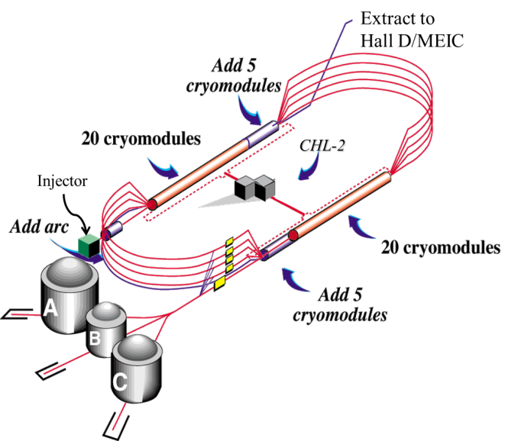
Overview: CEBAF
5.5 passes recirculating linac, newly upgraded to 12GeV
Beam gets accelerated 6 passes in north linac, 5 passes in south
Provides ~1MW CW extracted beam power, with ~2.6MW installed klystron power
~0.5MW CW RF to beam power in each of north and south linacs
RF frequency 1497MHz, 4.2µs revolution time
10 new C100 cryomodules, 40 original C50/C25 cryomodules

Slide 6
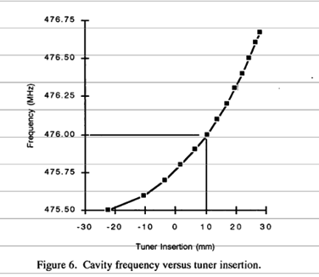
Frequency Matching
Bunch repetition rate from the electron gun should be integer fraction of both CEBAF and the collider ring
$$f_{CEBAF}=1497 MHz$$
$$f_{gun}=\frac{1497}{22}MHz=68.045 MHz$$
$$f_{Ring}=7{×f}_{gun}=476.318 MHz$$
476.3MHz falls within the tuning range of PEP-II RF cavities and klystrons, even with the detuning budgeted for beam loading and Robinson instability
PEP-II Cavity tuning range
(SLAC-PUB-7502)

Slide 7
Bunch Train Time Structure Injected into the e-ring
One gun provides two polarization states in CEBAF with two laser,
Injects 1 in every 7 ring buckets during 1 mid-cycle, 7 mid-cycles form 1 full-cycle
If Nh=7×N, ring RF phase need to advance several 476MHz bucket in every half of each mid-cycle. Can be achieved by shifting frequency by 1-100Hz to get the desired phase change, depending on damping time.
No need to shift phase in the other cases
Max charge per bunch is about 35pC
Mid-cycle 1, inject the 1st of every 7 buckets in the ring
injector pulse train up polarization from gun
injector pulse train down polarization from gun
68.05MHz bunch train, 3.23µs 220 bunches (I_{ave}≈2.4mA @3GeV)
68.05MHz bunch train, 3.23µs, 220 bunches (I_{ave}≈2.4mA @3GeV)
14.69 ns, 68.05 MHz (22 CEBAF buckets, 7 ring buckets)
2.1ns, 476.3 MHz (1 ring bucket)
1ps, 35 pC bunch
Waiting for damping
6-350ms
……
……
~τ_{d}, 6-350ms, ~N+1/2 turns in the ring
12-700ms, ~2τ_{d}, 2N+1 turns +1(or 2) bucket in the ring
Full-cycle, inject buckets in the full ring (example of Nh=3597 or 14N-1)
Mid-cycle 1
Injects 1st of every 7 buckets
Mid-cycle 2
Injects 2nd of every 7 buckets
~τ_{d} (6-350ms), 7N turns +1799 ring buckets in the ring
~τ_{d} (6-350ms), 7N turns +1799 ring buckets in the ring
~τ_{d} (6-350ms)
7N turns +1792 buckets in the ring
Full cycle ~14τ_{d}

Slide 8
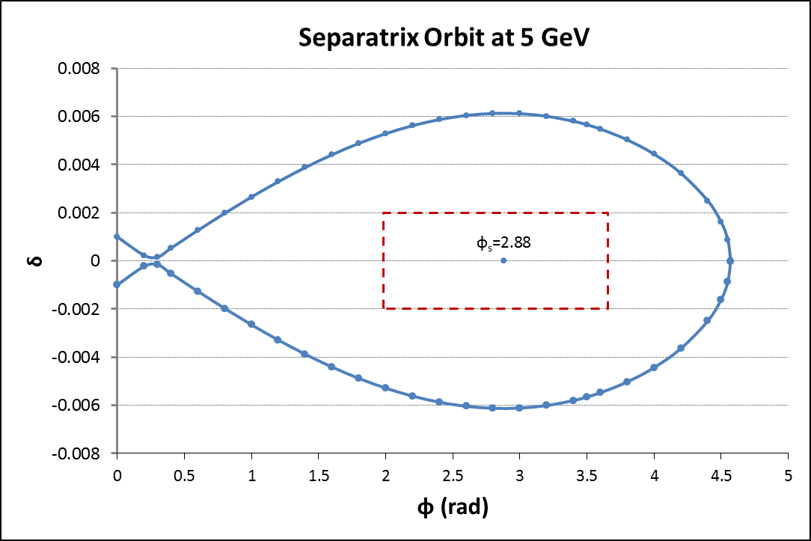
Dealing with Frequency Change Required by Electron/Ion Ring Sync
Currently, E-ring/I-ring sync at different ion β requires a change of electron path length in combination of change in harmonic number N_{h} and RF frequency in rings.
Range of RF frequency change is ±0.5f_{rev} if N_{h} can change in step of 1. ±70kHz for the 476.318MHz system assuming Nh≈3400
CEBAF can’t provide enough frequency change to match this change in ring frequency, as it requires ±10cm in each arc and exceeds the capability of the CEBAF. But we can live with this mismatched frequency of ±0.5*f_{rev}, and the resulting ±45° max RF phase error
Same ±45° max RF phase error after upgrade to 952.6MHz SRF system.
45° ($\frac{N_{h}}{4}\frac{f/2N_{h}}{f}360°$)
Δf=-70kHz
f₀=476.318MHz
Δf=+70kHz (f_{rev}/2, or f₀/2/N_{h})
Bucket #
0
850 (N_{h}/4)
1700(N_{h}/2)
RF phase error in the injected train with frequency mismatch between CEBAF and collider ring
Longitudinal acceptance in the collider ring

Slide 9
Bunch Train Time Structure in CEBAF
bunch train structure from the gun
~N+1/2 turns in the ring
Each bunch train 3.23µs
~τ_{d}, 6-350ms
~τ_{d}, 6-350ms
~τ_{d}, 6-350ms
bunch train structure in the CEBAF North linac
~N+1/2 turns in the ring
0.97µs
Each bunch train 3.23µs
~τ_{d}, 6-350ms
~τ_{d}, 6-350ms
~τ_{d}, 6-350ms
24.23µs, 6 turns-0.97µs in CEBAF (4.2µs per turn)
Each bunch train from the gun is 3.2-3.5µs, shorter than the CEBAF circumference 4.2µs
This time structure is independent of ring RF frequency
Head of the bunch train won’t see the tail in CEBAF
Multi-pass BBU won’t be an issue
Beam can gain up to $\frac{5.5MW∙4.2μs}{3.2μs}$ in pulsed power at different energy, after 5.5 passes in CEBAF; cavity coupling need to be tuned with stub tuners for different energy.

Slide 10
Pulsed Operation of CEBAF and Gradient Droop
Gradient drooping in a typical C100 cavity (Qe=3.2×10⁷) operating at 12.5MV/cav (corresponding to 12GeV) and 0.6mA pulsed beam current (7.2MW), assuming on resonance operation (need extra power for off resonance operation, with same droop)
CW RF input
Drooping Vc=12.5MV, ΔV/V≈0.38%
~τd
P=1.44kW
Each bunch train 3.233µs
0.967µs
~τd
24.23µs, 6 turns-0.97µs in CEBAF (4.2µs per turn)
Pulsed RF input with feed-forward.
Flat Vc=12.5MV, ΔV/V≈0.015% due to small gaps
~τd
P=5.85kW
0.967µs
~τd
Each bunch train 3.233µs
P=1.44kW
24.23µs, 6 turns-0.97µs in CEBAF (4.2µs per turn)

Slide 11
Gradient Droop of CEBAF Cavities w/ CW RF Power
Klystron power will be close to CW. Given the low duty factor of the beam current, this klystron power is only sufficient to provide the desired cavity voltage with no beam loading.
With beam loading, beam need to take power from the cavity’s stored energy
Have to lower current to reduce gradient droop, increasing injection time
Gradient droop in typical CEBAF cavities with CW RF:
Cavity type | Typical Q_{e} | Vc (MV) | Energy (GeV) | Extracted Ib(µA) | τ_{d} (ms) | ΔVc/Vc | Δp/p | Implied injection time for MEIC (minutes)
C100 | 3.2×10⁷ | 12.5 | 12 | 200 | 6 | 0.13% | 0.2% | ~0.4 (I_{ring}=341mA)
C50 | 6.6×10⁶ | 6.0 |  |  |  | 0.14%
C20 | 6.6×10⁶ | 3.0 |  |  |  | 0.29%
C100 | 3.2×10⁷ | 6.25 | 6 | 100 | 47 | 0.13% | 0.2% | ~50 (I_{ring}=3A)
C50 | 6.6×10⁶ | 3.0 |  |  |  | 0.14%
C20 | 6.6×10⁶ | 1.5 |  |  |  | 0.29%
C100 | 3.2×10⁷ | 3.1 | 3 | 50 | 376 | 0.13% | 0.2% | ~840 (I_{ring}=3A)
C50 | 6.6×10⁶ | 1.5 |  |  |  | 0.14%
C20 | 6.6×10⁶ | 0.75 |  |  |  | 0.29%
CEBAF arc momentum acceptance is ±0.2%

Slide 12
Gradient Droop of CEBAF Cavities w/ pulsed RF Power
Pulsate klystron power with feed-forward to reduce the gradient droop.
Cavity voltage close to constant, no periodic Lorentz force detuning
Coupling needs to be optimized with stub-tuners.
Gradient droop in typical CEBAF cavities with pulsed RF (assume 3.23µs bunch train):
Cavity type | Desired Q_{e} | Vc (MV) | Klystron power (kW) | Energy (GeV) | Ib_{ext} (µA) | Ib_{ext} (µA) Current CEBAF CW | Q/bunch, 68MHz (pC) | 2τd (ms) | ΔVc/Vc | Δp/p | MEIC injection time (minutes)
C100 | 1×10⁷ | 3 | 4.9 | 3 | 1500 | ~100 (Due to BBU) | 22 | 752 | 0.14% | 0.2% | ~25
C50 | 6.6×10⁶ | 1 | 1.7 |  |  |  |  |  | 0.25%
C20 | 6.6×10⁶ | 1 | 1.7 |  |  |  |  |  | 0.25%
C100 | 3.3×10⁶ | 3 | 6 | 3 | 2400 | ~100 | 35 | 752 | 0.24% | 0.33% | ~16
C50 | 3.3×10⁶ | 1 | 2.4 |  |  |  |  |  | 0.40%
C20 | 3.3×10⁶ | 1 | 2.4 |  |  |  |  |  | 0.40%
C100 | 1×10⁷ | 6 | 5.7 | 6 | 1200 | ~170 | 18 | 94 | 0.06% | 0.08% | ~4
C50 | 6.6×10⁶ | 2 | 1.9 |  |  |  |  |  | 0.10%
C20 | 6.6×10⁶ | 2 | 1.9 |  |  |  |  |  | 0.10%

Slide 13
Initial Injection Time
Assume currently CEBAF can get ~1MW CW beam power from the cavities at 3-12 GeV, then we should be able to get ~5.5MW pulsed beam power in the proposed scheme with RF feed-forward. Considering the 0.967µs gap in the bunch train we can have
$$I_{inj}≈\frac{5.5\left(MW\right)}{E\left(GeV\right)}\frac{C_{CEBAF}}{bunch train length}\left(mA\right)≈\frac{7.2\left(MW\right)}{E\left(GeV\right)}(mA)$$
$$T_{inj}=τ_{d}\frac{I_{ring}}{I_{inj}}\frac{C_{ring}}{bunch train length}≈τ_{d}\frac{I_{ring}(mA)E(GeV)}{5.5MW }\frac{C_{ring}}{C_{CEBAF}}$$
Actual injection time for E>6 GeV might be also limited by other factors, but should not exceed 4 minutes

Slide 14
Reduced Collision Rate
In the operation with higher e-ring energy, beam-beam tune shift is reduced due to both the higher beam energy and the lower beam current.
We may be able to increase luminosity by reducing the collision rate to a fraction n of 476.3MHz and increase charge per bunch in the ring.
If n=7 (which is likely to happen at energy close to 12GeV), we can simply make each mid-cycle equals 7N revolutions in the ring, and repeat injecting the 1st in every 7th ring buckets only.
If n is a number between 2 and 6, we can arrange to inject the 1st of every 7×nth bucket in the first pair of bunch trains, then fill the (1+n)th in the 2nd pair, until we finish 7 pairs.
The charge per bunch needs to be raised by n times, but since it only happens at higher energy, the max charge per bunch is expected to be less than 70pC.
Full-cycle, inject ½ of the buckets in the full ring (example of Nh=3596 or 14N-2)
1st of every 14 U buckets
3rd of every 14 U buckets
5th U
~τ_{d} (6-350ms)
3.5N turns +3584 buckets in the ring
1st of every 14 D buckets
3.5N turns in the ring
3.5N turns + 3598 buckets in the ring
3rd D
Full cycle ~14τ_{d}

Slide 15
Kicker Requirement
Forms local transverse orbit bump with 3 kickers near the septum
Rise/fall time <≈ gap length, ~200ns
Flat top >≈ bunch train length, ~3.5µs
Max repetition rate: 20 Hz is acceptable (enough to achieve ~4 min injection time for E>6GeV, may need to operate at lower rate at lower energy)
Specifications are considered as “conventional”.
Detailed kicker beam optics needs to be implemented.

Slide 16
Summary and Outlook
We developed an injection scheme that matches the MEIC electron collider ring with PEP-II RF system and the CEBAF as an injector.
The RF frequency of the ring will be 476.32MHz ±70kHz, which is within the operational range of the PEP-II cavities and klystrons.
Gradient drooping has been studied. After adding RF feed-forward in the CEBAF linac, the estimated injection time will be satisfactory for the full range of 3-12 GeV, with tolerable energy deviation in the injected bunch train.
The required charge per bunch from electron gun is up to 35pC for 476MHz operation. For reduced collision rate operation at higher energy, charge per bunch from gun is not likely to be more than 70pC.
Currently there is no show stopper for this injection scheme.
A proof of principle experiment of the RF feed-forward might be done in the future.
Kicker beam optics design needs to be implemented.

Slide 17
Acknowledgements
This work is done by the MEIC accelerator design study group, particularly
Joe Grames, Leigh Harwood, Curt Hovater, Andrew Hutton, Fanglei Lin, Vasiliy Morozov, Matt Poelker, Riad Suleiman, Robert Rimmer, Haipeng Wang, Shaoheng Wang, Yuhong Zhang (Jefferson Lab)
Mike Sullivan, Uli Wienerds (SLAC)

