Slide 1
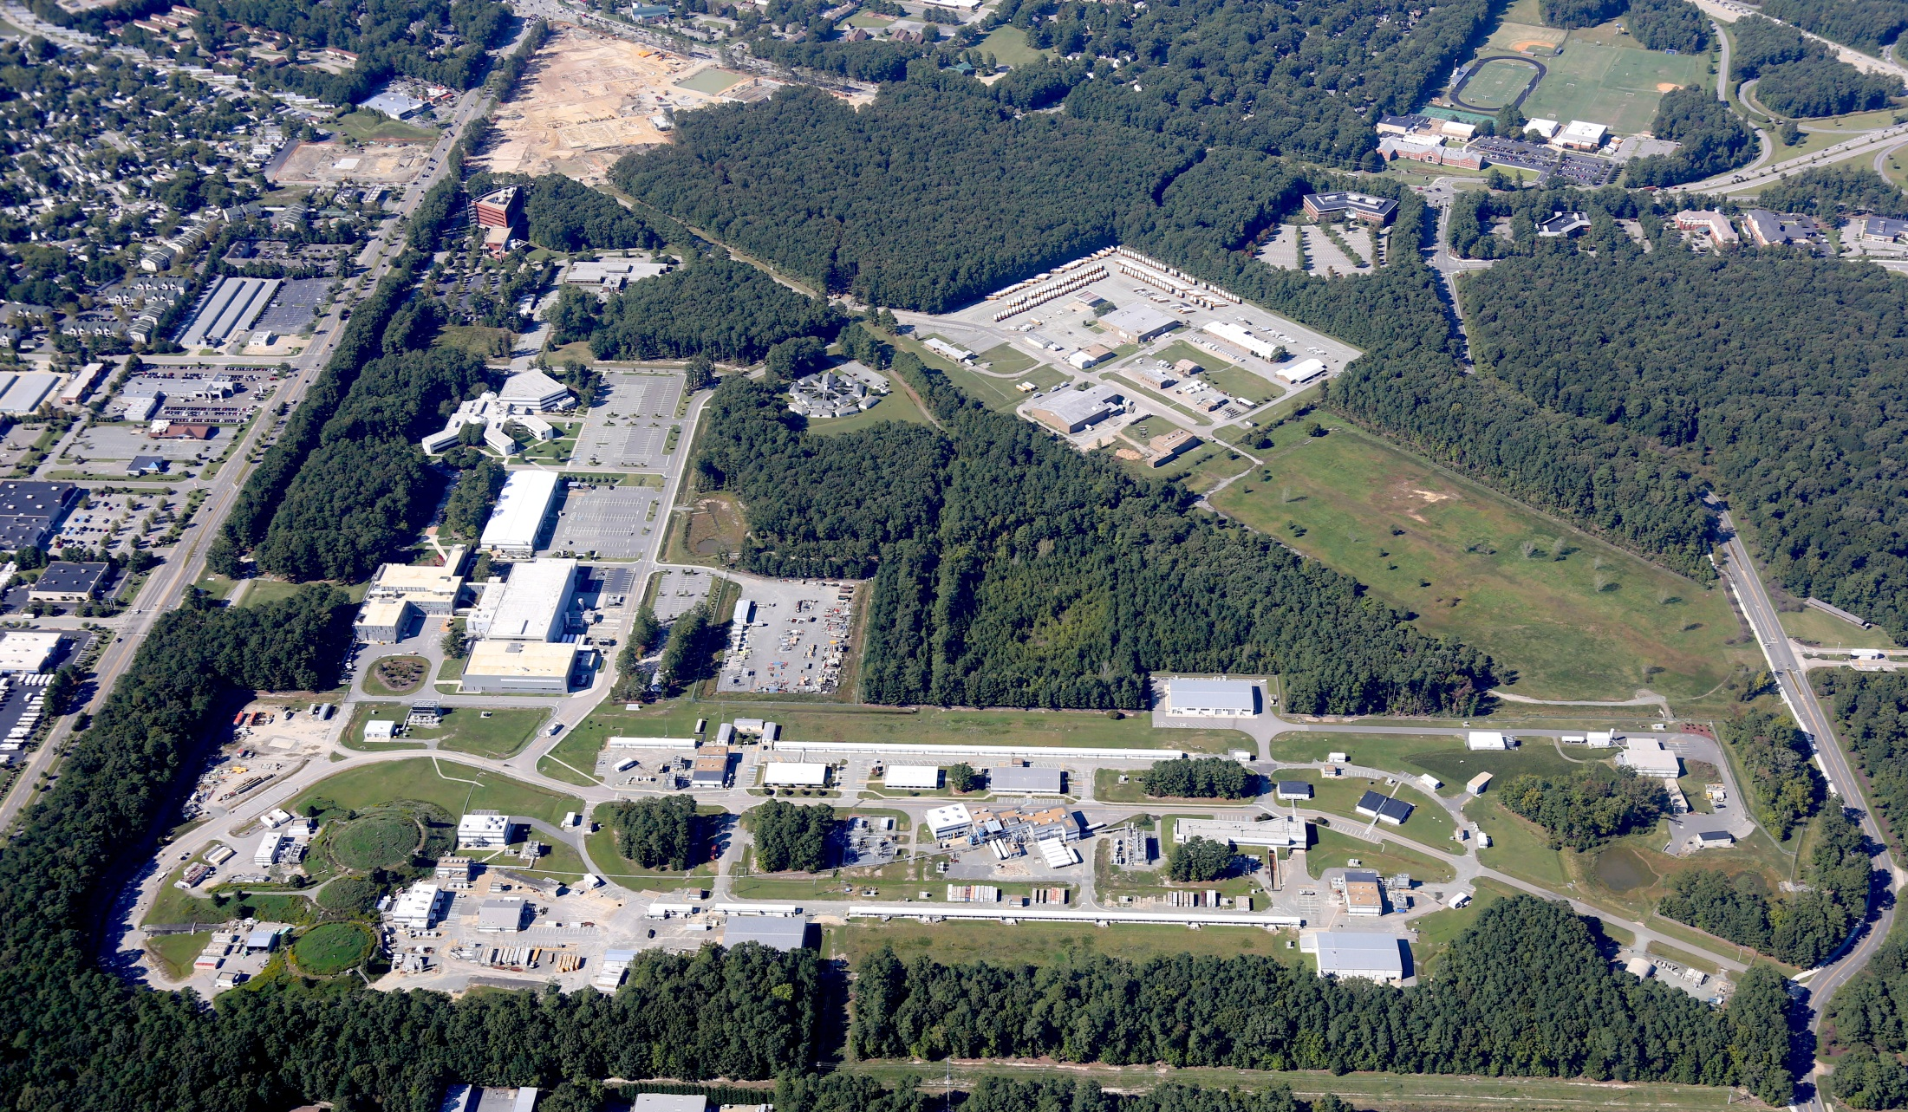
PEPII Magnet Feasibility in the MEIC ECR
Tommy Hiatt – MEIC Collaboration 10/07/2015

Slide 2
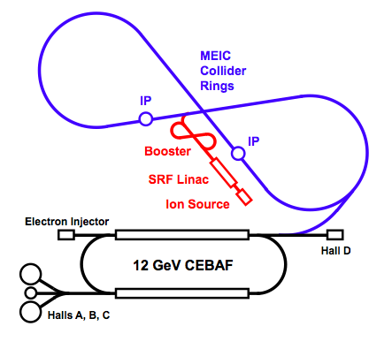
Introduction
Background
Available Quantities
Dipole Analysis
Quadrupole Analysis
Sextupole Analysis
Future Plans
Summary
Booster
Linac
Ion Source

Slide 3
Background
PEPII HER magnets are being considered for repurposing in the MEIC ECR
A deck was proposed (Dec 2014) that specifies quantities and strengths for several types of PEPII magnets
The MEG is endeavoring to understand the feasibility of using the repurposed PEPII magnets as prescribed in the deck
Cross checked magnet availability between the deck and PEP publications
Conducted several analysis to evaluate their usefulness
Field Analysis
Linear hand calculations of field strength (order of scale sanity checks)
2d Tosca modeling (some 3d too)
Saturation effects
Field strength
Gauge field quality
Cooling Analysis
Pressure drop
LCW velocity
Temperature rise

Slide 4
Available Quantities
We need to know how many and what kinds of magnets are available to put in the ECR.
There are two sources for the information - ’93 PEPII CDR and the ‘07 SuperB documents
The way the two documents refer to the magnets don’t match but the physical and magnetic characteristics do…mostly…
‘93 CDR named magnets by physical characteristic ie. “2.8C212”
SuperB named magnets by function/location ie. “IR Soft Bends”
Key to matching between the two documents was by physical and performance characteristics
Combed through the Deck magnet characteristics and grouped them by like types and field strengths
Deck element names are associated with location and type ie. “BXARCL”
Deck specified other (non-PEPII) magnets as “new”

Slide 5
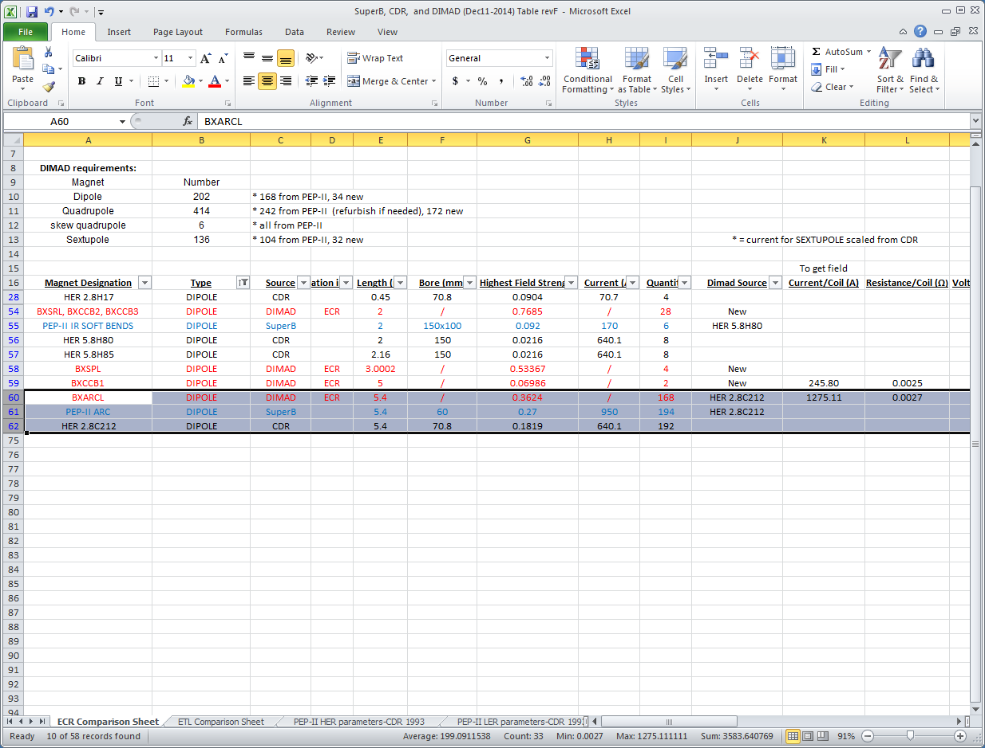
Available Quantities (cont.)

Slide 6
Available Quantities (cont.)
Magnet Name (‘93 CDR) | MEIC – ECR Quantity Required | 2007 SuperB CDR Available Quantity | 1993 PEPII CDR Available Quantity | ECR Field Strength Required (T, T/m or T/m²)
2.812C212 | 168 | 194 | 192 | 0.3624
4Q22 | 166 | 202 | 94 | 16.96
4Q29 | 88 | 81 | 82 | 17.53
10SF/10SD | 136 | 104 | 144 | 210
The two sources for quantities don’t reconcile
‘07 SuperB document doesn’t match ’93 PEPII CDR
(Uli tends to think SuberB is likely correct)
Another count will be performed at SLAC to confirm available quantities
Any shortages can be handled during the procurement of the new magnets that will be required in the ECR

Slide 7
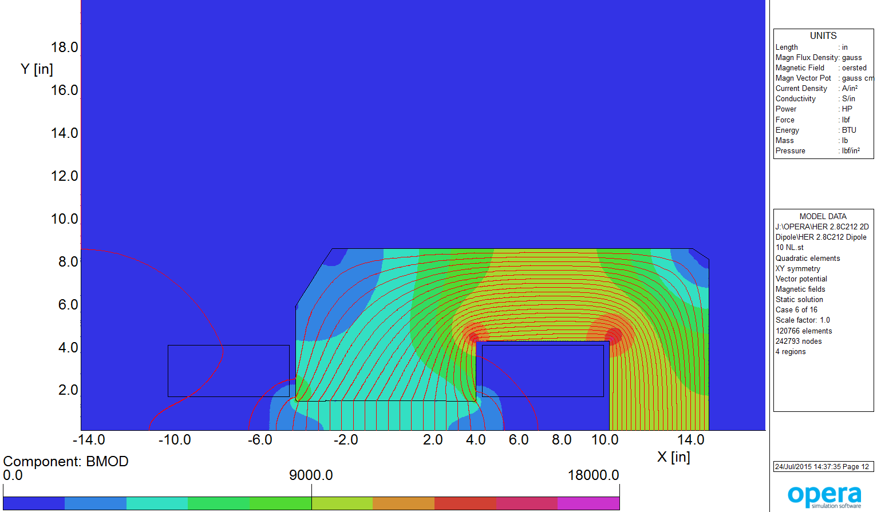
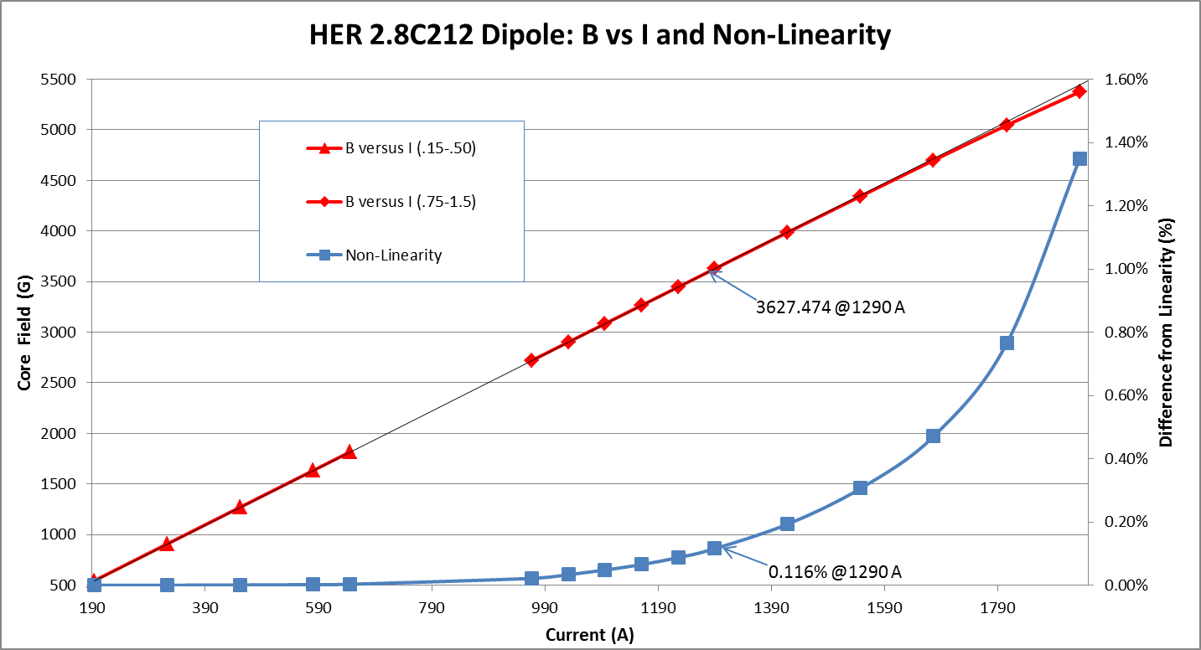
Dipole Analysis
“2.8C212” – ‘93 CDR name
12 GeV - 0.36T @ 1290 A
<0.2% saturation
~19 °C dT at 100 psid per coil
@ 12 GeV
0.3T @ 10 GeV (baseline)

Slide 8
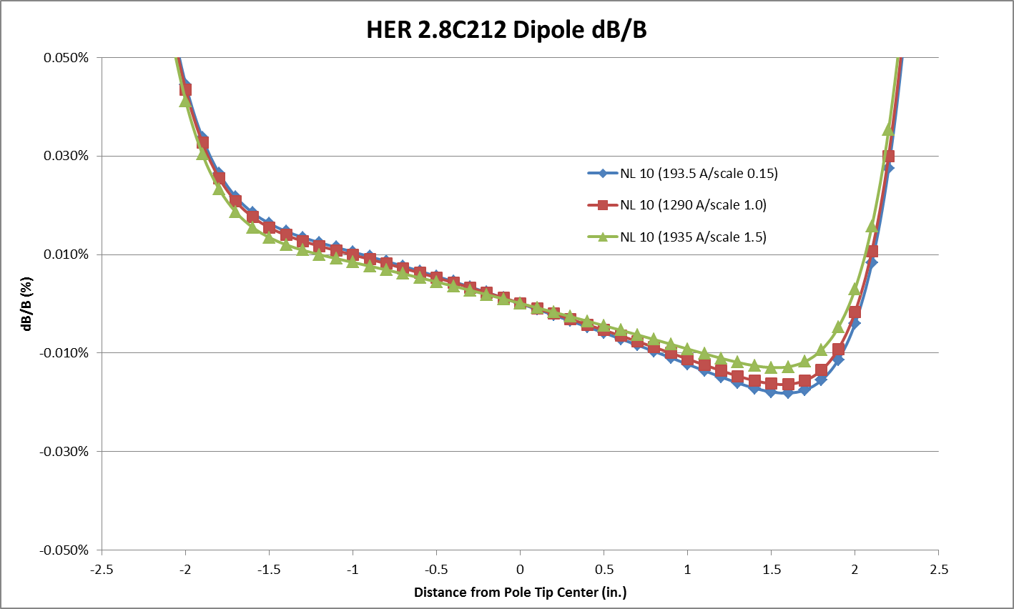
Dipole Analysis (cont.)
“2.8C212”
From 2-18 GeV dB/B flat at ~0.06%
Arc dipole transverse aperture @ 10 GeV: ± 4cm
±(10σ_{x} + sagitta/2 + 1cm closed orbit distortion)

Slide 9
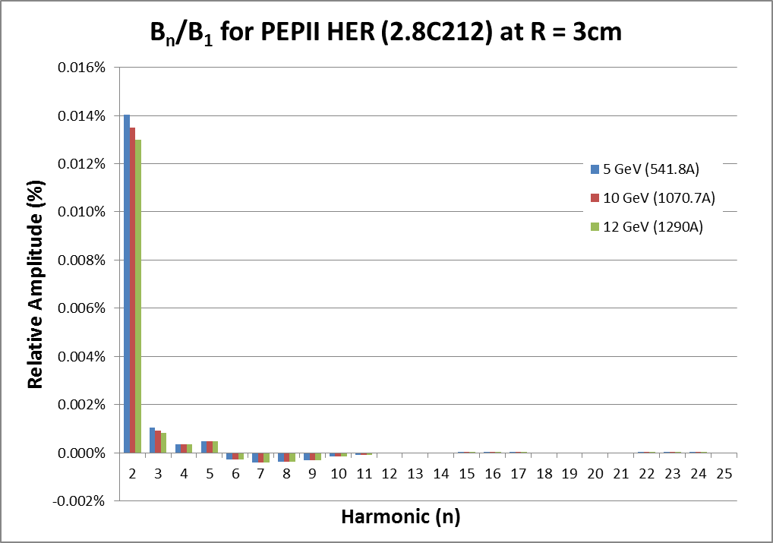
Dipole Analysis (cont.)
“2.8C212”
Harmonics taken at 3 cm (84%) aperture at 5, 10 and 12 GeV

Slide 10
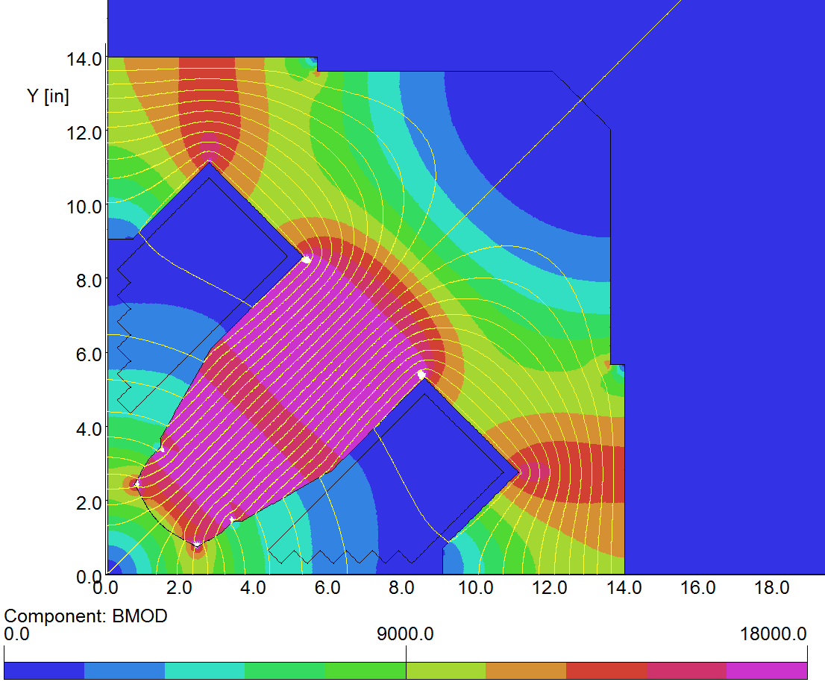
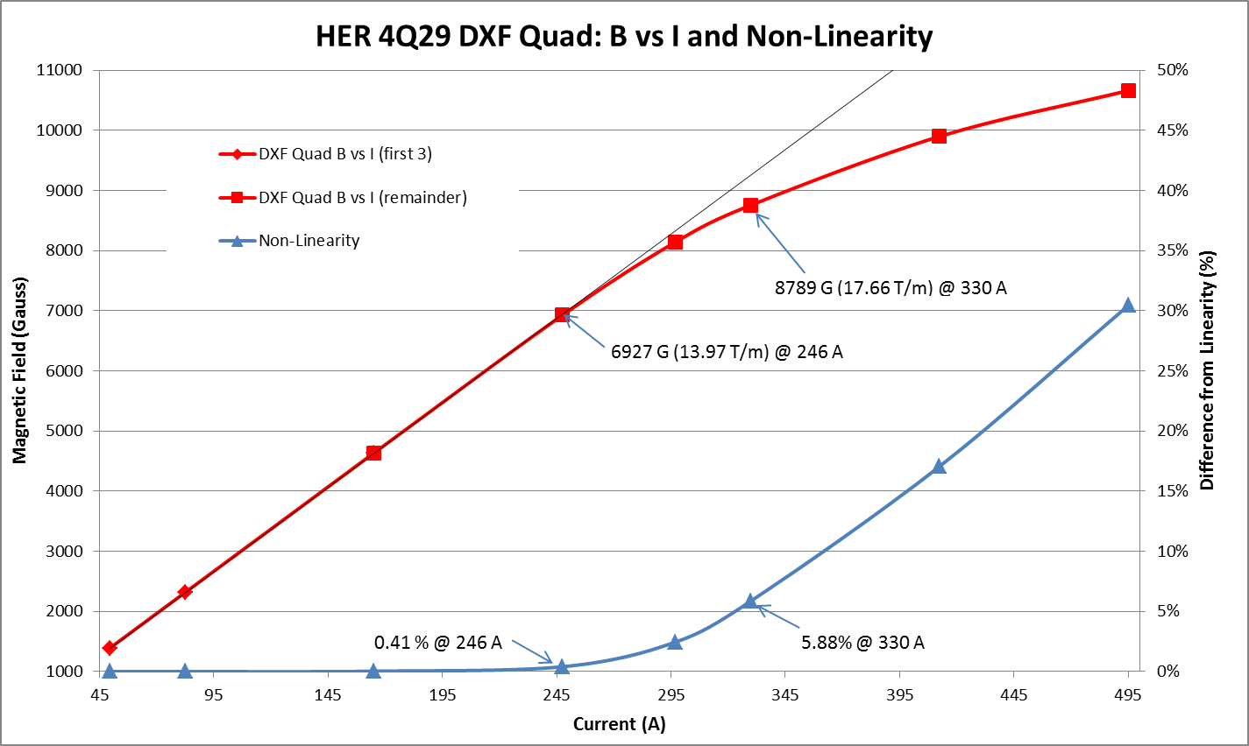
Quadrupole Analysis
“4Q22” and “4Q29” ‘93 CDR
Both quads have the same cross
section
17.7T/m @ 330 A
~6% saturation
~11°C dT @ 100 psid per coil
Most PEP-II quads used in the MEIC baseline design have the gradient lower than 14 T/m at 10 GeV. There are some quads running close to 17T/m, but their gradients can be (hopefully) reduced by the optics adjustment in the future.

Slide 11
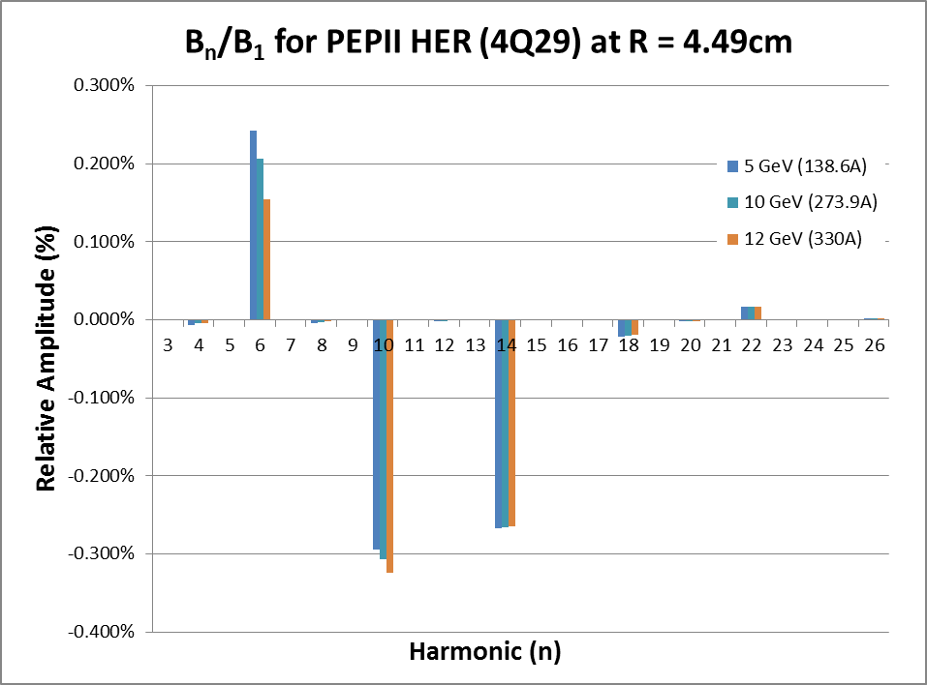
Quadrupole Analysis (cont.)
“4Q22” and “4Q29” –’93 CDR name
Harmonics taken at 4.49 cm (88%) aperture at 5, 10 and 12 GeV

Slide 12
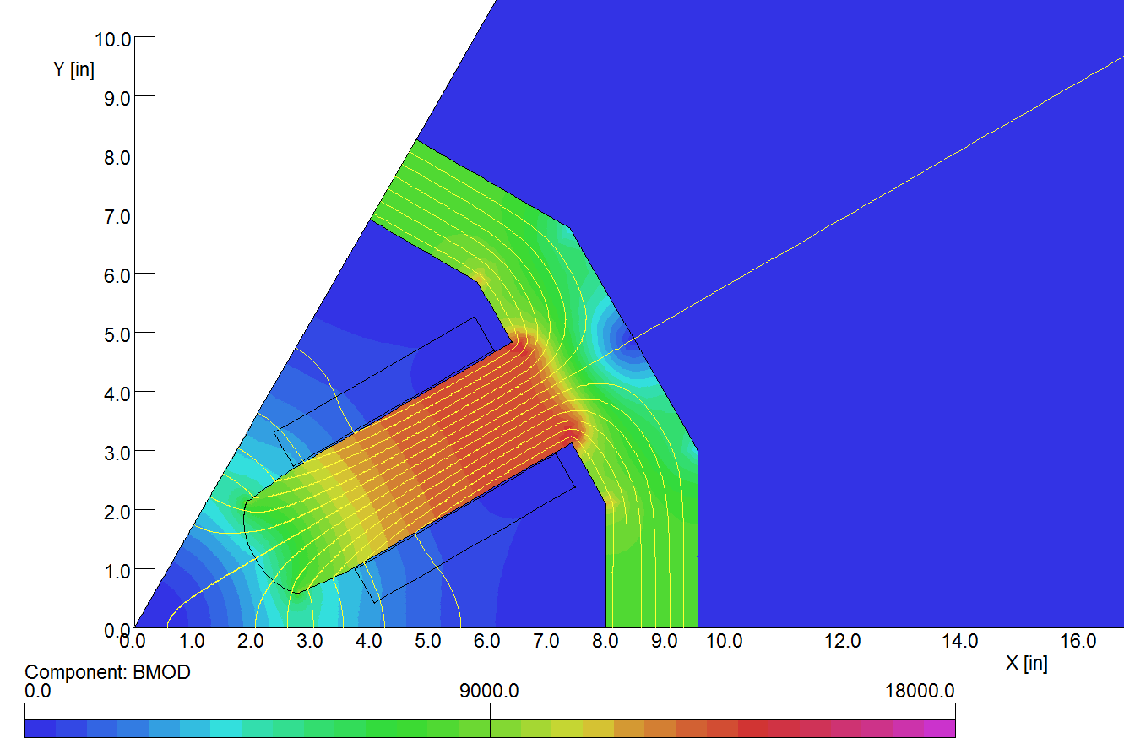
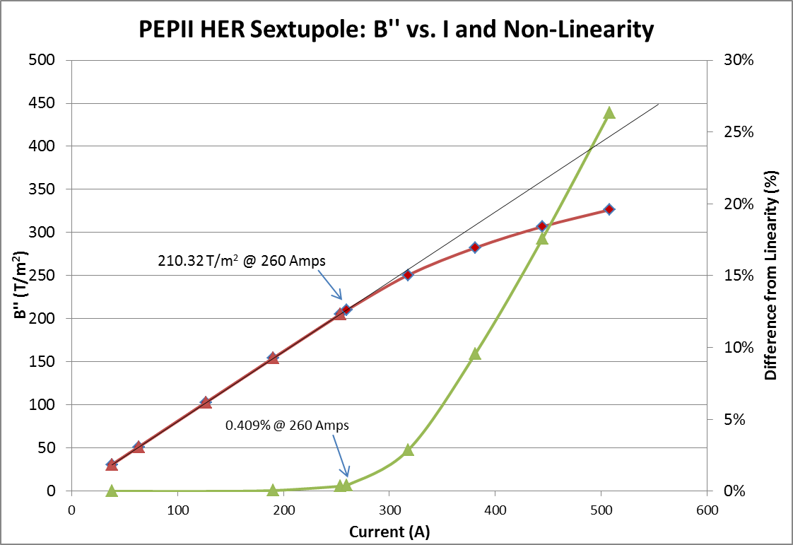
Sextupole Analysis
“10SD”/”10SF” ‘93 CDR name
Documentation doesn’t distinguish “10SD” from “10SF”
210 T/m² @ 260A
<0.5% saturation
~7°C dT @ 100 psid per coil

Slide 13
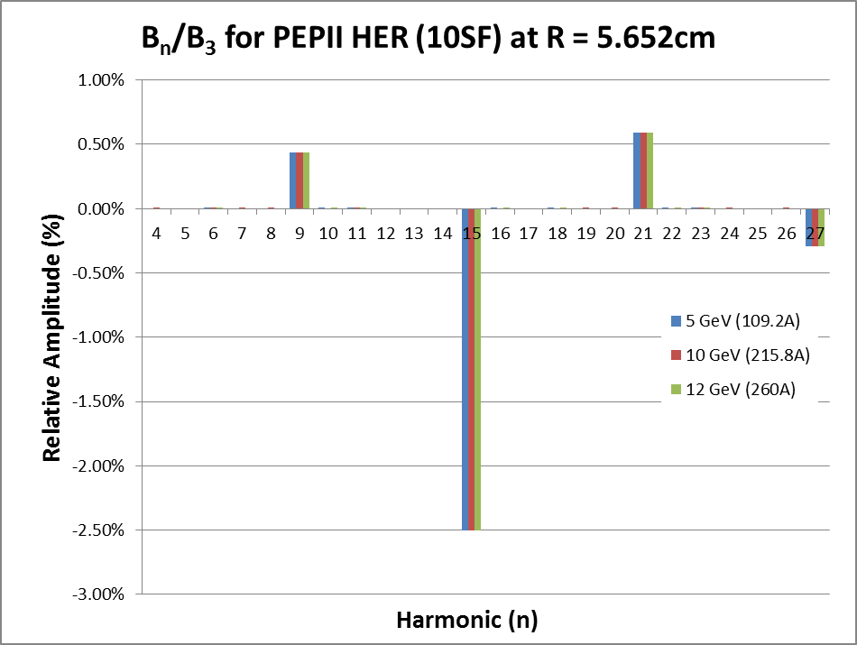
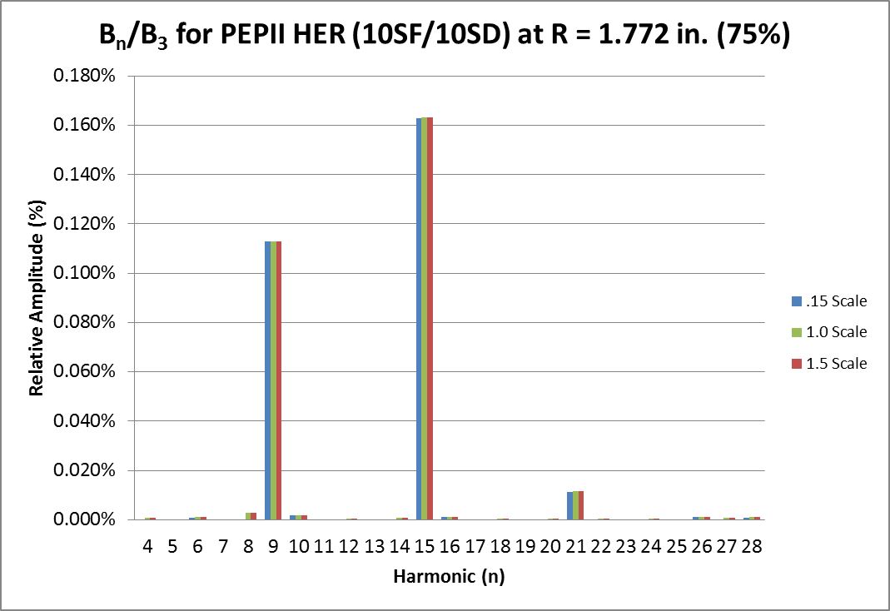
Sextupole Analysis (cont.)
“10SD”/”10SF” – ’93 CDR name
Harmonics taken at 5.65 cm (94%) aperture at 5, 10 and 12 GeV

Slide 14
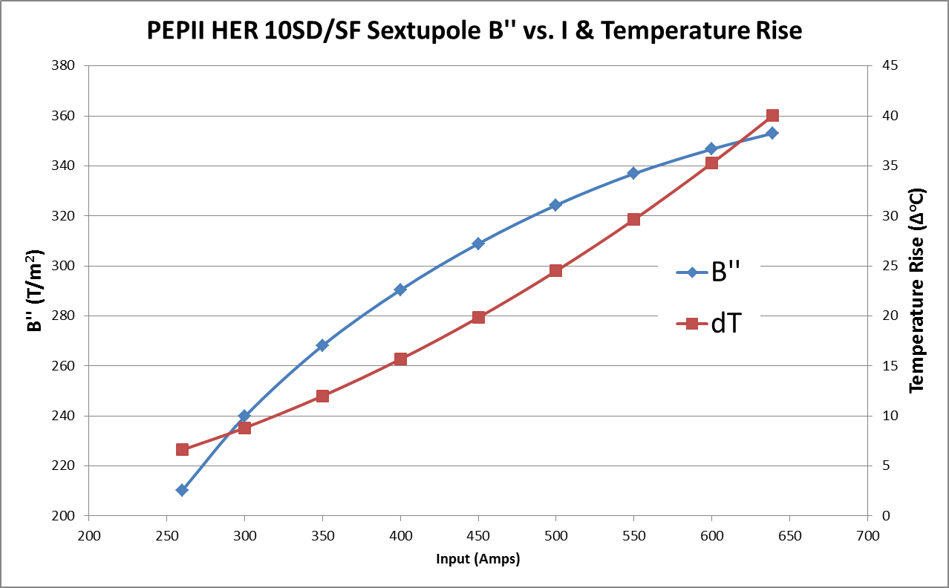
Sextupole Analysis (cont.)
Max achievable sextupole field ~360 T/m²
Saturation limits field
Joule heating reaches allowable 40 C dT (assuming 100psid )

Slide 15
Future Plans
The plan is to continue to evolve our understanding of repurposing issues
A magnet team will visit the PEPII ring
Count magnets
Visually examine magnets in situ
Maybe even hipot or flow check some of the magnets
Several magnets (at least one of each type) will be identified for removal and shipment to JLab
Magnets will be assessed and measured at JLab
Understand the full scope of refurbishment requirements
Understand field characteristics
Compare to models
Provide harmonic and strength information to CASA

Slide 16
Summary
Confirmed that all of the PEPII magnets can achieve the field strength requirements prescribed in the Dec 2014 deck
Confirmed that all of the magnets can be sufficiently cooled at those field strengths (LCW temperature rise less than 40 °C per coil)
A magnet team will visit the PEPII ring to count and examine magnets
Any shortages in magnet availability can be handled in conjunction with new magnet procurements
Several magnets (at least one of each type) will be identified for removal and shipment to JLab
Magnets will be assessed and measured to understand the full scope of refurbishment requirements and field characteristics

