Slide 1
Polarimetry in RHIC
Haixin Huang
Oct. 7, 2015
MEIC 2015

Slide 2
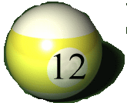
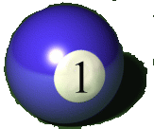
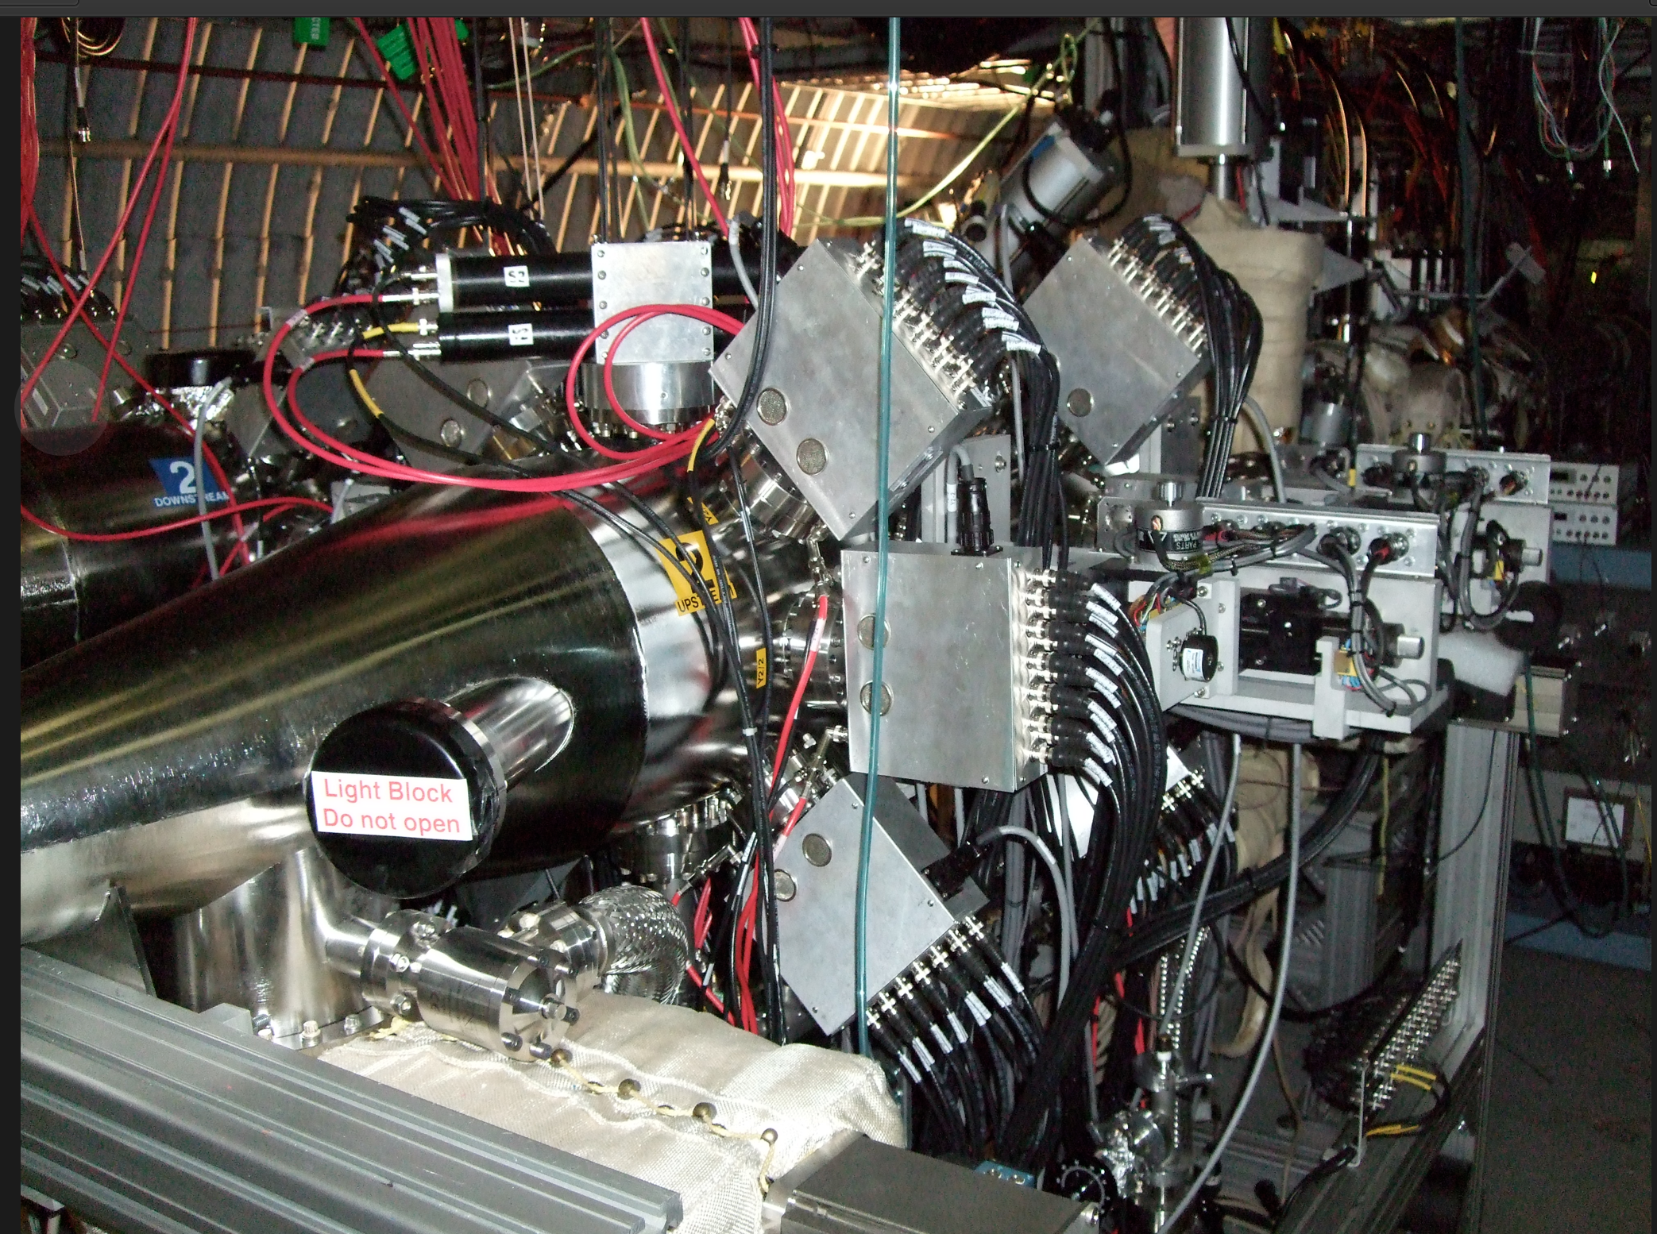
The RHIC p-Carbon CNI polarimeter
Elastic scattering: interference between electromagnetic and hadronic amplitudes in the Coulumb-Nuclear Interference (CNI) region.
A_{N}(pC)~1%
Carbon target
Polarized proton
Recoil carbon
6
1
Ultra thin Carbon ribbon Target
(5 μg/cm²)
18cm
5
2
Si strip detectors
(TOF, E_{C})
4
3

Slide 3
Si Ports Design
1, Preamp cards removable for baking
2, Minimizing distance between Si and preamp input
3, Reduce the effect of induced current by beam with fine mesh
Vacuum boundary
Preamp card
Fine mesh for electric shield
Si
Feed through
(Designed by George Mahler)
Detector ports

Slide 4
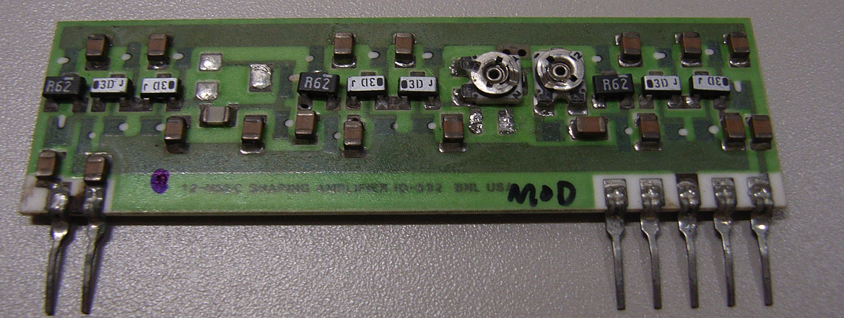
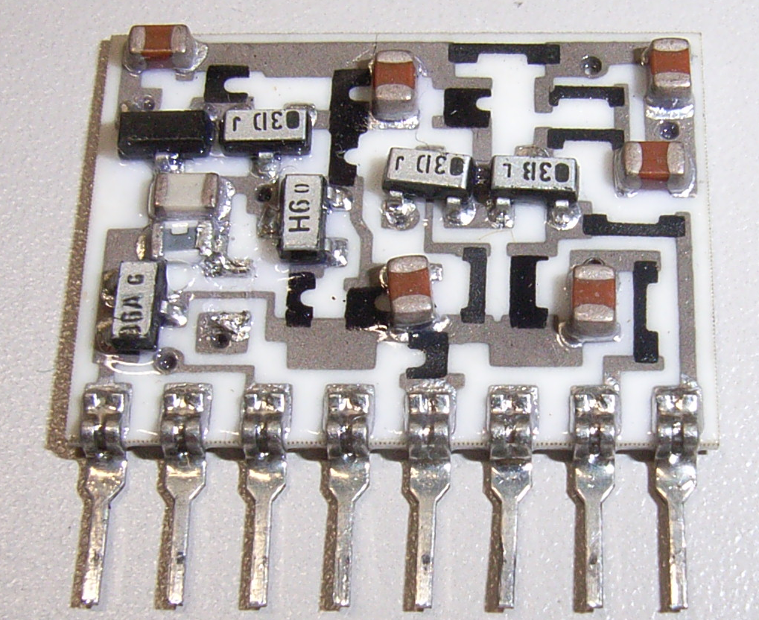
Si Detector Readout
Preamp
RG59
~300ft
WFD*
(FPGA)
shaper
IO446-2
Si strip detector
Mode 1
Mode 3
Mode 2
~50ns
E,T
~300mV
Identify Carbons using lookup table and records counts bunch by bunch
Carbon pulse after shaping
*WFD=Wave Form Digitizer (420MHz, 8bit )

Slide 5
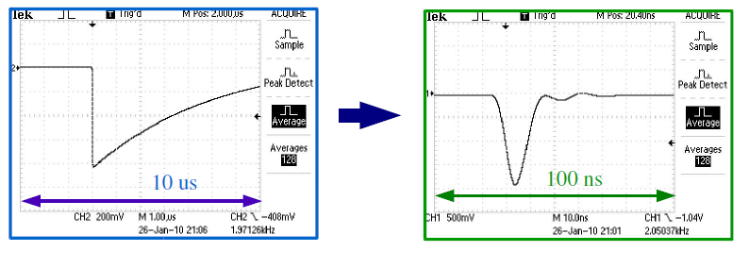
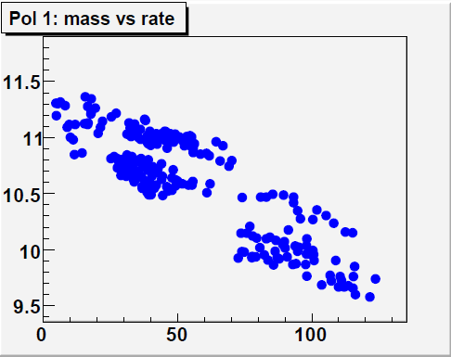
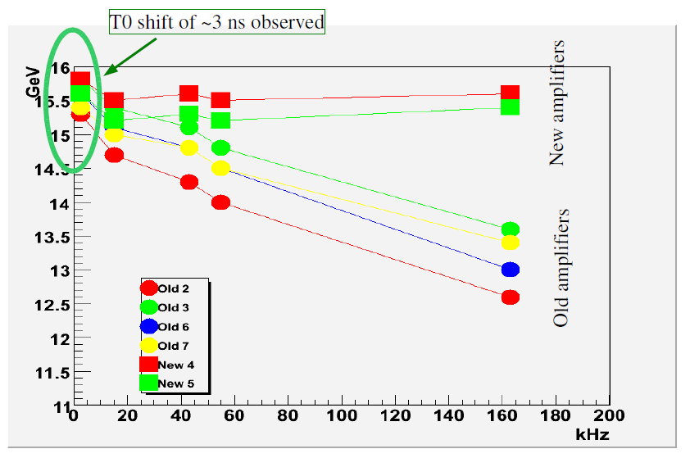
Rate Problem in Run9 and Solution
Run9, √s=500 GeV:
M∝E⋅ToF² vs Rate (kHz/strip)
Old amplifier
New amplifier
10 μs
0.1 μs
AGS tests, Mar 2010
Problems reproduced at AGS in Run 2010
No problems with new FEE (current sensitive amplifiers)

Slide 6
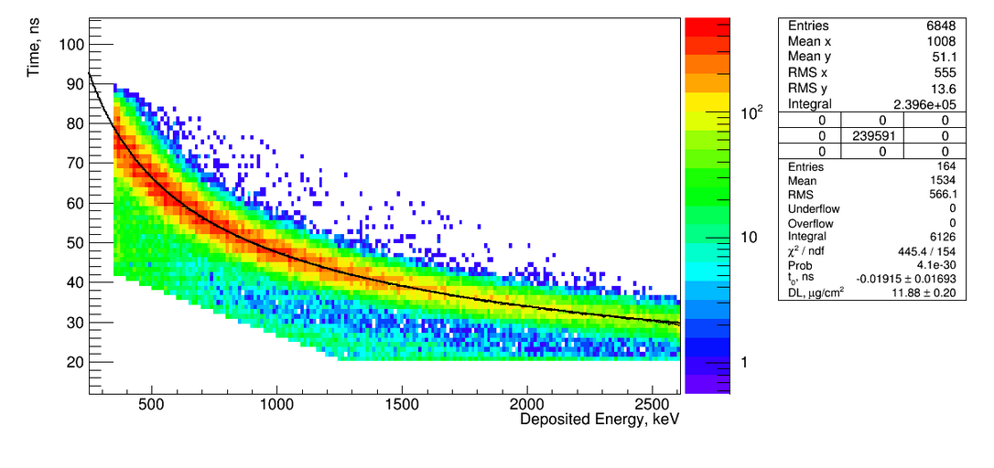
Carbon Event Selection
The effective energy losses E_{loss} and time offset t₀ are determined from the kinematical fit to the banana-like band
Carbon Events are selected within a Time-Energy window, 400 < T < 900 keV, optimized for minimal background

Slide 7
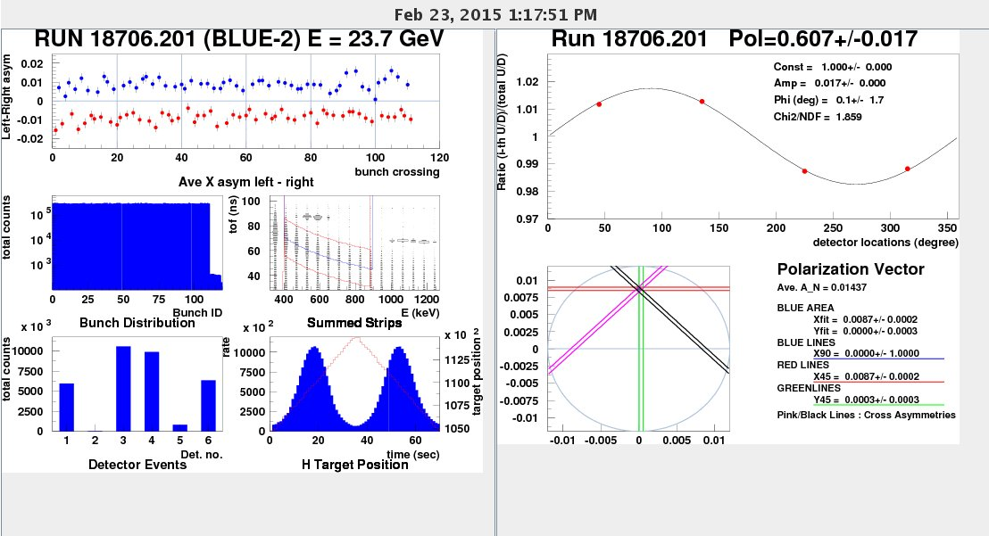
Bunch by Bunch Polarization is a Long Shot
Notes:
7

Slide 8
Operation of p-Carbon Polarimeter
Due to the target orientation and thickness variation, the calibration of p–Carbon polarimeter with polarized jet can not be once and done.
The polarized hydrogen jet needs to be running in parallel.
With upgraded Si detectors, the jet can give polarization error of ±3% for 8 hour store.
In sweep mode, a polarization of ±2% measurement can be done by p-Carbon polarimeter in about 30sec.
Normally, four sets of polarization measurements are done at store: 0, 3, 6, and 8 hours into a store. Each set consists of two polarization measurements done with horizontal and vertical targets, respectively. Besides polarization information, polarization profile information is also obtained.

Slide 9
Hydrogen Gas Jet and Carbon Ribbon Targets
H-Jet Target
Carbon Ribbon Target
Beam Cross Section
⬇
Average P_{ave}
Peak P_{peak}
Notes:
9

Slide 10
Carbon strip target deformation due to electrostatic interaction with the beam at injection energy 24GeV.

Slide 11
Carbon strip target deformation due to electrostatic interaction with the beam at 255 GeV.

Slide 12
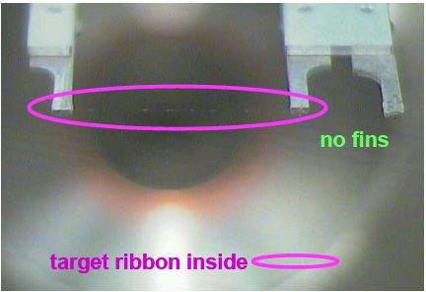
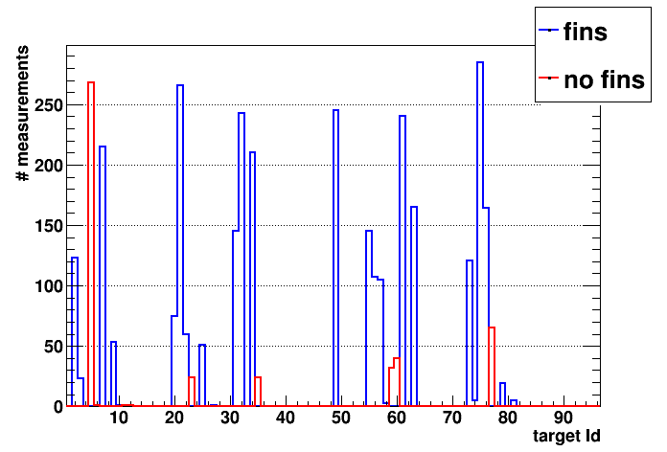
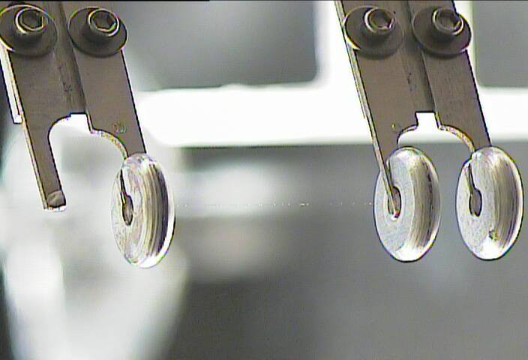
Hardware Improvements in 2015
use again 2mm Si-detectors → no gain instabilities
new target holders
EM simulation (J. Kewisch) showed beam charge induced high EM fields at target → frame attachment (lightning rod)
high fields ⇒ high current in target ⇒ heating
Such fins installed for 32 of 48 targets in 4 pC polarimeters (no room for fins other targets, hit chamber wall)
Fin size reduced from prototype (don't shadow detectors)
Targets survival

Slide 13
Target Sweep through Beam

Slide 14
Summary
The absolute polarization is determined from the polarized hydrogen jet running in parallel
p-Carbon polarimeters at RHIC have consistently performed well in 2011, 2012, 2013, and 2015
They provide information on the beam polarization profile and measures the polarization loss during a RHIC store
Target lifetime has improved thanks to the new fin design of the target holder

