Slide 1
Overview of RHIC Injector
Haixin Huang
Oct. 5, 2015
MEIC 2015

Slide 2
RHIC Injector Chain
To RHIC Injection
Pol. H⁻ Source
Gγ= 2.2... 4.5
Jump quads in adjacent super-periods I &J
EBIS
BOOSTER
Warm Helical Partial Snake
LINAC
AGS
200 MeV Polarimeter
Gγ= 4.5 … 45.5
AGS pC CNI Polarimeter
Cold Helical Partial Snake
AGS has been running as RHIC polarized proton injector with dual partial snakes and two horizontal tune jump quads. It has delivered 65-70% polarization with 2*10¹¹/bunch intensity and 80% as input polarization.
Notes:
Show layout & point of polarimeters and experimental locations
Emphasize bunch polarizations prepared at source going through AGS etc. to RHIC
Time spacing between them ~100 ns
Transverse polarization in ring, longitudinal at experiments (optional) using spin rotators
Emphasize none of these techniques existed just 4-5 years ago, all developed here at RHIC with international collaborations led by US and Japanese teams.

Slide 3
The OPPIS Upgrade with Atomic Hydrogen Injector
BNL - BINP, Novosibisk, INR, Moscow- collaboration

Slide 4
New Generation OPPIS with Atomic H⁰ injector
High-brightness proton beam inside strong 2.5 T solenoid field
produced by atomic H beam ionization in the He-gas ionizer cell
H⁻
Atomic H
injector
He-cell
The proton beam intensity is about 1.0 A !

Slide 5
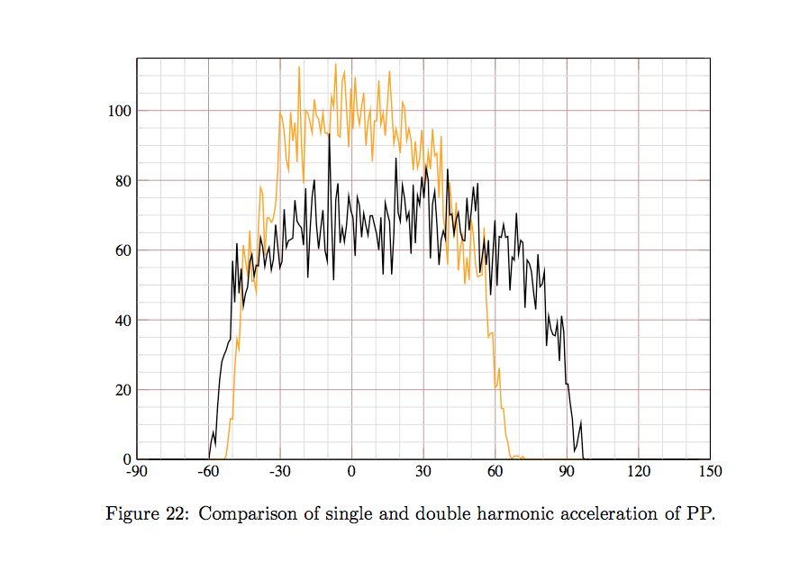
Booster Bunch with Different Harmonics
With Booster input current increased by a factor 2, space charge force becomes important.
The solution is to use dual RF harmonics in the Booster.
The reduction of peak current is about 25-30%.

Slide 6
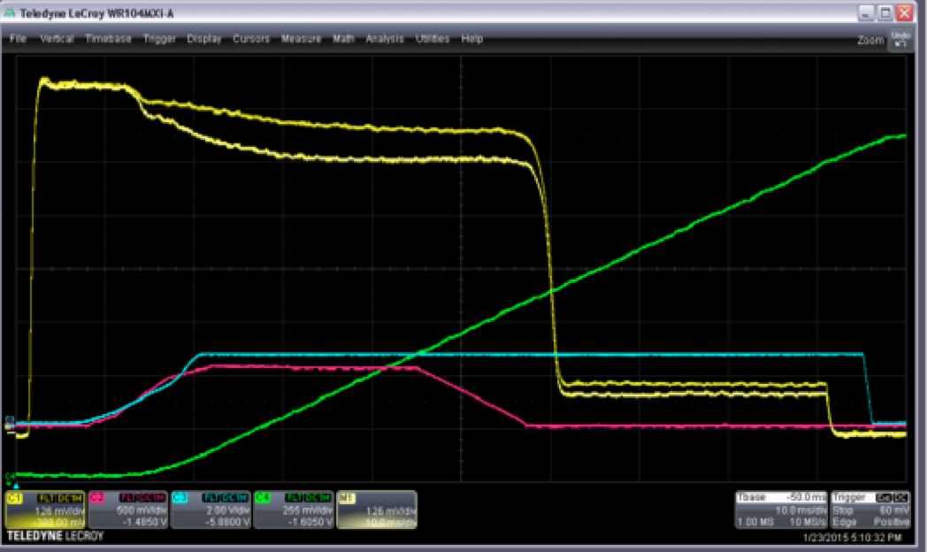
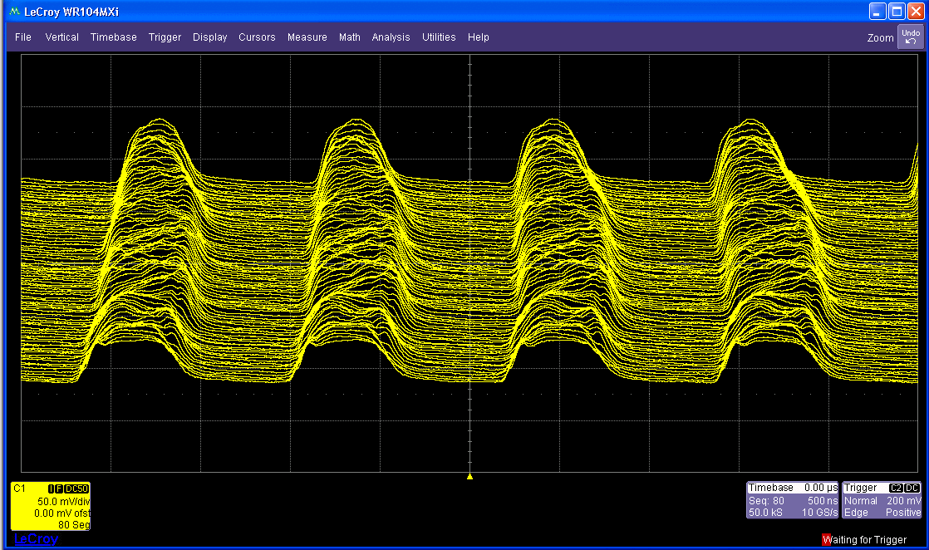
Booster Dual Harmonics RF Cavities
With dual harmonics,
more intensity got through the scraping, a brighter beam.

Slide 7
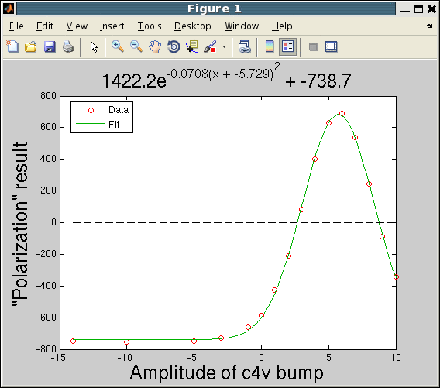
Booster cos4v Scan (1/24)
Froissart-Stora Formula:
Setting
Probably -10A is enough

Slide 8
AGS IPM Emittance at Extraction
Emittance with RF on/off. 14pi(H) and 16pi(V) at 2.5E11.
Taken on April 15.
Normalized 95% Emittance
AGS Intensity (0-3.5E11)
Emittance is smaller this year. This is mainly due to more Booster input (so heavier Booster scraping for the same AGS late intensity).

Slide 9
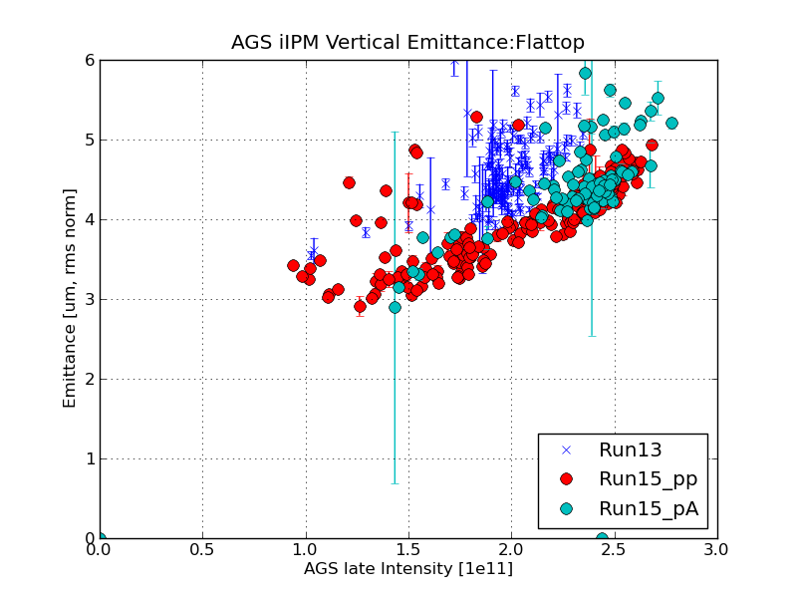
AGS Flattop IPM Vertical Emittance for RHIC Fills
Normalized ems Emittance
RF on, emittance is overestimated.

Slide 10
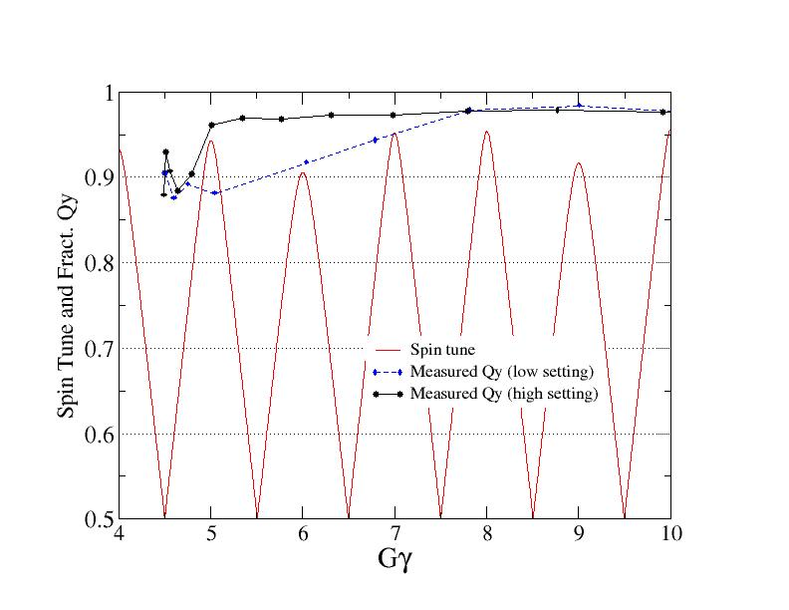
Higher Q_{y} Near Injection: within Spin Tune Gap

Slide 11
Simulation of Horizontal Intrinsic Resonances
Vertical intrinsic resonances and imperfection resonances have been avoided by introducing two partial snakes in the AGS. But the partial snake magnets also move the stable spin direction away from the vertical and consequently excite depolarizing resonances associated with horizontal tune, so-called horizontal intrinsic resonances. They are driven by vertical oscillating fields (horizontal focusing) with horizontal stable spin direction from partial snake
For 10% and 5.9% partial snakes and 15 π horizontal emittance polarization transmission is predicted to be 91% in beam center (red), 83% for average (blue)
F. Lin, et al, PR. STAB 10, 044001(2007).

Slide 12
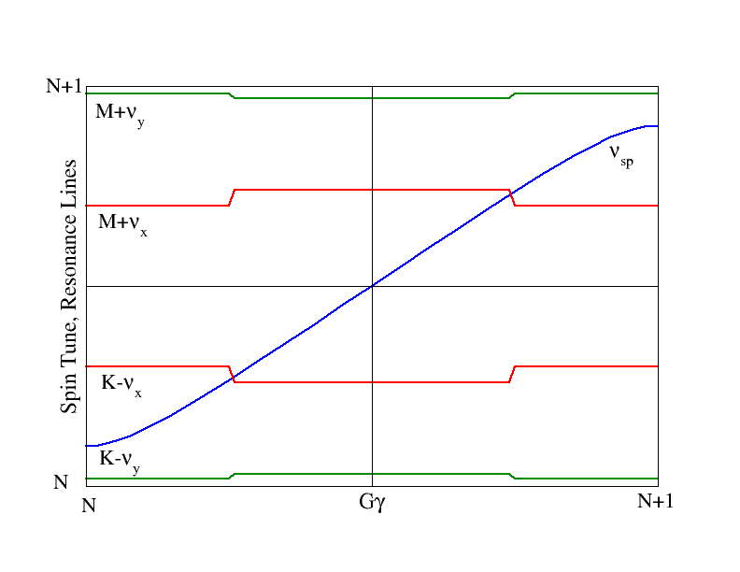
Horizontal Tune Jump
For an isolated resonance,
And resonance crossing rate is given by:
Change of ν_{x} is 0.04 in 100 μs. This increases the crossing speed about 4 times. Maintain the adiabaticity is the key to minimize any emittance growth even for the benign tune jump.

Slide 13
Measured Betatron Tune along Ramp with JQ on

Slide 14
Three Issues with Tune Jump Quads On
First one is the vertical emittance growth when both jump quads on. The vertical beta functions at the locations of both quads have to be equal to avoid emittance growth. A horizontal 6th harmonic was introduced during the run to minimize the beta beating.
Over time, the orbit could drift away from the quad center. An orbit feed forward system based on 9th harmonics was used.
The energy of beam has to be known along the ramp accurately so that the jump quad timing can be driven correctly(70 jumps). We are talking about ~100μs accuracy for 70 times.

Slide 15
Vertical Emittances with Jump Quads on
Energy ramp finishes

Slide 16
Overall Jump Quad Timing Scan
Gaussian fit gives σ=214μs
H. Huang, et al, PR. STAB 17, 081001(2014).

Slide 17
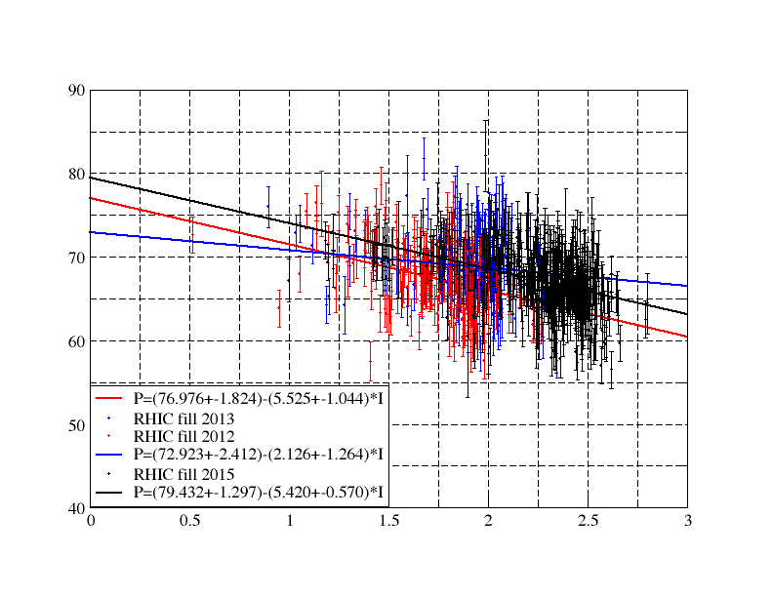
AGS Extraction Polarization for RHIC
The polarization maintained at similar level as run13 but at higher intensity. The emittance out of AGS is smaller due to heavier scraping in the Booster. The smaller emittance helped us to maintain polarization with higher intensity.

Slide 18
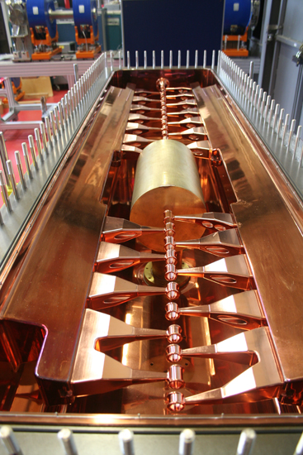
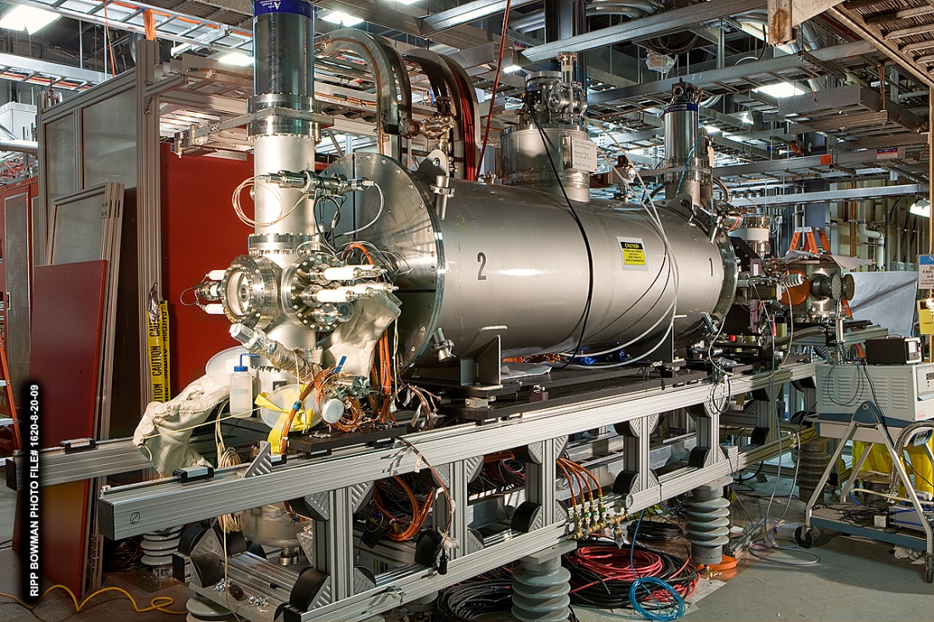
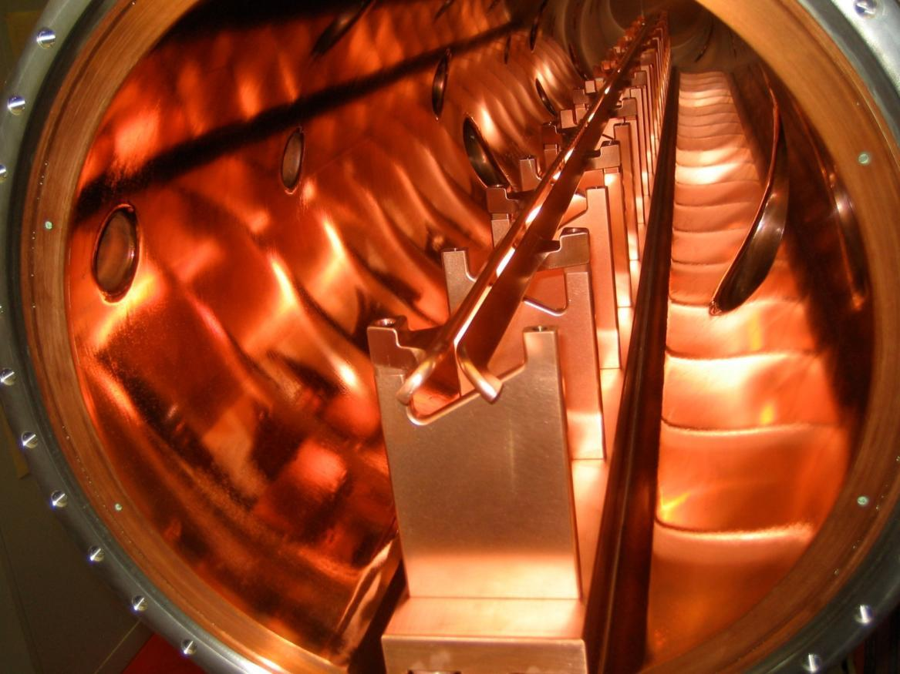
Electron Beam Ion Source (EBIS) Pre-injector
All ion species including noble gas ions (NSRL), uranium (RHIC) and polarized He³ (eRHIC) (~ 1-2  10¹¹ charges/bunch with e_{N,rms} = 1-2 μm)
Construction completed on schedule and budget
Operated reliably for NSRL with He⁺, He²⁺, Ne⁵⁺, Ne⁸⁺, Ar¹¹⁺, Ti¹⁸⁺, Fe²⁰⁺
Have been used for Au, Cu, Al and U in past a few RHIC runs
The operation is more stable with EBIS than with Tandem.

Slide 19
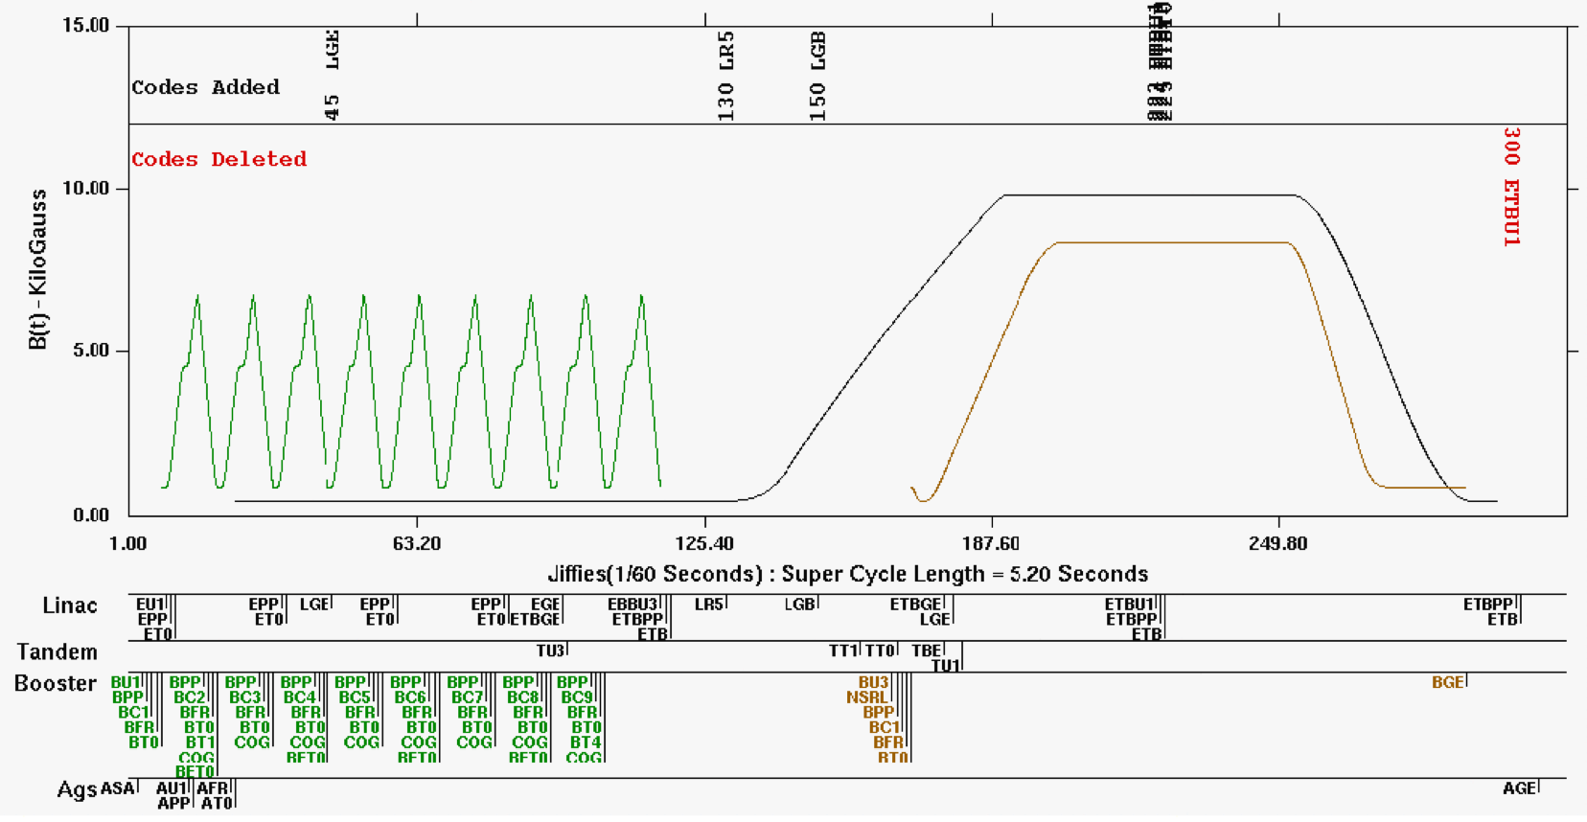
9 Booster Cycle per Supercycle

Slide 20
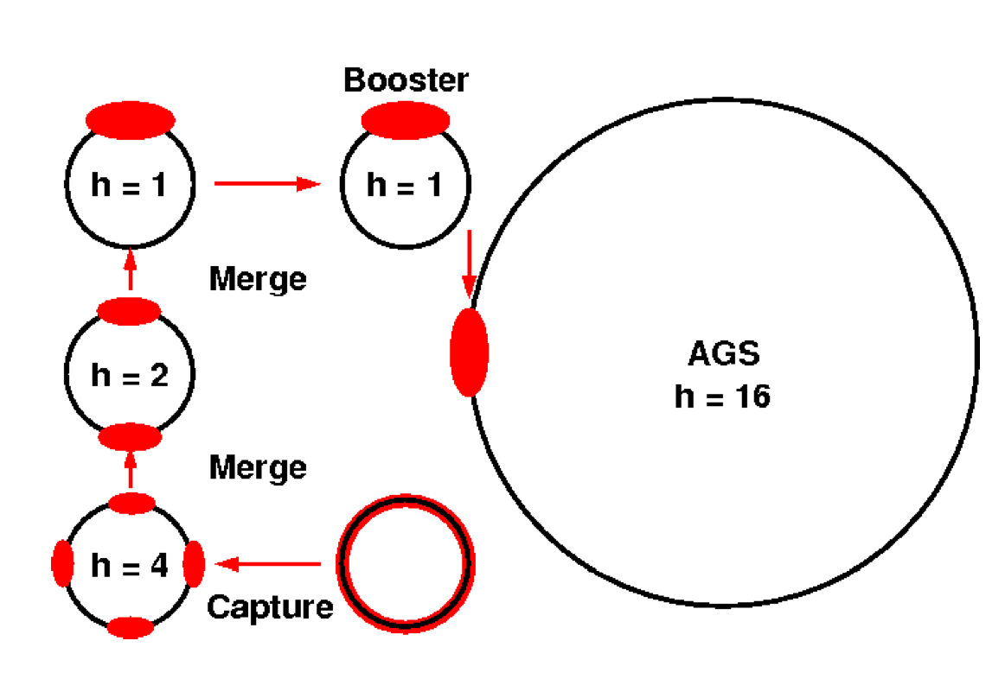
Booster Au Merge
Inject 2-turn pulse from EBIS.
Capture into h=4 buckets
Accelerate to merging porch (49MeV/A for Au³²⁺ ions).
Merge 4 bunches to 2; then 2 bunches to 1.
Accelerate Au32+ ions to 108MeV/A
Extract and transport to AGS.

Slide 21
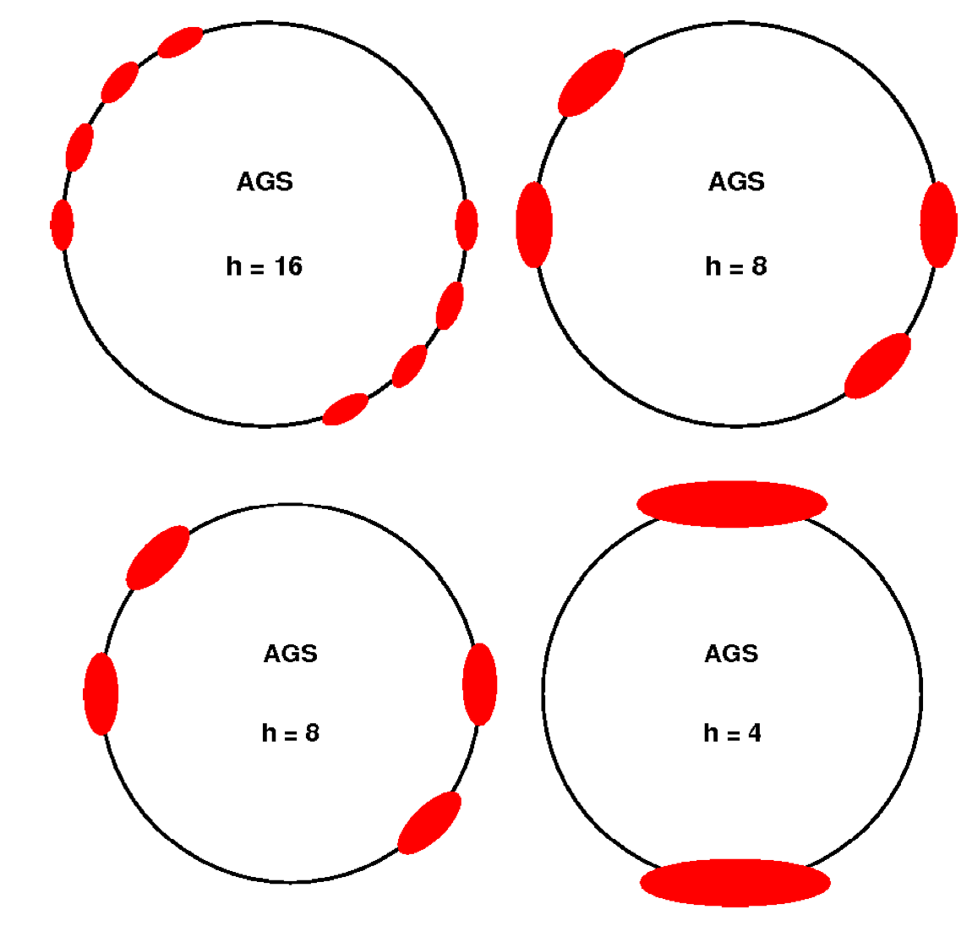
AGS Au Merge
Inject Booster loads of 1 bunch into harmonic 16 buckets.
Merge 8 to 4; then 4 to 2
Gives 4 Booster loads per bunch
Squeeze each bunch into a h=12 bucket
Accelerate Au77+ ions to 8.86GeV/A
Extract and transport to RHIC.

Slide 22
Gold Intensity
1) 1.2e9 Au32+ ions per EBIS pulse at end of ETB line
2) 0.95 injection efficiency
3) Booster Output/Input = 0.85
4) Gives 1.0e9 Au32+ ions per bunch at Booster extraction
5) 0.65 BTA stripping efficiency
6) AGS Input / Booster Output = 0.56 to 0.58
7) Gives 4.46e9 Au77+ on AGS injection porch after 8 transfers (8 x 1.2e9 = 9.6e9)
8) 2.23e9 Au77+ ions per bunch after merges on AGS injection porch
9) Some 2 to 3% ends up in satellite bunches during squeeze into harmonic 12
10) Most other loss occurs during h=12 capture and early acceleration
11) One ends up with 2.1e9 Au77+ ions per bunch at AGS extraction

Slide 23
6->3->1 Merge
1) Put 6 Booster(instead of just 4) loads into one bunch.
2) In principle we then should be able to get 3.0e9 Au77+ ions per bunch at AGS extraction. Factor of 1.5 increase.
3) Longitudinal emittance also increases by a factor of 1.5.
4) During the relatively short development time in May 2015 we were able to merge 6 bunches into 1 on the AGS injection porch and achieved 2.4e9 Au77+ ions per bunch at AGS extraction.
5) Loss during capture and early acceleration on AGS injection porch was substantial.
6) It is hoped that the resonance correction will significantly reduce the capture and early acceleration loss.
7) In order to reduce the amount of beam lost to satellite buckets we need to reduce the longitudinal emittance in Booster by a factor of 4/6. We hope that this is possible with further tuning on the longer injection porch.
8) This would give a final merged bunch with the same longitudinal emittance as the one obtained in the standard 4 to 2 to 1 scheme. We know that the 4 to 2 to 1 merged bunch produces only small satellites (2 to 3%) and it accelerates well in AGS and in RHIC.
9) A new version: 12->6->2.

Slide 24
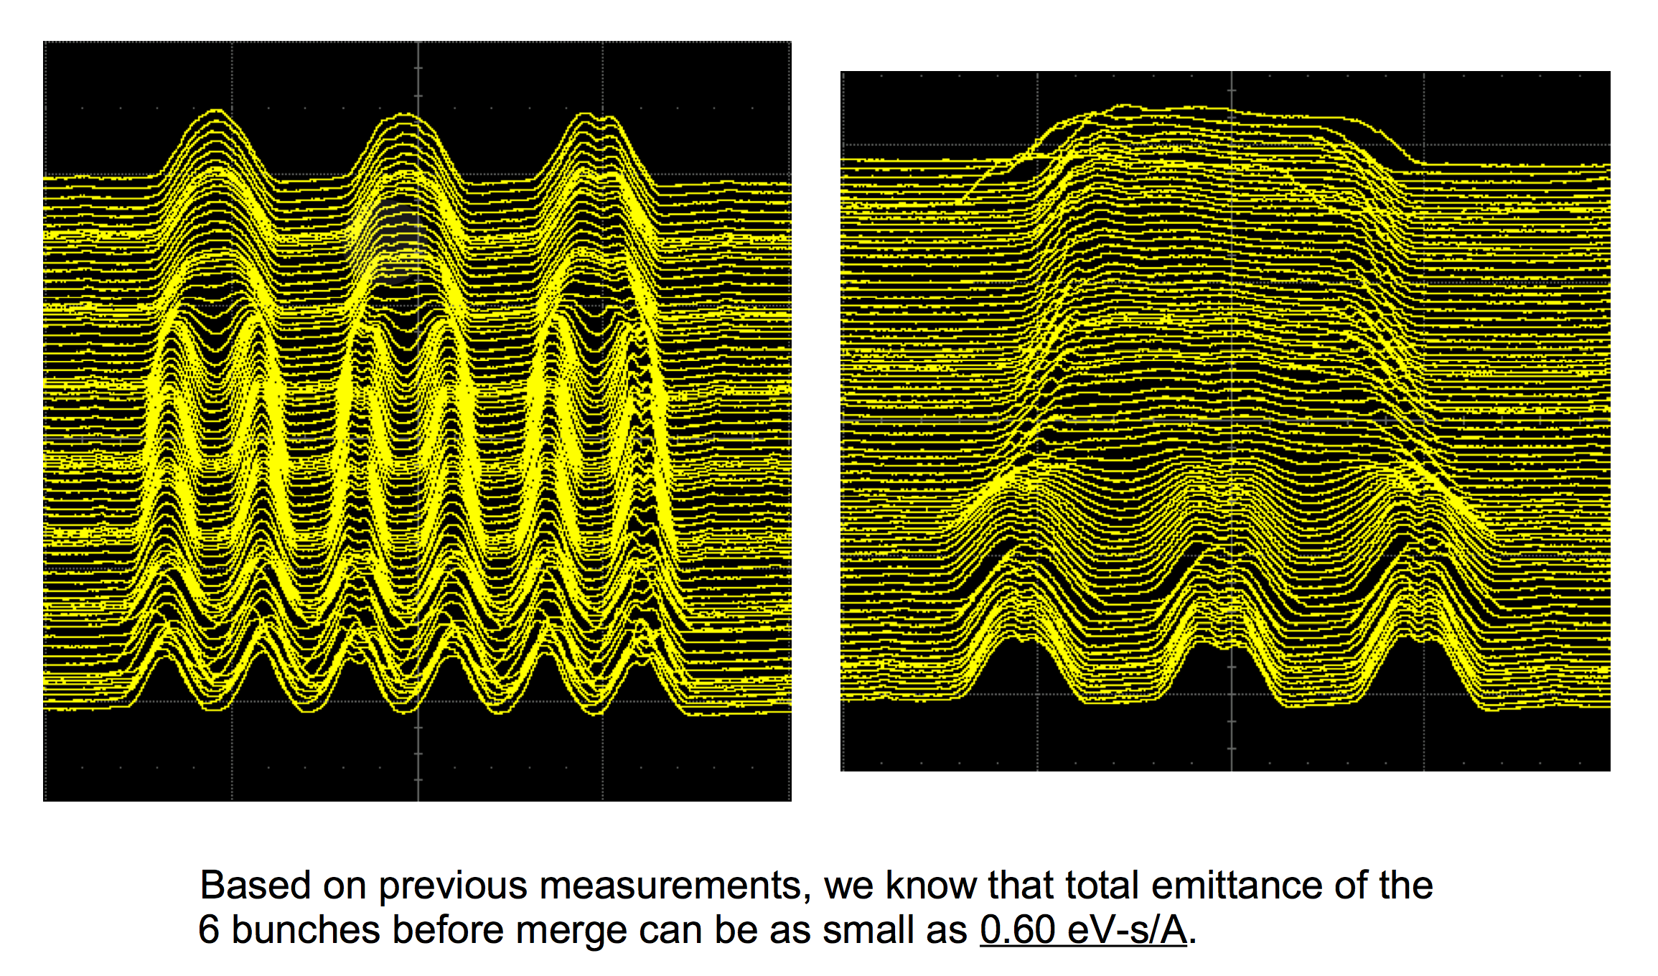
Observation of 6->3->1 Bunch Merge

Slide 25
Summary
OPPIS source upgrade provides more beam for Booster input, which makes the heavier scraping possible.
The introduction of partial snakes generates horizontal intrinsic resonances. They are generally weak but could cause accumulated polarization loss if left uncorrected.
A modest horizontal tune jump system has been used to overcome these weak but numerous resonances while maintaining the transverse emittances. A relative gain of 10-15% polarization has been achieved with the tune jump system.
The future plan is to control emittance growth in the injector chain to improve polarization.
EBIS source is more stable in operation. Bunch merge scheme allows us to increase bunch intensity for RHIC fill. More bunch merge is under consideration.

Slide 26
Backup Slides

Slide 27
Depolarizing Resonances in the AGS
Imperfection Resonances
ν_{s} =n (integer) Gγ=5,6,…45 partial snake(s)
Vertical Intrinsic Resonances
ν_{s} =kP±ν_{y}
Strong ones: Gγ=0+ν_{y},12+ν_{y},36±ν_{y} strong partial snakes
Note: with two partial snakes in the AGS, P=1. There are a lot weak intrinsic resonances as the result.
Horizontal Intrinsic Resonances
1. non-vertical stable spin direction due to strong partial snake.
2. betatron motion coupled to the vertical betatron motion by coupling elements: solenoid, helical magnet.
ν_{s} =k±ν_{x} fast crossing speed, strong partial snakes
Partial Snake Resonances
strength proportional to nearby intrinsic resonance strength.
ν_{s} =kP±mν_{y} , m>1 avoid the resonance tunes

Slide 28
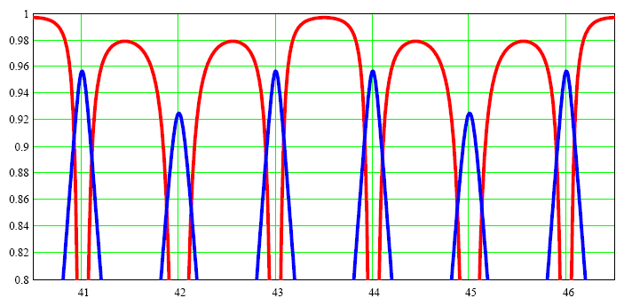
Spin tune with two partial snakes
36+ν_{y} intrinsic resonance
Fractional Vertical Tune and Spin Tune
Fractional vertical betatron tune
Vertical component
of stable spin
Extraction
Gγ
Spin tune gap modulation of the period of 3 units of Gγ:

