Slide 1
Dual-Frequency Approach to a High Average Current Thermionic Electron Source
Vadim Jabotinski and Alexei Kanareykin
Euclid TechLabs
Gaithersburg, MD Chicago, IL
MEIC Collaboration Meeting Fall 2015
Jefferson Lab • October 5-8, 2015

Slide 2
Outline
Target Beam Characteristics
Bunched Electron Sources and Limitations
Novel Dual-Frequency Scheme
Modeling and Simulations
Power Requirements
Summary

Slide 3
Target beam characteristics
Average current >0.2 A
Bunch charge 0.5-2 nC
Linac frequency 748.5 MHz
Magnetization 1-mm radius in 2-T cooling sol.
3-mm radius cathode in ~0.2 T.
Bunch duration 40-150 ps rms
94-353 ps FWHM
Y. Zhang “Overview of MEIC Cooling Design”
MEIC Collaboration Meeting Spring 2015
R. Suleiman and M. Poelker “200 mA Magnetized Beam for MEIC Electron Cooler” MEIC Collaboration Meeting Spring 2015

Slide 4
Bunched electron sources. Cathodes
Cathode: Photo- , Thermionic-, Field Emission
Extraction & Acceleration: HV DC or pulsed, RF
Thermionic cathode: Highest Average current
Drawbacks: E-spread, Duration, Back bombardment
No good emission gating method
Photocathode: High brightness, bunch charge
Drawback: Low average current
Field emission: Cold, no laser, no heating needed
Drawbacks: material issues, low bunch charge,
FEA gives higher charge but larger intrinsic emittance.

Slide 5
Bunched electron sources. Guns
Photo-guns (DC or RF accelerating structure)
- Linac subharmonic freq., low average current
- CW (LBNL VHF quarter-wave coaxial gun)
Beam magnetization impossible, large size VHF cavity
Thermionic guns: Cathode in RF cavity (diode)
180º, E-spread, Duration, Back bombardment, Beam capture
HV pulsed (~1.5μs) gridded guns, 1GHz modulation Subharmonic bunching, Low average current,
Beam capture example: 4500nC emitted for 1nC 10ps FWHM
Single frequency, gridded, DC bias, DC acc. (IOTs, TRIUMF) Long duration, limited exit energy 300-350keV

Slide 6
Bunched electron sources. Guns
Single frequency thermionic electron source, gridded, DC bias, DC acc. (IOTs, TRIUMF)
Still long bunch duration, limited exit energy 300-350keV
DC accelerating structure
Single-frequency RF source
Voltage break
DC Acceleration
Bidirectional coupler
Slug tuner
Thermionic cathode
Grid
Coaxial transmission line

Slide 7
Dual-Frequency Gating of the Emission
allows shorter bunch length
Gating the emission with the
1st harmonic (IOT, TRIUMF)
Gating the emission with the
1st and 3rd harmonics.

Slide 8
Dual-Frequency Gating of the Emission
FE cathode in RF cavity: Shorter bunch length
Drawbacks: FE material, RF structure, High power RF sources for both the 1st and 3rd harmonics, CONCEPT
J. W. Lewellen and J. Noonan “Field-emission cathode gating for rf electron guns” Phys. Rev. ST Accel. Beams 8, 033502, 2005
Thermionic cathode, gridded, DC bias, RF cavity
Shorter bunch length, injection phase, quality
Drawback: Inefficient feeding of the 3rd-harmonic power
P. Sprangle et al. “High average current electron guns for high-power free electron lasers” Phys. Rev. ST Accel. Beams 14, 020702, 2011

Slide 9
Dual-Frequency Thermionic Electron Source
shorter bunch length, injection phase, quality
P. Sprangle et al. “High average current electron guns for high-power free electron lasers” Phys. Rev. ST Accel. Beams 14, 020702, 2011
Experiment (DC acceleration): Inefficient feeding 3rd-harmonic power
S. H. Gold et al. “Development of a high average current rf linac thermionic injector” Phys. Rev. ST Accel. Beams 16, 083401, 2013
RF accelerating cavity
half-cell
1st harmonic
Dual-frequency RF source
1st and 3rd harmonic
Voltage break
cathode bias
Bidirectional coupler
1st harmonic
Slug tuner
3rd harmonic
Slug tuner
Thermionic cathode
Grid
Coaxial transmission line

Slide 10
Dual-Frequency Thermionic Electron Source
Novel Scheme (exciting the 3rd-harmonic mode)
RF accelerating cavity
half-cell, 1st harmonic
Beam magnetizing solenoid
< 30 mm bore radius
3rd harmonic RF source
Bidirectional coupler
1st harmonic
RF source
748.5 MHz
Coaxial low pass
harmonic filter
Slug
tuner
Voltage
break, 700 V DC
Coaxial transmission lines
Cathode region

Slide 11
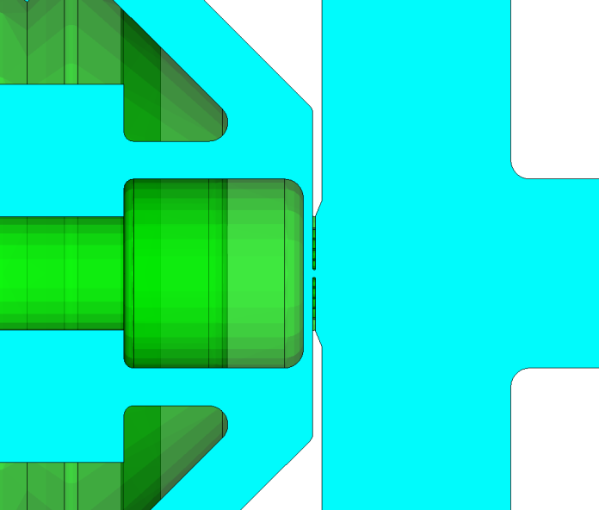
Dual-Frequency Thermionic Electron Source
Cathode region
3rd harmonic
Cathode-grid gap
0.25-0.5 mm
1st harmonic
Cathode region
Thermionic
cathode
3mm beam radius
Grid

Slide 12
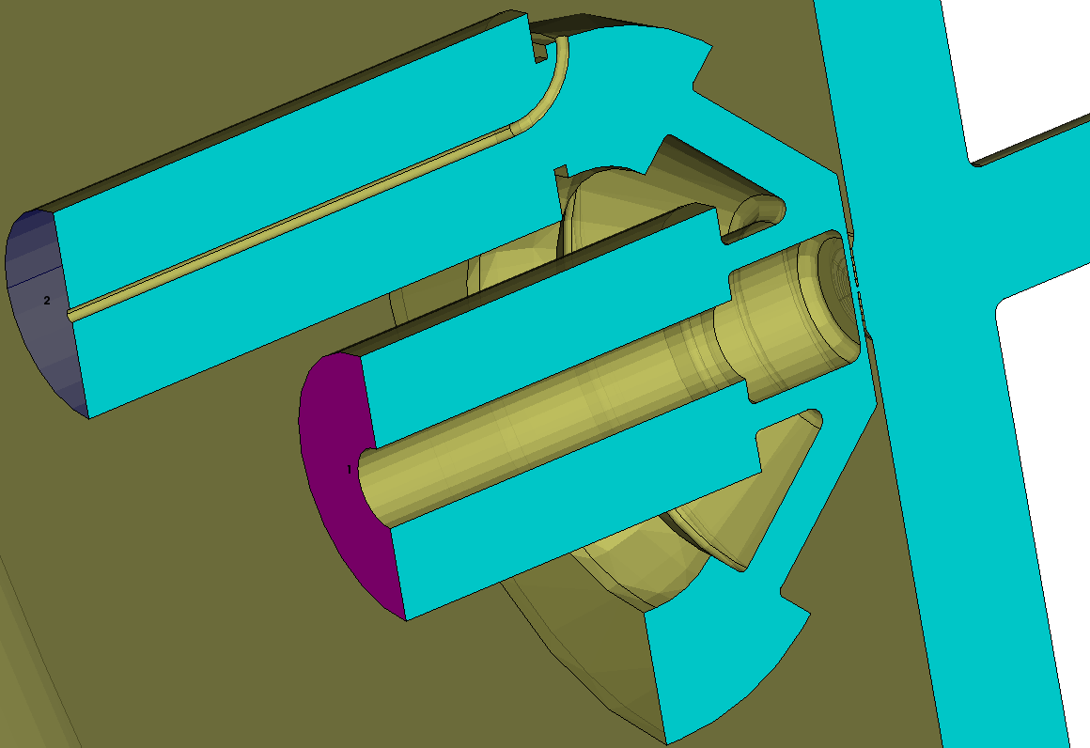
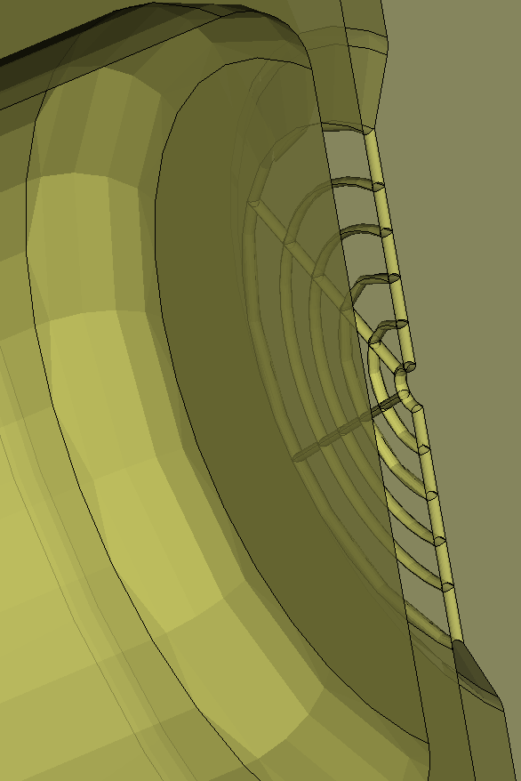
Dual-Frequency Thermionic Electron Source
Modeling and Simulations
Dual-frequency emission gating RF structure
Grid region
3rd harmonic
1st harmonic
Thermionic cathode
3mm beam radius
Cathode-grid gap
0.25-0.5 mm
RF accelerating cavity
half-cell, 1st harmonic

Slide 13
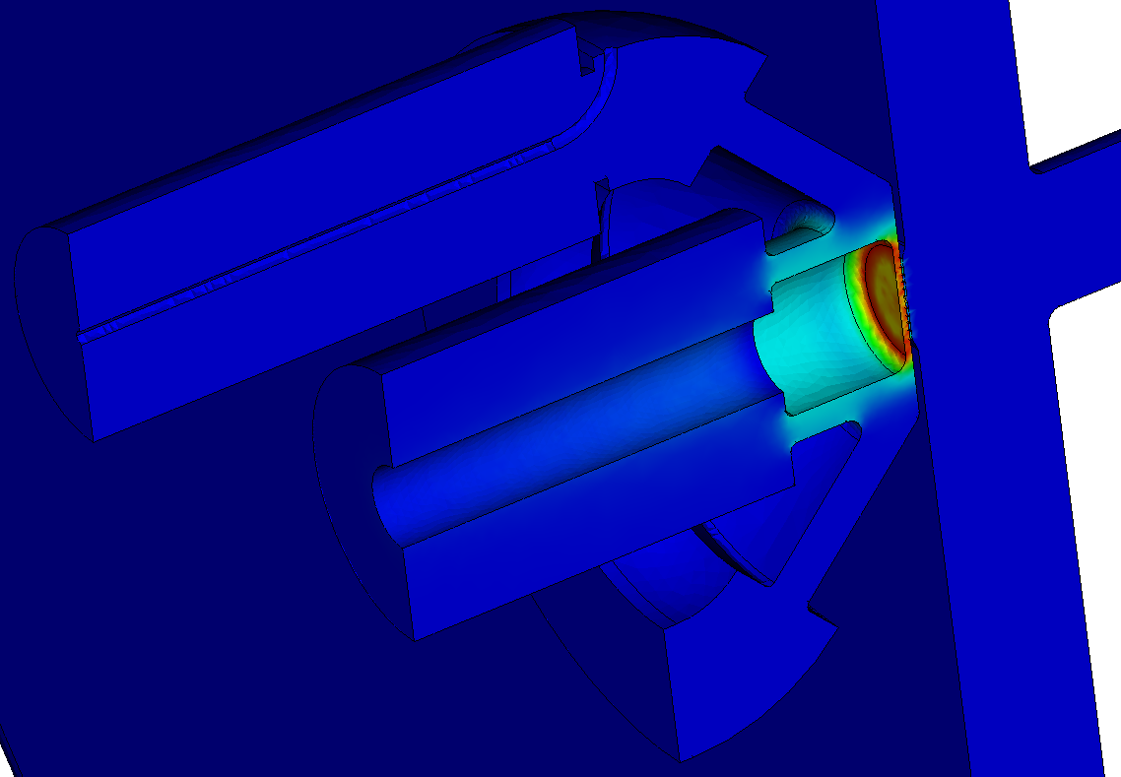
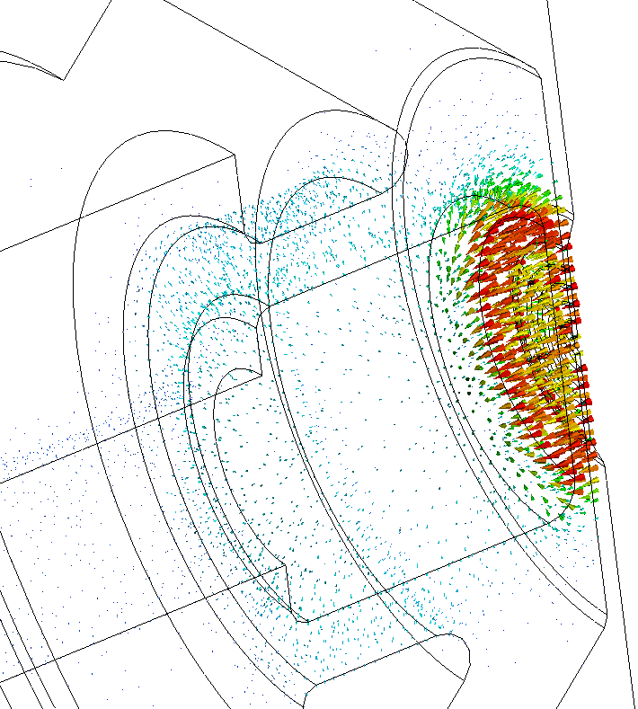
Dual-Frequency Thermionic Electron Source
Modeling and Simulations
1st harmonic (748.5 MHz) fed through the on-axis coaxial port
Electric field magnitude and vector plot
1st harmonic
Annotation_2: Electric Field [V/m] (0.7485 GHz)
The result is similar to the single-frequency structures (IOT, TRIUMF) and the dual-frequency structures which do not have the off-axis port.

Slide 14
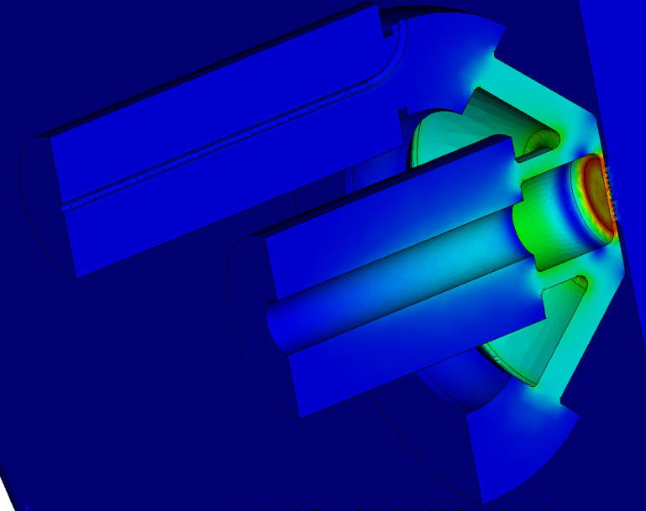
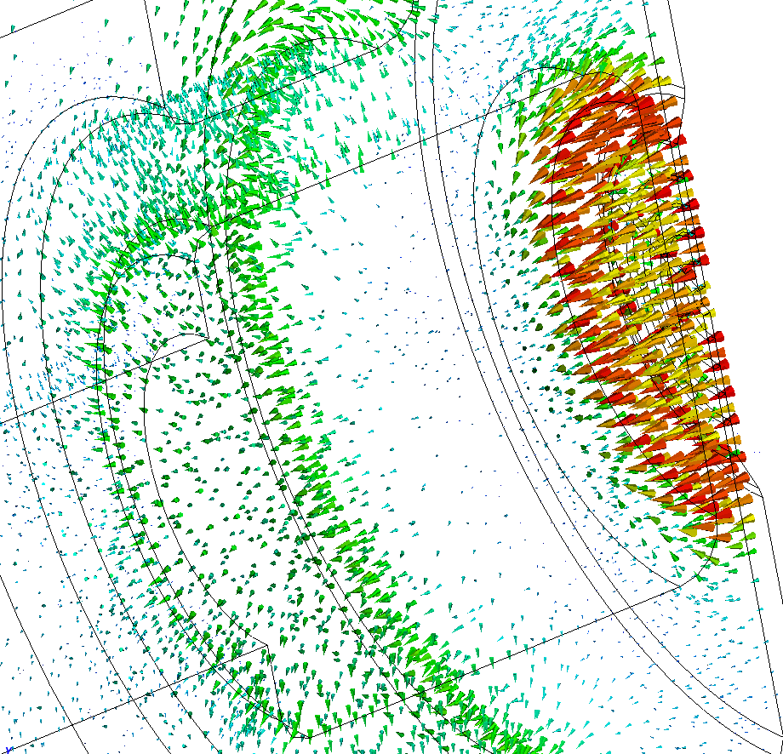
Dual-Frequency Thermionic Electron Source
Modeling and Simulations
3rd harmonic (2.2455 GHz) fed through the off-axis coaxial port
Electric field magnitude and vector plot
Annotation_2: Electric Field [V/m] (2.2455 GHz)
The S₁₁ plot assumes Mo-conductivity in the 0.25 mm gap. From eigenmode simulations Q is 1779. Based on the field pattern we identify this mode in such a non-standard geometry structure as a variation of the TM₀₂₀ mode.

Slide 15
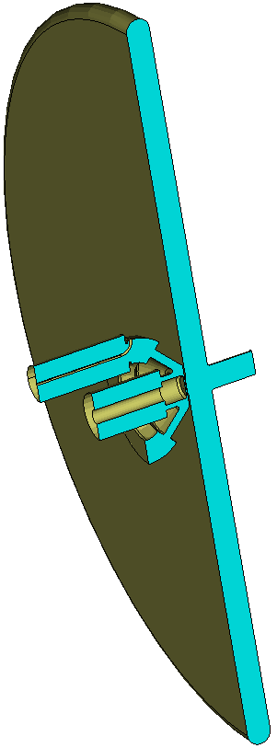
Power Requirements
Drive Power ~ Beam loading and Wall losses
$qEdf+ ε_{0}SE^{2}\sqrt{\frac{πf}{4μ_{0}σ}}$
Beam loading >> Wall losses
Cathode radius 3 mm
Gap 0.25 mm
Charge 1 nC
Repetition rate 748.5 MHz
Average current 0.7485 A
Peak gap field 7.5 MV/m
DC bias field -2.8 MV/m
Power for each harmonic 1 kW

Slide 16
Examples
Cathode: Baria impregnated tungsten dispenser matrix of Type M
20 A/cm² DC, 120 A/cm² pulsed
Grid: Pyrolytic graphite (PG),
Mo, Mo-coated PG
Cathode radius 3 mm
Operating current density range 10-20 A/cm² Repetition rate 748.5 MHz
Bunch duration:
150 ps rms → 1-2 nC , average current 0.7-1.4 A
40 ps rms→ 0.27-0.54 nC, average current 0.2-0.4 A

Slide 17
Summary
Introducing 3rd harmonic for gating thermionic emission improves the beam quality by allowing shorter bunches.
Existing dual-frequency methods do not realize energy efficient feeding of the 3rd-harmonic in the cathode gap.
Proposed scheme allows energy efficient feeding of the 3rd harmonic, along with the 1st harmonic.
The electron source is suitable for cooling of intense proton and ion beams applications.
The concept can be extended to field emission sources.
More potential applications: E-source for isotope linacs;
Fast time resolved microscopy; and spectroscopy.

Slide 18
Acknowledgements
I greatly appreciate Jefferson Lab scientists, especially
Yuhong Zhang, Matt Poelker, Riad Suleiman
for discussions on the electron sources and
critical issues for ion cooling applications.

