Slide 1
MEIC Electron Collider Ring Design
Fanglei Lin
MEIC Collaboration Meeting, October 5, 2015

Slide 2
Electron Collider Design Goal
Electron beam parameters
3-10 GeV energy
3A beam current up to 6-7 GeV
~1cm bunch length
small emittance
< 10MW total synchrotron radiation power
70% or above polarization
Longitudinal polarization at collision points with a long polarization lifetime
Forward electron detection
Up to two detectors
Provision for correction of beam nonlinearity
Warm magnets
PEP-II magnets

Slide 3
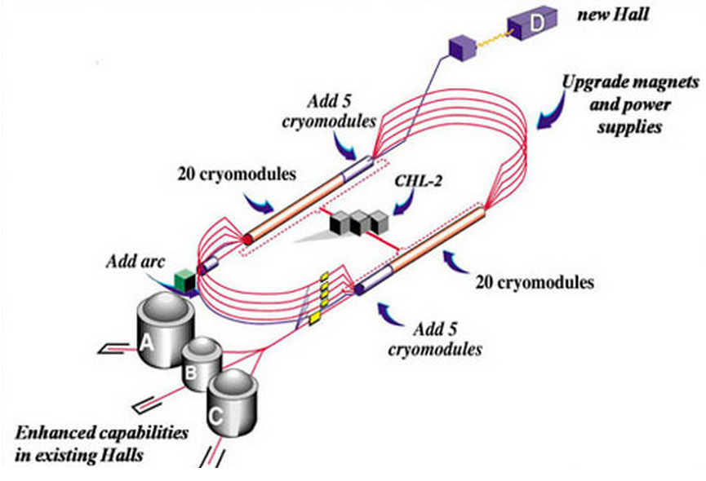
CEBAF - Full Energy Injector
CEBAF fixed target program
5-pass recirculating SRF linac
Exciting science program beyond 2025
Can be operated concurrently with the MEIC
e⁻ collider ring
Wien Filters and solenoids provide vertically polarized electron beam to the MEIC.
CEBAF will provide for MEIC
Up to 12 GeV electron beam
High repetition rate (up to 1497 MHz)
High polarization (>85%)
Good beam quality
Electron injection from CEBAF to the collide ring is Jiquan Guo’s talk (next).

Slide 4
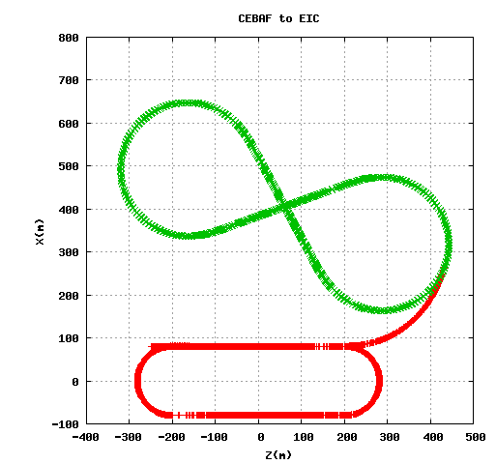
Transfer Line
Design requirements
No significant emittance growth
Room for matching and diagnostic region, compression chicane if needed, a spreader step if needed
PEP-II magnets (cost)
Realization
Utilizes PEP-II LER 156 dipoles and 68 quadrupoles
Dipoles are grouped six as one in FODO cells with 120^{ο} phase advance
Total length of transfer line is 333.25 meters
Injection scheme --- PEP-II-like design
Dispersion free injection insertion
Septum + DC + RF kickers
Vertical injection avoiding parasitic interaction with circulating
ion beams in the horizontal plane, simplifying the problem of
masking the detector from particle loss during injection
Courtesy of Y. Roblin

Slide 5
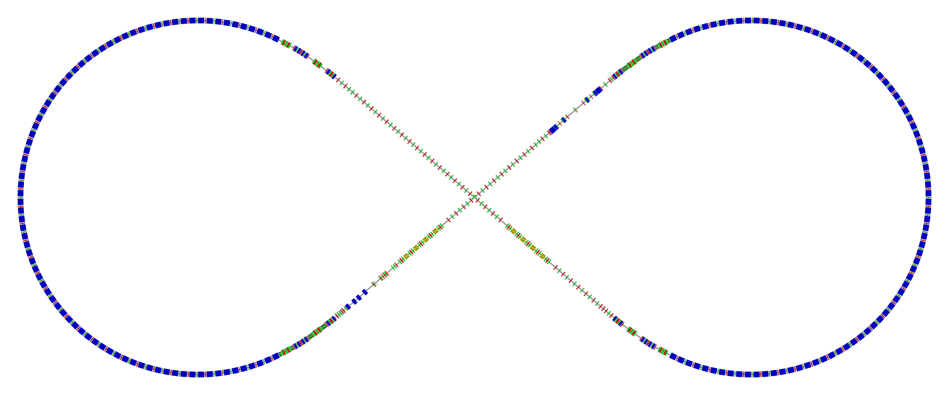
Complete Electron Collider Layout
Circumference of 2154.28 m = 2 x 754.84 m arcs + 2 x 322.3 straights
Figure-8 crossing angle 81.7°
Electron collider ring w/ major machine components
Spin rotator
Spin rotator
CCB
Tune trombone & Straight FODOs
R=155m
81.7°
e⁻
Arc, 261.7°
Future 2nd IP
RF
RF
Spin rotator
IP
Spin rotator
Forward e⁻ detection

Slide 6
Electron Ring Optics Parameters
Electron beam momentum | GeV/c | 10
Circumference | m | 2154.28
Arc’s net bend | deg | 261.7
Straights’ crossing angle | deg | 81.7
Arc/straight length | m | 754.84/322.3
Beta stars at IP β*_{x,y} | cm | 10/2
Detector space | m | -3 / 3.2
Maximum horizontal / vertical β functions β_{x,y} | m | 949/692
Maximum horizontal / vertical dispersion D_{x,y} | m | 1.9 / 0
Horizontal / vertical betatron tunes ν_{x,y} |  | 45.(89) / 43.(61)
Horizontal / vertical chromaticities ξ_{x,y} |  | -149 / -123
Momentum compaction factor α |  | 2.2 ×10⁻³
Transition energy γ_{tr} |  | 21.6
Hor./ver. emittance ε_{x,y} (normalized/un-normalized) | µm rad | 1093 / 219 (0.056/0.011)
Maximum horizontal / vertical rms beam size σ_{x,y} | mm | 7.3 / 2.7

Slide 7
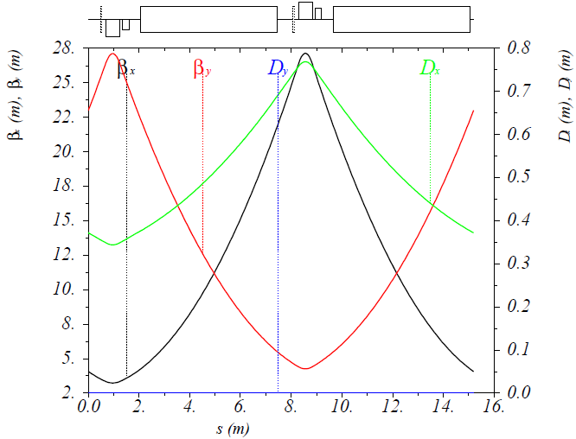
Normal Arc FODO Cell
Complete FODO (Each arc has 34 such normal FODO cell)
Length 15.2 m (arc bending radius 155 m)
2 dipoles + 2 quadrupoles + 2 sextupoles
108°/90° x/y betatron phase advance
Dipoles
Magnetic/physical length 5.4/5.68 m
Bending angle 48.9 mrad (2.8°), bending radius 110.5 m
0.3 T @ 10 GeV
Sagitta 3.3 cm
Quadrupoles
Magnetic/physical length 0.56/0.62 m
-11.6 and 12.8 T/m field gradients @ 10 GeV
0.58 and 0.64 T @ 50 mm radius
Sextupoles
Magnetic/physical length 0.25/0.31 m
-176 and 88 T/m² field strengths @ 10 GeV
for chromaticity compensation only in two arcs
(strengths will be determined in DA simulations)
BPMs and Correctors
Physical length 0.05 and 0.3 m

Slide 8
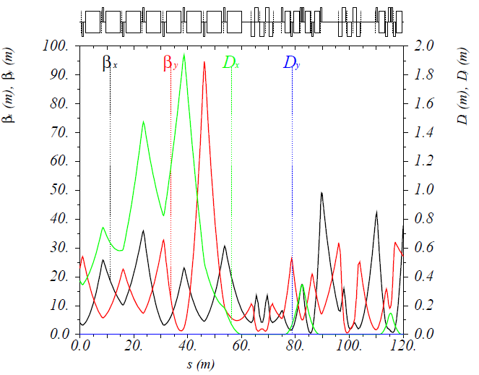
Matching + Universal Spin Rotator
Matching section: 4 arc FODO cells, all eight 0.56/0.62m-long quads’ strengths < 16.96 T/m @ 10 GeV
Universal Spin Rotator (USR)
Rotate the polarization between the vertical and the longitudinal from 3 to 10 GeV
Six 2m-long dipoles with 0.53 T @ 10 GeV
Two 2.5m-long solenoids and two 5m-long solenoids with maximum field 7 T @ 10 GeV
Quads have different lengths with maximum strength ~ 25 T/m @ 10 GeV
Arc
Matching section
USR
Straight
Was not optimized. Large contribution to the equilibrium emittance.
Is optimized to reduce the emittance contribution. (not integrated to the ring yet.)

Slide 9
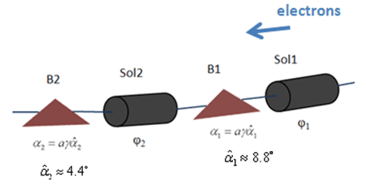
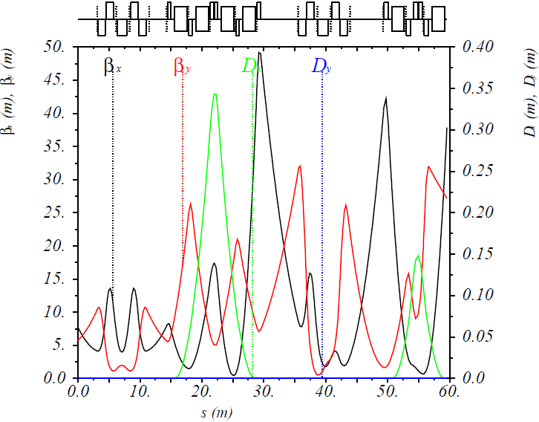
Electron Polarization Design
Schematic drawing and lattice of USR
1st Sol. + Dec. Quads
2nd Sol. + Dec. Quads
Dipole set
Dipole Set
P. Chevtsov et al., Jlab-TN-10-026
Arc
IP
Solenoid decoupling
Half Sol.
Dec. Quad. Insert
Half Sol.
Electron polarization configuration to achieve: two polarization states simultaneously in the ring with 70% (or above) longitudinal polarizations at IPs
Electron polarization direction
Universal Spin Rotator
Spin tuning solenoid
Detail is in my talk on electron polarization

Slide 10
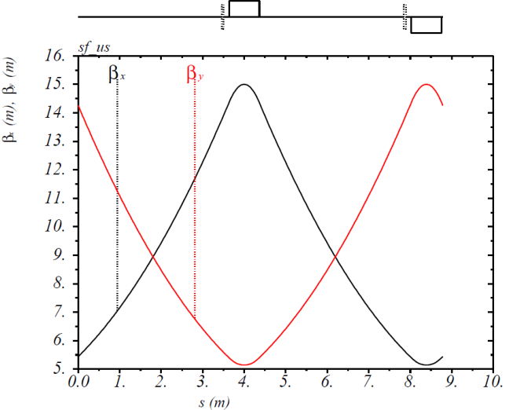
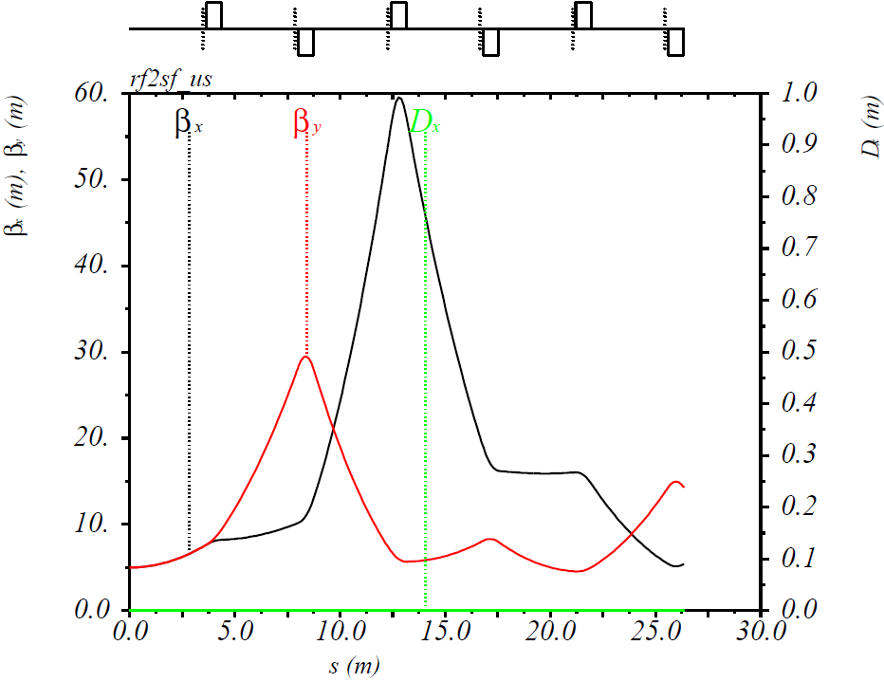
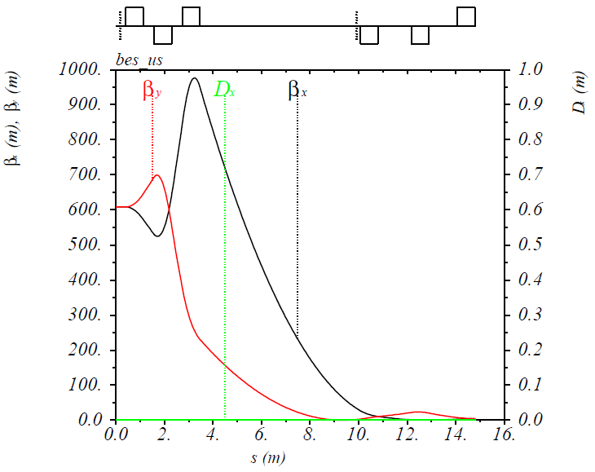
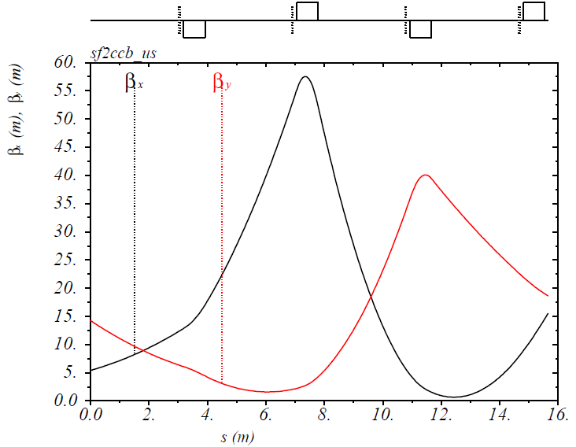
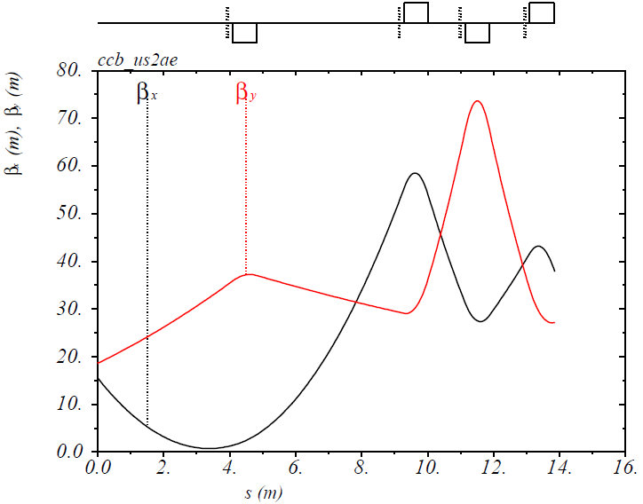
Tune Trombone/Straight FODO & Matching Sec.
Tune trombone/straight FODO cell (60° phase advance) and Matching sections
All quads have a magnetic/physical length of 0.73/0.79 m (PEP-II straight quads)
Whole ring has 76 such quads, of which 58 with a maximum field < 17.53 T/m @ 10 GeV and 18 with a maximum field ~ 25 T/m

Slide 11
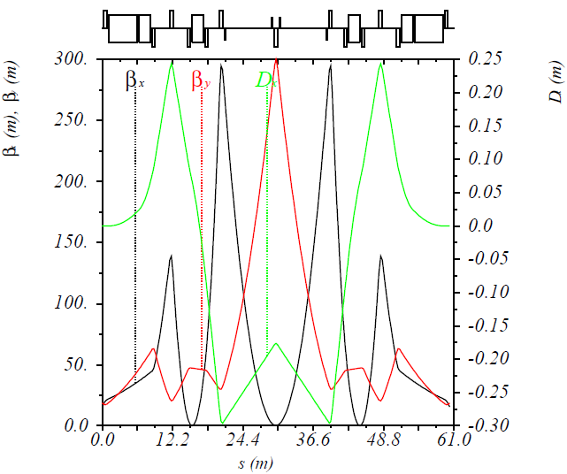
Chromaticity Compensation
Developed local Chromaticity Compensation Block (CCB)
Two 5m-long dipoles and four 2m-long dipoles with a maximum field 0.58 T @ 10 GeV
13 quads (7 families) have a maximum field ~25 T/m @ 10 GeV
4 sextupoles (2 families) are used for a compensation of local chromaticities from the FFQs
Distributed -I pair sextupoles compensation scheme will also be considered.

Slide 12
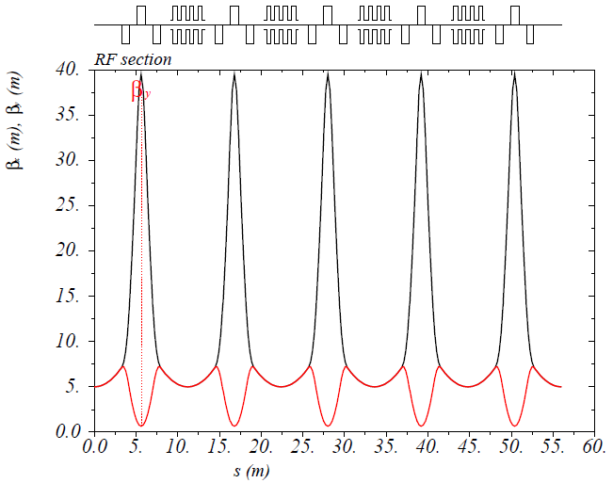
RF Section
RF section
Relatively small beta functions to improve the coupled beam instability thresholds
One such RF section in each straight, totally can accommodate up to 32 cavities (old)
15 quads (2 families) have a maximum field ~25 T/m @ 10 GeV
6.54 m

Slide 13
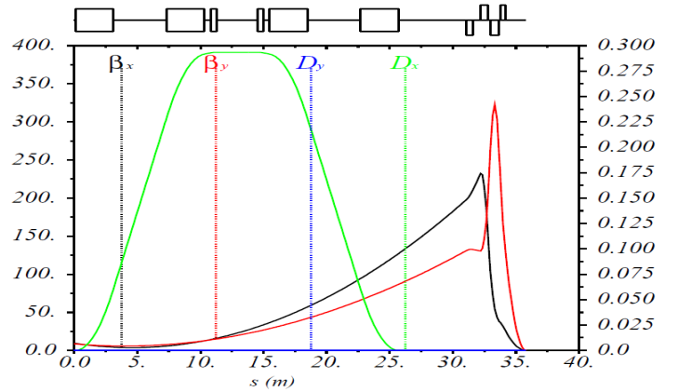
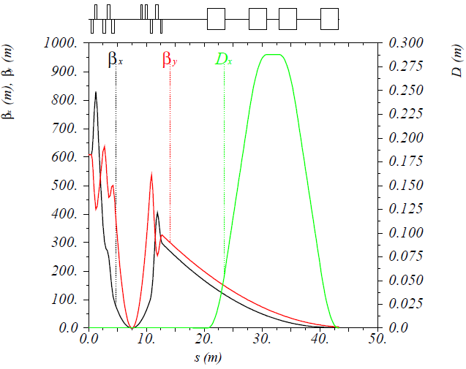
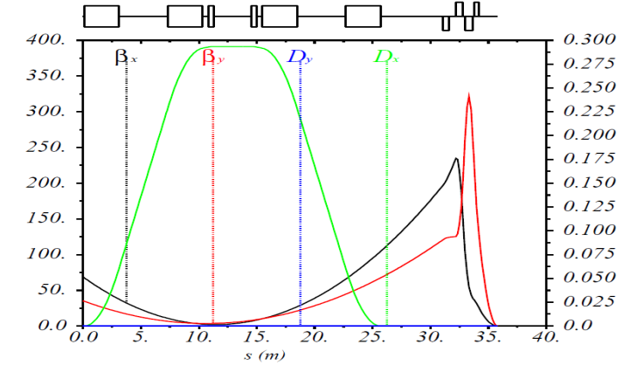
IP Region
IP region
Final focusing quads with maximum field gradient ~63 T/m
Four 3m-long dipoles (chicane) with 0.44 T @ 10 GeV for low-Q2 tagging with small momentum resolution, suppression of dispersion and Compton polarimeter
Baseline Design
Optimization
e⁻
forward e⁻
detection region
Compton polarimetry region
e⁻
FFQs
FFQs
IP
D_{x}(m)
β_{x}(m), β_{y}(m)
IP
β_{x}(m), β_{y}(m)
D_{x}(m)
or
e⁻
IP
D_{x}(m)
β_{x}(m), β_{y}(m)
Detail of interaction region design will be presented by Vasiliy Morozov.

Slide 14
Forward e⁻ Detection & Pol. Measurement
Forward electron detection: Dipole chicane for high-resolution detection of low-Q² electrons
forward e⁻ detection
Compton polarimetry
forward ion detection
local crab cavities
local crab cavities
IP
e⁻
Local crab cavities
ions
Compton polarimetry has been integrated to the interaction region design
Same polarization at laser at IP due to zero net bend
Non-invasive monitoring of the electron polarization
Courtesy of A. Camsonne
Photon
calorimeter
Laser + Fabry Perot cavity
γ_{c}
Low-Q² tagger for
low-energy electrons
Low-Q² tagger for high-
energy electrons
Electron
tracking detector
e⁻ beam
Electron polarimetry and low-Q² tagging will be discussed in Dave Gaskell’s talk.

Slide 15
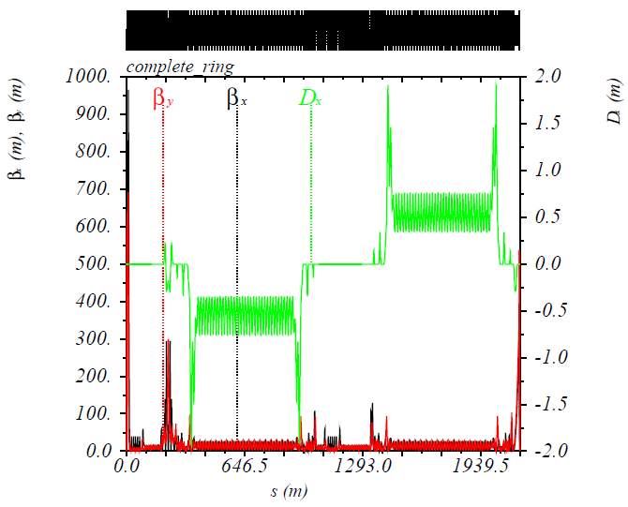
Complete Electron Ring Optics
The baseline design of MEIC electron collider ring is completed with all required machine elements or space for special machine components.
IP

Slide 16
Magnet Inventory of MEIC e-Ring
Magnet category | PEP-II HER magnet |  | New magnet
 | Number | Max. Strength | Number | Max. Strength
Dipole | 168 | 0.3 T | 34 | 0.64 T
Quadrupole | 263 | 17 T/m | 151 | 25 T/m
Sextupole | 104 | 600 T/m²(?) | 32 | 600 T/m²
Skew quadrupole | 12 | 2.33 T/m
BPM |  |  | 331
Corrector | 283 | 0.02 T | 48 | 0.02 T
MEIC (total)
Dipoles: 202
Quads: 414
Sextupoles: 136
Skew quads: 12
Correctors: 331
PEP-II (total, from SuperB CDR)
Dipoles: 200
Quads: 291
Sextupoles: 104
Skew quads: 12
Correctors: 283
Study of PEP-II magnets will be discussed in Tommy Hiatt’s talk.

Slide 17
Synchrotron Radiation Parameters
Beam current up to 3 A at 6.95 GeV
Synchrotron radiation power is under 10 MW at high energies
Beam energy | GeV | 3 | 5 | 6.95 | 9.3 | 10
Beam current | A | 1.4 | 3 | 3 | 0.95 | 0.71
Total SR power | MW | 0.16 | 2.65 | 10 | 10 | 10
Linear SR power density (arcs) | kW/m | 0.16 | 2.63 | 9.9 | 9.9 | 9.9
Energy loss per turn | MeV | 0.11 | 0.88 | 3.3 | 10.6 | 14.1
Energy spread | 10⁻³ | 0.27 | 0.46 | 0.66 | 0.82 | 0.91
Transverse damping time | ms | 376 | 81 | 26 | 14 | 10
Longitudinal damping time | ms | 188 | 41 | 13 | 7 | 5
Normalized Emittance | um | 30 | 137 | 425 | 797 | 1093

Slide 18
Approaches of Reducing Emittance
All following options have been investigated
Optimizing of sections, such as matching section, spin rotator, etc., to reduce the emittance contribution (30%)
Pros: do not change the optics of the rest of the ring, except some particular sections
Cons: ~110m additional space and 16 quads are needed (cost)
Adding (dipole) damping wigglers (50% @ 5 GeV)
Pros: do not change the baseline design, fast damping
Cons: need wigglers (cost), more radiation power (cost), larger energy spread (a factor of 2), not suitable at higher energies
Offsetting the beam in quads (~ 7 to 8 mm) in arcs (48%)
Pros: do not change the baseline design
Cons: larger energy spread (a factor of 2), longer (maybe) bunch length, have to center the sextupoles
New magnets (instead of PEP-II magnets) ring but still FODO cell arcs (50%)
Pros: with a small bending angle, dipole has no sagitta issue and the emittance can be reduced
Cons: all new magnets (cost), large chromaticities
Different types of arc cell, such as DBA, TME (> 50%)
Pros: much smaller emittance comparing to the FODO cell
Cons: more quads, stronger quads, larger ring (cost), large chromaticities

Slide 19
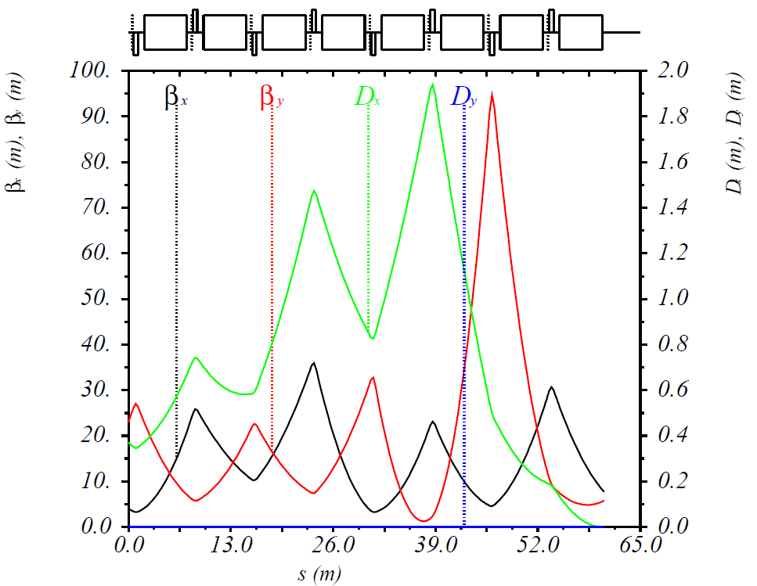
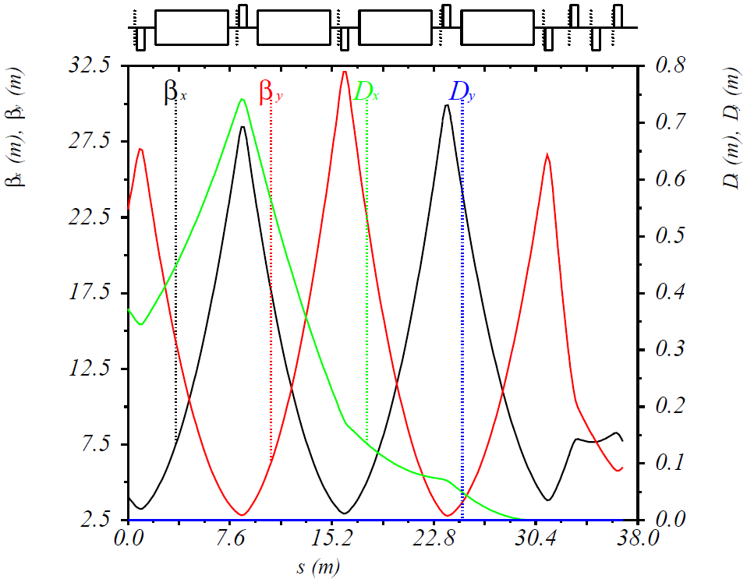
Optics of Matching Section
In the baseline design
Regular arc FODO cell: each dipole bending angle , phase advance
Matching section: each dipole bending angle
New matching section: “missing magnet” dispersion suppressor + beta function matching
Matching section dipole bending angles
Regular arc bending angle
8 extra dipoles (4 FODO cells) are needed
Regular arc FODO cell
Matching section
Spin rotator
Regular arc FODO cell
Spin rotator
Baseline
New

Slide 20
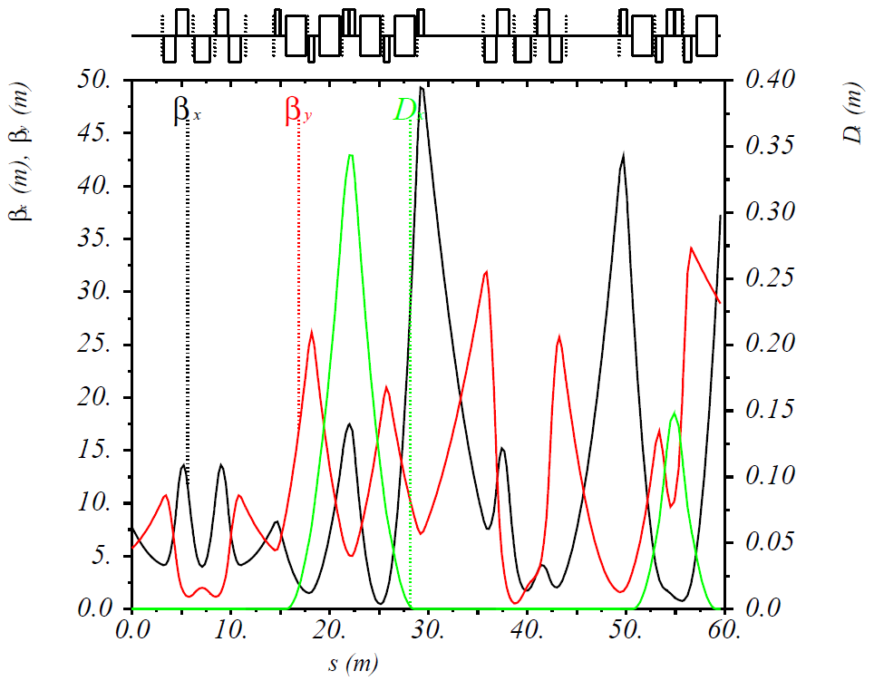
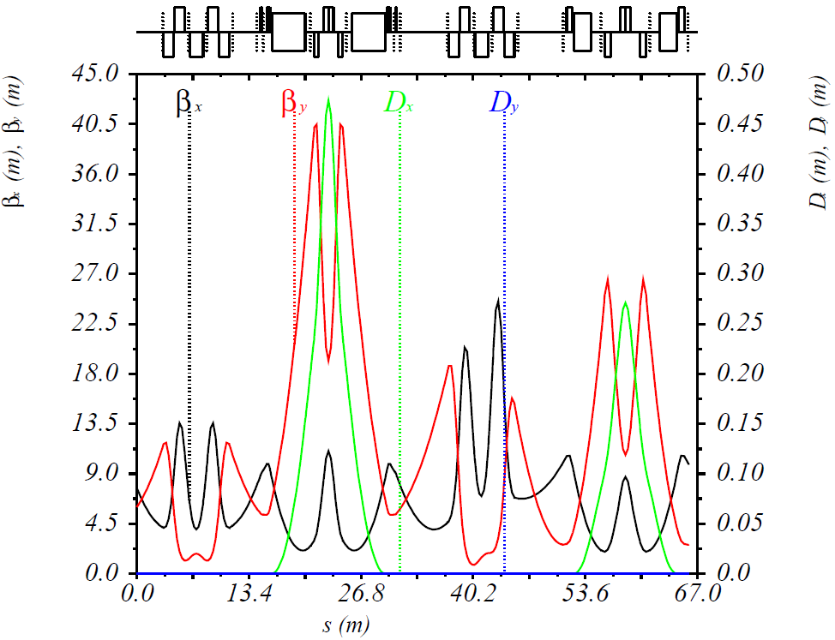
Optics of Spin Rotator
In the baseline design
Lattice in the two dipole sets was not optimized to have a small emittance contribution.
In the new design
Lattice in the two dipole sets is optimized to a DBA-like optics, which has a smaller emittance than that in the baseline design.
2nd sol. + decoupling quads
2nd sol. + decoupling quads
1st sol. + decoupling quads
1st sol. + decoupling quads
Dipole set
Dipole set
Dipole set
Dipole set
Baseline
New

Slide 21
Emittance @ 10 GeV (example)
Section | Normalized Horizontal Emittance (μm)
 | Baseline design | New design *
Regular FODO cells in two arcs | 476 | 569
Matching sections between FODO cells and spin rotators | 389 | 6
Spin rotators | 119 | 84
Straight with IP (CCB + Chicane) | 84 | 85
Straight without IP | 0 | 0
Total | 1068 | 745
Extra space needed (m) |  | 111
* Extra ~110 m-long space is needed for 4 extra arc FODO cells, new matching and spin rotator sections.
* Almost the same amount space is also required in the ion collider ring for the vertical chicanes.

Slide 22
Summary and Outlook
2.2km baseline design of MEIC electron collider ring has been completed
meeting all requirements on the beam parameters
incorporating dedicated electron polarization and forward detection design
accommodating up to two detectors
considering optics design for special elements, such as RF, etc.
Incorporating provisions for correction of beam nonlinearity
using the majority of PEP-II magnets (and vacuum chamber)
To do:
Optimization of the chromaticity compensation scheme
Study of error sensitivity
Further optimization to obtain smaller emittance if needed
Acknowledgements
A. Camsonne, D. Gaskell, Y.S. Derbenev, J. Grames, J. Guo, A. Hutton, L. Harwood, V.S. Morozov, P. Nadel-Turonski, F. Pilat, R. Rimmer, M. Poelker, R. Suleiman, H. Wang, S. Wang, Y. Zhang, – JLab
M. Sullivan, U. Wienands − SLAC

Slide 23
Thank You for Your Attention !

Slide 24
Back Up

Slide 25
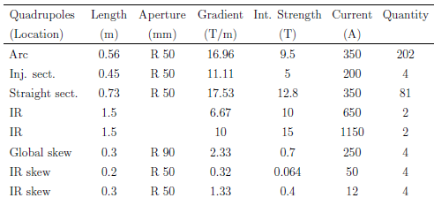
Magnet Inventory of PEP-II HER
Table from SuperB CDR, March 2007
Dipole field can achieve 0.363 T because it was designed for PEP 18 GeV electron beam
Quadrupoles and sextupoles are used in the MEIC arc and straight FODOs and some matching sections
Sextupoles strength can run up to 600 T/m² run in PEP (J.R. Rees, SLAC-PUB-1911)

Slide 26
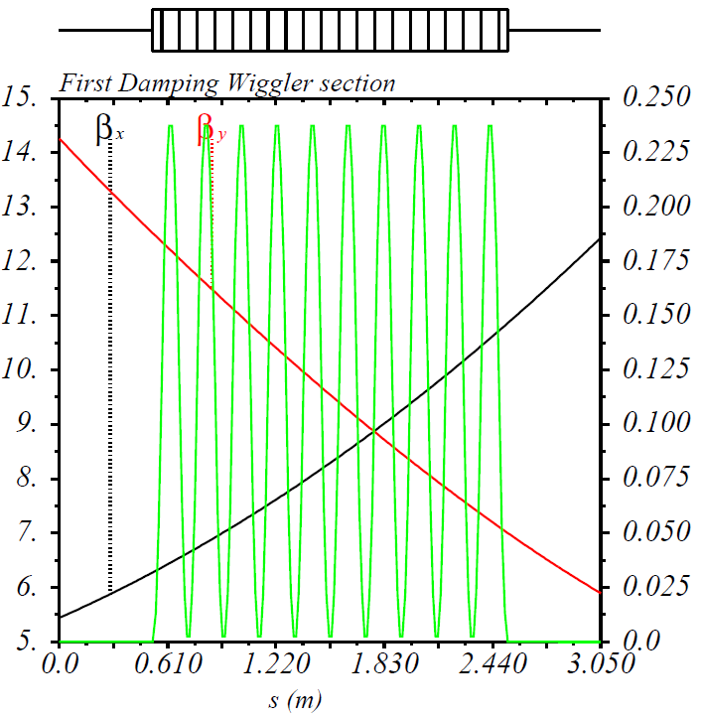
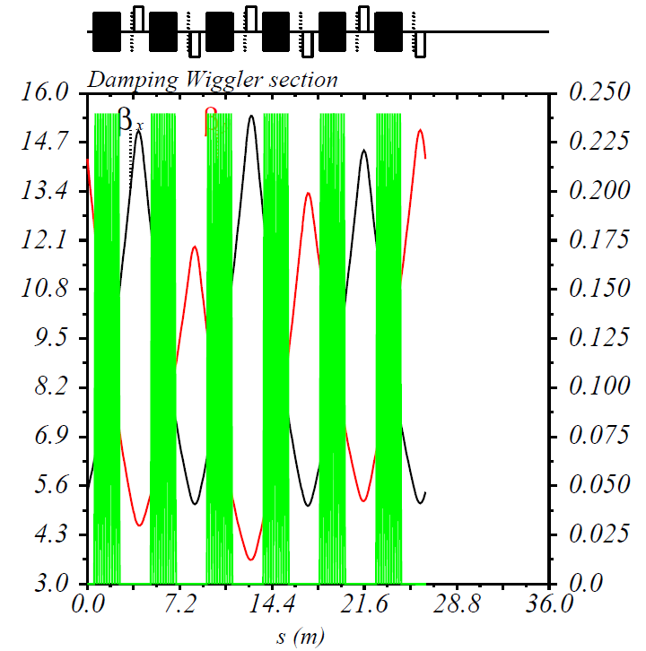
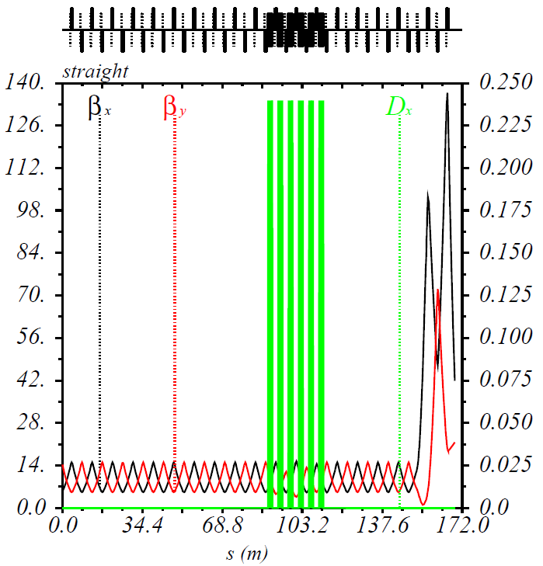
Damping Wigglers
Damping wigglers in the dispersion-free straight
Each damping wiggler has nine 0.1m-long and two 0.05m-long 1.6 T dipoles (alternate horizontally-deflecting fields)
6 damping wigglers in 3 straight FODOs lower the emittance by a factor of 2 at 5 GeV (from 138 to 69 um)
Total radiation power is 5.5 MW, with 3 MW from 6 wigglers
6 quads are used to match the lattice functions to the rest of the ring
Number of wiggler sections can be adjusted
β_{x}, β_{y} (m)
D_{x} (*10⁻³m )
β_{x}, β_{y} (m)
D_{x} (*10⁻³m )
β_{x}, β_{y} (m)
D_{x} (*10⁻³m )

Slide 27
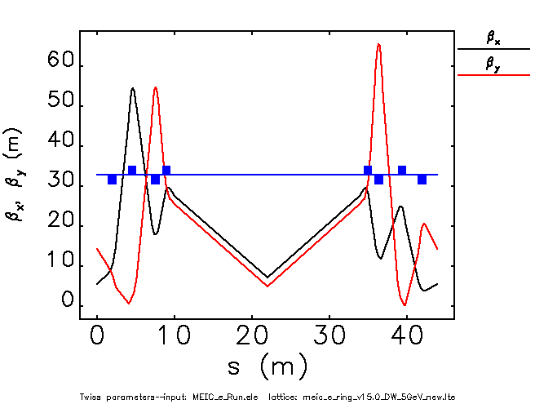
Damping Wiggler
Damping wiggler in the dispersion-free straight
24 m long with 240 periods
1.6 T maximum field with sinusoidal field variation along the electron path
horizontally deflecting
Straight FODO
Straight FODO
24m long damping wiggler

Slide 28
Synchrotron Radiation Parameters
 |  | One IP 2154m e-ring w/o DW |  | One IP 2154m e-ring w/ DW
Beam energy | Gev | 5 | 10 | 5 | 10
Beam current | A | 3 | 0.71 | 3 | 0.71
Energy loss per turn | MeV | 0.85 | 13.55 | 1.82 | 18.22
Total SR power | MW | 2.5 | 9.6 | 5.5 | 12.9
Norm. H. emittance | um | 138 | 1092 | 59 | 805
Energy spread | 10⁻³ | 0.45 | 0.91 | 0.94 | 1.14
Trans. damping time | ms | 85 | 11 | 39 | 8
Long. damping time | ms | 42 | 5 | 20 | 4
At 5 GeV, the energy spread is increase by a factor of 2. In order to keep the bunch length of 1.2cm, the RF peak voltage has to increase by a factor of 3.87. It results that we need 18 PEP-II cavities, instead of 10. (consulting with Shaoheng Wang)
Such a damping wiggler section (with quads) will need 30-40m long straight space.

Slide 29
Emittance, Energy Spread, Bunch Length
Radiation integrals:
where, is the dispersion, is the quadrupole strength
Damping partition numbers: here
Emittance:
Energy Spread:
Bunch length:
When , or
When , or
Offsetting the beam in quads will introduce a dipole field that generates a curvature.

Slide 30
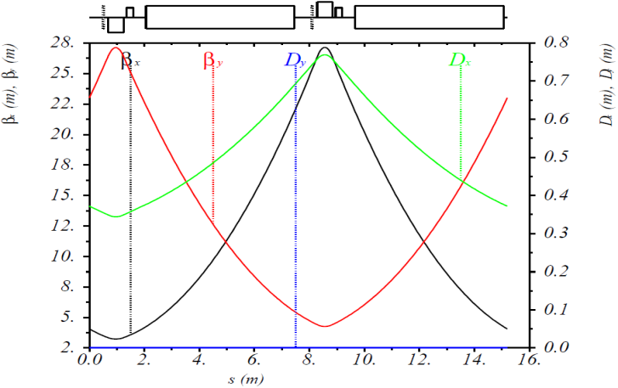
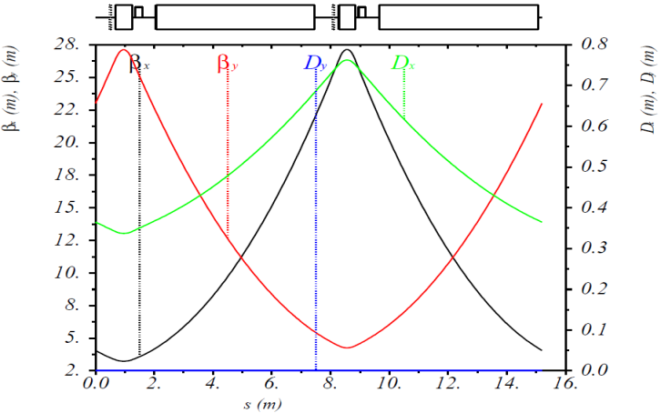
FODO Cell (@ 10 GeV)
Normal quads FODO cell (in MEIC e-ring arcs)
Combined function quads FODO cell
1st :
Quad settings
2nd :
Equivalent to offset the beam in quads by 8.2 mm and 7.4 mm, respectively.

Slide 31
MEIC Electron Collider Ring with New Magnets
Arc dipole length | m | 3.75
Arc quad length / strength @ 12 GeV | m / T/m | 0.56 / 21
Cell length | m | 11.4 (half of ion ring arc cell)
Arc dipole bending angle / radius | deg / m | 2.045 / 105
FODO cells per arc (no spin rotator included) |  | 64
Total arc dipoles |  | 256
Total bending angle per arc | deg | 261.7
Figure-8 crossing angle | deg | 81.7
Arc length (no spin rotator) | m | 729.6
Straight length | m | 369.46
Ring circumference | m | 2198
Beam current @ 10 GeV, arc only | A | 0.785 (@SR power < 10 kW/m)
Normalized emittance @10 GeV | mm mrad | 329
(including spin rotator, IR, etc.) | mm mrad | 329 x 1.7 ~ 559
Notes:
Red Interior Page Design 2

Slide 32
Optics of New Matching Section (I)
New matching section: “missing magnet” dispersion suppressor + beta function matching
Matching section dipole bending angles
Regular arc bending angle
No extra dipole is needed
Regular arc FODO cell
Spin rotator

Slide 33
Optics of New Matching Section (II)
New matching section: “missing magnet” dispersion suppressor + beta function matching
Matching section dipole bending angles
Regular arc bending angle
8 extra dipoles (4 FODO cells) are needed
Regular arc FODO cell
Spin rotator

Slide 34
Emittance
Section | Normalized Horizontal Emittance (μm)
 | Baseline design | New design 1* | New design 2**
Regular FODO cells in two arcs | 476 | 665 | 569
Matching sections between FODO cells and spin rotators | 389 | 7 | 6
Spin rotators | 119 | 81 | 84
Straight with IP (CCB + Chicane) | 84 | 82 | 85
Straight without IP | 0 | 0 | 0
Total | 1068 | 835 | 745
Extra space needed (m) |  | 50 | 111
* New design 1: Each regular arc FODO cell dipole bending angle is 2.94°. Extra 50 m-long space is needed for new matching and spin rotator sections.
** New design 2: Each regular arc FODO cell dipole bending angle is 2.80°. Extra 111 m-long space is needed for 4 extra arc FODO cells, new matching and spin rotator sections.

