Slide 1
MEIC Electron Polarization
Fanglei Lin
MEIC Collaboration Meeting, October 6, 2015

Slide 2
Outline
MEIC electron complex: Polarized CEBAF + electron collider ring
MEIC electron polarization design
Overview of strategies
Universal spin rotator
Polarization configuration
Estimation and simulation of polarization
Polarization measurement
Continuous injection
Conclusions & Outlook

Slide 3
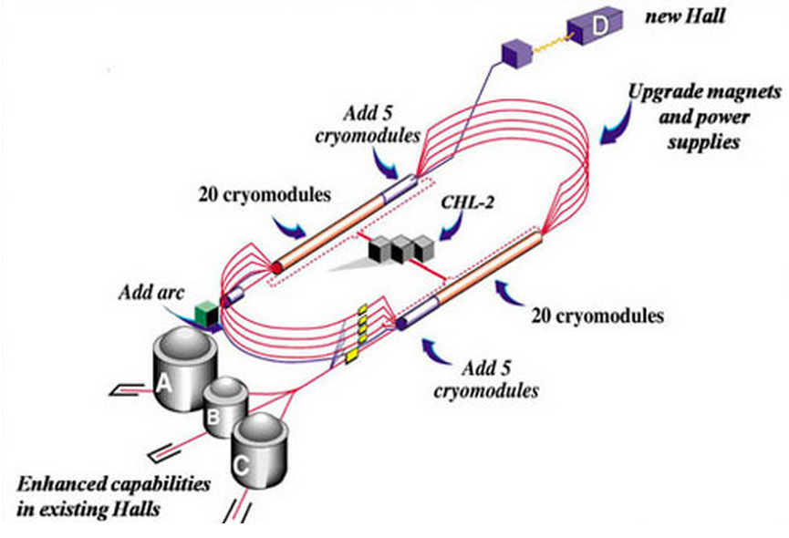
CEBAF - Full Energy Injector
CEBAF fixed target program
5-pass recirculating SRF linac
Exciting science program beyond 2025
Can be operated concurrently with the MEIC
e⁻ collider ring
Wien Filters and solenoids provide vertically polarized electron beam to the MEIC.
CEBAF will provide for MEIC
Up to 12 GeV electron beam
High repetition rate (up to 1497 MHz)
High polarization (>85%)
Good beam quality

Slide 4
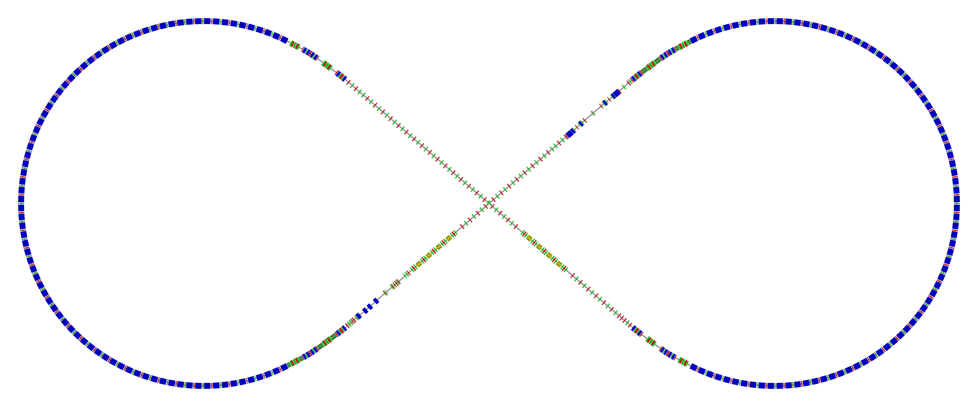
Complete Electron Collider
Electron collider ring geometry (circumference of 2154.28 m)
Spin rotator
Spin rotator
CCB
Tune trombone & Straight FODOs
R=155m
81.7°
e⁻
Arc, 261.7°
Future 2nd IP
Forward e⁻ detection
RF
RF
Spin rotator
IP
Spin rotator
CEBAF
Electron polarization requirements
Electron polarization of 70% or above
Longitudinal electron polarization at IP(s)
Spin flipping

Slide 5
Overview of e⁻ Polarization Strategies
Highly vertically polarized electron beams are injected from CEBAF
avoid spin decoherence, simplify spin transport from CEBAF to MEIC, alleviate the detector background
Polarization is designed to be vertical in the MEIC arc to avoid spin diffusion and longitudinal at collision points using spin rotators
Universal spin rotator (fixed orbit) rotates the electron polarization from 3 to 12GeV
Desired spin flipping is implemented by changing the source polarization
Polarization configuration with figure-8 geometry removes electron spin tune energy dependence
Significantly suppress the synchrotron sideband resonance
Continuous injection of electron bunch trains from the CEBAF is considered to
preserve and/or replenish the electron polarization, especially at higher energies
Spin matching in some key regions is considered to further improve polarization lifetime
Compton polarimeter is considered to measure the electron polarization
Two long opposite polarized bunch trains (instead of alternate polarization between bunches) simplify the Compton polarimetry
bunch train & polarization pattern (in arcs)
2.1 ns
476 MHz
Empty buckets
Empty buckets
…
…
…
…
Polarization (Up)
Polarization (Down)

Slide 6
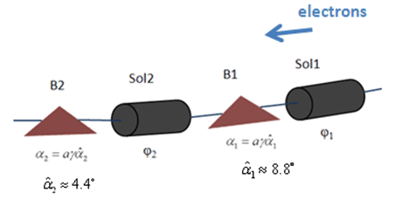
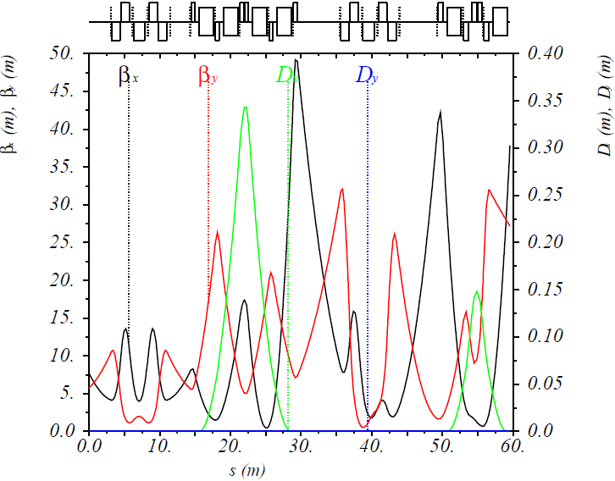
Universal Spin Rotator (USR)
Schematic drawing of USR
Solenoid decoupling & Lattice function
Half
Solenoid
Quad. Decoupling Insert
Half
Solenoid
Arc
IP
P. Chevtsov et al., Jlab-TN-10-026
Parameters of USR for MEIC
1st Sol. + Dec. Quads
2nd Sol. + Dec. Quads
Dipole set
Dipole Set
E | Solenoid 1 |  | Arc Dipole 1 | Solenoid 2 |  | Arc Dipole 2
 | Spin Rotation | BDL | Spin Rotation | Spin Rotation | BDL | Spin Rotation
GeV | rad | T·m | rad | rad | T·m | rad
3 | π/2 | 15.7 | π/3 | 0 | 0 | π/6
4.5 | π/4 | 11.8 | π/2 | π/2 | 23.6 | π/4
6 | 0.62 | 12.3 | 2π/3 | 1.91 | 38.2 | π/3
9 | π/6 | 15.7 | π | 2π/3 | 62.8 | π/2
12 | 0.62 | 24.6 | 4π/3 | 1.91 | 76.4 | 2π/3

Slide 7
e⁻ Inj. from CEBAF to Electron Ring
Electron injection bunch pattern @6 GeV (as an example) from CEBAF with
f_{ring}/ f_{cebaf} = 476.3MHz/1497MHz = 7/22
Two polarization states injection
Existing CEBAF source gun
Mid-cycle 1, inject the 1st of every 7 buckets in the ring
Bunch train, up polarization
Bunch train, down polarization
220 bunches, 3.233µs
(I_{ave}= 0.9mA @6GeV CEBAF)
14.69 ns, 68.05 MHz (7 ring buckets)
2ns, 476.3 MHz(ring freq.)
13 pC bunch
Waiting for damping 12-700ms
……
Waiting for 72.07µs
……
3416*10.5turns/476.3MHz=75.3μs
12-700ms, ~2× e-ring damping time at different energy
We should not expect polarization loss in the transfer line.

Slide 8
Polarization Configuration
Unchanged polarization in two arcs by having opposite solenoid field directions in two spin rotators in the same long straight section
figure-8 removes spin tune energy dependence
e⁻
Magnetic field
Spin Rotator
Polarization
FOSP: First Order Spin Perturbation from non-zero δ in the solenoid through G matrix.
IP
S-T: Sokolov-Ternov self-Polarization effect
Polarization orientation
Arc
Solenoid field
IP
Solenoid field
Arc
S-T
FOSP

Slide 9
Electron Polarization
Equilibrium electron polarization:
(Derbenev-Kondratenko formula)
Polarization lifetime:
Computer algorithm for estimating the equilibrium polarization and lifetime
Analytically, method based on evaluating $\hat{n}$ and ${\left|\frac{∂\hat{n}}{∂δ}\right|}^{2}$ in the D-K formula
SLICK (8x8 matrices) : linearized orbit motion + linearized spin motion
Based on Alex Chao’s SLIM algorithm, Desmond Barber extended to thick length optics
Only first order resonance behavior: , with
Numerically, Monte-Carlo based code to estimate the depolarization rate through particles and their spins tracking while photon emission is simulated approximately.
SLICKTRACK (9x9 matrices) : linearized orbit motion + non-linearized spin motion
Higher order resonance behavior: , with
d
Spin-orbit coupling function

Slide 10
Spin Tune Scan
SLICK/SLICKTRACK allows one to insert a zero length spin tuning magnet to move the spin tune away from zero. Such magnet in the code only rotates the spin, leaving the orbit intact.
Longitudinal field spin tuning solenoid in one straight where the polarization is longitudinal
Only moves the spin tune away from zero
Does not change the spin direction
Breaks the current spin matching condition in the straight
Spin tuning solenoid
e⁻
Magnetic field
Polarization
Spin Rotator
IP

Slide 11
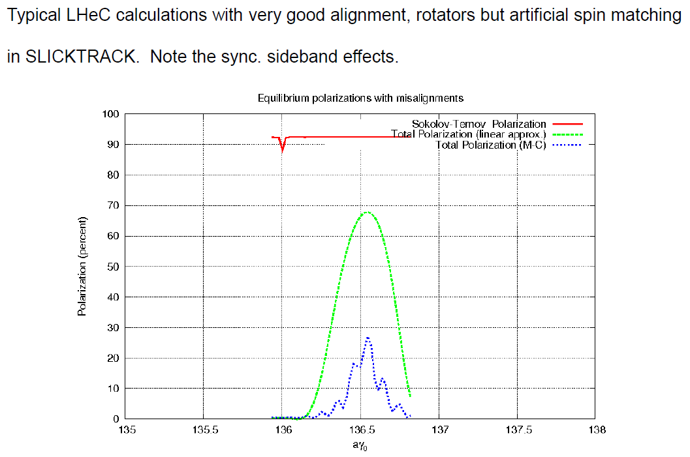
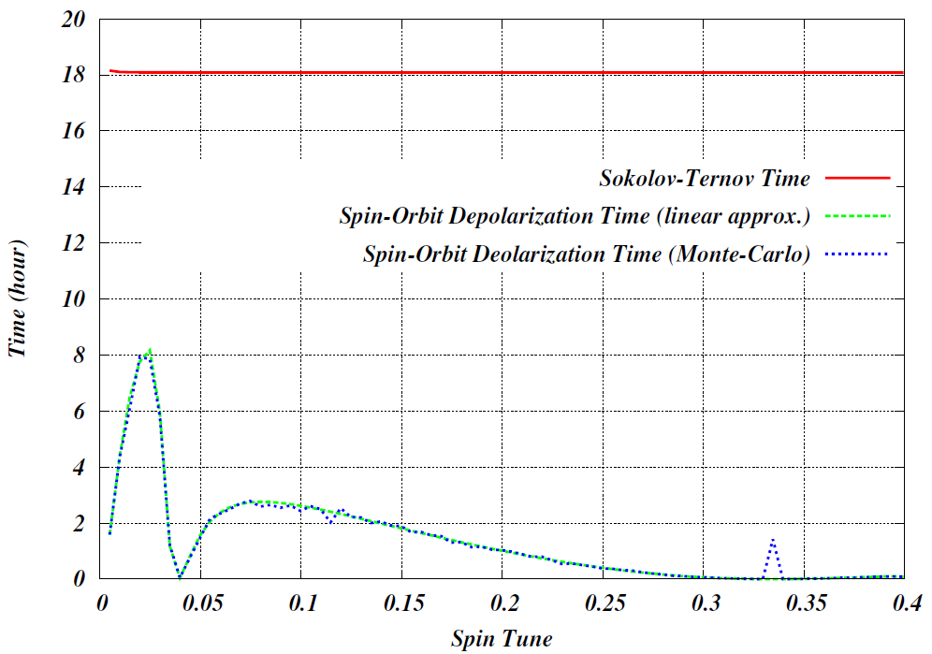
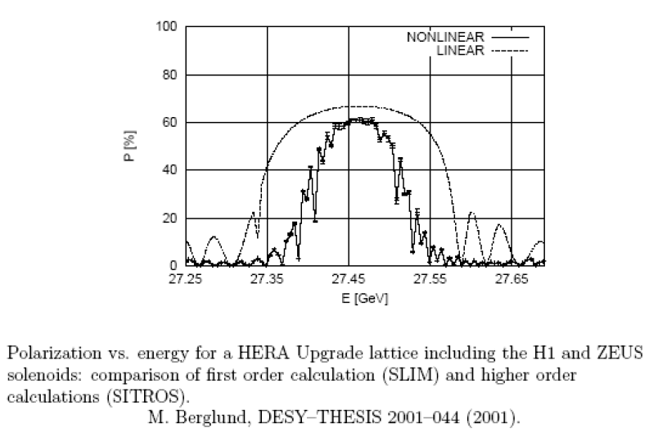
Spin Tune Scan @ 5 GeV
Quadrupole vertical misalignment with a rms value of 0.2mm and dipole role with a rms value of 0.2 mrad. The orbit is corrected with correctors around the ring.
First order spin resonance occurs when
500 electrons in the Monte-Carlo simulation
Optimum Spin Tune 0.0267
Nasty, nasty sidebands !
Figure-8 MEIC collider ring has no synchrotron sideband resonances !

Slide 12
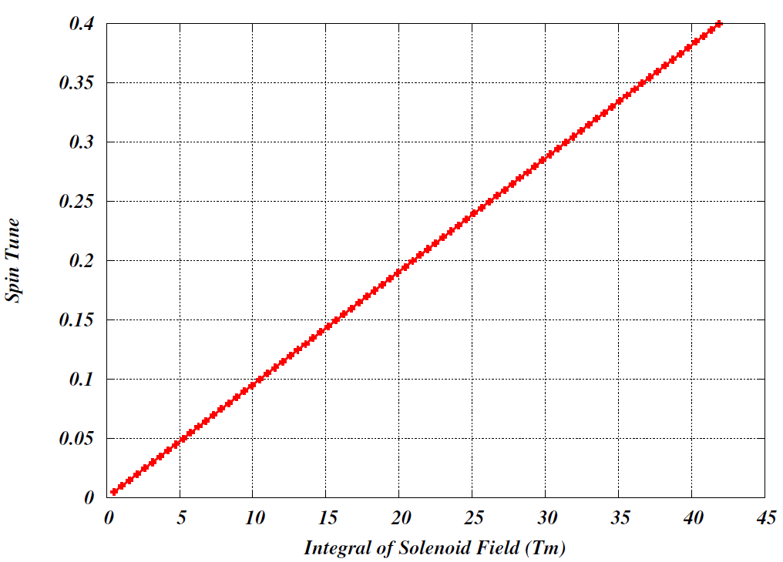
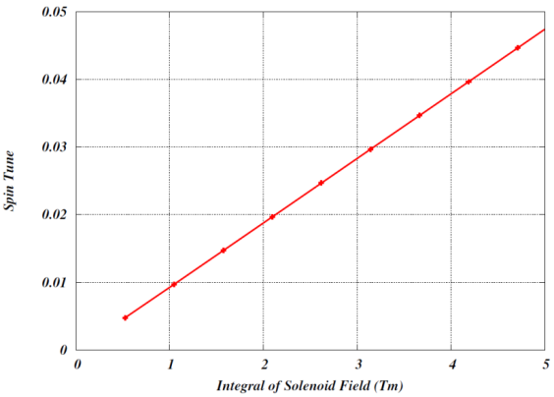
Solenoid Strength
Spin tuning solenoid strengths in spin tune scans
Optimum Spin Tune 0.0267
For the optimum spin tune of 0.0267 where the polarization lifetime reaches 8 hours, the required integral of spin tuning solenoid field is ~3 Tm.
The stronger the solenoid field is, the larger the spin tune is. But the strong solenoid field breaks the spin matching badly and leaves a short polarization lifetime.

Slide 13
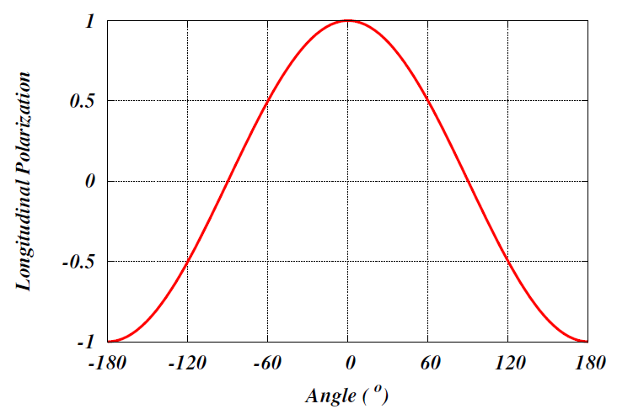
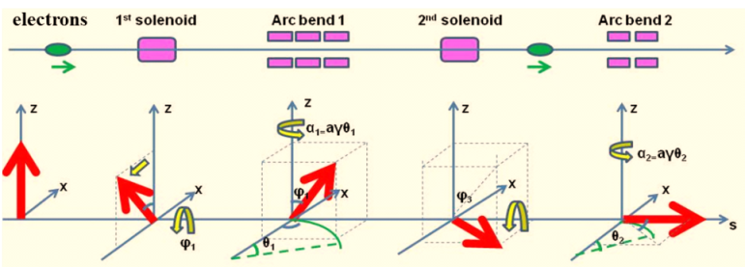
Polarization Measurement & Calibration
Compton polarimetry
same polarization at laser as at IP due to zero net bend
Spin dancing (using spin rotators):
Experimentally optimize (calibrate)
longitudinal polarization at IP
IP
forward ion
detection
ions
Photon
calorimeter
Laser + Fabry Perot cavity
Low-Q² tagger for
low-energy electrons
forward e⁻
detection
γ_{c}
Low-Q² tagger for high-energy electrons
Electron
tracking detector
e⁻ beam
e⁻ spin rotator
e⁻
final focusing
elements
Courtesy of Alexandre Camsonne
v-step and 50 mrad crossing
Schematic drawing of USR
Arc
IP
Illustration of spin rotation by a USR

Slide 14
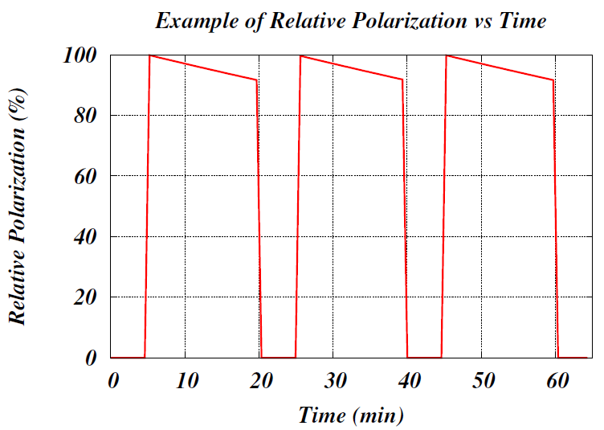
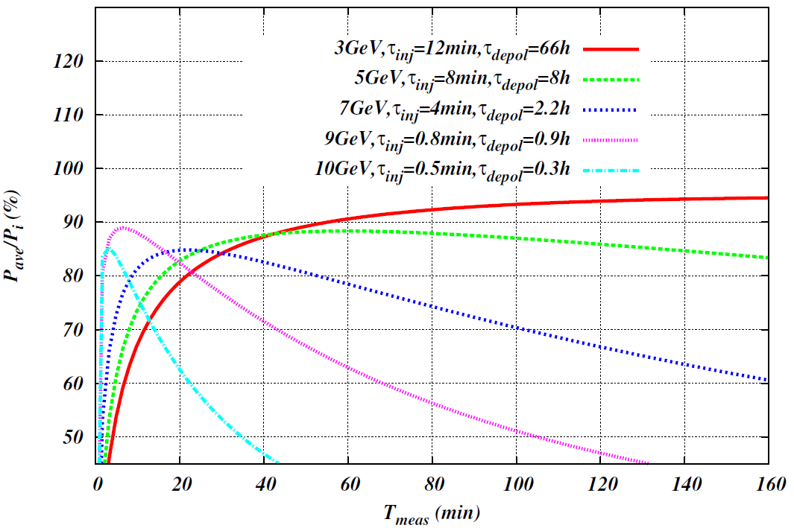
Optimization of Average Polarization
Injection pattern on polarization
Averaged Pol.
Relative Polarization (%)
Time (arbitrary scale)
Energy (GeV) | τ_{inj} (min) | τ_{opt_meas} (min) | (P_{ave}/P_{i})_{max} *
3 | 12 | 160 | 0.94
5 | 8 | 60 | 0.88
7 | 4 | 20 | 0.85
9 | 0.8 | 6 | 0.89
10 | 0.5 | 2.5 | 0.86
: Initial polarization
: Injection time
: Depolarization time
: Measurement time

Slide 15
Continuous Injection
Continuous injection (or top-off injection or trickle injection) has been applied in many modern electron storage ring light sources to maintain a constant beam current, and colliders (such as PEP-II, SuperB) to gain the average luminosity
Average luminosity is always near the peak luminosity
The collider looks like a “DC” accelerator allowing an improved operational consistency
MEIC may also consider the continuous injection of the electron beams to
Obtain a high average luminosity
Reach a high equilibrium polarization
Note that
If the beam lifetime is shorter than the polarization lifetime, continuous injection maintains the beam current and improves the polarization as well
If the beam lifetime is longer than the polarization lifetime, beam lifetime has to been shorten (collimation, scraping, or reduce the dynamic aperture)
From John T. Seeman, SLAC-PUB-5933, Sep. 1992
Lost or Extracted
P₀ (>P_{t})
P_{t}

Slide 16
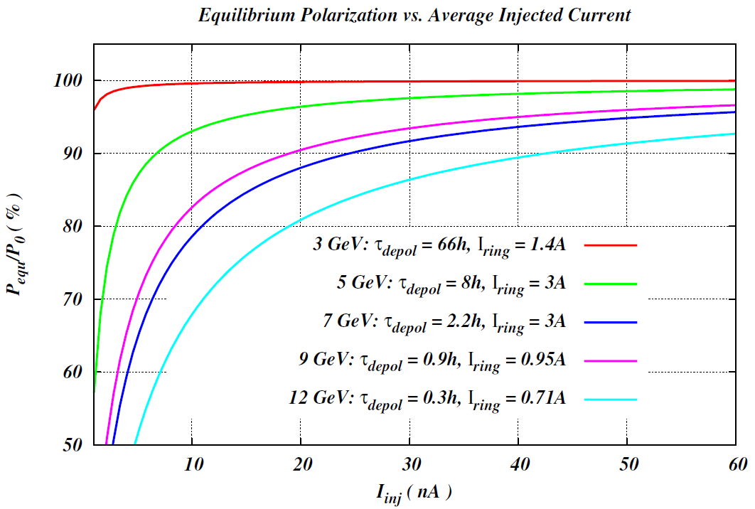
Equilibrium Polarization w Cont. Injection
Polarization w/ continuous injection
Equilibrium polarization
A relatively low average injected beam current of tens-of-nA level can maintain a high equilibrium polarization in the whole energy range.

Slide 17
Conclusion and Outlook
Electron polarization schemes have been developed
Comprehensive polarization strategies
Polarized CEBAF + figure-8 shape ring + universal spin rotator + polarization configuration (+ continuous injection) + Polarization measurement
Spin tune scan based on Mote Carlo simulation shows figure-8 shape MEIC collider ring has no synchrotron sideband resonances !
Outlook
Scheme or technique optimization
Spin matching through the optics to improve polarization lifetime, especially at high energies
Spin tracking using ZGOUBI and PTC for benchmarking
Acknowledgements
A. Camsonne, D. Gaskell, Y.S. Derbenev, V.S. Morozov, P. Nadel-Turonski, Y. Zhang, – JLab
D. P. Barber – DESY/Liverpool/Cockcroft

Slide 18
Thank you for your attention !

Slide 19
Back Up

Slide 20
SLIM Algorithm
Present expressions for ${∂\hat{n}}/{∂δ}$ in an linear approximation of orbit and spin motion.
For spin, the linearization involves assuming that the angle between $\hat{n}$ and ${\hat{n}}_{0}$ is small at all positions in phase space so that the $\hat{n}$ can be approximated by the form $\hat{n}\left(\overset{⃑}{u};s\right)={\hat{n}}_{0}\left(s\right)+α\left(\overset{⃑}{u};s\right)\hat{m}(s)+β(\overset{⃑}{u};s)\hat{l}(s)$ with an assumption that $\sqrt{α^{2}+β^{2}}≪1$. ($\hat{m}$ and $\hat{l}$ are 1-turn periodic and is orthonormal.)
The combined linear orbit and spin motion is described by 8x8 transport matrices of
$\left(\begin{aligned}\begin{matrix}x \\ x^{′} \\ y\end{matrix} \\ y^{′} \\ σ \\ δ \\ α \\ β\end{aligned}\right)(s_{1})=\left(\begin{matrix}M_{6×6} & 0_{6×2} \\ G_{2×6} & D_{2×2}\end{matrix}\right)$($s_{1}$, $s_{0}$) $\left(\begin{aligned}\begin{matrix}x \\ x^{′} \\ y\end{matrix} \\ y^{′} \\ σ \\ δ \\ α \\ β\end{aligned}\right)$($s_{0}$)
$M_{6×6}$ is a symplectic matrix describing orbital motion, $G_{2×6}$ describes the coupling of the spin variables ($α$, $β$) to the orbit and depend on $\hat{m}(s)$ and $\hat{l}(s)$, $D_{2×2}$ is a rotation matrix associated with keeping the motion in the periodic reference frame.
Describe the coupling of spin variable to the orbit motion and is the target of “spin matching” by adjusting the optics to make some crucial region spin transparent
Notes:
We understand those terminologies of electron polarization quantitatively. Now we need to describe (or estimate) the electron polarization quantitatively. Two classes of computer algorithm for estimating the equilibrium polarization and lifetime: i) methods on evaluating $\frac{∂\hat{n}}{∂δ}$ in the D-K formula given the ring layout and magnet strengths; ii) algorithm using Monte-Carlo tracking.
Class i) methods are further divided according the degree of linearization of the spin and orbit motion, SLIM family (linearization of orbital and pin motion), SMILE (linearized orbital motion but nonlinear spin motion), SPRINT (linearized orbital motion but nonlinear spin motion). Here I briefly introduce the SLIM algorithm created by Dr. Alex Chao and Dr. Desmond Barber, which is used widely for the estimation of electron polarization under the linearization scale for the first step of polarization studies, of course here for MEIC.

Slide 21
SLIM Algorithm (cont.)
The eigenvectors for one turn matrix can be written as
${\overset{⃑}{q}}_{k}\left(s_{0}\right)=\left(\begin{matrix}{\overset{⃑}{v}}_{k}(s_{0}) \\ {\overset{⃑}{w}}_{k}(s_{0})\end{matrix}\right), {\overset{⃑}{q}}_{−k}\left(s_{0}\right)={\left[{\overset{⃑}{q}}_{k}\left(s_{0}\right)\right]}^{∗}, for k=I,II, III$
${\overset{⃑}{q}}_{k}\left(s_{0}\right)=\left(\begin{matrix}{\overset{⃑}{0}}_{6}(s_{0}) \\ {\overset{⃑}{w}}_{k}(s_{0})\end{matrix}\right), {\overset{⃑}{q}}_{−k}\left(s_{0}\right)={\left[{\overset{⃑}{q}}_{k}\left(s_{0}\right)\right]}^{∗}, for k=IV$
${\overset{⃑}{v}}_{k}$ are the eigenvectors for orbital motion with eigenvalues $λ_{k}=e^{−i2πν_{k}} \left(k=I,II,III\right)$
${\overset{⃑}{w}}_{k}$ are the spin components of the orbit eigenvectors $\left(k=I,II,III\right)$.
Finally, the spin-orbit coupling term can be expressed as
$\frac{∂\hat{n}}{∂δ}≡i \sum_{k=I,II,III}{\left\{{v_{k5}}^{∗}{\overset{⃑}{w}}_{k}−v_{k5}{{\overset{⃑}{w}}_{k}}^{∗}\right\}}=−2 Im\sum_{k=I,II,III}{{v_{k5}}^{∗}{\overset{⃑}{w}}_{k}}$
${(\frac{∂\hat{n}}{∂δ})}^{2}=4\sum_{μ=1}^{2}{{(Im\sum_{k=I,II,III}{{v_{k5}}^{∗}w_{kμ}})}^{2}}$
This is the spin-orbit coupling function used in the code SLICK to calculate the equilibrium polarization and depolarization time.
Notes:
The ${\overset{⃑}{v}}_{k}$ are the eigenvectors for orbital motion with eigenvaluesof $λ_{k}=e^{−i2πυ_{k}}$
${v_{k5}}^{∗}$ embodies the impulse perturbation to electron state due to the photon emission event. In the spin-orbit coupling terms, each term is basically the product of the sensitivity of an orbit amplitude to a change of $δ$ and the sensitivity of $\hat{n}$ to a change of that orbit amplitude. ${\left|v_{k5}\right|}^{2}$ is the analogue of function H usually seen when using beta and dispersion functions

Slide 22
Injection Time
Initial injection time (to fill up the ring to the desired currents):
Perform injection every 15.4 minutes. Continuous injection time:

Slide 23
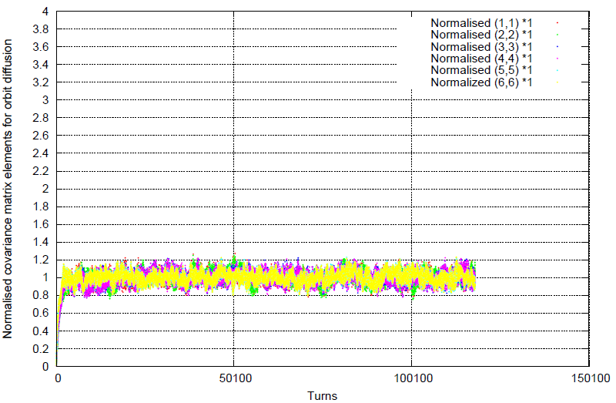
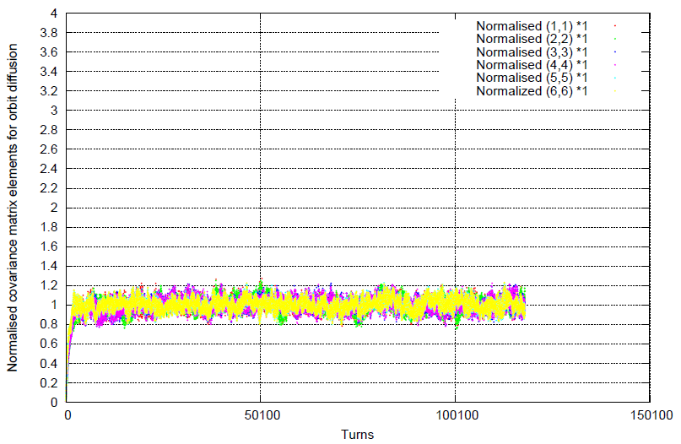
Orbit Diffusion
Longitudinal field spin tuning solenoid
Vertical field spin tuning dipole
500 particles

Slide 24
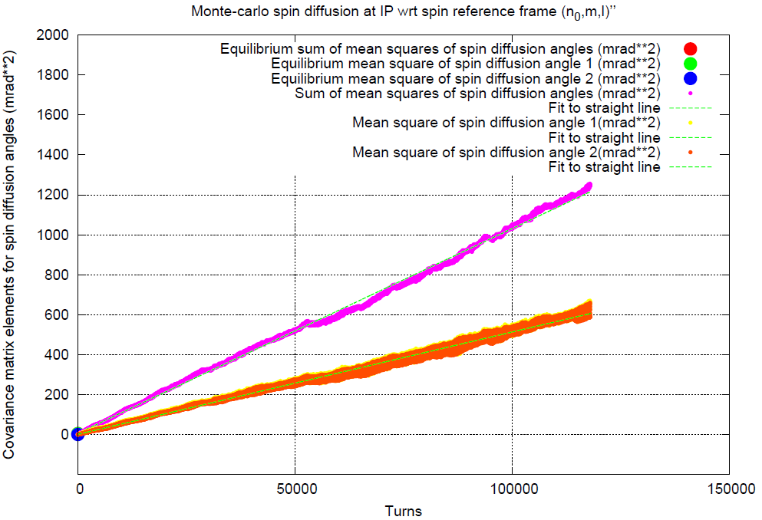
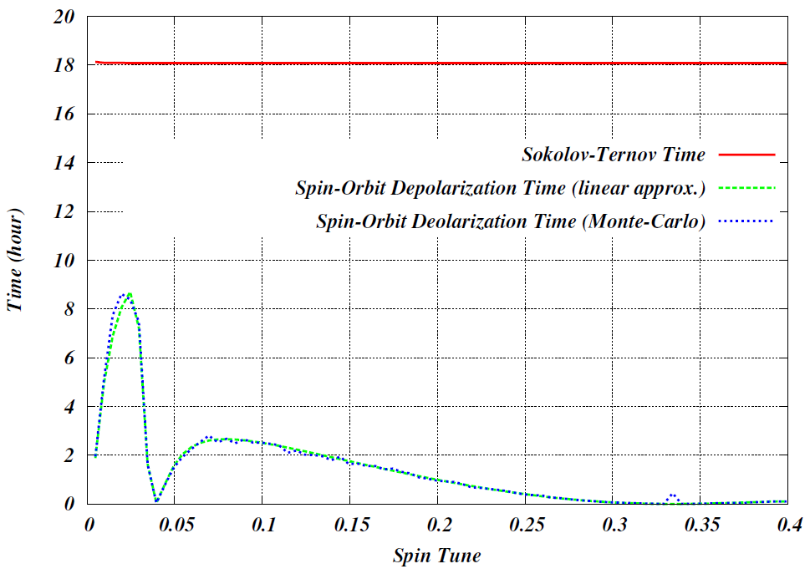
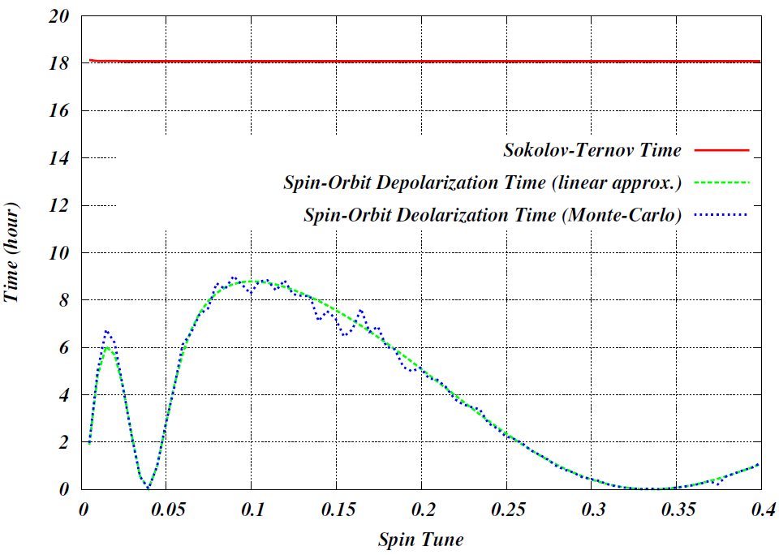
Spin Diffusion
Longitudinal field spin tuning solenoid
Vertical field spin tuning dipole
500 particles

