Slide 1
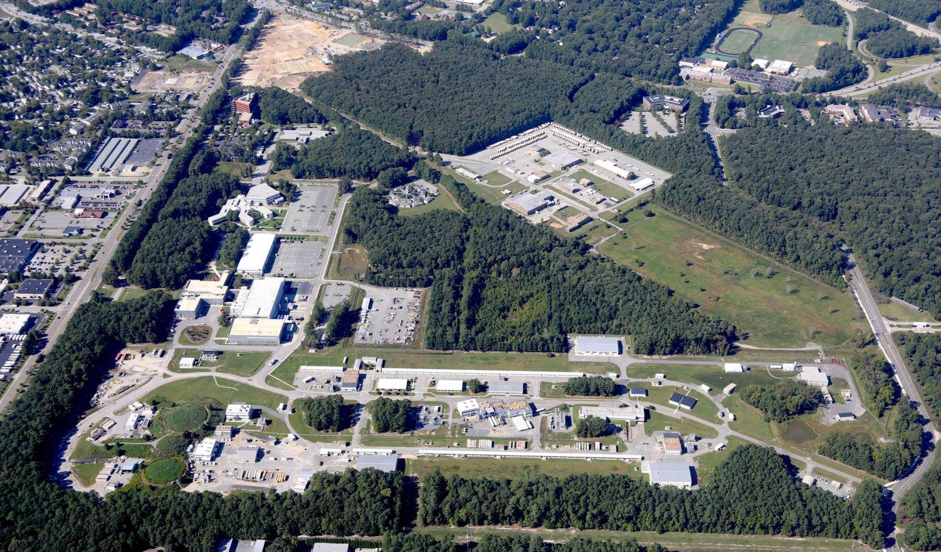
Engineering Issues in MEIC
Tim Michalski
October 6, 2015

Slide 2
MEIC Engineering R&D
Focus on areas of technical risk
Support R&D priorities of the MEIC Program
Support MEIC collaborations, as required

Slide 3
MEIC Engineering R&D
Superferric Model Dipole Magnet
PEP-II Magnets
FFQ / IR Magnets, other magnets
SRF R&D Support
Machine Layouts
Synchronization – Moving Magnets
Others Areas of Consideration

Slide 4
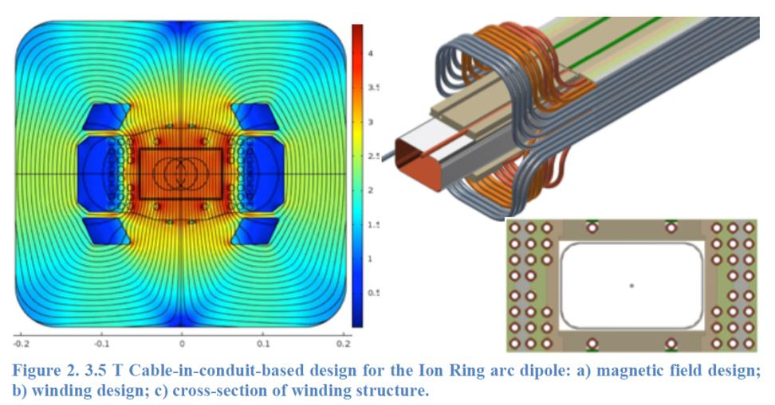
Superferric Model Dipole Magnet
JLab’s Goal: Develop a solid understanding of the SF magnet technology – champion its implementation for MEIC's Ion Collider Ring and Ion Booster Ring.
Collaborate with TAMU on the design and analysis of a 1.2m model dipole magnet prototype and test it to ensure performance to 3T.
Develop a cryostat concept design which is cost effective and manufacturable.
Notes:
1) Evaluate the TAMU contracts
2) Evaluate the deliverables
3) Evaluate methods, procedures, and tooling planned for the prototyping
4) Perform supplemental analyses that builds confidence in and understanding of SF magnet as a viable technology for MEIC
5) Plan, schedule, witness, and report on testing the 3T dipole at a 3rd party facility
6) Work w/ TAMU and SRF Eng to develop a cryostat concept
7) Update costing of the Arc Half Cell magnet assemblies
8) Assess methodologies necessary to test long magnets with a non-straight bore

Slide 5
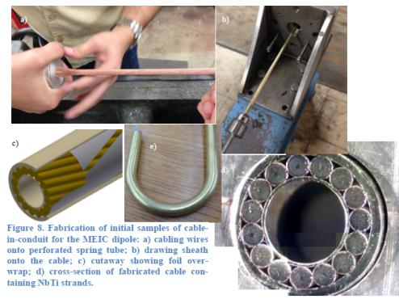
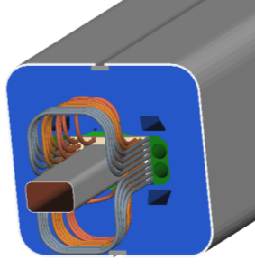
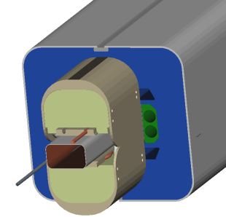
Status of the Superferric Magnet
Concept Design Review in June, 2015 – down select to CIC
JLab has contracted TAMU to develop a 1.2m superferric model dipole
Deliverable 1 – Concept Design – COMPLETE
Deliverable 2 – Prototype Cable-In-Conduit winding – In Process, due at the end of CY’15 – more from Peter McIntyre
Follow on fabrication contract is planned
Test to 3T at a 3rd party test facility
SF Dipole End – With and Without Coil Supports

Slide 6
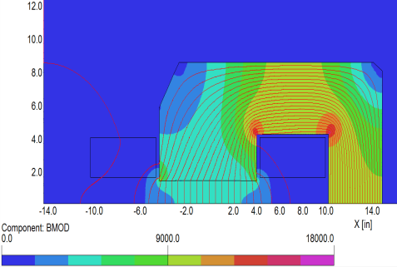
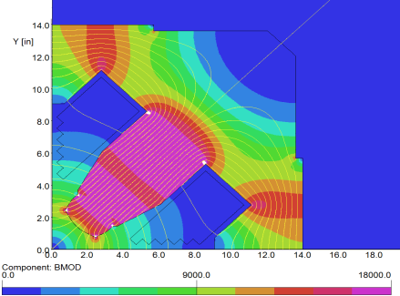
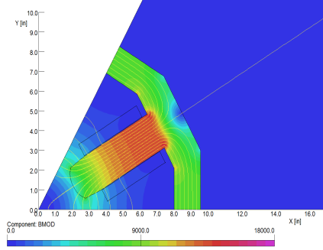
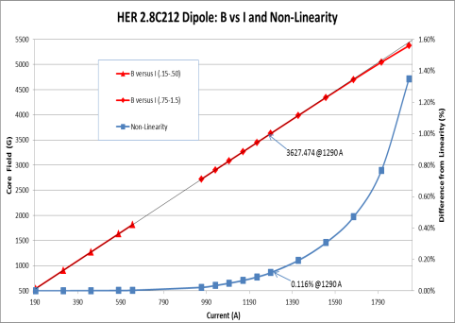
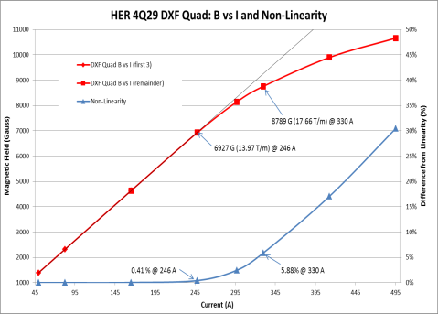
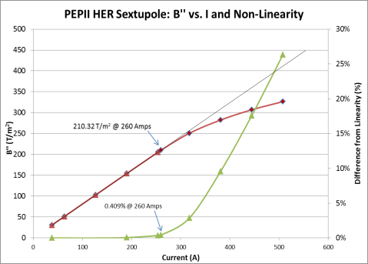
PEP-II HER and LER Magnet Evals
PEP-II designs reflected against requirements for MEIC Electron Collider Ring, modeled in TOSCA – more from Tommy Hiatt
Evaluated for field vs. current, multi-poles, temperature rise, etc.

Slide 7
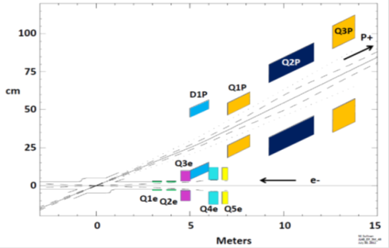
FFQ and IR Magnets Evaluations
Understand performance parameters of the FFQs and other Specialty Magnets in the Interaction Region and Straight Segments.
Perform initial assessments of stored energy, SC selection, current requirements, and design concept will be performed.

Slide 8
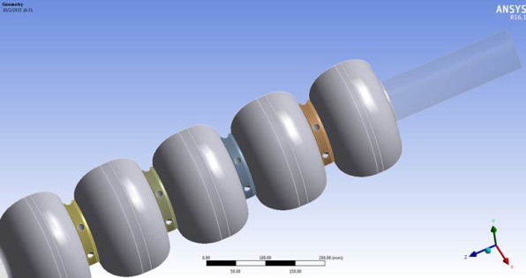
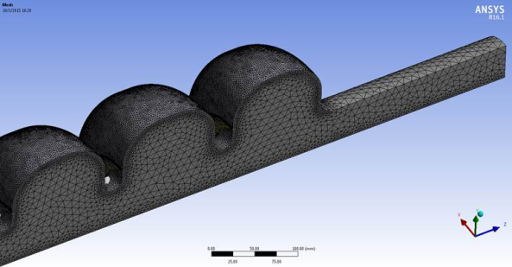
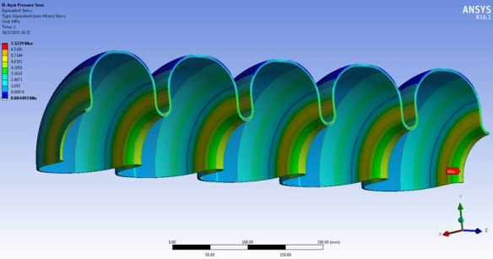
SRF R&D Support
Perform analyses in support of SRF cavity design, prototyping, and testing.
Analyzing tuning sensitivity/stiffness, pressure sensitivity, and Lorentz force detuning.

Slide 9
Machine Layouts
Develop mechanical layouts of the various beamlines within MEIC to assess fit of all machine elements.
1) Develop element lists for all beamlines.
2) Create baseline layouts of the various beamlines
3) Assess regions where density requires further evaluation - straights and Interaction Region
4) Assess interface between SF Arc Half Cell cryostats

Slide 10
Synchronization Concept Evals
Assess moving magnets in the Ion Collider Ring and Electron Collider Ring.
1) What is the cost of implementation for moving large, heavy magnets?
2) How much time will it take to reposition magnets for different energies?
3) Assess layout options in the tunnel - affect tunnel cross section.
Preliminary assessment complete on all questions

Slide 11
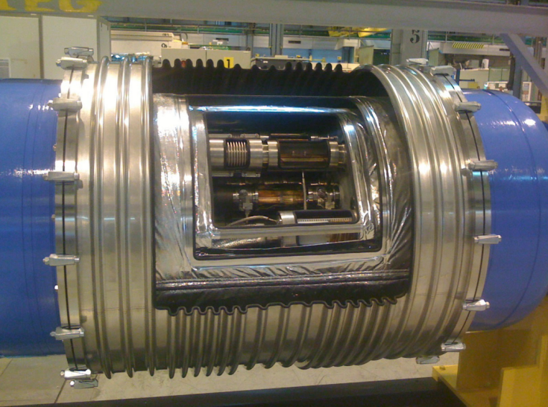
Considerations for Repositioning Superferric Magnets
Moving a string of magnets radially inward and outward is feasible
Use slides and measurement scheme to make repeatable
Rotation of magnets will be required as well
Considerations for interfaces between magnets and to outside world
Beamline Vacuum – bellows between adjacent beam pipe vacuum chambers
Insulating Vacuum – bellows between adjacent Arc Half-Cells
Power – “service loop” for conductors
Cryogens – flex hoses between adjacent Arc Half-Cell cryostats
Example: LHC Magnet Cryostat Interface

Slide 12
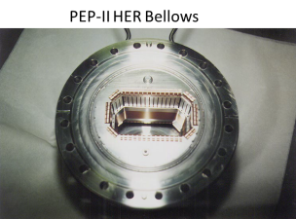
Considerations for Repositioning PEP-II Magnets
Moving radially inward and outward is feasible
Use slides and measurement scheme to make repeatable
Rotation of magnets will be required as well – if not doing entire arc
Considerations for interfaces between magnets and to outside world – no major issues
Vacuum – assess capacity to expand/contract RF shielded bellows between raft and dipole

Slide 13
Other Areas of Consideration
JLab Electron Cooling – ERL
Support JLab's design of an ERL for bunched beam electron cooling.
RF Systems Development
LLRF development required more than HPRF.
Vibration effects – tolerance of machine elements versus environment
Inspect and test PEP-II magnets and RF/HPA/PS
System Optimization – SF Magnets, Cryo System, DC Power, Power Distribution
Costing Updates – Design Report

Slide 14
PEP-II Magnets
POTENTIAL FUTURE ACTIVITY: Evaluation of reusing the HER raft assemblies and, more importantly, the Vacuum System elements.
Inspect magnets and vacuum elements in-situ at SLAC.
Select 1 each of the HER and LER magnets for de-installation and delivery to JLab for further evaluation and testing.
Test the HER and LER magnets for comparison to existing SLAC data.
Inspect the HER and LER magnets for degradation and validate assumptions on refurbishment labor and materials.
Inspect the HER magnet vacuum chambers for cleanability, refurbishment, and potential re-use in MEIC's Electron Collider Ring.

Slide 15
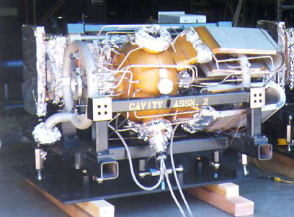
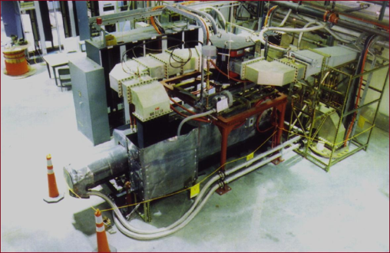
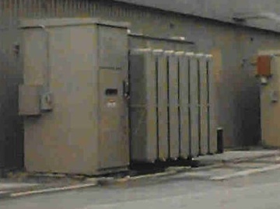
PEP-II RF/HPA/PS
POTENTIAL FUTURE ACTIVITY: Evaluation the functional state of PEP-II RF/HPA/PS elements
Inspect the RF/HPA/PS elements in-situ at SLAC.
Select 1 each of the elements for de-installation and delivery to JLab for further evaluation and testing.
Test the RF Cavity, HPA, and PS for MEIC specs.
Inspect the elements for degradation and validating assumptions on refurbishment labor and materials.

Slide 16
Summary – Next Steps
Summary: Continued efforts on magnets. Continued support of SRF. RF systems work coming.
Next Steps:
SF Magnet Review at TAMU in December
Review of overall machine size – all elements
Update machine layouts in CAD
FFQ and IR magnets – Q2’16
LLRF systems – Q2’16
Acknowledgements: Peter McIntyre and the team at TAMU, Tommy Hiatt, Renuka Rajput-Ghoshal, Cory Johnson, Mitch Laney, Fredrik Fors

