Slide 1
Chromaticity compensation options for the ion collider ring
Y. Nosochkov, M-H. Wang
October 05, 2015
MEIC Collaboration Meeting Fall 2015 Thomas Jefferson National Accelerator Facility Newport News, VA

Slide 2
Introduction
Due to the low-β*, the MEIC Interaction Region is characterized by very high β-functions in the final focus (FF) quadrupoles. The latter cause large chromatic perturbation of energy dependent betatron tune and beta functions. This creates a large non-linear tune chromaticity and chromatic beam size and may significantly reduce the energy dependent dynamic aperture.
The solution is to provide a local compensation of the FF chromaticity using special sextupoles placed in the nearby dispersive region (Chromaticity Compensation Block). The CCB must also compensate the non-linear geometric (amplitude dependent) aberrations created by the sextupoles.
One version of the CCB system has been already developed for the MEIC (V. Morozov, Ya. Derbenev, et. al).
In this report we present three alternative CCB options based on a more traditional scheme using –I sextupole pairs. Corrections using local non-interleaved and distributed interleaved –I pairs will be compared.

Slide 3
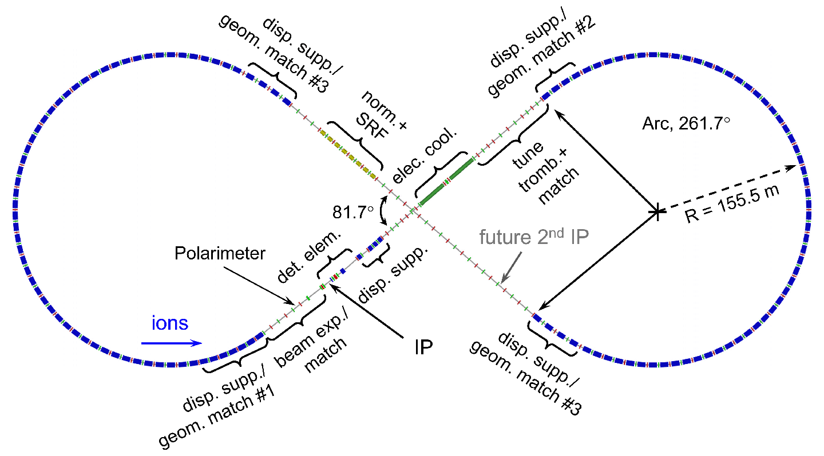
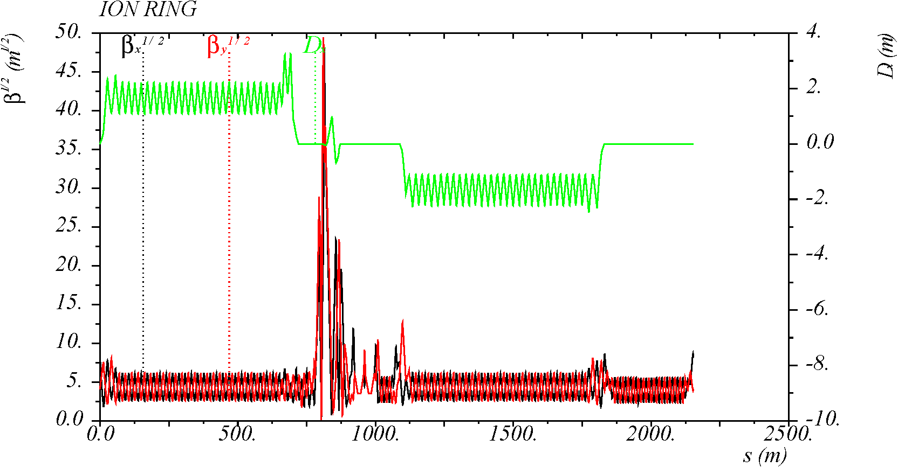
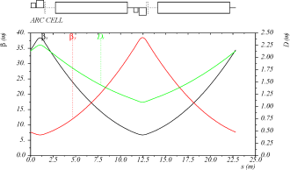
Lattice without CCB
2.15 km 8-figure ring with one IP (baseline)
IR
Arc (90° cells)
Arc (90°)
Straight (90°)
IP

Slide 4
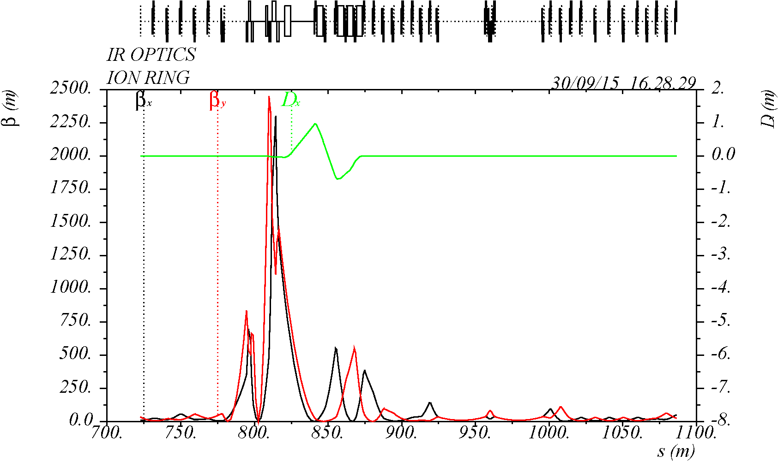
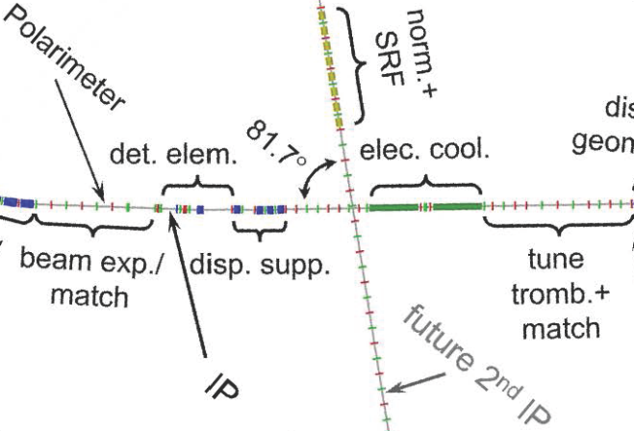
Final Focus and IR
IP
Asymmetric optics with L* = 3.6 m / 7.0 m.
β_{x}* = 10 cm, β_{y}* = 2 cm, β_{max} = 2340 m (60 times higher than in arcs).
No dispersion for CCB sextupoles → must be placed outside of the IR.

Slide 5
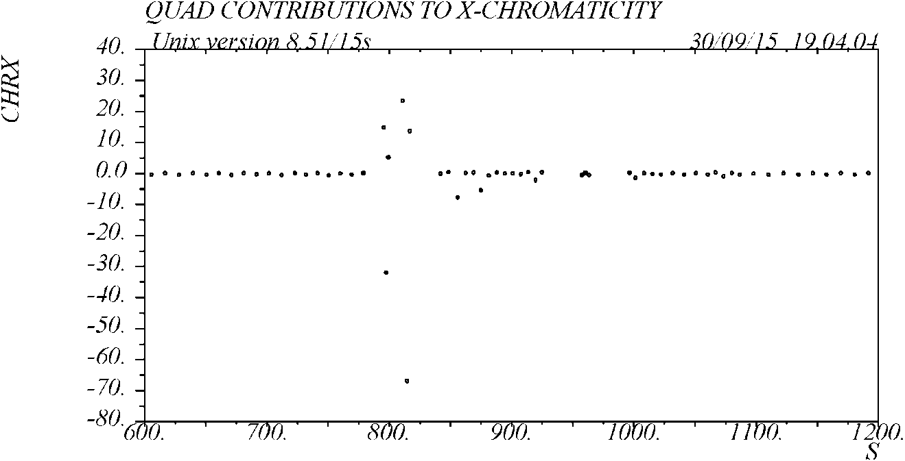
FF and linear chromaticity
Due to the very high β, the FF quads generate very large linear chromaticity βKL/(4π) (up to 65 units from one FF quad versus ~0.5 units from an arc quad).
Due to the optics asymmetry, the downstream FFB creates ~2.5 times more chromaticity than the upstream FFB.
In total, the FF quads create 40-50% of the ring linear chromaticity.
6 FF quads

Slide 6
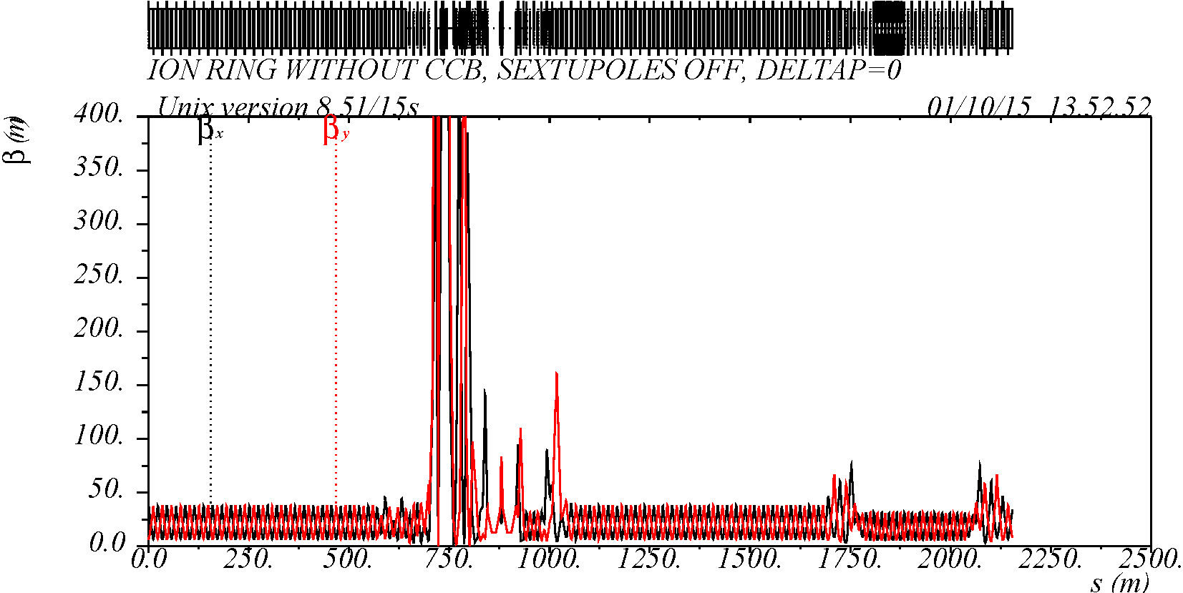
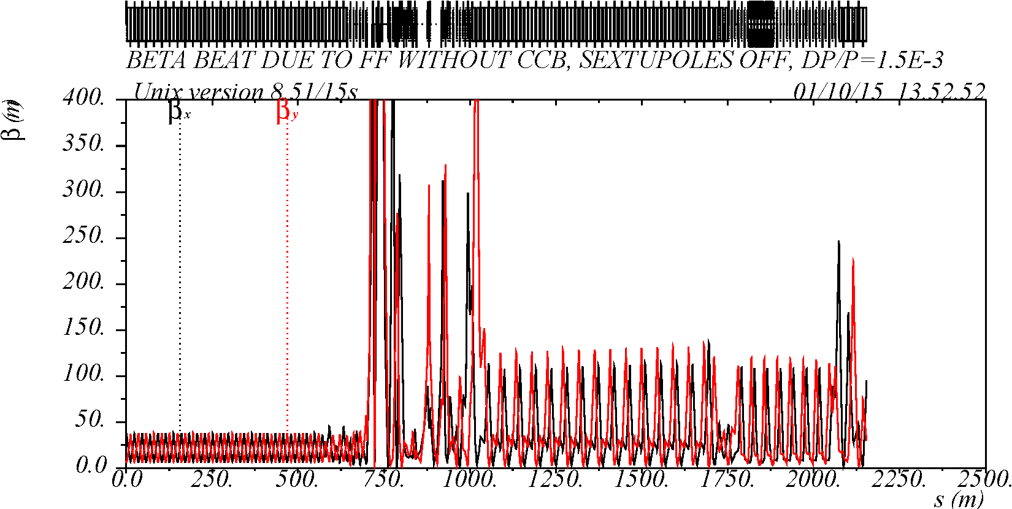
FF and non-linear chromaticity
One of the main sources of non-linear chromaticity is perturbation of β functions with δ=Δp/p, proportional to βKLδ.
Due to high β and π phase advance between the two FFBs, they amplify each other and generate very large Δβ/β(δ). See example on the right showing propagation of β(δ) through FF.
If not corrected, the chromatic β would lead to large non-linear chromatic tune shift and chromatic beam smear at IP.
Remedy: compensate the FFB linear and non-linear chromaticity with special local sextupoles (CCB).
δ = 0
δ = 0.15%
β(δ) before FF
β(δ) after FF

Slide 7
Local compensation of FF Δβ/β (δ)
CCB
FFB
FFB
CCB
Δβ/β (δ)
IP
nπ
$$\frac{∆β}{β} \sim −β_{s}{η_{s}K}_{2}lδ$$
$$\frac{∆β}{β} \sim β_{q}K_{1}lδ$$
Use CCB to create a wave of Δβ/β (δ) opposite to the one from FFB for local cancellation.
nπ phase advance from CCB sextupoles to FFB (in the correction plane).
Large β_{s}η_{s} at CCB sextupoles for a reasonable sextupole strength.
Large ratio β_{x}/β_{y} (or β_{y}/β_{x}) at X (Y) CCB sextupoles for more orthogonal X-Y correction (to reduce contributions to Δβ/β not in phase with FF).
Minimize other chromatic perturbations between CCB and FFB (from other quads) → place CCB and FFB close to each other if possible.
Compensate geometric (amplitude dependent) non-linear effects from the CCB sextupoles (for example, using -I pairs).

Slide 8
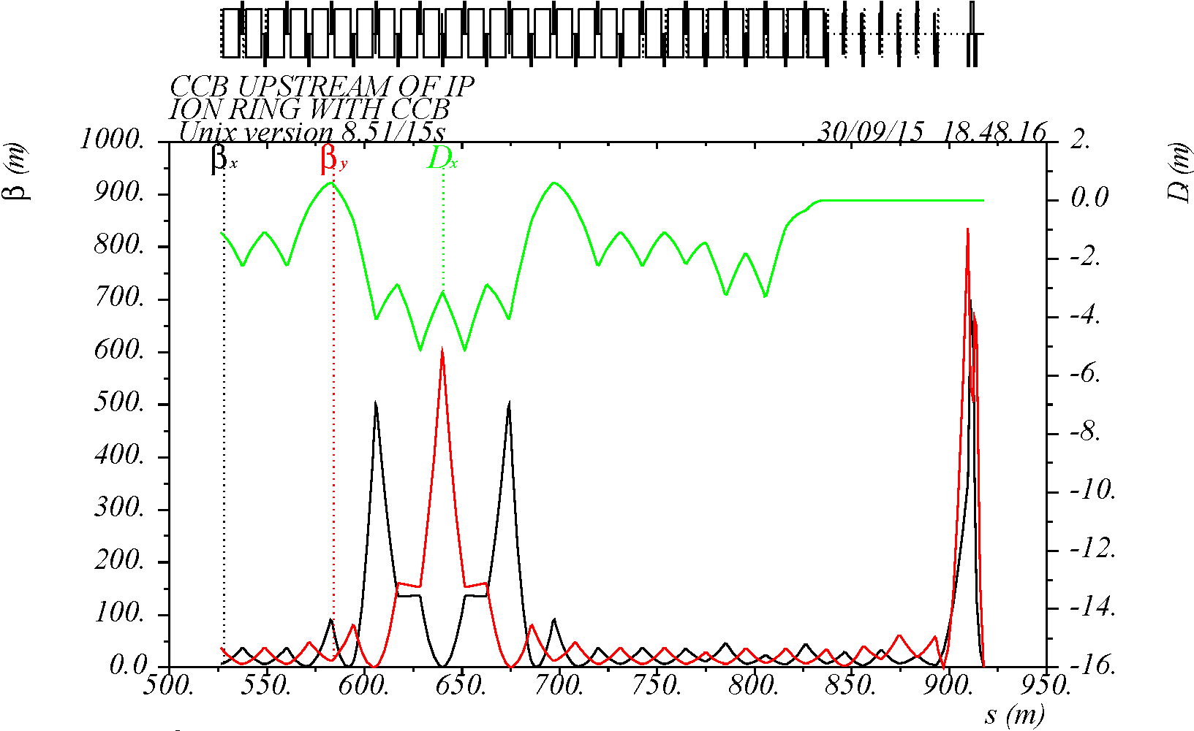
Original CCB design
CCB
FF
μ_{y} = nπ
μ_{x} = mπ
IP
SY
SX
π
SX
Conceptual design by V. Morozov, Ya. Derbenev, et al.
Compact optics, large β and η at sextupoles → weak sextupoles, good chromatic correction.
However, recent studies (V. M.) showed that uncompensated non-linear geometric effects (dν_{x}/dJ_{y}), caused by interleaved SX, SY sextupoles, limit dynamic aperture.

Slide 9
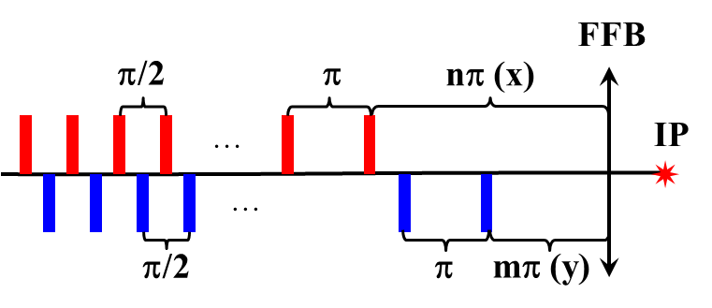
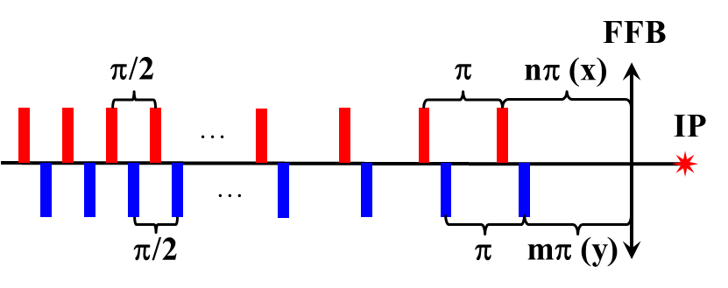
Alternative CCB schemes based on –I sextupole pairs
Advantage: sextupole non-linear geometric effects in a –I pair are self-compensated (if no other sextupoles within the pair).
Disadvantage: the CCB section becomes longer compared to original CCB.
Three sextupole schemes have been studied:
Two non-interleaved –I pairs (X and Y) per each side of IP.
Several interleaved –I pairs distributed in 90° arc cells nearest to IP with nominal arc β functions.
Distributed interleaved –I pairs in arc cells where β functions at CCB sextupoles are locally increased.
The -I sextupoles can be implemented using pairs of 90° arc cells.
Two family sextupoles in the other arc cells compensate linear chromaticity.
CCB
CCB
Scheme 1: two non-interleaved –I pairs
(cancellation of geometric effects)
Schemes 2,3: Distributed interleaved
–I pairs (some residual geometric effects)

Slide 10
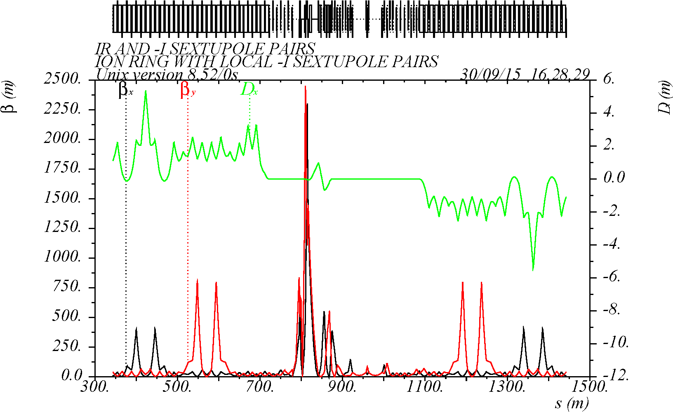
Scheme-1: non-interleaved –I sextupole pairs
2 upstream and 2 downstream non-interleaved –I pairs, where β at sextupoles is increased to 400-800 m, and β_{x(y)}/β_{y(x)} ratios are a factor of 25-40 higher relative to the nominal arc.
Advantages:
► high β allows fewer CCB sextupoles,
► high β ratio makes a more efficient correction,
1 (x) + 1 (y)
–I pairs
12 (x) + 12 (y)
sextupoles
1 (x) + 1 (y)
–I pairs
12 (x) + 12 (y)
sextupoles
► non-interleaved –I pairs provide self-compensation of sextupole non-linear geometric aberrations.
The remaining linear chromaticity is canceled using 48 two-family sextupoles in the other arc cells.
As a future study, the CCB β-functions on the left/right sides could be made different to reflect the IR asymmetry.
Q_{x,y} = 24.22 / 23.16
Y-pair
Y-pair
X-pair
X-pair

Slide 11
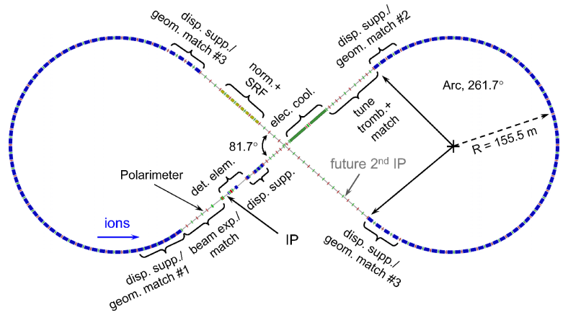
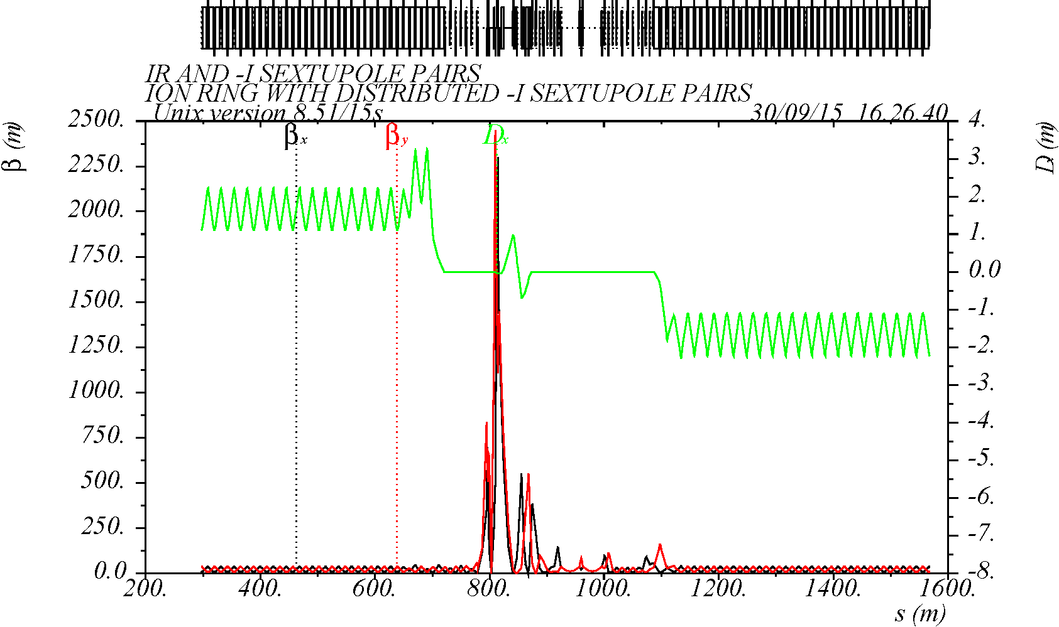
Scheme-2: distributed interleaved –I pairs with nominal arc β functions
In this scheme, the CCB uses the nominal periodic arc cell optics, where β is <40 m. 8 upstream and 10 downstream pairs are used.
The remaining linear chromaticity is canceled using 32 two-family sextupoles in the other arc cells. Using multiple of 4 sextupoles in 90° cells provides self-compensation of Δβ/β(δ) and the sextupole geometric effects.
8 (x) + 8 (y)
sextupoles
5 (x) + 5 (y)
–I pairs
4 (x) + 4 (y)
–I pairs
8 (x) + 8 (y)
sextupoles
Disadvantages:
► low β requires more –I pairs for a reasonable sextupole strength,
► low ratio of β_{x(y)}/β_{y(x)} ~ 5 would result in less efficient correction due to more chromaticity generated not in FF phase,
► interleaved –I pairs may result in residual non-linear geometric aberrations.
Q_{x,y} = 24.625 / 24.32
4+4 pairs
5+5 pairs

Slide 12
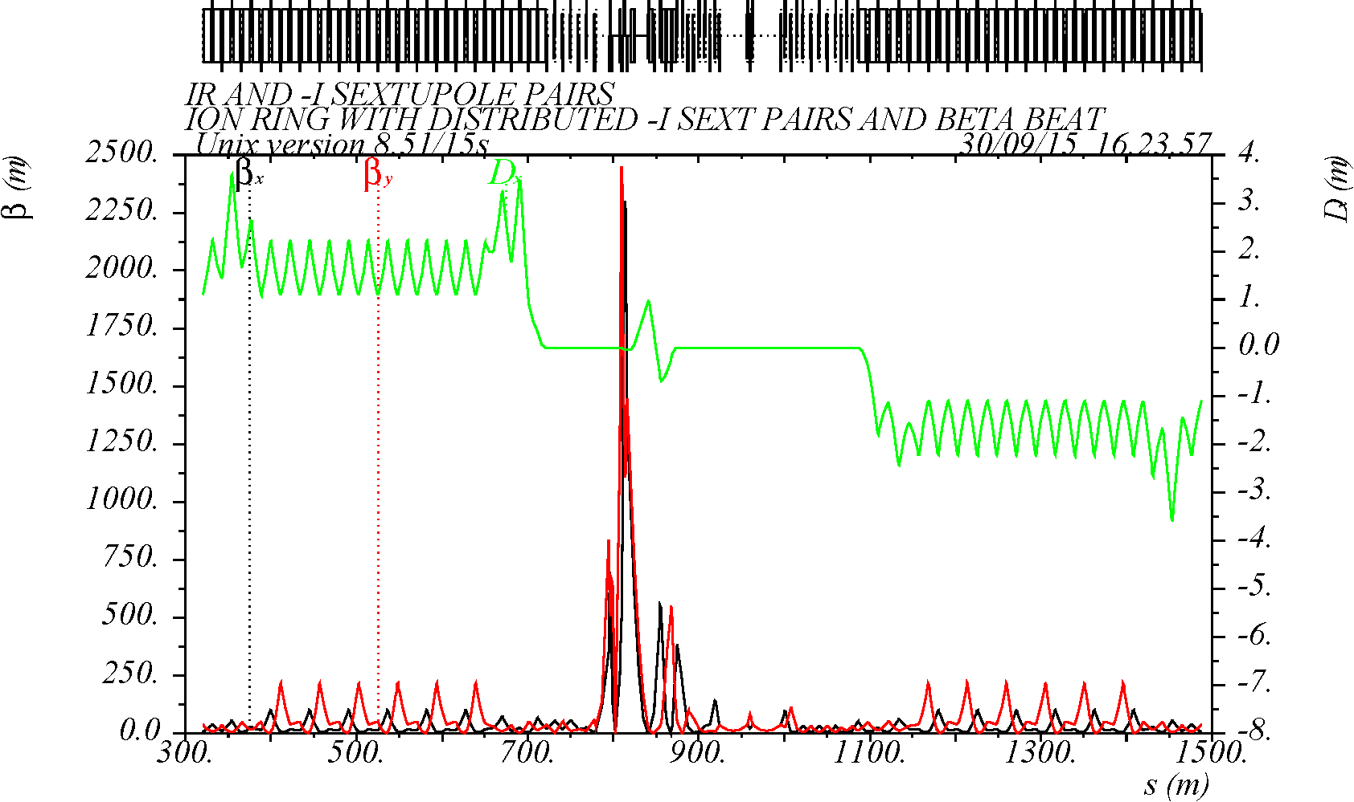
Scheme-3: distributed interleaved –I pairs with increased β functions
β functions at the CCB sextupoles are locally increased to 100-200 m, thus increasing β ratios a factor of 3-5 relative to nominal arc.
6 upstream and 6 downstream pairs are used.
Advantages:
► higher β allows fewer CCB sextupoles, thus leaving more cells for linear chromaticity sextupoles which will become weaker,
3 (x) + 3 (y)
–I pairs
12 (x) + 12 (y)
sextupoles
3 (x) + 3 (y)
–I pairs
12 (x) + 12 (y)
sextupoles
► higher β ratio would make a more efficient correction.
Disadvantages:
► interleaved –I pairs may result in residual non-linear geometric aberrations.
The remaining linear chromaticity is canceled using 48 two-family sextupoles in the other arc cells.
Q_{x,y} = 24.22 / 24.16
3+3 pairs
3+3 pairs

Slide 13
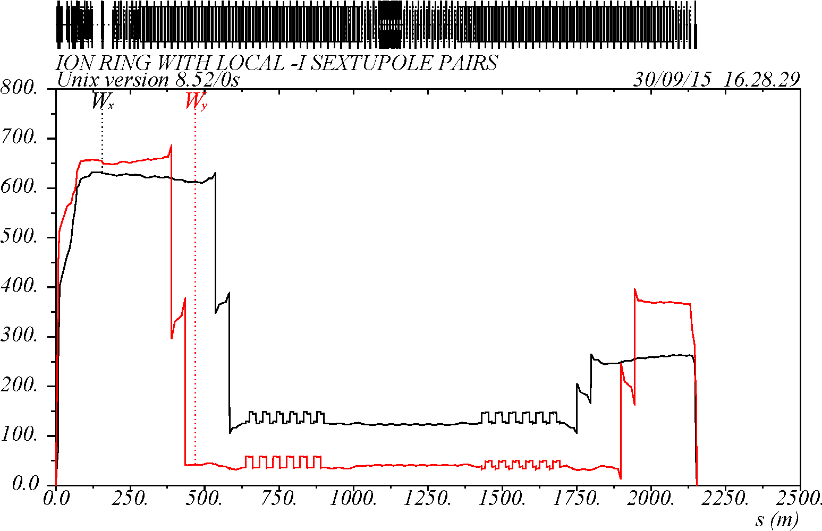
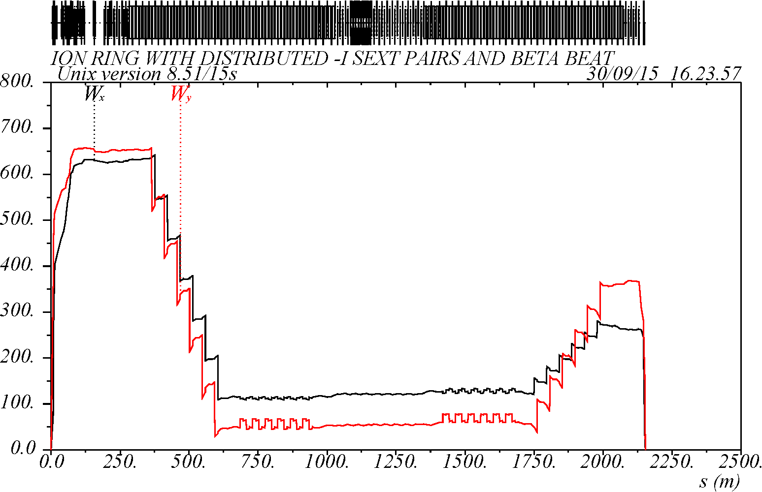
Compensation of Δβ/β (δ) (W-function)
Scheme-1
2-pair correction
Scheme-3
6-pair correction
IP
IP
IP
IP
2 non-interleaved –I pairs per half-IR
3(x) + 3(y) distributed interleaved –I pairs per half-IR with increased β
MAD W-function is a chromatic invariant related to amplitude of Δβ/(βδ).
W-function is cancelled at the IP in order to minimize chromatic beam smear due to variation of β* with δ.
W-function outside of IR is not perfectly cancelled due to contributions from other IR quads. It can be improved by fine tuning of phase advance between CCB and FFB, however it should be optimized along with chromatic tune shift and dynamic aperture.

Slide 14
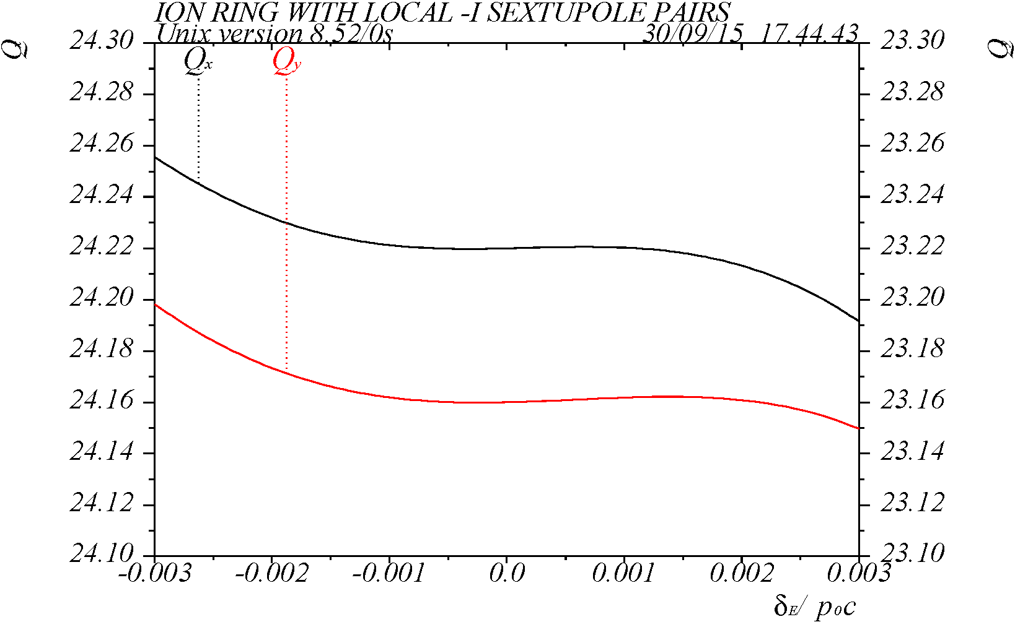
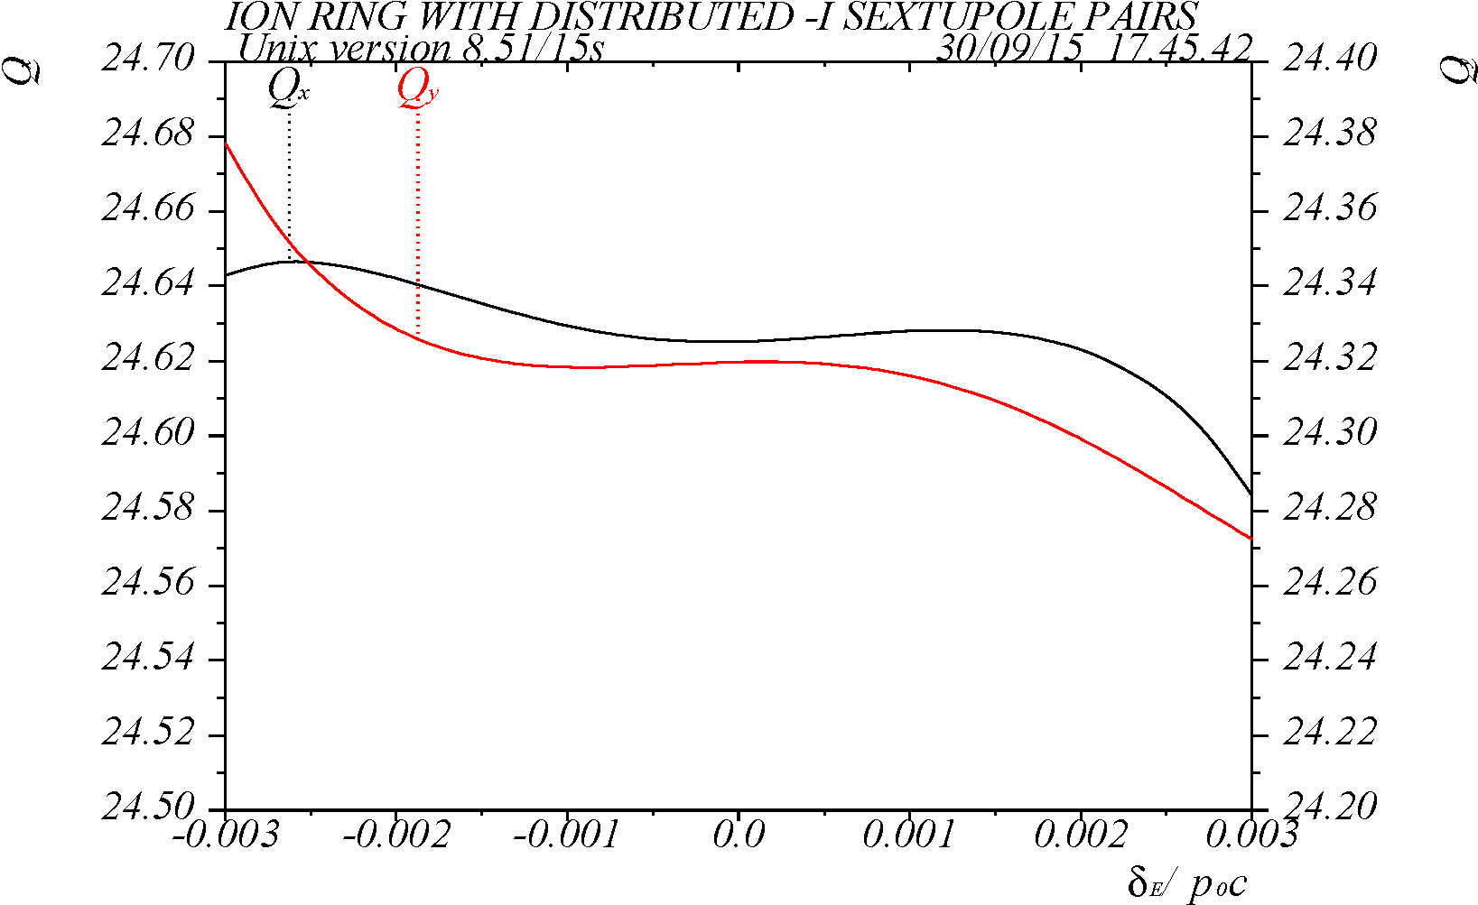
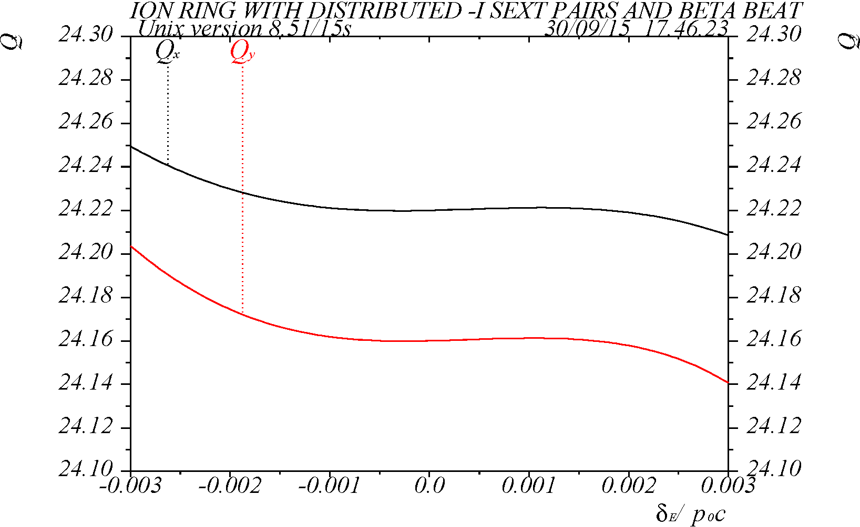
Non-linear chromatic tune shift (for δ=±10σ_{p})
Scheme-1
Scheme-2
Q_{x,y} = 24.22 / 23.16
Q_{x,y} = 24.625 / 24.32
Schemes 1 and 3 provide a similar level of correction comparable to the original CCB. The tune is nearly flat within ±6σ.
In scheme-2 the tune non-linearities are larger. This is due to lower β ratio at the sextupoles and longer CCB creating more contributions to chromaticity not in phase with the FF. Changing tune did not improve performance of this scheme.
In all schemes, linear chromaticity is corrected to +1.
Scheme-3
Q_{x,y} = 24.22 / 24.16

Slide 15
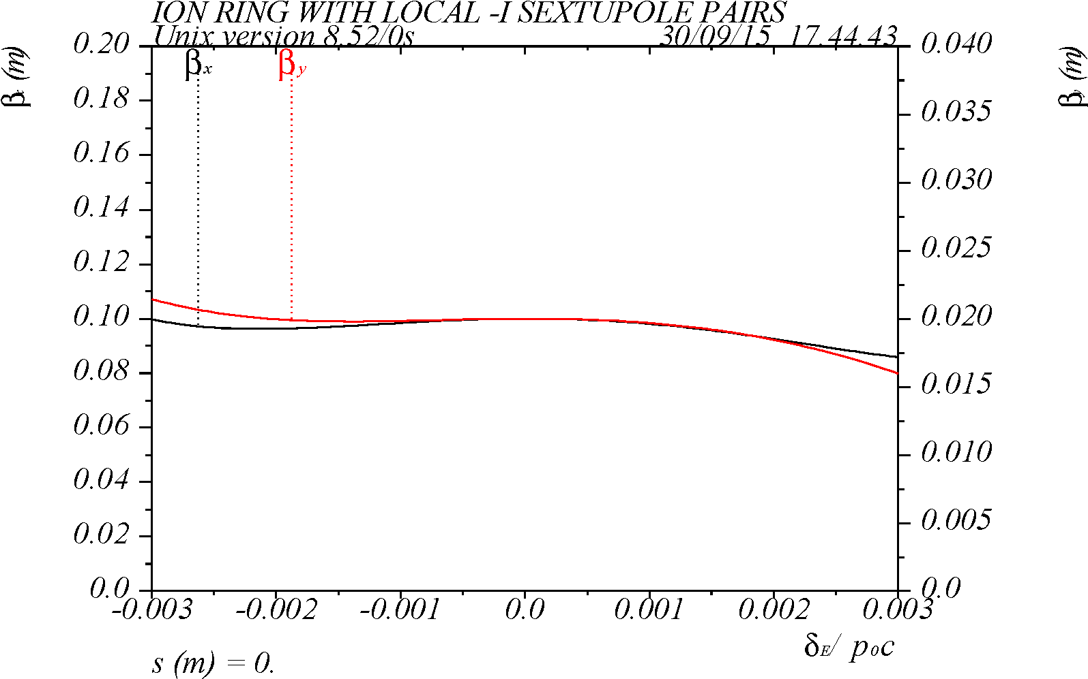
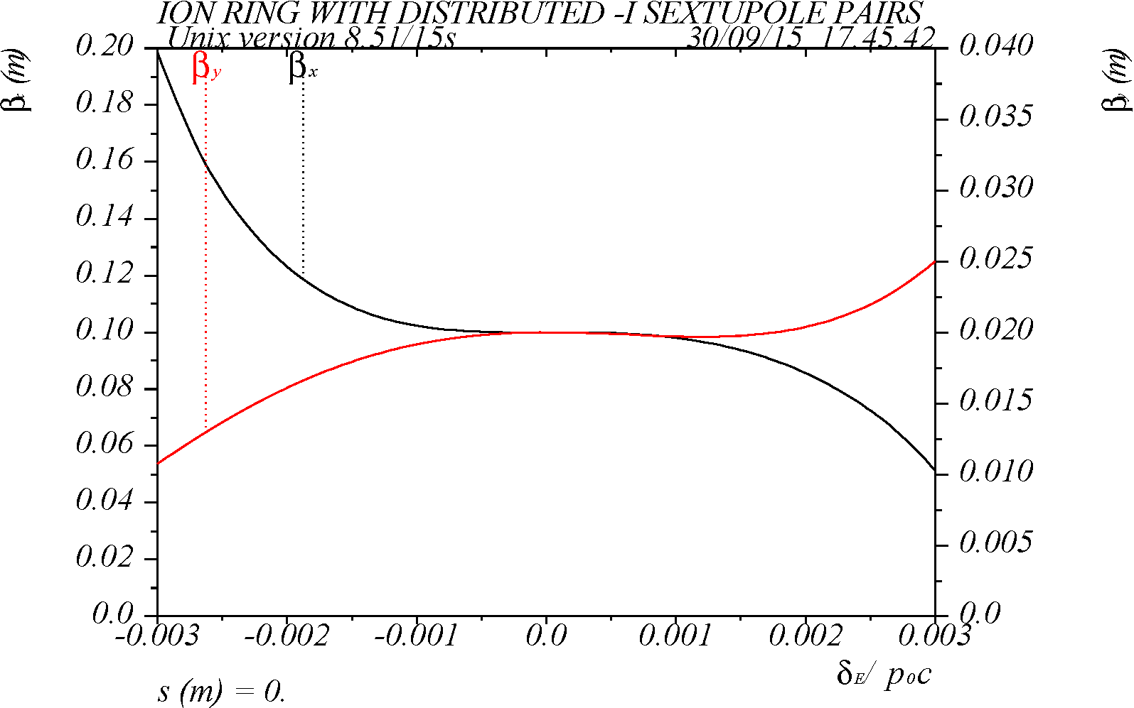
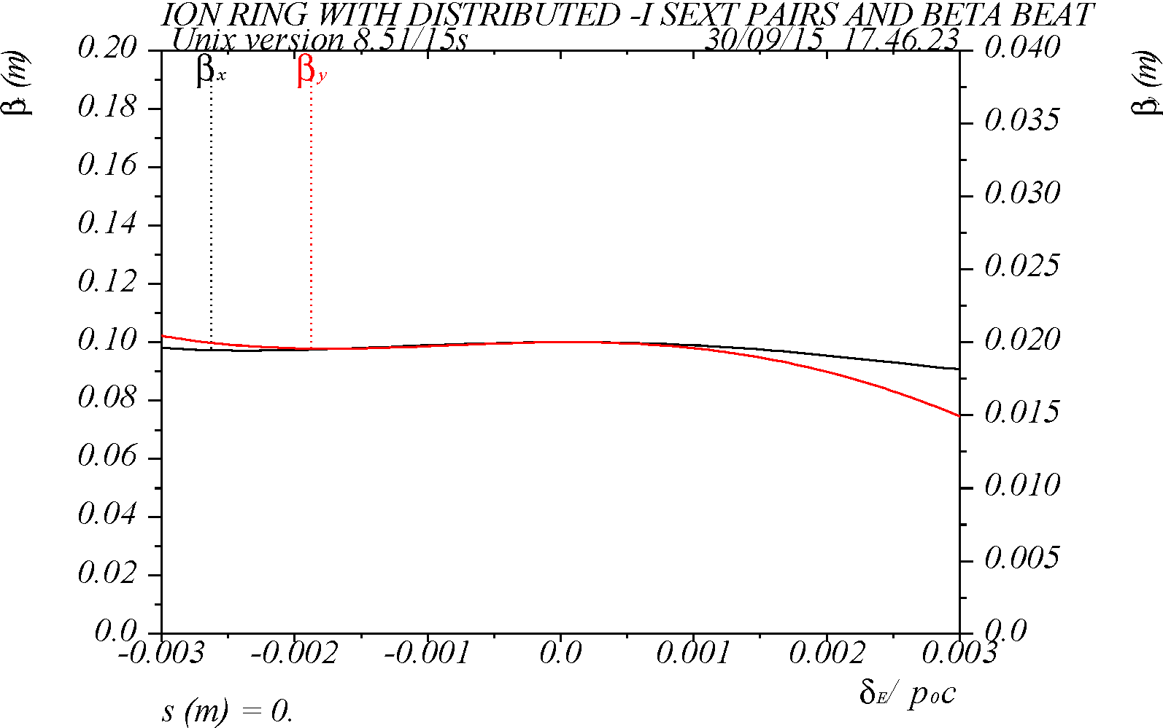
Variation of chromatic β* (for δ=±10σ_{p})
Scheme-1
Scheme-2
Q_{x,y} = 24.22 / 23.16
Q_{x,y} = 24.625 / 24.32
Schemes 1 and 3 provide a very good correction comparable to the original CCB. The β* is nearly flat within ±6σ.
In scheme-2 the non-linearities are much larger, as explained earlier.
Scheme-3
Q_{x,y} = 24.22 / 24.16

Slide 16
Sextupole K-values and parameters
Sextupoles | Scheme-1: local non-interleaved –I pairs | Distributed interleaved –I pairs
 |  | Scheme-2: nominal arc β | Scheme-3: increased β
SXT01,1R (linear) | 0.8172 | 1.5143 | 0.7305
SXT02,2R (linear) | 1.1938 | 2.9742 | 1.1698
SXTIPX (CCB) | 0.2448 | 0.4756 | 0.3573
SXTIPY (CCB) | 0.4849 | 1.4237 | 0.6929
SXTIPXR (CCB) | 0.6868 | 1.4232 | 0.9669
SXTIPYR (CCB) | 0.8140 | 2.7850 | 1.1880
Qty of SXT01,02(R) | 48 | 32 | 48
Qty of SXTIPX,Y(R) | 8 | 36 | 24
CCB quad K1_{max} | 0.2074 | 0.1587 | 0.1999
Tune, X/Y | 24.22 / 23.16 | 24.625 / 24.320 | 24.22 / 24.16
Natural ξ, X/Y | -111.5 / -131.7 | -101.5 / -112.2 | -105.4 / -130.6

Slide 17
Conclusions
Three options of CCB optics, based on –I sextupole pairs, were studied – with non-interleaved and distributed interleaved –I pairs (with and without β enhancement).
The best compensation of non-linear chromaticity (tune and β*) (which is comparable to correction in the original CCB) was achieved using schemes 1 (non-interleaved –I pairs) and 3 (distributed interleaved pairs) where β-functions and β-ratio at the sextupoles were made large.
The scheme-1 appears as the best option (out of three) as it provides a better self-compensation of the sextupole non-linear amplitude dependent effects. It also uses fewer sextupoles.
Potential improvements to these schemes could include fine tuning of the phase advance between the CCB and the FFB, and optimization of CCB β-functions taking into account the IR optics asymmetry.
The next step is to study dynamic aperture for these schemes (see next talk by M-H. Wang).

