Slide 1

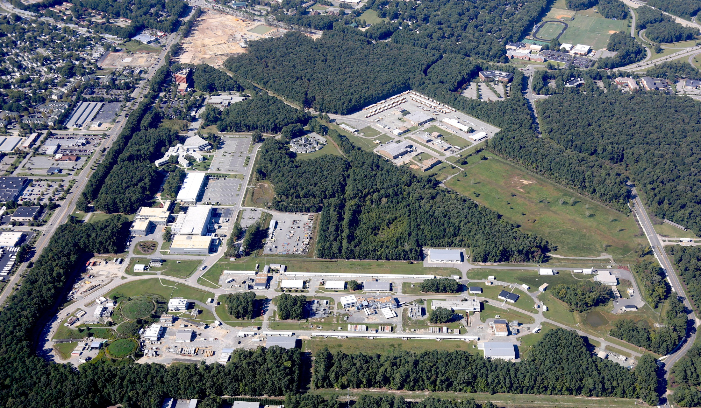
MEIC RF R&D
R. Rimmer on behalf of MEIC RF team
MEIC collaboration meeting, 10/7/15

Slide 2
MEIC RF systems
MEIC baseline design updated in Jan 2015
PEP-II warm RF adopted for electron ring
  Proven technology, looking for a new home
  Enough cavities and klystrons available
  476.3 MHz buckets can be filled from CEBAF linac with simple timing system
Ion ring frequency now 952.6 MHz
Crab cavity system now 952.6 MHz (?)
Cooler source and ERL now 952.6 MHz (?)
  Cooler baseline became 200 mA, no circulator ring
Ion injector chain frequency not affected

Slide 3
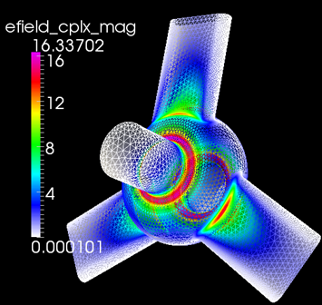
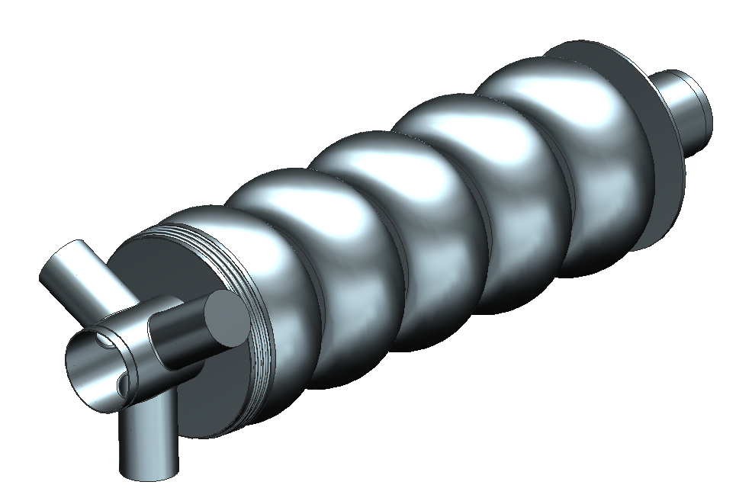
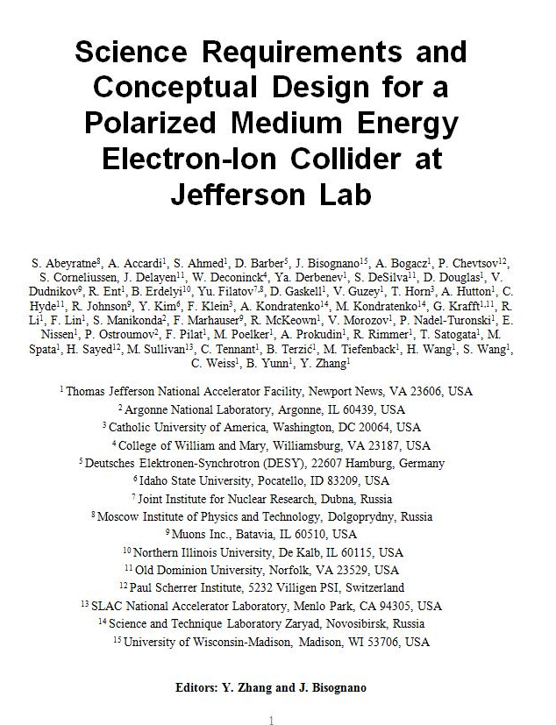
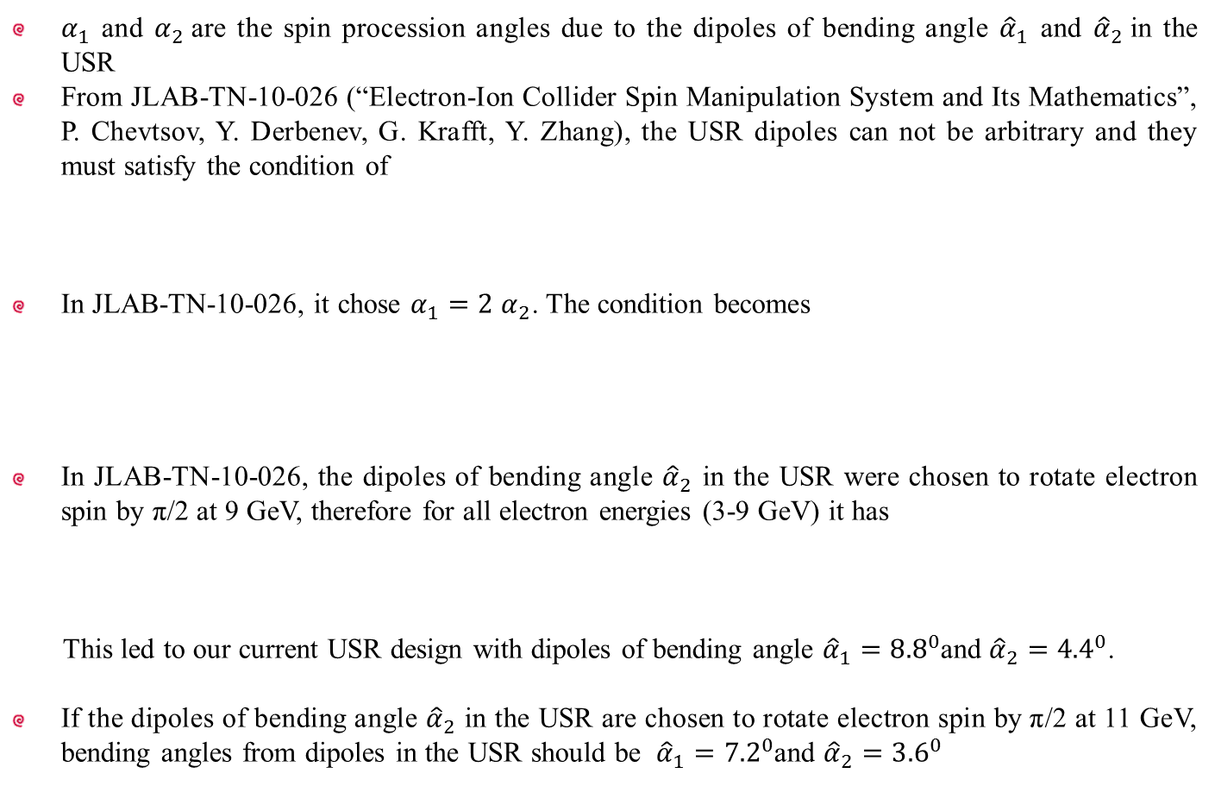
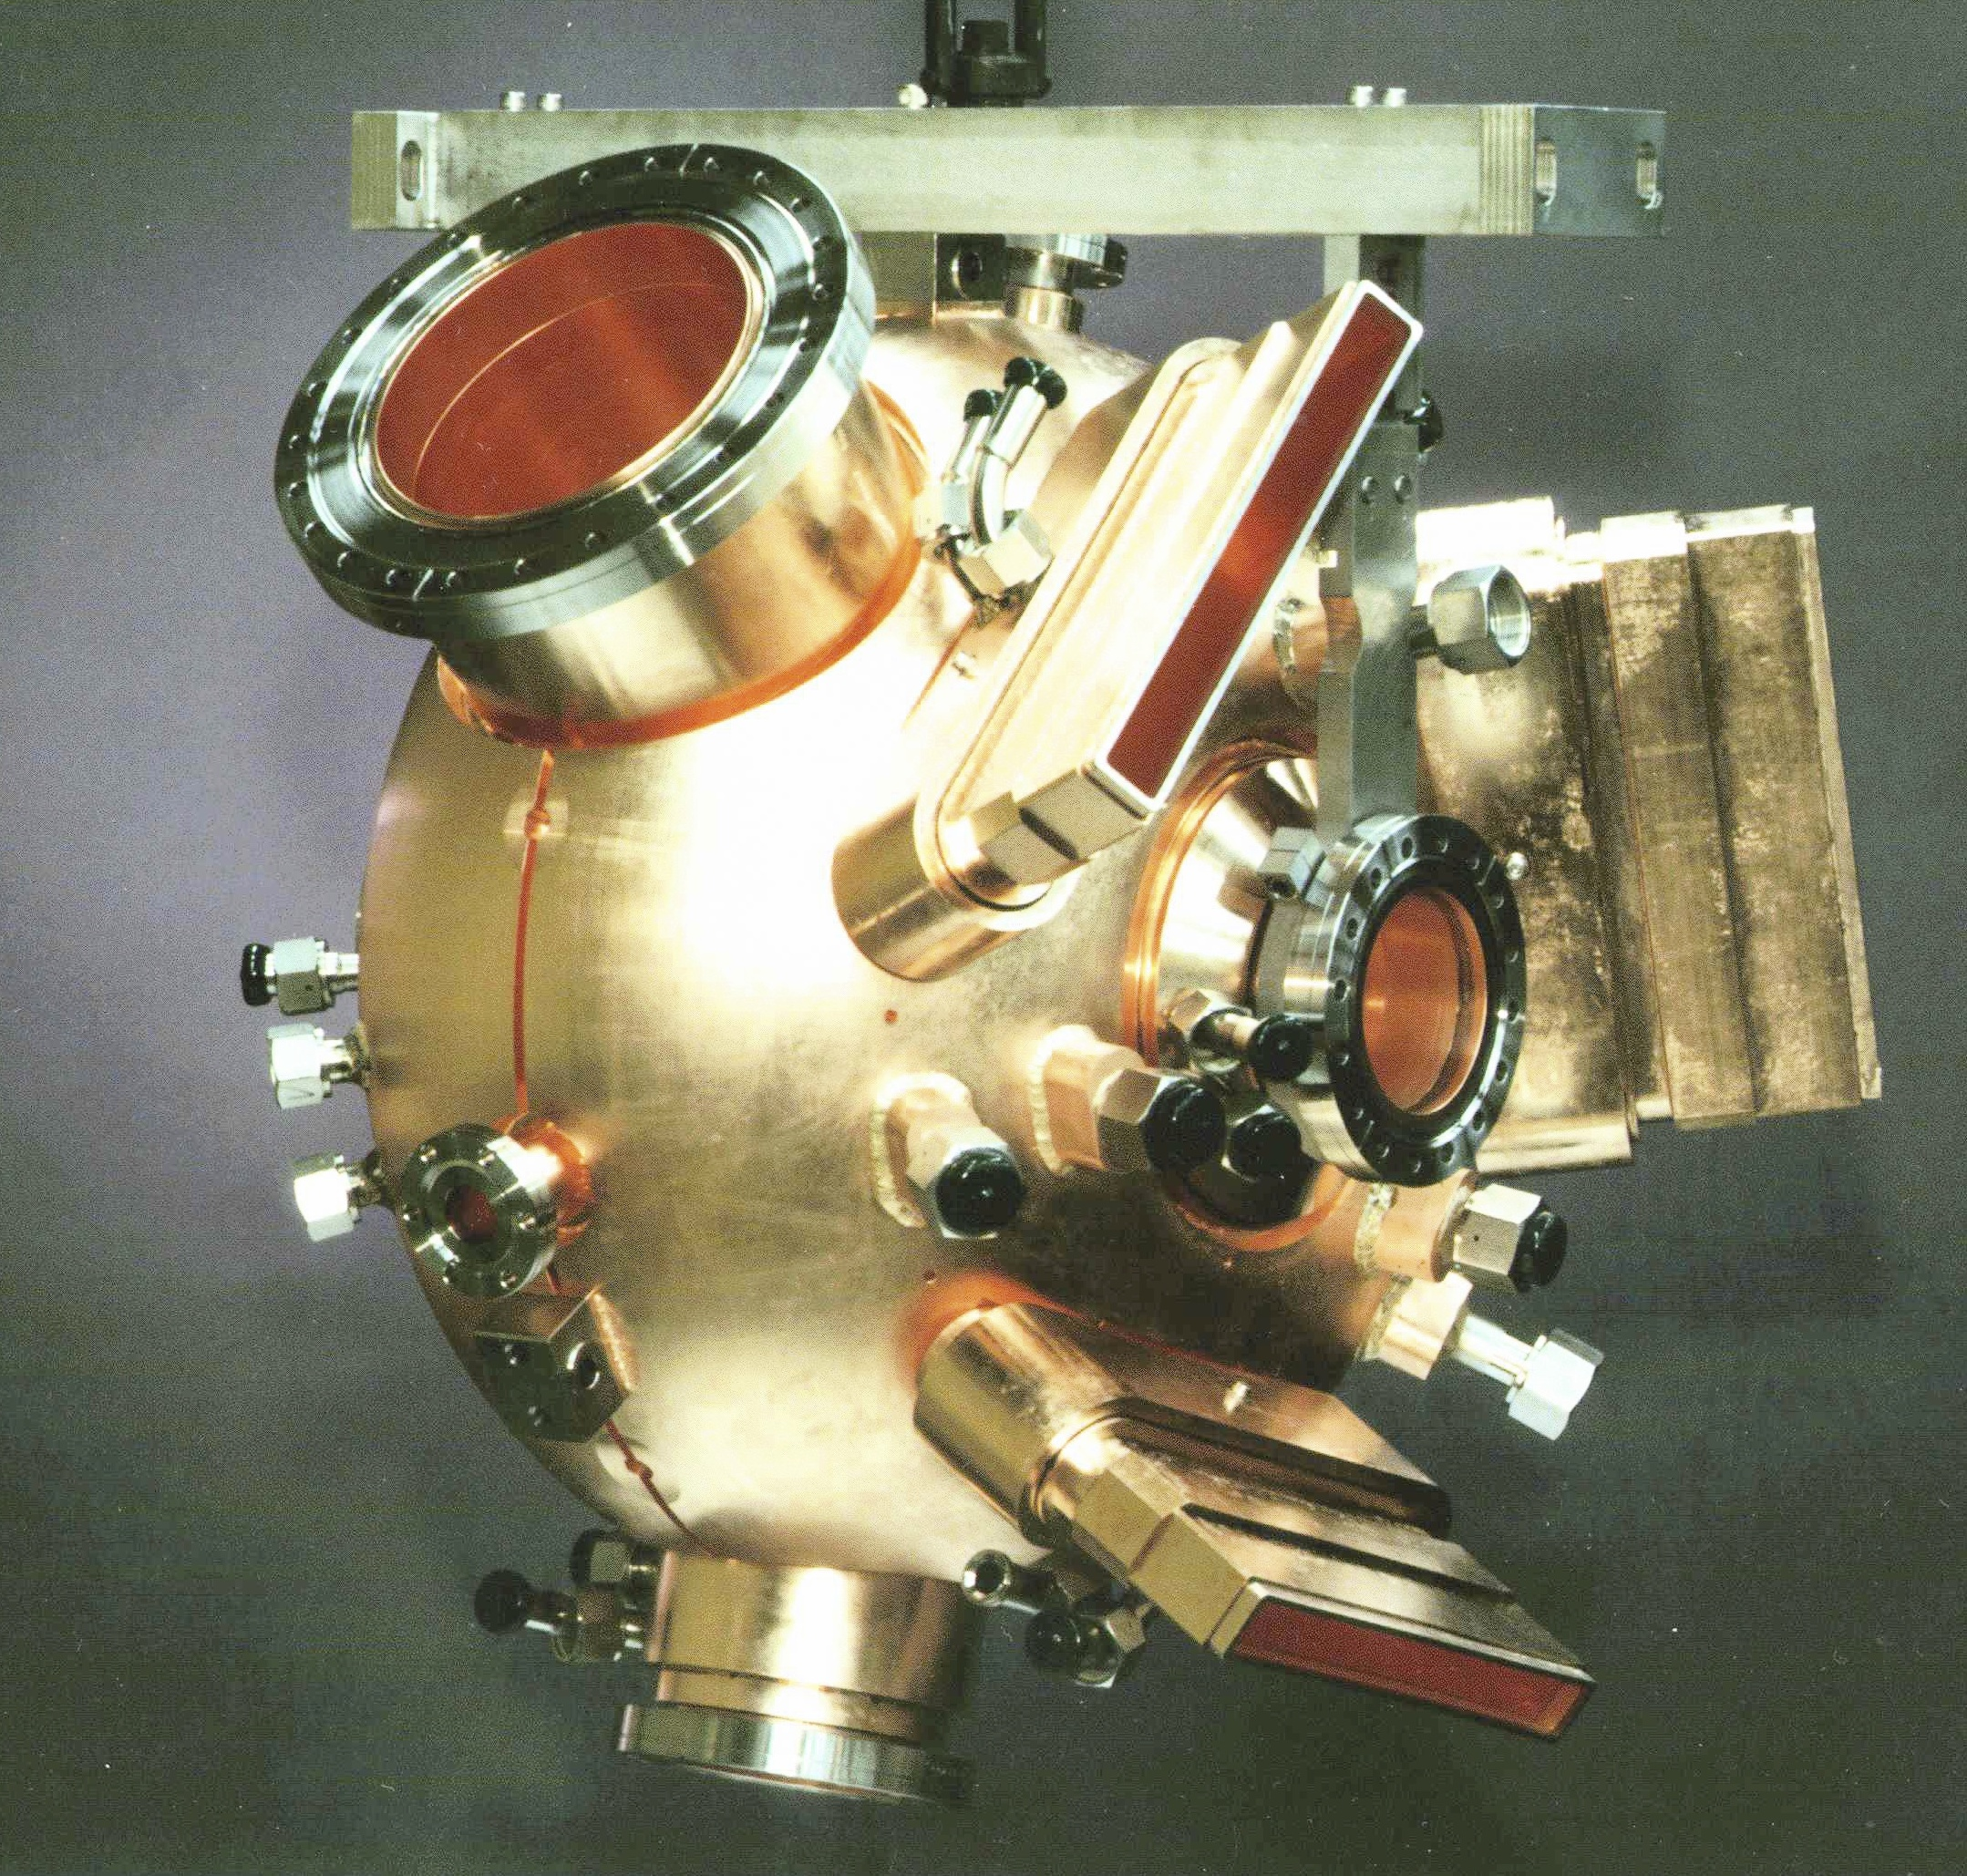
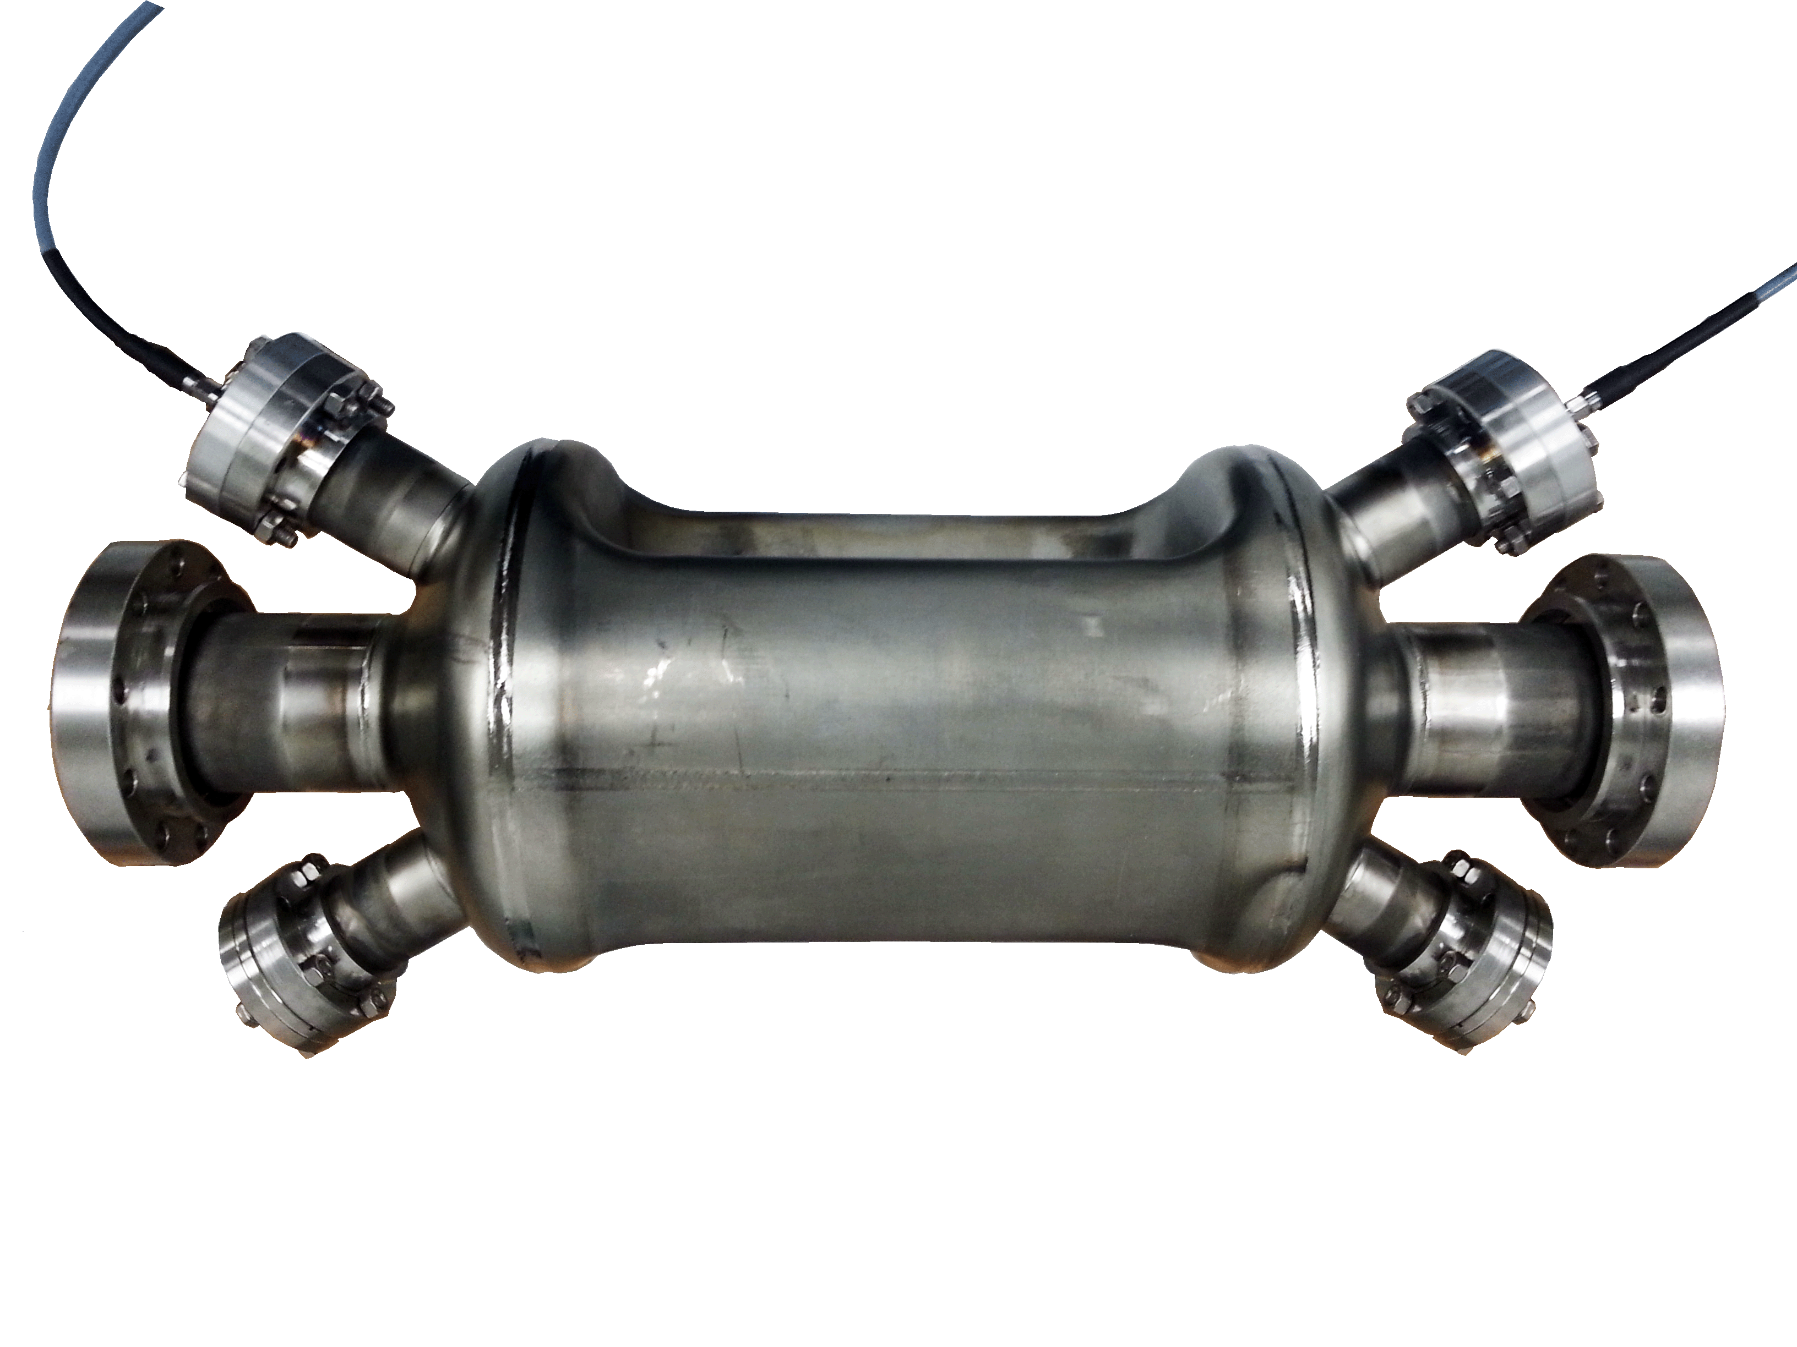
MEIC Conceptual Design
MEIC
Collider
Rings
i-SRF +
NCRF
ERL
HE Cooling
updated
Crab
IP
e-RF
e-RF
Crab
?
Future IP
Booster
SRF Linac
Stage I MEIC
  CEBAF as full-energy e⁻/e⁺ injector
  3-10 GeV e⁻/e⁺
  8-100 GeV protons
  <40 GeV/u ions
Stage II EIC
  up to 20 GeV e⁻/e⁺
  up to 250 GeV protons
  up to 100 GeV/u ions
Ion Source
Electron Injector
Hall D
12 GeV CEBAF
Halls A, B, C

Slide 4
High level RF parameters
 | electron ring NCRF |  |  |  | Proton SRF |  | Lead ion
Energy | 4 | 5 | 10 | GeV | 30 | 100 | 40 | GeV/u
Frequency | 476.3 | 476.3 | 476.3 | MHz | 952.6 | 952.6 | 952.6 | MHz
Current | 3.00 | 3.00 | 0.71 | A | 0.50 | 0.50 | 0.50 | A
SR power per ring | 1.08 | 2.65 | 10.00 | MW | - | - | - | MW
Energy Loss per Turn | 0.36 | 0.88 | 14.12 | MV | - | - | - | MV
Veff | 0.36 | 0.88 | 14.12 | MV | - | - | - | MV
Vpeak | 1.74 | 3.44 | 20.56 | MV | 4.94 | 18.95 | 17.93 | MV
Syn. Phase | 12.01 | 14.89 | 43.39 | degree | 0.0 | 0.0 | 0.0 | degree
Vgap | 0.43 | 0.34 | 0.79 | MV | 1.23 | 1.18 | 1.20 | MV
Gradient | 1.4 | 1.1 | 2.5 | MV/m | 7.8 | 7.522 | 7.591 | MV/m
Beam Power per Cavity | 271.2 | 264.8 | 384.6 |  | - | - | -
Forward Power | 455.5 | 497.8 | 492.0 | kW | 51.0 | 46.94 | 109.88 | kW
Cavity Power Loss | 27.0 | 16.9 | 89.3 | kW | 23.4 | 21.6 | 22.0 | W@4K
Reflected Power | 157.3 | 216.1 | 18.0 | kW | 50.9 | 46.9 | 109.9 | kW
Qext | 8.89E+03 | 8.89E+03 | 8.89E+03 |  | 7.07E+04 | 7.07E+04 | 3.08E+04
Minimum Cavity Number | 4 | 10 | 26* |  | 4 | 16 | 15
*Assumes 2 cavities per klystron.

Slide 5
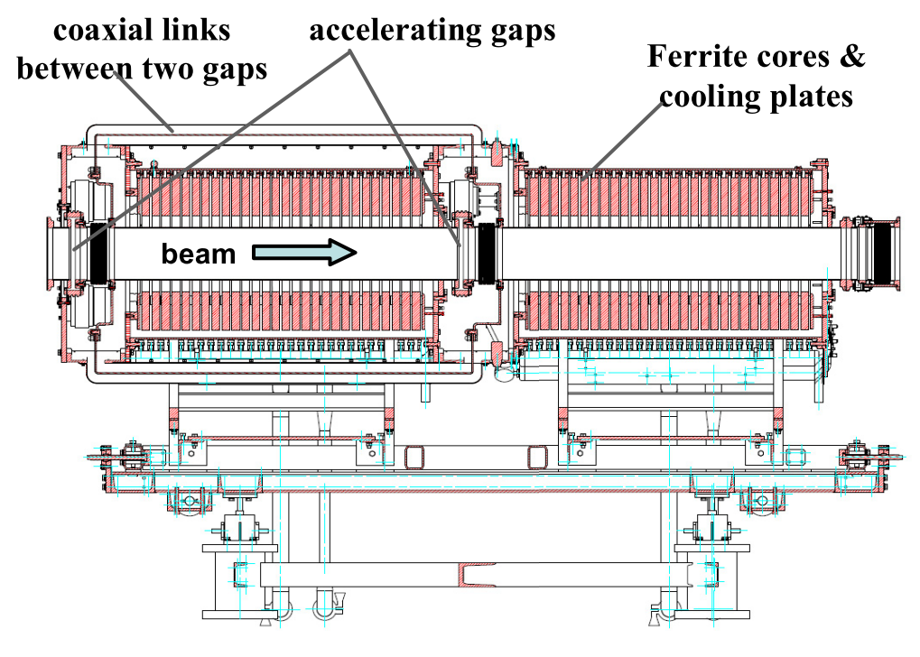
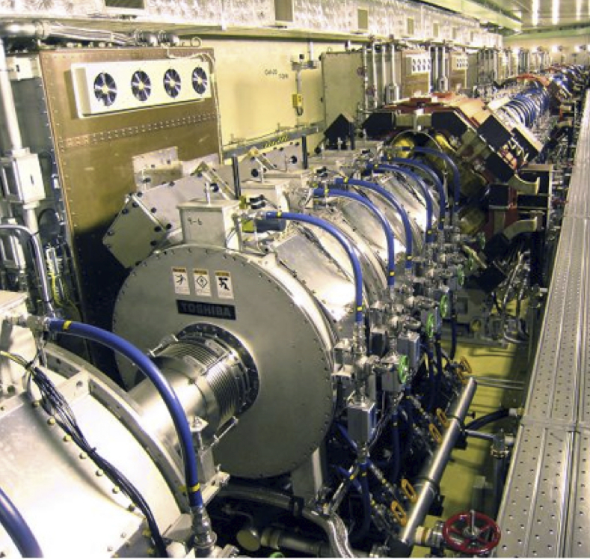
Low Frequency RF examples
Needed to capture and accelerate ions in booster and collider ring
  Low frequency (~1 MHz)
  Tunable for ramping
JPARC cavity (Metglass loaded).
Used as basis for MEIC.
CSNS cavity (ferrite loaded)

Slide 6
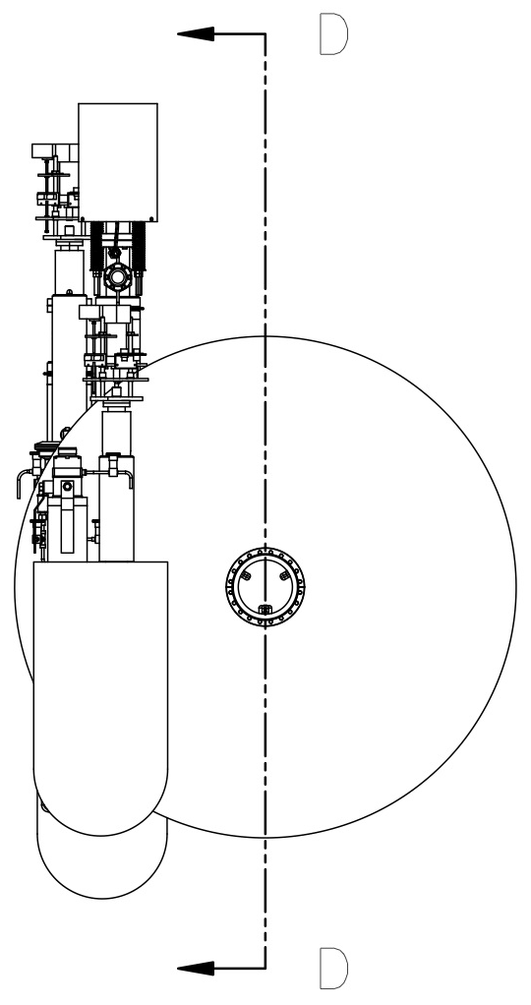
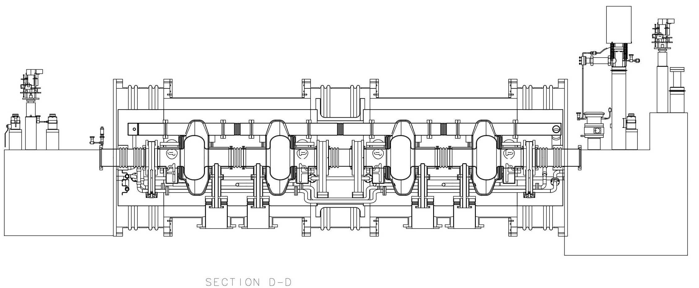
ion-ring design concept
952.6 MHz HOM damped 1-cell cavities, modular JLab type cryomodule
High frequency/high voltage for short bunch (re-bucket at energy)
Medium-power couplers , no synch. rad. Power.
Tunable within one harmonic (harmonic jumps for path length changes with energy)
Current limited by space charge (limits charge per bunch)
Impedance is still a concern so HOM damping is still needed.
952.6 MHz single cell 4-seater CM
(~4.3m flange to flange)
New HOM damped cavity concept

Slide 7
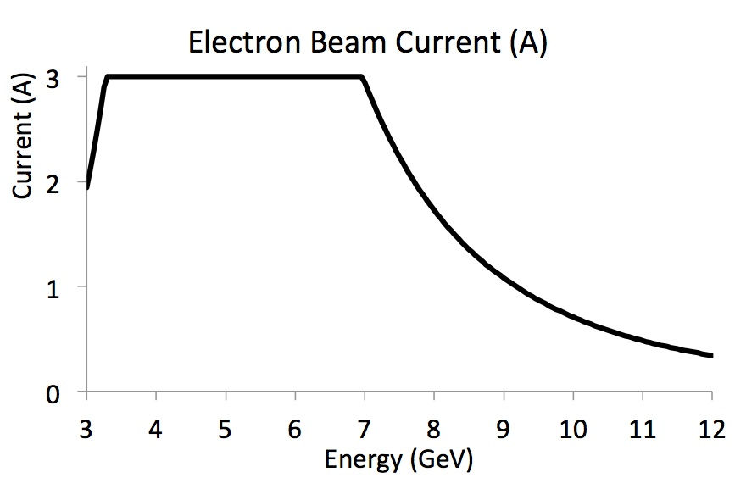
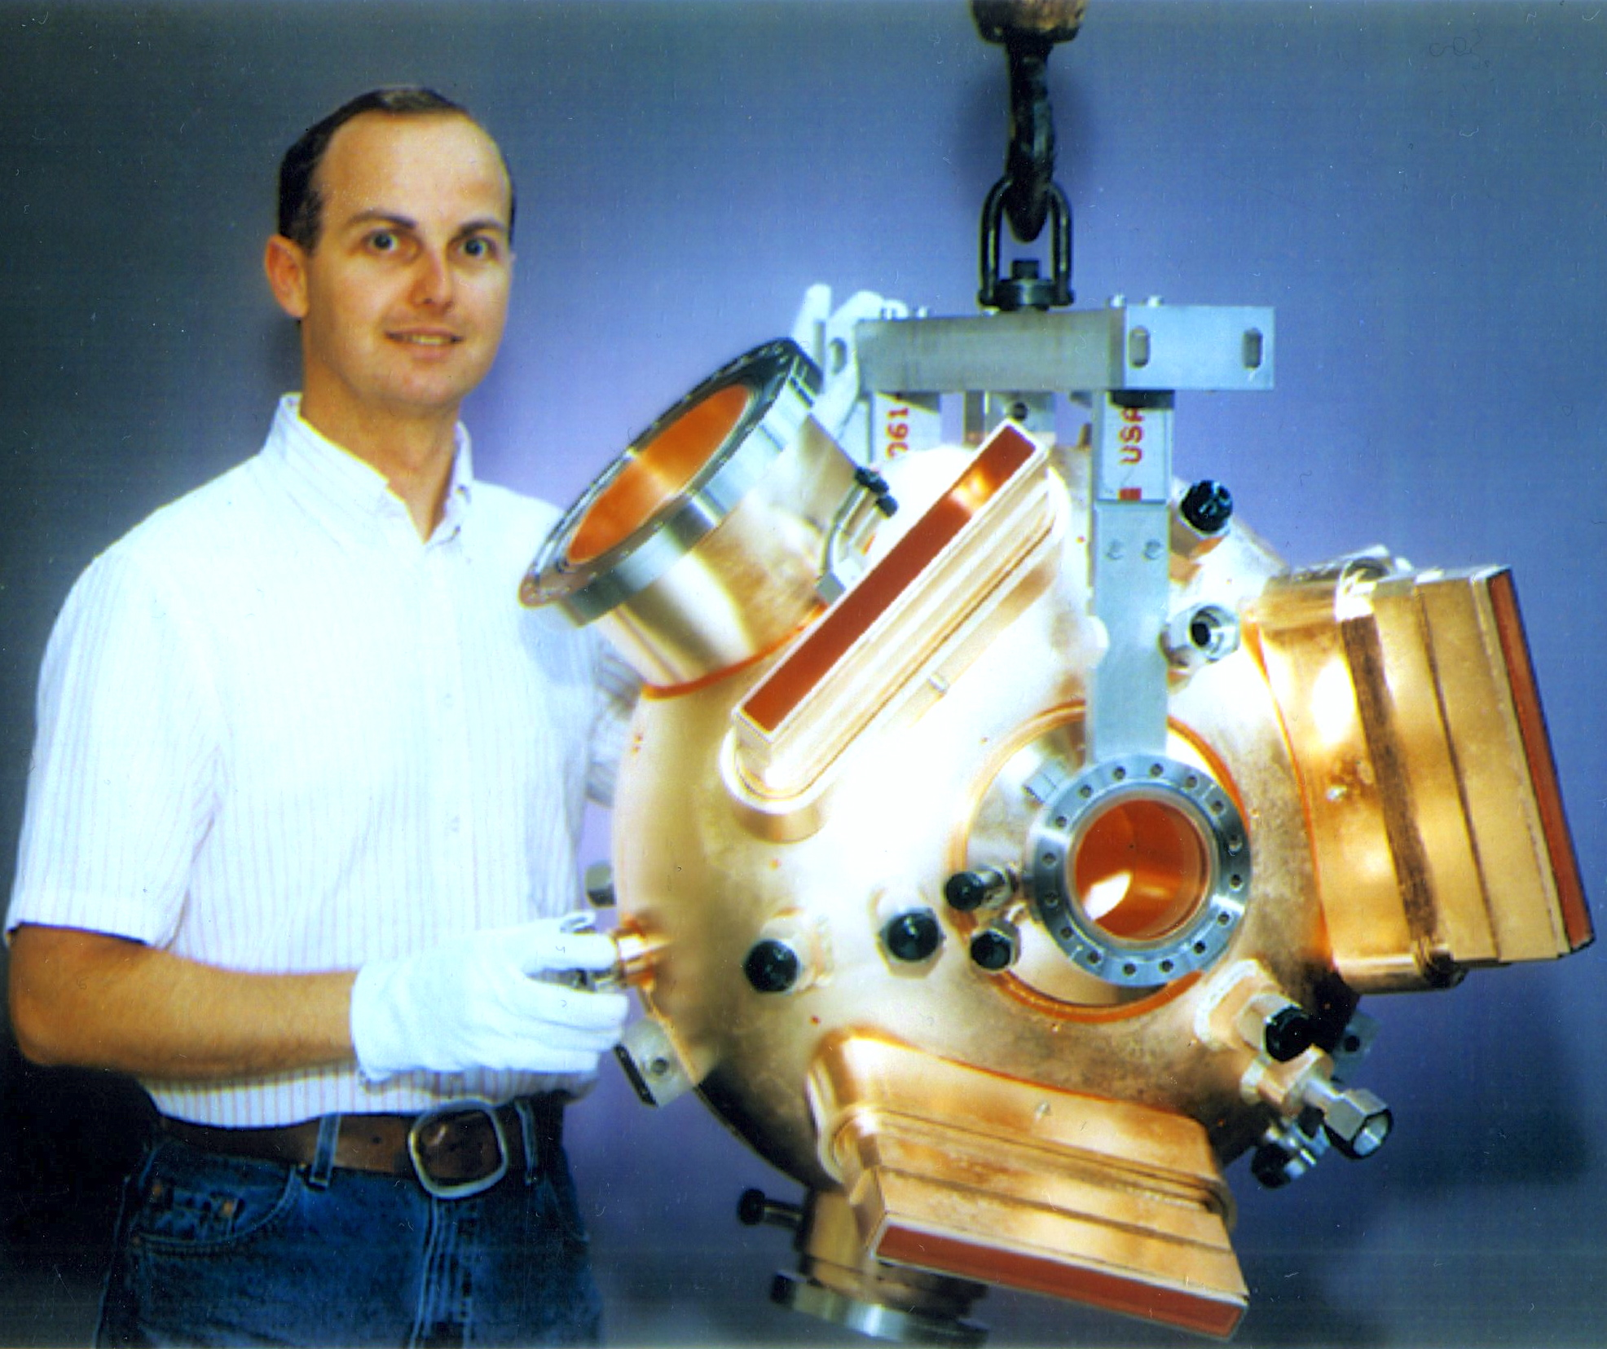
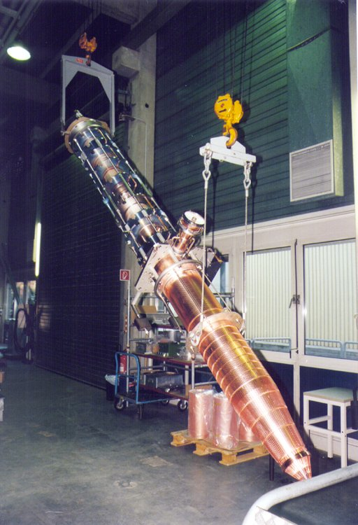
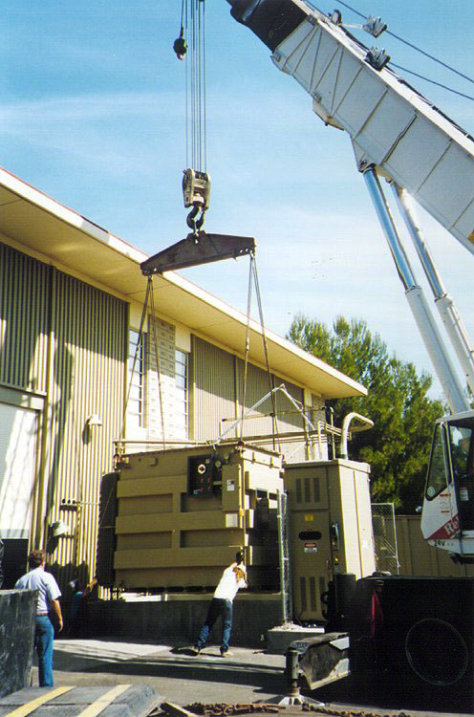
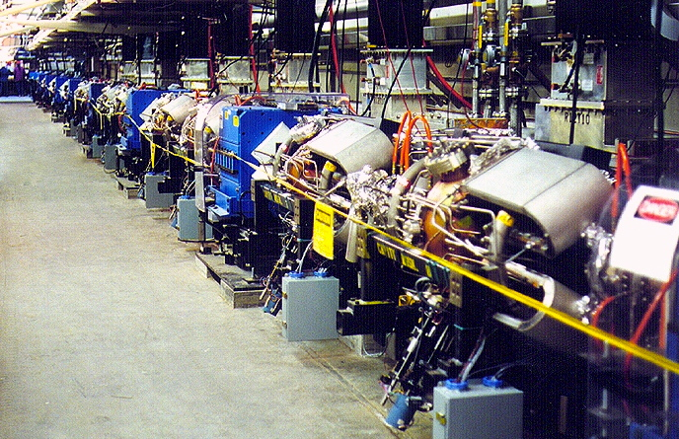
e-ring RF design
Re-use proven PEP-II RF stations
476 MHz HOM damped 1-cell cavities
  34 cavities available
1.2 MW klystrons, 13 available
  Including power supplies etc.
Current limited by synch. rad. power at high energy, impedance at low energy
Refurbishment will be needed
nominal
Impedance limited
Synchrotron power limited
PEP-II RF cavity
1.2 MW Klystron
2 MVA HVPS
PEP-II Cavities in the SLAC tunnel

Slide 8
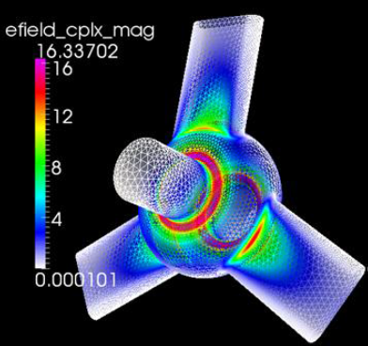
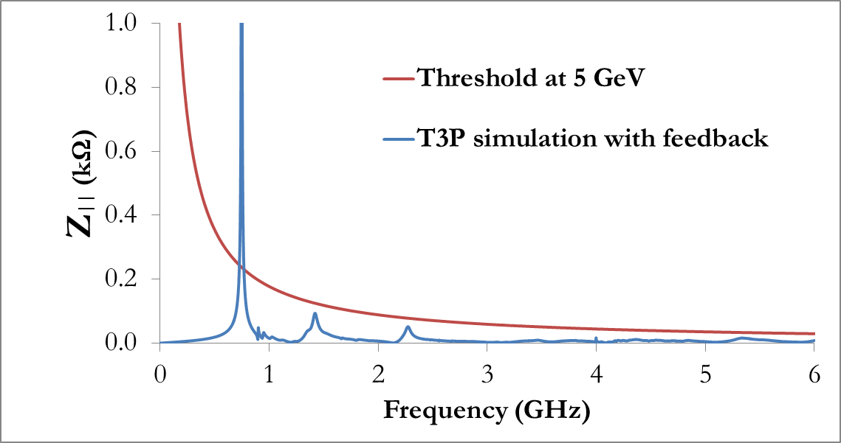
Impedance Requirements
S. Wang
In electron ring, coupled bunch instability is suppressed by Synchrotron radiation damping and feedback, which sets the cavity impedance threshold
Impedance (kΩ)
Frequency (GHz)
In ion ring, coupled bunch instability is suppressed by Landau damping, which set the cavity impedance threshold
Need to re-do with PEP-II cavity spectrum

Slide 9
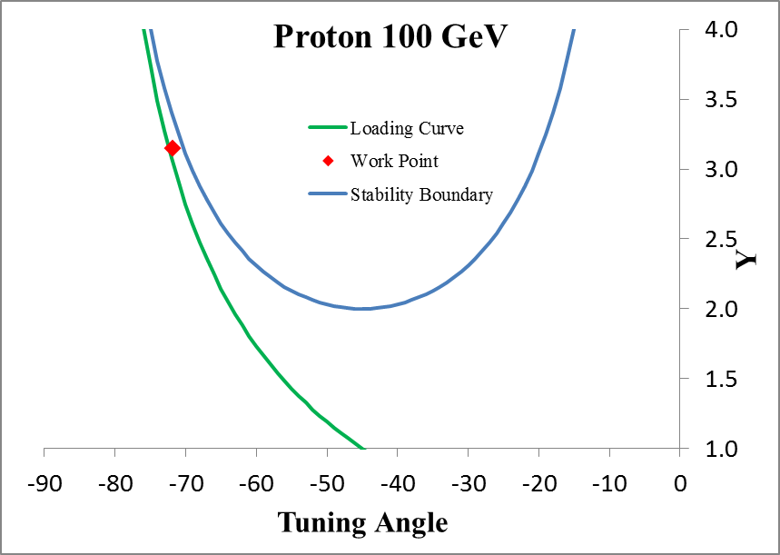
Ion Bunching Requirements
S. Wang
Reactive power is needed to provide the desired bunch length, cavity number is also determined.
RF parameters are selected to ensure the Robinson stability.

Slide 10
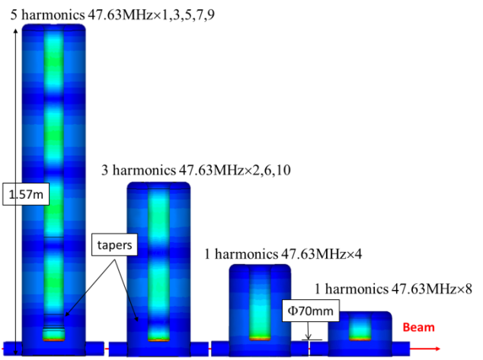
e-cooler ERL
Injector Cromodule similar to storage ring, 1 CM, 4 x 1-cell 952.6 MHz cavities, high- power couplers.
ERL LINAC needs 1 CM with four 5-cell 952.6 MHz cavities, lower-power couplers
Cooling section
ion bunch
electron bunch
solenoid
Future fast kicker
Future fast kicker
Future fast kicker
Future fast kicker
Future circulator ring
Future circulator ring
Gun/ Inj.
SRF Linac
dump
Harmonic kicker system
(Y. Huang)
Notes:
Booster ?

Slide 11
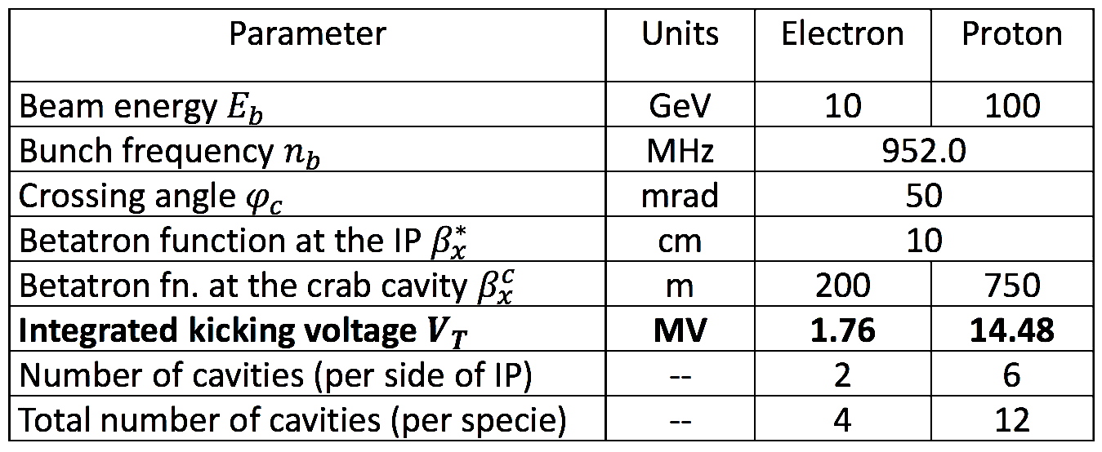
Crab cavity
Design by ODU (A. Castilla Ph.D project)
952.6 MHz “RF dipole” like LHC
Modest RF system (no beam loading)
Must have good HOM damping
Count for 1 IP in baseline
Assume cryostat cost/cavity same as ion storage ring
Per side

Slide 12
Cavity and CM counts
Up to 10 GeV electrons, 3 A max current, 100 GeV protons, 0.5 A max.
 | cavity type | Frequency | voltage/cav | power/cav | # cavities | # CM | total volts | total power | Design basis | cost basis
 |  | MHz | MV | kW |  |  | MV | kW
ion booster | NC/Ferrite | 0.58-1.27 | 0.016 | 45.2 | 2 | - | 0.032 | 90.4 | CSNS | JPARC
ion ring | NC/Ferrite | 1.22-1.26 | 0.016 | 27.5 | 7 | - | 0.111 | 192.5 | CSNS | JPARC
ion ring | SRF | 952.6 | 1.18 | 109.9 | 16 | 4 | 18.95 | 1758 | New | SNS†
e-ring | NC/PEP-II | 476.3 | 0.79 | 497.8 | 26 | - | 20.56 | 12792 | PEP-II | Re-use
i-crab | SRF | 952.6 | 2.41 | 12.5 | 12 | 4 | 28.96 | 150 | ODU | SNS†
e-crab | SRF | 952.6 | 1.68 | 12.5 | 4 | 2 | 3.37 | 50 | ODU | SNS†
cooler ERL* | SRF 5 cell | 952.6 | 14 | 30 | 4 | 1 | 56 | 120 | FEL | SNS†
cooler booster | SRF 1 cell | 952.6 | 2.5 | 500 | 4 | 1 | 10 | 2000 | FEL | SNS†
total |  |  |  |  | 75 | 12 | 138.12 | 17153
Total cryo load estimated ≤2.9 kW equivalent at 4.5K +2.4 kW 50K Shield + 3.3 g/s coupler flow, (wall plug ~1.45 MW). Probably will be reduced by running cavities at 2K
*200 mA gun, 10 MeV booster, 50 MeV ERL
† escalated to current FY

Slide 13
MEIC modular cryostat
Goals:
Take the best features of previous JLab designs
Modular approach to hold various different cavities
Design suitable for industrial production
Simple concepts, low parts count to reduce costs

Slide 14
JLab SNS module experience is the starting point
• Ion Storage Ring CMs (4 x 4-seater)
• e-cooler Booster (1 x 4- seater)
• e-cooler Linac CM (1 x 4-seater 5-cell)
• Crab Cavity CMs (2 x 2-seater and 4 x 4-seater)
Updated modular design under development
MEIC SRF design basis
SNS high β module
A. McEwen

Slide 15
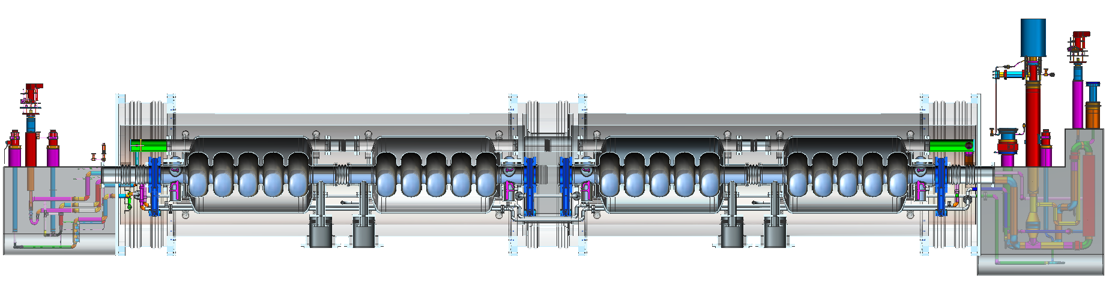
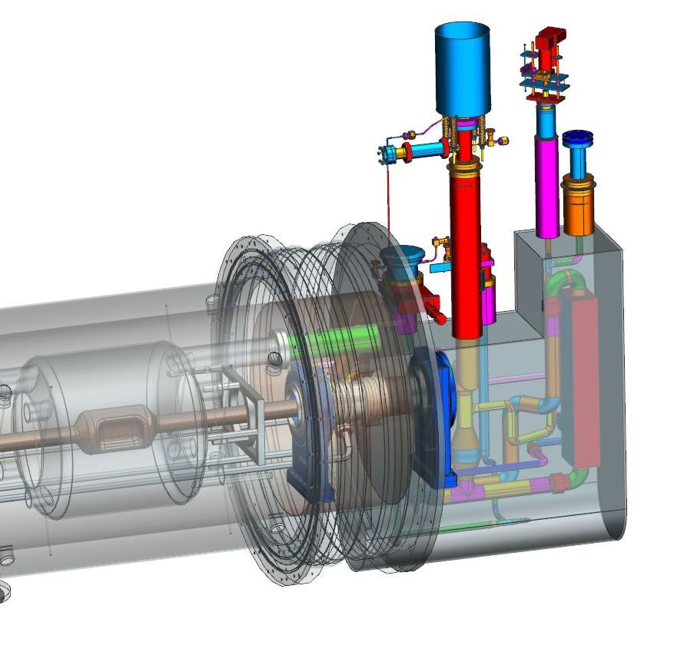
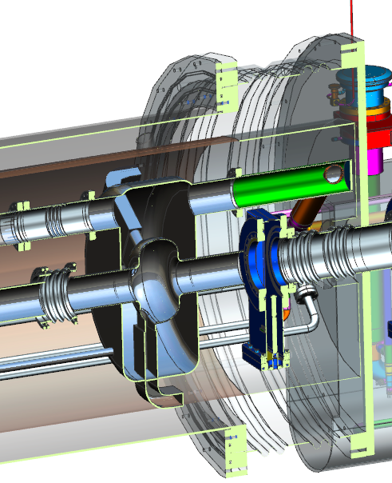
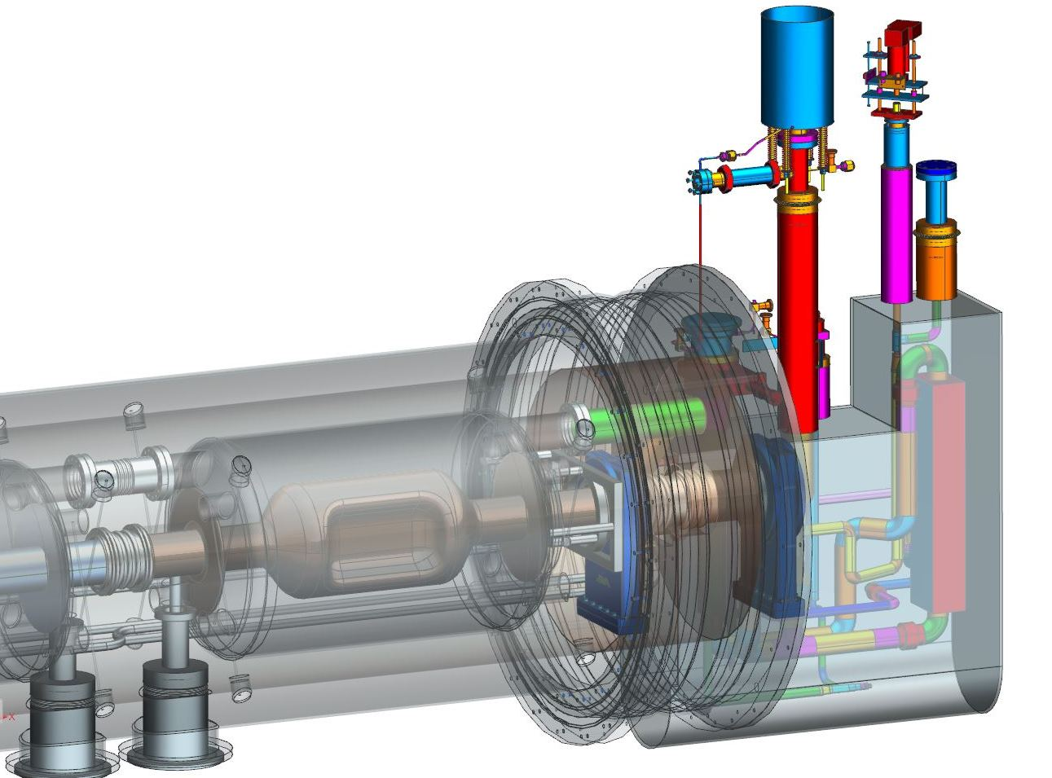
Modular Cryostat
Modular approach to hold various different cavities
Cooler ERL 5-cell cavities
476.3 MHz or 952.6 MHz Crab cavity
952.6 MHz Ion ring concept

Slide 16
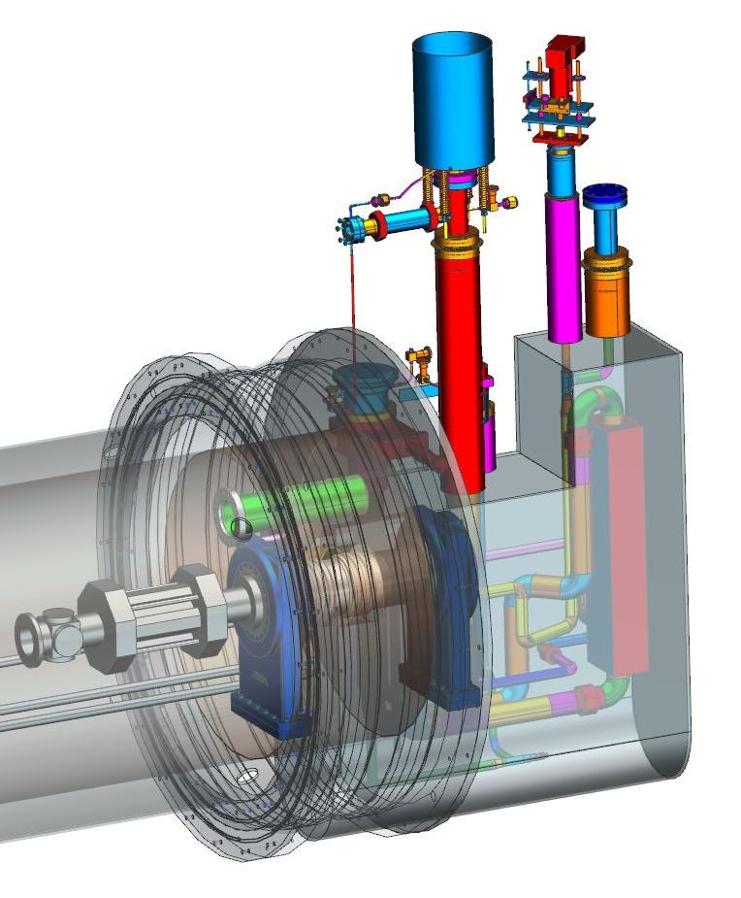
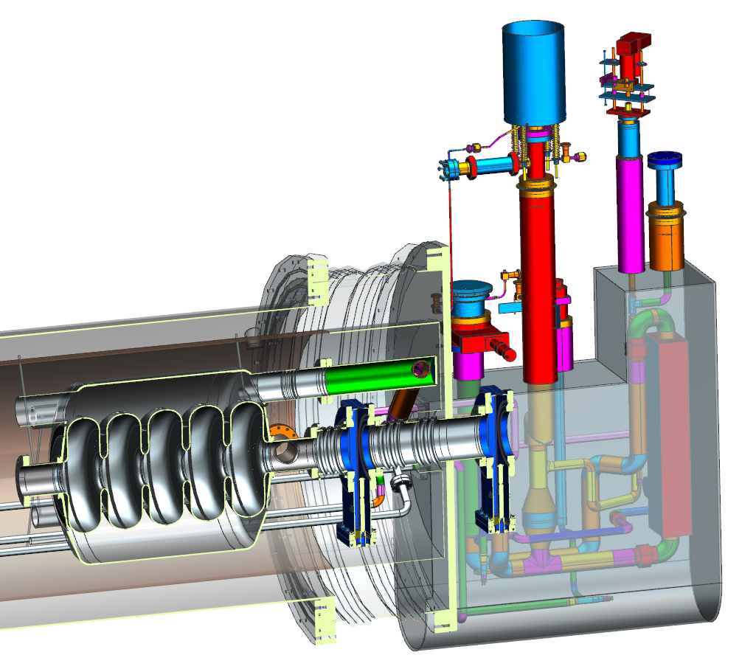
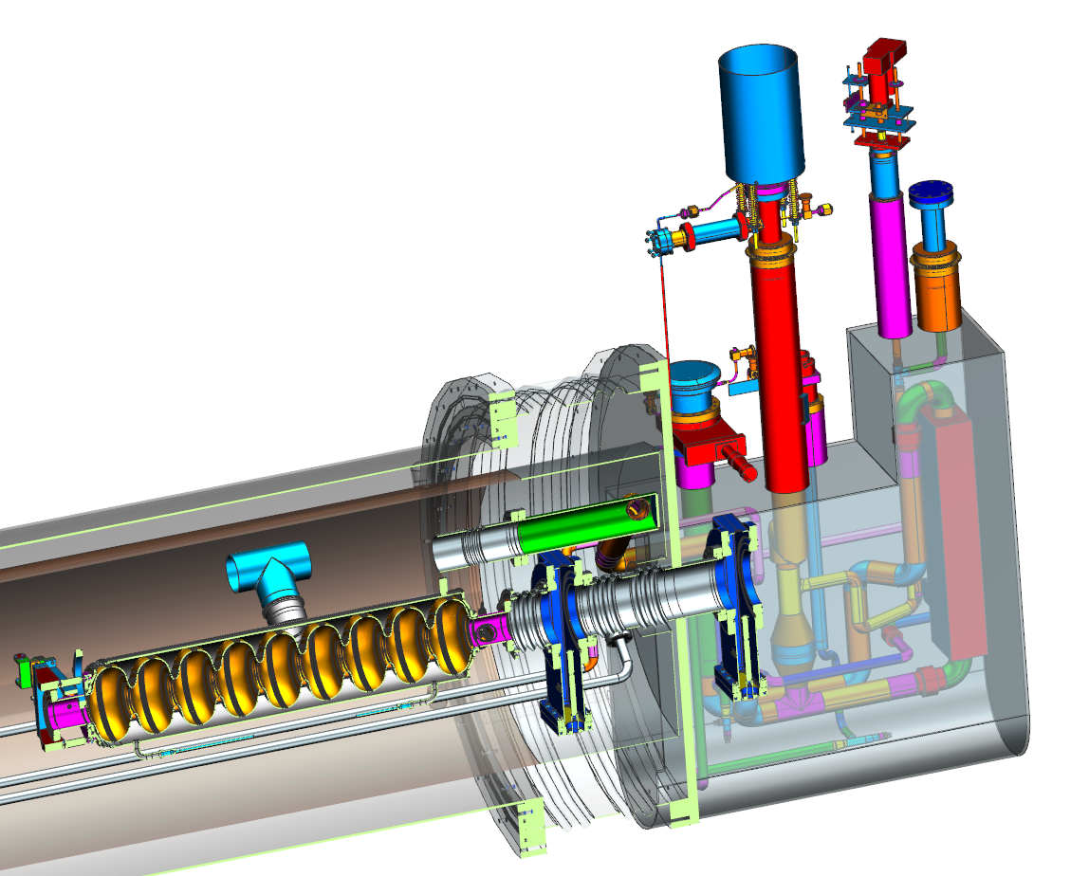
Modular Cryostat
Modular approach to hold various different cavities
LCLS-II SC quadrupole
650 MHz (Project-X)
LCLS-II 9-cell, 1.3 GHz

Slide 17
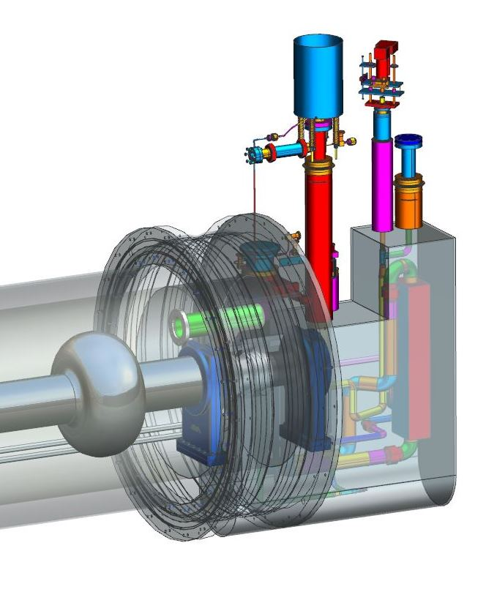
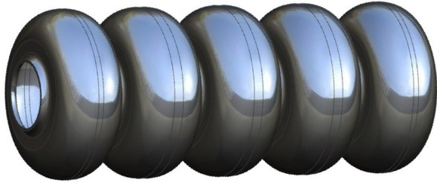
Modular Cryostat: 476 MHz?
476.3 MHz 5-cell: difficult
952.6 MHz 5-cell and 1-cell
476.3 MHz 1-cell: possible

Slide 18
RF R&D task list:
Cavity prototypes
  i-ring RF: HOMs, FPC
  Cooler Mech: Pressure, Lorentz, microphonics
  Booster Thermal: Static, intercepts, trace cooling
  Crab (ODU)
Tuner: same for all cavities? (Crab may be exception)
FPC: common format, ~10 kW, 50 kW, 500 kW versions
Cryostat: Modular Hybrid SNS/CEBAF, hold all cavity types,
LLRF, HPRF, transient analysis, stability, feedback/forward
Fredrik Fors
Tom Powers, Tomasz Plawski, etc.

Slide 19
Draft high-level schedule
Pre-project R&D activity | FY15 Q3 | FY15 Q4 | FY16 Q1 | FY16 Q2 | FY16 Q3 | FY16 Q4 | FY17 Q1 | FY17 Q2 | FY17 Q3 | FY17 Q4
Super-ferric 1.2m dipole prototype (Texas A&M, Dubna, GSI)
952 MHz cavity prototype (Jlab SRF)
Crab cavity R&D (JLAB SRF and ODU)
Ion Injector design and R&D (ANL, FRIB)
Fixed energy cooler design (Texas A&M)
SLAC R&D (IR, detector integration, non-linear corrections, DA)
bunched e-cooling experiment (JLAB, IMP Langzhou)
FF quad design and downselect
Magnetized e- source for ERL cooler - design and downselect
ion polarization design and simulation (Kondratenko)
e- cooling simulation
instabilities, beam-beam
As shown by Fulvia
design
fab

Slide 20
Summary
Use of PEP-II RF systems saves money but requires re-optimization of other systems – 952.6 MHz.
High current, frequency and gradients needed.
Simple low-cost modular cryostat for all SRF cavities
Take advantage of ODU/LHC crab cavity R&D but need to integrate into MEIC cryostat.
2-3 year R&D plan to prepare for CDR
  Prototype ion ring cavity
  Full set of system requirements
  Understand synchronization, stability, transients, etc.

Slide 21
Thanks to all MEIC RF team and collaborators

Slide 22
Backup

Slide 23
Draft schedule by task
 | FY15 Q3 | FY15 Q4 | FY16 Q1 | FY16 Q2 | FY16 Q3 | FY17 Q4 | FY17 Q1 | FY17 Q2 | FY17 Q3 | FY17 Q4
i ring cavity
cooler cavity
booster cavity
crab cavity
tuner
FPC
Cryostat
LLRF
HPRF
design
fab
test
write up CDR

Slide 24
Deliverables
Tested cavity prototype (1)
Concepts of ancillary components (HOMs, tuner, FPC)
Cryostat conceptual design, engineering calculations.
no detailed drawings
no prototype cryomodule until project
LLRF and HPRF concepts and POP demos
Does not include:
Bunch splitting RF systems or barrier bucket system
PEP-II refurbishment – collaboration with SLAC?
Low frequency warm cavities for ions – collaboration?
No testing with beam – LERF or UITF?

Slide 25
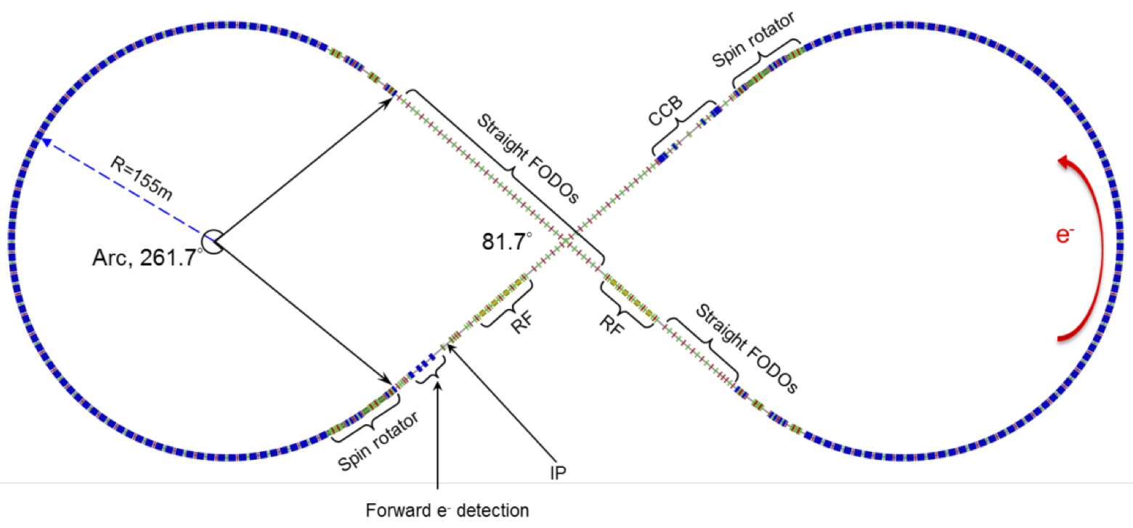
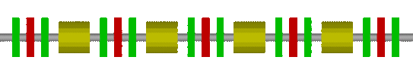
Electron Ring Layout
Electron Ring circumference 2154.3 m, each arc 754.84 m, each straight 322.31 m.
Figure-8 crossing angle 81.7°
6.54 m
Four 1m-long cavities (4 m)

Slide 26
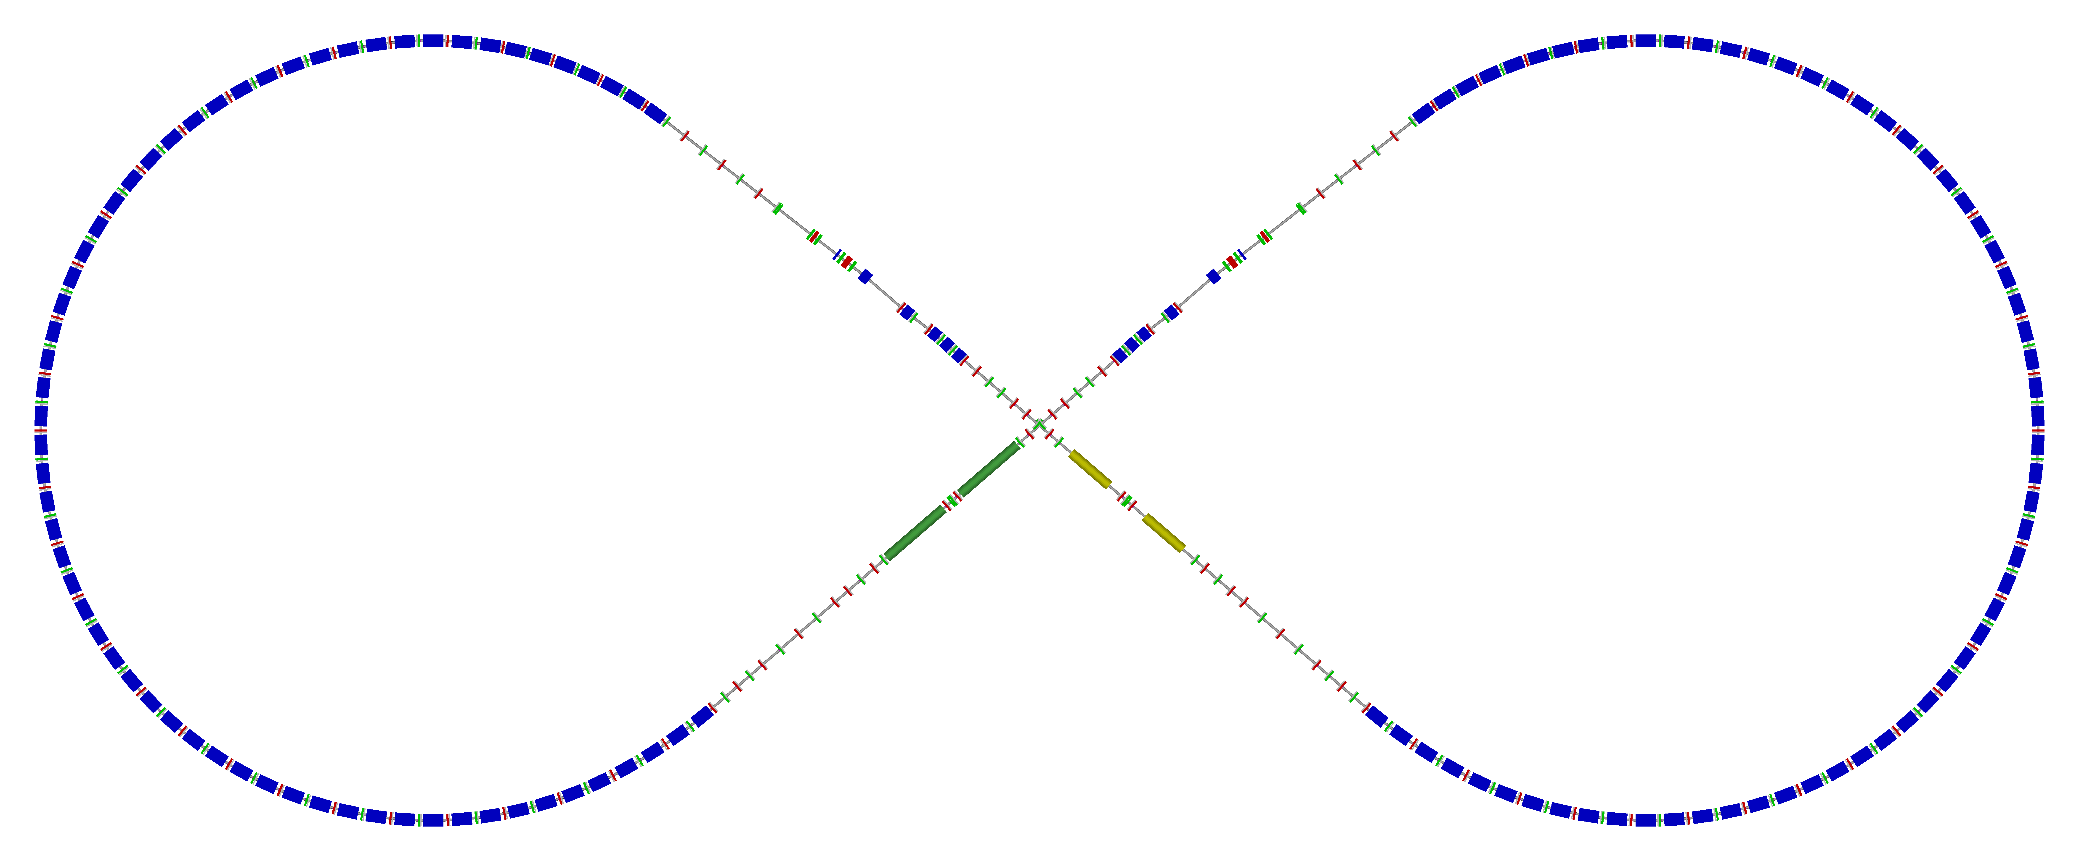
Ion Collider Ring
Circumference of 2153.5 m = 2 x 710.3 m arcs + 2 x 366.4 m straights
81.7° figure-8 crossing angle
disp. supp./
geom. match #2
disp. supp./
geom. match #2
Arc, 261.7°
tune
tromb.+
match
el. cool.
norm.+
SRF
det. elem.
R = 155.5 m
beam exp./
match
disp. supp.
ions
IPs
disp. supp./
geom. match #1
disp. supp./
geom. match #1

