Slide 1

EXPERIMENTAL STUDIES OF OPTICS SCHEMES AT CEBAF FOR SUPPRESSION OF COHERENT SYNCHROTRON RADIATION INDUCED EMITTANCE GROWTH
Yves Roblin, Computational Accelerator Physics Group, CASA
David Douglas, Fay Hannon, Alicia Hofler, Geoff Krafft, Chris Tennant

Slide 2
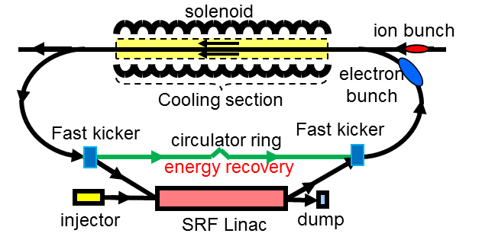
Bunched Beam Electron Cooler
Baseline cooling requirements
  Emittance 0.5 to 1 mm-mrad -> reduce IBS effect
  Magnetized beam, up to 55 MeV energy, 200 mA current
  Linac for acceleration
  Must utilize energy-recovery-linac (beam power is 11 MW)
Solution : cooling by a bunched electron beam
Electron energy | MeV | up to 55
Current and bunch charge | A / nC | 0.2 / 0.42
Bunch repetition | MHz | 476
Cooling section length | m | 60
RMS Bunch length | cm | 3
Electron energy spread | 10⁻⁴ | 3
Cooling section solenoid field | T | 2
Beam radius in solenoid/cathode | mm | ~1 / 3
Solenoid field at cathode | KG | 2
Notes:
The second stage of cooling will occur in the collider ring. It is more challenging.
Once we have the beam in the collider ring, it will be bunched. In order to keep lifetime and luminosity high, we will provide cooling by an electron beam. We have several cooler designs all of them challenging. Space charge and beam breakup also are investigated in the acceleration of the magnetized beam.
What we are trying to address is whether or not the electron beam can be recirculated long enough to cool the ion beam. The main impediment is the microbunching from coherent synchrotron radiation. The goal of this proposal is to explore which kind of lattices are needed in the circulating cooler ring to overcome this.
Shown here is an option where one uses a very high current electrron beam (200mA) and recover it via an ERL in order to dump it. The Beam is magnetized in order to keep the electron emittance as cool as possible.
State of the art is a few 10’s of millamps, not 200 mA. One option is to combine three injectors in a gatling gun arrangment... Lots of opportunities and needs here for simulations. We have formed a working group to evaluate all the options and determine what is needed.

Slide 3
Introduction
MEIC cooling design uses recirculator
  Very sensitive to CSR microbunching
  Methods to reduce effect of CSR microbunching
    Di Mitri et al, Phys. Rev. Lett. 110 (2013) 014801
    outlined method based on symmetric CSR kicks, i.e lattice structure
    Douglas et al, JLAB-ACP-14-1751 extended to more generic lattices
Notes:
Recently reexamined by DiMitri et al, although there has been earlier work on that.
Based on the fact that transverse momentum kicks coming from CSR can be compensated by the opposite kick half a betatron phase away given a properly configured lattice. Its easy to see with even number of super periods.
It was recently extended to arbitrary number of super periods by realizing that this cancelation occurs on a slice by slice
basic in the longitudinal phase space.

Slide 4
Goal of this LDRD
Carry out studies to prepare a proposal for an actual experiment at CEBAF.
Scope:
  Design optics to enhance/suppress CSR in east ARC (ARC3)
  Study transport from injector to ARC, optimize
  for high charge.
  Determinate optimal injector setup
Notes:
Amongst the things to do are :
1) Find the optimal longitudinal phase space configuration that is supported by CEBAF conducive to this experiment.
2) Design optimal lattices for CEBAF, find what are the requirements on the beam properties out of the injector
3) Recommend an injector configuration to support this.
4) We have extensive experience from FEL to build upon.

Slide 5
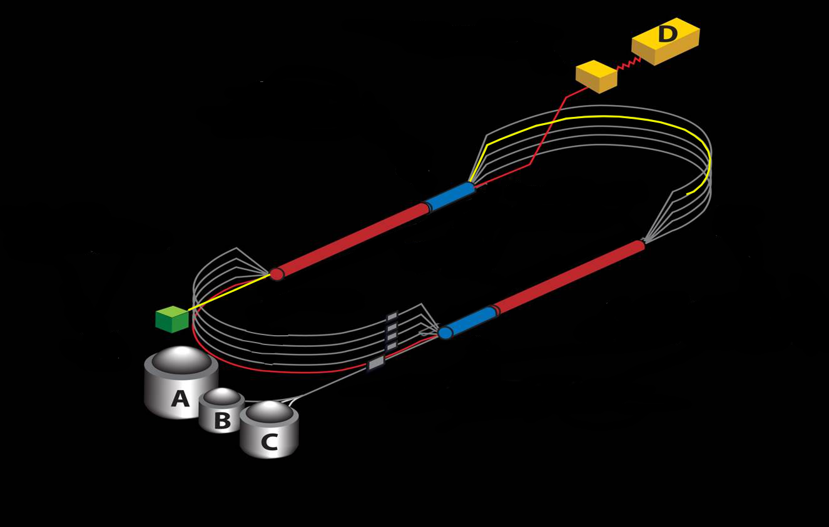
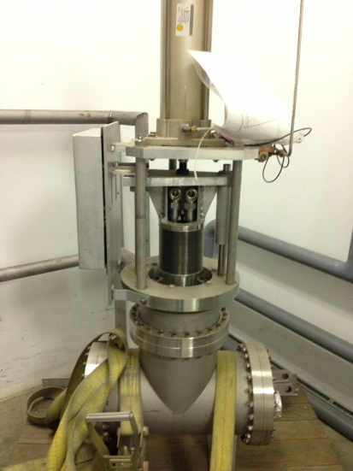
Experiment Layout
Notes:
6GeV: Recirculating SRF linacs, low emittance, low dp/p machine. Dp/p dominated by bunchlength and rf linac phases
Arcs are isochronous bends to keep M56=0, and hence, keep bunch short (avoid head-tail effects which grows emittance)
We will reconfigure CEBAF to accelerate at around 500 MeV and go through ARC3, terminating the beam at the end of the ARC. No recirculation. We have a 123 MeV/c injector followed by a chicane with tunable M56, a linac and a two step spreader leading to a recirculation arc for each pass. We propose to do the experiment in the recirculation arc. We will reconfigure the injector to deliver a high brilliance beam, compressing at the chicane and at the spreader. Lattices will be installed in the east ARC (ARC3) for “good” and “bad” CSR.
12GeV: emittance growth and dp/p now dominated by Synch. Rad. We can relax M56 condition and go to DBA to reduce transverse emittance
Added an extra half pass and another arc to deliver to hallD a 12 GeV beam.
ARC1 and ARC2, high dispersion arcs for centroid and energy spread monitoring
SPREADER: achro. Vert. bend to move beam from linac to arc + matching section
RECOMBINER achro. Vert. bend to move beam from arc to linac. + matching section
ARC3-ARCA 180 isochronous achromatic bends (unless its DBA) l
Beam is send to hallD on a target which produces photons. Electron beam is then deflected into a tagger magnet for momentum determination and terminates at the dump. Photon beam is collimated and goes to the experimental target located in the detector package.

Slide 6
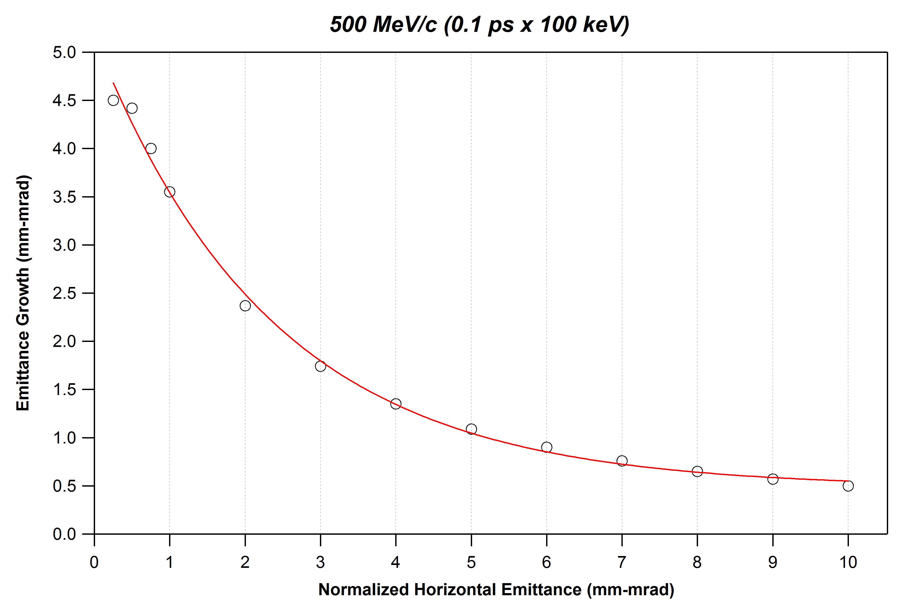
CSR Induced Emittance Growth
courtesy C. Tennant
Notes:
Need to keep transverse emit well below 5 mm.mrad ? To get significant growth (measurable) for 20pC.
Brightness is important. We have to control both charge and transverse emittance.

Slide 7
Preliminary Injector simulations
(courtesy A. Hofler)
Notes:
That was with 350 KeV gun in front of machine. GA optimization. That’s the pareto front at entrance of ¼ cryo.
This study shows that one has to consider an alternate injector configuration. Reaching low transverse emittance while achieving high bunch charge is impossible due to the long injector transport line (that was designed for fractions of pC).

Slide 8
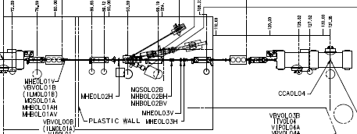
Proposed location for new injector
Injector linac
Minimal modifications. Remove differential pump
And diagnostic girder, add new injector
Notes:
No need to run new cryo lines. This can be a temporary installation for the duration of the experiment.

Slide 9
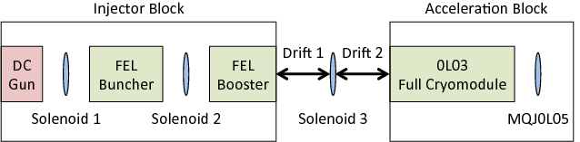
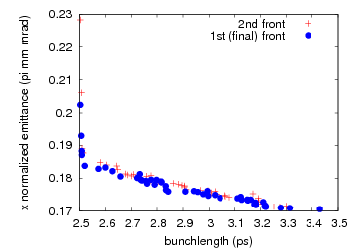


Option 1: Use FEL Booster cavity
$$σ_{z}=2.5−3pS$$
$$ε_{x}=0.2 mm.mrad$$
Notes:
This utilizes a 350 KeV gun and a configuration similar to the FEL without the merger. One can reach a pretty small transverse emittance.
The plot on the left shows the pareto front. A Genetic algorithm was employed for this. There is a wide range of solutions, for which we can trade
bunch length with transverse emittance.

Slide 10
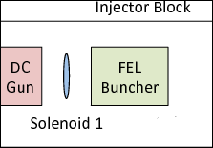
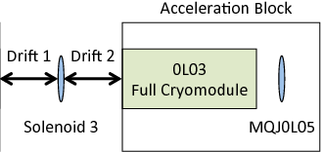
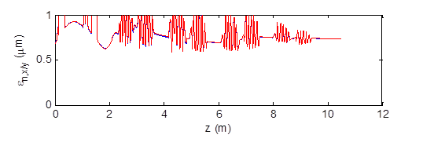
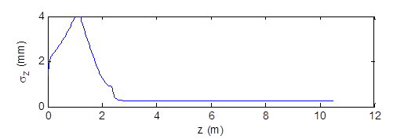


Option 2: Capture via 0L03
$$ε_{x}=0.7 mm.mrad$$
$$σ_{z}=0.25 mm=0.8 pS$$
Notes:
If one drops the FEL booster cavities, the new injector only utilizes warm RF and hence, does not require cryoline hookups.
The first few cavities in the first cryozone of the injector linac are used to capture the beam.
This is just one example of an optimization with a small bunchlength. Likewise, it is possible to reach a broad range of parameters.
The final choice will be made when we carry out the detailed front to end simulations in preparation for the proposal for the actual experiment.
Note that both of these options can easily produce and transport 10’s of pC. This is something we need for that experiment. It also will be beneficial for the MEIC injection scheme. One needs a similar amount of bunch charge.

Slide 11
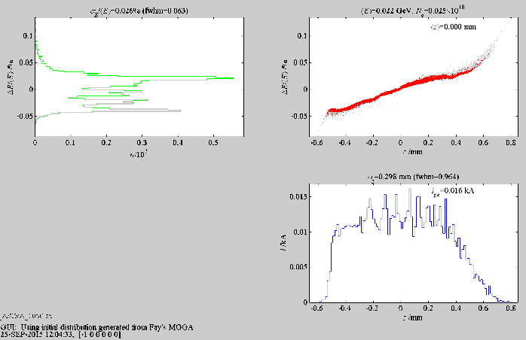
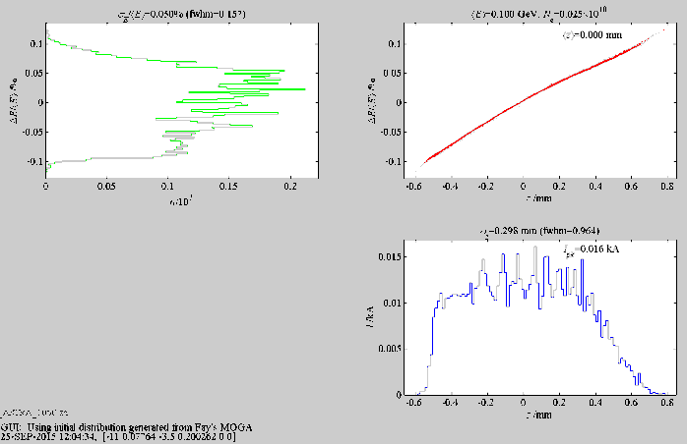
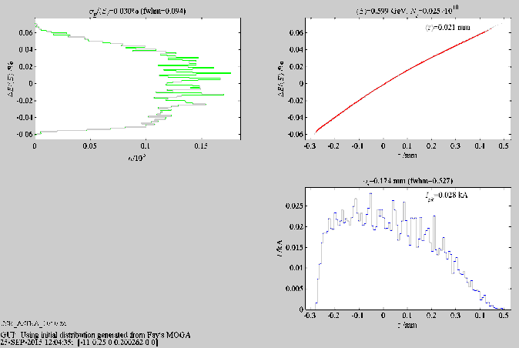
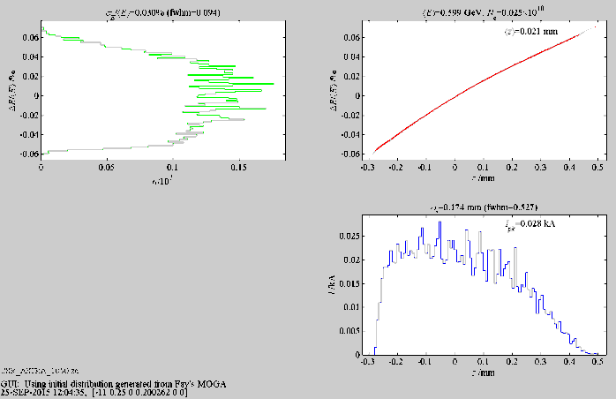
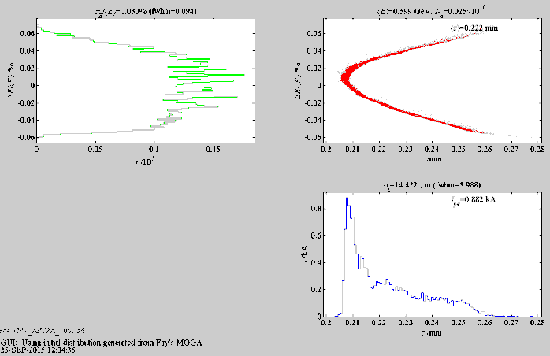
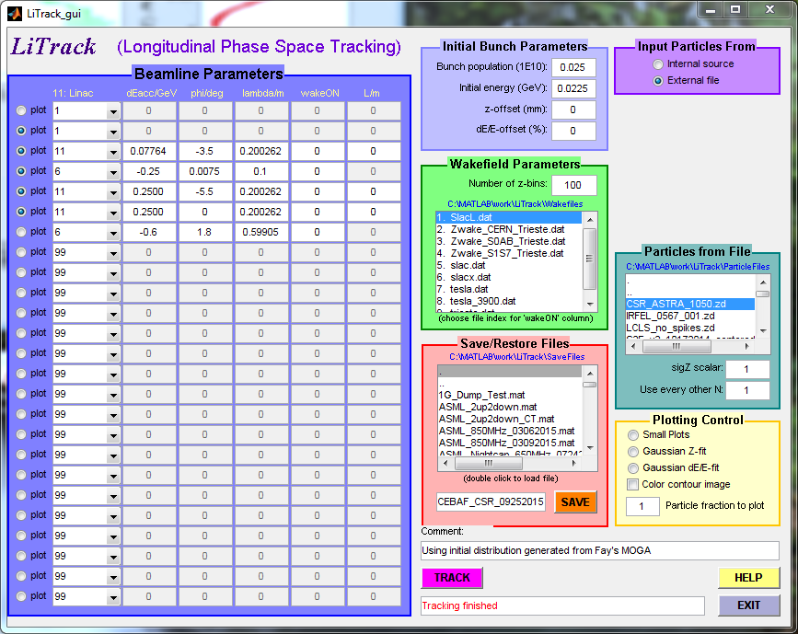
Longitudinal match
Entrance 0L04
Exit 0L04
Exit chicane
Exit North Linac
Entrance ARC3
Notes:
The generated beam at the injector is then send through the injector linac (0L03+0L04). It is chirped and undergoes compression in the injector chicane.
After acceleration in the linac where it is further manipulated (half the linac is run off crest to rotate the phase space)

Slide 12
CSR suppression lattice
Recipe:
  2nd order achromat with achromatic and isochronous super periods to suppress CSR induced emittance growth in transverse emittance
  Low M56 variations within the lattice to also reduce the microbunching gain.
  CEBAF lattices can meet that requirement.

Slide 13
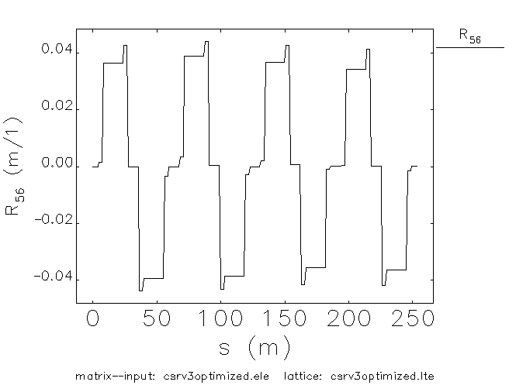
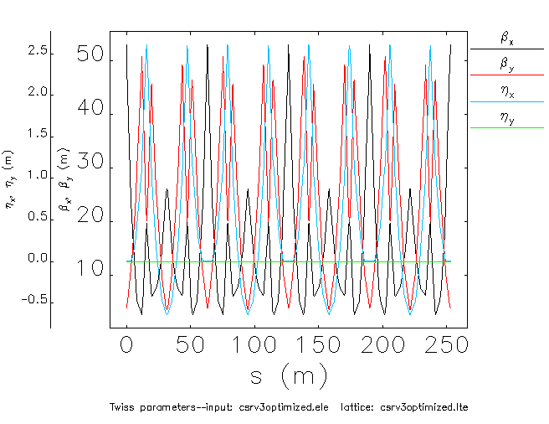
CSR ARC3 suppressed lattice (cont)
Small R56 variation,
2nd order achromat,
4 superperiods.
Notes:
It is achromatic and isochronous to 2nd order. Shown are R56, T166, T266 and T566. (T16 is shown on previous slide as dispersion)

Slide 14
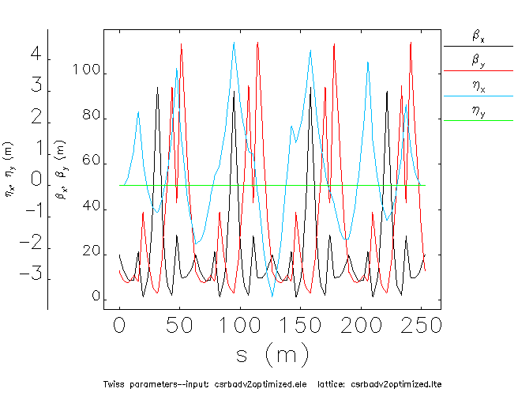
CSR Enhancing Lattice
Notes:
Based on a mismatched dispersion pattern. Superperiods are not individually achromatic and isochronous. Instead the whole arc is corrected to 2nd order globally. This results in large variations in R56 inside the lattice and produce
a large microbunching gain.

Slide 15
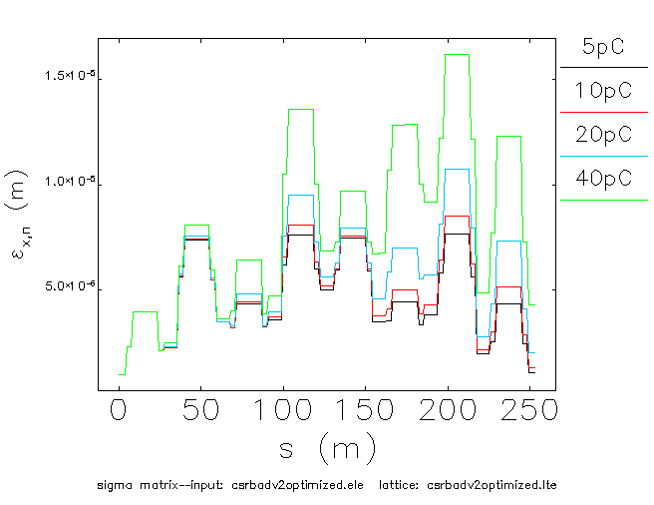
CSR Enhancing Lattice
Notes:
That is for 1mm.mrad transverse emittance and 300fs bunchlength.
We start seeing emittance growth right away at 5pC. Note that we can not go much beyond 40pC in the machine for lack of place to dump the beam (dump limit=2kW) unless we recirculate and energy recover in the south linac…

Slide 16
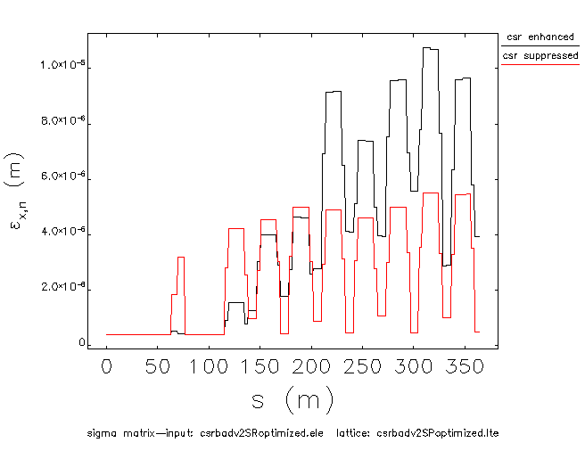
Emittance Growth in ARC3
Bunchlength fs, transverse emittance 0.2 mm.mrad
Notes:
This is for 1mm.mrad of transverse emittance and xxx fs bunchlength. No sign of emittance growth at end of arc up to 40 pC. Its true for much higher bunch charges too but we cant reach them in CEBAF (insertable dump power limit amongst other things)

Slide 17
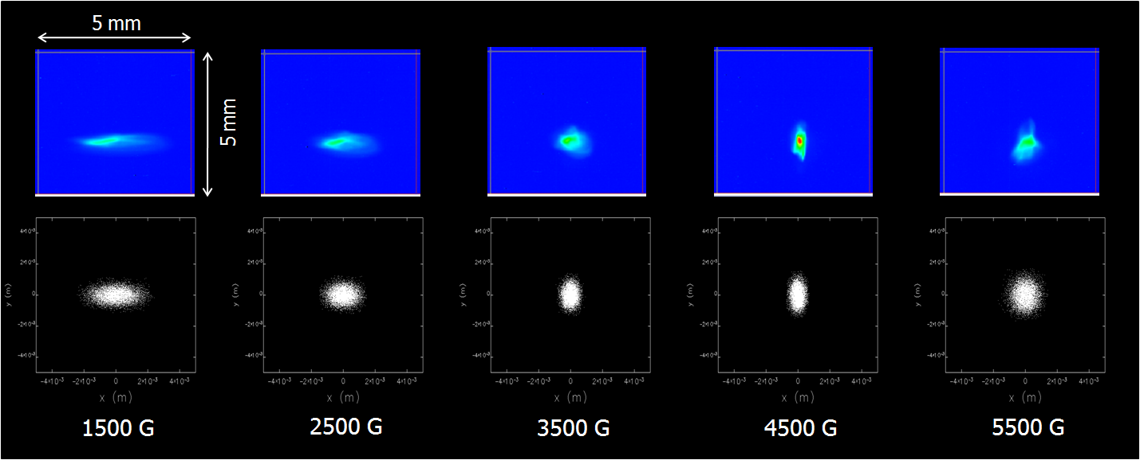
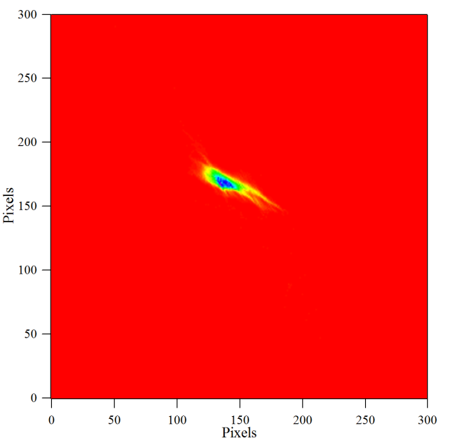
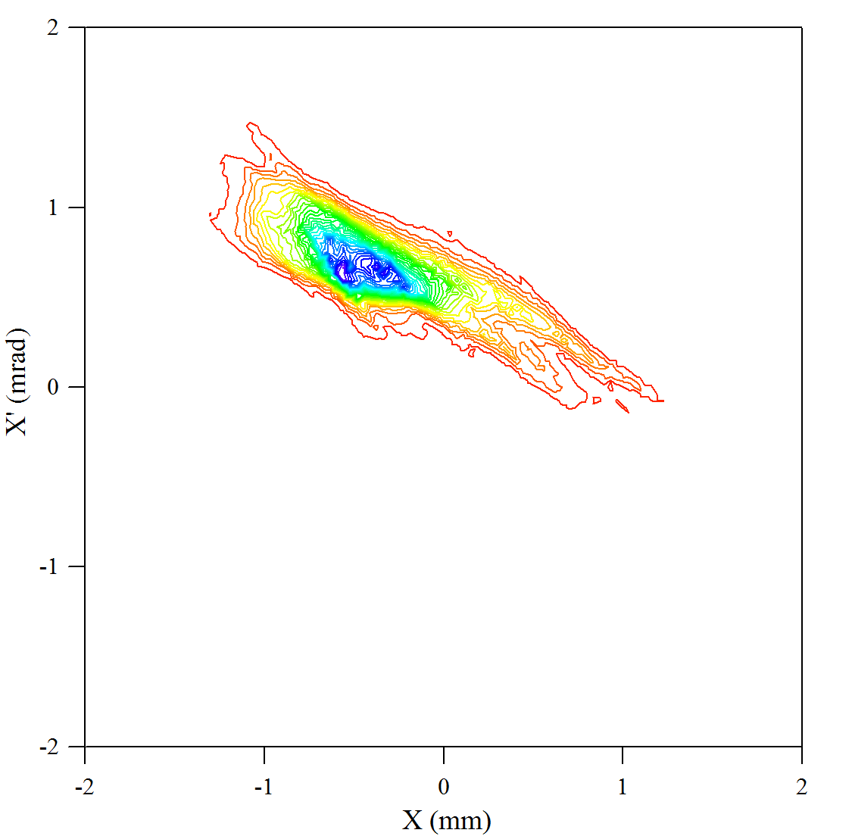
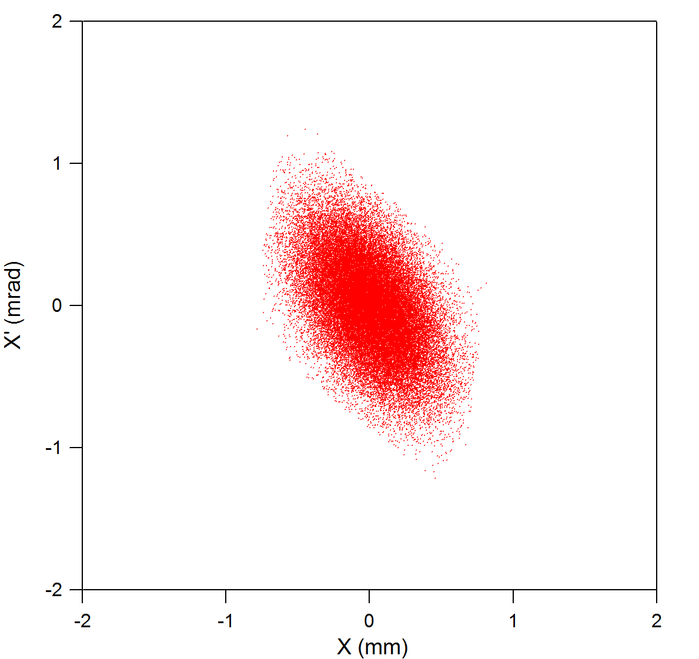
Tomography at the FEL
With similar phase coverage (157°) we were able to reconstruct horizontal phase space in the FEL Upgrade Driver (TN-09-021)
Actual beam spots
Simulated beam spots
MENT output
courtesy C. Tennant
Reconstructed (x,x’)
Simulated (x,x’)

Slide 18
Insertable dump design (cont)
Beam parameters at dump
Bunch repetition rate | 31 MHz
Transverse emittance | < 1mm.mrad
Macro pulse | 200 μs , 60 Hz
Charge | 40 pC (15 μA average)
Bunch Length rms | < 0.1 pS
Energy spreader rms | < 10 KeV
Energy | 500-600 Mev
Power deposited | 7.5 kW (at 500 MeV)
Notes:
Out of those 7.5 kW, 400 watts exit the dump in the form of gamma and neutrons.

Slide 19

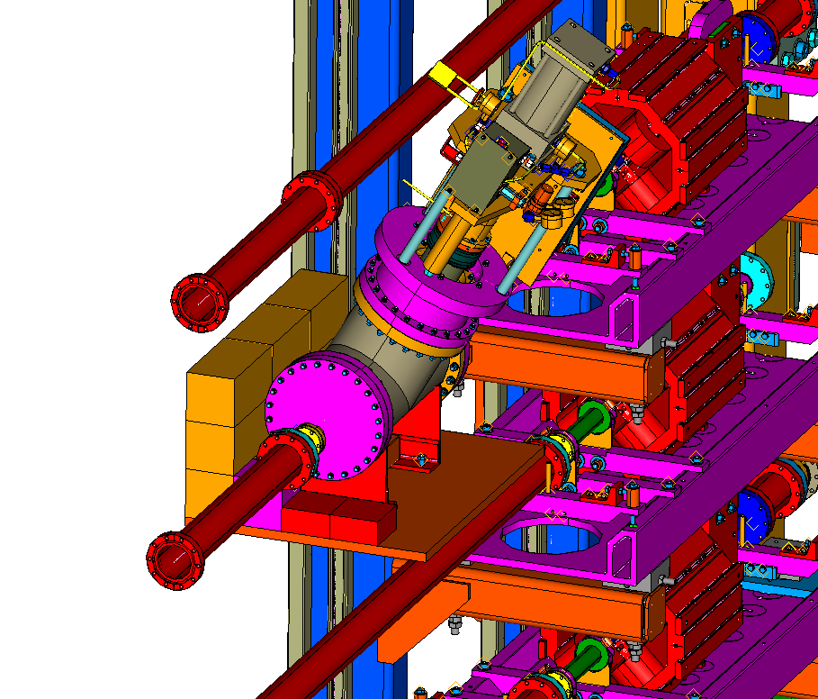
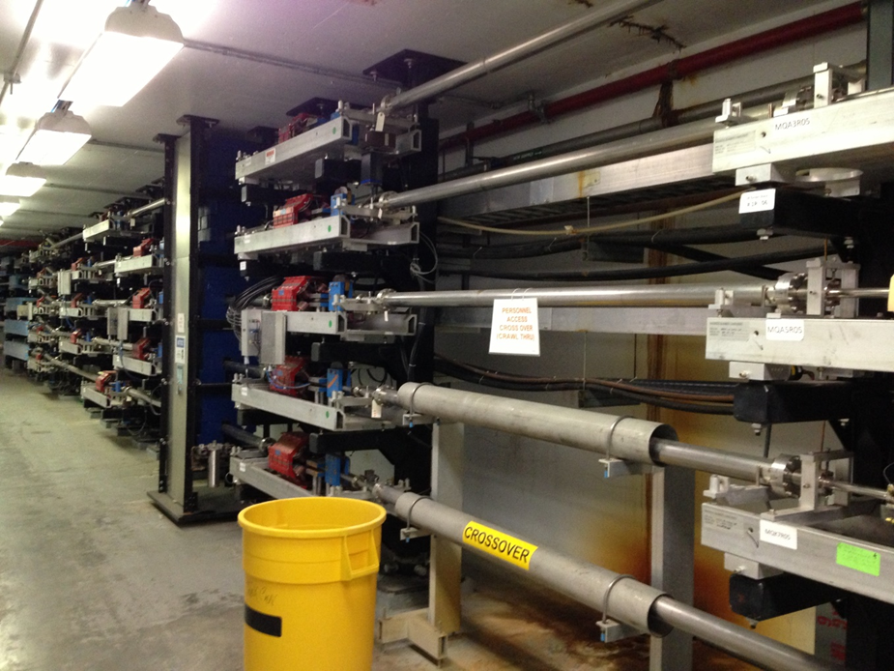
Insertable dump design
Located past 3R04 girder
17 kW dump
Notes:
We designed an insertable dump in order to terminate the beam at the end of ARC3.

Slide 20
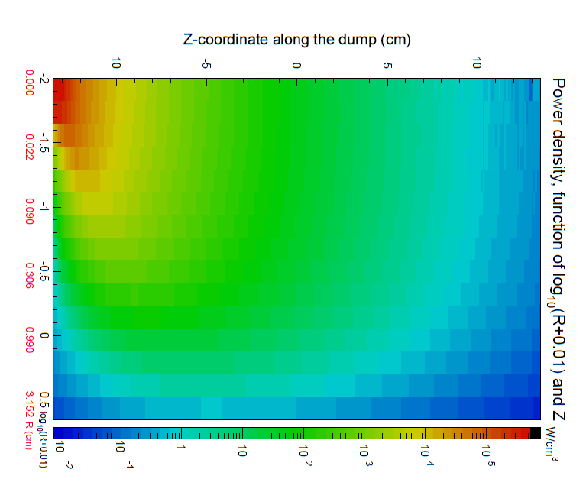
Power density in dump
7.5 kW beam
7.1 kW deposited
0.4 escape as neutrons
and gammas
Notes:
For the final iteration, we will calculate the radiation load in the tunnel as a consequence of this and dictate the design for the shielding.

Slide 21
Conclusions
Proof of principle CSR suppression experiment seems feasible at CEBAF
Writing a proposal to the Program Advisory Committee
Transporting high brilliance beam at CEBAF will also be needed for injection into MEIC

