Slide 1
Overview of Collective Effects in MEIC
Rui Li
MEIC Collaboration Meeting
Oct. 6-8, 2015

Slide 2
Outline
Unique features of MEIC design and challenges
Impacts of collective effects in MEIC
Collective effects in ERL-based e-cooler
Collective effects in the electron ring
Collective effects in the proton ring
Beam-beam in MEIC
Mitigation schemes
Topics for future R&D

Slide 3
I. Unique Features of MEIC Design
Unique Features:
Luminosity performance is based on scheme of high collision frequency, low bunch charge and short bunches. This luminosity strategy has been achieved at PEPII and KEKB.
ERL-based high energy electron cooling at colliding energy
Design Limit:
Stored beam current
Electron SR power density
Direct space-charge tune shift
Beam-Beam tune shift limit

Slide 4
Challenges to MEIC
High energy bunched e-cooling
High current electron source for magnetized beam
Beam transport for magnetized beam and collective effects on e-beam stability
Wide energy range and wide range of ion species
Low energy
- space charge of ion beam limit bunch charge
- select longer bunch length (2.5cm) so Laslett tune shift =0.06
-Longer bunch length but smaller beta: hourglass effect
-low energy beam-beam
High energy
-SR limit average current for e-beam
(Keeping bunch Q, but reduce rep frequencies)

Slide 5
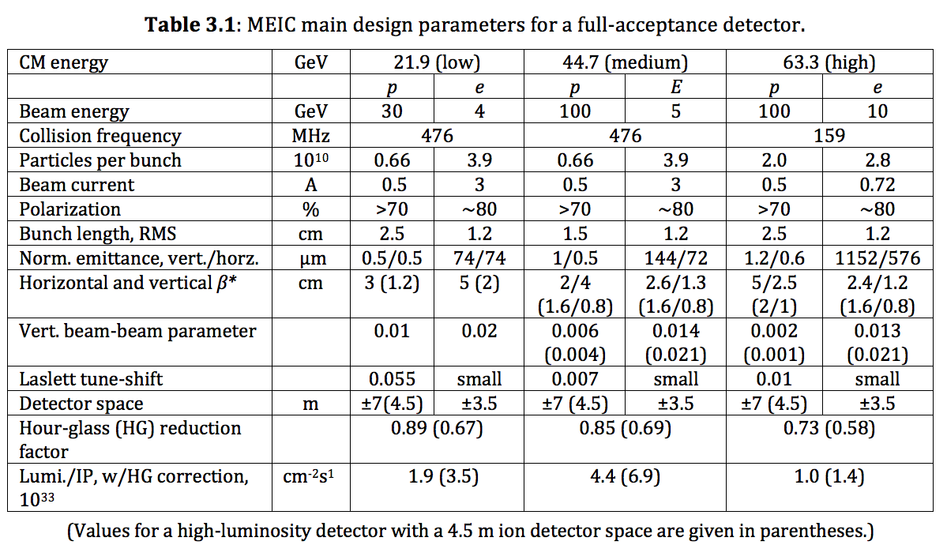

Slide 6
Luminosity vs. Energy

Slide 7
Unique to MEIC
ERL-based electron cooler: all issues with high power ERL, and electron beam dynamics in the beam transport for magnetized beam (space charge, CSR, shielding)
Bunched e-beam to cool long p-beam: synchro-betatron resonances
Short ion bunch length, implication to beam-beam
Short bunch spacing, implication to electron cloud and ion effect, especially for coupled bunch instabilities
Cooling for colliding ion bunch, leads to dense core, impact on beam-beam and luminosity lifetime
Switch gear for synchronization, beam-beam coupled bunch instability
Low-energy collision: Beam-beam with space charge
p: 9-100 GeV,

Slide 8
Ion Beam in MEIC
 | RHIC | LHC | MEIC
E (GeV) | 100 | 7000 | 100
N_{b}
Energy spread
Bunch length (cm) | 30 | 7.5 | 1.5
Synchrotron tune
Beam-beam Tune shift | 0.01 | 0.0034 (achieved: 0.006) | 0.006

Slide 9
II Impacts of Collective Effects
Set ultimate limit to luminosity performance
Depends on bunch intensity and bunch filling pattern
Cause effects such as
Parasitic losses
Beam instabilities
Degrade phase space quality (emittance growth)
Poor lifetime

Slide 10
ERL-based e-cooler
Generation and transport of magnetized beam
Space charge effects
BBU
CSR effects and shielding by vacuum pipe
Ion trapping
Touschek scattering and halo management
Single bunch head-tail dipole instability
IBS
Two stream instability

Slide 11
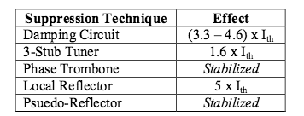
BBU in ERL Cooler
For JLAB FEL, the lowest BBU threshold was observed for
By optics adjustment the current threshold can be increased by a factor of 100.
Mitigation of BBU
Strong damping of HOM
Optics
Feedback system
(C. Tennant)
The optics prepared for magnetized beam transport will also play a role for BBU suppression

Slide 12
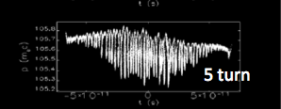
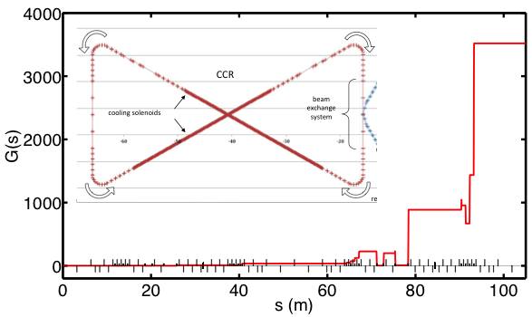
LSC and CSR Induced Microbunching Instability in CCR
Gain vs. path length
Name | Value | Unit
Beam energy | 54 | MeV
Bunch current | 60 | A
Norm. emittance | 3 (in both planes) | μm
β_{x0,y0} | 10.695/1.867 | m
α_{x0, y0} | 0.0/0.0
Slice energy spread | 1 × 10⁻⁴
Chirp | 0.0 | m⁻¹
Gain Spectrum
CSR +LSC
Steady-state CSR only
It’s important to study MBI for a magnetized beam in CCR

Slide 13
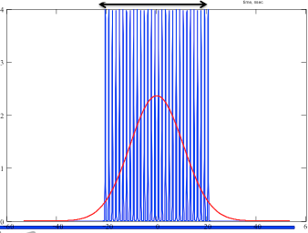
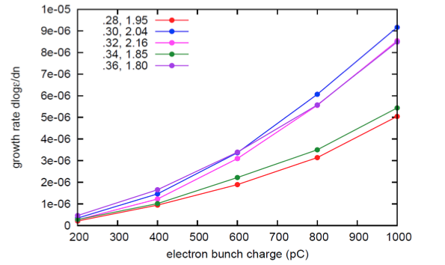
Emittance Growth in Bunched Beam Cooling
Low Energy Bunched Cooling at RHIC
(M. Blaskiewicz, COOL’15)
30 electron
bunches
to cool a
long ion
bunch
The electron bunches exerts focusing
force on the ion bunch.
The ion does half synchrotron oscillation
before kicked by electrons again
Cause synchro-betatron coupling
Simulated emittance growth rate
vs. electron bunch charge

Slide 14
Collective Effects for the Electron Beam
Impedance budget
Coherent Instabilities
-Single bunch effect:
Longitudinal: microwave instability, potential well, CSR effect
Transverse: mode-coupling instability
-coupled bunch instability: longitudinal, transverse
Scattering (IBS, Touschek)
Ion Effects

Slide 15
Impedance Budget
Broad-band impedance (low Q)
-lead to single bunch instability
-BPM, Bellows, Vacuum valves, RF cavities, space charge, collimators
Narrow-band impedance (high Q)
-lead to coupled bunch instability
-from damped or undamped HOM of RF cavities, trapped modes of vacuum chamber
Resistive wall impedance, transverse and longitudinal (narrow-band nature of RW impedance at low frequency leads to coupled bunch instability)
-estimate of RW impedance for each beamline section
-collimator

Slide 16
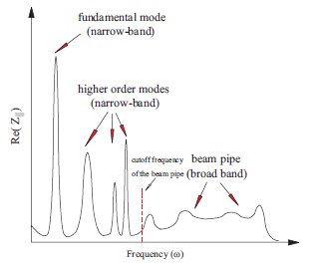
Typical Impedance Behavior

Slide 17
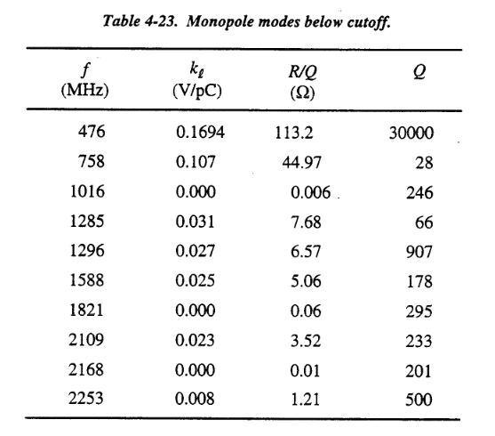
Impedance Budget
Narrow-band impedance from RF cavities
PEPII RF cavity modes:

Slide 18
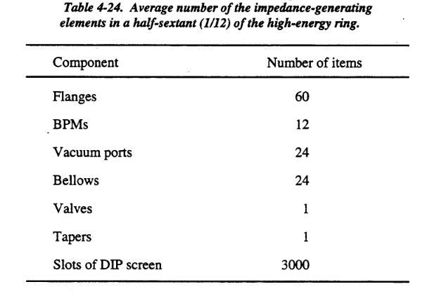
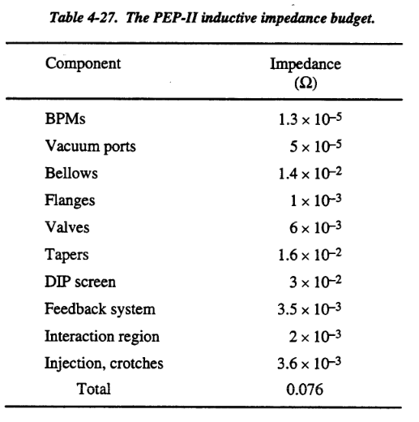
General longitudinal impedance (Broadband):
Miscellaneous
elements
For HER, <b>=3.3cm
Transverse impedance:

Slide 19
Single Bunch Instabilities
Longitudinal microwave instability:
Instability in longitudinal phase space modulation caused by longitudinal impedance and slip factor
Transverse mode-coupling instability :
fast head-tail instability

Slide 20
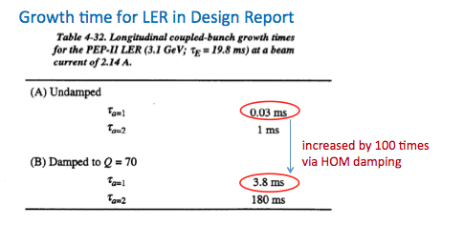
Longitudinal Coupled Bunch Instability
Coupled Bunch Instabilities (CBI) are the most important instabilities encountered in a storage ring in multibunch operation.
The narrow-band impedances of RF HOM are the main source of CBIs.
High current at PEPII is supported by large RF system, high power cavities with HOM damper, longitudinal and transverse bunch-to-bunch feedback system, and high performance of vacuum system.
MEIC design parameters of I=3A for the e-ring at E=3-5GeV should be within reach, but this requires very careful
Achieved current:

Slide 21
Collective Effects for the Proton/ion Beam
Impedance budget
Coherent Instabilities
-Single bunch effect:
Longitudinal: microwave instability, potential well
Transverse: mode-coupling instability
-coupled bunch instability
Electron cloud
Scattering (IBS, Touschek, residual-gas scattering)
Bunch formation
Incoherent emittance growth, beam loss and heat load

Slide 22
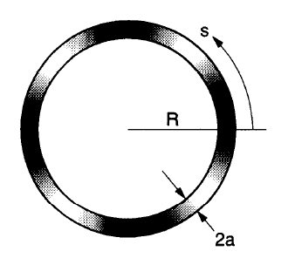
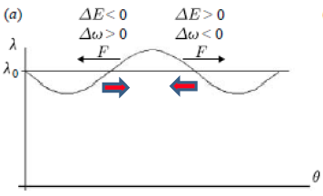
Negative Mass Instability for a Coasting Beam or with Barrier Bucket
Proton energy: 9-100 MeV
transition gamma for the ion ring: 12.46
Collective interaction within the long bunch via space charge force, resistive wall and cavity wakefield
Landau damping from spread of revolution frequency
Necessary energy spread to damp the negative mass instability
This condition may not hold when
bunches are joined in barrier bucket

Slide 23
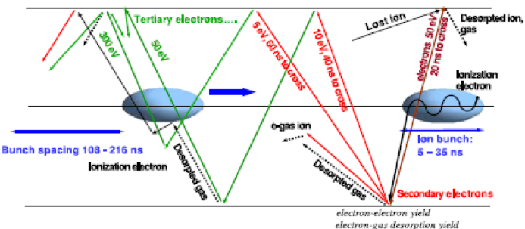
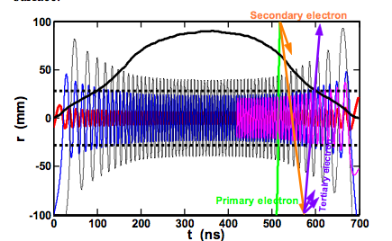
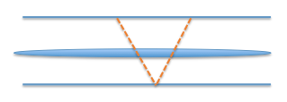
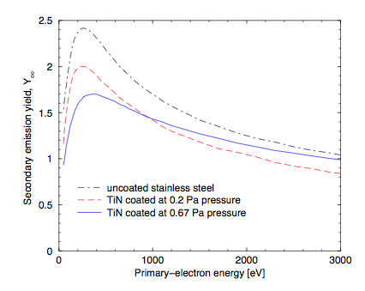
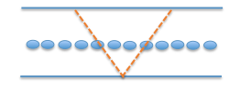
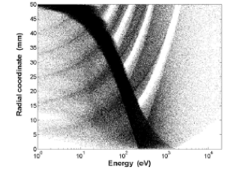
Electron Cloud Effects
Electron cloud effects (ECE) are the result of interplay between the beam and vacuum chamber. These effects have been observed at many ion and positron storage rings
Resonance condition:
Long bunches: trailing-edge effects
The case for almost all ion rings
Secondary emission yield
Short bunches, high rep rate
(L. Wang)
(MEIC case: similar to PEPII,
but unlike usual ion rings)
Electron distribution
In energy and radius

Slide 24
(K. Ohmi)
Single bunch instability threshold for MEIC
Higher than neutralization level: safe

Slide 25
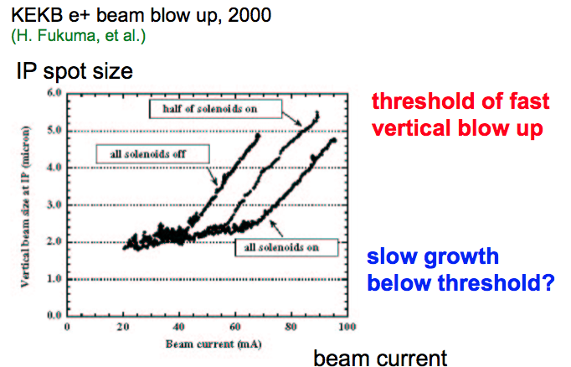
Slow Growth Below Threshold?
(with SR damping)

Slide 26
Beam-Beam
Unique to MEIC: (short p bunch of 1cm)
Short p bunch: Large synchrotron tune, synchro-betatron resonances
Strong cooling for colliding beam
dense core, beam lifetime is a big problem.
Synchronization by changing gear leads to coupled bunching dipole instability
Hourglass effects
Beam-beam at low energy with space charge: poor beam lifetime.
Crab cavity: synchrobetatron resonances
Beam-beam tune spread effect on polarization choice of tune was crucial
Dynamic Aperture: Joint effect of nonlinear optics and beam-beam on dynamic aperture
Crab Cavity: Effect of phase noise on beam emittance growth
Multi-bunch, multi-IP effect on coupled bunch instability
Beam lifetime
Joint effect of beam-beam with other collective effects

Slide 27
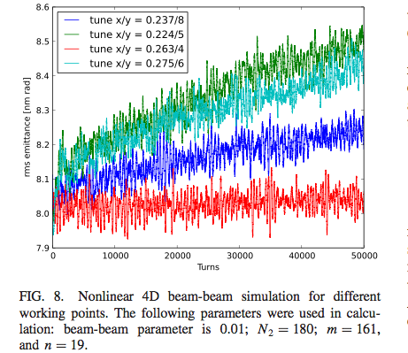
Coupled Bunch Beam-Beam Instability due to “Swithching Gear”
We need to address the challenge of
coupled bunch beam-beam instability if we use
bunch harmonics for synchronization.

Slide 28
Beam-Beam Effect at Gear Changing Case
Synchronization is needed for bunch collision at IP when hadron beam energy is changed for non-relativistic beam
Change bunch number in a ring, causing asymmetric collision pattern
Dipole moments of one bunch will affect dipole moments of many bunches in the other ring
There are many more linear resonances to be avoided than in a symmetric pattern for any selected working point in the tune diagram
Only linear beam-beam effects are considered for coupled beam-beam resonances

Slide 29
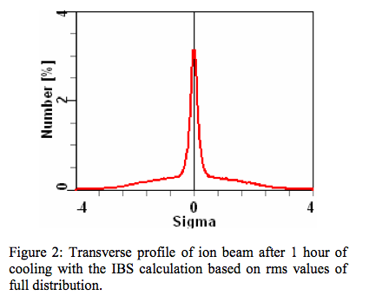
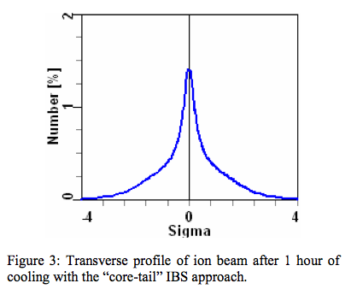
Dense Core of Ion Beam After e-Cooling
The dense core of the ion beam formed after strong electron cooling can induce
strong nonlinear beam-beam force on the electron bunch and
shortening luminosity lifetime. We need to study the comparison of the
characteristic time of beam loss with e-cooling time

Slide 30
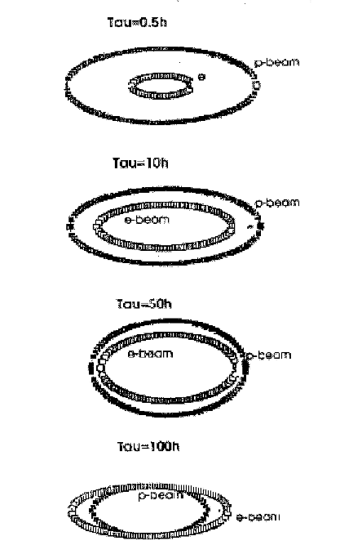
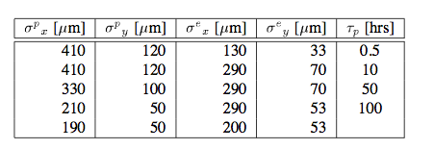
Lifetime and Cross Section Match at HERA
Without collision, the proton beam
lifetime is 5000h.
With weak beam-beam parameter for electron in MEIC (0.01), there may have some room for hard-core cooled proton beam

Slide 31
Beam-beam effects on Polarization
Beam-beam effect
on depolarization needs
to be addressed

Slide 32
More on beam-beam effects
Dynamic beta effect at above half integer
Hourglass effect on beam lifetime
Larger synchrotron tune for ion ring
Interplay of beam-beam with nonlinear optics and other collective effects on dynamic aperture, stability…

Slide 33
IV. Future R&D Topics
Beam dynamics for ERL cooler
Beam-beam effects of MEIC
Ion bunch formation and instabilities
Impedance budget for each beamline
All other collective effects, especially feedback for coupled bunch instabilities
Electron clouds and ion effects
Incoherent emittance growth, scattering, etc

