Slide 1
MEIC Ion Bunch Splitting
Todd Satogata (Jefferson Lab/ODU) and Randika Gamage (ODU)
Defining the Problem
Beam definition and bunch structure
Operability and machine constraints
Possible Approaches
Debunch/rebunch
Adiabatic bunch splitting
RF modulation gymnastics
FEL-like microbunching
Plans and Path Forward

Slide 2
Defining the Problem: Parameters
Starting with ArXiV “MEIC Design Summary” parameters
Table 7.1: α_{C}=6.45e-3, γ_{tr}=12.46 => phase slip η_{tr}=6.362e-3
Table 3.2: Collisions occur with 6.6e9 p/bunch with 1cm (33 ps) rms bunch length
rms bunch length is ~1/30 of h=6832 bucket length
Bucket area: A=0.223 eV-s, (dp/p)_{max}=1.67e-3
Bunch longitudinal emittance: ε_{L}≅7e-3 eV-s!
Perfect adiabatic splitting: h=9 bunches: ε_{L}≅5.4 eV-s!

Slide 3
Defining the Problem: Operability
Bunch splitting constraints
Protect superconducting magnets from sudden beam losses
Maintain at least one abort gap (of undetermined length)
Barrier buckets or resonant gap clearing/collimation
Impedance budget must be reasonable
Splitting must be consistent with impedance model
Impedance sources: SRF, BPMs, kickers, beam pipe transitions
RF control loop constraints
Beam loading at first seems insignificant
But still possibly concern with low voltage, fine phase control
RF costs and complexity
Some scenarios require 7+ different RF frequencies!
Harmonic cavity/control options?
Final bunch distribution should be “even”
Bunch intensity variation among final bunches should be small

Slide 4
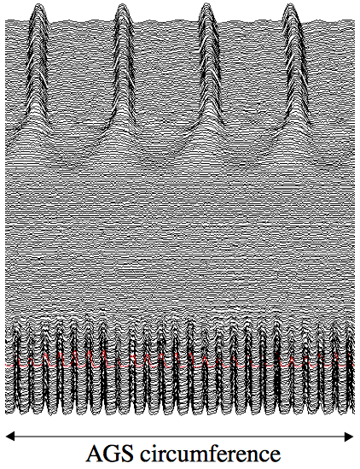
Approach 1: Debunch/Rebunch (Conservative)
Debunch beam completely and rebunch into higher harmonic
Only two RF frequencies needed! ✓
“Adiabatic” if RF voltages are changed on timescales much longer than synchrotron periods
“long” times of small RF voltage: beam loading?
Coasting beam instabilities ✗
major concern of this approach
Tradeoff cavity impedance/RF control vs non-adiabatic emittance growth
Only one final spin orientation ✗
Needs theory/simulations
4 bunches
Debunched beam
24 bunches
1 AGS revolution period
T. Roser, Transversity Workshop, Sep 2000

Slide 5
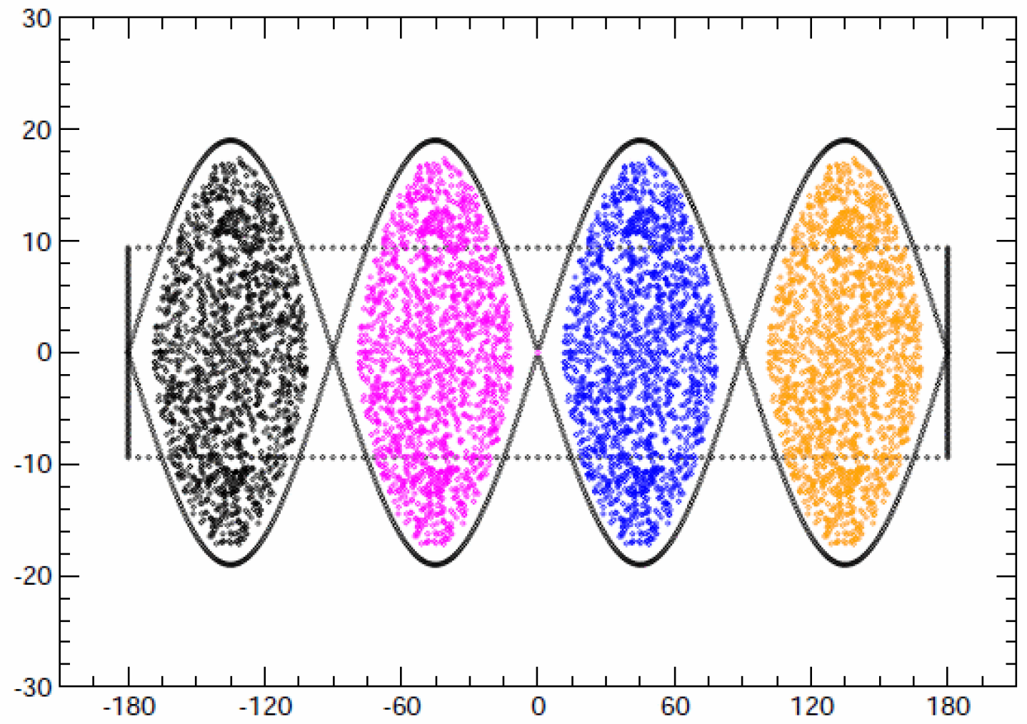
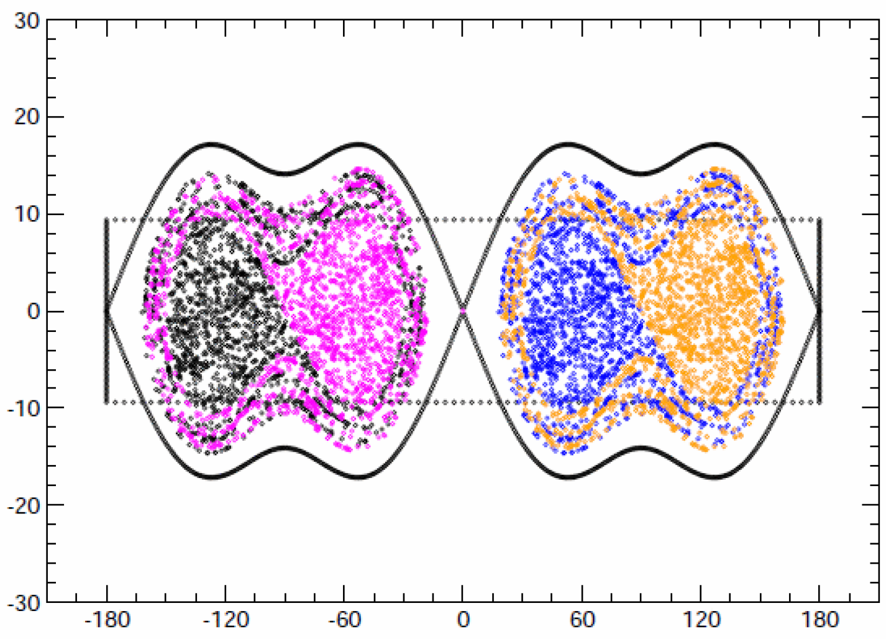
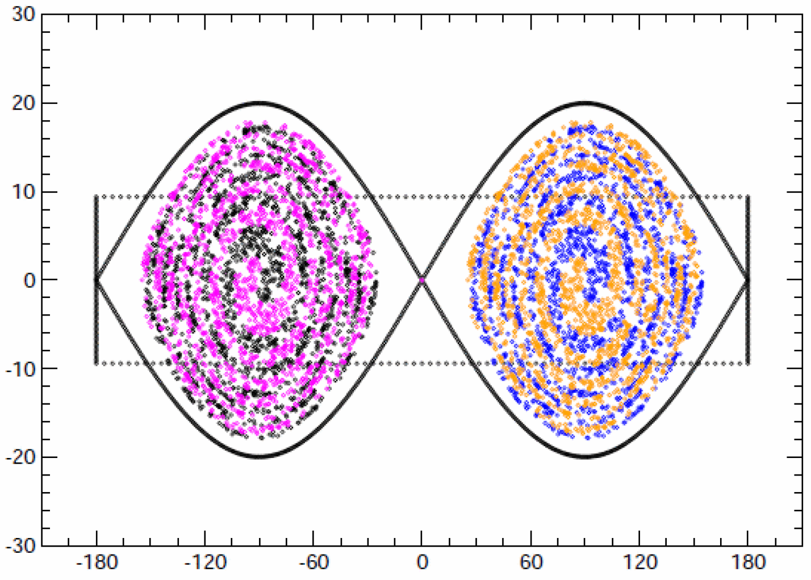
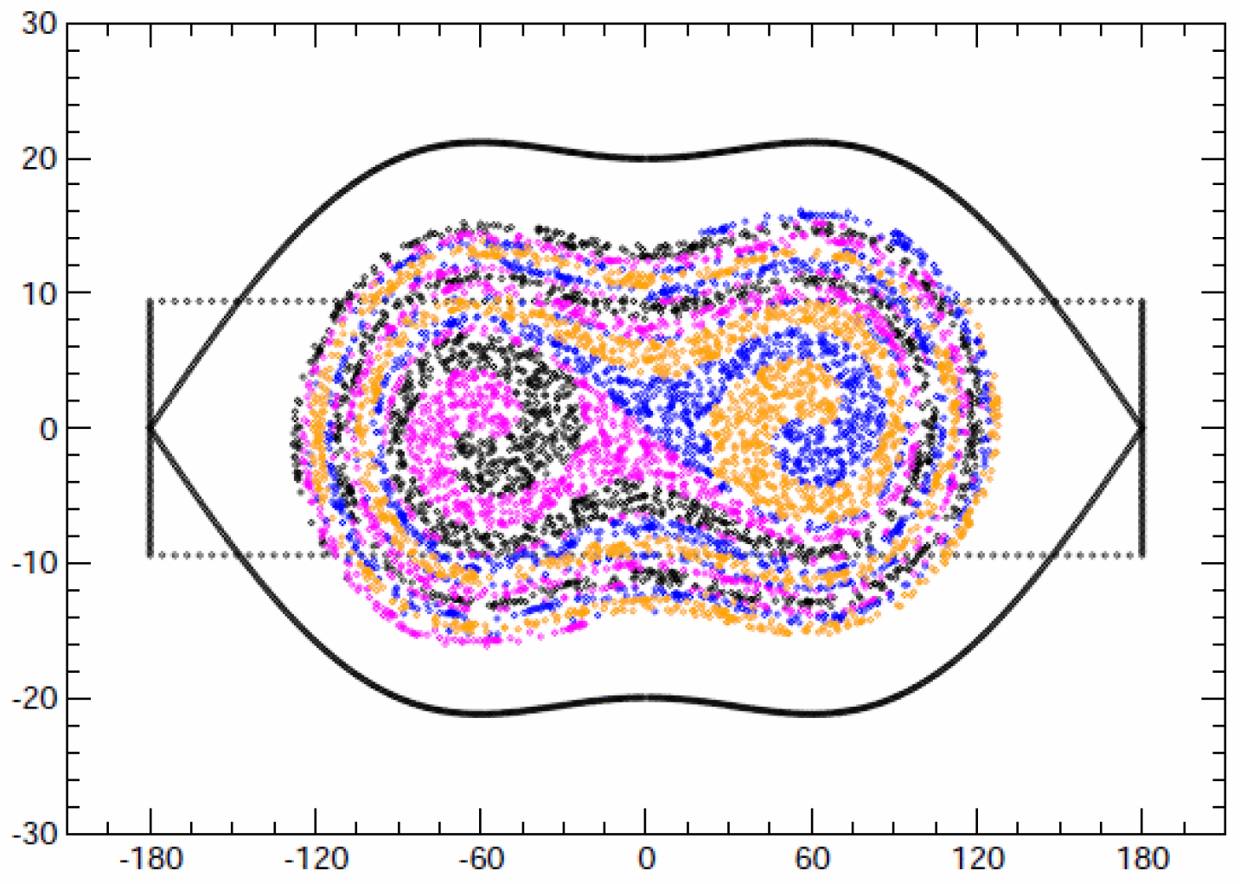
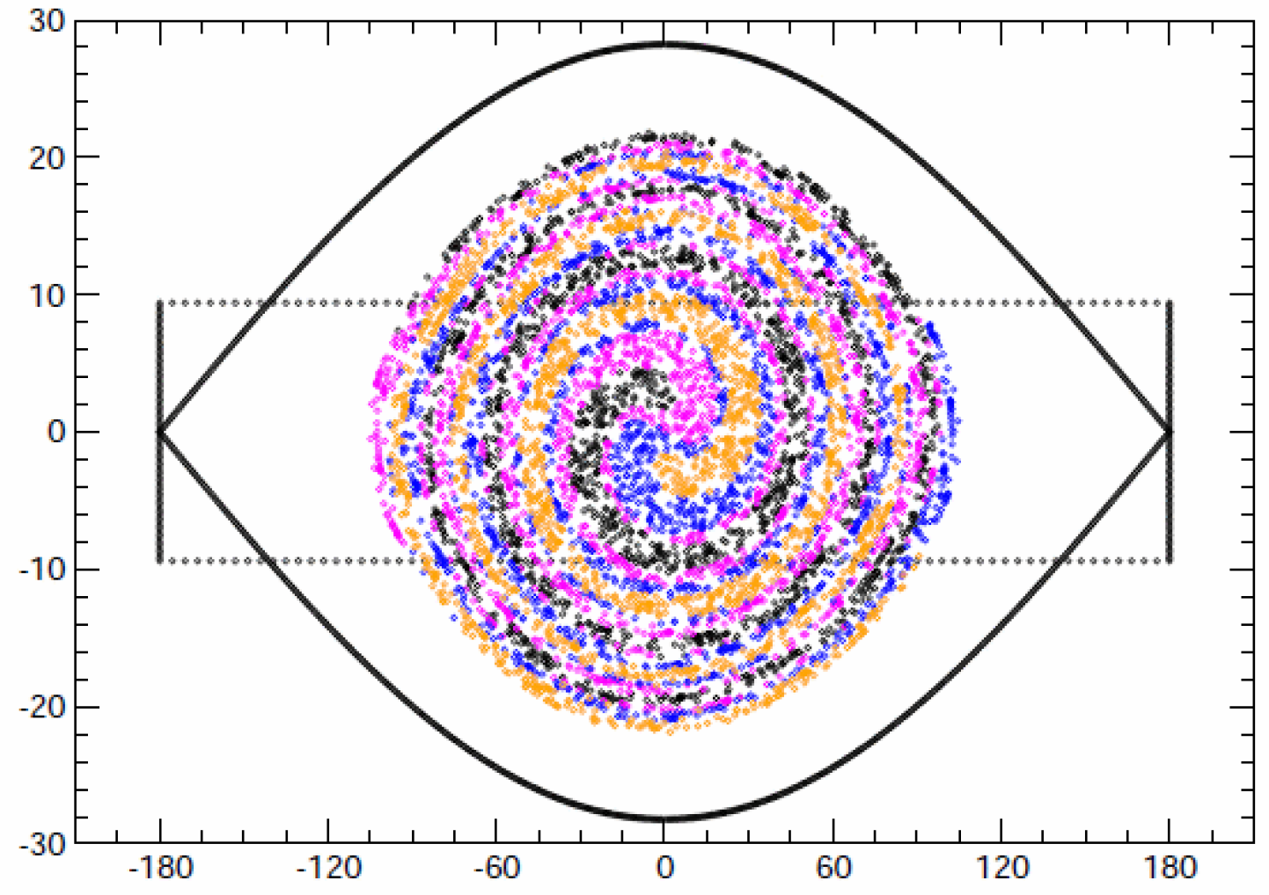
Approach 2: Adiabatic Bunch Splitting (Conservative)
AGS 2:1 / 2:1 Bunch Merge
Split bunches successively
“Adiabatic” if RF voltages are changed on timescales much longer than synchrotron periods
Voltages must be carefully matched
~Doubles with every 2:1 split
Reversible: bunch merging
Requires many RF frequencies ✗
Few instability/impedance concerns ✓
Can also perform 1:n splits/merges ✓
Higher than 1:2 require many harmonics, hard to operate reliably
1:2 splits are reliable, well-understood
Initial bunches can be different spin orientations ✓
K. Gardner, CA-AP 460, 2012

Slide 6
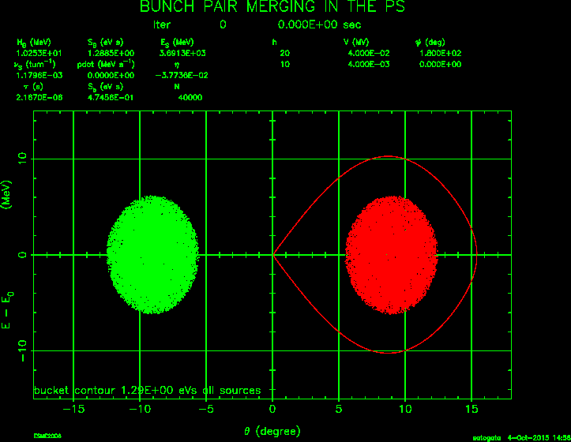
Approach 2: Adiabatic Bunch Splitting
PS bunch merge animation from ESME base distribution (plus some postprocessing for movie)
Randy and I have been working with longitudinal simulations in elegant (a code we’re both familiar with)
But it’s not very effective for longitudinal dynamics of this sort
Strong dependency on time coordinate, RF phasing, slow 6D tracking
Shifting towards putting parameter set into ESME
Fermilab longitudinal dynamics (only) code: faster, longitudinally oriented

Slide 7
Possible Choices of Nh
Nh |  | 3600 |  |  | 3584
Circumference (m) |  | 2266 |  |  | 2256
Nh0 |  | 16 | 30 | 40 | 16 | 28 | 32
Occupied long bunches |  | 14 | 28 | 36 | 14 | 26 | 30
Gap length (ns, ×2) |  | 472 | 252 | 378 | 470 | 269 | 235
Linac Energy (MeV/u) | Pb | 100 | 55 | 42 | 100 | 57 | 50
 | Proton | 215 | 125 | 100 | 215 | 130 | 115
Occupied short bunches |  | 3150 | 3360 | 3240 | 3136 | 3328 | 3360
Split scheme |  | ×3×3×5×5 | ×5×4×3×2 | ×5×3×3×2 | ×7×2⁵ | ×2⁷ | ×7×2⁴
Plenty of options to reduce bunch reprate
Binary split, might be the easiest
Factor of 7 split, might be beneficial for e-ring injection with reduced reprate
~110m longer than 2154m, just enough for the bypass lines
J. Guo, MEIC Weekly

Slide 8
Approach 2: Adiabatic Bunch Splitting
This many bunch splits/merges is unprecedented
A “simple” 2^{n} scheme is conservative and workable
But it still has challenges
Naïve ratio of RF voltages is 1:2 with each step, or over two orders of magnitude in total
Many RF voltages: multiplicity of expense, impedances
Bunch splitting must be performed with barrier bucket
Every split will not be perfectly adiabatic
Determine workable initial parameter set
Evaluate final bunch quality sensitivities to errors
Evaluate impact on project costing, impedance budget

Slide 9
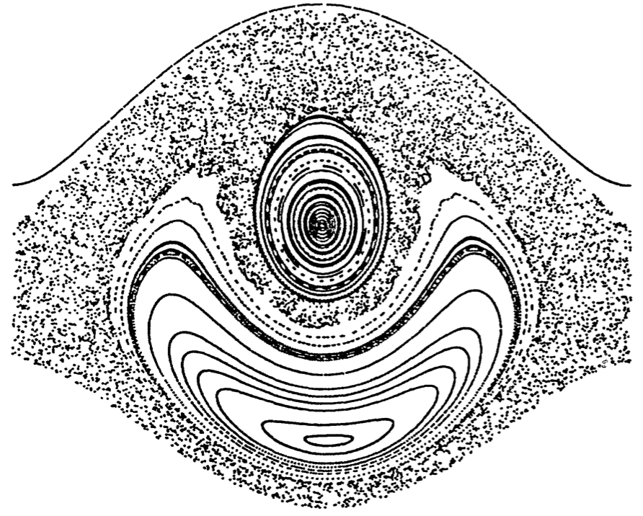
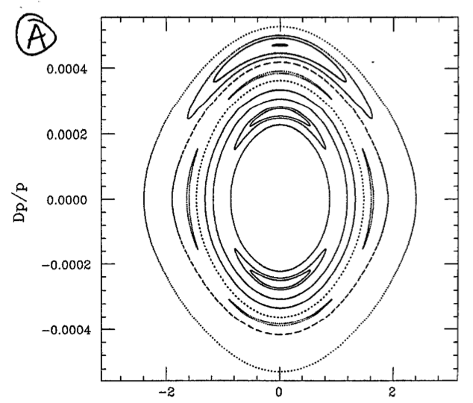
Approach 3: RF Modulation (Liberal)
RF Nonlinear Resonance Island
Create resonances in longitudinal phase space with RF phase/voltage modulation
Devised to “mine” particles from core to high momentum for parasitic extraction
A different type of bunch splitting
Could also envision “reverse slip stacking” or “reverse muon coalescing”
Does not need full spectrum of RF cavities ✓
Never investigated for bunch splitting ✗
Biggest challenges:
Even bunch distribution in split bunches
RF phase/frequency modulation control
Linear 90 degree bunch rotation
Adiabatic phase shift?
Likely requires big momentum aperture
5-1 split after 90° phase rotation
S. Peggs, Proton Mining, FNAL AP-91-001

Slide 10
Approaches 4: FEL Microbunching (Very Liberal)
“Single long bunches becoming many short bunches” happens in other places:
Electron beams in SASE FELs
Bunching potential exponentially created by FEL beam
Could one substitute many passes through an intense laser for reduction in laser intensity, increased beam rigidity vs FEL?
Or create a controlled impedance-driven coherent instability that drives bunching
Crazy? Probably…
Discussions with S. Webb (Radiabeam) and C. Prior (ASTeC)
Use RF modulation methods to distribute RF bucket evenly
Evaluate near transition first where there is no RF slip (but high sensitivity to driving impedances)

Slide 11
Plans and Path Forward
The MEIC ion bunch splitting problem is interesting!
Split h=9 to h=6832 beam with barrier buckets, no cooling
Even bunch distribution, multiple polarization orientations
Worthy breadth of topics to finish R. Gamage’s PhD thesis
The MEIC ion bunch splitting problem is challenging!
Classical debunch/rebunch is likely infeasible (instabilities)
Adiabatic bunch splitting is likely feasible but expensive (lots of RF)
Simulate with esme rather than elegant, define parameter space
Parameter sensitivity studies must be done
1:2 splits are much easier to control than other splits
Other research-oriented approaches are being investigated
Longitudinal nonlinear bunch splitting (proton mining)
Controlled FEL-like microbunching

