Slide 1
Interaction Region Backgrounds
M. Sullivan
for the
MEIC Collaboration Meeting
Oct. 5-7, 2015

Slide 2
Outline
Brief Introduction
Synchrotron Radiation backgrounds
Beam-Gas-Bremsstrahlung
Luminosity backgrounds
Wake-field and Higher-Order-Mode Power
Summary
Conclusion

Slide 3
Electron IR Parameters
Electron beam
  Energy range 3-10 GeV
  Current (5/10 GeV) 3/0.7 A
  Beam-stay-clear 12 beam sigmas
  Emittance (ε_{x}/ε_{y}) (5 GeV) (14/2.8) nm-rad
  Emittance (ε_{x}/ε_{y}) (10 GeV) (56/11) nm-rad
  Betas
    β_{x}* = 10 cm β_{x} max = 300 m
    β_{y}* = 2 cm β_{y} max = 325 m
Final focus magnets
  Name Z of face L (m) k G (10 GeV-T/m)
  QFF1 2.4 0.7 -1.3163 -43.906
  QFF2 3.2 0.7 1.3644 45.511
  QFFL 4.4 0.5 -0.4905 -16.362

Slide 4
Ion IR Parameters
Proton/ion beam
  Energy range 20-100 GeV
  Beam-stay-clear 12 beam sigmas
  Emittance (ε_{x}/ε_{y}) (60 GeV) (5.5/1.1) nm-rad
  Betas
    β_{x}* = 10 cm β_{x} max = 2195 m
    β_{y}* = 2 cm β_{y} max = 2580 m
Final focus magnets
  Name Z of face L (m) k G (60 GeV)
  QFF1 7.0 1.0 -0.3576 -71.570
  QFF2 9.0 1.0 0.3192 63.884
  QFFL 11.0 1.0 -0.2000 -40.02

Slide 5
IR Layout
Ultra forward
hadron detection
Small angle
hadron detection
Low-Q²
electron detection
Central detector with endcaps
dipole
ion quads
Large aperture
electron quads
IP
dipole
dipole
Small diameter
electron quads
~50 mrad crossing
Solenoid yoke + Muon Detector
Solenoid yoke + Hadronic Calorimeter
RICH
EM Calorimeter
Tracking
RICH
Muon Detector
EM Calorimeter
HTCC
Hadron Calorimeter
Courtesy
Pawel Nadel-Tournski and Alex Bogacz
5 m solenoid

Slide 6
SR backgrounds
We need to check background rates for various electron machine designs
The 5 GeV e- design has the highest beam current
The 10 GeV design has the highest photon energies and largest beam emittance

Slide 7
SR for 5 GeV (3 A)
Photons/crossing >10 keV

Slide 8
SR for 10 GeV (0.7 A)
Photons/crossing >10 keV
Numbers are Watts
Beam pipe design fits 10σ beam envelope. Prefer larger.

Slide 9
10 GeV (0.7 A) with tighter mask
Photons >10 keV/crossing
Numbers are Watts

Slide 10
SR results
Difficult to get an IR beam pipe much smaller than a 3cm radius in X. Y is better.
  Need to see how many photons penetrate the beam pipe and make a hit in the first inner detector
Need to know how long the central pipe needs to be
  Shorter pipes are easier to shield
For the 10 GeV case the masking is tight
  This is probably a problem for BGB backgrounds (next topic)

Slide 11
BGB, Coulomb, etc.
There are several processes that enter here:
  Electron – gas molecule inelastic collision (BGB)
  Electron – gas molecule elastic collision (Coulomb)
  Ion – gas molecule nuclear collision (Inelastic)
  Ion – gas molecule elastic collision (Coulomb)
The elastic collisions tend to produce a halo (or tail) distribution around the beam
  Need to track these collisions around a much larger part of the ring (perhaps the entire ring)

Slide 12
Electron – gas molecule
BGB – Electron-gas inelastic collision
Result is a high energy gamma and a very off-energy electron beam particle
Coulomb – Electron-gas elastic collision
Result is an on-energy electron beam particle but with a large scattering angle

Slide 13
Ion – gas molecule
Ion-gas nuclear collision
Result is a mess with probably all particles lost locally
Ion-gas elastic collision
Result is an on-energy ion beam particle but with a large scattering angle

Slide 14
More on BGB, etc.
I think the nuclear collisions between ion and gas molecule will vanish from the machine close to the location of the collision point
The elastic ion – molecule collision will probably also produce a halo around the ion beam but this we should be able to collimate away

Slide 15
Program Decay Turtle
This program can be used to track the off-energy beam particles and the produced gammas from BGB as well as the Coulomb scattered beam particles
  I have an old FORTRAN version
Uses an input deck with as much of the beam line as you want to install
Collimators are essential but collimating much closer than about 7σ will probably start to lower the electron beam lifetime
  If a collimator starts to affect the beam lifetime then that collimator becomes a big source of local backgrounds

Slide 16
Luminosity backgrounds
Luminosity backgrounds include:
  eP bremsstrahlung (also lumi signal and low Q² data)
  Off-energy electron beam particles from above (also low Q² data)
    > MHz data rate
  eP → eeeP (two photon electron pair production)
    The very low energy e+e- pair curl up in the detector field and make multiple hits in the vertex tracker
These will need to be checked to make sure they are under control or are not an issue

Slide 17
Wake-fields and HOMs
HOM power and wake fields mostly come from the electron beam and travel up (and down) the electron beam pipe and the proton beam pipe
  It comes from the shared IP beam pipe
The proton beam does not generate nearly as much HOM power as the electron beam mainly because of the low gamma
  Still needs to be checked for beam pipes that have cavities. Low power can still melt vacuum elements.

Slide 18
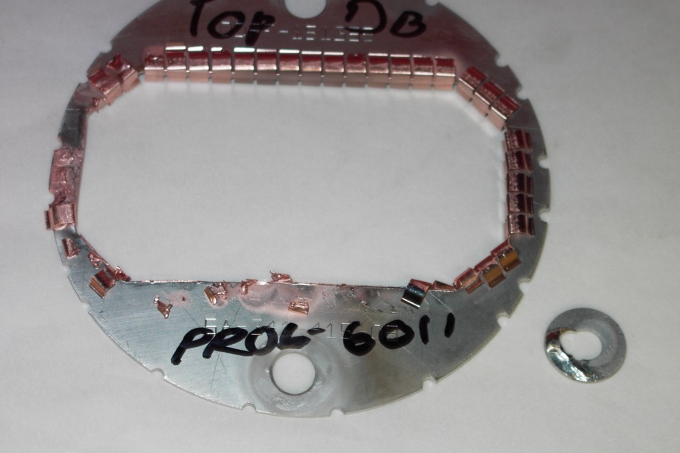
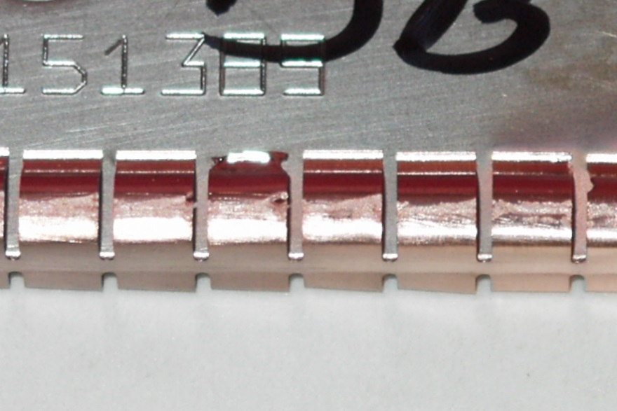
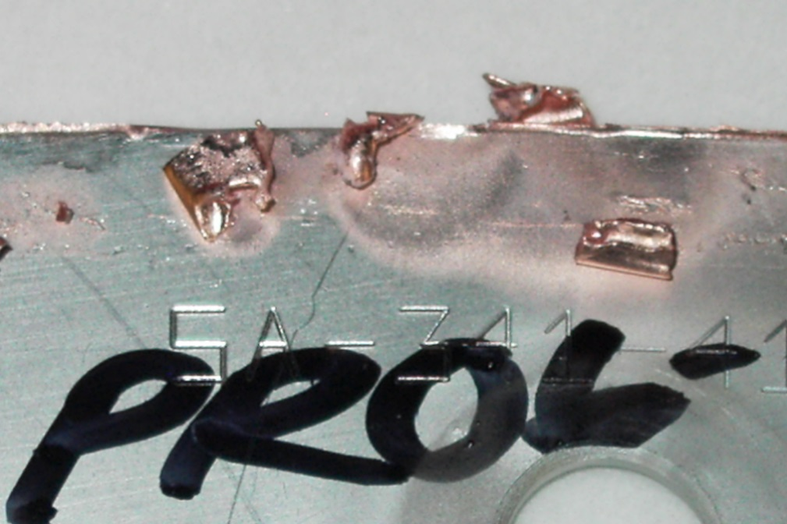
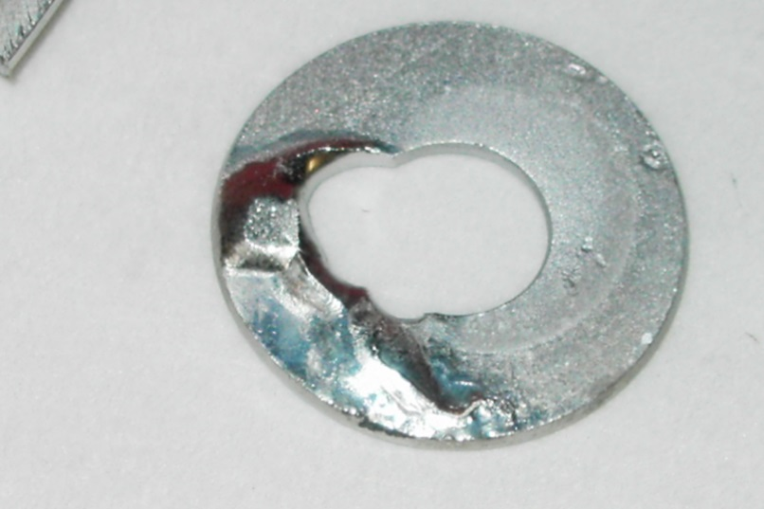
We estimate that a few Watts did this
The seal frame was SS and was bolted to water cooled Cu
HER beam 1.5-1.8 A
This RF seal was suppose to seal off HOM power from getting between two vacuum flanges that had some amount of internal flex
3/8” SS washer melted
Vaporized and melted Cu RF seal
Cu melts at 1357
Vaporizes at 2840
Fe melts at 1808

Slide 19
Wake field simulation
With permission from Sasha Novokhatski, I have the following slide show of what the fields of a beam bunch do as the bunch travels through the PEP-II IR shared beam pipe

Slide 20
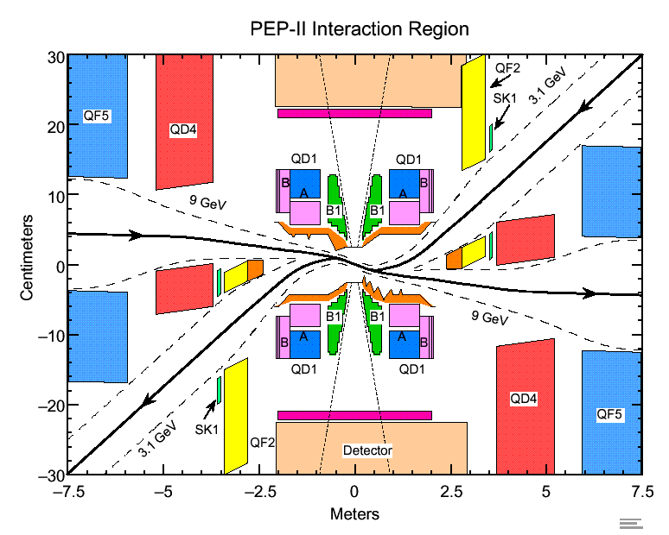
PEP-II IR

Slide 21
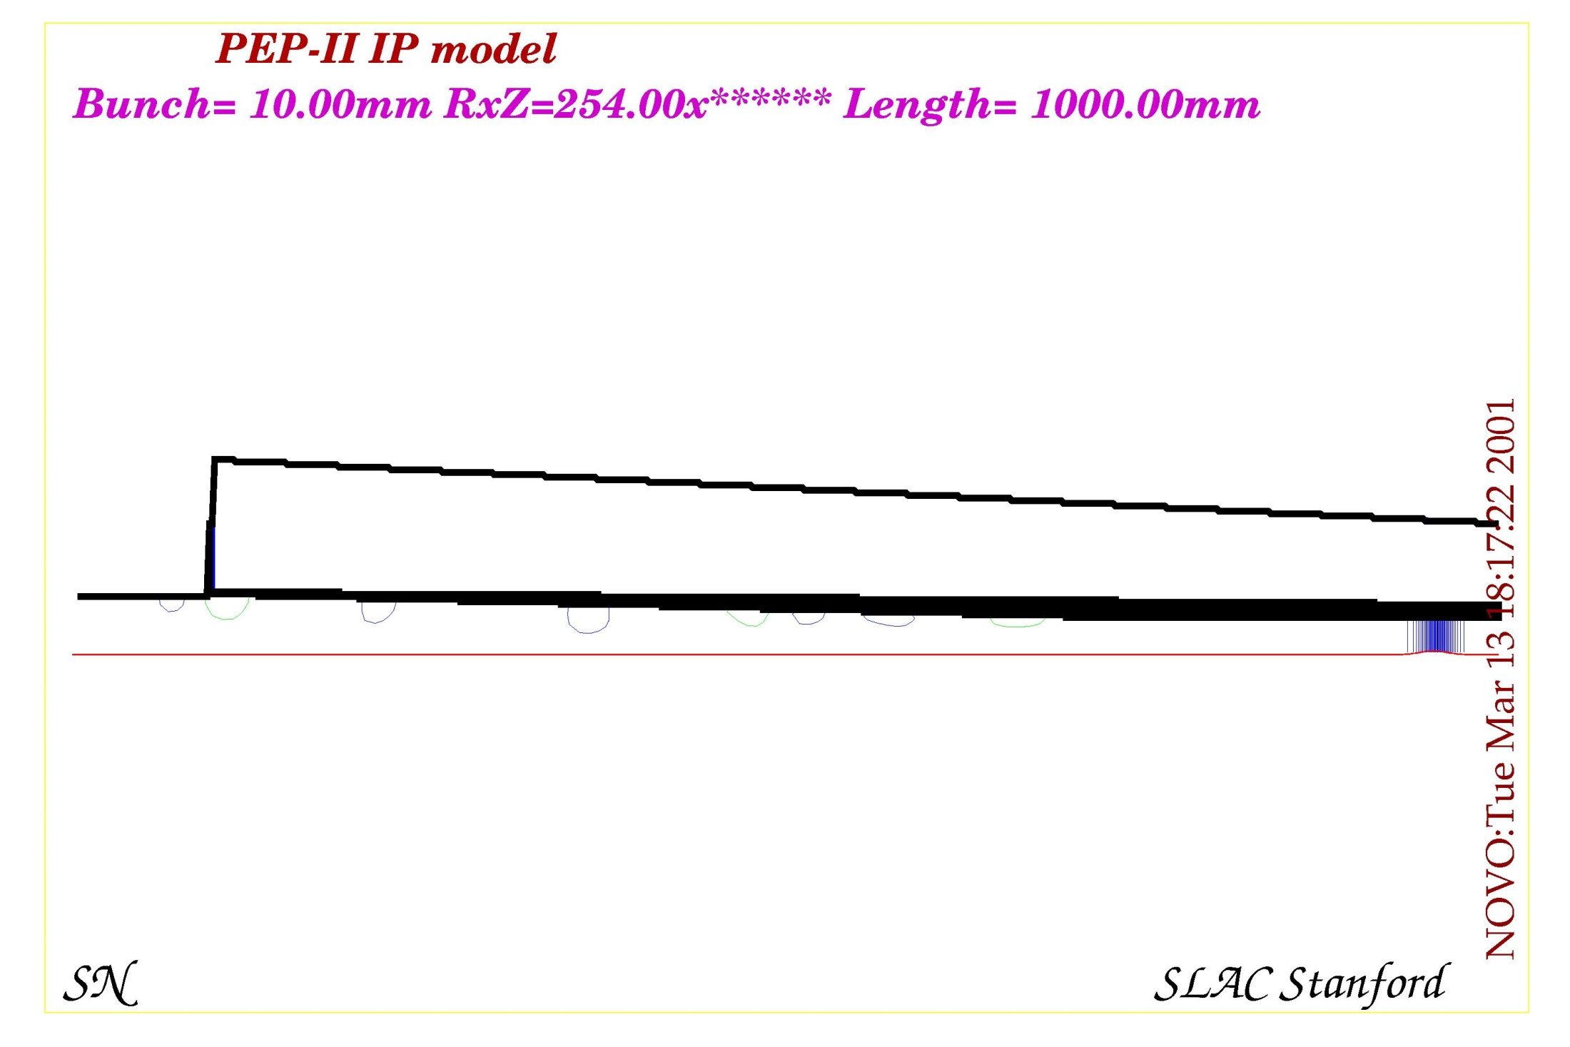
2001 Calculations

Slide 22
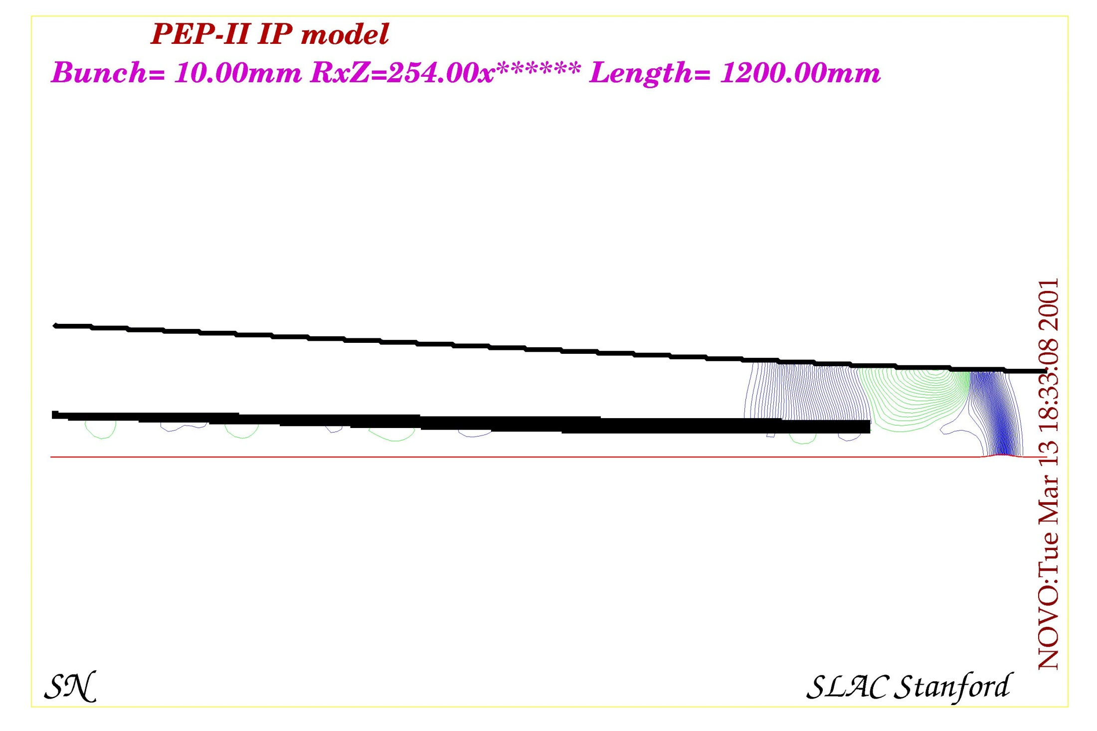

Slide 23
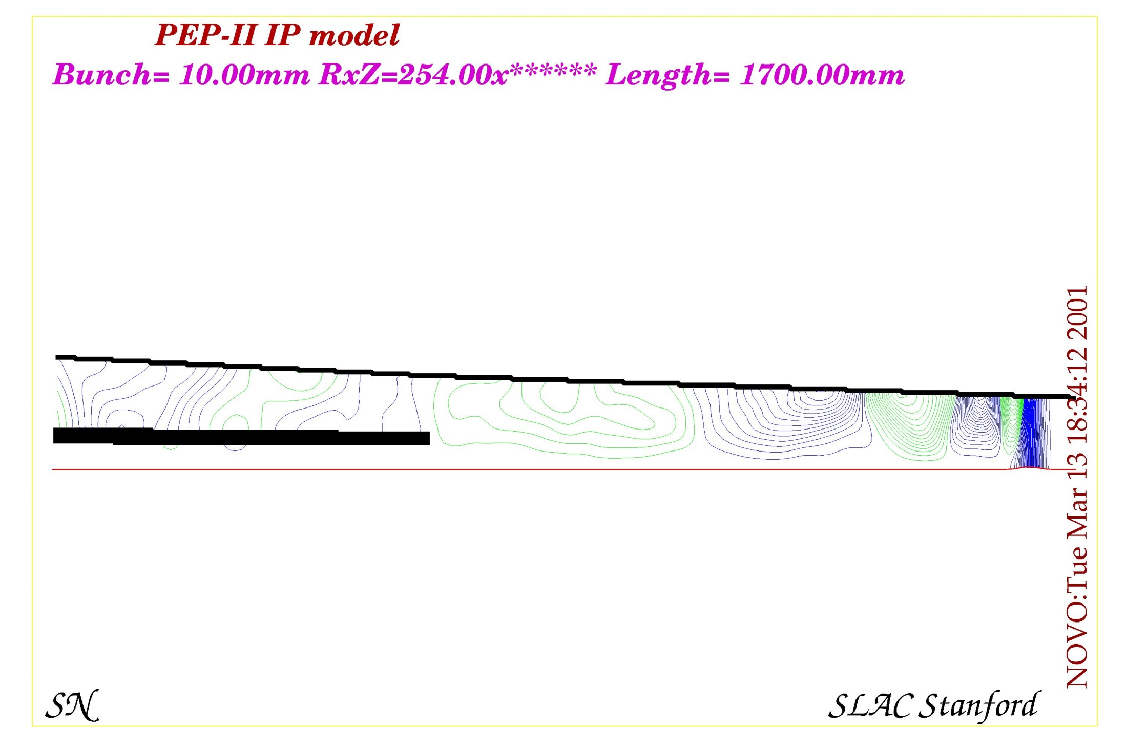

Slide 24
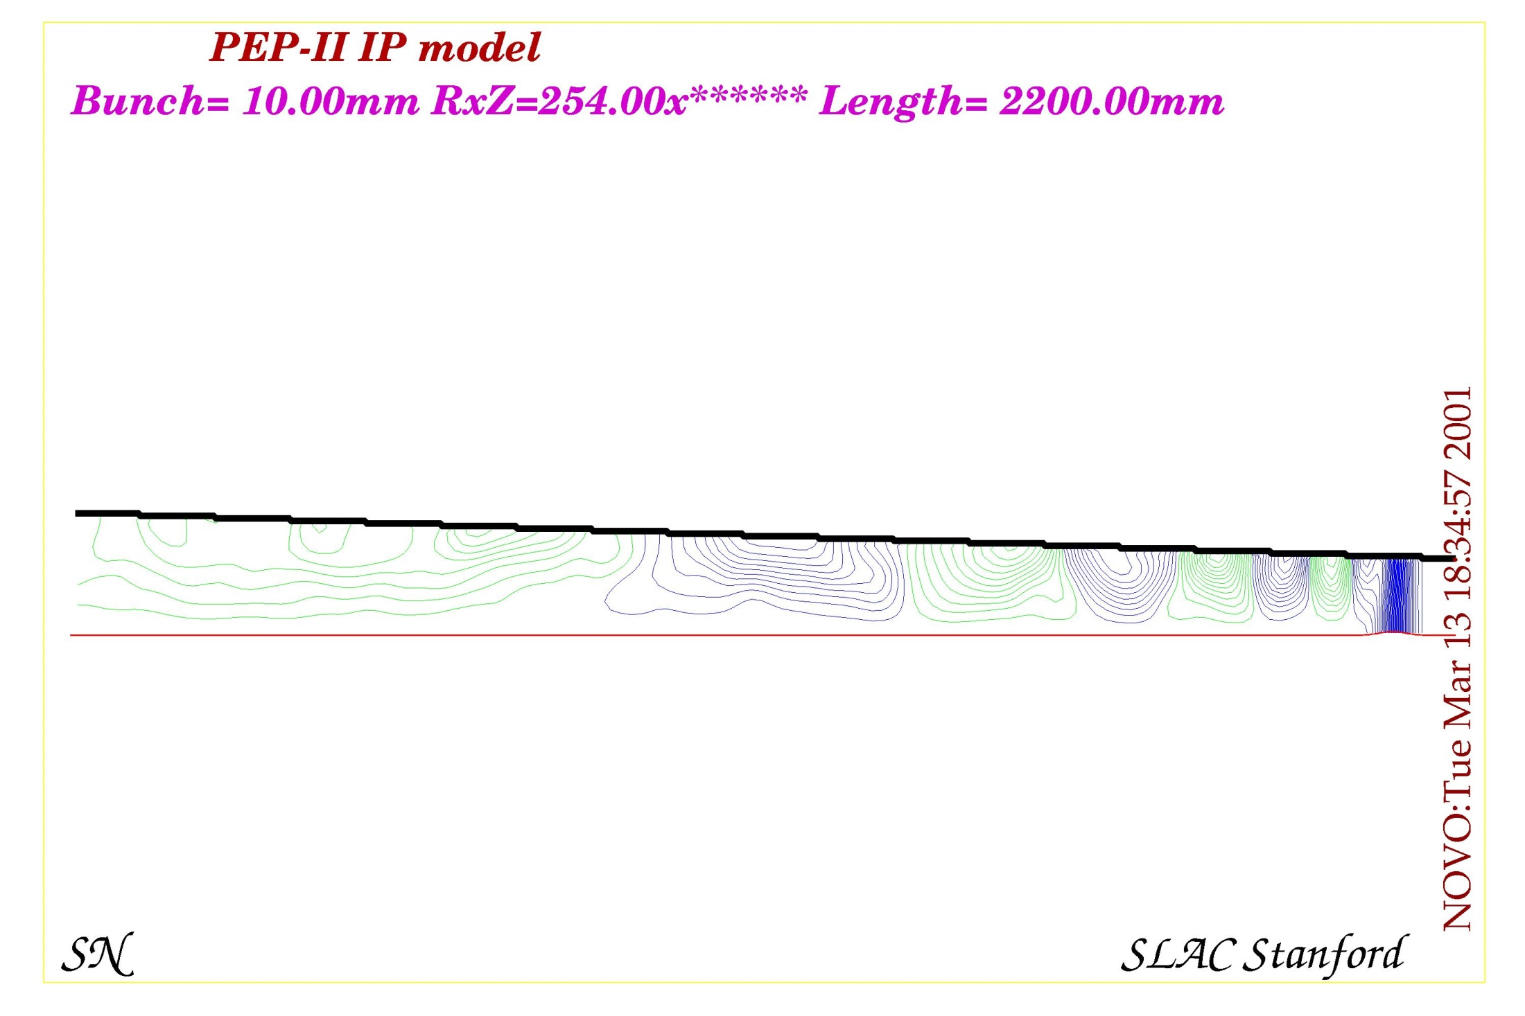

Slide 25
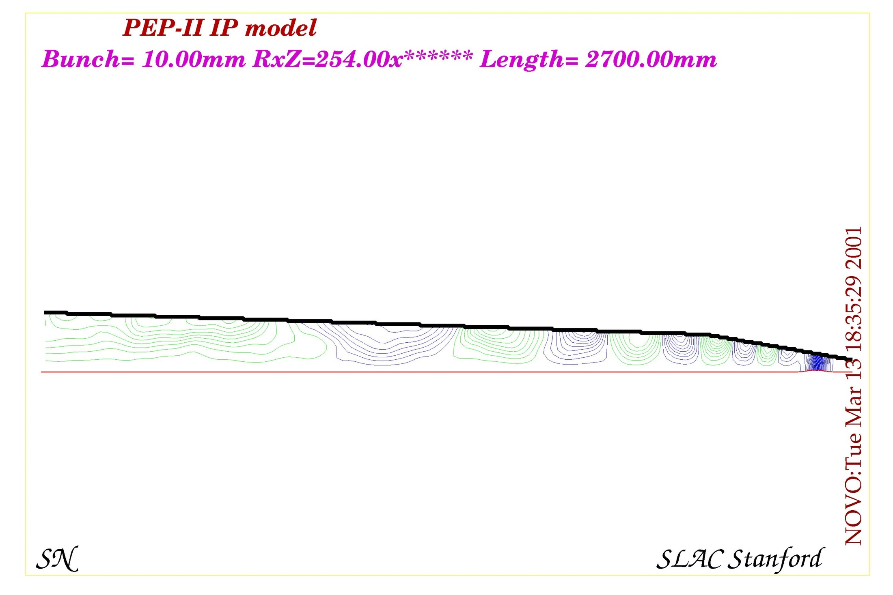

Slide 26
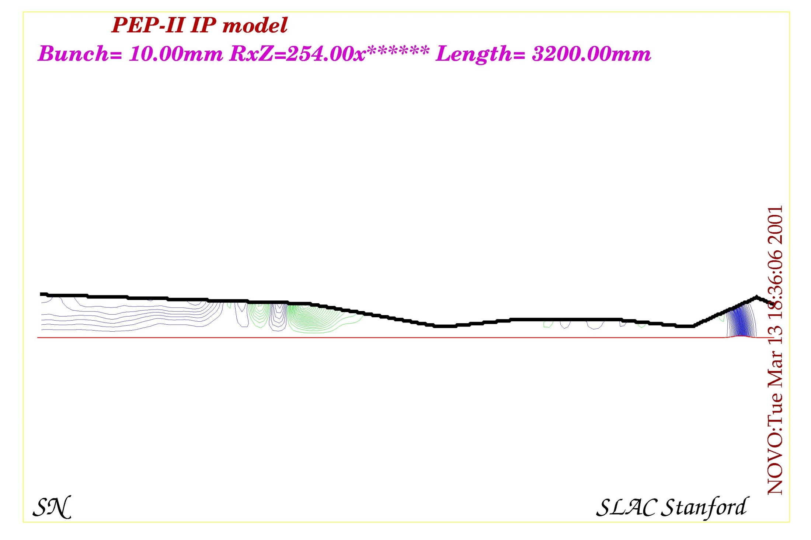

Slide 27
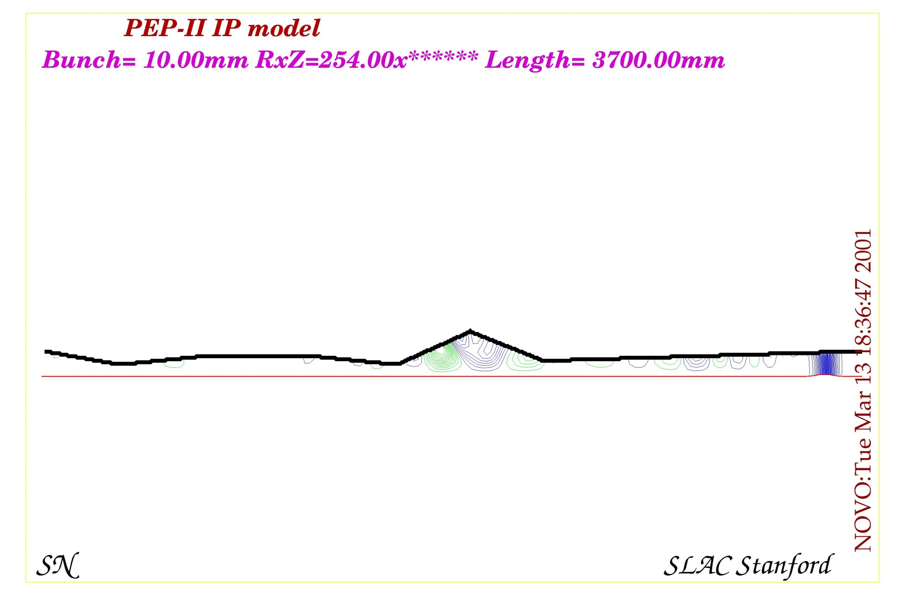

Slide 28
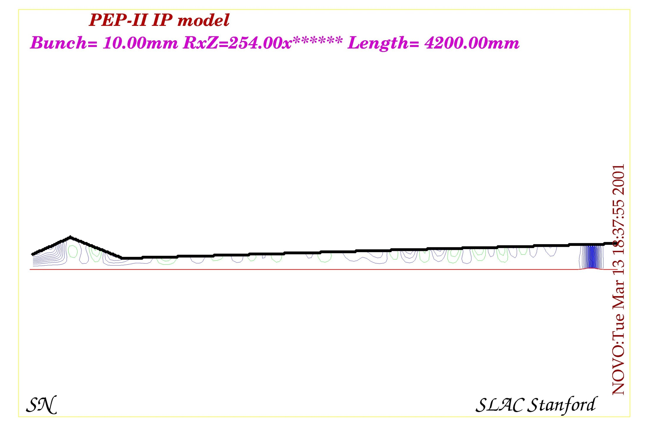

Slide 29
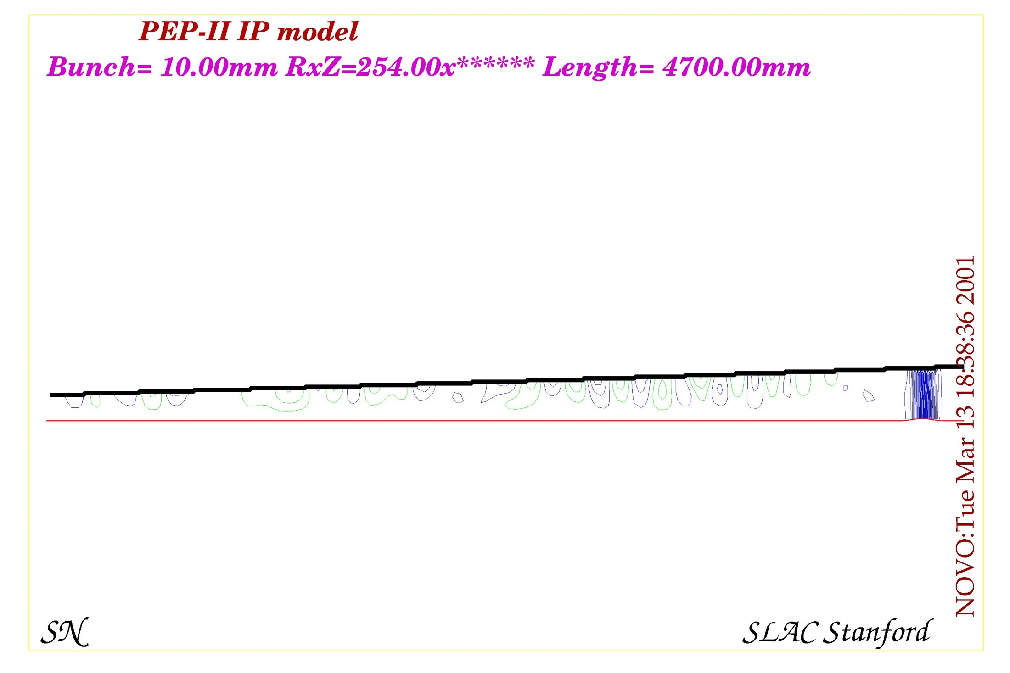

Slide 30
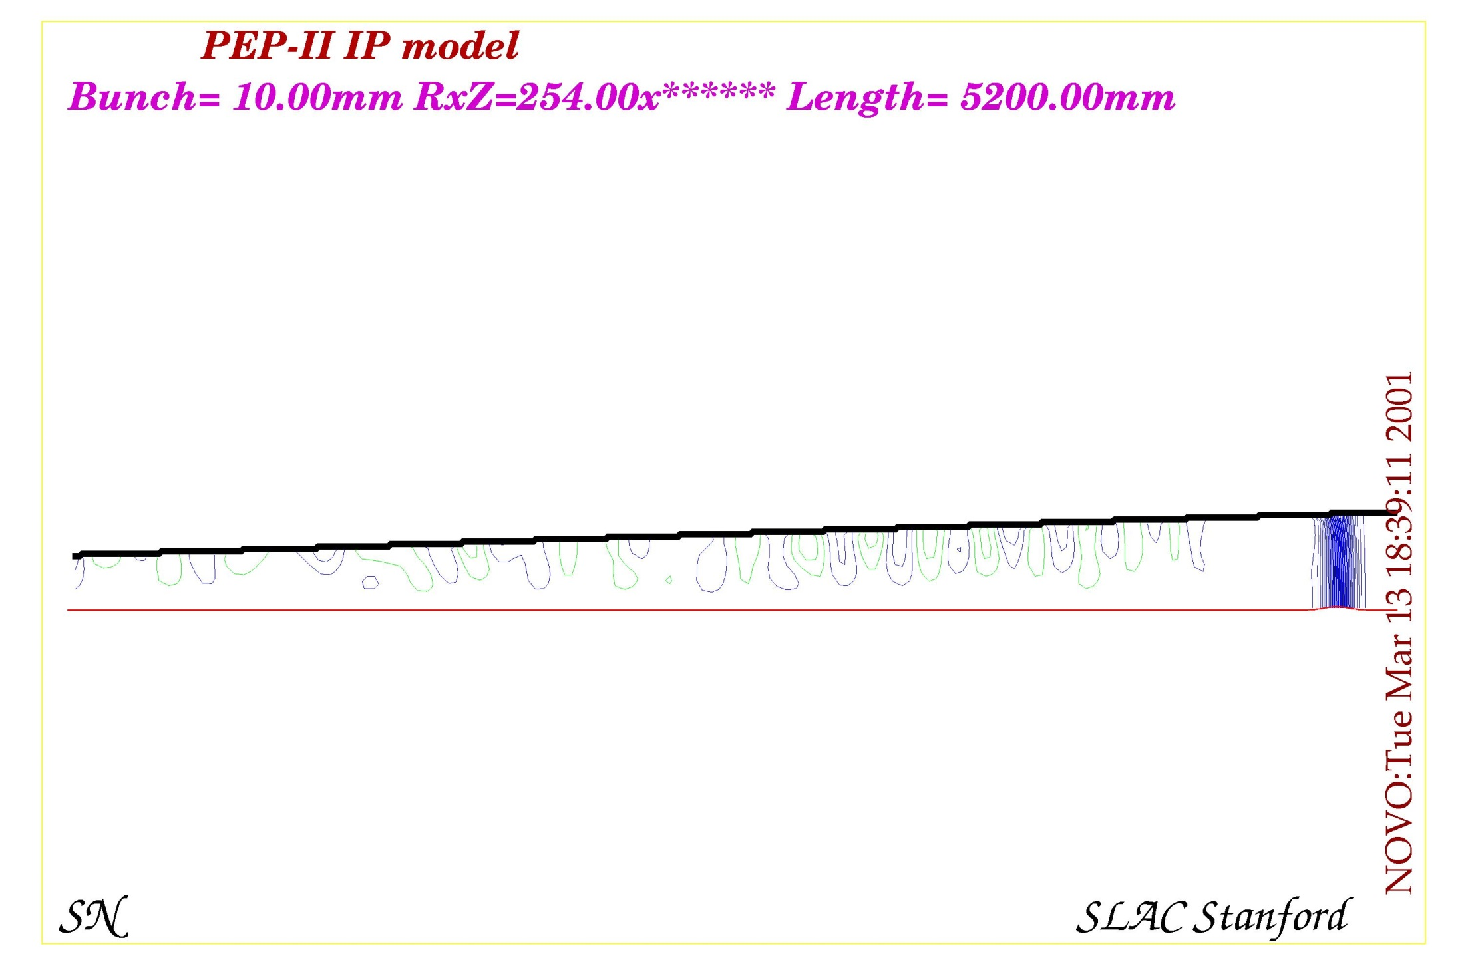

Slide 31
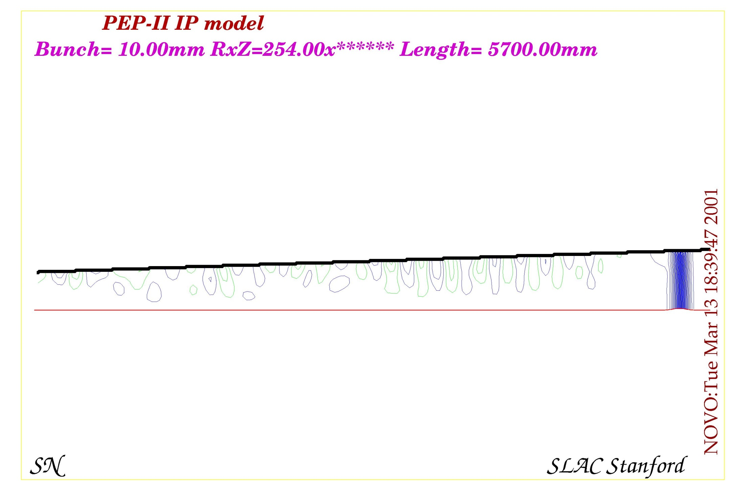

Slide 32
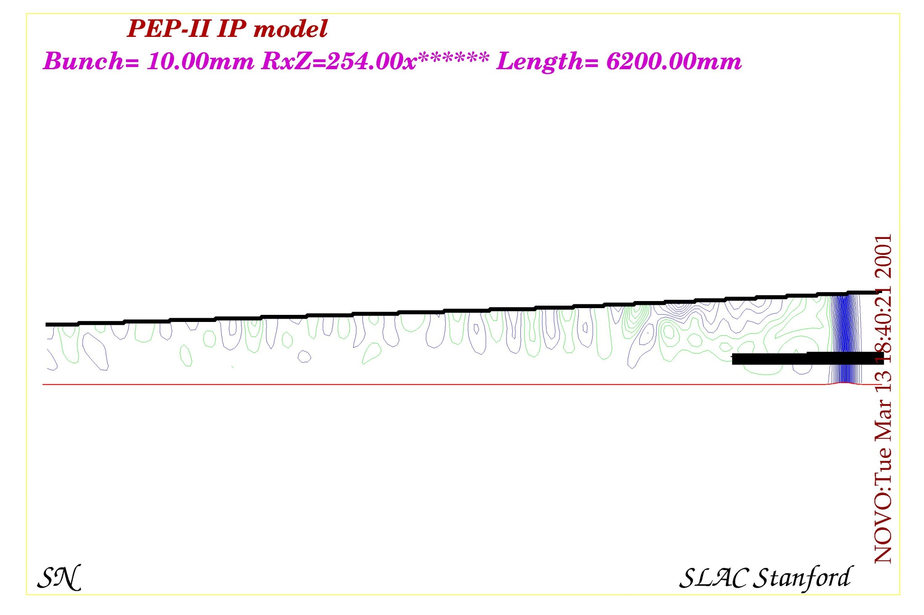

Slide 33
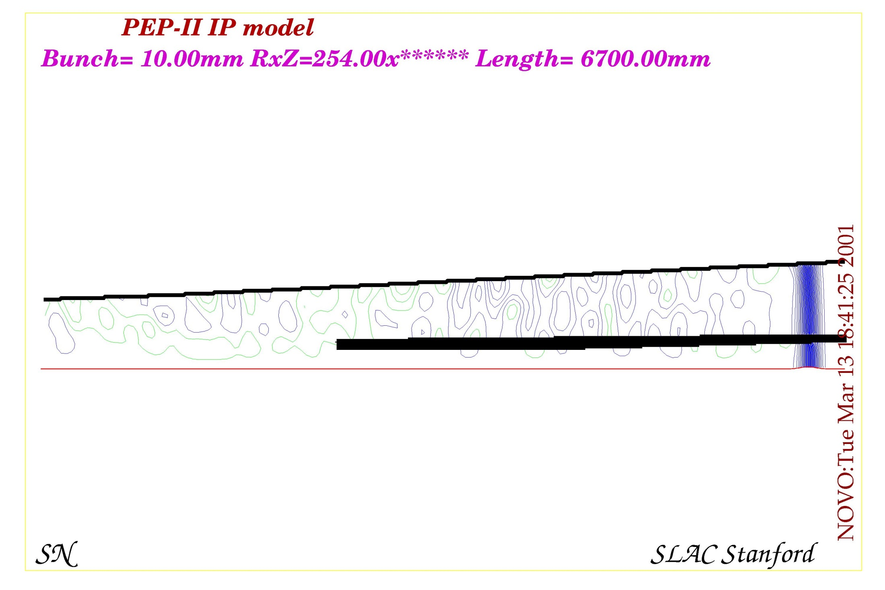

Slide 34
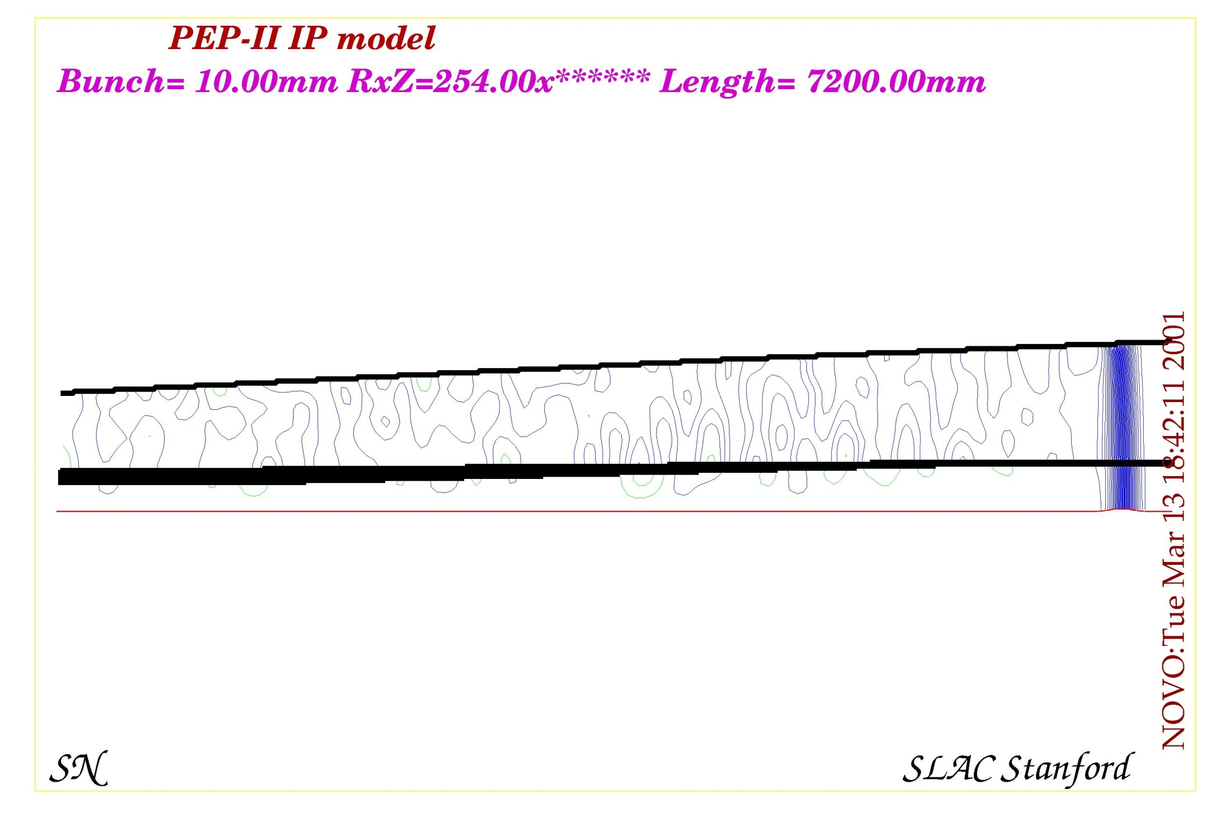

Slide 35
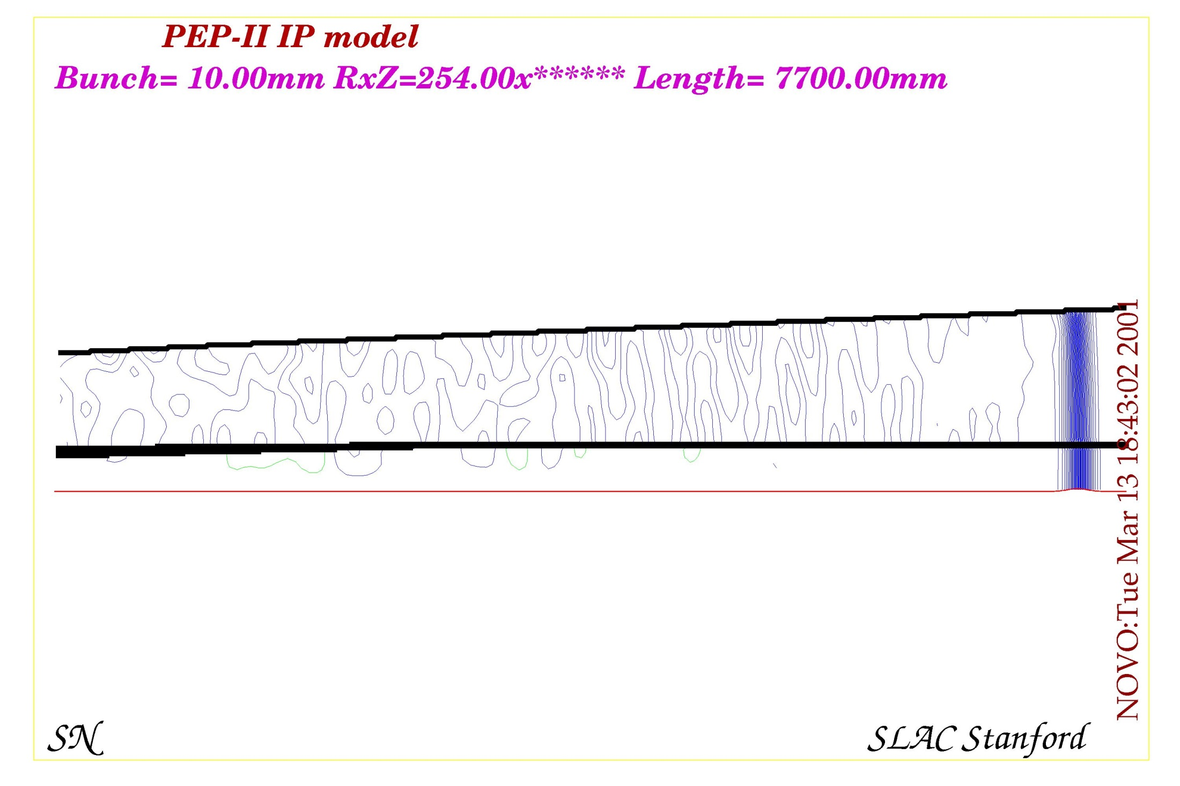

Slide 36
Summary
There are several background sources that need to be studied
We need to make sure all of the sources are under control
Backgrounds can change as the IR design evolves
We need to continue to check the background sources

Slide 37
Conclusions
SR looks under control but needs further study
BGB backgrounds need to be checked
Luminosity backgrounds should be calculated
HOM effects will need to be estimated
Lots to do…

