Slide 1
High-Performance Modeling of Electron Cloud Effect and RF Diagnostics
S.A. Veitzer
MEIC Collaboration Meeting
JLAB, October 6, 2015
This work was performed under the auspices of the Department of Energy as part of the ComPASS SCiDAC-2 project (DE-FC02-07ER41499), and the SCiDAC-3 project (DE-SC0008920). Additional support from the Department of Energy, HEP division through the SBIR program.

Slide 2
Electron Cloud Effect (ECE) Can Limit Accelerator Performance
What is the ECE?
Primary electrons are accelerated by the beam potential to beam pipe walls as successive bunches cross
Secondary electrons are produced with low energy at the walls, and are then accelerated by the next bunch
If the secondary electron yield > 1 then the electron cloud density increases
The cloud dissipates during gaps in the bunch train

Slide 3
Electron Cloud Effect (ECE) Can Limit Accelerator Performance
What is the ECE?
Exists in both lepton and hadron circular accelerators
Electron plasma buildup can interfere with beams
Increase emittance
Create beam instabilities
Primary electron production
Beam scrape-off
Synchrotron radiation
Residual neutral gas ionization
Secondary electron production
Acceleration of electrons by beam potential to opposite beam pipe walls
Resonant behavior (similar to multipacting)
Depends on the bunch spacing, current, magnetic fields, and physical dimensions of the beam pipe
Three regimes: Buildup, Saturation, Dissipation
magnetic fields are important
Electrons can become trapped, e.g. quadrupole magnets
Solenoidal B can confine electrons near beam pipe edges
Dipole B affects electron trajectories
There are a variety of mitigation techniques
Surface coatings (lower SEY)
Solenoidal fields (confine electrons near beam pipe walls)
Surface grooving
Modified bunch spacing

Slide 4
Computational PIC Requirements
Electrons are non-relativistic
So electrostatic models are accurate
Typically very little along-beam motion, so 2D models are useful, usually
There exists a natural separation of scales, that makes modeling difficult
Electron motions and cloud modulation by bunch crossings is on the order of bucket time
Collective effects and bunch instabilities are on the order of revolution time scales.
There are a number of PIC simulation codes that have been used to model ECE
WARP+POSINST
ECLOUD
VORPAL
+
In general, requires
Parallel computation; electrostatic solvers with domain decomposition
Self-consistent particle evolution (space charge)
Cut-cell algorithms for solution accuracy
Ability to model externally applied magnetic fields
Secondary electron surface and materials models
Short time steps, long simulation times
MEIC parameters are in a regime that has not yet been modeled
Long trains of high frequency buckets

Slide 5
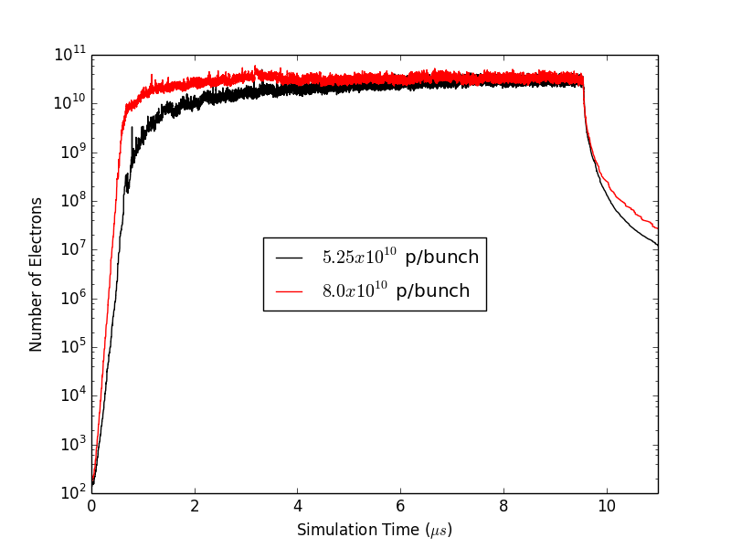
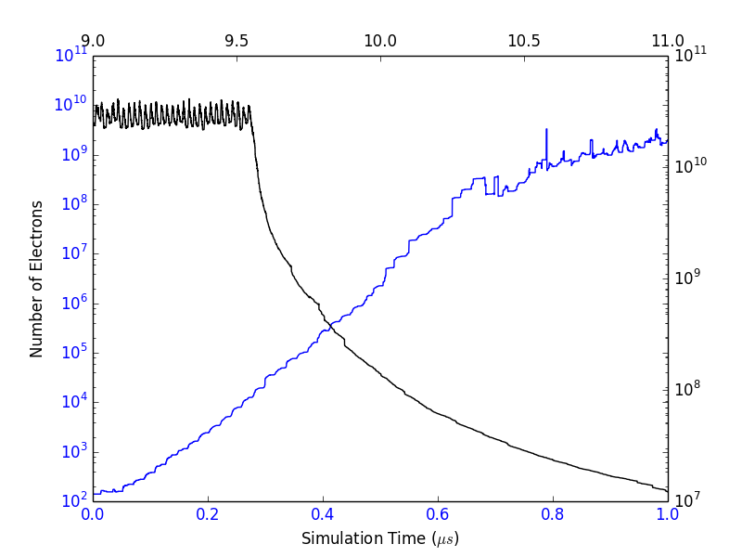
Buildup and Dissipation Simulations
Cloud buildup is fast
Saturation at some large fraction of linear beam charge
Dissipation during gap in bunch train
We can model electron cloud survival rate
Model effect of low-charge trailing bunch on cloud survival rate
Veitzer & Stoltz, Electron Cloud Buildup and Dissipation Models for PIP-II, IPAC’15, MOPMA037

Slide 6
RF Diagnostic Modeling
Injected RF energy is affected by ecloud modulation
The ecloud plasma changes the dispersion relation, modulation of ecloud density can be measured experimentally
Phase shift if f_{rf} > f_{cutoff}
Frequency shift if f_{rf} < f_{cutoff}
Phase shift is proportional to cloud density
In spectral measurements, the side band
amplitudes are also (ideally) linearly related
to cloud density
N. Eddy, Project X Collaboration Meeting, 2009
Veitzer, Smithe, Application of New Simulation Algorithms for Modeling RF Diagnostics of Electron Clouds, AAC’12

Slide 7
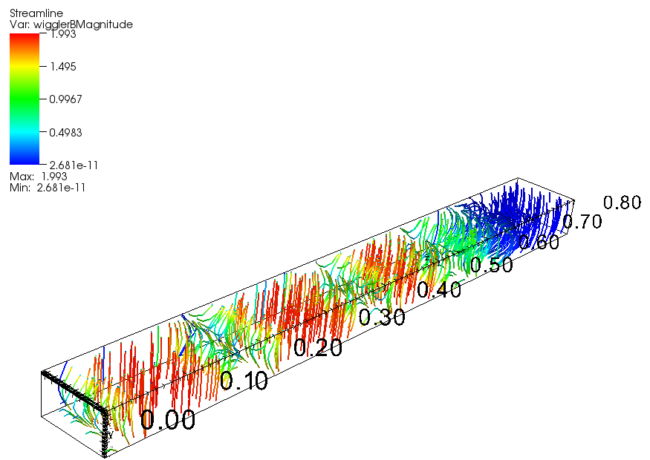
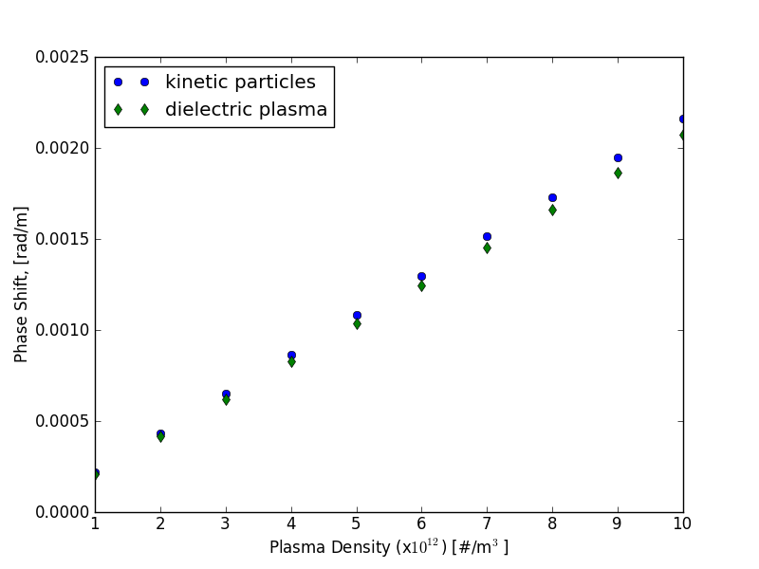
RF Diagnostic Modeling
Magnetic fields play a large role in cloud evolution
Plasma dielectric models can predict phase shifts for different B configurations
Veitzer, Vorpal Simulations Of Traveling Wave RF In Wiggler Magnetic Fields, ECLOUD’12

Slide 8
Traveling RF Diagnostic Modeling
Perform buildup simulations for one revolution, including dissipation (2 μs)
Derived dielectric tensor from time-dependent cloud density (magnetized)
Perform dielectric simulations of RF propagation for many revolutions
Field updates only, stable for long simulation times
No particle noise (grid heating)
Measure side-bands due to modulation of electron plasma
Veitzer, Stoltz, Lebrun, Integrated Kinetic And Plasma Dielectric Models of Electron Cloud Buildup And TE Wave Transmission, NAPAC’14, MOPBA24

Slide 9
Traveling RF Diagnostic Modeling
Perform buildup simulations for one revolution, including dissipation (2 μs)
Derived dielectric tensor from time-dependent cloud density (magnetized)
Perform dielectric simulations of RF propagation for many revolutions
Field updates only, stable for long simulation times
No particle noise (grid heating)
Measure side-bands due to modulation of electron plasma
B=0
f = 1.5 f_{c}
B=0.5 T dipole
f = 1.05 f_{c}
Upper hybrid resonance
Veitzer, Stoltz, Lebrun, Integrated Kinetic And Plasma Dielectric Models of Electron Cloud Buildup And TE Wave Transmission, NAPAC’14, MOPBA24

Slide 10
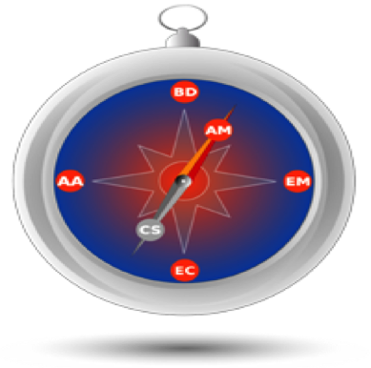
Modeling rf Resonant Cavity Method For Measuring Electron Cloud Effect Using Plasma Dielectrics
Seth A. Veitzer, David N. Smithe, Peter H. Stoltz, Tech-X Corp., Boulder, CO USA
The resonant cavity technique will reduce uncertainties in EC measurements due to rf attenuation and reflections
Perform detailed electrostatic PIC simulations to model plasma build-up and dissipation over one revolution period
Derive dielectric tensor strength from electron positions
Model rf injection below cutoff through time varying plasma dielectric over many thousands of revolution periods to measure sidebands
Evanescent wave traps rf energy, providing localized sampling of electron cloud, creating a virtual resonant cavity
The resonant frequency of this cavity depends on the EC, via the dielectric strength, which is modulated by the beam
Simulated spectrum showing side bands from frequency modulation, that are generated by harmonic modulation of electron cloud density (dielectric tensor)
First attempt to numerically model the resonant cavity technique, and compute side bands due to EC modulation
Non-zero side band amplitude at same location as rf injection due to frequency modulation, as opposed to travelling-wave side bands, that are due to phase shifts
Numerically stable simulations with more than 40 million time steps using dielectric models, needed to resolve 500 kHz side bands, that are otherwise not possible with kinetic PIC codes due to grid heating
Linear increase in side band amplitudes as a function of distance from the rf source
This work was performed under the auspices of the Department of Energy as part of the ComPASS SCiDAC-2 project (DE-FC02-07ER41499), and the SCiDAC-3 project (DE-SC0008920)

Slide 11
Conclusions
MEIC beam parameters are unique and the effect on electron cloud buildup is not known
Modeling of ECE for MEIC can be useful for aiding design to mitigate performance degradation
Materials
Bunch structure
Magnetic field configurations
Focus is on both particle/surface interactions and modeling of cloud/beam collective effects
Secondary electron processes
Multipacting
Beam instabilities
ECloud-induced emittance growth and tune shifts
Addition of RF diagnostics to design may aid in assessing efficacy of ECE mitigation

