Slide 1

Dynamic Aperture Study for the Ion Ring Lattice Options
Min-Huey Wang, Yuri Nosochkov
MEIC Collaboration Meeting Fall 2015
Jefferson Lab, Newport News, VA
Oct. 5, 2015

Slide 2
Outlines
Optimization of on and off momentum dynamic aperture of bare lattice
  Correct linear chromaticity, correct Wx/Wy to zero at IP.
  Using tune trombone to maximize the range of chromatic tunes.
  Using tune trombone to scan the dynamic aperture versus tune.
Effects of alignment and field errors
  Correction procedures
  Dynamic aperture after correction
Effects of Magnet Multipole Field Errors
  Dynamic aperture reduction due to multiple field errors

Slide 3
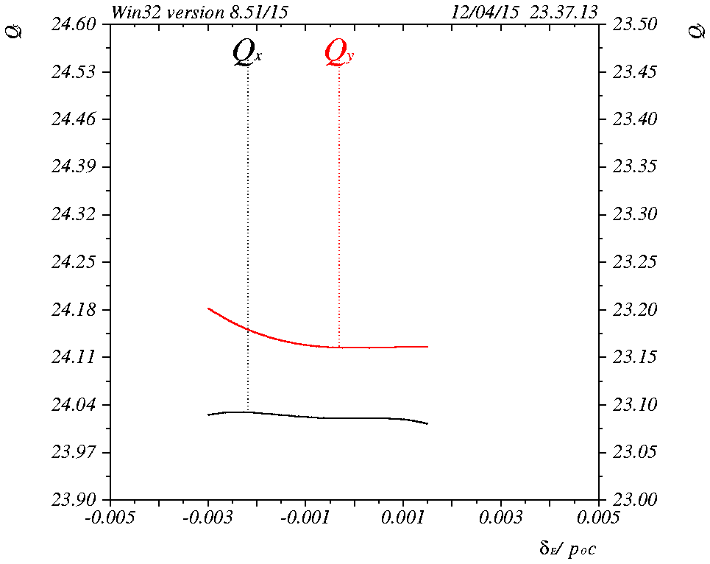
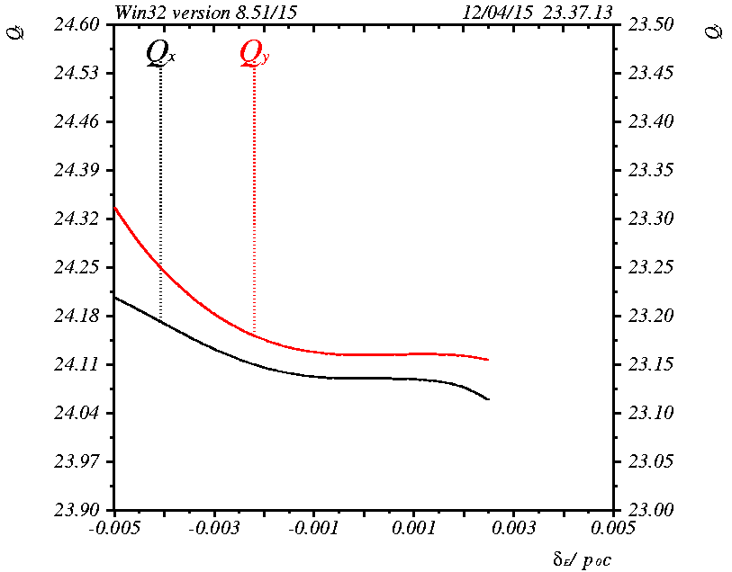
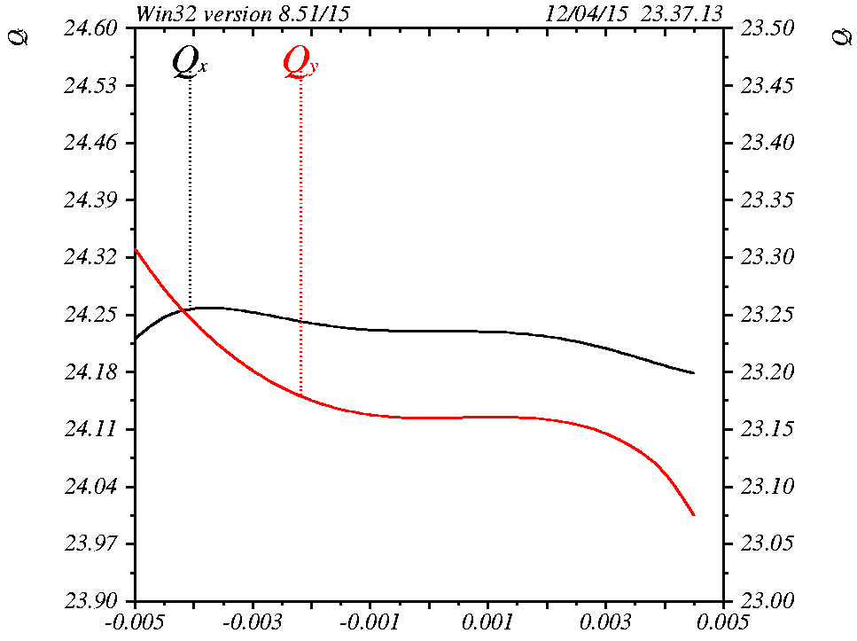
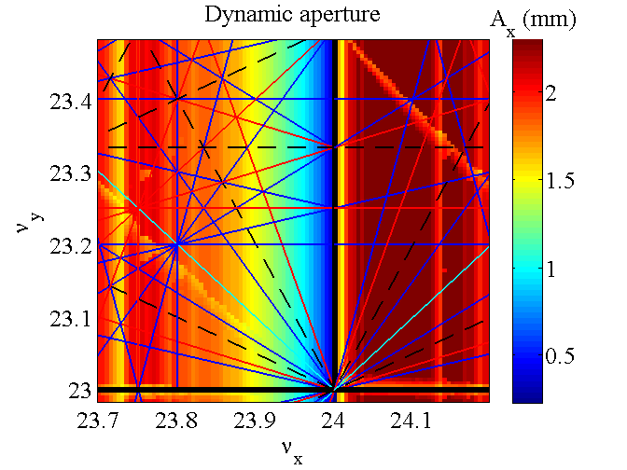
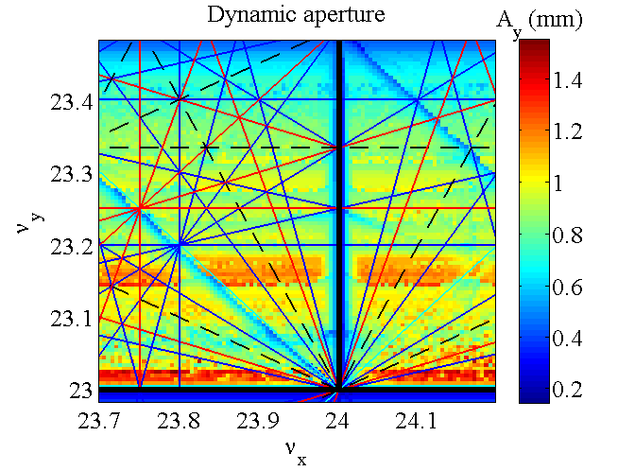
Global tune scan using tune trombone
ν_{X}: 24.01
ν_{y} :23.15
ν_{X}: 24.10
ν_{y} :23.15
ν_{X}:24.24
ν_{y} :23.15
Choosing
Fractional
ν_{x} :0.22
ν_{y} :0.16
ξ_{X}: +1
ξ_{y} :+1

Slide 4
Chromatic tunes
Non-interleaved –I pairs
Interleaved –I pairs
Interleaved –I pairs with beta beat
CCB

Slide 5
Chromatic β*
Non-interleaved –I pairs
Interleaved –I pairs
Interleaved –I pairs with beta beat
CCB

Slide 6
Bare lattice dynamic aperture
Non-interleaved –I pairs
Interleaved –I pairs
Interleaved –I pairs with beta beat
CCB

Slide 7
Comparison for bare lattice
Scheme | Non-interleaved –I pairs | Interleaved –I w/o beta beat | Interleaved –I with beta beat | CCB*
Tune, ν (x,y) | 24.22/23.16 | 24.22/24.16 | 24.22/24.16 | 25.22/23.16
Natural chromaticity (x,y) | -111.5, -131. | -101.5, -112.2 | -105.4, -130.6 | -120/-119
ξ₁ = dν/dδ_{p} (x,y) | +1, +1 | +1, +1 | +1, +1 | +1, +1
ξ₂ = dν/dδ_{p}² (x,y) | 7.82E2/1.88E3 | 4.6E3/-4.2E3 | 1.5E3/1.39E3 | 7.29E1/2.00E2
ξ₃ = dν/dδ_{p}³ (x,y) | -1.50E6/-1.06E6 | -2.4E6/-2.96E6 | -1.11E6/-1.39E6 | -1.2E6/-1.52E6
dν_{x}/dJ_{x} | 1.93E3 | 6.08E+03 | 4.36E+02 | 1.15E+01
dν_{y}/dJ_{y} | 1.78E3 | 1.12E+03 | 1.74E+03 | 1.01E+02
dν_{y}/dJ_{x} | -6.7E1 | -3.04E+03 | -5.68E+03 | -1.26E+04
Nonlinear chrom sextupoles | 8 | 36 | 24 | 6
Linear chrom sextupoles | 48 | 32 | 48 | 48
Max K₂L (nonlinear sext), m⁻² | 0.414 | 1.39 | 0.65 | 0.37
Max K₂L (linear sext), m⁻² | 0.598 | 1.492 | 0.389 | 0.485
DA at δ_{p} = 0 (x/y), mm | 1.55/1.00 | 0.8/0.55 | 1.15/0.40 | 0.92/0.27
DA at δ_{p} = ±0.1% (x/y), mm | 1.22/0.86 | 0.61/0.42 | 0.88/0.33 | 0.97/0.27
DA at δ_{p} = ±0.2% (x/y), mm | 0.89/0.69 (-) | 0.38/0.2 (-) | 0.66/0.38 (-) | 0.52/0.21 (+)
DA at δ_{p} = ±0.3% (x/y), mm | 0.22/0.635 (-) | -------- (+) | 0.64/0.32 (-) | 0.32/0.14 (+)
*Lattice named MEIC_P_RING_V15C.1_CCB_V3_TRACK_16JUN15 from Vasiliy, not updated.

Slide 8
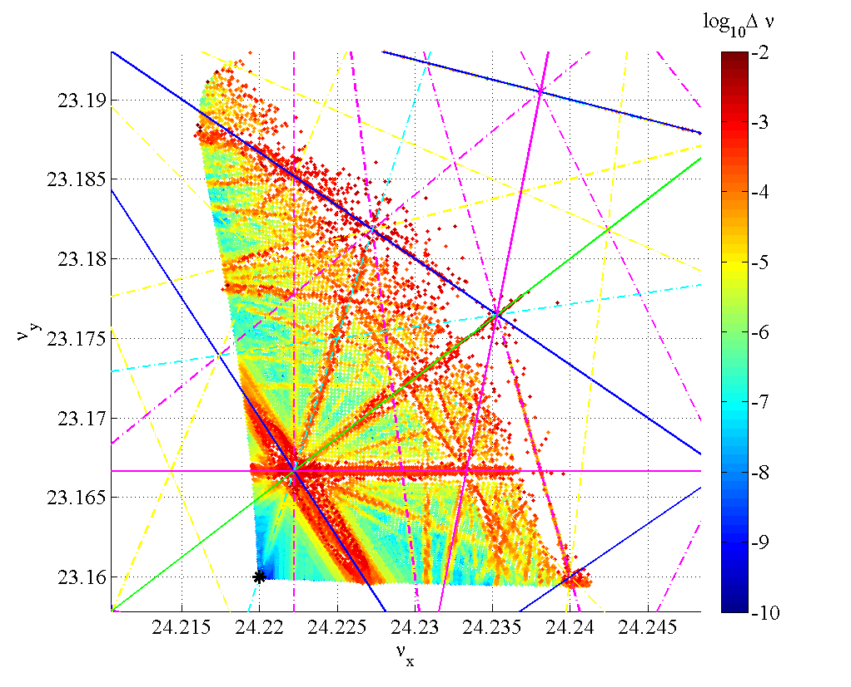
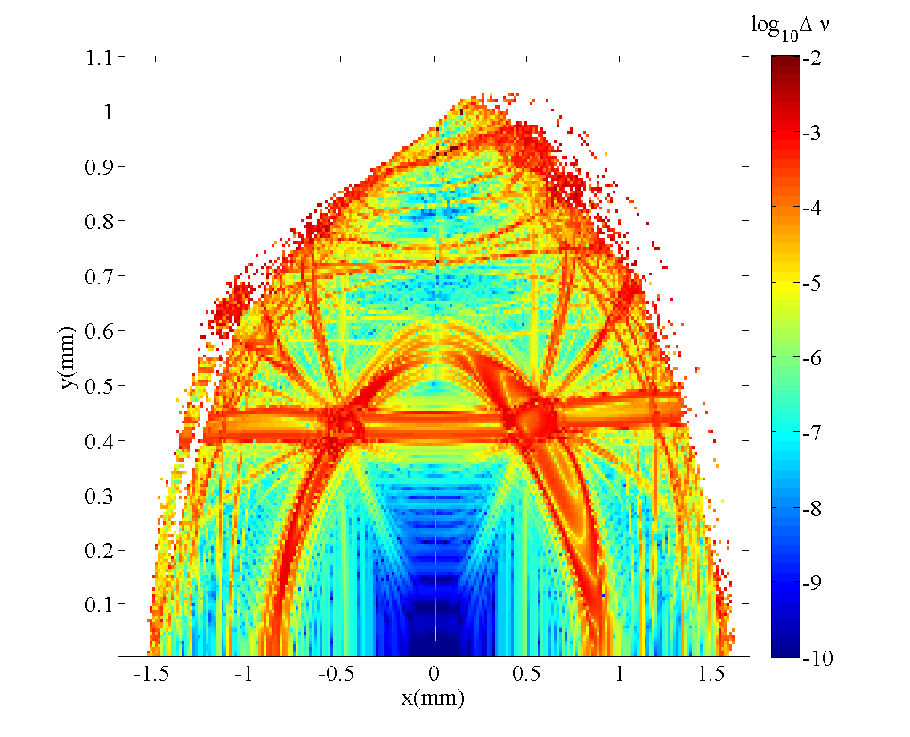
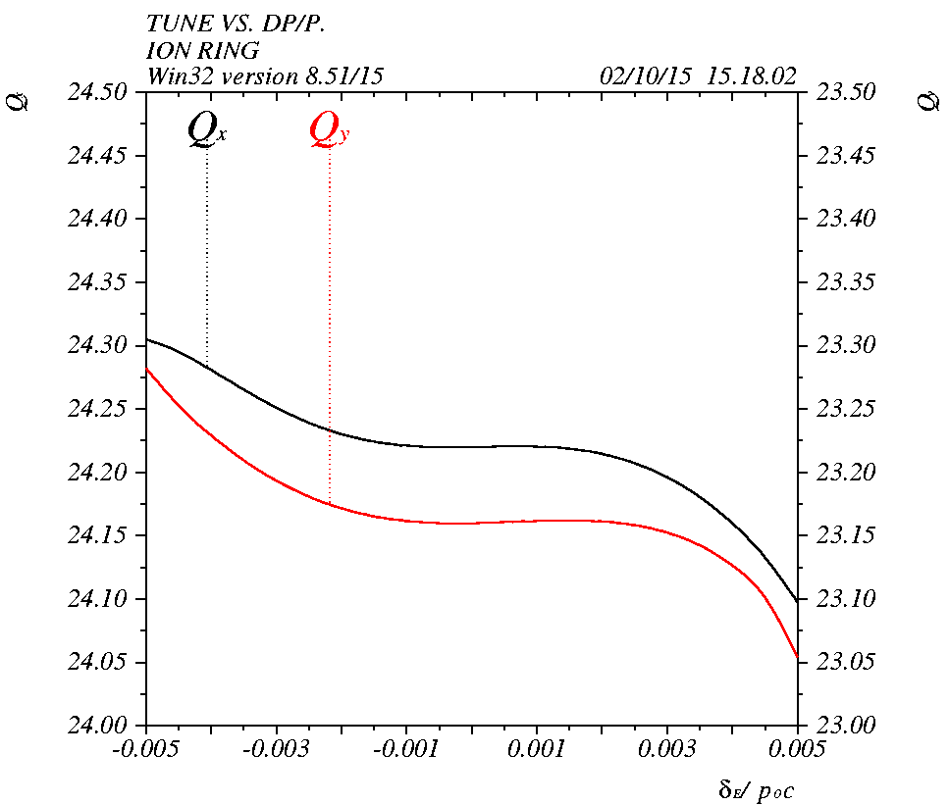
Beam dynamics of non-interleaved –I pairs
Tune foot print
DA frequency map
Qx = 24.22
Qy = 23.16
Blue 5th
ε_{XN}=0.35E-6,
ε_{yN}=0.07E-6
Magenta 6th
β_{X,ip}=0.1 m
β_{y,ip}=0.02 m
Chromatic tune
E= 60 GeV
σ_{X,ip}= 23.4 μm
σ_{y,ip}= 4.7 μm
Amplitude dependent tune

Slide 9
Effects of alignment error and field error
The alignment error and field error are provided by Guohui.
  s misalignment it’s not included in LEGO.
  The errors of final focus quads are different.
There are total 178 H/V correctors and 199 H/V monitors for orbit correction.
Using QSFB01, QSFB02 for tune correction.
Using SXT01R, SXT02R for linear chromaticity correction.
Table of alignment and field errors
 | Dipole | Quadrupole | Sextupole | FFQ | BPM(noise) | Corrector
x misalignment(mm) | 0.1 | 0.1 | 0.1 | 0.01 | 0.02 | -
y misalignment(mm) | 0.1 | 0.1 | 0.1 | 0.01 | 0.02 | -
x-y rotation(mrad) | 0.1 | 0.1 | 0.1 | 0.05 | - | 0.1
s misalignment(mm) | 0.0 | 0.0 | 0.0 | 0.0 | - | -
Strength error(%) | 0.01 | 0.1 | 0.1 | 0.01 | - | 0.01

Slide 10
Correction scheme
Correct orbit in both planes
Correct coupling (w/o skew quadrupole)
  steer orbit
Correct chromaticity, correct tune
Correct beta beat in both planes
  correct betax/y, correct tune
Correct chromaticity, correct tune
Correct vertical dispersion
  steer vertical orbit
Correct chromaticity, correct tune
Do the above correction several iterations. (for example 4 times)
check the final orbit
check the final tune and chromaticity
check the final beta beat
check the final coupling
For every random seed the error can be divided into several steps if the effect of error is too large. (10 steps for example).

Slide 11
Alignment error and field error with correction
Dynamic aperture can be restored after all the corrections
Correction result of one random seed, total 10 random seeds.
Rms of final horizontal orbit:
1.68E-01 mm
Rms of final vertical orbit:
1.62E-01 mm
FINAL BETA BEAT
Rms of final horizontal beta beat is: 3.80E-02
Rms of final vertical beta beat is: 3.94E-02
FINAL COUPLING
Rms of final coupling is:
4.96E-02

Slide 12
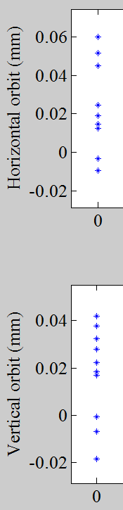
Orbit after correction
Orbit at IP
Orbits after correction of 10 random seeds

Slide 13
Corrector strength
Corrector strength of 10 random seeds

Slide 14
Effects of magnet multipole field errors
Check the effects of multipole field (MP) error of magnet at different region (beta function).
  No MP errors of FF quads
  No MP errors of magnet at beta function larger than 500 m.
  MP in arc sections only.
Double check with elegant
    Check the effects of different harmonics of multipole field on dynamic aperture in arc

Slide 15
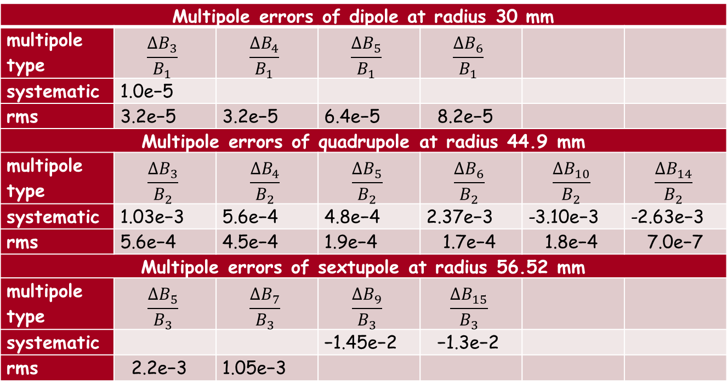

Magnet multipole tolerances (from PEPII study)
The magnet multipole tolerance is defined relative to the field component normalized at a reference radius r:
$$\frac{∆B_{n}}{B_{N}}= \frac{(N−1)! B^{(n−1)′}}{(n−1)! B^{(N−1)′}} r^{n−N} ,B^{(n−1)′}= \frac{∂^{n−1}B}{∂^{n−1} x}$$
Multipole errors of dipole at radius 30 mm
multipole type | $$\frac{∆B_{3}}{B_{1}}$$ | $$\frac{∆B_{4}}{B_{1}}$$ | $$\frac{∆B_{5}}{B_{1}}$$ | $$\frac{∆B_{6}}{B_{1}}$$
systematic | 1.0e−5
rms | 3.2e−5 | 3.2e−5 | 6.4e−5 | 8.2e−5
Multipole errors of quadrupole at radius 44.9 mm
multipole type | $$\frac{∆B_{3}}{B_{2}}$$ | $$\frac{∆B_{4}}{B_{2}}$$ | $$\frac{∆B_{5}}{B_{2}}$$ | $$\frac{∆B_{6}}{B_{2}}$$ | $$\frac{∆B_{10}}{B_{2}}$$ | $$\frac{∆B_{14}}{B_{2}}$$
systematic | 1.03e−3 | 5.6e−4 | 4.8e−4 | 2.37e−3 | -3.10e−3 | -2.63e−3
rms | 5.6e−4 | 4.5e−4 | 1.9e−4 | 1.7e−4 | 1.8e−4 | 7.0e−7
Multipole errors of sextupole at radius 56.52 mm
multipole type | $$\frac{∆B_{5}}{B_{3}}$$ | $$\frac{∆B_{7}}{B_{3}}$$ | $$\frac{∆B_{9}}{B_{3}}$$ | $$\frac{∆B_{15}}{B_{3}}$$
systematic |  |  | −1.45e−2 | −1.3e−2
rms | 2.2e−3 | 1.05e−3

Slide 16
Non-interleaved –I pairs (no FF Quad MP errors)

Slide 17
Non-interleaved –I pairs ( no MP errors@ β_{x,y} > 500m)

Slide 18
Non-interleaved –I pairs ( MP errors in Arcs)

Slide 19
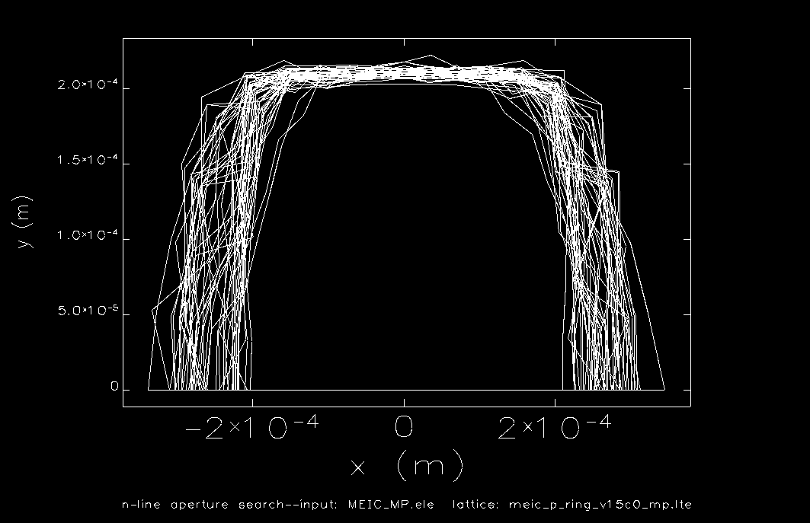
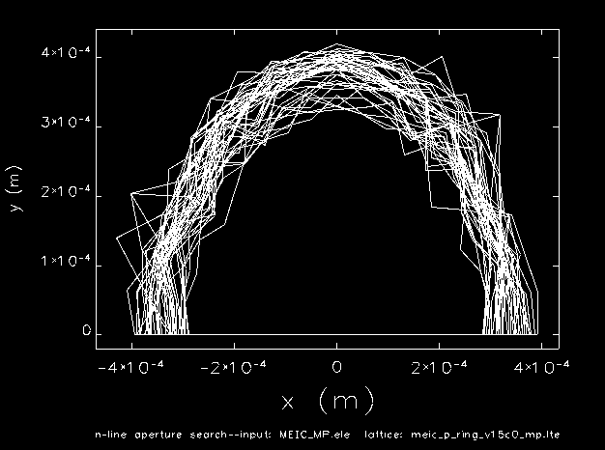
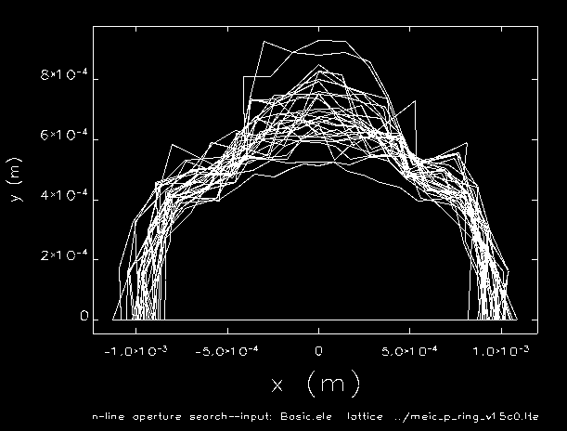
Dynamic aperture with MP errors using elegant
no FF Quad MP errors
no MP errors@ b_{x,y} > 500m
Tracking dynamic aperture with 50
random seeds using elegant.
The horizontal aperture is similar as
LEGO result, the vertical aperture
all larger than LEGO result.
MP errors in Arcs

Slide 20
Systematic + rms single MP term in Arcs
Dipole B3
Quad B3
Quad B4
Quad B5
Quad B6
Quad B10
Quad B14
Sext B9
Sext B16
Individual term does not affect dynamic aperture
The cancelation of MP effect may due to the periodicity of FODO cell in arc

Slide 21
Systematic term add on
Dipole B3
Quad B3
Quad B4
Quad B5
Quad B6
Quad B10
Quad B14
Sext B9
Sext B16
Add on the systematic MP error term from Dipole to sextupole,
low order to high order

Slide 22
Systematic plus rms term add on
System + skew
Quad B3
Quad B4
Quad B5
Quad B6
Quad B10
Quad B14
Sext B9
Sext B16
Add on the rms MP error term from Dipole to sextupole,
low order to high order

Slide 23
Dynamic aperture with MP correction in arc
Assuming the MP error can be corrected by implanting higher order magnets
The dynamic aperture reduction of MP errors in arc is due to B5 and B6 terms,
which is consistent with the resonances seen in tune foot print.

Slide 24
Conclusion
Among all of the four ion ring lattices the non-interleaved –I pairs gives the best dynamic aperture
The dynamic aperture can be restored under current misalignment and field error budget with orbit, tune, chromaticity, coupling, bata beat and vertical dispersion corrections.
Big dynamic aperture reduction due to multiple field errors of –I pairs lattice.
To restore the dynamic aperture reduction due to multiple field errors
  Adding MP correction components
  Modified the MP field tolerance table
  Move working tune to enlarge resonance free tune space.

