Slide 1

Nonlinear Dynamics and Error Study of the MEIC Ion Collider Ring
G.H. Wei, V.S. Morozov, Fanglei Lin JLAB
Yuri M. Nosochkov, Min-Huey Wang, SLAC
MEIC Collaboration Meeting Fall 2015, Oct 5, 2015

Slide 2
Contents
Two Schemes for the Ion collider ring
Lattice of CCB Scheme and Tune Survey
Error Sensitive Study
Lattice of -I Scheme and Error Study
Summary
Layout of the ion collider ring
F. Lin etc, PAC’13, TUPAC28

Slide 3
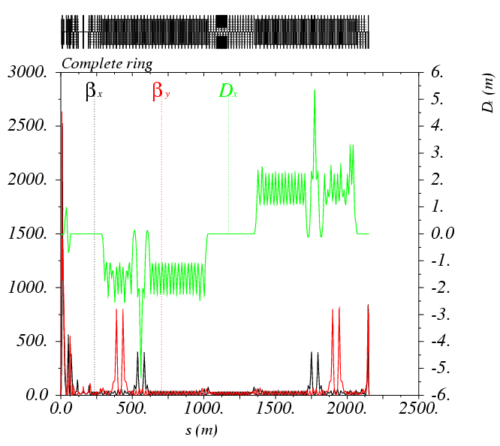
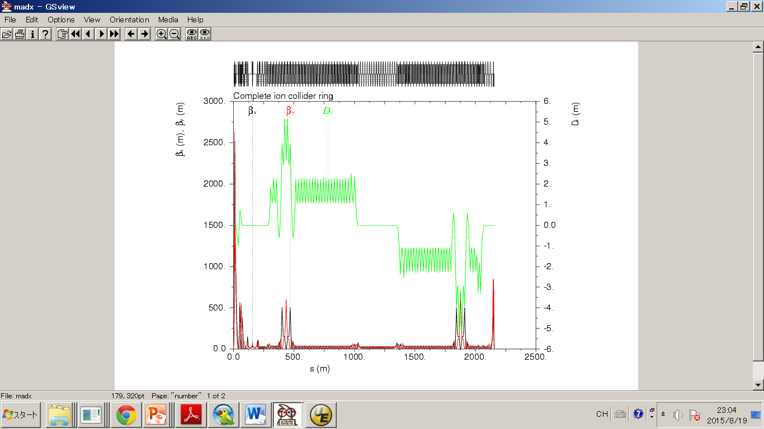
Two Schemes for the Ion collider ring
-I Scheme
From Yuri and Ming-Huey
CCB Scheme
From Vasiliy

Slide 4
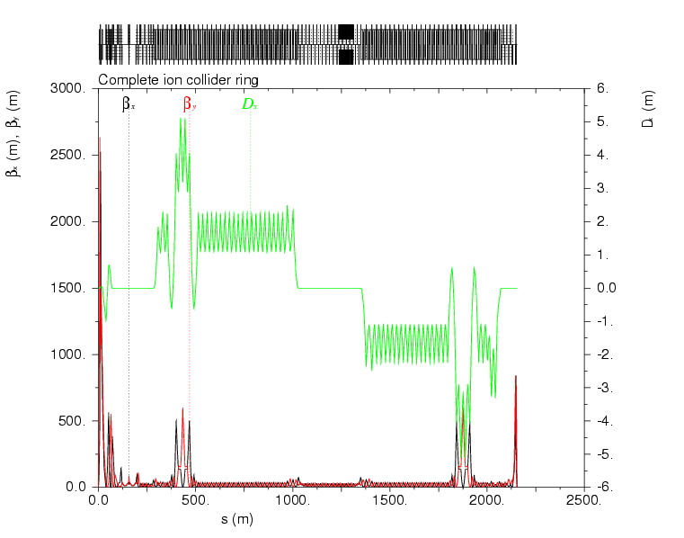
Lattice of CCB Scheme & Tune Survey
two lattices of CCB scheme
CCB lattice-June18
CCB lattice-July28

Slide 5
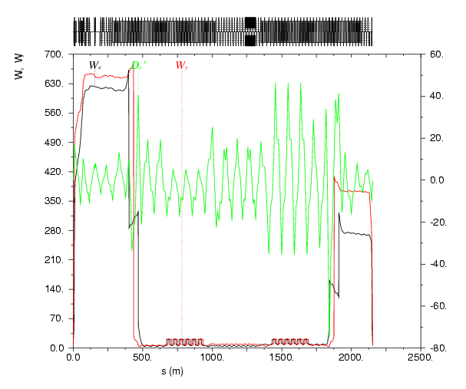
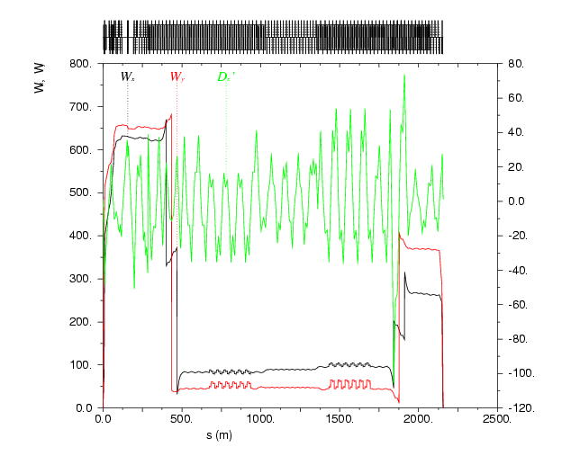
Lattice of CCB Scheme & Tune Survey
Difference between the two CCB lattices
CCB lattice-June18
CCB lattice-July28

Slide 6
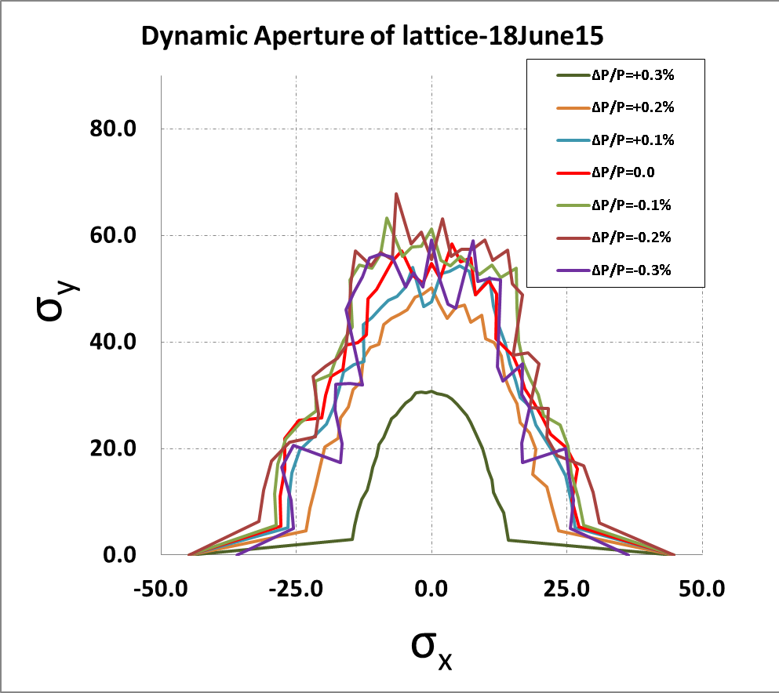
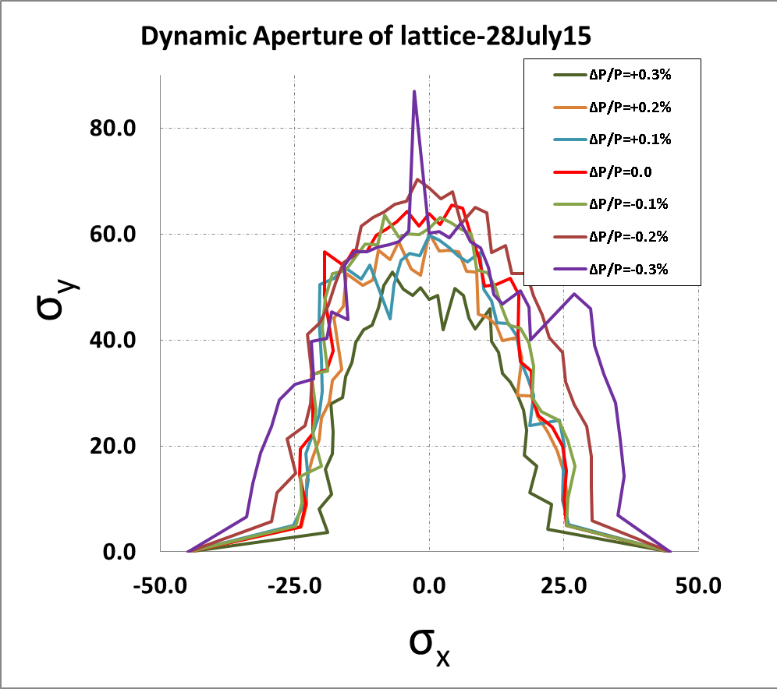
Lattice of CCB Scheme & Tune Survey
Dynamic Aperture of ΔP/P (-0.3%, +0.3%)
CCB lattice-July28 has better DA at ΔP/P = +0.3 %

Slide 7
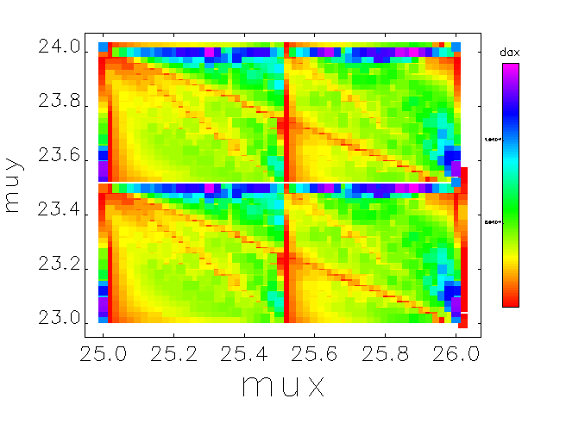
Lattice of CCB Scheme & Tune Survey
Tune Survey
μx+2μy=73
μx+μy=49
μx+μy=48.5
μx+2μy=72

Slide 8
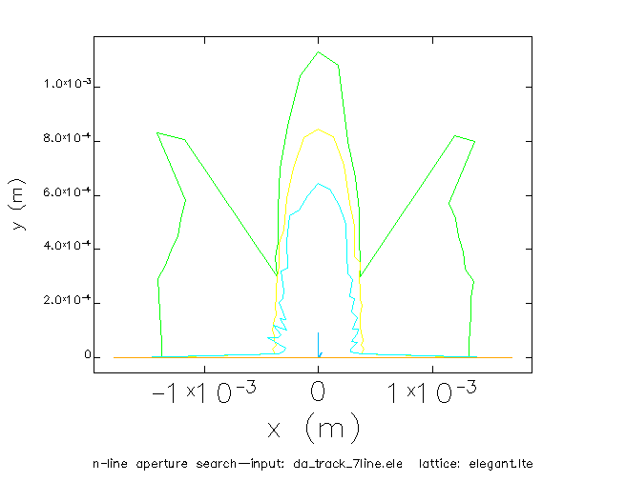
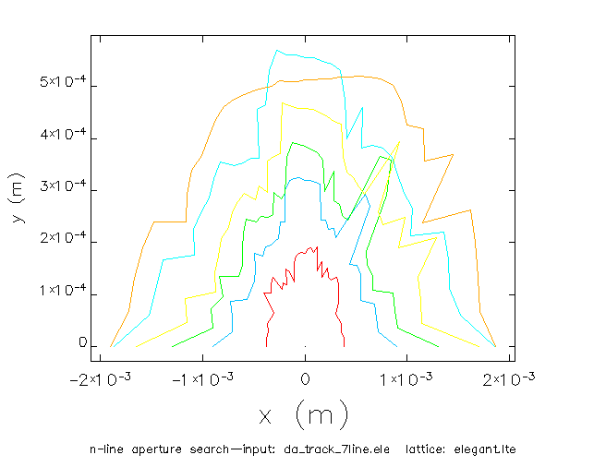
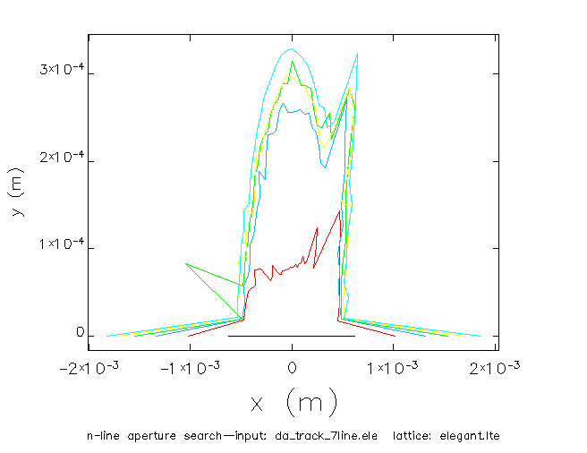
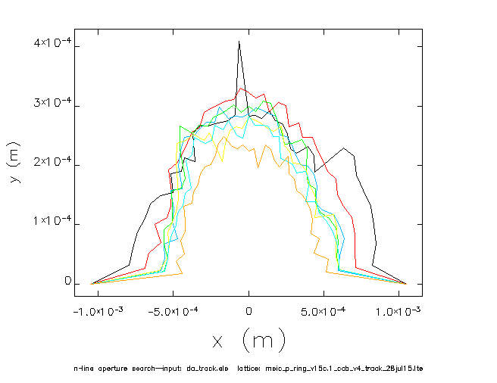
25.78,23.50
25.44,23.42
25.82,23.42
25.22,23.16

Slide 9
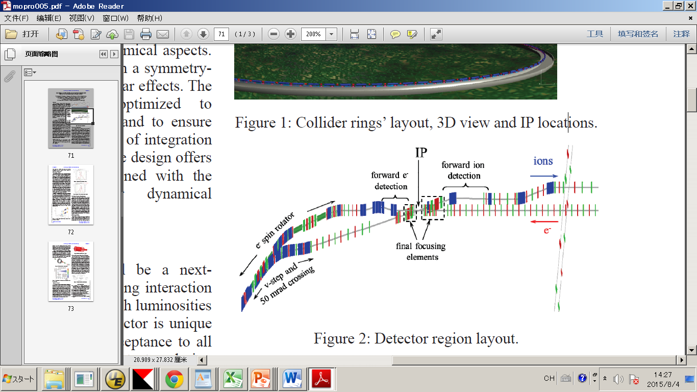
Error Sensitive Study
Error species
  Magnet: misalignment of 3-D, x-y rotation, and strength error
    FFQ: ~10 % error of normal Quads
IPAC14’ MOPRO005, V.S. Morozov,etc

Slide 10
Error Sensitive Study
  BPM: only noises of X and Y direction. Considering calibration and beam based alignment
  Corrector: x-y rotation error & jitter error of strength.
  Error: Gaussian distributions with a cut-off at 3 standard deviations.
 | Dipole | Quadrupole | Sextupole | BPM(noise) | Corrector
x misalignment(mm) | 0.1 | 0.1, FFQ0.01 | 0.1 | 0.02 | -
y misalignment(mm) | 0.1 | 0.1, FFQ0.01 | 0.1 | 0.02 | -
x-y rotation(mrad) | 0.1 | 0.1, FFQ0.05 | 0.1 | - | 0.1
s misalignment(mm) | 0.1 | 0.1, FFQ0.01 | 0.1 | - | -
Strength error(%) | 0.01 | 0.1, FFQ0.01 | 0.1 | - | 0.01

Slide 11
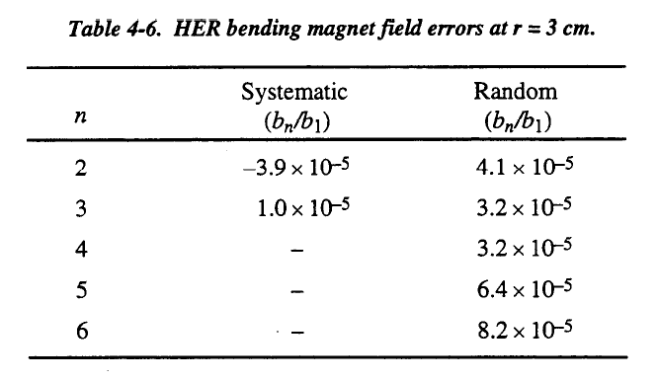

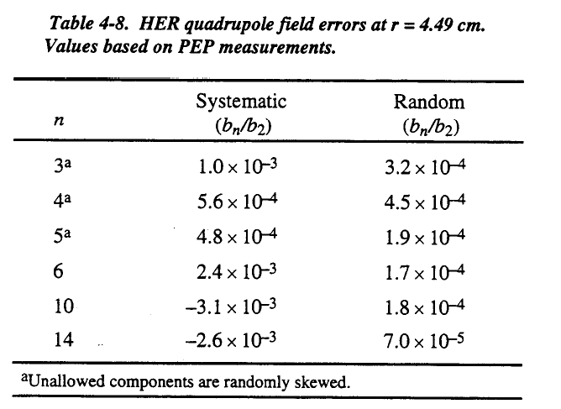
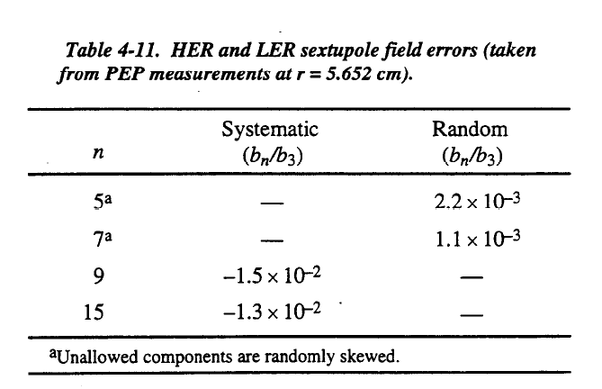
slac-r-418a-PEPII: PEPII CDR June 1993
Multiple errors of PEPII
are used in the study.

Slide 12
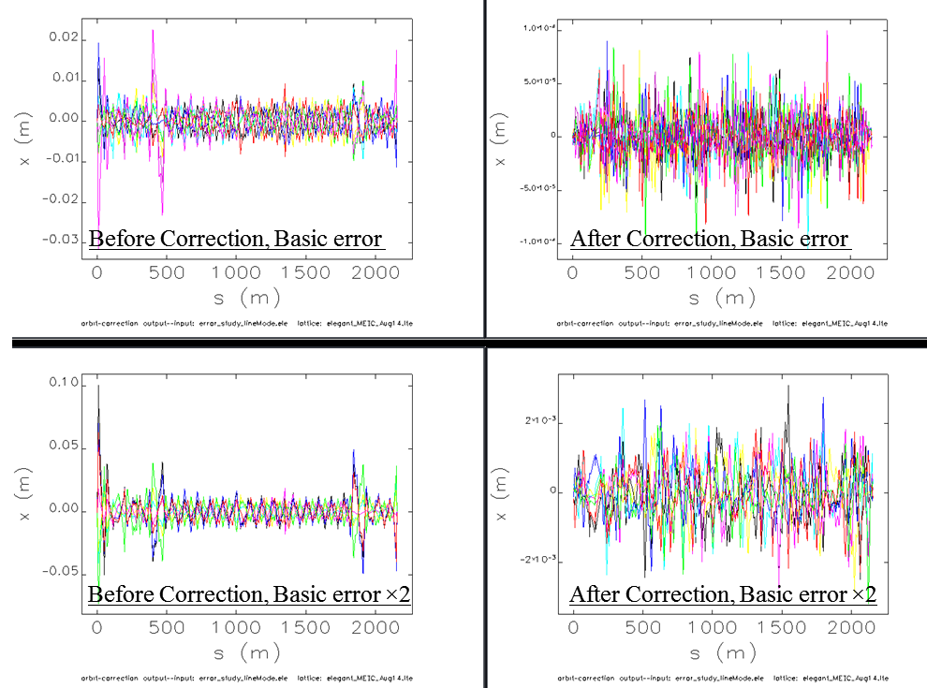
Closed Orbit Distortion and correction
+10⁻⁴
-10⁻⁴
+2 mm
-2 mm

Slide 13
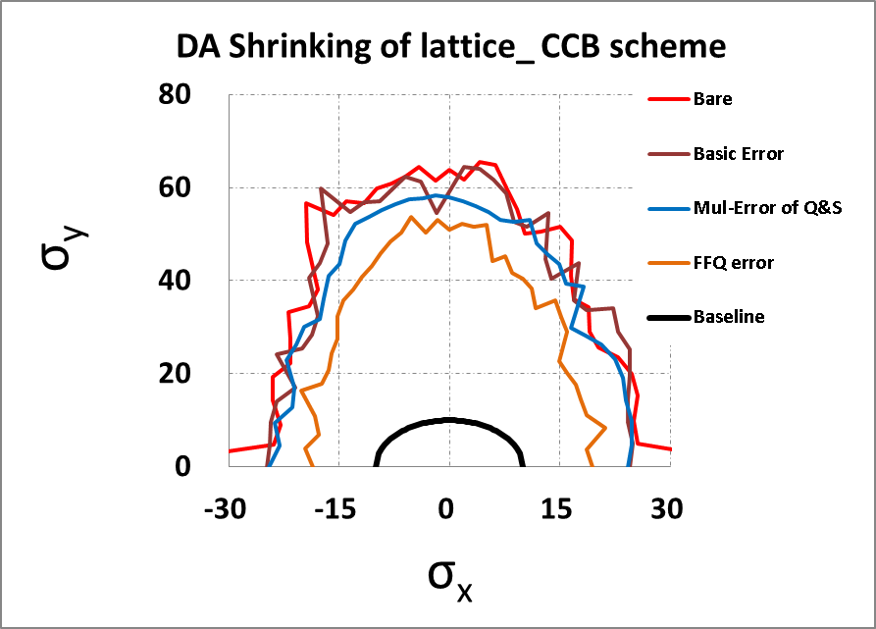
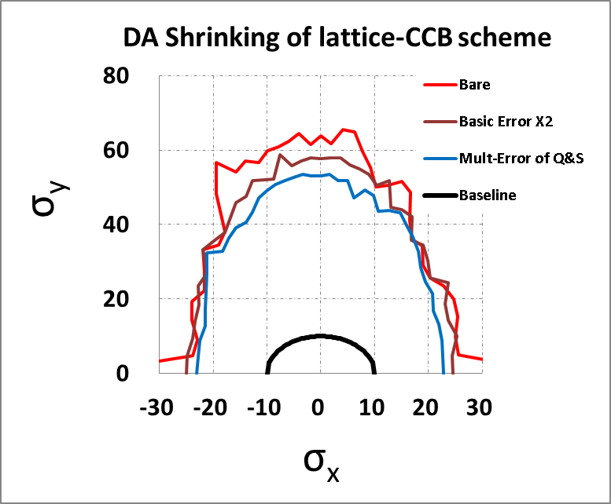
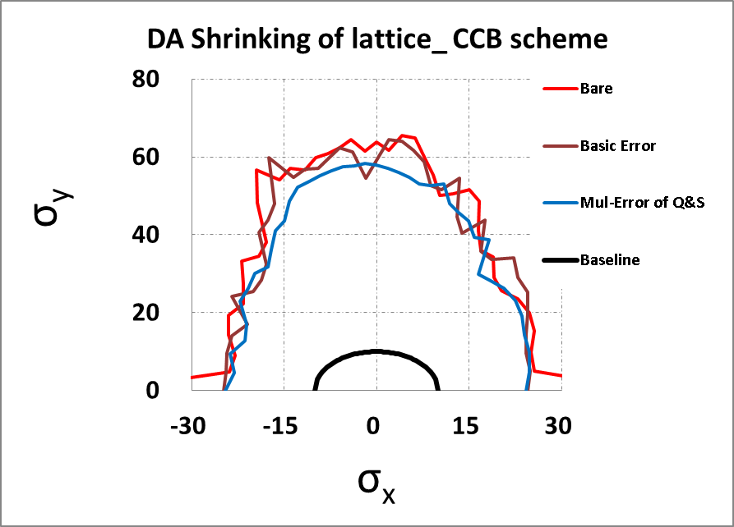
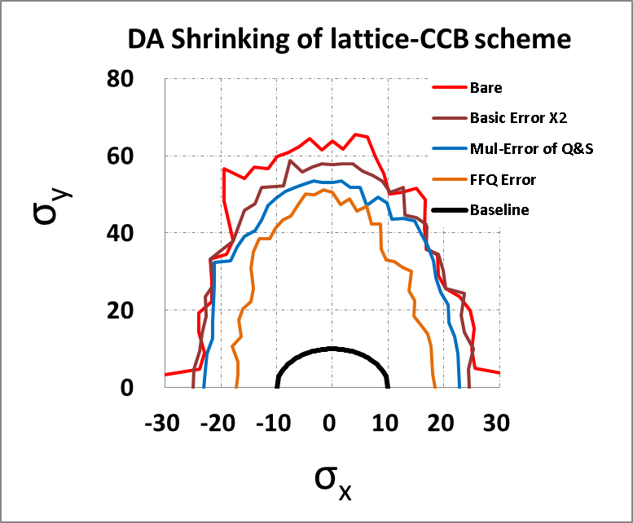
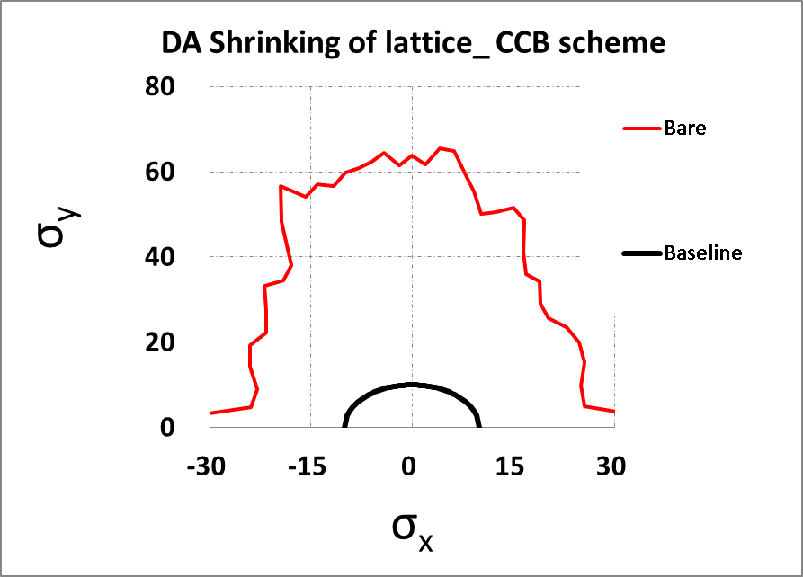
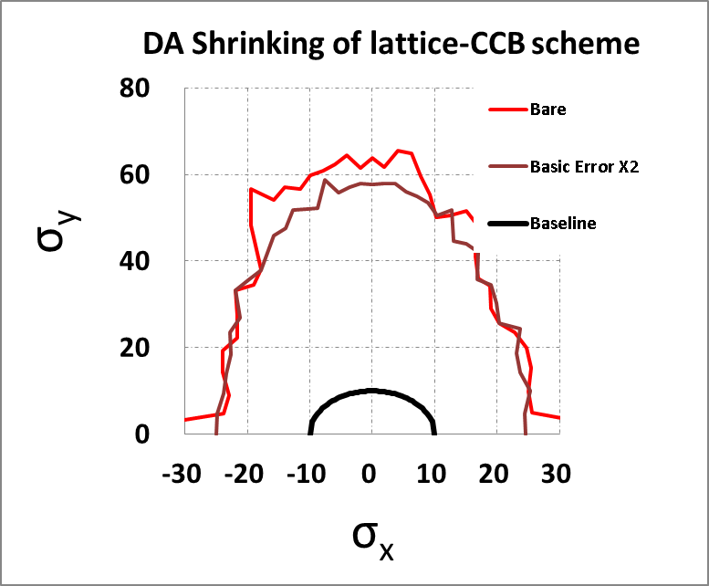
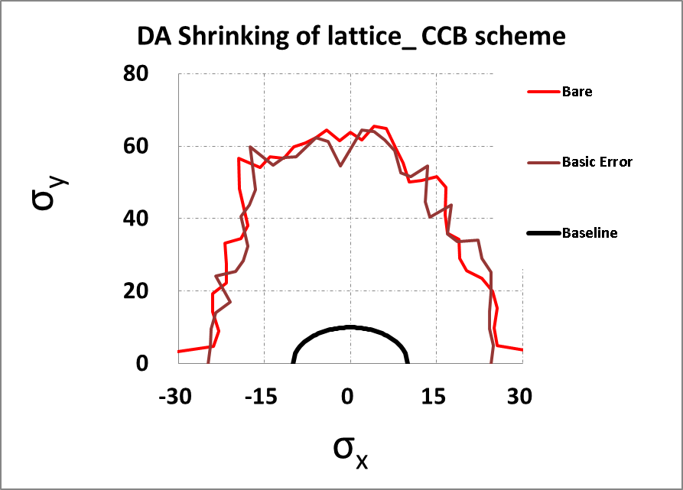
Error Sensitive Study
Baseline of Dynamic Aperture at IP
10 σ of X & Y beam sizes

Slide 14
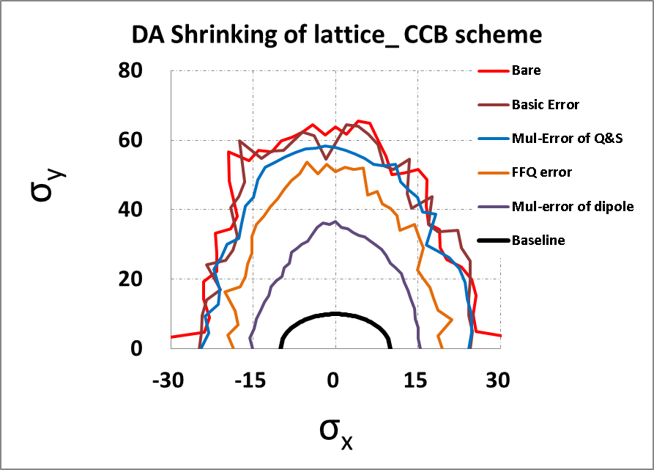
Error Sensitive Study
Peter Mclntyre, report of the MEIC magnets, tomorrow
Bare 100%: -3% Basic error, -10% Mul-error of Q&S,
-17% FFQ error, -42% Mul-error of dipole
Less multipole error from SC dipole is wanted.

Slide 15
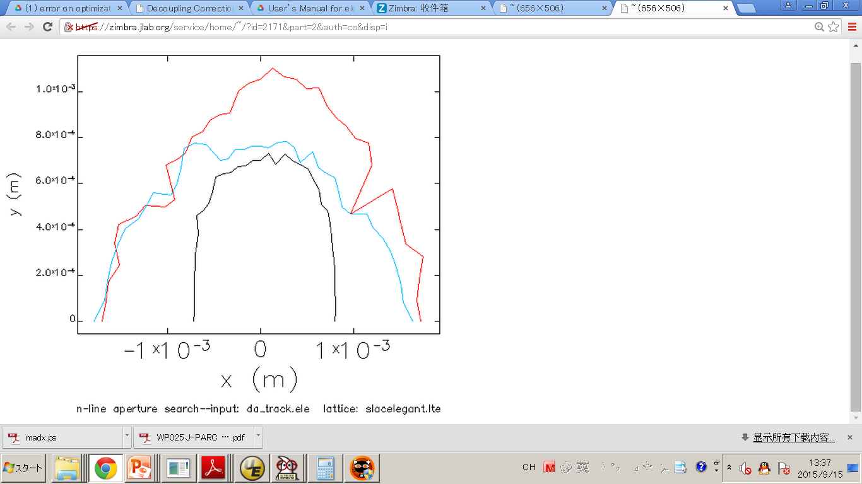
Lattice of -I Scheme and Error Study
From Yuri Nosochkov & Ming-Huey Wang
Δp/p=0
Δp/p= 0.3%
Δp/p=-0.3%

Slide 16
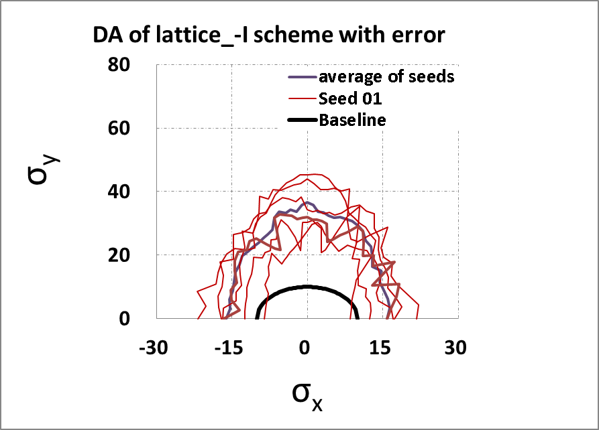
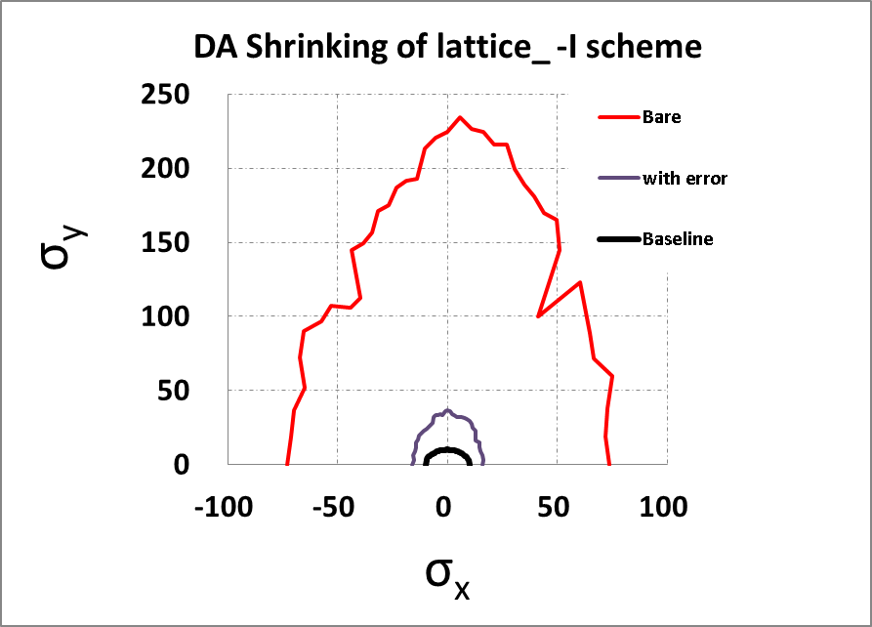
Lattice of -I Scheme and Error Study
With error & orbit correction

Slide 17
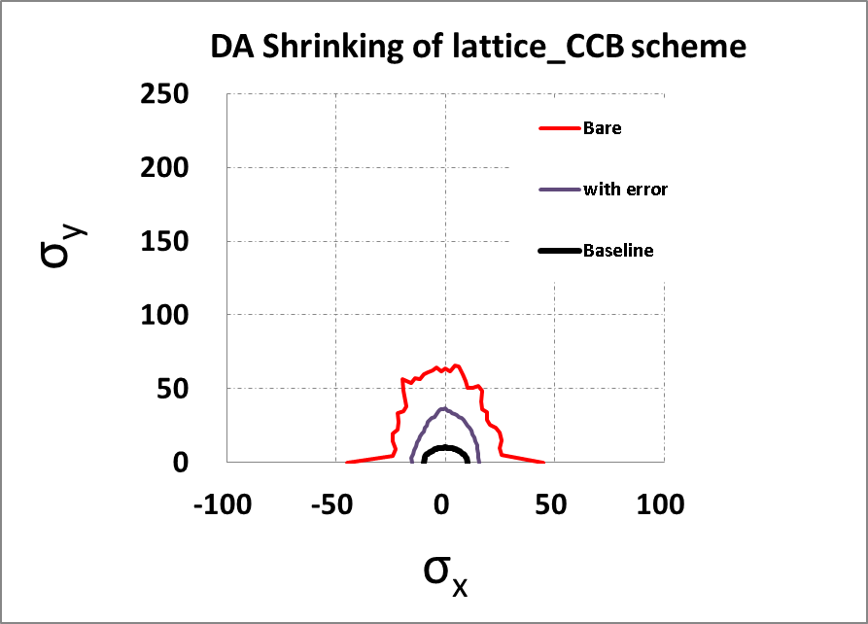
Comparison of CCB scheme & -I scheme of ion ring lattice with error

Slide 18
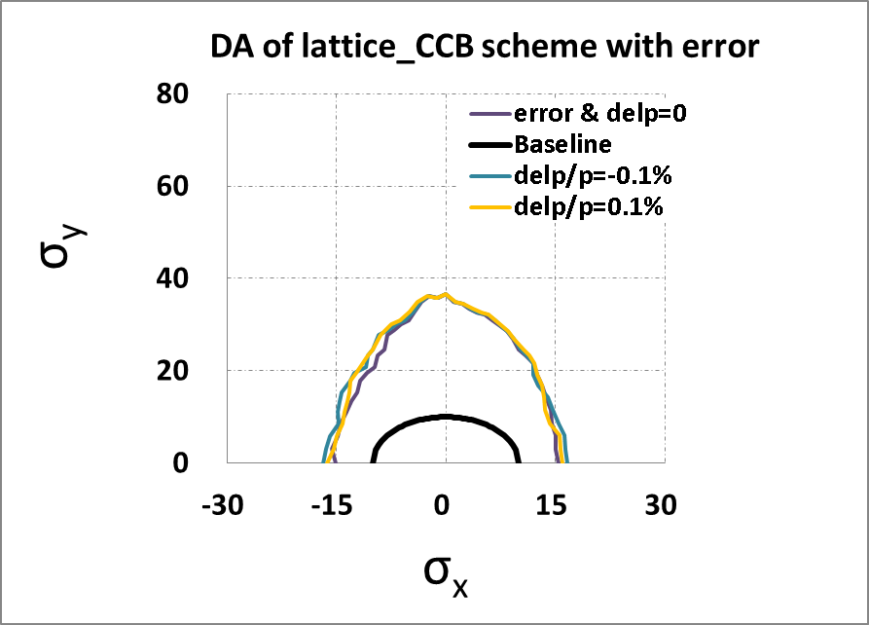
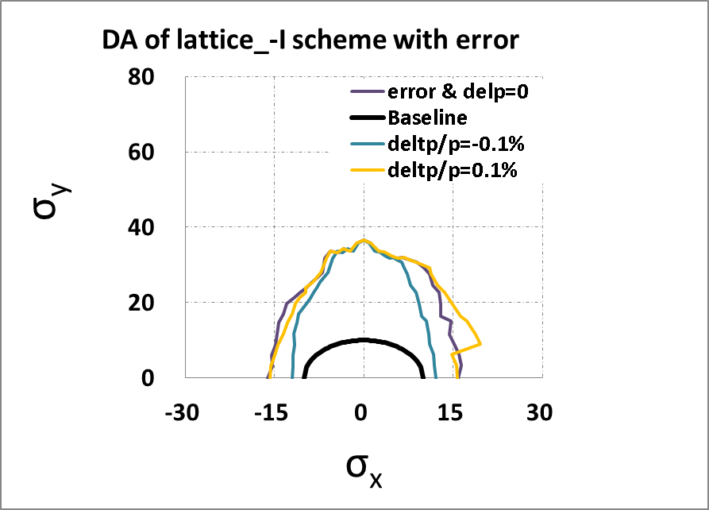
DA of CCB scheme & -I scheme of ion ring lattice with error & ΔP/P

Slide 19
Summary
Due to baseline of 10 σ of H/V at IP, Both MEIC ion ring lattice of CCB scheme and –I scheme have enough dynamic aperture with assuming error.
Influence by multipole error of dipole is very large
Deep study :
  CCB scheme of dynamic aperture without error
  -I scheme of dynamic aperture with error
 | Bare H,V | With error H,V
CCB scheme | 25σ, 62σ | 15σ, 36σ
-I scheme | 70σ, 110σ | 15σ, 36σ

Slide 20
Thank you

Slide 21
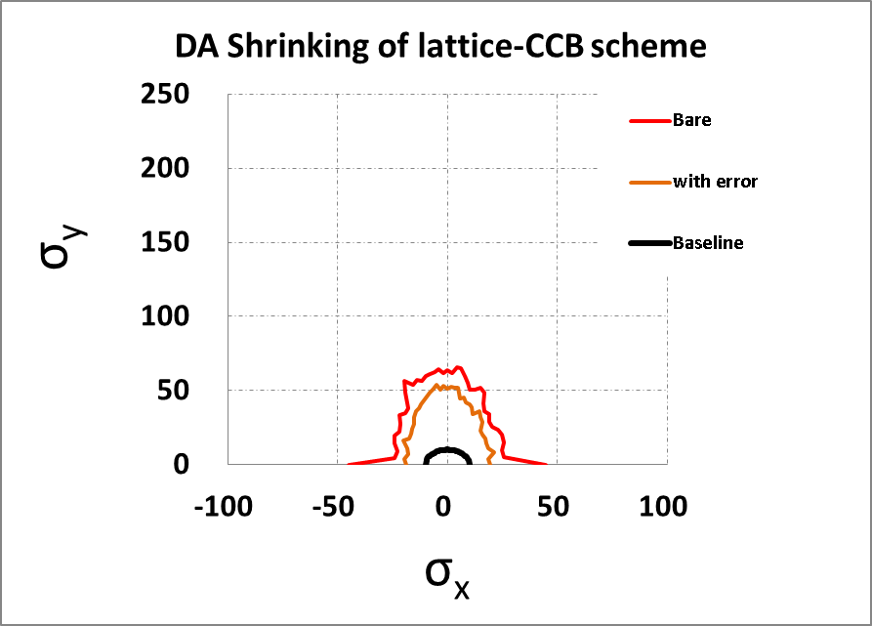
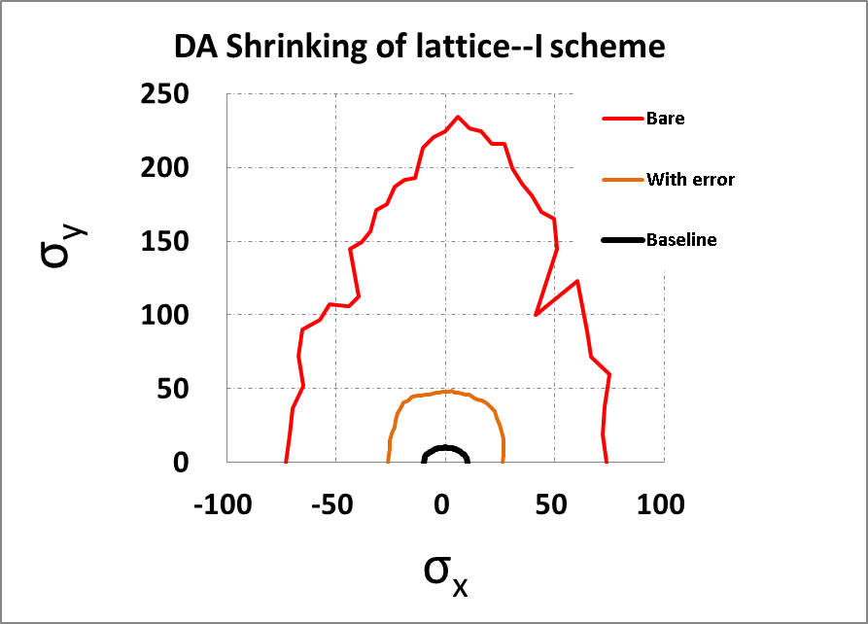
Comparison of CCB scheme & -I scheme of ion ring lattice with error

Slide 22
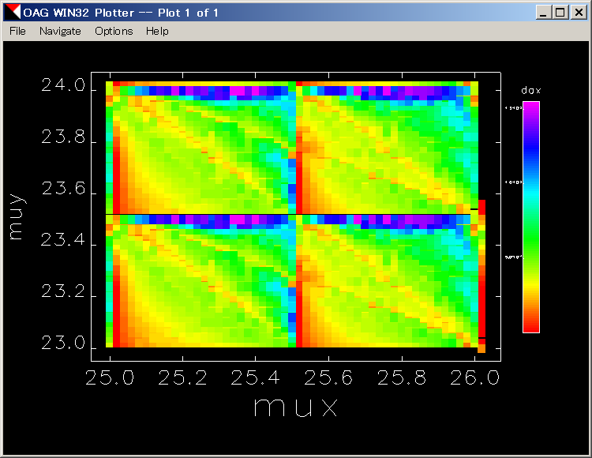
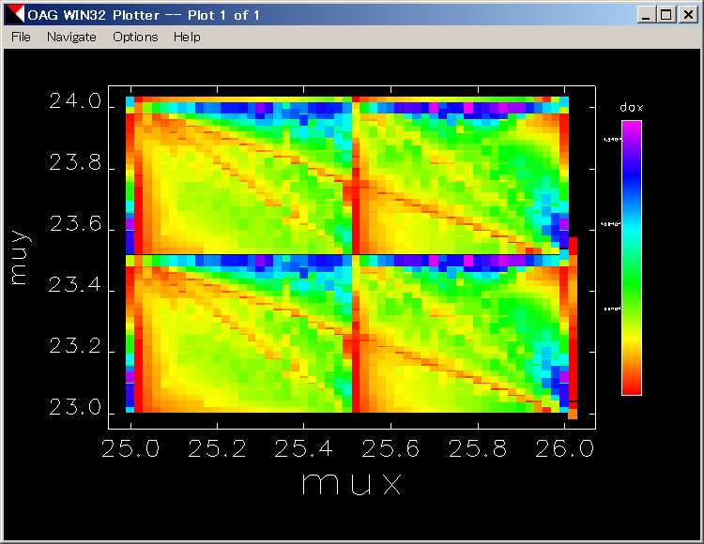
Two CCB Lattice for Ion Collider Ring
Dynamic Aperture of tune scan

Slide 23
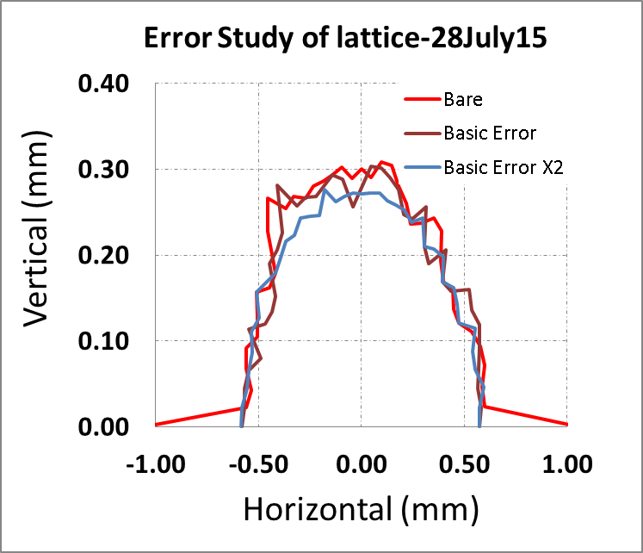
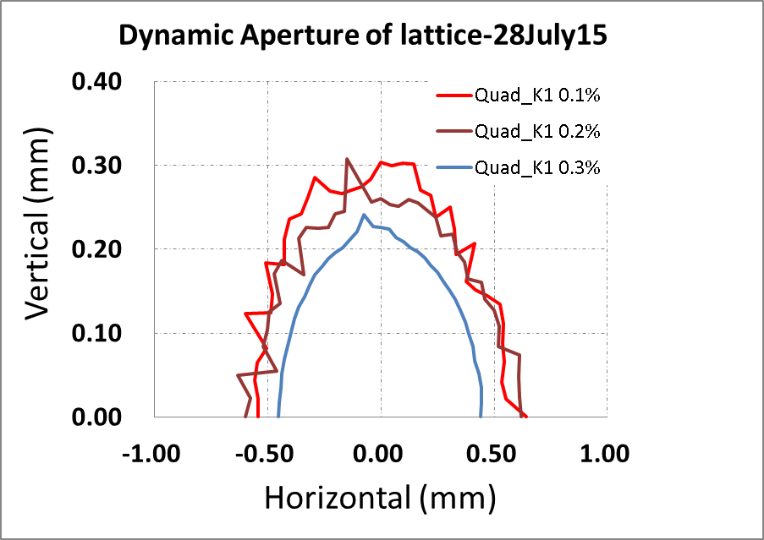
Error study of misalignment, strength error, BPM noise

Slide 24
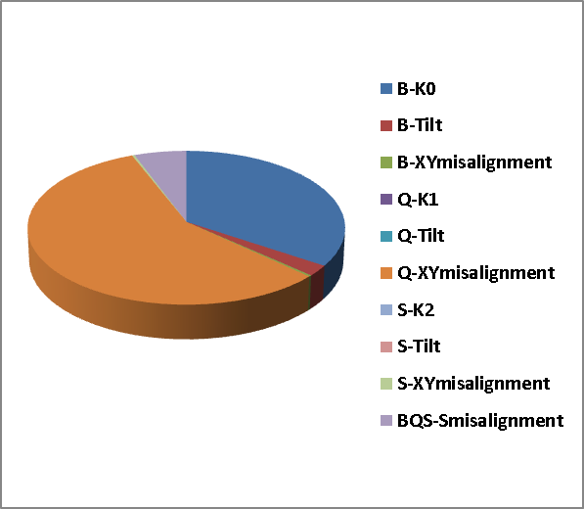
Error study of misalignment, strength error, BPM noise
Closed orbit oscillation mainly caused by:
  Q X&Y misalignment
  K0 error of dipole
  Longitudinal misalignment of dipole.

Slide 25
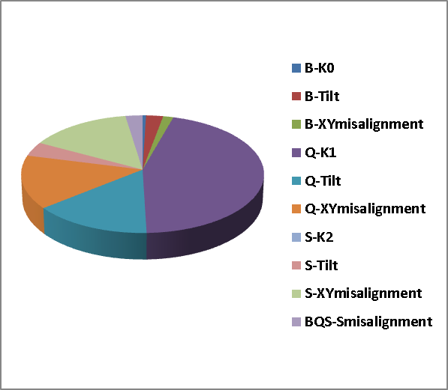
Error study of misalignment, strength error, BPM noise
Dynamic aperture shrinking mainly caused by:
  K1 error of Quads
  Tilt error of Quads
  X&Y misalignment of Sextupoles
  X&Y misalignment of Quadrupoles
1. & 3. → twiss, tune, & chromaticity matching
2. → decoupling

Slide 26
Local Chromaticity Compensation
Large chromaticity due to tight focusing at IPs
  challenge to compensate chromaticity while preserving dynamic aperture
Dedicated Chromaticity Compensation Blocks (CCB)
  dominant (after expansion) cos-like trajectory component u_{x} anti-symmetric with respect to the center of CCB
  symmetric cos-like u_{y}
  symmetric D
  symmetric quadrupole n and sextupole n_{s} field components
CCB
Q
S
Q
S
Q
S
Q
FFB
x_{b}, y_{b}
y_{b}
y_{b}
nπ
Beam
Dipole
x_{b}
Dipole
IP
nπ
D_{x}
x_{b}

Slide 27
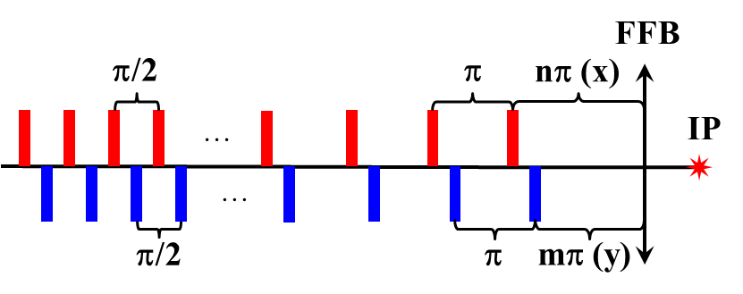
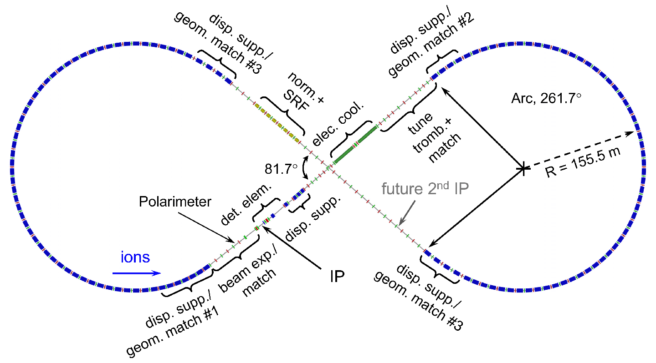
Sextupole layout
Use interleaved –I pairs of arc sextupoles (nearest to IP) for FFB non-linear chromaticity correction. Make –I pairs by placing the x and y-sextupoles in every second 90° cell. Use regularly located sextupoles in the remaining part of the arcs for linear chromaticity correction.
12 (x) + 12 (y)
sextupoles
3 (x) + 3 (y)
–I pairs
3 (x) + 3 (y)
–I pairs
12 (x) + 12 (y)
sextupoles

Slide 28
