Slide 1

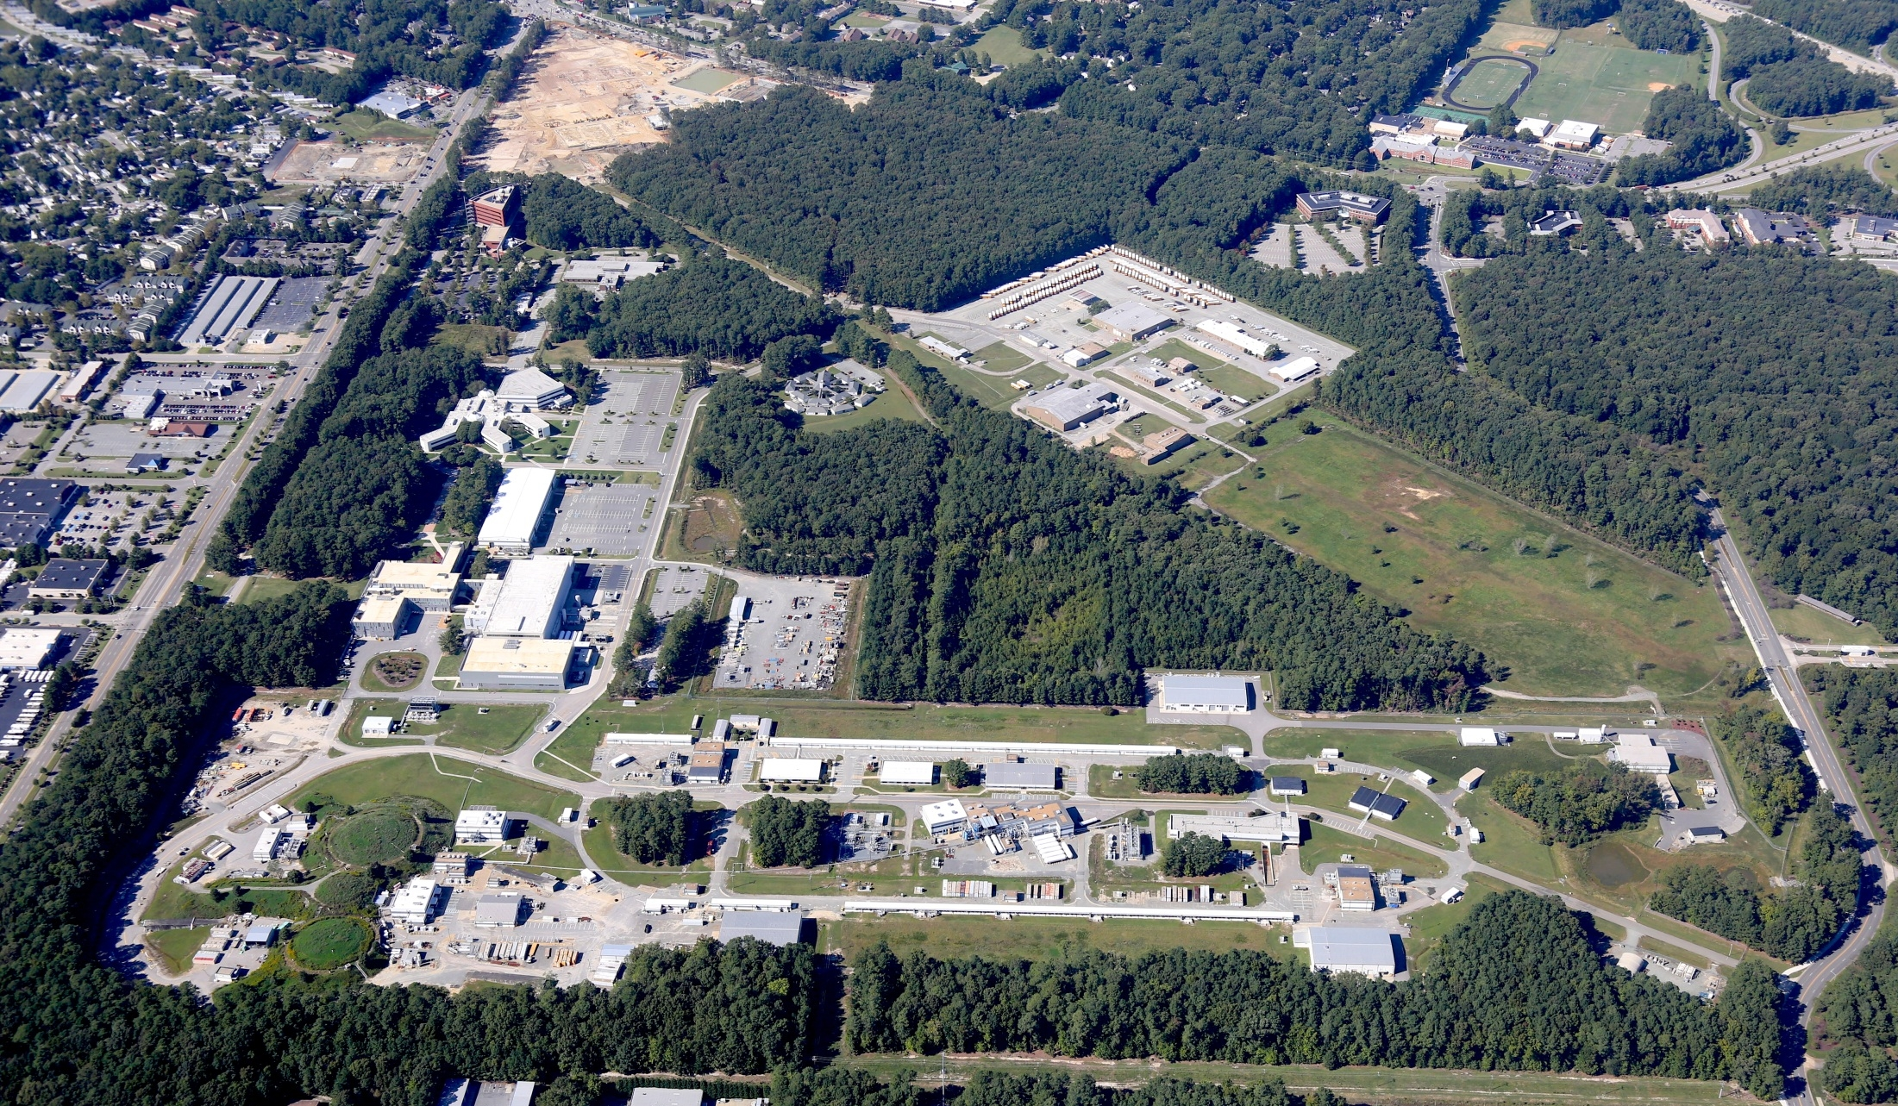
MEIC Collaboration Meeting
Site Development - Rebecca Yasky October 6, 2015

Slide 2
Site Development Progress
NSAC Cost Review in January 2015
  Scope of the MEIC Conventional Facilities
    Site Layout
    Structures – similar to CEBAF
  Work breakdown schedule (WBS)
  Bottoms up cost estimate
Engineering Services Contract – Indefinite Delivery Indefinite Quantity (IDIQ)
  Site Characterization & Early Project Development
  Commonwealth of Virginia funds
  Procurement process
  Initial task orders

Slide 3
MEIC Site Layout

Slide 4
MEIC – Conventional Facilities (CF) Scope
Similar to Existing CEBAF (continuous electron beam accelerator facility)
Types of Structures:
Underground tunnel – houses electron and ion beam lines
Detector hall – interaction regions, houses experimental equipment.
  Truck ramp access
Counting house – supports the detector halls.
Service building – houses accelerator equipment such as RF. No personnel or equipment access to the tunnels.
Access building - provides personnel and equipment access to the tunnel and houses low conductivity water (LCW) plants.
Egress building – personnel access to tunnel to meet life safety egress requirements for the tunnels.
Cryogenics plant building – Cryogenics plant is not part of the CF scope
Sitework & Utilities to support the MEIC operations
Power
Water – domestic and process
  Low Conductivity Water for cooling scientific equipment
Cryogenics distribution
Sanitary
Stormwater
Communications
Roads, Parking & Sidewalks

Slide 5
MEIC Site Plan with Building Labels
cs9
4
cs10
cs11
cs8
cs12
cs7
cs6
12
3
cs13
cs14
cs15
cs5
14
5
11
13
cs4
1
15
cs16
cs3
cs2
cs1
9
10
2
cs17
8
7
cs18
6
cs24
cs19
cs23
cs22
cs20
et5
cs21
et4
et1
et3
et2

Slide 6
Structure Dimensions & Power Requirements
WBS | Description | Length/ SF Area | No. of Bldgs | Label on Site Plan | Power, kVA | Comments
1.4.2.2 | Underground Structures
1.4.2.2.1 | Collider Tunnel | 2,154 m |  |  | 40,250 | width & height varies
1.4.2.2.2 | Detector Halls | 8,000 SF | 2 | 1, 2
1.4.2.2.3 | Ion & Booster Tunnel | 560 m |  |  | 2,550 | width & height varies
1.4.2.2.4 | Electron Transfer Tunnel | 270 m |  |  |  | 2.5 m high x 2.5 m wide
1.4.2.2.5 | HE Cooler – ERL Tunnel | 70 m |  |  | 1,900 | 4 m high x 35 m wide
1.4.2.3 | Aboveground Structures
1.4.2.3.1 | Collider Service Buildings | 33,325 SF | 27 | 11, 12, 13, cs1 thru cs24
1.4.2.3.2 | Collider Access & Egress Buildings* | 12,000 SF | 2 | 4, 5
1.4.2.3.3 | Counting House (CH) | 3,600 SF | 1 | 3 |  | Equal to Hall D CH
1.4.2.3.4 | Ion Buildings* | 3,150 SF | 2 | 6, 7
1.4.2.3.5 | Electron Transfer Buildings* | 2,250 SF | 5 | et 1 thru et 5
1.4.2.3.6 | HE Cooler – ERL Buildings | 2,000 SF | 1 | 15
1.4.2.3.7 | Booster Service Buildings* | 2,400 SF | 3 | 8, 9, 10
1.4.2.3.8 | Cryo Plant Building | 9,900 SF | 1 | 14 | 3,800 | Similar to CHL II
* Site Plan does not include egress buildings for life safety code. Costs for these egress buildings are included.

Slide 7
CF Cost Estimating Methodology
Bottoms up estimate based on assemblies
  For example, the roof slab unit cost includes the formwork with scaffolding to support, reinforcing steel, and the concrete in the unit cost
  Unit cost includes material, labor, and equipment costs
Developed assemblies level templates for the different types of structures based on existing Jefferson Lab structures
  Underground tunnel section similar CEBAF tunnel
  Detector hall similar to Halls B & D
  Service building similar to CEBAF Extractor/Spreader Service Bldg, #68
  Access building similar to CEBAF North Access Building, #67
  Egress building similar to CEBAF Exit Stair, #4
  Cryogenics Plant similar to 12GeV CHL II
Tops down check on the template
  Used existing Jefferson Lab structure quantities
  Reviewed the total costs against the 100% design estimate (escalated to 2014 dollars)

Slide 8
Conventional Facilities, 2014 $K Direct
WBS | Description | 2014 $K | 2014 $K | 2014 $K
1.4 | Conventional Facilities |  |  | 201,725
1.4.1 | Design |  | 17,894
1.4.2 | Construction |  | 178,936
1.4.2.1 | Sitework & Utility Distribution | 27,436
1.4.2.2 | Underground Structures
1.4.2.2.1 | Collider Tunnel | 47,354
1.4.2.2.2 | Detector Halls | 18,402
1.4.2.2.3 | Ion & Booster Tunnel | 11,859
1.4.2.2.4 | Electron Transfer Tunnel | 4,976
1.4.2.2.5 | HE Cooler – ERL Tunnel | 7,865
1.4.2.3 | Aboveground Structures
1.4.2.3.1 | Collider Service Buildings | 7,389
1.4.2.3.2 | Collider Access & Egress Buildings | 38,004
1.4.2.3.3 | Counting House | 1,386
1.4.2.3.4 | Ion Buildings | 2,461
1.4.2.3.5 | Electron Transfer Buildings | 1,600
1.4.2.3.6 | HE Cooler – ERL Buildings | 2,441
1.4.2.3.7 | Booster Service Buildings | 3,983
1.4.2.3.8 | Cryo Plant Building | 3,780
1.4.3 | Commissioning |  | 895
1.4.4 | Management |  | 4,000

Slide 9
MEIC IDIQ Engineering Services
Site Condition Surveys:
Topographic land surveys
Property surveys
Geotechnical investigation - soil borings
Groundwater studies
Environmental Services:
Environmental site assessments
Wetland delineation
Preparation of NEPA documents
Ecological surveys
Stormwater management plan
Site Development:
Site plan with roads, parking, and structures
Utility services & distribution
Traffic Study
Alternative analysis
Feasibility Studies
Project Planning:
Budgetary cost estimate
Preliminary risk assessment
Schedule development
Pre-conceptual design report
Design requirements document
All potential needs up to the start of design

Slide 10
MEIC IDIQ Contract – Procurement Process
Award – Atkins North America
  Offices located throughout the US
  Office in Newport News & working relationship with the City
  Consultants with previous experience at JLab
Phase I – Qualifications
  Experience; Staff Qualifications; Approach; Geographic Location
  Three (3) offerors selected
Phase II – Best Value
  Request for Proposal (RFP) sent only to Phase I selected offerors
  Capability: more important than price
    Phase I proposals
    Timeline of project development to assess their understanding of sequencing & interdependencies
    Past performance
  Price: Labor rate schedule and effort associated with Task Order 1

Slide 11
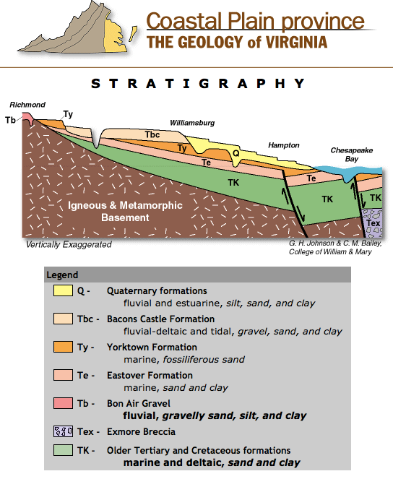
MEIC IDIQ – Task Order #1
Kick-off Meeting held October 1, 2015
Included tour of accelerator tunnel, linac service building & the LCW plant
Scope:
Topographic land survey ~ 100 acres
  Includes the adjacent properties
Geotechnical investigation
  About 50 borings at 75’ depth
  Locate the Yorktown Formation
Phase I environmental site assessment
  First step for property transfer & NEPA
Develop the site plan
  Engineering drawings with roads & utilities
Preliminary risk assessment
Budgetary cost estimate
  Validate JLab estimate

Slide 12
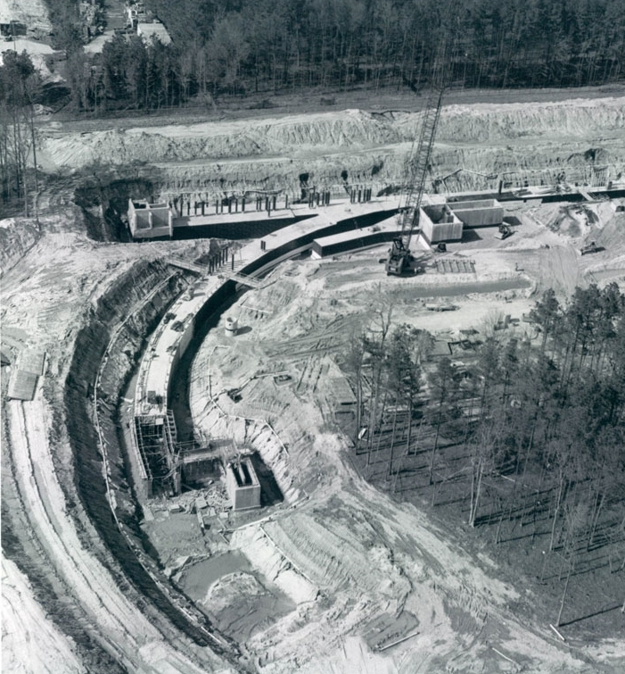
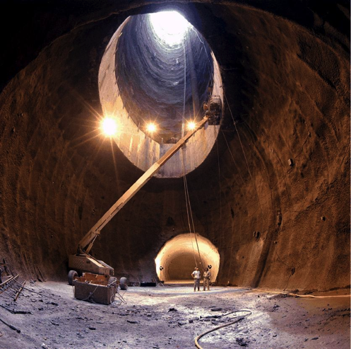
MEIC IDIQ – Task Order #2 Feasibility Study
Tunnel construction – bore deep versus cut & cover
Developing the scope of the study – initial look at a high level
  Geological
  Cost increases
Initial discussions
  Tunneling consultant: Lachel & Associates
  Considerations
    Tunnel diameter
    Radius of the boring machine
  Increase depth of a few soil borings to 200’
CEBAF – Cut & Cover
SSC – Bore

Slide 13
Questions?

Slide 14
Backup / Alternate Slides

Slide 15
MEIC – Conventional Facilities WBS
WBS | Description
1.4.1 | Design
1.4.2 | Construction
1.4.2.1 | Sitework & Utility Distribution
1.4.2.2 | Underground Structures
1.4.2.2.1 | Collider Tunnel
1.4.2.2.2 | Detector Halls
1.4.2.2.3 | Ion & Booster Tunnel
1.4.2.2.4 | Electron Transfer Tunnel
1.4.2.2.5 | HE Cooler – ERL Tunnel
1.4.2.3 | Aboveground Structures
1.4.2.3.1 | Collider Service Buildings
1.4.2.3.2 | Collider Access & Egress Buildings
1.4.2.3.3 | Counting House
1.4.2.3.4 | Ion Buildings
1.4.2.3.5 | Electron Transfer Buildings
1.4.2.3.6 | HE Cooler – ERL Buildings
1.4.2.3.7 | Booster Service Buildings
1.4.2.3.8 | Cryo Plant Buildings
1.4.3 | Commissioning
1.4.4 | Management

Slide 16
List of Aboveground Buildings

Slide 17
List of Underground Tunnel Segments

Slide 18
WBS 1.4.2.1 – Sitework & Utility Distribution
WBS | Description | Level 6 2014 $K | Level 5 2014 $K | Level 4 2014 $K | Comments
1.4.2.1 | Sitework |  |  | 27,436
1.4.2.1.1 | Site Preparation |  | 3,617 |  | Includes demolition of Residence Facility and Relocation of Hall D Service Building
1.4.2.1.2 | Stormwater Management |  | 3,025 |  | Includes 2 new retention ponds and rework of an existing pond
1.4.2.1.3 | Utilities |  | 19,200
1.4.2.1.3.1 | Water Distribution | 2,202 |  |  | 12” main around the site with 8” sub-loop distribution
1.4.2.1.3.2 | Sanitary Sewer | 944 |  |  | Includes 5 lift stations
1.4.2.1.3.3 | Electrical Distribution | 15,347 |  |  | Based on two primary substations & 6 primary loops.
1.4.2.1.3.4 | Communications Distribution | 707
1.4.2.1.4 | Roads and Pavement |  | 1,594

Slide 19
Conventional Facilities – Cost per SF
WBS | Description | Net SF Area | Costs 2014 $K | Cost per SF | Comments
1.4.2.2 | Underground Structures
1.4.2.2.1 | Collider Tunnel | 107,406 | 47,354 | 441 | height varies 8.5 to 11 feet
1.4.2.2.2 | Detector Halls | 16,000 | 18,402 | 1,150
1.4.2.2.3 | Ion & Booster Tunnel | 24,691 | 11,859 | 480 | height varies 8 to 11 feet
1.4.2.2.4 | Electron Transfer Tunnel | 7,265 | 4,976 | 685 | 8 feet high
1.4.2.2.5 | HE Cooler – ERL Tunnel | 26,371 | 7,865 | 298 | 13 feet high
1.4.2.3 | Aboveground Structures
1.4.2.3.1 | Collider Service Buildings | 33,325 | 7,389 | 222
1.4.2.3.2.1 | Collider Access Buildings | 12,000 | 31,598 | 2,633 | Includes LCW plants
1.4.2.3.2.2 | Collider Egress Buildings | 7,200 | 6,406 | 890
1.4.2.3.3 | Counting House (CH) | 3,600 | 1,386 | 385 | Equal to Hall D CH
1.4.2.3.4 | Ion Buildings | 3,950 | 2,461 | 623
1.4.2.3.5 | Electron Transfer Buildings | 3,450 | 1,600 | 464
1.4.2.3.6 | HE Cooler – ERL Buildings | 2,000 | 2,441 | 1,221 | Includes LCW plant
1.4.2.3.7 | Booster Service Buildings | 4,000 | 3,983 | 996
1.4.2.3.8 | Cryo Plant Building | 9,900 | 3,780 | 382 | Similar to CHL II

Slide 20
CF Unit Costs
Unit costs using past project data and MEANS estimating manuals
Past project data was escalated to 2014 dollars:
  CEBAF & End Stations, 1988
  East Retention Pond, 2007
  12 GeV Hall D, 2007
  12 GeV CHL II, 2007
  12 GeV Linac Power Upgrades, 2010
  Retention Pond #2, 2012
Escalation Factor Used, average
  Engineering News Record
  Means Historical Cost Index
  Bureau of Labor Statistics Producers Price Index for construction

Slide 21
CF Unit Cost Data - Example
Cost Estimate
Unit Cost Data
Unit cost used in the cost estimate is the median of the unit cost data for each assembly.
The shaded areas under the unit cost data indicates no data available from that source.
unit costs from the 100% design estimate
unit cost escalated to 2014$
Means 2014$

