Slide 1
MEIC Staged Cooling Scheme and Simulation Studies
He Zhang
MEIC Collaboration Meeting, 10/06/2015

Slide 2
Outline
Staged cooling scheme
Numerical simulation
Cooling with correlated electron beam
Simulation code development
Summary

Slide 3
I. Staged cooling scheme

Slide 4
MEIC Design Strategy
The MEIC conceptual design aims for reaching ultra high luminosity up to 10³⁴ cm⁻²s⁻¹ per interaction point
The MEIC luminosity concept is based on high repetition rate crab- crossing colliding beams.
This design concept relies on strong cooling of protons & ions
Achieving small transverse emittance (small spot size at IP)
Achieving short bunch (with strong SRF)
Enabling ultra strong final focusing (low β*) and crab crossing
Suppressing IBS, expanding high luminosity lifetime
MEIC design adopts traditional electron cooling
MEIC design adopts a multi-phase cooling scheme for high cooling efficiency

Slide 5
Staged Cooling Scheme
MEIC ion complex layout
Multi-phased scheme takes advantages of high electron cooling efficiency at low energy and/or small 6D emittance
Low energy DC cooler at the booster:
Reduce the emittance
2GeV/u ion beam, 1.6 MeV electron beam
High energy bunched cooling at the collider ring:
Maintain the emittance
Up to 100 GeV/u ion beam, 55 MeV electron beam

Slide 6
DC Cooler and Bunched Beam Cooler
MEIC needs two electron coolers
DC cooler (within state-of-art, a 2 MeV cooler is in commissioning at COSY)
Bunched beam cooler (Needs R&D):
ERL single pass cooler (I_{e} = 0.2 A, MEIC baseline design, no circulator ring)
ERL circulator cooler (I_{e} = 1.5 A, lower emittance, higher luminosity)
Challenges of the high energy bunched cooler
Cooling by a bunched electron beam
Making and transport of high current/intensity magnetized electron beam
Cooling section
Cooling section
ion bunch
ion bunch
Cooling section
solenoid
electron bunch
solenoid
electron bunch
energy recovery
Fast kicker
circulator ring
Fast kicker
injector
dump
injector
SRF Linac
dump
SRF Linac

Slide 7
II. Numerical simulation

Slide 8
Cooling Simulation
Ion beam has Gaussian distribution.
Electron beam is magnetized.
Electron beam has uniform distribution in the DC cooler (booster) and Gaussian distribution in the ERL circulator cooler (Collider ring).
The shape and distribution of electron beam does NOT change during cooling.
Misalignment is not considered.
Cooler is modeled as thin lens.
Use betacool and the new simulation code we are developing.

Slide 9
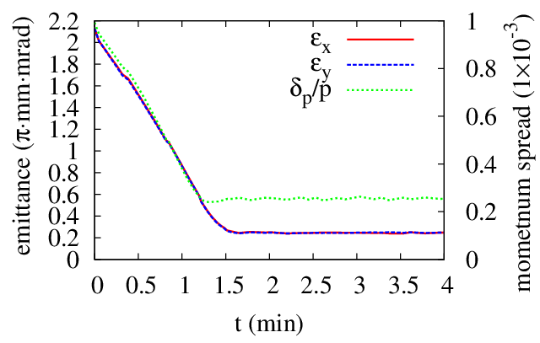
DC Cooling at the Booster
Proton beam:
KE = 2 GeV
Emit = 2.15 mm mrad
dp/p = 0.001
N = 2.8E12
Electron beam:
I = 2 A
T_{tr} = 0.1 eV, T_{s} = 0.1 eV
DC cooler:
L = 10 m
B = 1 T
 |  | IBS | ECOOL | IBS+ECOOL
R_{H} | 1/s | 3.86E-4 | -9.05E-3 | -9.10E-3
R_{V} | 1/s | 3.86E-4 | -9.00E-3 | -8.71E-3
R_{L} | 1/s | 2.27E-4 | -15.3E-3 | -15.3E-3

Slide 10
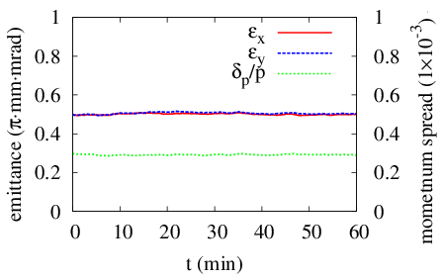
Bunched Cooling at the Collider Ring
Proton beam:
KE = 30/60/100 GeV
Emit = 0.5/0.5/0.4 $μ$m$⋅$rad
dp/p = 3/3/4 $×{10}^{−4}$
$σ_{s}$ = 2.5/2.5/2 cm
N = 6.56E9
Electron beam:
I = 0.2/0.6/1.05 A
T_{tr} = 0.1 eV, T_{s} = 0.1 eV
Bunched cooler:
L = 30$×$2 m
B = 2 T
 |  | IBS | ECOOL
R_{H} | 1/s | 5.70E-3 | -2.85E-3
R_{V} | 1/s | -1.34E-4 | -2.93E-3
R_{L} | 1/s | 8.17E-3 | -8.55E-3
KE_{p}=30 GeV, I_{e} = 0.2 A

Slide 11
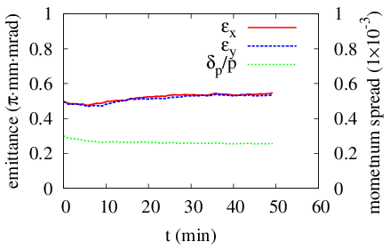
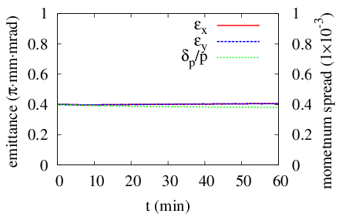
Bunched Cooling at the Collider Ring
 |  | IBS | ECOOL |  | IBS | ECOOL
R_{H} | 1/s | 4.11E-3 | -2.29E-3 |  | 4.74E-3 | -2.36E-3
R_{V} | 1/s | -3.86E-5 | -2.25E-3 |  | -1.71E-5 | -2.32E-3
R_{L} | 1/s | 3.25E-3 | -3.95E-3 |  | 1.17E-3 | -2.96E-3
KE_{p}=60 GeV, I_{e} = 0.6 A
KE_{p}=100 GeV, I_{e} = 1.05 A

Slide 12
III. Cooling with correlated electron beam

Slide 13
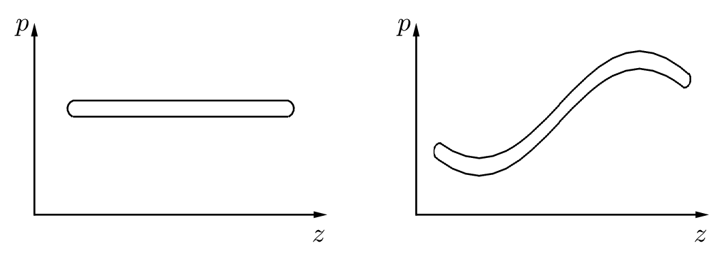
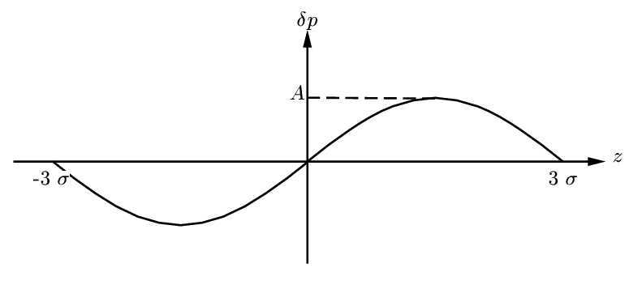
Model of the Correlated Beam
How will the correlation affect cooling rate?
Uncorrelated
Correlated

Slide 14
Cooling with Correlated Beam
Parkhomchuk formula: $F=−V\frac{4Z^{2}e^{4}n_{e}L_{p}}{m}\frac{1}{{\left(V^{2}+Δ_{e,eff}^{2}\right)}^{\frac{3}{2}}}$
Ion beam $V^{2}=V_{⊥}^{2}+V_{∥}^{2}$
Electron beam $Δ_{e,eff}^{2}=v_{eff}^{2}+v_{e,∥}^{2}$
L_{p} also depends on $v_{e,∥}^{}$
If the longitudinal momentum is not correlated with longitudinal position, we use the rms of $v_{e,∥}^{}$ for all the ions.
If the longitudinal momentum is correlated with longitudinal position, the local momentum spread is still $v_{e,∥}^{}$, but the electrons have a drift momentum or velocity, which is determined by its longitudinal position.
In the local electron beam frame, the ion get a drift velocity. $V_{∥}$ is replaced as $V_{∥}−v_{d}$, with $v_{d}$ the drift velocity.

Slide 15
Parameters for Ion & Electron Beam
Proton beam:
KE = 100 GeV,
Emit_n = 0.4 $μ$m
dp/p=4$×$10⁻⁴
Np = 6.56$×$10⁹ /bunch
$σ_{s}$ = 2 cm
Electron beam:
Ne = 1.4$×$10¹⁰/bunch
$σ_{⊥}$ = 0.02 cm
$σ_{s}$ = 2.1 cm
$kT_{⊥}$ = 0.1 eV or $\frac{dp_{⊥}}{p}=4.4×{10}^{−4}$
$\frac{dp_{∥}}{p}∈[1×{10}^{−4}, 5×{10}^{−4}]$
Cooler:
L = 30m$×$2 = 60m
B = 2T
$β_{⊥}$ = 10 m
Collider ring:
Circ = 2153 m
Friction force is calculated for 11 cases from $A=4σ$ to $A=8σ$, and then take the average of them.

Slide 16
Numerical Result
Monte Carlo model.
Enough sample to make sure the result is stable till the third effective digit .
$$δ_{p}$$ |  | Non-correlated |  |  | Correlated
$$×{10}^{−4}$$ | eV | $$R_{x}(×{10}^{−3})$$ | $$R_{y}(×{10}^{−3})$$ | $$R_{z}(×{10}^{−2})$$ | $$R_{x}(×{10}^{−3})$$ | $$R_{y}(×{10}^{−3})$$ | $$R_{z}(×{10}^{−2})$$
1 | 0.00511 | 1.59 | 1.59 | 1.66 | 1.53 | 1.53 | 1.22
2 | 0.02044 | 1.54 | 1.54 | 1.50 | 1.33 | 1.33 | 0.66
3 | 0.04599 | 1.48 | 1.48 | 1.34 | 1.14 | 1.14 | 0.39
4 | 0.08176 | 1.41 | 1.41 | 1.19 | 0.99 | 0.99 | 0.25
5 | 0.12775 | 1.34 | 1.34 | 1.06 | 0.87 | 0.87 | 0.17
Cooling rate is severely reduced, especially in the longitudinal direction.

Slide 17
Numerical Result
Monte Carlo model.
Enough sample to make sure the result is stable till the third effective digit .
Assume the amplitude is 4$σ_{p}$ and does NOT change in the cooler
$$δ_{p}$$ |  | Non-correlated |  |  | Correlated
$$×{10}^{−4}$$ | eV | $$R_{x}(×{10}^{−3})$$ | $$R_{y}(×{10}^{−3})$$ | $$R_{z}(×{10}^{−2})$$ | $$R_{x}(×{10}^{−3})$$ | $$R_{y}(×{10}^{−3})$$ | $$R_{z}(×{10}^{−2})$$
1 | 0.00511 | 1.59 | 1.59 | 1.66 | 1.57 | 1.57 | 1.42
2 | 0.02044 | 1.54 | 1.54 | 1.50 | 1.43 | 1.43 | 0.91
3 | 0.04599 | 1.48 | 1.48 | 1.34 | 1.28 | 1.28 | 0.57
4 | 0.08176 | 1.41 | 1.41 | 1.19 | 1.14 | 1.13 | 0.38
5 | 0.12775 | 1.34 | 1.34 | 1.06 | 1.01 | 1.01 | 0.26

Slide 18
Numerical Result
Monte Carlo model.
Enough sample to make sure the result is stable till the third effective digit .
Assume the amplitude is 2$σ_{p}$ and does NOT change in the cooler
$$δ_{p}$$ |  | Non-correlated |  |  | Correlated
$$×{10}^{−4}$$ | eV | $$R_{x}(×{10}^{−3})$$ | $$R_{y}(×{10}^{−3})$$ | $$R_{z}(×{10}^{−2})$$ | $$R_{x}(×{10}^{−3})$$ | $$R_{y}(×{10}^{−3})$$ | $$R_{z}(×{10}^{−2})$$
1 | 0.00511 | 1.59 | 1.59 | 1.66 | 1.60 | 1.60 | 1.60
2 | 0.02044 | 1.54 | 1.54 | 1.50 | 1.53 | 1.53 | 1.30
3 | 0.04599 | 1.48 | 1.48 | 1.34 | 1.43 | 1.43 | 1.02
4 | 0.08176 | 1.41 | 1.41 | 1.19 | 1.33 | 1.33 | 0.79
5 | 0.12775 | 1.34 | 1.34 | 1.06 | 1.23 | 1.23 | 0.61

Slide 19
IV. Simulation code development

Slide 20
Goals and Approach
Goals:
Enhance the simulation capability for electron cooling in MEIC project
Different scenarios: DC cooling, bunched electron to bunched ion cooling, bunched electron to coasting ion cooling
More flexibility, higher efficiency.
Approaches:
Following the models in BETACOOL whenever applicable
Revise the models whenever needed
Improve the efficiency by strategically arrange the computation
Formulas and models implemented:
IBS: Martini model (no vertical dispersion lattice)
Friction force: Parkhomchuk formula (magnetized cooling)
Cooling rate: single particle model, Monte Carlo model
Cooling dynamics: RMS method (with single particle model or Monte Carlo model), model beam method

Slide 21
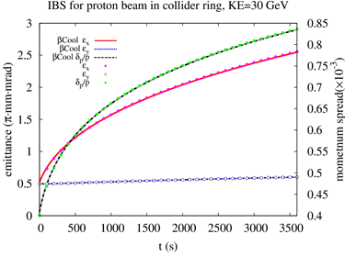
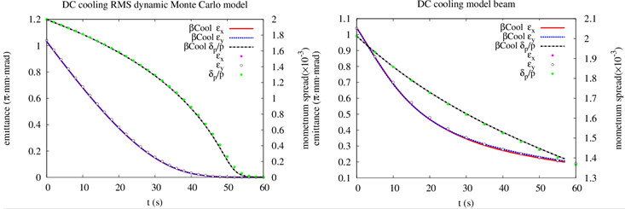
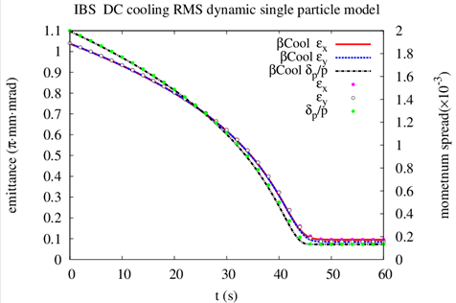
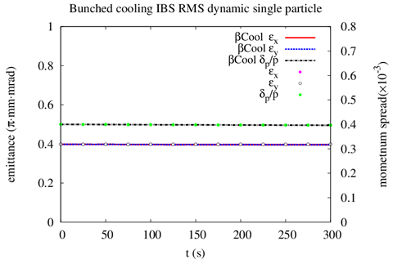
Benchmark with BETACOOL
Time cost: 133 s (BETACOOL 3060 s)
Time cost: 30.7 s (BETACOOL 422 s)

Slide 22
Summary
Staged cooling scheme:
Traditional electron cooling
DC cooling reduce the emittance at 2 GeV (booster)
Bunched cooling maintain the emittance at collision energy (collider)
Simulation suggests the design parameters are achievable, at least in the ideal case.
Challenges: generation and transport of the high current high energy magnetized electron beam (cathode, circulator ring, fast kicker, …)
Start studying on non-ideal case: eg. correlated electron beam, misalignment, …
Other problems: space charge on cooling, bunched cooling induced instability, electron density close to ion density, …

