Slide 1
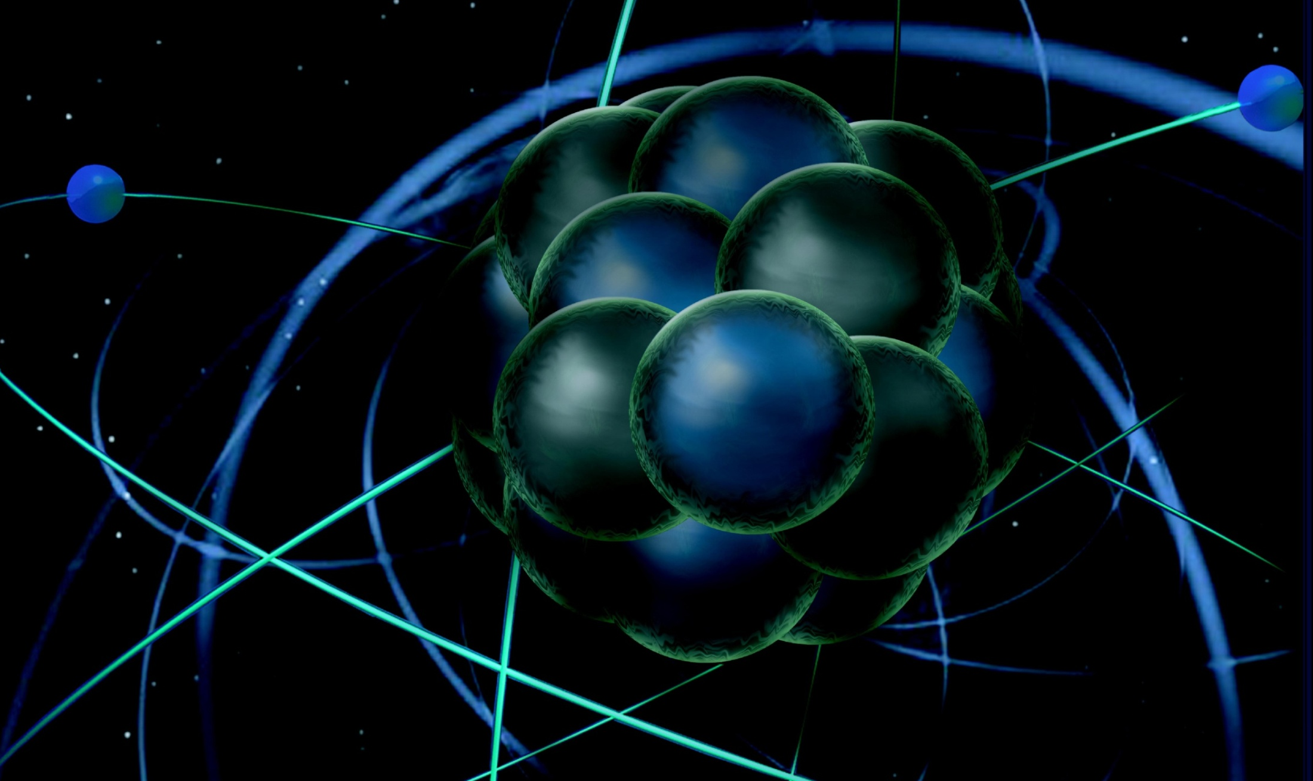
R&D, Collaborations and Closeout Fulvia Pilat
MEIC Collaboration Meeting
March 30-31

Slide 2
Pre-Project R&D (for CD-1)
PROTOTYPES
Development and testing of 1.2m 3T SF magnets for MEIC ion ring and booster Collaboration with Texas A&M, FY15-16
Crab cavity development. Collaboration with ODU, leveraging R&D for LHC/LARP FY15-17
952 MHz Cavity development, JLAB SRF FY15-17
DESIGN OPTIMIZATION
Optimization performance and cost of conceptual design of MEIC ion linac
Collaboration with ANL, FY 15-17
Design and simulation of fixed-energy electron cooling ring (integrated in the Ion Ring arc cryostats) to enable cooling and stacking of polarized ions. Lumi evaluation needed.
Collaboration with Texas A&M, FY 15-17
Optimization of Integration of detector and interaction region design, detector background, non-linear beam dynamics, PEP-II components
Collaboration with SLAC, JLAB Engineering and SRF FY 12-17
Feasibility study of an experimental demonstration of cooling of ions using a bunched electron beam
Collaboration with Institute of Modern Physics, China, FY15

Slide 3
Pre-Project R&D
MODELING
Studies and simulations on preservation and manipulation of ion polarization in a figure-8 and possibly racetrack
Collaboration with A. Kondratenko, FY 13-15
Algorithm and code development for electron cooling simulation
Collaboration JLAB-ODU FY 15-16
Collective effects, analysis and simulations
JLAB, Collaborations TBD, FY15-17

Slide 4
On-Project R&D
PROTOTYPES
Prototype for magnetized ERL e-cooler gun 3 M$
952 MHz prototype cryomodule components 2 M$
Crab cavity prototype cryomodule components 2 M$
Prototype for ion ring IR FF triplet 2 M$
VALUE ENGINEERING (cost and risk reduction)
Super-ferric Cable-in-Conduit magnets R&D for the ion rings 1.5 M$
Optimization of of PEP-II components (tubes, LLRF, vacuum) 1.3 M$
R&D on high-efficiency RF sources 1 M$
Optimization of linac front end components for low duty factor 1 M$
Total 13.8 M$

Slide 5
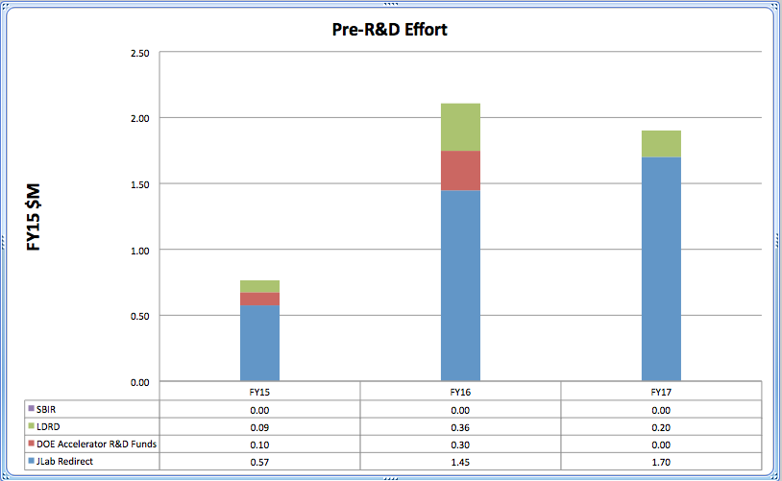
Draft Timeline

Slide 6
MEIC Collaboration Meeting Goals
Define and compare options with the goal of optimizing cost and performance for the:
Injector complex
Electron cooling
(Race-track vs. figure-8)
Discuss and start define roles, responsibilities and deliverables of collaborators for:
Design optimization
Pre-project R&D
CDR writing
Engage industrial partners and form basis for collaboration and potential SBIR’s
Plan future Collaboration Meetings

Slide 7
Define and compare options with the goal of optimizing cost and performance for the:
Injector complex
In general, alternative designs for the injector complex technically not competitive with the baseline SRF linac option
Optimization of the SRF linac and sources for performance and cost. Optimize design and develop a bottom up cost estimate (ANL and JLAB)
Better define potential cost savings of alternative solutions before major re-design efforts
Electron cooling
Evaluate alternative proposal for cooling strategy (DC cooler & freezer), derive luminosity (Texa A&M and JLAB)
Clarify strategy and techniques to be used for e-cooling simulations

Slide 8
Discuss and start define roles, responsibilities and deliverables of collaborators for:
Design optimization
Pre-project R&D
CDR writing
Engage industrial partners and form basis for collaboration and potential SBIR’s
Bilateral meetings with Collaborators at the end of this Meeting and in the next few weeks
Timeline
Pre project R&D plan finalized (including funding sources and profile) end of April
Design optimization and definite choice of baseline for CDR: end of May
Finalize collaboration agreements, labs and industries: end of June including MEIC related and supported SBIR’s - (NP submission deadline mid October)_

