Slide 1
Cooling with Magnetized Electron Beam
Y. Derbenev
MEIC Spring Collaboration meeting
March 30, 2015
CASA/JLab

Slide 2
Outline
Cooler principal layout and parameters
Why magnetized beam?
Magnetized beam transport
Reduction of Space Charge and CSR
Fast kicker
Preview of the source/injector/ERL
Summary

Slide 3
ERL based magnetized HEEC*
E-gun cathode immersed in solenoid
Optical matching between two solenoids through all beam lines
Circulator-cooler ring makes up to 100 time reduction of required beam current from injector/ERL
Fast kickers operated at 15 MHz repetition rate and 2 GHz frequency bend width are required
solenoid
ion bunches
electron bunches
Cooling section
kicker
kicker
energy recovery path
Initial cooling after injection in collider ring
Final cooling after boost & re-bunching,
reaching design values
Continuous cooling during collision for
suppressing IBS
SRF Linac
dump
e-Gun magnetized
Notes:
(see invited talk by Yuhong Zhang, Tuesday June 11)

Slide 4
Magnetized e-beam (MB)
At cathode immersed in solenoid, the gun generates almost parallel (laminar) beam state of a large size (Larmor circles are very small compared to beam size)
Such beam state is then transplanted to the solenoid in cooling section (preserving the magnetic flux across the beam area)
The solenoid field can be controlled to make e-beam size matching properly the ion beam size
MB can be emitted from solenoid and transported as round-rotated in the axial or quadrupole optics, then returned into a solenoid matched
In CCR, MB can be transformed quickly from round to a flat beam in the injection/ejection sections, and returned to a round state

Slide 5
Why Magnetized Electron Cooler? /sinopsis/
Magnetization results in the following critical advantages:
Tremendous reduction (by two orders of value) of very bad impact of the regional and global Space Charge to dynamics in a single path cooler or CCR
(angle kick. tune shift, microbunching)
Strong mitigation (or suppression) of CSR microbunching/energy spread growth
Large mitigation/suppression of very bad impacts of high electron transverse temperature and short-wave misalignments to cooling rates (thanks to ion collisions with “freezed” electrons)
Easing the injection/ejection into the CCR
Notes:
At cathode immersed in solenoid, one can generate almost parallel (laminar) beam state after the gun

Slide 6


Canonical emittances of a magnetized beam
Conventional emittance $ε_{0}$ :
MG generates two circular modes of two very different uncorrelated invariant norm. emittances:
Cyclotron emittance $ε_{c}$ at
/Can be increased by aberrations in two orders of value/
Drift emittance $ε_{d}$ :
Relations to conventional emittance:
$T_{c}=0.1 eV;$
$a_{0}=$3mm ; $ε_{0}=\frac{1}{2}\frac{p_{⟘0}}{mc}a_{0}=0.8μm$
B $=2 KGs :$
$${ r}_{c}=\frac{p_{⟘}}{eB}=5μm; ε_{c}=\frac{T_{c}}{eB}=1.25∙{10}^{−3}μm$$
$$ε_{d}=\frac{1}{2}\frac{Ba^{2}}{mc^{2}}=500μm$$
$\frac{ε_{0}}{ε_{d}}=\sqrt{\frac{ε_{c}}{ε_{d}}}=\frac{r_{c}}{a}=\frac{1}{600}$
$$ε_{0}=\sqrt{ε_{c}ε_{d}} ;$$
An ideally matched transport (from the gun to cooling solenoid) preserves each of two emittances:
The drift emittance is easy to preserve (it is very large!)
The cyclotron emittance being very small is sensitive to aberrations
Three critical issues:
Sensitivity to the Space Charge, especially in the cooling ring ?
Sensitivity to CSR ?
Sensitivity to aberrations ? / an affect to cooling rates ?/
Notes:
The drift emittance is easy to preserve

Slide 7
Cooling rates in a magnetized beam
Short term (instantaneous) rate:
Long term rate (averaged over many ion revolutions):
Notes:
Short term rate:

Slide 8
Magnetized Circulated Cooling
Max/min energy of e-beam | MeV | 54/11
Electrons/bunch | 10¹⁰ | 1.25
Bunch revolutions in CCR |  | ~100
Current in CCR/ERL | A | 1.5/0.015
Bunch repetition in CCR/ERL | MHz | 750/7.5
CCR circumference | m | ~80
Cooling section length | m | 15x2
Circulation duration | μs | 27
RMS Bunch length | cm | 1-3
Energy spread | 10⁻⁴ | 1-3
Solenoid field in cooling section | T | 2
Beam radius in solenoid | mm | ~1
Solenoid beta-function | m | 0.25
Thermal cyclotron radius | μm | 5
Beam radius at cathode | mm | 3
Solenoid field at cathode | KG | 2
Laslett’s tune shift @60 MeV |  | 0.07
Longitudinal inter/intra beam heating | μs | 200

Slide 9
Reduction of the Space Charge impact with a magnetized beam
Requirement to angle kick in a single path EC line:
$\frac{δθ_{e}}{θ_{e}}=\frac{I_{max}L_{c}}{γ^{2}I_{Al}}(\frac{1}{ε_{0}}⟶\frac{1}{ε_{d}}$) << 1; $I_{Al}=$17 KA
Requirement to Laslett detune in CCR:
$δν=\frac{I_{max}Π_{c}}{γ^{2}I_{Al}}∙(\frac{1}{ε_{0}}$ $⟶\frac{1}{ε_{d}}$ + $\frac{l_{k}}{Π_{c}}\frac{2}{ε_{0}})\sqrt{\frac{β_{ky}}{β_{kx}}}$) << 1 ;

Slide 10
Mitigation/suppression of CSR in CCR
Conventional (base line?) agenda : arcs design of CCR with a natural weak (“betatron”) focusing (matched with the cooling solenoid) will introduce a large dispersion. In cooperation with smear of microbunching by the large beam (horizontal) size, Landau damping will suppress the short waves range of CSR. The long waves range (up to the bunch length) is subject of suppression by the vacuum chamber shield effect.
In addition, possibility of using a special method of a background optical control (suppression) of CSR interaction is under study.

Slide 11
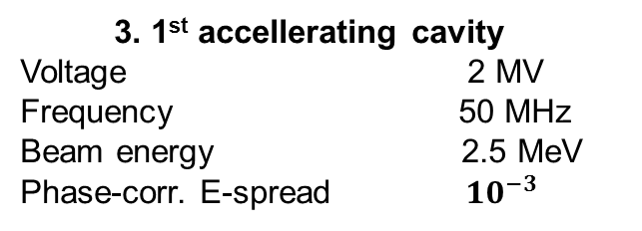
Estimations of Injector for ERL
1. Magnetized grid-operated DC gun
Voltage 500 KeV
Solenoid field 2 KG
Beam radii 2 mm
Pulse duration 1 ns
Bunch charge 2 nC
Peak current 2 A
Rep.rate 15 MHz
Average current 30 mA
2. 1st compressor
Chirper frequency 50 MHz
Voltage 0.33 MV
Energy gradient after chirper 2 x 10%
1st (bent) drift 2 m
Bunch length after 1st compression 7.5 cm
Dechirper frequency 100 MHz
Voltage 0.75 MV
Coulomb defocusing length 1m
4. 2nd compressor
Chirper frequency 250 MHz
Voltage 1.5 MV
Energy gradient 2 x 10%
2nd drift (bent) 2 m
Bunch length, final 2 cm
Dechirper frequency 500 MHz
Voltage 3 MV
Beam radius 2 mm
3. 1st accellerating cavity
Voltage 2 MV
Frequency 50 MHz
Beam energy 2.5 MeV
Phase-corr. E-spread ${10}^{−3}$
Notes:
5. ERL 55

Slide 12
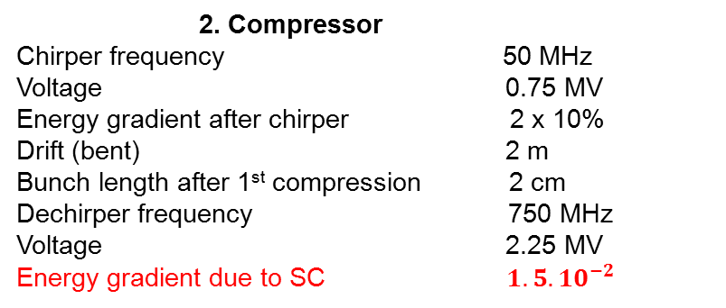
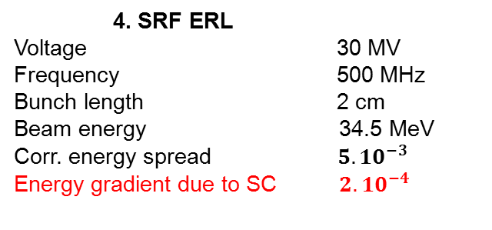
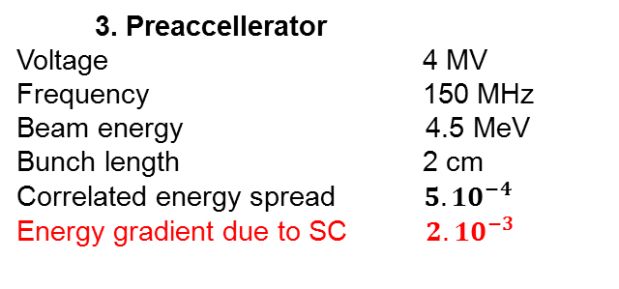
Estimations of Injector for CCR
Notes:
5. ERL 55

Slide 13
Beam-beam Kicker
Ejection/injection of cooling bunches in the horizontal plane by kicks in x-direction
Both beams magnetized
Both beams should be flattened in the kick sections to have a small horizontal size while relatively large the vertical sizes
A short (1~ 3 cm) target electron bunch passes through a long (10 - 20 cm) low-energy flat bunch at a very close distance, receiving a transverse kick :
Coherence conditions:
F
surface charge density
v≈c
D
h
σ_{c}
kicking beam
v₀
L
Circulating beam energy | MeV | 33
Kicking beam energy | MeV | ~0.3
Repetition frequency | MHz | 5 -15
Kicking angle | mrad | 0.7
K- bunch length | cm | 15-30
K- bunch width | cm | 0.5
K-bunch charge | nC | 2

Slide 14
Obtaining a Flat Cooling Beam in the kick-sections
While the magnetized state of a cooling beam is transplanted from the gun to the solenoids in the cooling section, the beam can be made flat at the kicker sections of the circulator ring applying round-to-flat beam transformation proposed for an angular momentum dominated beam [12]. Such transformation can be performed by a special group of skew-quadrupoles matched with optics of the circulator ring. This will create flat beam with two very different plane emittances [7]:

Slide 15
Making of a Flat Kicker Beam
A flat kicker beam can be produced utilizing a grid-operated DC (thermionic) electron gun with a round magnetized cathode. While maintaining the beam in solenoid, one can impose a constant skew-quadrupole field that causes beam shrinking in one plane while enlarging in the other plane due to the drift motion of particles. The process should be adiabatic relative to the particles’ cyclotron motion in the solenoid [6]. The beam current density could be specifically profiled at the cathode to create uniform distribution in a homogenous field in a direction transverse to in the “plane” of flattened beam.

Slide 16
Summary
Magnetized Beam based EC is envisioned compatible with:
- Lumped optics beam transport
RF/SRF acceleration
Circulated EC
The considered advantages of the magnetized EC:
Large reduction of the Space Charge limitations (Laslett tune), thank to the huge CAM emittance (large beam size in solenoid)
Strong reduction of CSR (by use of a large slip in arcs due to both emittance and dispersion)
Strong reduction of impacts of e-beam angle divergence and misalignments to cooling rates
Easing the kicker constraints – by use round to flat beam transformations
make Magnetized Beam a prominent concept for efficient cooling of intense short bunches ion beams in EIC.
The end of the story… – hopefully, for the
beginning of a real work!
– Thank you! -

Slide 17
Backup pages

