Slide 1
Magnetron R&D Needs
for MEIC High Efficiency RF Sources
Haipeng Wang, Jefferson Lab
MEIC RF high power needs and efficiency problem for the NC RF structures
Comparison of klystrons and magnetrons and motivation of magnetron R&D
R&D demonstrations for magnetron phase and amplitude controls in the past
Amplitude control requirement for a SRF cavity, CW and pulsed modes
Early magnetron design, phase lock and frequency pushing and pulling models
More R&D needs for the magnetron RF system application for MEIC (CEBAF) like machine operation

Slide 2
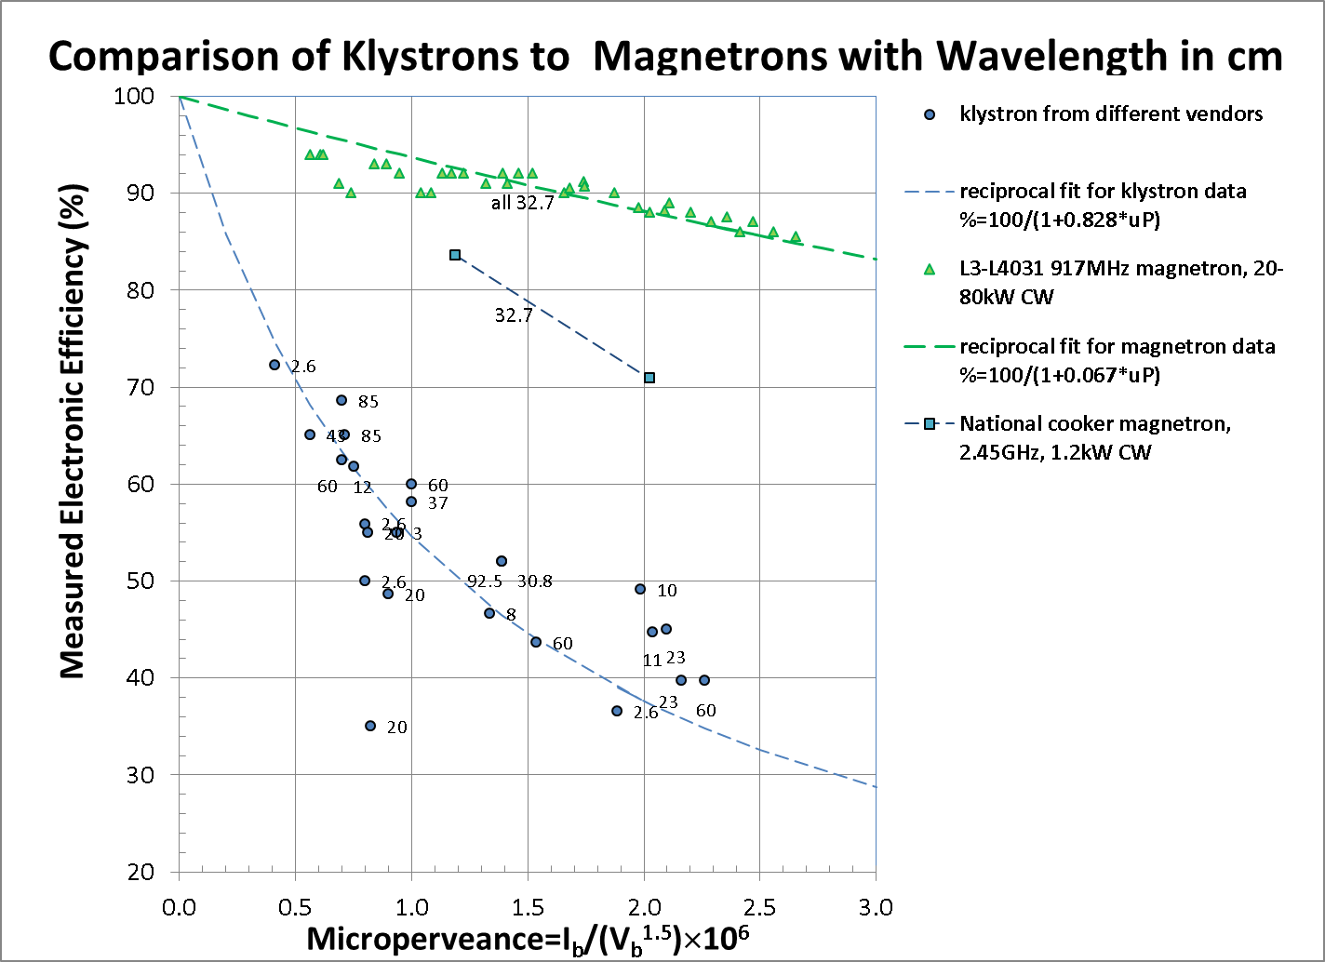
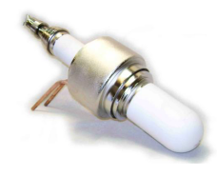
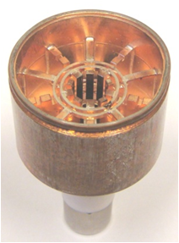
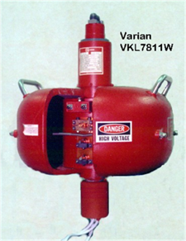
Comparison of Klystrons verses Magnetrons
Why?
Klystron: Space-charge effect in electron bunch forming process in linear motion dominates the efficiency. Spent energy deposits in the collector.
Magnetron
forms bunches in spoke-on-hub process in circular motion. Beam-to-RF cavity interaction in multiple passes. Much less wasted energy.
L3 20-80kW magnetron
L3 13 kW klystron
National 1.2kW oven magnetron
Varian 5kW klystron

Slide 3
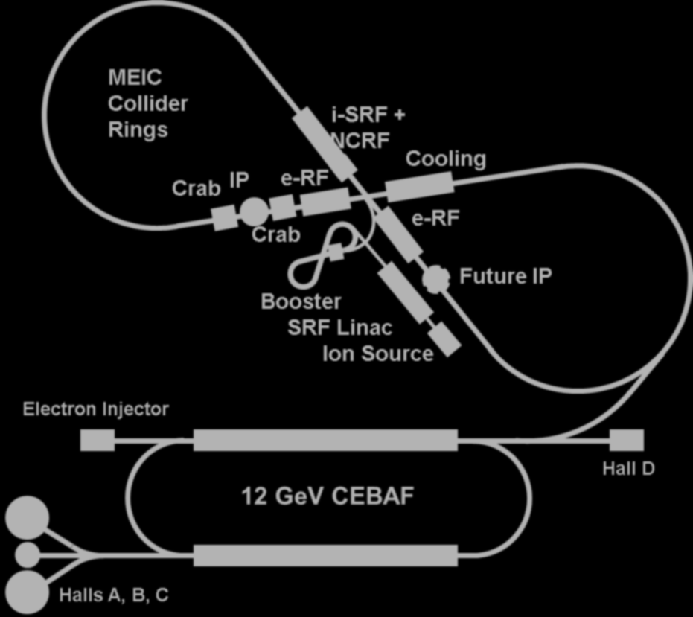
MEIC High Frequency, High Power RF Power Needs
 | CEBAF 12GeV | E-Ring PEP-II 10GeV | Ion-linac Pb 60MeV/u | Booster | Ion-Ring Pb 40GeV/u |  | CC-ERL Cooler 55MeV | Crab (16+6)X2MV
Frequency (MHz) | 1497 | 476.3 | 162.5 /325 | 0.6-1.3 | 1.2-1.3 | 952.6 | 476.3 /952.6 | 952.6
Duty Cycle (%) | cw | cw | 0.5 | ramp | ramp | cw | cw | Cw
Cavity | sc 2K | nc | nc | nc | nc | sc 2K | nc/sc 2K | sc 2K
Max Peak Power(MW) | 2.76 | 12.79 | 42 |  | 0.36 | 0.73 | 0.12 | 0.0023
Average Power (MW) | 2.76 | 12.79 | 0.46 | 0.084 | 0.36 | 0.73 | 0.12 | 0.0023
Klystron DC-RF Efficiency (%) | 35-51 | 67 | 50-60 | na | na | 50-60 | 50-60 | 50-60
Magnetron DC-RF Efficiency (%) | 80-90 | 80-90 | 80-90 | na | na | 80-90 | 80-90 | 80-90
DC Power Save (MW) | 3.4-3.8 | 3.1-4.9 | 0.26-0.35 | na | na | 0.41-0.55 | 0.07-0.09 | 0.0013-0.0017
cost reduction driver for magnetron R&D
Magnetrons can save MEIC DC power of 7.2-9.7MW, or $3.9-5.2M annual (41wks) power bill cost.

Slide 4
Comparison of Klystrons verses Magnetrons
Klystrons: (vs Linacs)
Linear amplifier
Can be driven by a low level signal in linear gain regime
Output phase and amplitude can be controlled at both low and high levels
High gain, high production cost ($5-25/output Watt)
Low DC-RF efficiency at high perveance level
Can be operated in both CW and pulsed with modulator modes
Magnetrons: (vs Synchrotrons)
Saturated oscillator
Do not need a drive (seed) for oscillation (high power) output
Output phase can be controlled by an injection signal back to oscillator.
High gain if design properly, low production cost (<$1/output Watt)
High DC-RF efficiency even at high perveance level
Can be operated in both CW and pulsed (with modulator) modes
Need amplitude control ! How?
Could magnetron be operated as a voltage controlled oscillator while maintaining the injection phase lock?
Magnetron R&D needs to answer:
If yes, it can apply to the SCRF accelerator
If no, it still can service the NCRF accelerators where copper is dominant RF loss

Slide 5
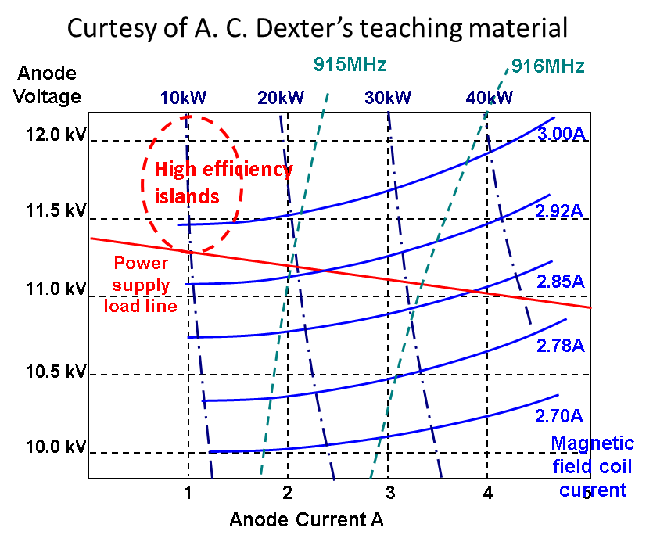
Complication of Magnetron Phase and Amplitude Controls
Phase of output follows the phase of the input signal
Phase shift through magnetron depends on difference between input frequency and the magnetrons natural frequency
Output power has minimal dependence on input signal power
Phase shift through magnetron depends on input signal power
There is a time constant associated with the output phase following the input phase
Magnetron frequency and output vary together as a consequence of
Varying the magnetic field
Varying the anode voltage (pushing)
Varying the reflected power (pulling)
0º
towards
magnetron
Arcing
Moding
900 W
700 W
800 W
VSWR
270º
2
3
4
6
90º
+5MHz
-5MHz
+2.5MHz
-2.5MHz
180º
+0MHz

Slide 6
Magnetron Injection Works as a Reflection Amplifier
Cavity
Principle of injection phase lock
Adler Equation (1946):
Load
Magnetron
Steady state solution
Circulator
Injection Source
[1] J.C. Slater “The Phasing of Magnetrons” MIT Technical Report 35, 1947
[2] J. Kline “The magnetron as a negative-resistance amplifier,”
IRE Transactions on Electron Devices, vol. ED-8, Nov 1961
[3] H.L. Thal and R.G. Lock, “Locking of magnetrons by an injected r.f. signal”,
IEEE Trans. MTT, vol. 13, 1965
Notes:
The most convenient way to set up a magnetron as a reflection amplifier is with a circulator.

Slide 7
Power Needed for Injection Phase Locking
The minimum locking power is given when sin ψ = 1
P_{RF} is output power
Q_{L} refers to the loaded magnetron.
For our 2.45 GHz cooker magnetron
Pushing
(f_{i} –f_{o}) due to ripple ~ 2 MHz
(f_{i} –f_{o}) due to temperature fluctuation > 5 MHz
-23.5dB in actual experiment demo in 2010
For pulse mode operation, startup time is critical
Time response ~
~ 200 ns ~ 500 RF cycles

Slide 8
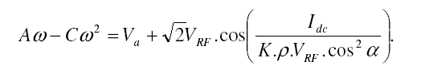
Vaughan Magnetron Analytical Model (1973)
It shows that the magnetron can be treated either as a voltage controlled oscillator or as a current controlled oscillator.

Slide 9
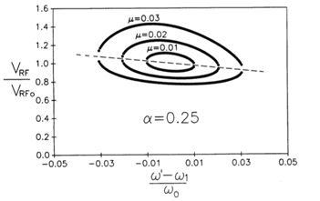

Injection Phase Locking Bandwidth and Stability Analysis by Chen’s Model 1989
Extension of Adler’s equation
Amplitude V change can be changed by changing V_{DC} and B_{DC}.
V_{DC} and B_{DC} will change I_{DC,} then I_{RF}
I_{RF} will cause the frequency pushing effect
Frequency pushing determined by the phase lag between beam spoke and RF crest α (beam dynamics)
Can be compensated by frequency pulling effect by an inductive load
Injection amplitude and frequency can be also used to control the (phase locked) output amplitude but limited by S/N ratio
θ₁
stable
θ₂
unstable
$$σ_{m}=μsinα$$
Free running freq.
Injection freq.
magnetron natural freq.
Both θ₁ and θ₂ caused by frequency pushing parameter α=0.25
locked frequency offset determined by the injection parameter μ
Higher injection signal enlarges the locking bandwidth
Frequency pulling causes the bandwidth and amplitude asymmetric
This model can be included in the Simulink simulation.

Slide 10
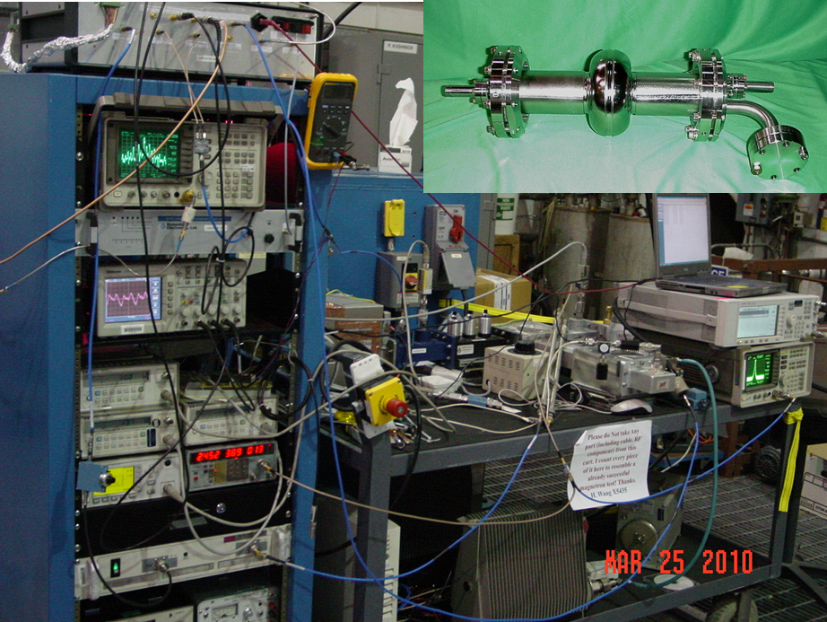
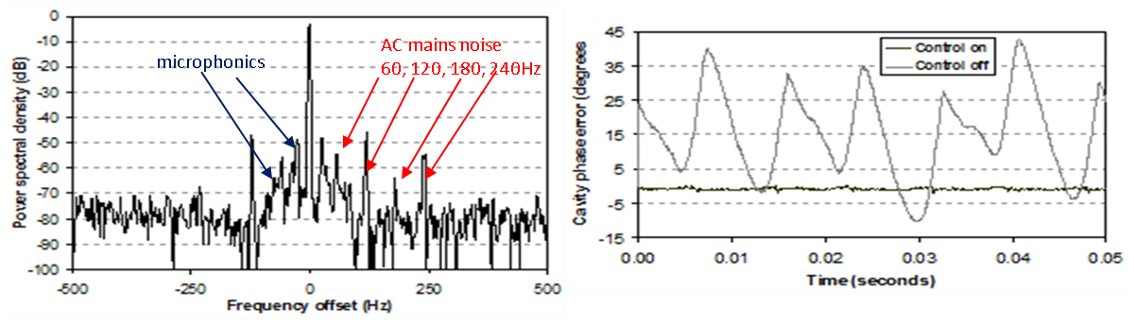
JLab R&D Result on Magnetron Driven SRF Cavity with Injection Phase Locking in 2010
“First Demonstration and Performance of an Injection Locked CW Magnetron to Phase Control a Superconducting Cavity” was done at JLab in conjunction with Lancaster University, UK, in 2010 [1] with accuracy of 0.95º rms , -23.5dB injection on 540W output
References:
[1] H. Wang, I. Tahir, A. C. Dexter etc., Use of an Injection Locked Magnetron To Drive a Superconducting RF Cavity, Proceedings of IPAC 2010, Kyoto, Japan, May 23-28-2010.
[2] A. C. Dexter, G. Burt, R. G. Carter, I. Tahir, H. Wang, K. Davis and R. Rimmer, PRST-AB, 14, 032001 (2011).
[3] M. Nuebauer, A.Dudas, R. Rimmer, H. Wang, An Efficient RF Source for JLab, PAC 2013, Pasadena, CA, USA.
[4] H. Wang, T. Plawski, R. Rimmer, A. Dexter, I. Tahir, M. Neubauer, A. Dudas, System Study Using Injection Phase Locked Magnetron as an Alternative Source for Superconducting Radio Frequency Accelerator, IVEC 2014, Monterey, CA.

Slide 11
Proposal to SPL Project by A. C. Dexter in SPL09
Phasor diagram
Permits fast full range phase and amplitude control
output of magnetron 1
output of magnetron 2
Cavity
Combiner/magic tee
Advanced Modulator
Advanced Modulator
440 kW Magnetron
Load
440 kW Magnetron
Fast magnetron tune by varying output current
Fast magnetron tune by varying output current
~ -30 dB needed for locking
440 W
440 W
LLRF
440 kW Magnetron design is less demanding than 880 kW design reducing cost per kW, and increasing lifetime and reliability.

Slide 12
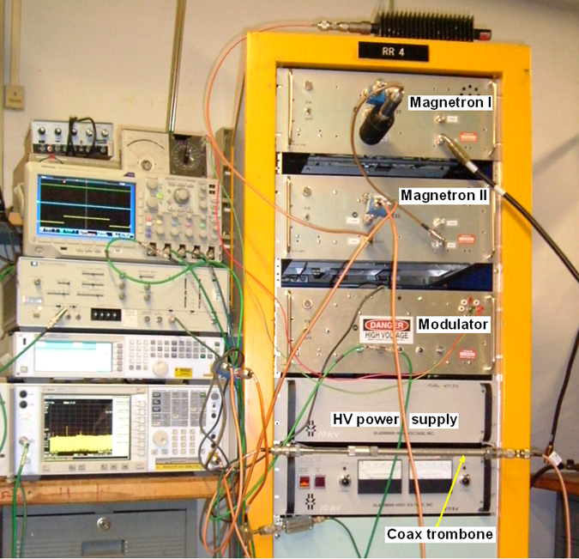
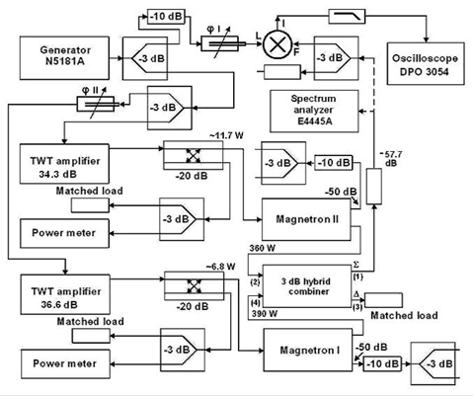
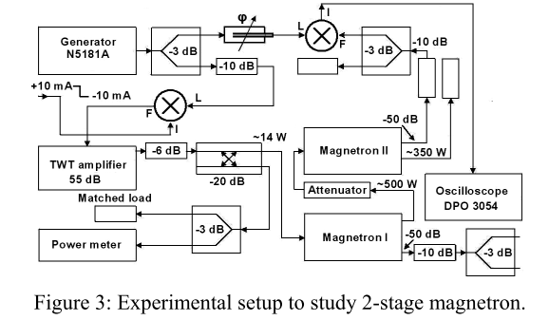
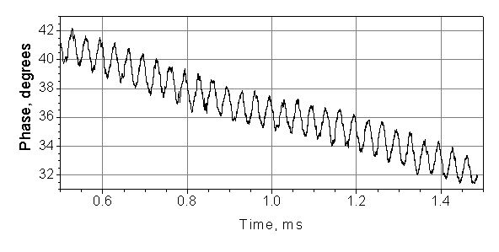
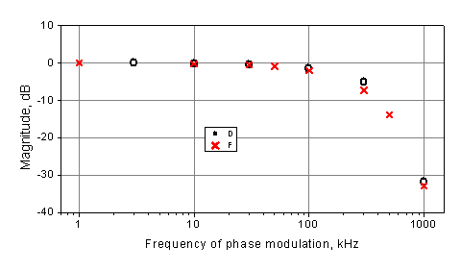
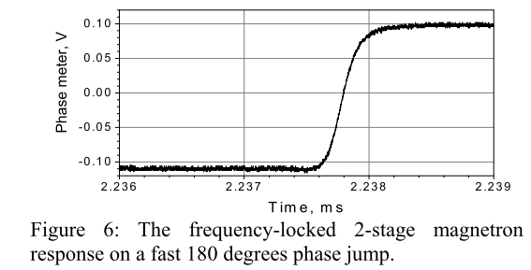
Gregory’s Injection Phase Locked Magnetron Experiments
Two stage cascade for pulsed response
Power combine by vector sum
Power combine with PM in 30kHz, phase slew ~10º, locking BW~ 1MHz
Response of the frequency-locked 2-cascade magnetron on a fast 180 degrees phase flip measured at P_{out}/P_{loc}k= 33.5 dB.
All experiments were done on 1.2kW, 2.45 GHz cooker magnetrons to a match load

Slide 13
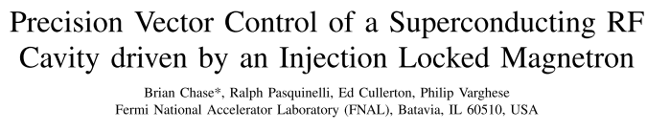
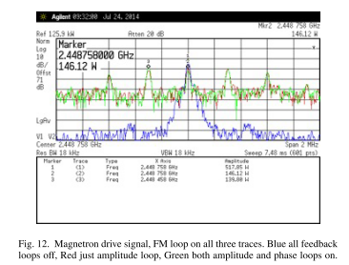
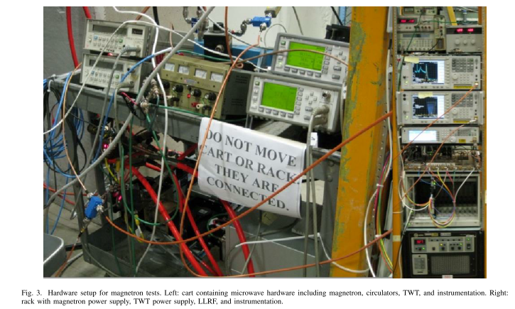
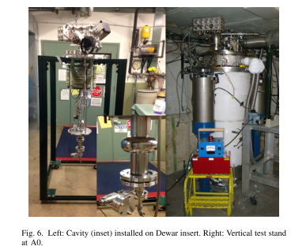
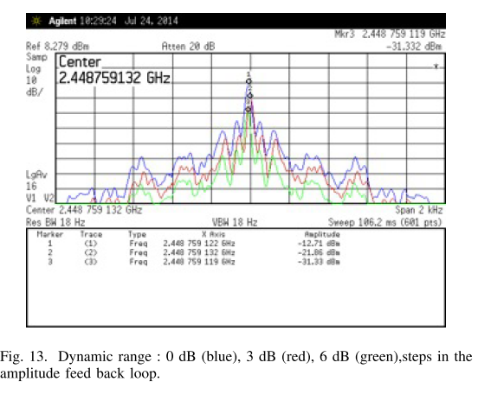
Magnetron Amplitude Control by PM Scheme at Fermi Lab
Experiment was done in May, 2013 using JLab provided single-cell 2.45GHz SRF cavity
PM drive signal
Experiment was done at both 2K and 4K
Transmitted signal with 6dB dynamic range

Slide 14
Why Does RF Source Need Large Amplitude Control Range for a SRF Cavity?
Example of CEBAF C100 cavity, Qext=3.2E7, 20MV/m, 480uA
Cavity wall is lossless
Beam loading is dominated power
Microphonics vibration consume extra power than the beam only need for fixed gradient operation
Need ~10dB dynamic range in RF source power output

Slide 15
Efficiency Issue of Amplitude Control by Phase Modulation or Vector Sum
0 to 10 V corresponds to TTL control signal for RF amplitude from 0 to 100%
Vector Sum (VS) scheme wastes the vector difference (VD) power to the circulator
Phase Modulation (PM) scheme wastes the sideband power to the circulator
Both schemes end up lower efficiencies when amplitude output requirement is low
for output amplitude range from 0 to 100%

Slide 16
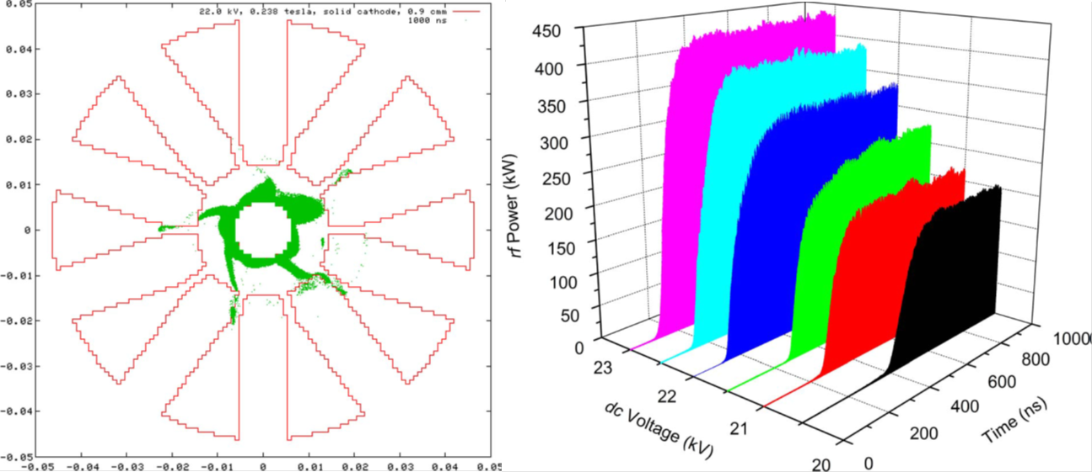
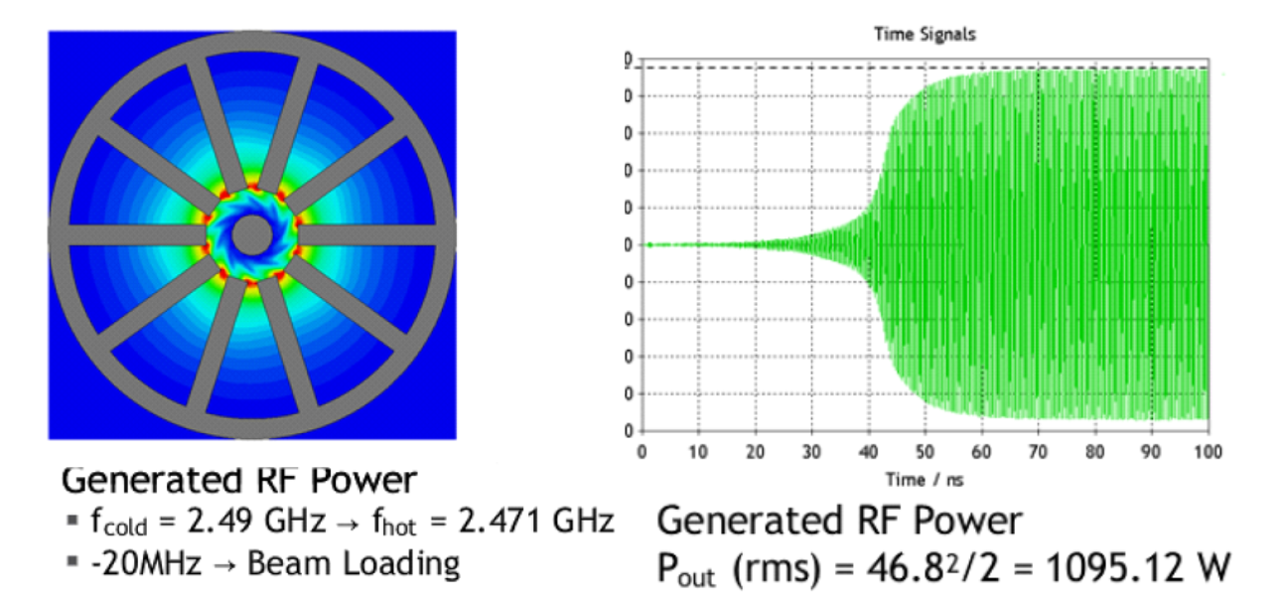
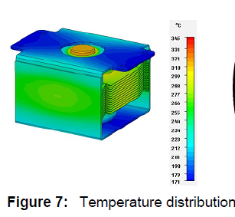
Simulations of PIC Codes Design to Understand the Startup and Noise
Left: computer simulations
by ICEPIC
Bottom: Multi-physics simulation by CST

Slide 17
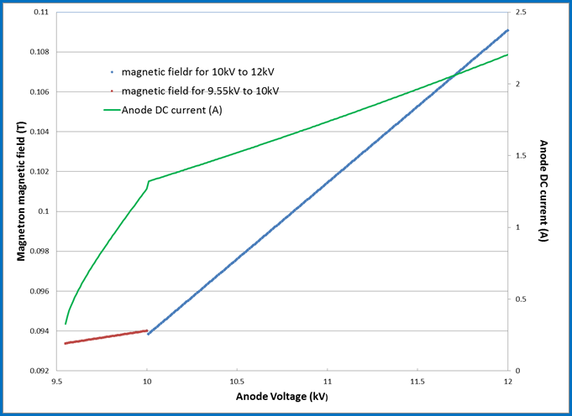
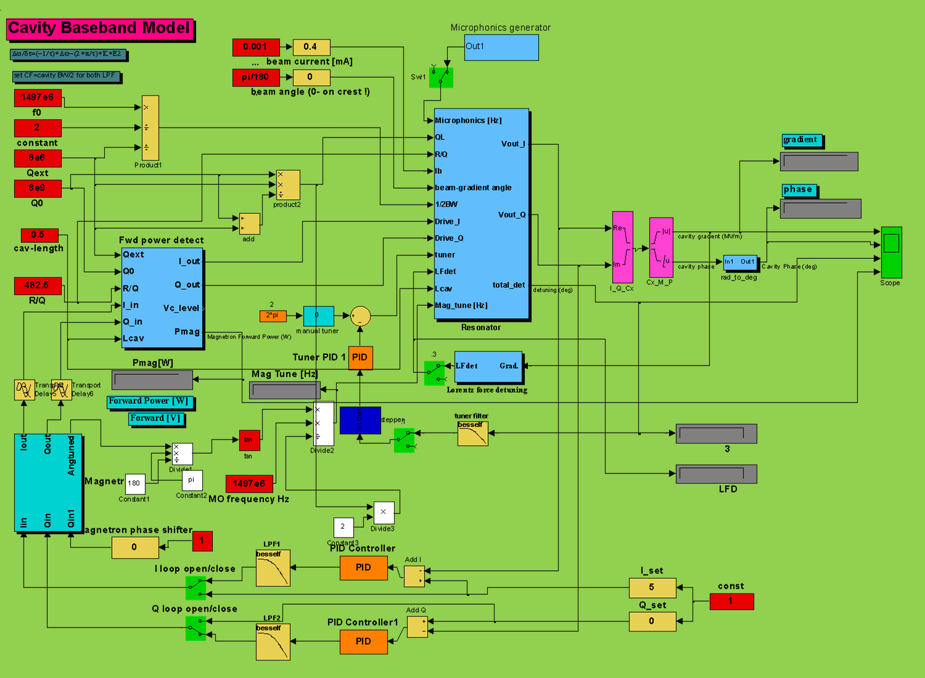
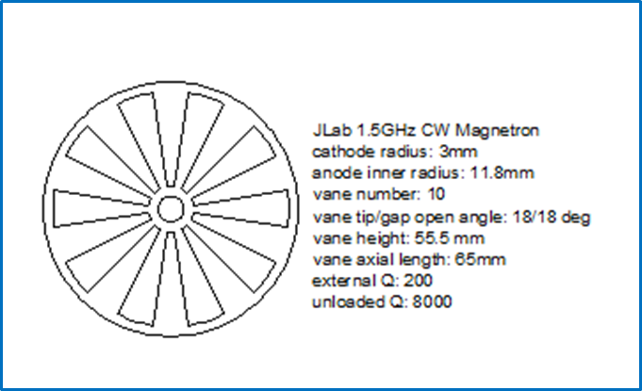
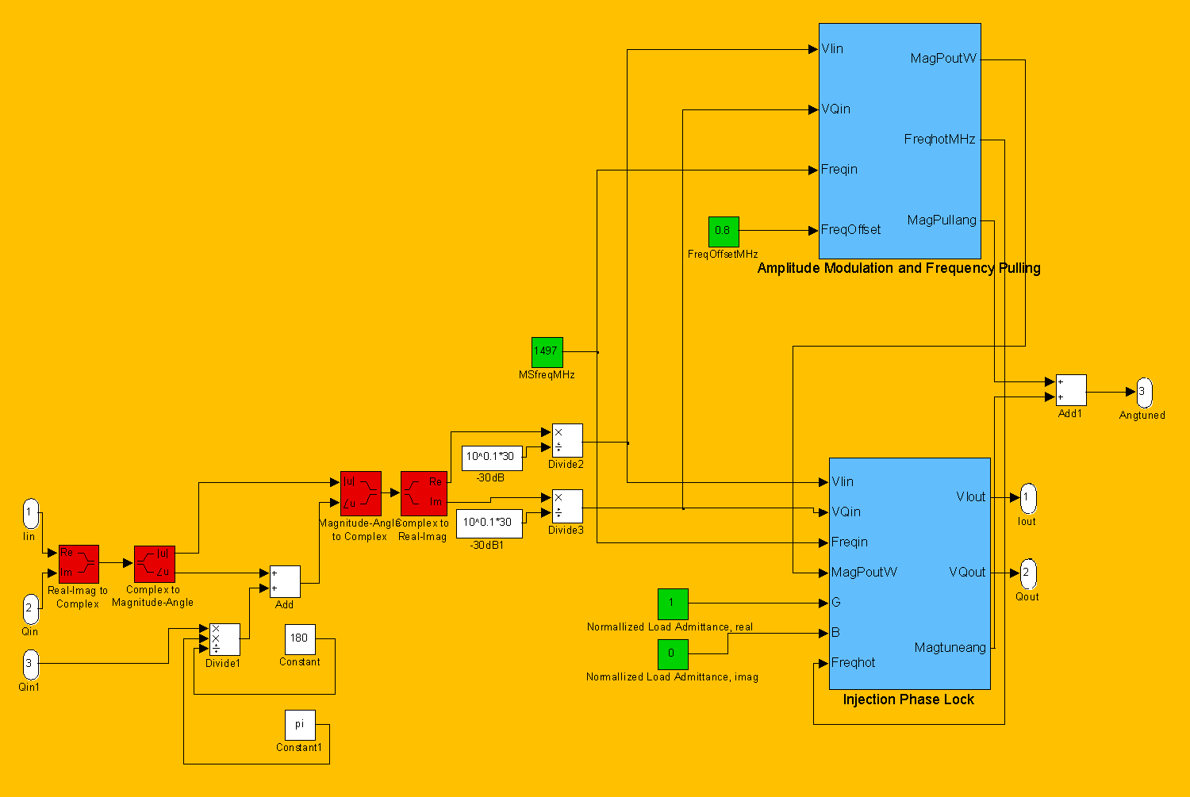
Simulink Simulation Result for IVEC April, 2014
Magnetron design & control with Vaughan model
Klystron LLRF SEL/GDR control system at 15MV/m for C50 cavities
Using a -30dB injection signal, the Adler model phase locks the Vaughan model magnetron
Phase lock within +-0.8MHz frequency pulling by anode current
Otherwise a frequency pushing needs to be used
For a 10dB amplitude variation, control can use a linear response of anode voltage and magnetic field
For the microphonis control need, it is normally sufficient
To get both amplitude and phase control, different gain is needed in each regulation slop.
The magnetron can be modelled as an anode voltage controlled oscillator, loop gain and bandwidth of LLRF control determine the locking stability and accuracy
Frequency pulling by the output circuit of magnetron has not been simulated in this model.
Need to include Chen’s model for stability simulation

Slide 18
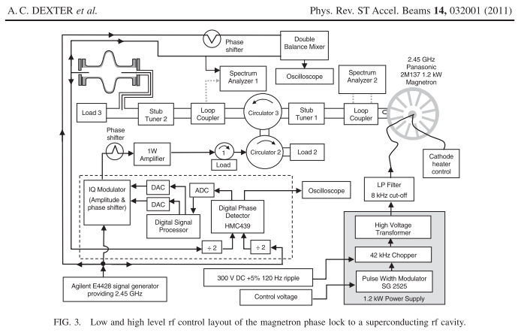
Restart of JLab R&D Effort on Magnetron RF Source for Amplitude Control
Purchase new 2.45GHz, 1.2kW oven magnetron system
Customized C100 type LLRF control module
Modify magnetron electro-magnetic circuit
Reduce industrial type
DC PS chopper noise

Slide 19
Summary
High efficiency and low construction and operation costs of magnetron RF system have a significant benefit for CEBAF and MEIC operations
Injection phase lock of a cooker magnetron to drive a SRF cavity has been experimental demonstrated at JLab with the collaborators from LU, UK in 2010
With injection phase lock, Fermi lab has demonstrated Phase Modulation scheme of magnetron amplitude control in 30dB dynamic range for a SRF cavity operated at 4K
Power combined and cascaded magnetron schemes for the pulse mode operation have also been experimented on the match load
For high efficiency magnetron operation, the goal of application to CEBAF and MEIC, particularly for the SRF cavities, the amplitude control is a critical R&D item
Magnetrons need further model validation, simulation study, design prototype in new frequencies
Need an experimental R&D program to study the LLRF digital ,non-linear programmable controls for the klystron drop-in replacement and in high efficiency operation.
Magnetron with injection phase lock only scheme is nearly ready for the pulsed mode operation of NC ion linac and CW mode for storage ring operation if amplitude regulation requirement is >60%, then the advantage of high efficiency is benefit

