Slide 1
Multi-Harmonic Bunched Electron Sources
Vadim Jabotinski and Alexei Kanareykin
Euclid TechLabs
Gaithersburg, MD Chicago, IL
MEIC Collaboration Meeting Spring 2015
Jefferson Lab • March 30-31, 2015

Slide 2
Outline
Multi-Harmonic Excitation of Emission
Normal Conducting Magnetized Electron Source
Superconducting Source
Multi-Harmonic Linearization
Modeling, Simulations, and Software tools
Summary

Slide 3
Multi-Harmonic Bunched Electron Gun
Concept
1st reduced-length accelerating cell
RF excitation
650…3000 MHz
+ harmonics
Thermionic cathode
Option: FE cathode
Option: Gap-cavity tuned
to 3rd harmonic
Shorter bunch duration Injection phase Temporal profile

Slide 4
Multi-Harmonic Excitation of Emission
Thermionic and FE: Harmonics allow shorter bunch length
Gating the emission with the
1st harmonic (conventional IOT)
Gating the emission with the
1st and 3rd harmonics.

Slide 5
Normal Conducting Magnetized Source
Thermionic : High-peak current, high-bunch charge, low-emittance
Emittance compensation solenoids
Downstream
acceleration,
compression,
EEX to round
ε_{x,n}/ε_{y,n}/ε_{z,n}
<0.15/0.15/10
Magnetization coil
Skew quadrupole
triplet
Accelerating cells
Multi-harmonic
linearizer
RF excitation
650…3000 MHz +
harmonics
Thermionic cathode
R~0.5-4 mm
0.1-2 nC
Option: FE cathode
12 keV
0.3 MeV
8 MeV
7 MeV
2-30 ps rms
Round beam
E-spread min.
7 MeV
2-30 ps rms
Flat beam
ε⊥ uncorrelated
Option: Tuned to the 3rd harmonic
ε_{x,n}/ε_{y,n}/ε_{z,n} (μm) 1.22/1.22/0.15 0.15/10/0.15

Slide 6
Normal Conducting Magnetized Source
Photocathode : High-peak current, high-bunch charge, low-emittance
Emittance compensation solenoids
Downstream
acceleration,
compression,
EEX to round
ε_{x,n}/ε_{y,n}/ε_{z,n}
<0.15/0.15/10
Magnetization coil
Skew quadrupole
triplet
Accelerating cells
Multi-harmonic
linearizer
Photocathode
Can emit spin-polarized e-beam
Needs laser
0.6 MeV
8 MeV
7 MeV
2-30 ps rms
Round beam
E-spread min.
7 MeV
2-30 ps rms
Flat beam
ε⊥ uncorrelated
ε_{x,n}/ε_{y,n}/ε_{z,n} (μm) 1.22/1.22/0.15 0.15/10/0.15

Slide 7
Superconducting Source
High-average current, CW, high-bunch charge, low-emittance
Emittance
compensation
solenoids
SRF ½-cell
SRF cells
Multi-harmonic
linearizer
RF excitation
650…3000 MHz +
harmonics
quadrupoles
Thermionic cathode
R~0.5-4 mm
Option: FE cathode
7 MeV
ΔE-min.
12 keV
0.5 MeV
8 MeV
2-30 ps rms
Round beam
EXIT: 7 MeV
2-30 ps rms
Flat beam
ε⊥ uncorrelated
Option: Tuned to the 3rd harmonic

Slide 8
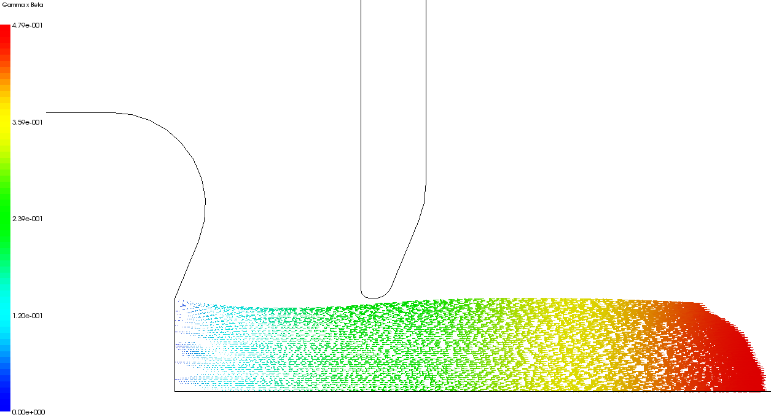
Formation of bunched electron beam
solenoid
1st reduced-length cell
β
5-20 mm
0.48
0.36
0.24
0.12
0
Aperture
RF excitation
650 MHz +
3rd harmonic
Cathode
Beam axis
R=0.5 mm E_{acc}=30 MV/m B=0.4 T j_{e}=120 A/cm² ε_{⊥ RMS Norm}=2 μm

Slide 9
Effect of Injection Phase and
3rd Harmonic Linearization
Effect of the injection phase
Red – for acceleration
Blue – for bunch compression
3rd harmonic linearization
Higher harmonics reduce ΔE

Slide 10
Bunch induced current and phase space
Bunch current after the 1st cell
r-r’ phase space

Slide 11
Modeling, Simulations, Software tools
New physics models with Advanced codes
RF solver Analyst AWR / National Instruments
Particle emission and transport
MICHELLE Leidos (formerly SAIC)
Advanced meshing facility
Visualization
User friendly interface
Parallel computing, handling large meshes
Variety of emission models, thermal effects
Some models:
FE, breakdown, plasma, multi-particle and beam systems

Slide 12
Summary
Multi-harmonic emission excitation in combination with magnetized electron beam can be the approach to higher-quality electron bunches
Higher order harmonic linearization reduces the bunch energy spread and thus the phase space volume
Normal-conducting configuration is good for pulsed regimes with high-peak current bunches
Superconducting configuration is good for CW regimes with high-peak and high-average current bunches
We develop and implement our new physics models into advanced simulation codes

