Slide 1
MUONS, INC. & MUPLUS, INC.
Batavia, IL Newport News, VA
μ
Muons, Inc.
CREATIVE, experienced physicists and engineers
Founded 2002 - by R. Johnson (10y LBNL, 17y FNAL, 3y Maxwell, 5y JLab, 12 MI )
Infrastructure and partners at 9 National Labs and 8 universities
PARTICLE ACCELERATOR R & D
Muon Collider, Neutino Factory, Muon Decay Expts (Mu2E, g-2)
muon beam cooling – Helical Cooling Channel, High Pressure RF, PIC (YD, VM)
Superconducting RF accelerators/components (RAR, FM, HW)
magnetron RF power sources, power couplers, HOM dampers, loads
Designs and Simulations (VM)
G4beamline (GEANT4), CST, ACE3P, MuSim (MCNP6, GEANT4, MARS, ….)
Ion Sources - polarized et al - new SBIR with SNS for CW H- or p source with saddle antenna.
Special devices for unique applications
Superconducting radiation-tolerant, extreme high-field magnets
Supported 7 post-docs, 7 subgrant postdocs (Amy Sy), 4 Ph.D. Students
Funded at ~$3.5M/y revenue
SBIR-STTR grants – 50 Phase I, 25 Phase II, (~$26,000,000 total in 13 y)
DOE Laboratory contracts – PNNL, LANL, Fermilab, JLab
Contracts with industries – Niowave, Lockheed Martin

Slide 2
MUONS, INC. & MUPLUS, INC.
Batavia, IL Newport News, VA
μ
Muons, Inc.
MuSim – (Tom Roberts) new graphical user interface to all simulation programs, including G4beamline and MCNP6. MuSim is a new and innovative graphical system that permits the user to construct, explore, optimize, analyze, and evaluate accelerator and particle-based systems efficiently and effectively. (investor funded)
Ion Sources – (Vadim Dudnikov)
new Phase II SBIR grant with ORNL-SNS for CW H- or p source -Stockli
saddle RF antenna surface plasma source
(Still looking for funding polarized source development)
magnetron power sources (Mike Neubauer, Al Dudas)
building a 350MHz CW 120 kW magnetron for Niowave (investor funded)
new STTR grant with JLab to replace CEBAF 1497 MHz klystrons -Haipeng
accelerator design – (me, Tom Roberts)
new STTR grant with JLab and Niowave to design an ERL for radioisotope production – Geoff
RF Components – loads (SLAC Ph II), SC RF gun, couplers, circulators,...

Slide 3
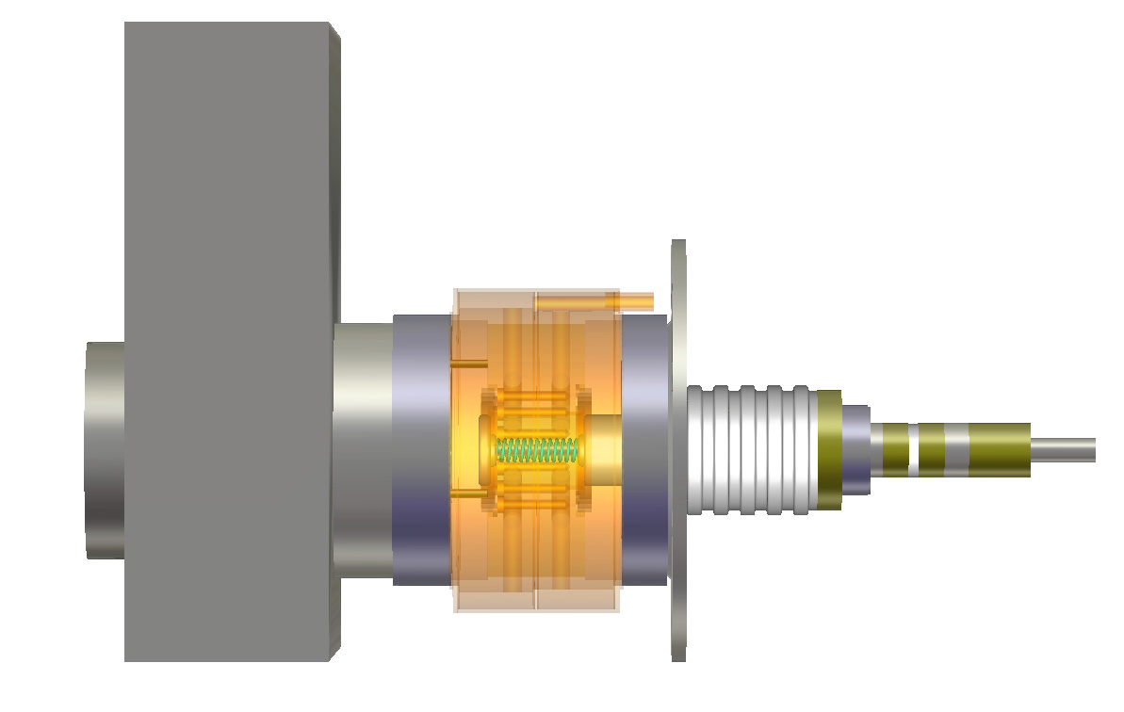
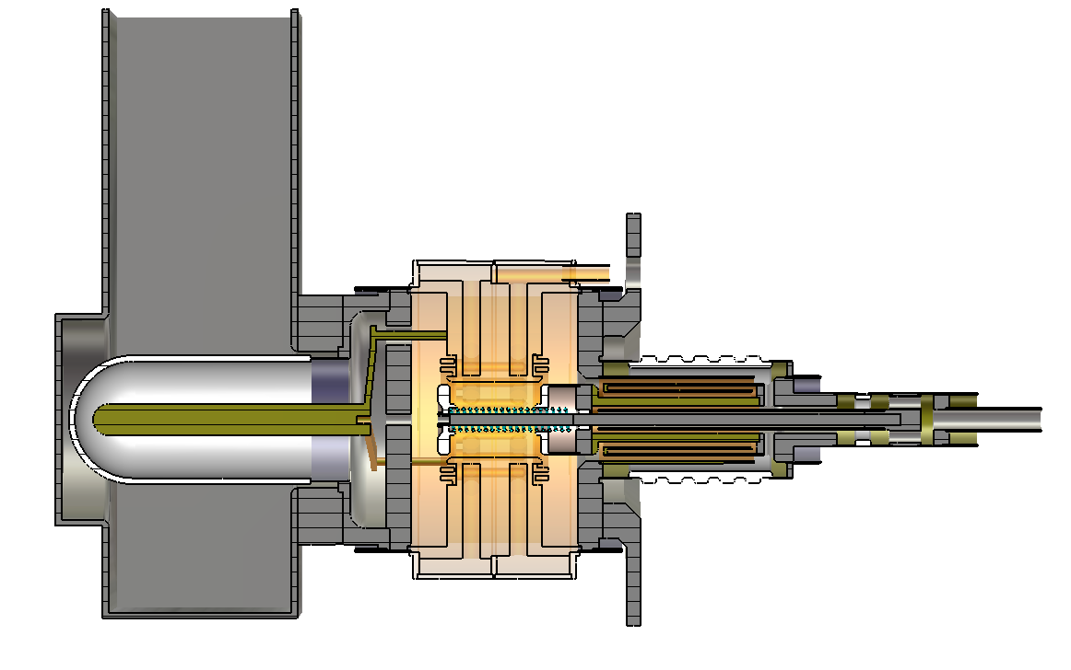
μ
Muons, Inc.
CST 3d model of magnetron power source

Slide 4
G4beamline User Survey, September 2014 Tom Roberts, Muons, Inc.
μ
Muons, Inc.
In February 2013 a survey was added to the g4beamline.muonsinc.com download page.
It asked users to make a broad-brush estimate of how much time they have spent using
G4beamline, including all design and analysis for which G4beamline was an essential tool.
Between then and September 2014, G4beamline was downloaded 920 times, and users
have self-reported 87 FTE-years of usage.
Jan. 2013 Oct. 2013 Sept. 2014
Total estimated non-SBIR usage 40 FTE-years 57 FTE-years 87 FTE-years
Average time using G4beamline 3.1 years 2.1 years 1.4 years
Estimating an FTE-year to cost $200k, this represents at least $17 Million in investment by the G4beamline user community. Multiple downloads by a single person have been removed, as have spam and other junk records; all of the people reporting usage > 1 FTE-year are known to me. As only 20% of the downloads provided data, this is clearly an underestimate. The decrease in the second row shows the user community is growing.
For an encore, Tom has created Muonsinc Simulation (MuSim) GUI to MCNP6

Slide 5
MuSim Tom Roberts, Muons, Inc.
μ
Muons, Inc.
MuSim is a new and innovative graphical system that permits the user to construct, explore, optimize, analyze, and evaluate accelerator and particle-based systems efficiently and effectively. It is designed for both students and experienced physicists to use in dealing with the many modeling tools and their different description languages and data formats. It will be easy to use fast but less realistic codes to design and optimize a system, and then use slower but more realistic codes to evaluate its performance. Graphical interfaces are used throughout, making it easy to construct the system graphically, display the system with particle tracks, analyze results, and use on-screen controls to vary parameters and observe their effects in (near) real time. Such exploration is essential to give students insight into how systems behave, and is valuable to the experienced accelerator physicist. The use of URL-based component libraries will encourage collaboration among geographically diverse teams.
Here is a movie that introduces MuSim by showing how to construct a Simple Proton Storage Ring in 20 minutes: http://musim.muonsinc.com

Slide 6
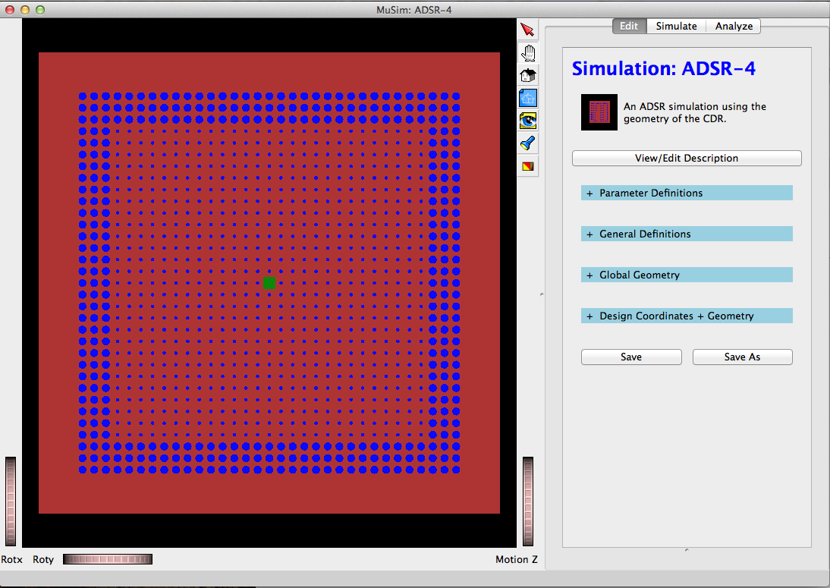
First MuSim Application -GEM*STAR
μ
Muons, Inc.
Screen shot of MuSim: carbon is brown, salt is blue, the spallation target (natural uranium) is green; the right side is an editing pane: ADSR-4 is the name of this simulation, and the blue headers are categories to specify the simulation that can be edited; Parameters are for parametrizing the simulation; Definitions define general things like materials; GlobalGeometry includes all objects, solids, sources, and detectors (except objects placed via design coordinates); DesignCoordinates are for a beamline and define its centerline for placing objects.

Slide 7
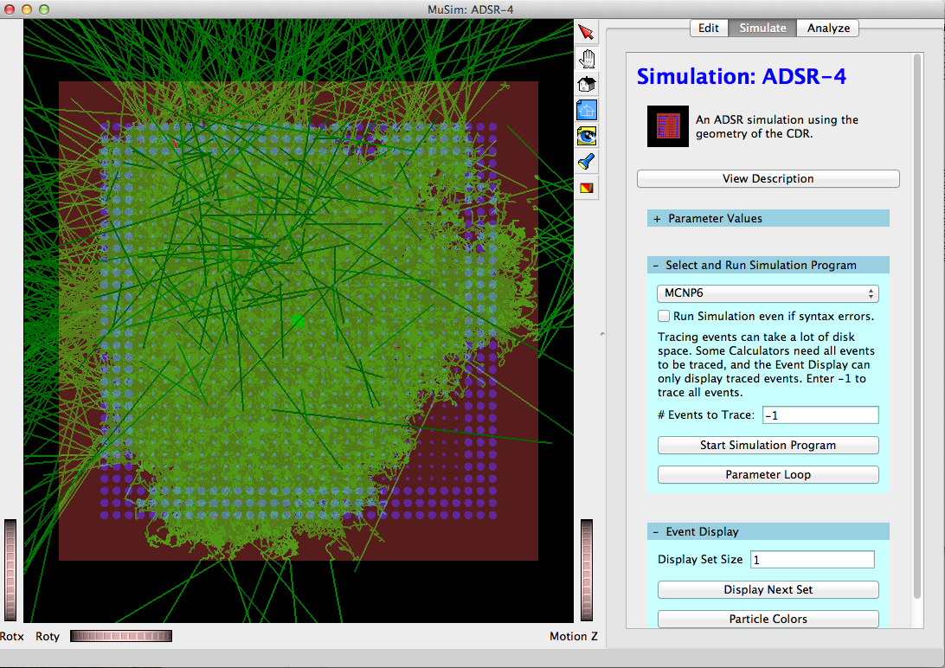
MuSim MCNP6 single event display
μ
Muons, Inc.
Here is a single event, green=neutron, darkgreen=gamma. This single proton generated 402,138 tracks (not counting e- < 0.5MeV). I used a "transparency slider" to make the solids mostly transparent, so tracks inside them can be seen. This makes the solids darker, because the black background show through; tracks inside them affect their color.

Slide 8
Optimum Beam Energy
μ
Muons, Inc.

Slide 9
ABSTRACT - GEM*STAR:
Accelerator-Driven Subcritical-System for Improved Safety, Waste Management, and Plutonium Disposition
μ
Muons, Inc.
The successful operation of high-power superconducting radio-frequency particle accelerators at two US national laboratories allows us to consider a new kind of nuclear reactor that operates without the need for a critical core, fuel enrichment, or reprocessing. We consider a multipurpose reactor design that takes advantage of this new accelerator capability that includes an internal spallation neutron target and high-temperature molten-salt fuel with continuous purging of volatile radioactive fission products. The reactor contains less than a critical mass and a million times fewer volatile radioactive fission products than conventional reactors like those at Fukushima. These and other safety features will help to generate public enthusiasm for this new CO2-free and weapons proliferation-resistant technology. We describe GEM*STAR [1], a reactor that without redesign will burn spent nuclear fuel, natural uranium, thorium, or surplus weapons material. A first application is to burn 34 tonnes of excess weapons grade plutonium as an important step in nuclear disarmament under the 2000 Plutonium Management and Disposition Agreement [2]. The process heat generated by this W-Pu can be used for the Fischer-Tropsch conversion of natural gas and renewable carbon into 42 billion gallons of low-CO2-footprint, drop-in, synthetic diesel fuel for the DOD at less than $2/g, to turn a $30B US government liability into a $40B profit. The Savannah River MOX plant could supply PuF3 salt for a GEM*STAR demonstration plant to be built at that site.
[1] Charles D. Bowman, R. Bruce Vogelaar, Edward G. Bilpuch, Calvin R. Howell, Anton P. Tonchev, Werner Tornow, R.L. Walter, “GEM*STAR: The Alternative Reactor Technology Comprising Graphite, Molten Salt, and Accelerators,” Handbook of Nuclear Engineering, Springer Science+Business Media LLC (2010).
[2] http://www.state.gov/r/pa/prs/ps/2010/04/140097.htm

Slide 10
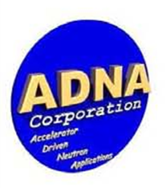
Industry can take nuclear waste or excess plutonium and produce energy from it
μ
Muons, Inc.
Molten-salt Reactor Experiment (MSRE) 1965-1969
continuous purging of volatile radioactive elements – no zircaloy
Accelerator-Driven Subcritical Reactors (ADSR)
reactor concept uses molten salt fuel (e.g. UF₄ ,ThF_{4,} or PuF₃)
GEM*STAR
Avoids nuclear weapon proliferation concern of reprocessing for 200 years
The next step is a prototype ADSR to inspire industry
Inexpensive natural gas changes things in the US
New Nuclear Power cannot compete with 4.5 c/kW-h from natural gas
ADSR process heat can make synthetic diesel out of natural gas and carbon
GEM*STAR technology can
Turn excess weapons-grade plutonium into process heat,
with remnants useless for weapons,
to provide the DOD with inexpensive, green diesel fuel

Slide 11
Outline - GEM*STAR:
Accelerator-Driven Subcritical-System for Improved Safety, Waste Management, and Plutonium Disposition
μ
Muons, Inc.
Green Energy Multiplier*Subcritical Technology Alternative Reactor
graphite-moderated, thermal spectrum, accelerator driven
GEM*STAR - based on ORNL Molten Salt Reactor Experiment 1965-1969
SRF accelerator power recently demonstrated at ORNL SNS and JLab CEBAF
Need to merge 3 known technologies: Accelerator, MS Reactor, F-T diesel prod.
Public safety and public perception
Safety: subcritical, low volatile Fission Product (FP) inventory
Security: no enrichment or reprocessing
1st Application burns weapons-grade Pu (also a Security feature) w/o NRC
Costs versus benefits
SNS SRF accelerator with 4 GEM*STAR SMRs and F-T diesel costs ~$3B
burns SNF, W-Pu, natural uranium, thorium, without redesign
no enrichment, no reprocessing, less complex reactor - reduces costs!
Impact of a successful W-Pu Disposition demo
Large profits from process heat for F-T diesel: 34 T W-Pu => 42B g =~$42B
Proliferation-resistant, exportable technology
Burning SNF enables/extends conventional LWRs

Slide 12
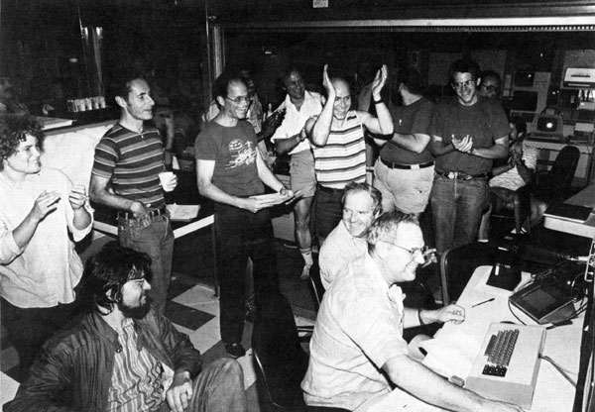
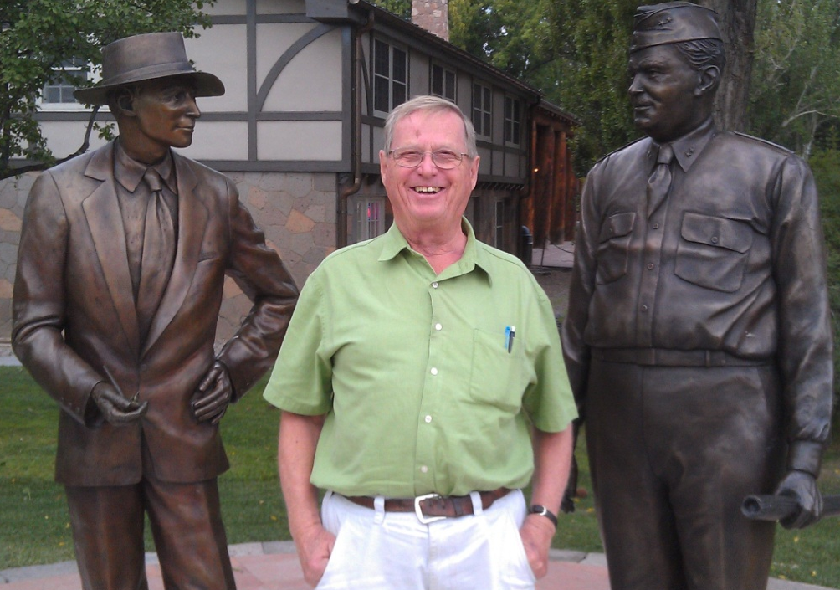
GEM*STAR
Generating Intrinsically Safe Power
Combining Subcritical System and Accelerator Technologies
First Customers can be: NNSA and DOD
μ
Muons, Inc.
Rolland P. Johnson, Ph. D.
President , Muons Inc.
www.muonsinc.com
Charles D. Bowman, Ph. D.
President ADNA Corporation
Accelerator-Driven Neutron Applications
512 GeV at Fermilab
Charlie at LANL

Slide 13
Charles D. Bowman (from CV) of ADNA Corp.
Ph. D. in Neutron Physics, 1961 Duke University
M..A Neutron Physics, 1958 Duke University
B.S. in Physics, Magna cum Laude, 1956 Virginia Tech
1997 - Present President, ADNA Corporation
1999 - French Atomic Energy Commission (CEA)
1996 - Los Alamos National Laboratory
Associate Division Leader for Basic Research
Construction Project Manager for LANSCE
Project Leader for the Los Alamos ADTT program
Led Project 17 of the ISTC, ~500 Russian scientists ADTT program
1982 - (NIST) National Bureau of Standards
1968 - Oak Ridge National Laboratory
1972 - Lawrence Livermore National Laboratory
1969 Honored as a Fellow of the American Physical Society (recommended by Teller)
1978 Admitted to the Senior Executive Service (civil equivalent to General/Admiral)
1982 Awarded the U. S. Department of Commerce Silver Medal
1984 Appointed Construction Project Manager for the LANSCE Experimental Halls
1990 Patent awarded; “Apparatus for Nuclear Transmutation and Power Production Using an Intense Accelerator-Generated Thermal Neutron Flux”
1991 Honored as a Fellow of the Los Alamos National Laboratory
2001 Patent Awarded; “Apparatus for Transmutation of Nuclear Reactor Waste”

Slide 14
μ
Muons, Inc.
Neutrons! Needed to cause fission
Operating at or above criticality in a traditional reactor generates the needed extra neutrons
Or
High-power proton accelerators can break apart large nuclei to generate the extra neutrons, 1 proton => 30 neutrons
Superconducting RF (SRF) accelerators,
CEBAF at JLab
Spallation Neutron Source at ORNL
have demonstrated the required technology
However, we are improving this technology by developing a magnetron power source that will be less expensive and more wall-power efficient than klystrons or IOTs! See assy drawings of a 350 MHz Magnetron we are building:
CW, 120 kw, 90% efficient, tube itself ~$20k

Slide 15
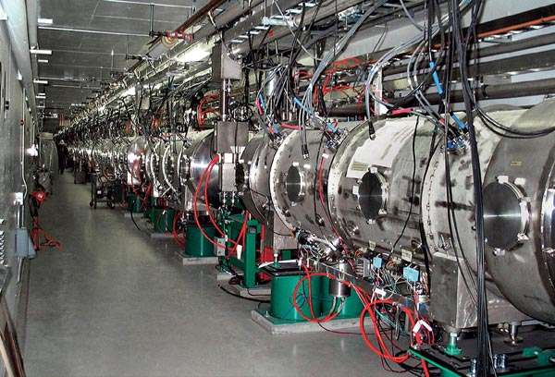
μ
Muons, Inc.
New Accelerator Technology Enables GEM*STAR
OAK RIDGE, Tenn., Sep. 28, 2009 — The Department of Energy's 1 GeV Spallation Neutron Source (SNS), breaks the one-megawatt barrier! Operating at <10% duty factor, this corresponds to >10 MW at CW.
Based on Superconducting RF Cavities, available from U.S. Industry:

Slide 16
μ
Muons, Inc.
An intrinsic safety problem for conventional reactors is enclosed solid fuel.
a natural solution is to use molten-salt fuel
that is also well suited to accelerator-driven subcritical reactors.
A major difficulty is fatigue of UO₂ fuel in rods caused by accelerator trips – no such problem for molten salt fuel
The technology of molten-salt fuel was developed in the 1960s in the Molten-Salt Reactor Experiment (MSRE) at ORNL.
Use of molten salt fuel was later abandoned
not enough Pu-239 for bombs?
President Nixon?
(See MSRE on wikipedia for nice summary)

Slide 17
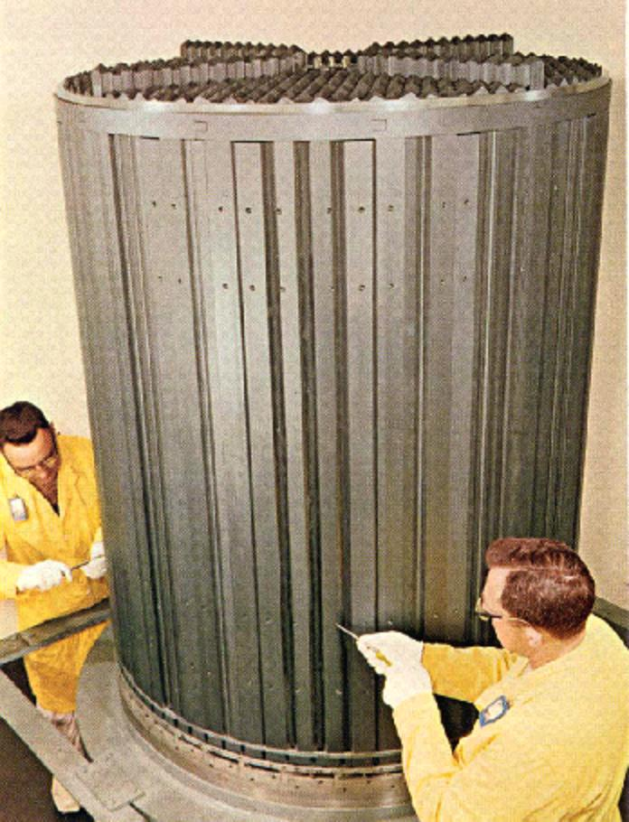
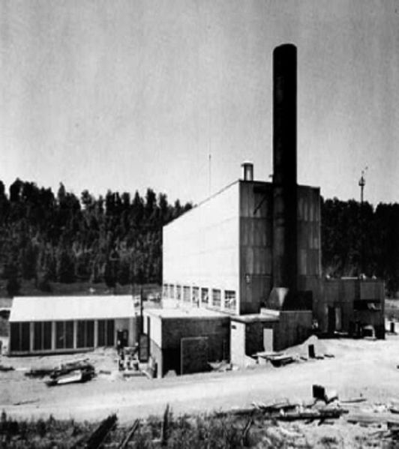
μ
Muons, Inc.
1965-69 ORNL Molten-Salt Reactor Experiment

Slide 18
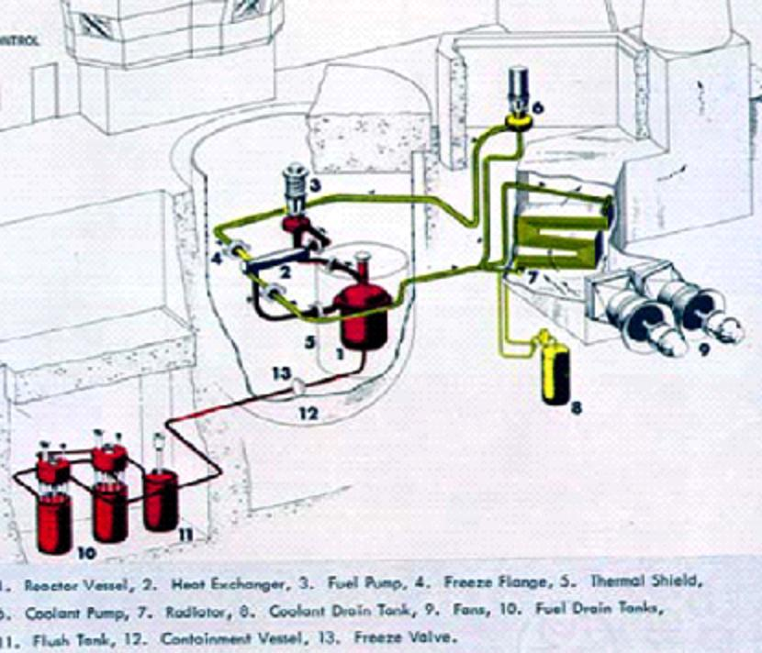
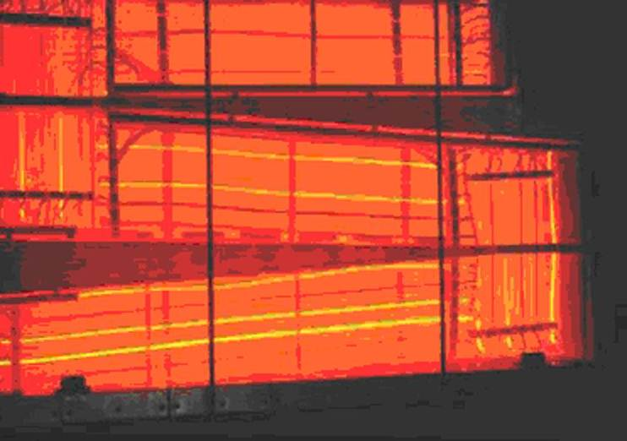
μ
Muons, Inc.
1965-69 ORNL Molten-Salt Reactor Experiment
Glowing radiator

Slide 19
From 1969 MSRE Report Abstract
“The MSRE is an 8-MW(th) reactor in which molten fluoride salt at 1200°F (650 C) circulates through a core of graphite bars. Its purpose was to demonstrate the practicality of the key features of molten-salt power reactors.
The MSRE has shown that salt handling in an operating reactor is quite practical, the salt chemistry is well behaved, there is practically no corrosion, the nuclear characteristics are very close to predictions, and the system is dynamically stable. Containment of fission products has been excellent and maintenance of radioactive components has been accomplished without unreasonable delay and with very little radiation exposure.
The successful operation of the MSRE is an achievement that should strengthen confidence in the practicality of the molten-salt reactor concept.”

Slide 21
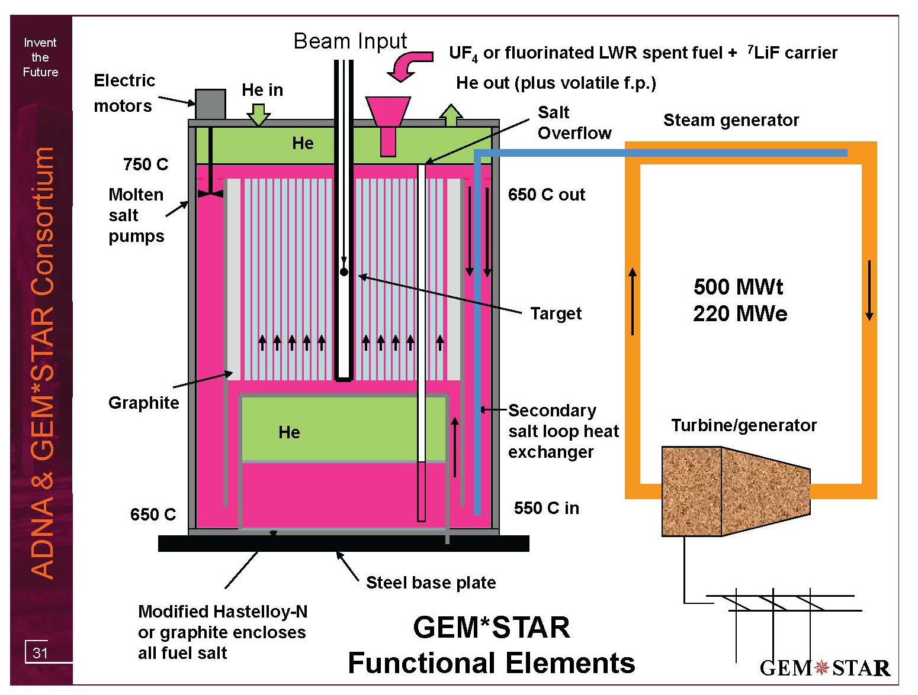
W-Pu as PuF₃ (30 g/h) plus carrier salt
2.5 MWb provides
6 meter diameter
Overflow reservoir

Slide 23
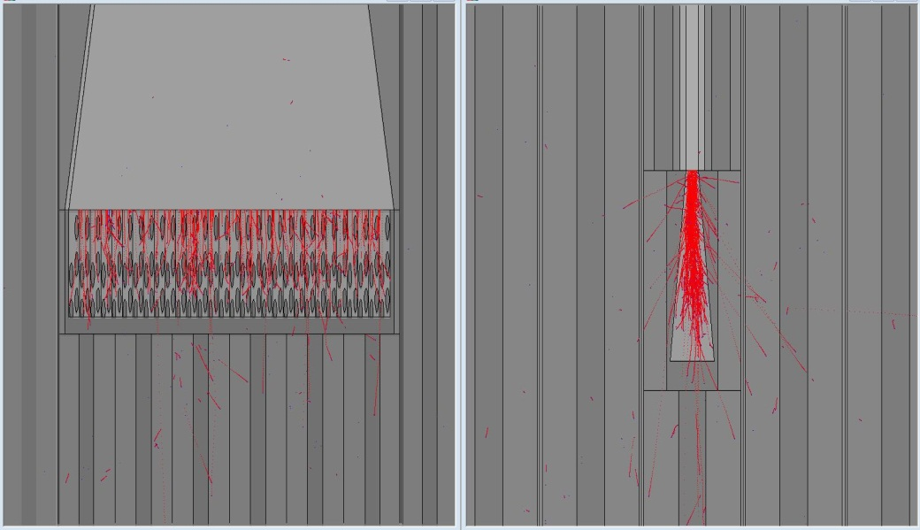
Target Considerations
Work of Bruce Vogelaar
of Virginia Tech (co-author of GEM*STAR article in HB of NE)
GEM*STAR Internal Target
diffuse (or multiple) beam spots
molten salt used for heat removal
high neutron yield from uranium (but minimize target fission)
spent target fluorinated and used as fuel
minimize impact on local reactivity

Slide 24
μ
Muons, Inc.
Is W-Pu a Killer Application?
34 metric tons of excess weapons-grade plutonium slated to be destroyed by the troubled 2000 U.S.-Russian Plutonium Management and Disposition Agreement (PMDA)[2]
GEM*STAR allows a better solution than either MOX (US) or BR (Russia)
<7% Pu240 vs >19%
Here we do some handwaving to explain how a Pu bomb works and what weapons grade refers to:

Slide 25
Four GEM*STAR Units Burn 34 Tonnes W-Pu
Without U or Th in 30 Years
μ
Hourly fill:
30 g W-Pu
as PuF₃ +
carrier salt
Superconducting
Accelerator
2.5 mA, 1 GeV
Magnet
W-Pu
Inflow W-Pu:
93 % ²³⁹Pu
7 % ²⁴⁰Pu
Volatile f. p. removed by
closed cycle He flow
Free
surface
K_{eff}
0.98-0.99
Overflow
pipe
Target
Hourly overflow:
7.5 g as PuF₃ +
carrier salt +
22.5 g of fission product
93 % graphite
7 % salt
Non-W-Pu
W-Pu transformed
to permanent
non-weapons Pu
immediately upon
adding and mixing
Non-weapons Pu Outflow:
52.4 % ²³⁹Pu
25.4 % ²⁴⁰Pu
10.6 % ²⁴¹Pu
11.7 % ²⁴²Pu
Salt Overflow
tank
Fission power 500 MWt
for each GEM*STAR unit

Slide 26
Small Modular Reactors
<300 MWe follows from requiring that each reactor contain less than a critical mass and recover passively from a power or coolant loss accident

Slide 27
FB BN800 MOX-LWR GEM*STAR
²³⁹Pu | α | 24,110 years
²⁴⁰Pu | α,sf | 6,561 years
²⁴¹Pu | β | 14.325 years
²⁴²Pu | α,sf | 373,300 years

Slide 28
http://www.nuclearfaq.ca/cnf_sectionF.htm#x2

Slide 29
μ
Muons, Inc.
Benefits of GEM*STAR
Never requires a critical mass so no control rods
Never contains large volatile fission product inventory as in LWRs
No reprocessing or enrichment required
No pressure vessel
Passive recovery from loss of coolant or loss of power accidents
Higher actinides effectively destroyed with thermal neutron spectrum
Molten salt fuel tested to be effective, practical, less demanding than pins
Eliminating problems avoids the need for Defense in Depth

Slide 30
μ
Muons, Inc.
Benefits of GEM*STAR for W-Pu
Burned W-Pu never useful for weapons
No conversion to MOX; simple conversion of Pu metal and PuO₂ to PuF₃
Fission energy converted to diesel and sold as green fuel to DOD
Benefits of GEM*STAR for SNF
SNF burned without need for reprocessing (separation of elements)
Simple conversion of oxides to fluorides
Fission energy converted to green diesel and/or efficient electricity (650C)
200 year fuel cycle,
7 times original LWR energy output
85% of higher actinides destroyed

Slide 31
A Perfect Storm of Opportunities?
Muons, Inc.
μ
US Plan to use MOX plant and LWRs not working
SRS Plant overspent: $2B -> $5B -> asking for $2B more,
No LWR ready to accept W-Pu MOX fuel =>
Obama MOX budget on hold while alternatives examined
Eliminate W-Pu (State Department-DOE/NNSA)
Opportunity for Lavrov and Kerry to extend cooperation
2000 Plutonium Management and Disposition Agreement
(DOE Secretary Moniz was major proponent of PMDA)
Navy adds nuclear power expertise, and location for demo
Solves Navy or Maersk long-range synthetic fuel need
Turn $30B liability into $42B Profit (Congress/OMB)

Slide 32
Summary - GEM*STAR:
Accelerator-Driven Subcritical System for Improved Safety, Waste Management, and Plutonium Disposition
μ
Muons, Inc.
Green Energy Multiplier*Subcritical Technology Alternative Reactor
graphite-moderated, thermal spectrum, accelerator driven
GEM*STAR - based on ORNL Molten Salt Reactor Experiment 1965-1969
SRF accelerator power recently demonstrated at ORNL SNS and JLab CEBAF
Public safety and public perception
Safety: subcritical, low volatile Fission Product inventory
Security: no enrichment or reprocessing
1st application is to burn weapons-grade Pu (another Security feature)
Costs versus benefits
SNS SRF accelerator with 4 GEM*STAR SMRs and F-T diesel costs ~$3B
burns SNF, W-Pu, U233, natural uranium, thorium, without redesign
no enrichment, no reprocessing, less complex reactor - reduces costs!
Impact of a successful W-Pu Disposition demo
Large profits from process heat for F-T diesel: 34 T W-Pu => 42B g =~$42B
Proliferation-resistant, exportable technology
Burning SNF enables/extends conventional LWRs

