Slide 1
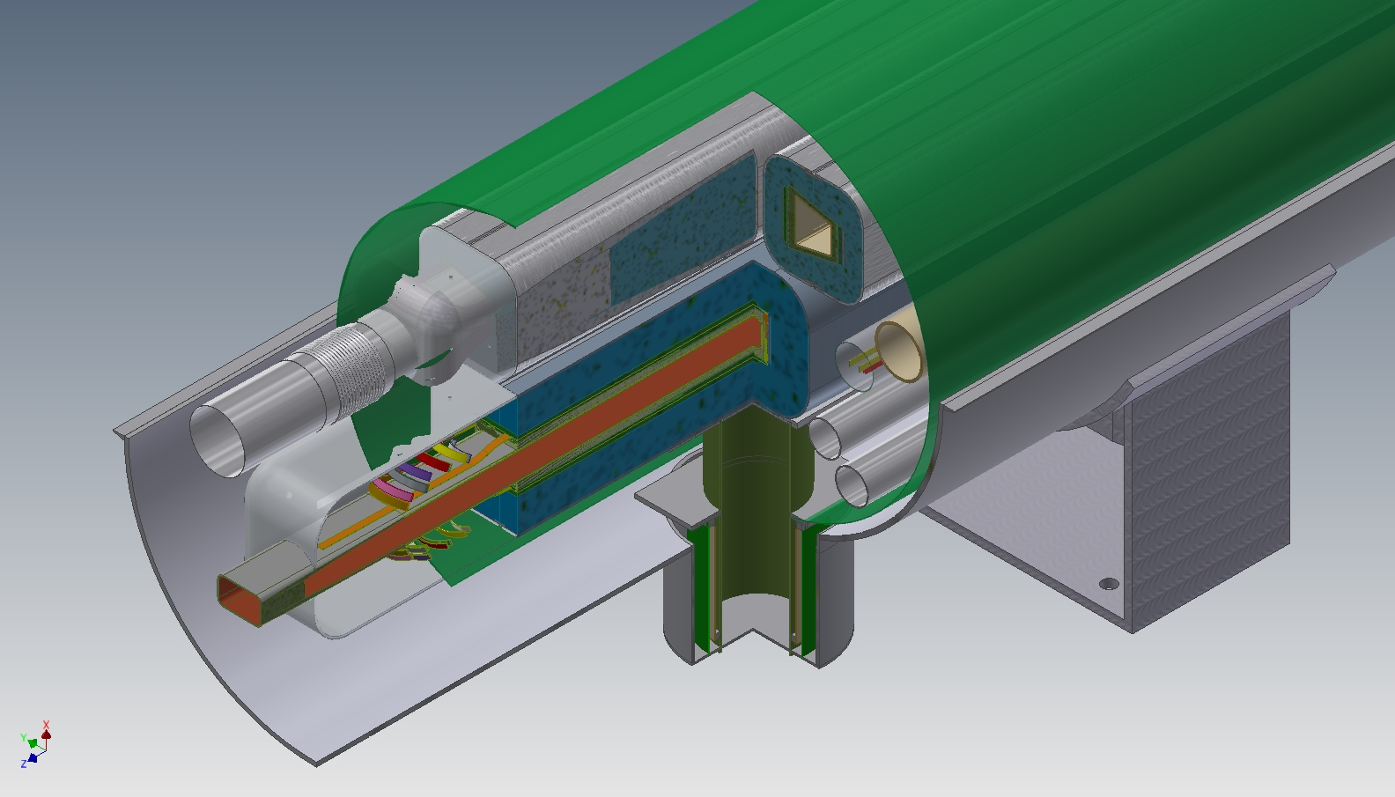
Cooling and Stacking for MEIC
Peter McIntyre, Saeed Assadi, Daniel Chavez, James Gerity, Karie Melconian, Nate Pogue, Dior Sattarov
Texas A&M University

Slide 2
Particle flow in MEIC is limited by space charge and intrabeam scattering
Space charge tune shift and intrabeam scattering both limit the line charge density that can be accelerated and accumulated in the acceleration sequence.
Both effects are worse at low energy, short bunch length. We need to start with bunches of ~10⁸ in the injector and booster, and end with bunches of ~10¹⁰ in the Ion Ring.

Slide 3
Cool and accumulate using d.c. electron cooling in dedicated cooling rings
Integrating electron cooling in an accelerator asks conflicting requirements of the magnet, rf, and cooling systems.
Cooling is best done in a ring that sits at fixed energy, cools and stacks beam.
The cold stack can then be transferred in toto to the accelerator to go to the next stage of energy.
This works most naturally if the cooler is piggy-backed on the accelerator.

Slide 4
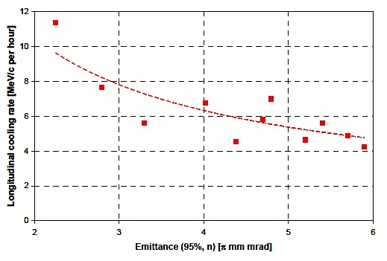
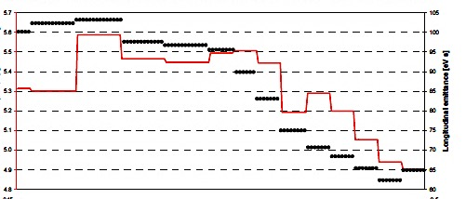
Fixed-energy e-cooling at 2-8 GeV
Fermilab’s Recycler was a highly successful fixed-energy 8 GeV e-cooler.
It cooled and stacked antiprotons, and was at the heart of the world-record antiproton accumulations. It makes an inspiring start to the needs for MEIC ion cooling…
horizontal emittance
hours
with 200 mA e-beam
with 100 mA e-beam

Slide 5
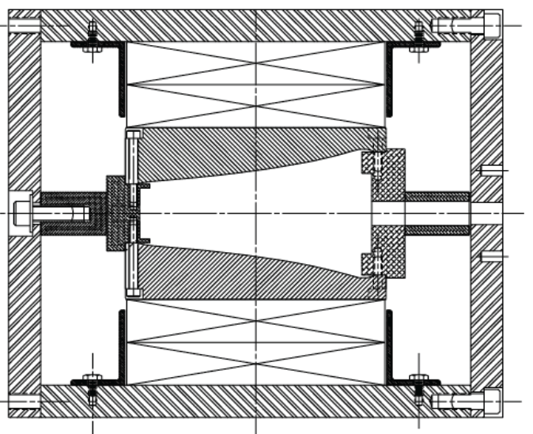
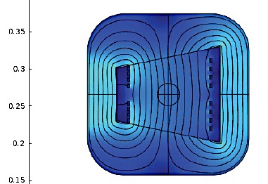
Combined-Function Dipoles for a Cooler
Fermilab’s Recycler was designed as a fixed-energy 8 GeV storage ring, using combined-function permanent magnets.
The choice of permanent magnet made sense because it was installed in the Main Injector tunnel with no cryogenics.
For MEIC, we have designed a 1 T combined-function superferric dipole. It is a simple window-frame winding, with the quad gradient necessary for a half-cell optics.
Two CF dipoles are configured piggy-back on opposite ends of the two ICR dipoles, so that each ICR half-cell becomes a Cooler full-cell.

Slide 6
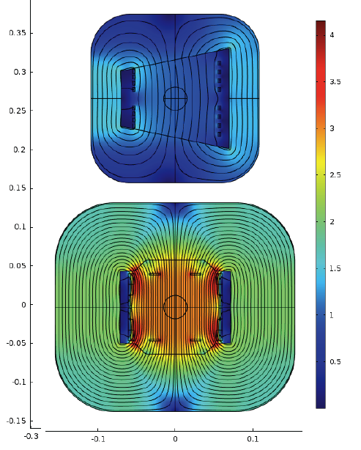
No magnetic coupling between the ICR dipole and the e-Cooler dipole
In the Recycler there was a troublesome field coupling between the Main Injector (cycling 8-150 GeV) and the Recycler (fixed @ 8 GeV).
We modeled the same question for the mounting of the Cooler dipole piggy-back on the ICR dipole, 1” spacing between flux returns, sharing the ICR cryostat.
No magnetic coupling at level of 0.5 unit.

Slide 7
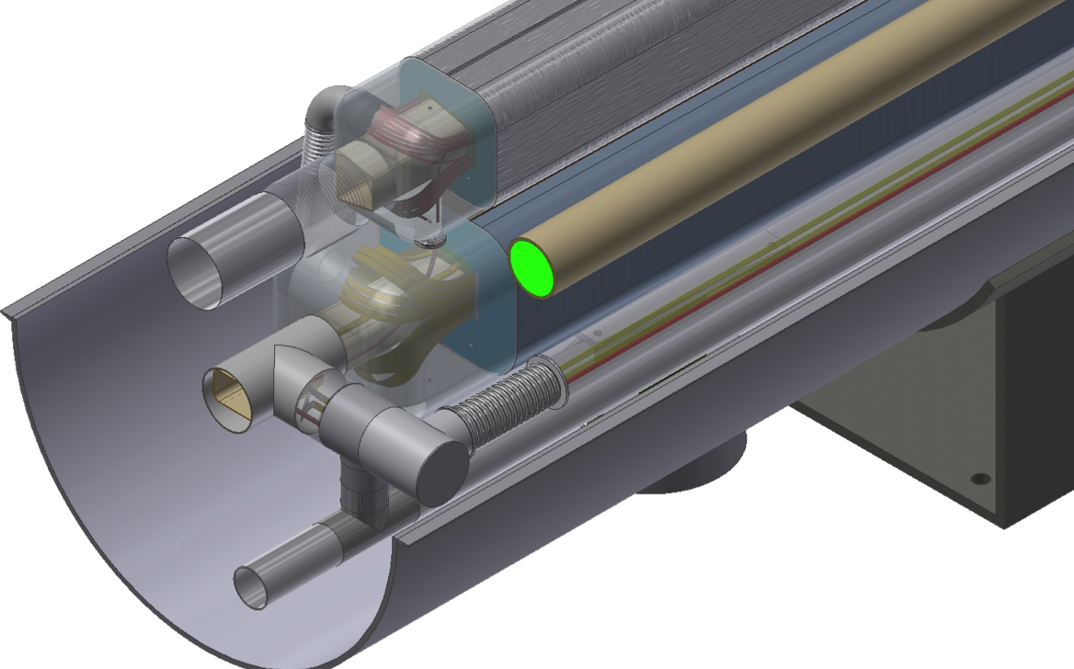
The Superferric ICR half-cells provide a robust platform for initial MEIC performance and upgrade for the future
The ICR naturally preserves polarization, has ample admittance for ion beams. The superferric ring costs half as much as a cos θ ring.
The fixed-energy e-Cooler can support cooling of full-circumference fills of ions; top-down cost of 1 T CF dipole ring = $ 2.8 million
and stacking of multiple fillings during a store so that a cooled, high-intensity ion stack is ready to accelerate when the luminosity declines. It has twice the tune of the ICR, lots of admittance.

Slide 8
Staged d.c. Electron Cooling
100 MeV – to cool/stack ions from injector prior in a Booster-circumference Chiller
1-8 GeV – to accumulate ions accelerated in the Booster in an IonRing-circumference Cooler
15 GeV – the Cooler stack reaches a limit from IBS, accelerate and stack in an IonRing-circumference Freezer
No ring operates at IBS limit, beam is never accelerated through transition.
Full design intensity of >2 x 10¹³ in Ion Ring is achieved without need for bunched-beam cooling.

Slide 9
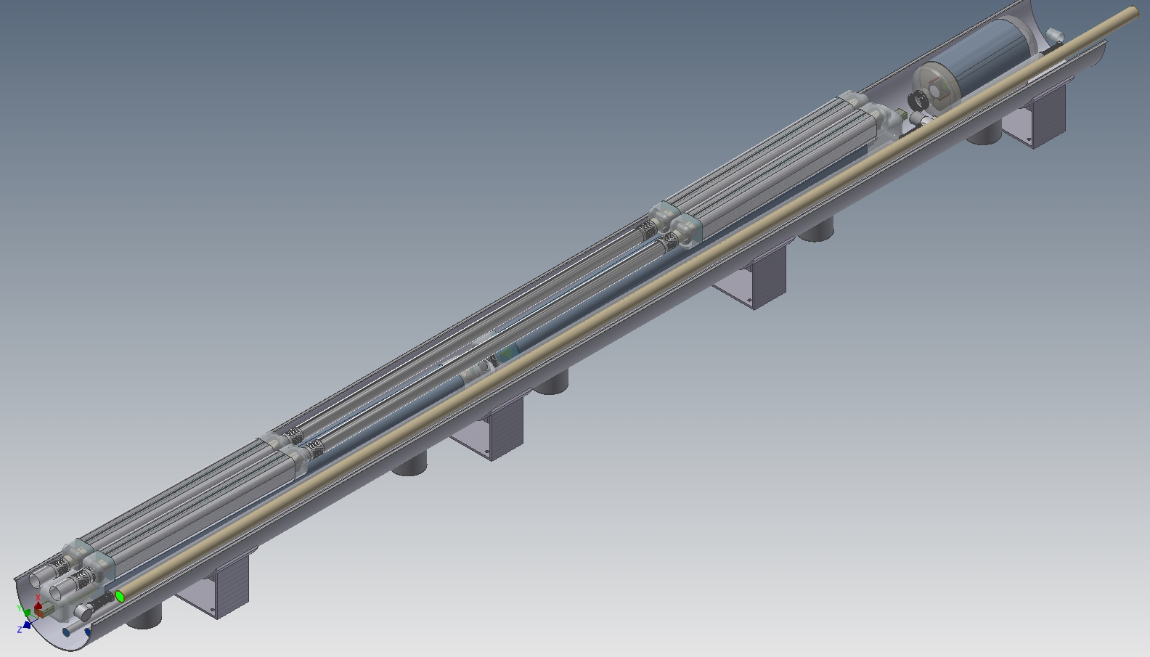
Chiller and Freezer Piggy-Back on Ion Ring
Each half-cell of the Ion Ring arcs contains two 4 m 3 T dipoles and one 0.8 m quad.
We can mount a pair of 1 T superferric combined-function magnets piggy-back with the Ion Ring to make a full-cell of a Cooler and a Freezer.

Slide 10
Cool and stack Booster cycles in Cooler. Accelerate to 15 GeV and stack in Freezer.
Because Cooler and Freezer have full circumference of Ion Ring, the entire fill of ions is cooled with its final line charge density.
Stack in Cooler until IBS lifetime approaches cooling time.
Then accelerate to 15 GeV (IBS time 4 times longer), continue to stack to >2 x 10¹³.
Cooler and Freezer have twice the tune of the Ion Ring, so twice its γ_{t}.
Cooler and Freezer always operate below their γ_{t} (24 GeV).
Freezer transfers to Ion Ring at 15 GeV, above its γ_{t} (12 GeV).
So ion beam is never accelerated through transition.

Slide 11
Configure Electron Ring and Ion Ring to be co-planar – not over/under.
In the MEIC Baseline Ion Ring is located above the Electron Ring, and deflected down/up to make collision. The vertical deflections introduce vertical dispersion, which creates serious challenges to fully correct for long-lived colliding beam lifetime.
The two rings can be located side-by-side, eliminating vertical dispersion.
Their harmonic numbers can be kept the same by locating Ion Ring on inside in one loop, outside in the other.

Slide 12
Is there a way to build and operate an actual Ion Test Ring at JLab?
A number of technical challenges for the MEIC design would benefit from a test bed, where they could actually be tested for finite cost, so that schemes could be tried, perfected, or evolved to meet the needs for the project:
Bunched-beam cooling
Magnetized/non-magnetized d.c. cooling
Stacking scenarios, beam dynamics limits
Is there any possibility to do that at JLab?

Slide 13
FEL Lab is a shielded sub-grade vault. It could house a 3 GeV proton storage ring, with long straight sections and potentially with an injector synchrotron e.g. CIS.
The storage ring shown has 10 m diameter arcs with 30 m long straight sections. The two 180 arcs could be assembled using ~20 1.2 m Booster dipoles. With the 2.7 T field of the Booster dipoles, the ring would circulate 3 GeV protons.
The vault is sub-grade, and has 8’ of concrete and sand over the roof.

