Slide 1
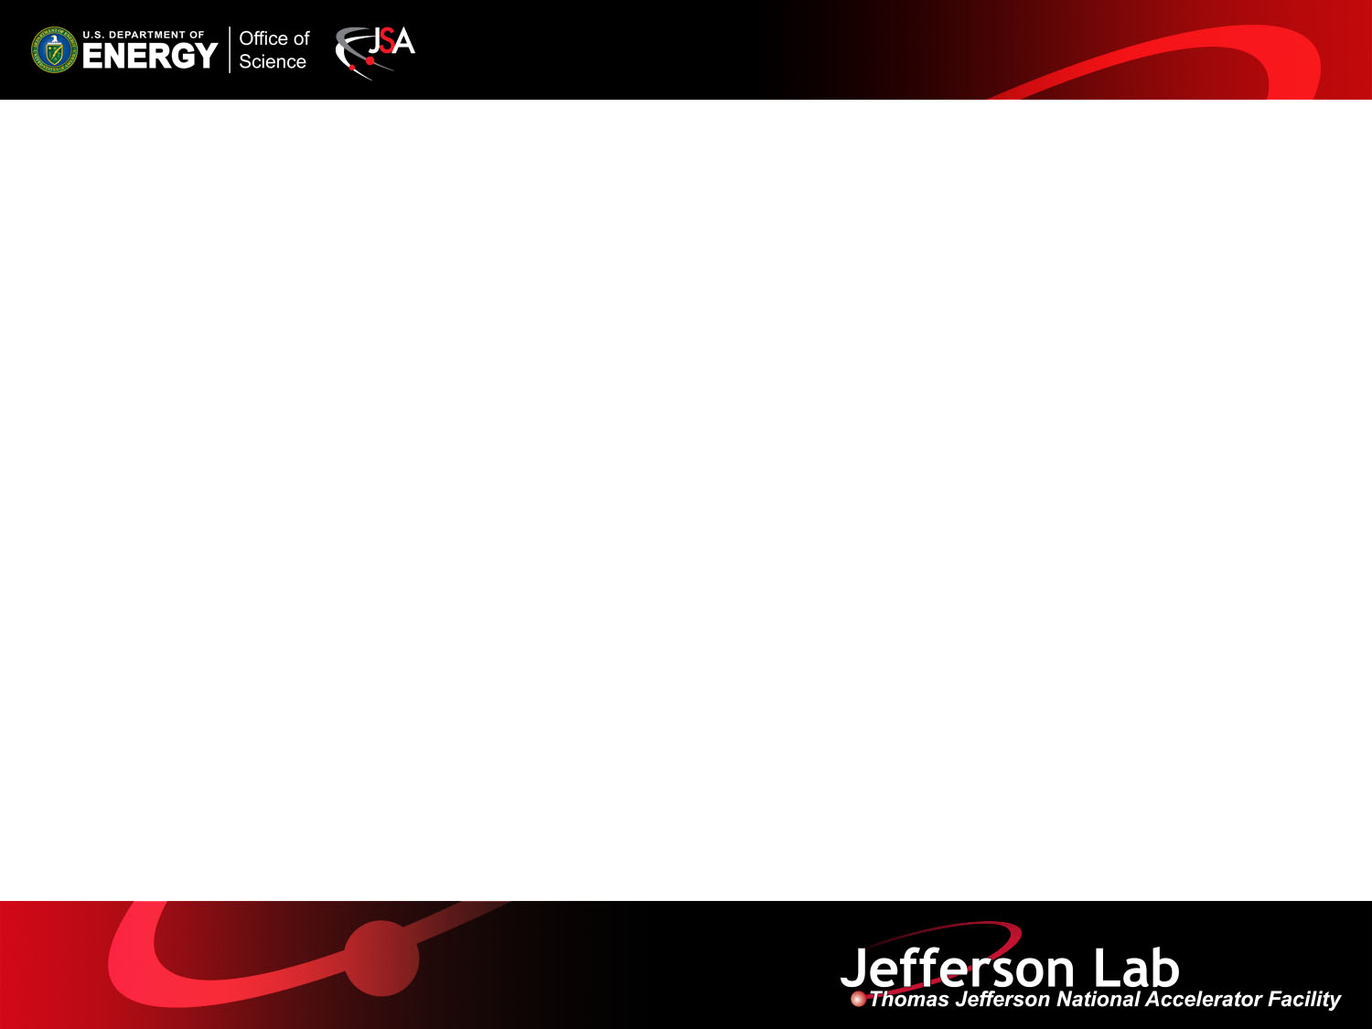

MEIC Overview and Pre-Project R&D
Fulvia Pilat
MEIC Collaboration Meeting
March 30-31

Slide 2
Outline
Design strategy for the EIC at JLAB
Design optimization (cost, performance and potential for upgrade)
MEIC baseline
Machine performance
R&D: pre-project and on-project
Conclusions

Slide 3
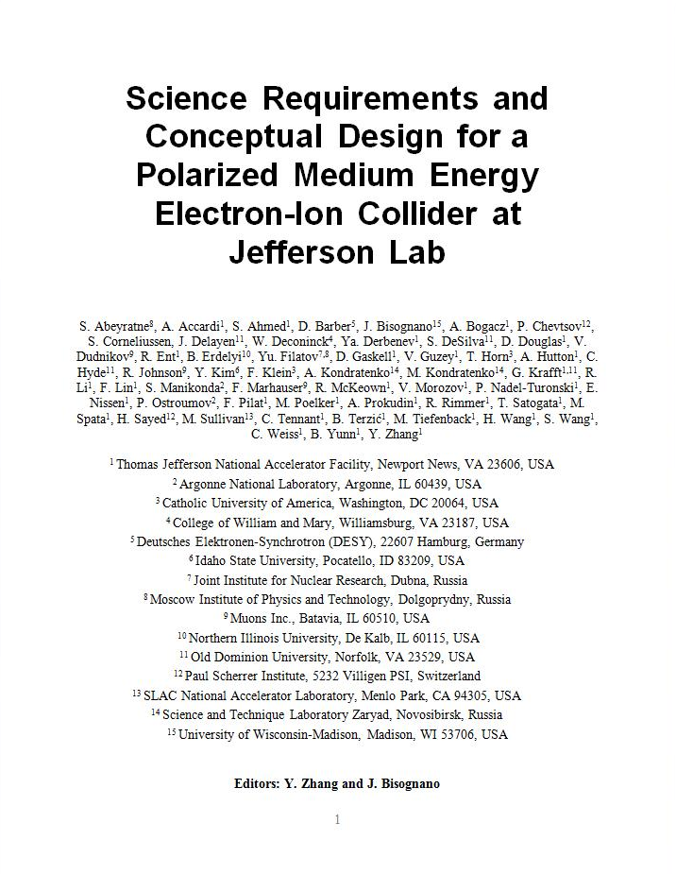
MEIC Design Goals
Energy
  Full coverage of √s from 15 to 65 GeV
  Electrons 3-10 GeV, protons 20-100 GeV, ions 12-40 GeV/u
Ion species
  Polarized light ions: p, d, ³He, and possibly Li
  Un-polarized light to heavy ions up to A above 200 (Au, Pb)
Space for at least 2 detectors
Full acceptance is critical for the primary detector
Luminosity
  10³³ to 10³⁴cm⁻²s⁻¹ per IP in a broad CM energy range
Polarization
  At IP: longitudinal for both beams, transverse for ions only
  All polarizations >70%
Upgrade to higher energies and luminosity possible
  20 GeV electron, 250 GeV proton, and 100 GeV/u ion
  Design goals consistent with the White Paper requirements

Slide 4
Design Strategy: High Luminosity
The MEIC design concept for high luminosity is based on high bunch repetition rate CW colliding beams
KEK-B already reached above 2x10³⁴ /cm²/s
Beam Design
High repetition rate
Low bunch charge
Short bunch length
Small emittance
“Traditional” hadrons colliders
Small number of bunches
Small collision frequency f
Large bunch charge n₁ and n₂
Long bunch length
Large beta-star
IR Design
Small β*
Crab crossing
Damping
Synchrotron radiation
Electron cooling
Linac-Ring colliders
Large beam-beam parameter for the electron beam
Need to maintain high polarized electron current
High energy/current ERL

Slide 5
Design strategy: High Polarization
All rings are figure-8 → critical advantages for both ion and electron beam
  Spin precessions in the left & right parts of the ring are exactly cancelled
  Net spin precession (spin tune) is zero, thus energy independent
  Spin is easily controlled and stabilized by small solenoids or other compact spin rotators
  Advantage 1: Ion spin preservation during acceleration
  Ensures spin preservation
  Avoids energy-dependent spin sensitivity for all species of ions
  Allows a high polarization for all light ion beams
  Advantage 2: Ease of spin manipulation
    Delivers desired polarization at the collision points
  Advantage 3: The only practical way to accommodate polarized deuterons
  (given the ultra small g-2)
  Advantage 4: Strong reduction of quantum depolarization thanks to the energy independent spin tune.

Slide 6
Design Optimization
The MEIC goals, strategy and basic design choices (figure-8, B-factory beam structure for high luminosity for e- and ion rings) have NOT changed since 2006
The goal of cost, performance and upgrade optimization led us to the following implementation:
1. A circumference of ~2.2 km will allow:
Re-use of the PEP-II machine for the electron ring and e- transfer lines
Use of super-ferric magnets for the ion ring instead of cos-θ super-conducting magnets
Only one booster needed, accelerating from 285 MeV to 8 GeV

Slide 7
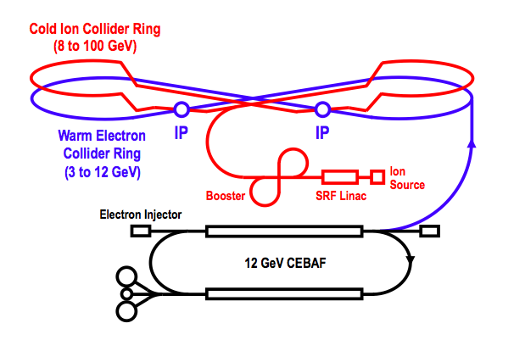
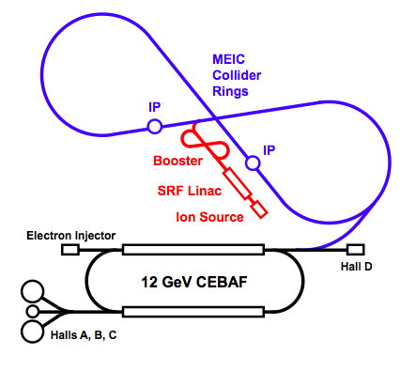
Baseline Layout
Booster
Warm Electron
Collider Ring
(3 to 10 GeV)
Linac
Ion Source
Booster
Linac
Ion Source
CEBAF is a full energy injector.
Only minor gun modification is needed
MEIC Cost Review December 18 2014

Slide 8
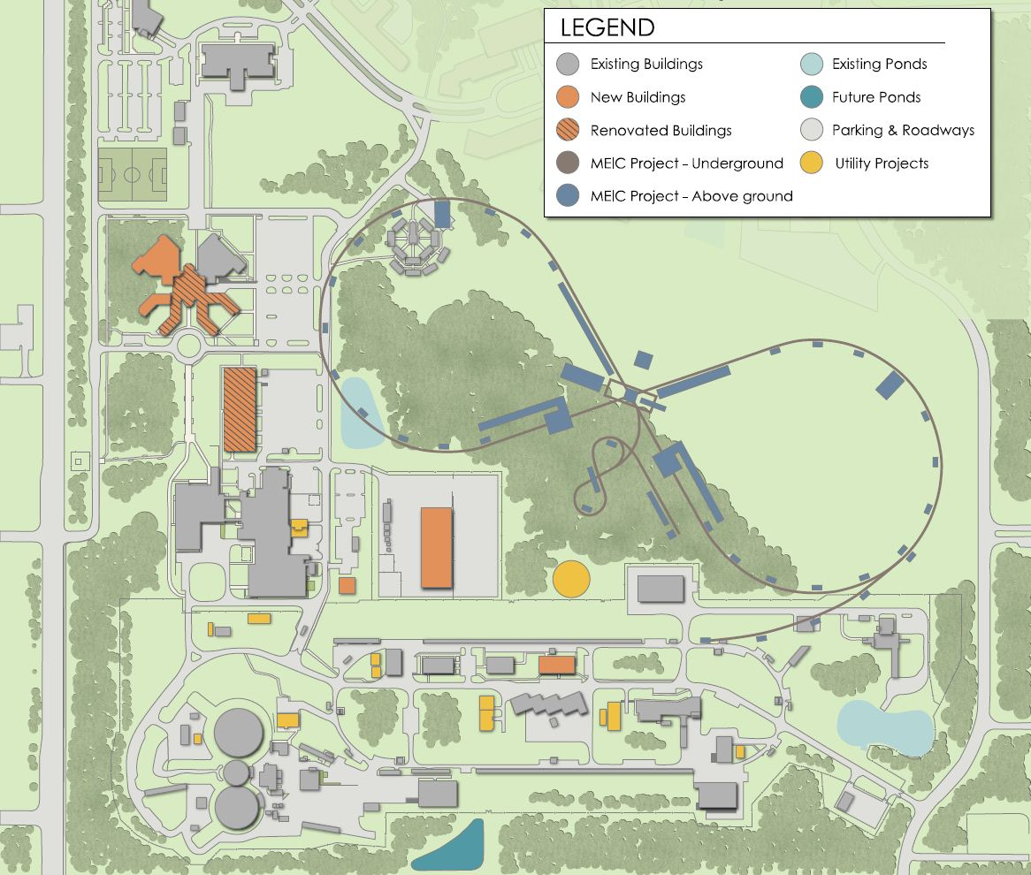
Campus Layout
~2.2 km circumference
E-ring from PEP-II
Ion-ring with super-ferric magnets
Tunnel consistent
with a 250+ GeV upgrade

Slide 9
MEIC Baseline
Baseline for the cost estimate
Collider ring circumference: ~2200 m
Electron collider ring and transfer lines : PEP-II magnets, RF (476 MHz) and vacuum chambers
Ion collider ring: super-ferric magnets
Booster ring: super-ferric magnets
SRF ion linac
Energy range
Electron: 3 to 10 GeV
Proton: 20 to 100 GeV
Lead ions: up to 40 GeV
Design point | p energy (GeV) | e- energy (GeV) | Main luminosity limitation
low | 30 | 4 | space charge
medium | 100 | 5 | beam beam
high | 100 | 10 | synchrotron radiation

Slide 10
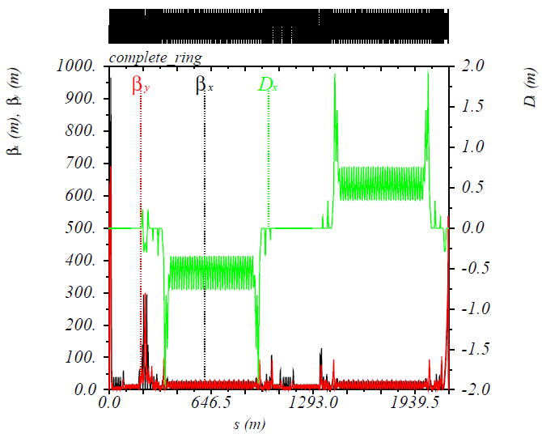
MEIC Electron Complex
CEBAF provides up to 12 GeV, high repetition rate and high polarization (>85%) electron beams, no further upgrade needed beyond the 12 GeV CEBAF upgrade.
Electron collider ring design
  circumference of 2154.28 m = 2 x 754.84 m arcs + 2 x 322.3 m straights
  Meets design requirements
  Provides longitudinal electron polarization at IP(s)
  incorporates forward electron detection
  accommodates up to two detectors
  includes non-linear beam dynamics
  reuses PEP-II magnets, vacuum chambers and RF
Beam characteristics
  3A beam current at 6.95 GeV
  Normalized emittance 1093 μm @ 10 GeV
  Synchrotron radiation power density 10kW/m
  total power 10 MW @ 10 GeV
CEBAF and the electron collider provide
the required electron beams for the EIC.
IP
Electron Collider Ring Optics
D_{x}(m)
β_{x}(m), β_{y}(m)

Slide 11
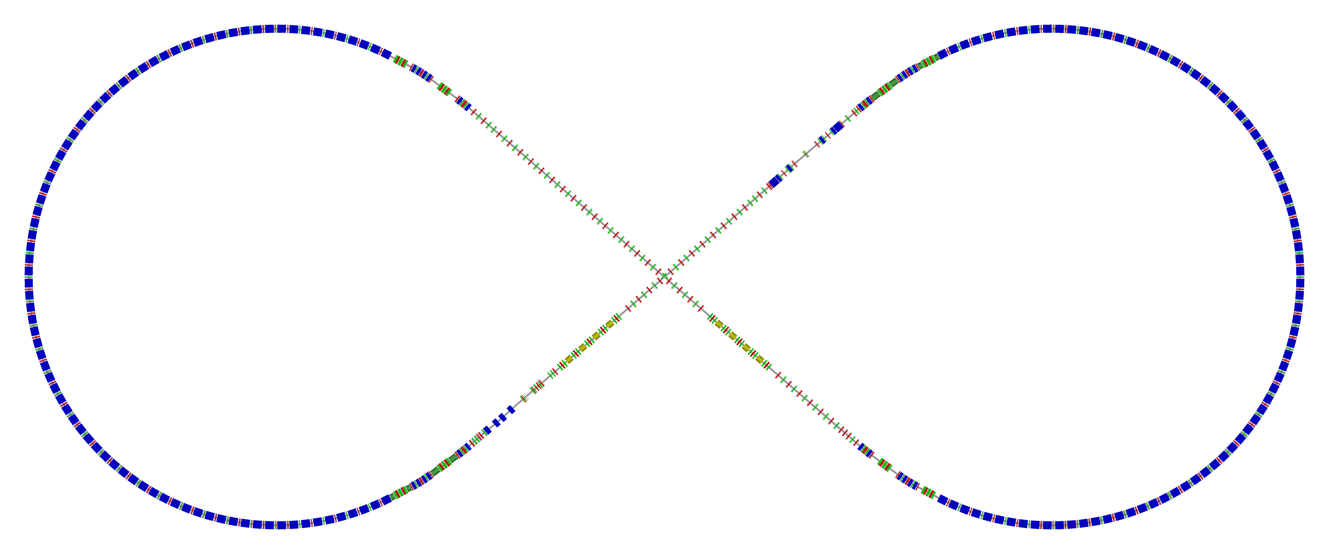
Electron Collider Ring Layout
  Circumference of 2154.28 m = 2 x 754.84 m arcs + 2 x 322.3 m straights
Figure-8, crossing angle 81.7°
  Electron collider ring w/ major machine components
Spin rotator
Spin rotator
CCB
Tune trombone & Straight FODOs
R=155m
81.7°
e⁻
Arc, 261.7°
Future 2nd IP
RF
RF
Spin rotator
IP
Spin rotator
Forward e⁻ detection

Slide 12
Electron Ring Optics Parameters
Electron beam momentum | GeV/c | 10
Circumference | m | 2154.28
Arc net bend | deg | 261.7
Straights’ crossing angle | deg | 81.7
Arc/straight length | m | 754.84/322.3
Beta stars at IP β*_{x,y} | cm | 10/2
Detector space | m | -3 / 3.2
Maximum horizontal / vertical β functions β_{x,y} | m | 949/692
Maximum horizontal / vertical dispersion D_{x,y} | m | 1.9 / 0
Horizontal / vertical betatron tunes ν_{x,y} |  | 45.(89) / 43.(61)
Horizontal / vertical chromaticities ξ_{x,y} |  | -149 / -123
Momentum compaction factor α |  | 2.2 ×10⁻³
Transition energy γ_{tr} |  | 21.6
Horizontal / vertical normalized emittance ε_{x,y} | µm rad | 1093 / 378
Maximum horizontal / vertical rms beam size σ_{x,y} | mm | 7.3 / 2.1

Slide 13
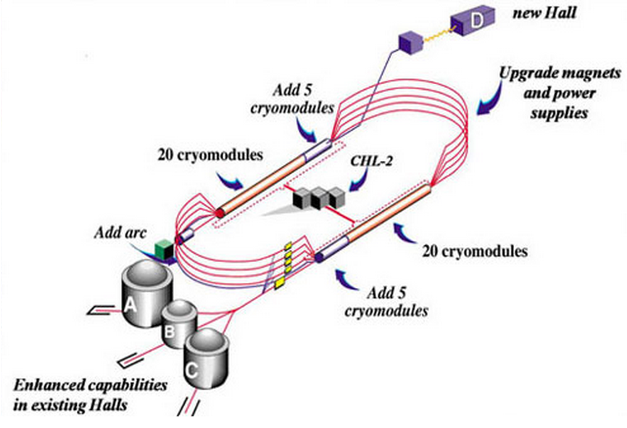
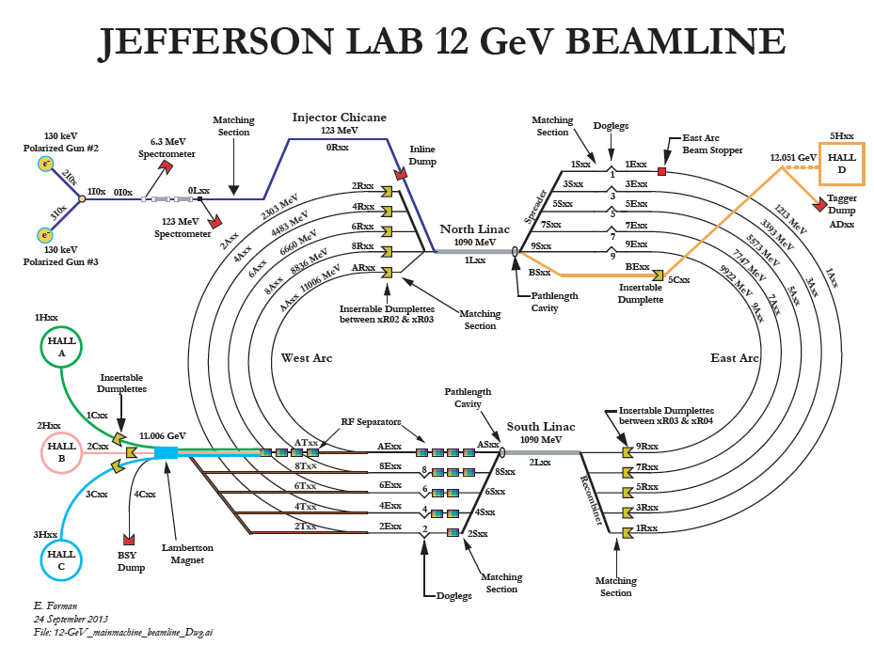
CEBAF - Full Energy Injector
CEBAF fixed target program
  5-pass recirculating SRF linac
  Exciting science program beyond 2025
  Can be operated concurrently with the MEIC
CEBAF will provide for MEIC
  Up to 12 GeV electron beam
  High repetition rate (up to 1497 MHz)
  High polarization (>85%)
  Good beam quality up to the mA level

Slide 14
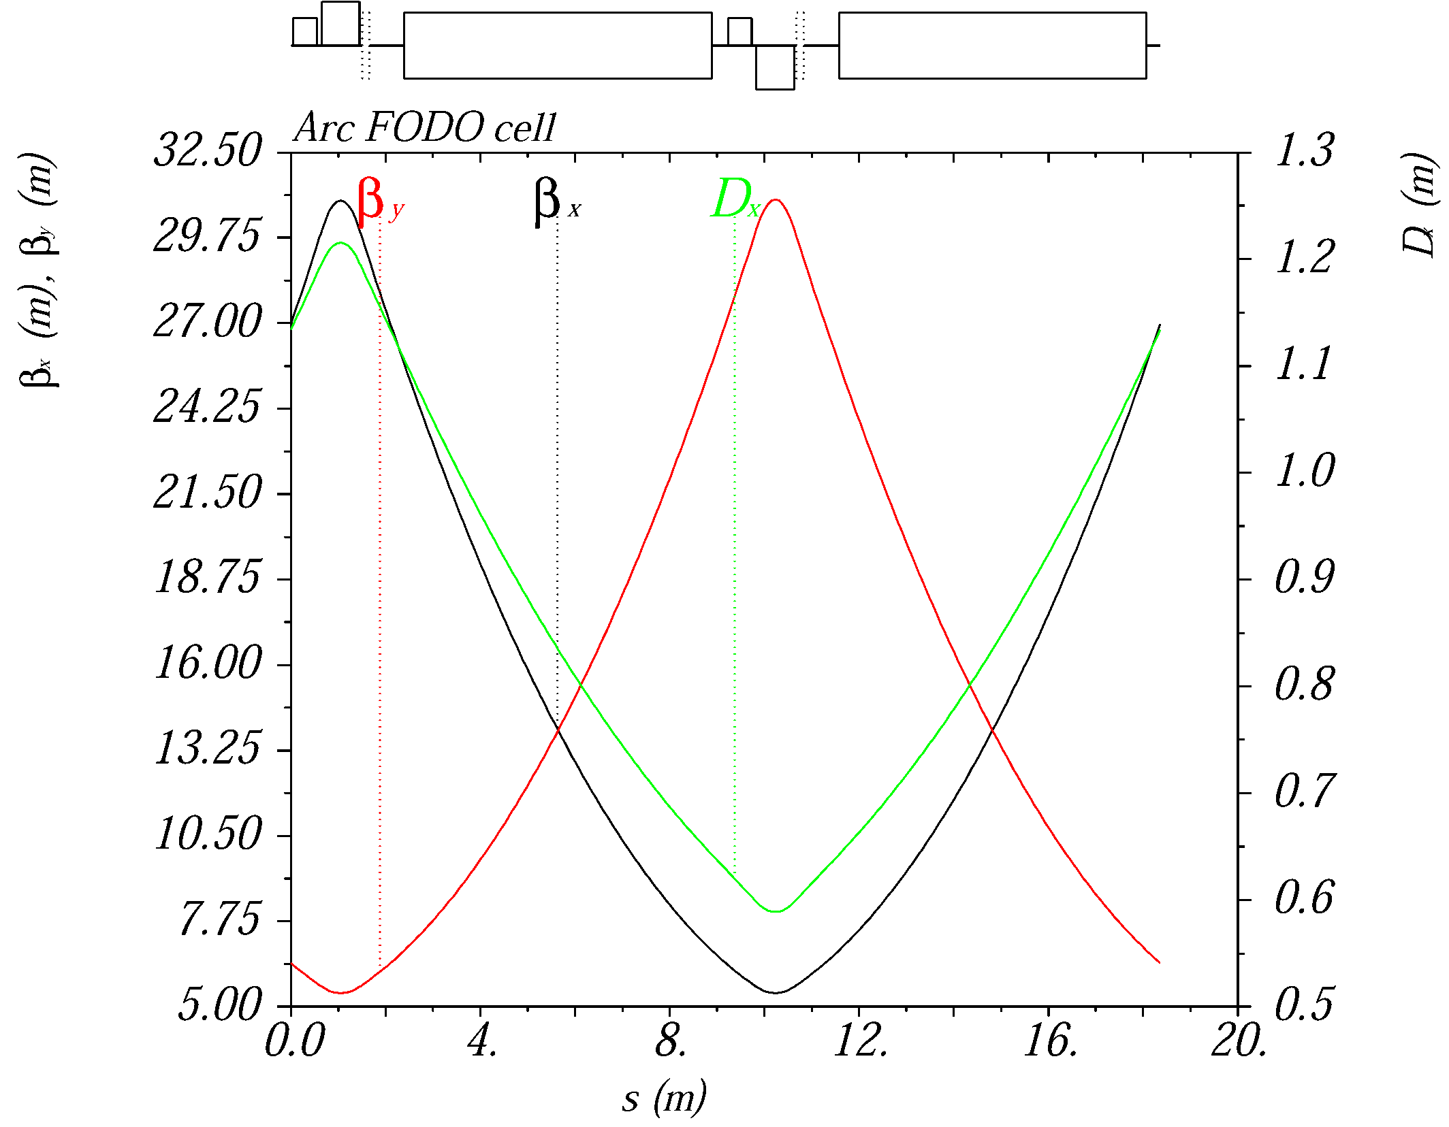
Ion Collider Ring with Super-Ferric Magnets
~2.2 km circumference to match PEP-II-magnet-based electron ring
Super-ferric magnets for the ion collider ring
  ~3 T maximum field, 4.5 K operating temperature
  Cost effective, construction and operation ( factor of ~2 cheaper to operate, GSI)
Maximum proton momentum of 100 GeV/c
The lattice is based on a FODO cell
length of 22.8 (1.5x PEP-II FODO cell)
optimized for an 8m long SF dipole
magnet
The lattice is fully matched

Slide 15
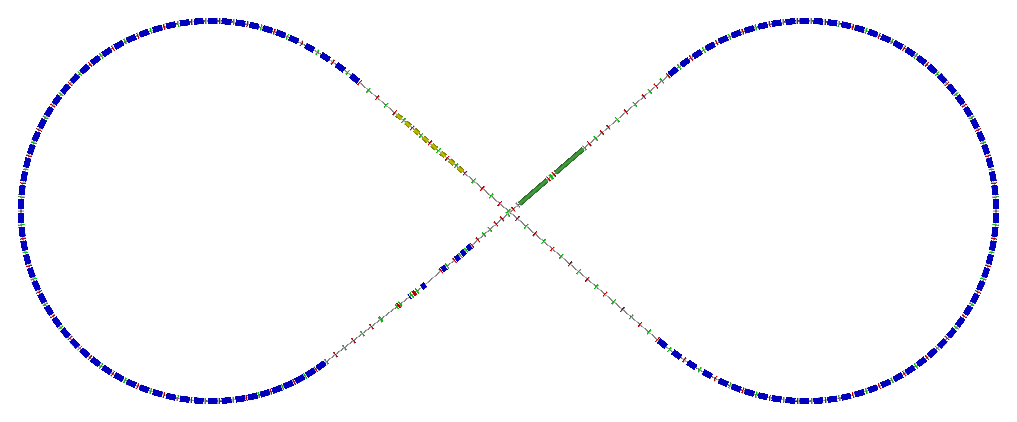
Ion Collider Ring
Figure-8 ring with a circumference of 2153.9 m
Two 261.7° arcs connected by two straights crossing at 81.7°
disp. supp./
geom. match #3
disp. supp./
geom. match #2
norm.+
SRF
Arc, 261.7°
elec. cool.
tune
tromb.+
match
81.7°
R = 155.5 m
future 2nd IP
det. elem.
disp. supp.
ions
beam exp./
match
IP
disp. supp./
geom. match #3
disp. supp./
geom. match #1

Slide 16
Ion Collider Ring Parameters
All design goals achieved
Resulting collider ring parameters
Proton energy range | GeV | 20(8)-100
Polarization | % | > 70
Detector space | m | -4.6 / +7
Luminosity | cm⁻²s⁻¹ | > 10³³
Circumference | m | 2153.89
Straights’ crossing angle | deg | 81.7
Horizontal / vertical beta functions at IP β*_{x,y} | cm | 10 / 2
Maximum horizontal / vertical beta functions β_{x,y} _{max} | m | ~2500
Maximum horizontal dispersion D_{x} | m | 3.28
Horizontal / vertical betatron tunes ν_{x,y} |  | 24(.38) / 24(.28)
Horizontal / vertical natural chromaticities ξ_{x,y} |  | -101 / -112
Momentum compaction factor α |  | 6.45 × 10⁻³
Transition energy γ_{tr} |  | 12.46
Normalized horizontal / vertical emittance ε_{x,y} | µm rad | 0.35 / 0.07
Horizontal / vertical rms beam size at IP σ*_{x,y} | µm | ~20 / ~4
Maximum horizontal / vertical rms beam size σ_{x,y} | mm | 2.8 / 1.3

Slide 17
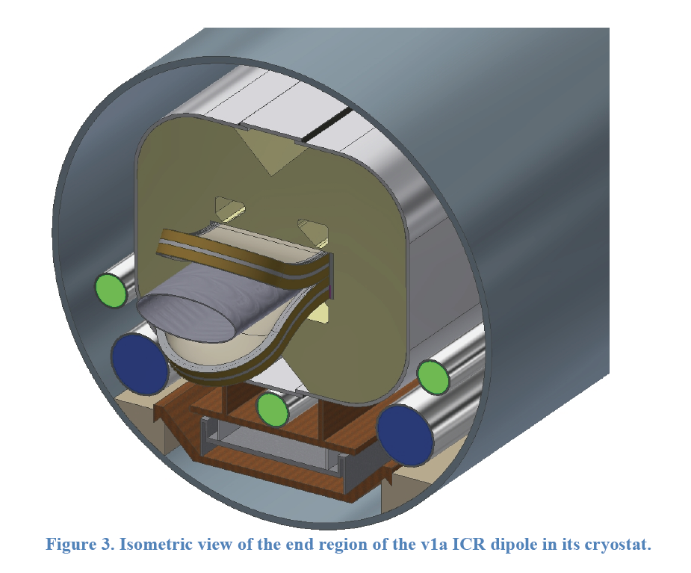
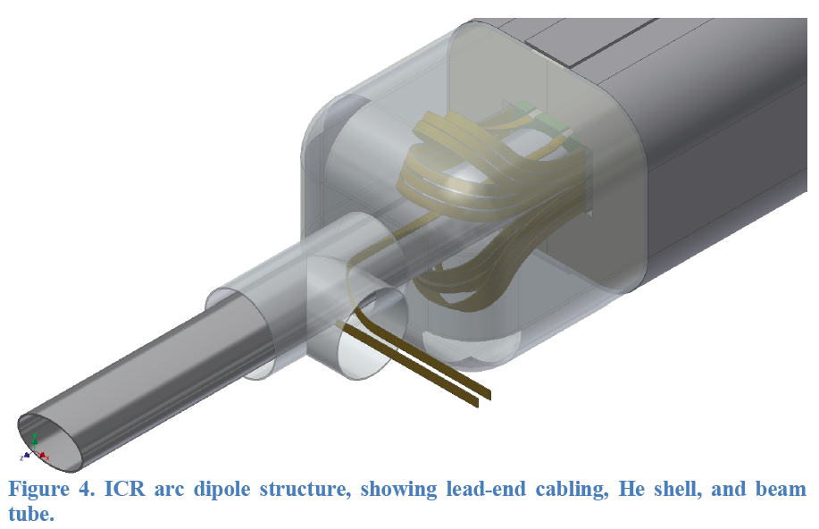
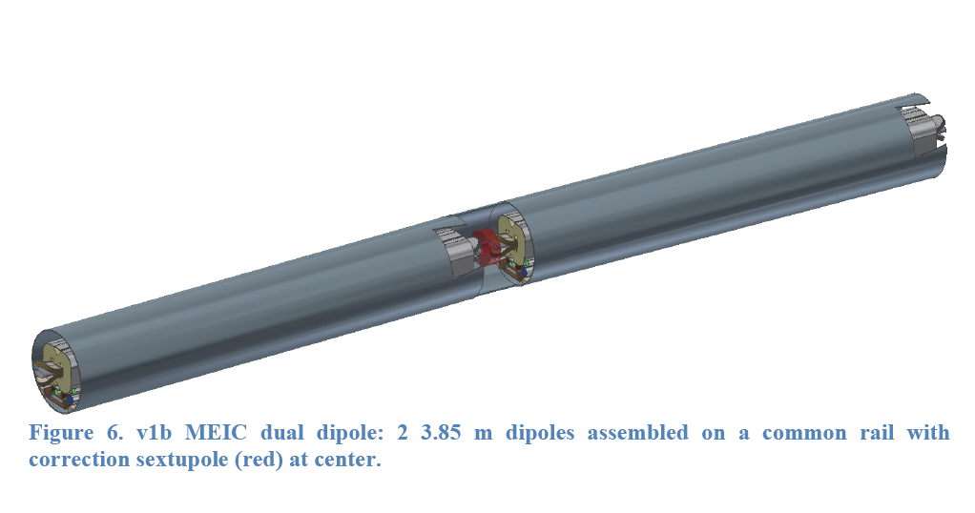
MEIC super-ferric dipole
2 X 4m long dipole
NbTi cable
3 T
Correction sextupole
Common cryostat

Slide 18
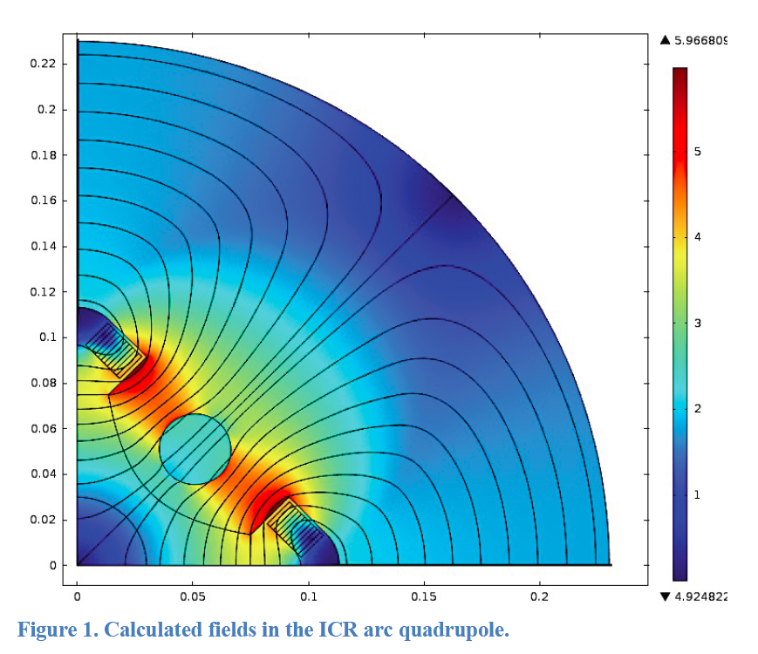
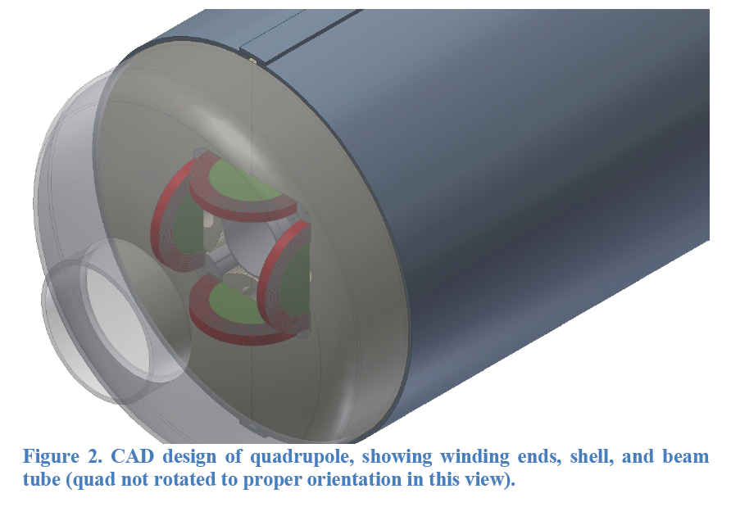
MEIC super-ferric Quadrupole
Arc quads ~50 T/m SF
Matching quads ~80 T/m SF
FF triplets cos-θ

Slide 19
Ion Injector Complex − Overview
Booster (8 GeV)
(accumulation)
DC e-cooling
Ion Sources
SRF Linac (285 MeV)
Status of the ion injector complex:
Relies on demonstrated technology for injectors and sources
Design for an SRF linac exists
8 GeV Booster design to avoid transition for all ion species and based on
super-ferric magnet technology
Injection/extraction lines to/from Booster are designed

Slide 20
MEIC Multi-Step Cooling Scheme
ion sources
BB cooler
ion linac
DC cooler
Booster
(0.285 to 8 GeV)
collider ring
(8 to 100 GeV)
Ring | Cooler | Function | Ion energy | Electron energy
 |  |  | GeV/u | MeV
Booster ring | DC | Injection/accumulation of positive ions | 0.11 ~ 0.19 (injection) | 0.062 ~ 0.1
 |  | Emittance reduction | 2 | 1.1
Collider ring | Bunched Beam Cooling (BBC) | Maintain emittance during stacking | 7.9 (injection) | 4.3
 |  | Maintain emittance | Up to 100 | Up to 55
DC cooling for emittance reduction
BBC cooling for emittance preservation

Slide 21
Performance MEIC baseline
Achieved with a single pass ERL cooler
For a full acceptance detector
CM energy | GeV | 21.9 (low) |  | 44.7 (medium) |  | 63.3 (high)
 |  | p | e | p | E | p | e
Beam energy | GeV | 30 | 4 | 100 | 5 | 100 | 10
Collision frequency | MHz | 476 |  | 476 |  | 159
Particles per bunch | 10¹⁰ | 0.66 | 3.9 | 0.66 | 3.9 | 2.0 | 2.8
Beam current | A | 0.5 | 3 | 0.5 | 3 | 0.5 | 0.72
Polarization | % | >70% | >70% | >70% | >70% | >70% | >70%
Bunch length, RMS | cm | 2.5 | 1.2 | 1 | 1.2 | 2.5 | 1.2
Norm. emitt., vert./horz. | μm | 0.5/0.5 | 74/74 | 1/0.5 | 144/72 | 1.2/0.6 | 1152/576
Horizontal and vertical β* | cm | 3 | 5 | 2/4 | 2.6/1.3 | 5/2.5 | 2.4/1.2
Vert. beam-beam param. |  | 0.01 | 0.02 | 0.006 | 0.014 | 0.002 | 0.013
Laslett tune-shift |  | 0.054 | small | 0.01 | small | 0.01 | small
Detector space, up/down | m | 7/3.6 | 3.2 / 3 | 7/3.6 | 3.2 / 3 | 7/3.6 | 3.2 / 3 (3)
Hour-glass (HG) reduction |  | 0.89 |  | 0.88 |  | 0.73
Lumi./IP, w/HG, 10³³ | cm⁻²s¹ | 1.9 |  | 4.6 |  | 1.0
For a high(er) luminosity detector
Horizontal and vertical β* | cm | 1.2 | 2 | 1.6 / 0.8 | 1.6 / 0.8 | 2 /1 | 1.6 / 0.8
Vert. beam-beam param. |  | 0.01 | 0.02 | 0.004 | 0.021 | 0.001 | 0.021
Detector space, up/down | m | ±4.5 | 3 | ±4.5 | 3 | ±4.5 | 3
Hour-glass (HG) reduction |  | 0.67 |  | 0.74 |  | 0.58
Lumi./IP, w/HG, 10³³ | cm⁻²s¹ | 3.5 |  | 7.5 |  | 1.4

Slide 22
e-p Luminosity
10³⁴
10³³
The baseline performance requires a ERL bunched beam cooler but no circulator cooler

Slide 23
e-ion luminosity
For a full acceptance detector
 |  | Electron | Proton | Deuteron | Helium | Carbon | Calcium | Lead
 |  | e | P | d | ³He⁺⁺ | ¹²C⁶⁺ | ⁴⁰Ca²⁰⁺ | ²⁰⁸Pb⁸²⁺
Beam energy | GeV | 5 | 100 | 50 | 66.7 | 50 | 50 | 39.4
Particles/bunch | 10¹⁰ | 3.9 | 0.66 | 0.66 | 0.33 | 0.11 | 0.033 | 0.008
Beam current | A | 3 | 0.5 | 0.5 | 0.5 | 0.5 | 0.5 | 0.5
Polarization |  | >70% | >70% | > 70% | > 70% | - | - | -
Bunch length, RMS | cm | 1.2 | 1 | 1 | 1 | 1 | 1 | 1
Norm. emit., horz./vert. | μm | 144/72 | 1/0.5 | 0.5/0.25 | 0.7/0.35 | 0.5/0.25 | 0.5/0.25 | 0.5/0.25
β*, hori. & vert. | cm | 2.6/1.3 | 4/2 | 4/2 | 4/2 | 4/2 | 4/2 | 5/2.5
Vert. beam-beam parameter |  | 0.014 | 0.006 | 0.006 | 0.006 | 0.006 | 0.006 | 0.005
Laslett tune-shift |  |  | 0.01 | 0.041 | 0.022 | 0.041 | 0.041 | 0.041
Detector space | m | 3.2 / 3 | 7 / 3.6
Hour-glass (HG) reduction factor |  |  | 0.89 | 0.89 | 0.89 | 0.89 | 0.89 | 0.89
Lumi/IP/nuclei, w/ HG correction | 10³³ cm⁻²s⁻¹ |  | 4.6 | 4.6 | 2.2 | 0.77 | 0.23 | 0.04
Lumi/IP/nucleon, w/HG correction, | 10³³ cm⁻²s⁻¹ |  | 4.6 | 9.2 | 6.6 | 9.2 | 9.2 | 7.8
For a high(er) luminosity detector
β*, hori. & vert. | cm | 1.6/0.8 | 1.6/0.8 | 1.6/0.8 | 1.6/0.8 | 1.6/0.8 | 1.6/0.8 | 1.6/0.8
Vert. beam-beam parameter |  | 0.02 | 0.004 | 0.004 | 0.004 | 0.004 | 0.004 | 0.004
Detector space | m | 3 | 4.5
Hour-glass (HG) reduction factor |  |  | 0.74 | 0.74 | 0.74 | 0.74 | 0.74 | 0.74
Lumi/IP/nuclei, w/ HG correction | 10³³ cm⁻²s⁻¹ |  | 7.5 | 9.3 | 3.7 | 1.37 | 0.38 | 0.08
Lumi/IP/nucleon, w/HG correction, | 10³³ cm⁻²s⁻¹ |  | 7.5 | 15.1 | 11.1 | 15.1 | 15.1 | 17.3

Slide 24
Overview R&D for the MEIC baseline
Needed R&D | Risk level | Mitigating strategies | Mitigated risk level
Bunched beam electron cooling ERL only | MEDIUM | Test of bunched beam cooling at IMP (LDRD) Experience from RHIC low energy cooling Development of a 200 mA unpolarized e- gun | LOW
Low β* ion ring | MEDIUM | Chromatic and IR nonlinear correction schemes DA tracking with errors and beam beam Operational experience at hadron colliders | LOW
Space charge dominated beams | MEDIUM | Simulation DC cooling in Booster Operational experience at UMER and IOTA rings Study of space charge compensation at eRHIC | LOW
Figure 8 layout | MEDIUM | Spin tracking simulations | LOW
Super ferric magnets | MEDIUM | Existing prototypes (SSC, GSI) Early MEIC prototype (FY15-16) Operational experience at GSI Alternative cosθ designs | LOW
Crab cavities | MEDIUM | Prototypes Operational experience at KEK-B and LHC Test of crab cavity in LERF (FEL) | LOW
SRF R&D | LOW | 952 MHz RF development | LOW

Slide 25
Pre-Project R&D (for CD-1)
PROTOTYPES
Development and testing of 1.2m 3T SF magnets for MEIC ion ring and booster Collaboration with Texas A&M, FY15-16
Crab cavity development (collaboration with ODU, leveraging R&D for LHC / LARP crab)
952 MHz Cavity development, FY15-17
DESIGN OPTIMIZATION
Optimization of conceptual design of MEIC ion linac
Collaboration with ANL and/or FRIB, FY 15-17
Design and simulation of fixed-energy electron cooling ring (integrated in the Ion Ring arc cryostats) to enable cooling and stacking of polarized ions during each store so that a fresh high-brightness fill is ready when needed
Collaboration with Texas A&M, FY 15-17
Optimization of Integration of detector and interaction region design, detector background, non-linear beam dynamics, PEP-II components
Collaboration with SLAC, FY 12-17
Feasibility study of an experimental demonstration of cooling of ions using a bunched electron beam
Collaboration with Institute of Modern Physics, China

Slide 26
Pre-Project R&D
MODELING
Studies and simulations on preservation and manipulation of ion polarization in a figure-8 storage ring
Collaboration with A. Kondratenko, FY 13-15
Algorithm and code development for electron cooling simulation, FY 15-16
We believe that this covers our R&D needs for the CDR and CD1

Slide 27
On-Project R&D
PROTOTYPES
Prototype for magnetized ERL e-cooler gun 3 M$
952 MHz prototype cryomodule components 2 M$
Crab cavity prototype cryomodule components 2 M$
Prototype for ion ring IR FF triplet 2 M$
VALUE ENGINEERING (cost and risk reduction)
Super-ferric Cable-in-Conduit magnets R&D for the ion rings 1.5 M$
Optimization of of PEP-II components (tubes, LLRF, vacuum) 1.3 M$
  R&D on high-efficiency RF sources 1 M$
  Optimization of linac front end components for low duty factor 1 M$
  Total 13.8 M$

Slide 28
Conclusions and Outlook
The MEIC baseline based on a ring-ring design is mature
and can deliver luminosity from a few 10³³ to a few 10³⁴
and polarization over 70% in the √s 15-65 GeV range with low
technical risks.
The MEIC baseline fulfills the requirements of the white paper.
We continue to optimize the present design for cost and performance.
The design can be upgraded in energy and luminosity.

Slide 29
Backup Slides

Slide 30
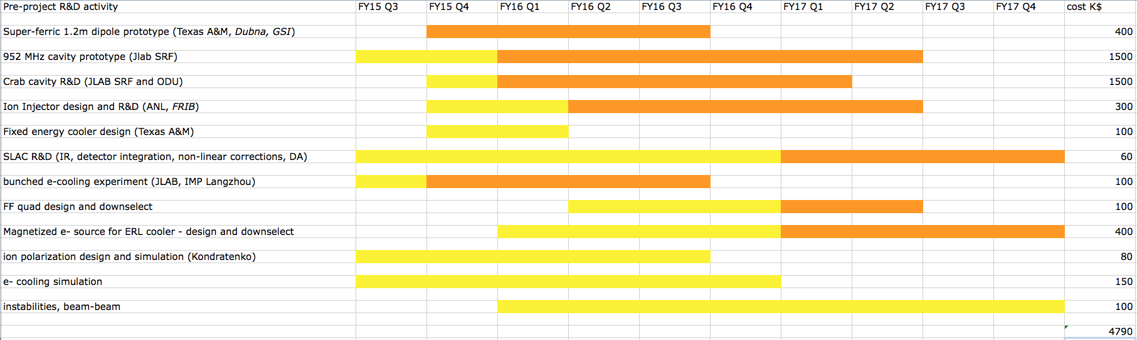
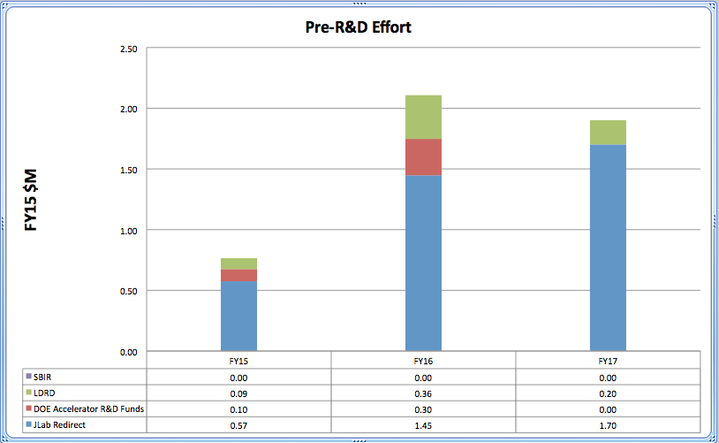
Draft Timeline

Slide 31
Areas of Design Optimization
RF power of the high energy electron beam
Limit average current, but allow a higher bunch charge
Lower bunch repetition rate can increase luminosity as long as the ion space charge is OK
Space charge effect for the low energy proton beam
Limit bunch charge, but allow higher average current (higher bunch frequency)
Increase bunch length to store more charge in a bunch (hour glass effect)
Increase the bunch repetition rate
Beam-beam effect
Limit bunch charge, but allow higher average current (bunch frequency)
Electron emittance
Due to the large bending angle of PEP-II dipoles and PEP lattice
Emittance reduction with damping wiggler and/or TME lattice

Slide 32
Performance Enhancements: energy reach and operations
Raise the e-ring energy to 12 GeV by adding more RF to the e-ring
(all other e-ring components already consistent with 12 GeV)
Raising the ion-ring energy to 120 GeV (That requires an increase of the super-ferric magnet field strength by 20%).
Raising the ion-ring energy to >250 GeV (a 5.5 T design for cos-theta RHIC-like magnets has been already considered and appears feasible, and we can capitalize on R&D on high field superconducting magnets for the LHC upgrade and beyond).
Modifying the ion ring lattice to avoid transition crossing for all ion species through replacement of present FODO arcs with a newly developed negative momentum compaction optics, which yields imaginary transition gamma for the ion ring.

Slide 33
Performance enhancements: luminosity
Reduce e- emittance:
Reduce growth from spin rotators (new design, -35%)
TME lattice for the e-ring (We have a lattice solution already and it requires swapping
a fraction of the PEP-II dipoles with new ones)
Add a damping wiggler
 | Nor. Equilibrium Emittance ε_{x}^{N} (μm)
Energy (GeV) | 5 | 10
Arc FODO (108° pha. adv.) | 95 | 759
Arc (FODO + old spin rotators) | 128 | 1026
Whole ring (Arcs + IR) | 139 | 1163
 | Nor. Equilibrium Emittance ε_{x}^{N} (μm)
Energy (GeV) | 5 | 10
TME cell | 26 | 204
Arc (TME + 35% less emittance new spin rotators) | 48 | 378
Whole ring (Arcs + 35% less emittance IR) | 56 | 467
Whole ring (Arcs + 35% less emittance IR + DW) | 40 | 440
Reduce the ion emittance by ~factor 3 by adding a circulator cooler to the ERL cooler
Double the repetition rate

Slide 34
MEIC enhanced performance
CM energy | GeV | 21.9 (low) |  | 44.7 (medium) |  | 63.3 (high)
 |  | p | e | p | e | p | e
Beam energy | GeV | 30 | 4 | 100 | 5 | 100 | 10
Collision frequency | MHz | 952 |  | 952 |  | 159
Particles per bunch | 10¹⁰ | 0.66 | 3 | 0.66 | 2.6 | 2.0 | 2.8
Beam current | A | 1 | 4.5 | 1 | 4 | 0.5 | 0.72
Polarization | % | >70% | >70% | >70% | >70% | >70% | >70%
Bunch length, RMS | cm | 2.5 | 1.2 | 0.7 | 1 | 2.75 | 0.7
Norm. emitt., vert./horz. | μm | 0.45/0.45 | 30/30 | 0.35/0.07 | 40/20 | 0.35/0.07 | 440/220
Horizontal and vertical β* | cm | 1/1 | 3.7/3.7 | 5/1 | 4/0.8 | 7.5/1.5 | 4/0.8
Vert. beam-beam param. |  | 0.008 | 0.05 | 0.015 | 0.061 | 0.06 | 0.061
Laslett tune-shift |  | 0.061 | small | 0.055 | small | 0.013 | small
Detector space, up/down | m | 7/3.6 | 3.2 / 3 | 7/3.6 | 3.2 / 3 | 7/3.6 | 3.2 /3
Hour-glass (HG) reduction |  | 0.65 |  | 0.86 |  | 0.65
Lumi./IP, w/HG, 10³³ | cm⁻²s¹ | 6.7 |  | 32.6 |  | 4
About a factor 7 better than the baseline
This is for the full acceptance detector

