Slide 1
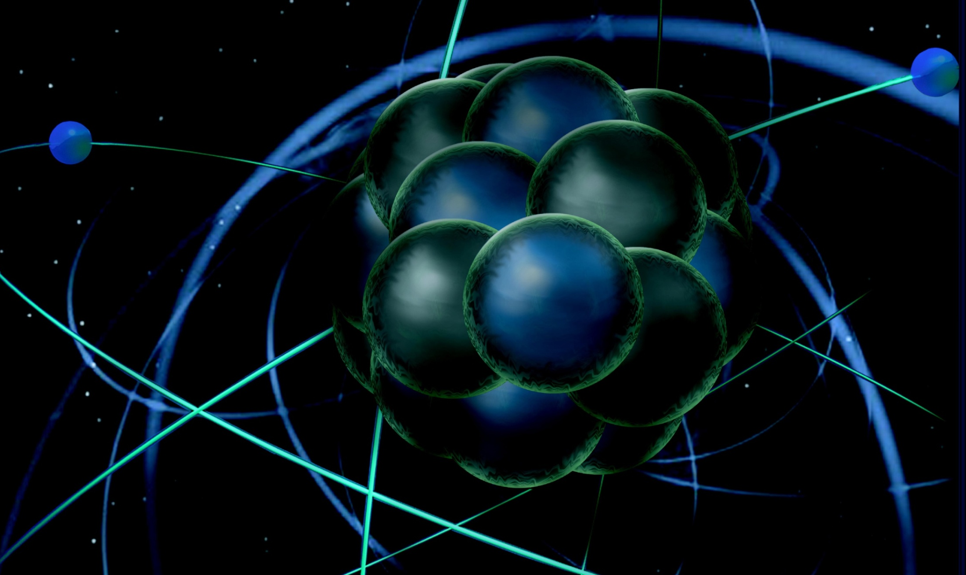
Welcome and Charge Fulvia Pilat
MEIC Collaboration Meeting
March 30-31

Slide 2
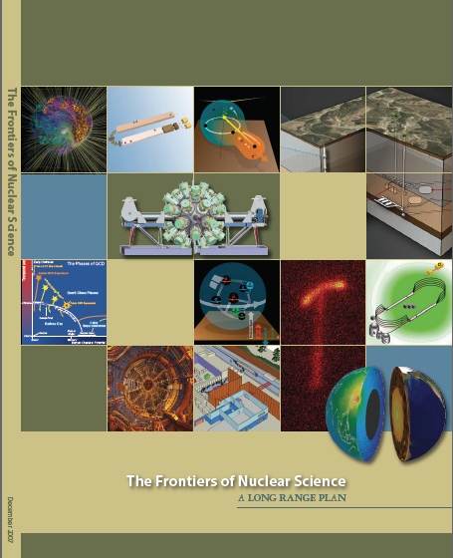
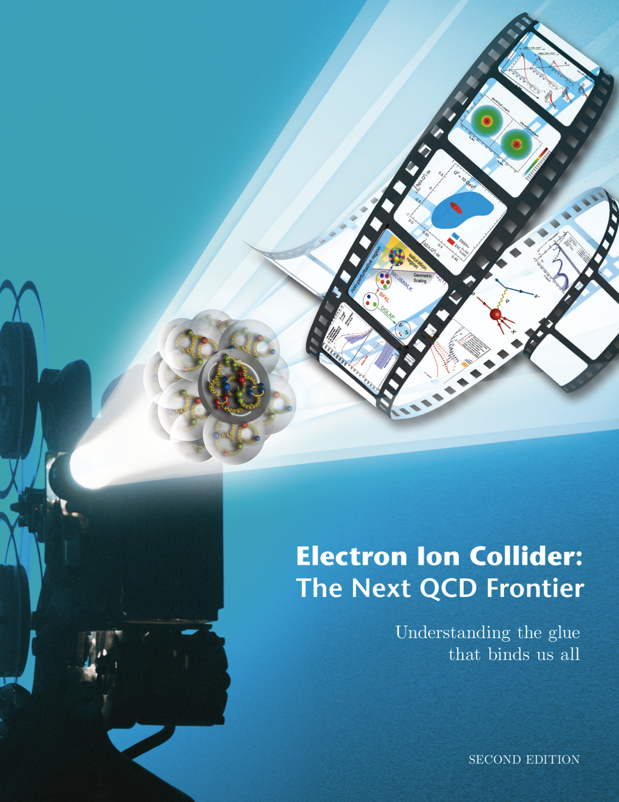
Electron Ion Collider
NSAC 2007 Long-Range Plan:
“An Electron-Ion Collider (EIC) with polarized beams has been embraced by the U.S. nuclear science community as embodying the vision for reaching the next QCD frontier. EIC would provide unique capabilities for the study of QCD well beyond those available at existing facilities worldwide and complementary to those planned for the next generation of accelerators in Europe and Asia.”
EIC Community White Paper arXiv:1212.1701

Slide 3
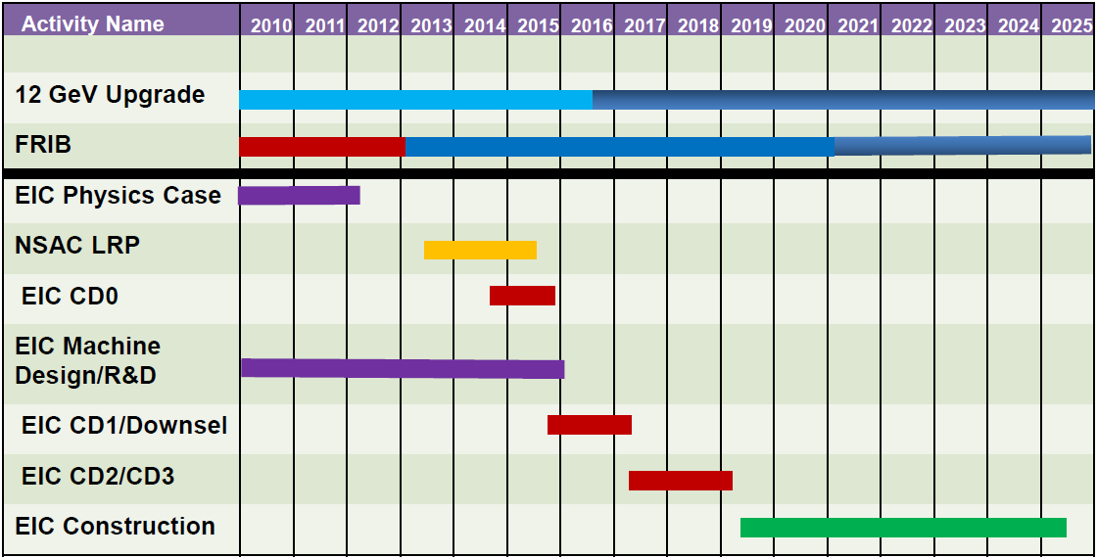
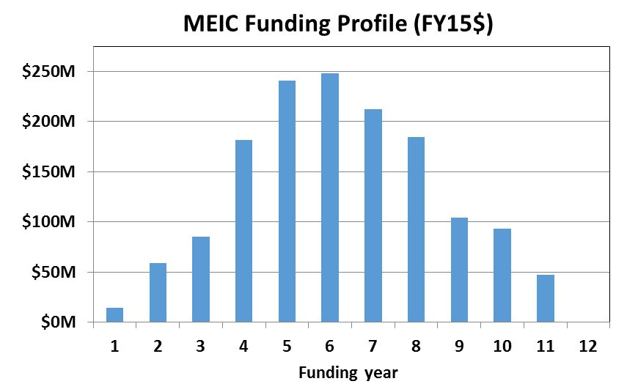
(M)EIC Realization Imagined
Shown as most optimistic (wishful) schedule
Start EIC construction after FRIB completion
Fixed-target 12 GeV CEBAF operations can continue throughout the construction period.
Assumes endorsement for an EIC at the next (this) NSAC Long Range Plan
Assumes relevant accelerator R&D for down- select process done around 2016/17
EIC Cost Review suggested a TPC of $1,500M for a generic EIC including detector
Design studies continue for reduction of the TPC below this
The relatively low technical risk of the MEIC design requires only minor investments in pre-R&D
CD3 is year when long-lead procurements can start, we think this is FY20 at the earliest.
The EIC TPC and an assumed 15 year of operations ($117M/yr in FY15$) would be of similar cost as the CEBAF 4-6 GeV life cycle costs: $3.24B vs. $2.98B.
Nuclear Physics can afford this.
Year 4 ~ CD3
FY20?
Year 12 ~ CD4
FY28?

Slide 4
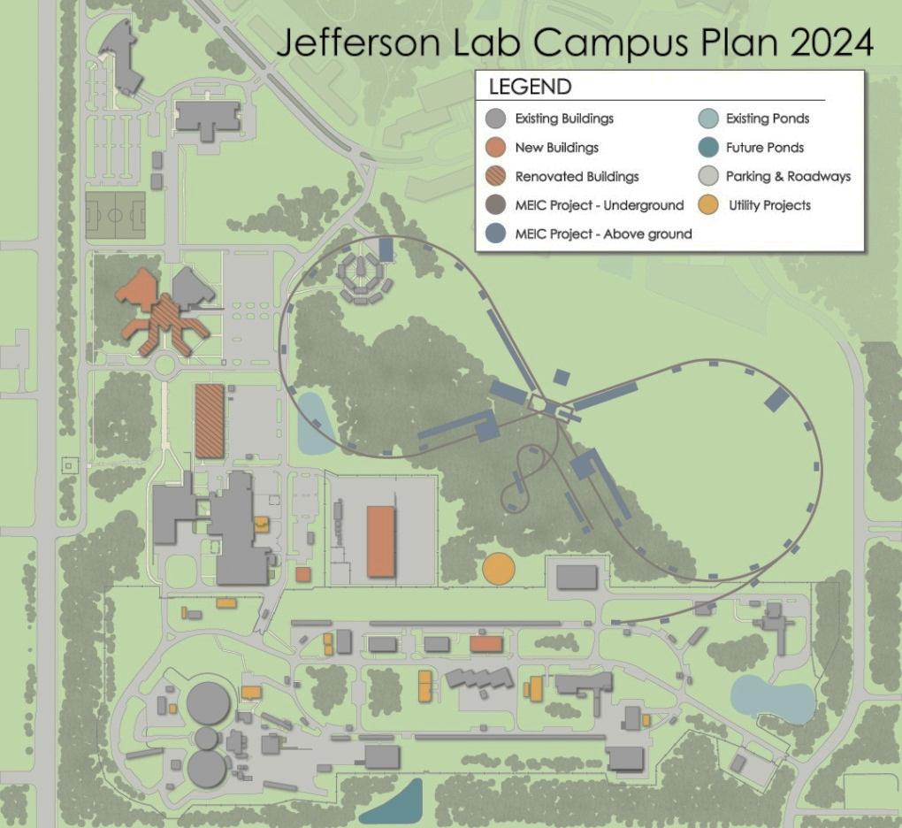
Jefferson Lab Mission: MEIC
JLab MEIC Figure 8 Concept
Initial configuration:
3-10 GeV on 20-100 GeV ep/eA collider
Optimized for high ion beam polarization:
polarized deuterons
Luminosity:
up to few x 10³⁴ e-nucleons cm⁻² s⁻¹
Low technical risk
Upgradable to higher energies
250 GeV protons + 20 GeV electrons
Flexible timeframe for Construction consistent w/running 12 GeV CEBAF
Thorough cost estimate completed
presented to NSAC EIC Review
Cost effective operations
 Fulfills White Paper Requirements

Slide 5
MEIC Timeline and context
MEIC design (10+ years)
Physics case and machine requirements defined by White Paper (2011)
Preliminary conceptual design report (2012)
Design optimization, EICAC reviews, internal reviews
NSAC/LRP process starts (2014)
NASC/LRP Cost Review (January 2015)
Final design optimizations (February-June 2015) → baseline
Pre-project R&D planning and execution (2015-2017)
Conceptual Design Report planning and execution (2015-2017)
GOAL: Ready for CD1 and down-select

Slide 6
MEIC Collaboration Meeting Goals
Define and compare options with the goal of optimizing cost and performance for the:
Injector complex
Electron cooling
(Race-track vs. figure-8)
Discuss and start define roles, responsibilities and deliverables of collaborators for:
Design optimization
Pre-project R&D
CDR writing
Engage industrial partners and form basis for collaboration and potential SBIR’s
Plan future Collaboration Meetings

