Slide 1
Fermilab DC Cooler Experiences
Lionel Prost
MEIC Collaboration Meeting Spring 2015 (Topics: Ion Beam Formation and Cooling)
30 March 2015

Slide 2
Outline
Why Fermilab needed it
Choice of the scheme
Challenges, remedies and cooling optimization
Operation

Slide 3
Tevatron luminosity and antiprotons
The Tevatron luminosity is almost linear with respect to the total number of antiprotons available for Tevatron stores. Increase of antiproton production and improvement of the beam quality was the central component of the Tevatron Run II.
Average initial luminosity as a function of the number of antiprotons injected into the Main Injector. Shown are the stores in 2011.

Slide 4
Fermilab’s antiproton production chain
3⋅10¹¹
ρ = 1⋅10⁸
1⋅10⁸
ρ = 1
8 GeV
1⋅10⁸
ρ = 300
8 GeV
Proton beam 8⋅10¹² protons every 2.2 sec
120 GeV
Debuncher (stochastic cooling)
Accumulator (stochastic cooling)
Nickel target
1⋅10¹²
until 2005
8 GeV
1 TeV
150 GeV
Tevatron
4⋅10¹²
ρ = 4⋅10⁹
Recycler (stochastic and electron cooling)
Main injector
Electron cooling in the Recycler Ring eliminated a bottleneck in the antiproton production chain.

Slide 5
COOLER DESIGN SCHEME

Slide 6
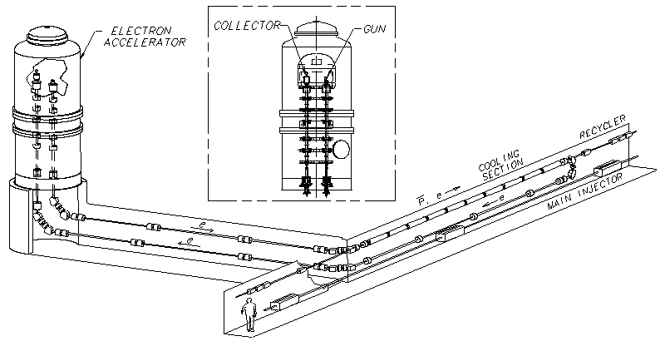
Cooler’s features
  Design parameters of the RR ECool
    Energy 4.3 MeV
    Beam current (DC) 0.5 Amps
    Angular spread 0.2 mrad
    Effective energy spread 300 eV
RR = Recycler Ring
Electrostatic accelerator
  4 MeV × 0.5 A = 2 MW DC
    Energy recovery; very low beam losses; overcoming high voltage discharges
Novel transport scheme
  Longitudinal magnetic field in the cooling section and in the gun with lumped focusing in between
  100 G in cooling section; 10 solenoids
The solution allowed building the cooler with a modest budget and in time for Run-II
Primarily for longitudinal cooling
  Required cooling times were many minutes

Slide 7
Transport with interrupted longitudinal magnetic field
Longitudinal magnetic field in the cooling section and in the gun with lumped focusing in between
Beam line
Cathode
Cooling section
B_{cz} = 90 G
R_{cath} = 3.8 mm
B_{z} = 0
R = 2 -10 mm
B_{cz} = 105 G
R_{beam} = 3.5 mm
(normalized)
(normalized)
(normalized)
The transverse velocities in the cooling section can be low only if the magnetic fluxes through the emitter and the beam in the cooling section are equal.
Outside of the field, the beam behavior is dominated by an effective emittance proportional to the magnetic flux through the emitter

Slide 8
Applicability
When is the scheme with interrupted magnetic field applicable?
  The figure of merit is the magnetic flux through the beam in the cooling section and the energy
  The scheme can work when the required beam radius and the magnetic field in the cooling section are low and the energy is high
Cooling time required from RR Ecool is many minutes
  Cooling is adequate without effects of strong magnetization
Typical rms radius of the antiproton beam is 1-2 mm
  Electron beam size can be similar
Outside of the magnetic field, the (non-normalized) effective emittance is tolerable, ~4μm

Slide 9
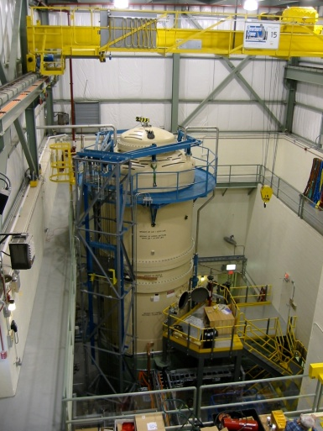
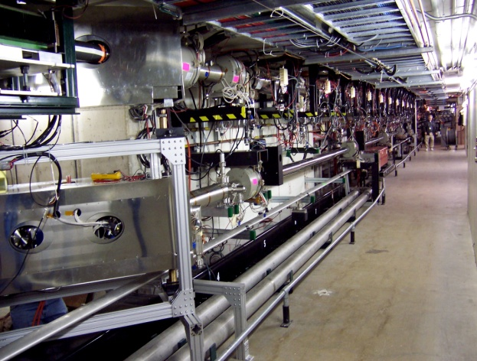
Cooler in the Recycler Ring
February, 2005
beginning of commissioning
The Pelletron and beam “supply” and “transfer” lines
20 m
Portion of the Main Injector tunnel containing the cooling section and the “return” line.

Slide 10
Some useful decisions
Long off-line testing
Nominally “round” optics in the supply line
Zero dispersion in the cooling section
High dispersion after the cooling section to measure energy drifts
Placement of elements with tuning convenience in mind
  Each solenoid is followed by dipole correctors and, after a drift space, by a BPM right upstream of the next solenoid
Data logging of all parameters
Well–thought procedure of energy tuning
Initial transverse tuning with round orifices in the cooling section (“scrapers”)

Slide 11
CHALLENGES, REMEDIES & COOLING OPTIMIZATION

Slide 12
Difficulties
Magnetic fields from the Main Injector
  Compensation of bus currents, additional
  magnetic shielding
  Changes in optics that made the system more
  tolerable to the beam motion
First energy matching
  Absolute energy calibration of the electron beam
  by measuring the electron Larmor wave length in
  the magnetic field of the cooling section
  A special wide energy distribution of antiprotons to
  observe the first interaction between beams
Full discharges, stability of operation
  Lots of work but not discussed here
Energy stability
  Temperature stabilization
  Feedback from e-position in a high-dispersion region
  “Peakiness” of the Schottky distribution after cooling
Tuning, life time
  See in following slides
Δp/p=3%
One of the first indications of interaction between antiprotons and electrons.
More later on

Slide 13
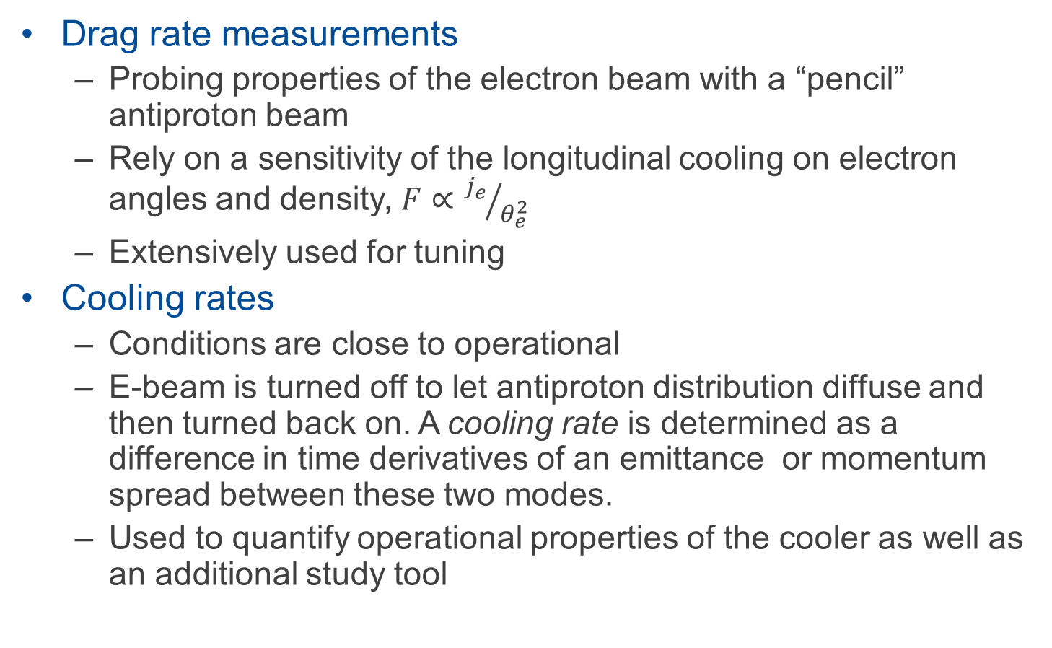
Drag rates and cooling rates
Drag rate measurements
  Probing properties of the electron beam with a “pencil” antiproton beam
  Rely on a sensitivity of the longitudinal cooling on electron angles and density, $F∝{j_{e}}/{θ_{e}^{2}}$
  Extensively used for tuning
Cooling rates
  Conditions are close to operational
  E-beam is turned off to let antiproton distribution diffuse and then turned back on. A cooling rate is determined as a difference in time derivatives of an emittance or momentum spread between these two modes.
  Used to quantify operational properties of the cooler as well as an additional study tool

Slide 14
Drag rate measurements
Coasting “pencil” antiproton beam (N_{p}~1×10¹⁰); changes in average momentum are recorded after a jump of electron energy; drag rate = time derivative of the average momentum
Drag rate ≈ longitudinal cooling force for an “average” particle
Example of evolution of the mean and rms values of the momentum distribution after a 1.9 keV e-energy jump . The drag rate is 71 (MeV/c)/hr. I_{e}= 0.5 A.

Slide 15
Cooling force as a function of the beam current
In all measurements, the voltage jump was 2 kV and the electron beam was “on axis”. All points in each curve are taken at constant focusing settings

Slide 16
Cooling force as a function of the beam current
At low beam currents, main improvements came from
  Alignment of the field in the cooling section
  Adjustment of quadrupole focusing
All adjustments were made at I_{e} = 0.1A

Slide 17
Cooling section field alignment
The cooling section consists of 10 identical modules, which are rigid but can move with respect to one another due to tunnel deformations, hence creating field errors.
  Area being measured
  Transition area (large angle)
  Large offset (4 mm with the electron beam radius ~2.3 mm)
Procedure: Optimize 10 pairs of correctors in each module measuring the cooling force produced by the module.
  Tilt or shift of the solenoid results in dipole fields similar to fields generated with either 8 pairs of central correctors or 2 pairs of end correctors
Drag rate as a function of a change in currents of all 8 central X correctors by the same amount in module #3.

Slide 18
Adjustments of focusing
There were several indications of large focusing errors
  In part, drag rates measured across the beam were dropping with the offset much faster than the calculated electron beam density
Beam imaging at a YAG scintillator showed a large ellipticity
  Could be corrected with quadrupoles
  YAG ⇨ pulse mode, where focusing was different from DC
    Could not use it for an effective DC tuning
Quadrupoles
YAG location
Images of the beam with zero (1 and 2) and optimized (3 and 4) quadrupole currents.
I_{e} ~ 0.1A, 2µs pulse.

Slide 19
Adjustments of focusing (cont.)
Tuned quadrupoles based on the drag rate measurements (off-axis)
  Maximizing the drag rate for each of 6 quadrupoles
Cooling rates increased by ~1.5 times longitudinally and by ~2 times transversely (at I_{e} = 0.1A)
Longitudinal cooling rates at various vertical offsets of the electron beam before (set 2) and after (set 1) adjustments of quadrupoles. I_{e} ~ 0.1A.
Typical cooling rate measurement (October 26, 2007) .
I_{e} ~ 0.1A, beam on axis, focusing settings include quadrupoles.
Transverse emittances measured with flying wires.

Slide 20
Improvements at high beam current
At higher beam currents, the main improvement came from ion clearing
Tuning was made mainly at I_{e} = 0.3A

Slide 21
Ions - Effect
Contour plots of drag rates.
Left - I_{e} = 0.3A,
Right - I_{e} = 0.1A.
Contour levels are in MeV/c/hr.
While at I_{e}= 0.1A the drag rates drops with offset smoothly, at
I_{e}= 0.3A there are three narrow areas of good cooling
Hypothesis: the reason is a highly non-linear focusing effect of ions
Proposed remedy: clear ions by interrupting the electron current for a microsecond
  In the beam electric field, the ions gain a high transverse velocity
  (W_{i} ~10 eV) to reach the wall in ~1 µs after turning the beam off.

Slide 22
Ions - Removal
The capability to interrupt the beam for 2 – 20 µs at frequencies up to 100 Hz was implemented
Strong dependence of drag rates on the interruption frequency
  Naturally, the rate is maximum where it had been optimized
  Duration of the interruptions doesn’t have any measurable effect
Drag rate as a function of the interruption frequency for I_{e} = 0.3 A (left) and 0.1 A (right). The interruption length was 2 µs; beams were on axis. The squares represent the data, and the solid lines are fits. Focusing was optimized at 15 Hz for 0.3 A and with no interruptions for 0.1A (January 26, 2010).

Slide 23
Cooling with ion clearing
Contour plot of drag rates with ion clearing.
I_{e} =0.3A, 100 Hz. Contour levels are in MeV/c/hr.
Longitudinal cooling rate measured in 2006-2010.
The arrows connect points measured on the same day to show the range of several improvements. All measurements are “on axis”.
While cooling improved significantly, we couldn’t use it to its full strength in operation because of an antiproton instability.
  Also, the beam trips are more frequent at higher electron currents
  In 2011, we used I_{e} = 0.2 A and ion clearing in the time of beam preparation for Tevatron shots

Slide 24
Summary of cooling improvements
Tuning of focusing with quadrupoles
Alignment of the magnetic field in the cooling section
Ion clearing
All improvements of cooling properties were made through decreasing the transverse electron velocities (angles) in the cooling section
  The main study tool was the drag rate measurements
  The total rms angle is decreased probably by 1.5 – 2 times
    θ_{t} - electron angle, δW_{e} – energy spread
Drag rate as a function of momentum offset. I_{e} = 0.1A, focusing is optimized for ion clearing, 100 Hz. The circles are data, and the solid line is a calculation with θ_{t} = 80µrad, δW_{e} = 200eV, L_{c} = 9. January 4, 2011.

Slide 25
OPERATION

Slide 26
Recycler cooling cycle
Efficient storage of antiprotons and cooling them for shots to the Tevatron
  Typical beam loss due to the finite life time in the Recycler is ~5%
  Number of stored antiprotons is up to 6·10¹² with a life time > 300 hrs
  Phase density at extraction is limited by an instability
Typical cycle of accumulation of antiprotons in the Recycler ring and following extraction.
June 17-18, 2011. Electron beam was kept at 0.1A , shifted by 2 mm from the axis except right before extraction, when it was switched to 0.2A in ion clearing mode and moved on axis. Average life time was 256 hours.

Slide 27
Cooling
July 9, 2005 – First indication of the cooling force
The cooler’s performance was significantly improved and optimized
  Procedures for tuning, feedback loops, automation…
  Optimization of the cooling scenario
    Cooling off – axis
    Cooling with a helical trajectory
    Increasing the electron beam current for
    final cooling before extraction
Significant efforts for maintenance
  When the cooler was ‘broken’, the rate of
  integrating luminosity was dropping by ~3
Electron beam
“On axis”
2 mm offset
~95% of antiprotons

Slide 28
Availability/Reliability
Pelletron ran 24/7 and was turned off only when either a component had failed or during planned shutdowns (~once a year)
  Beam ‘interruptions’ (short)
    Beam trips:
      Protection system turns off the beam if a drop of HV by >5 kV or other problem is detected
      < 1 trip per day
      ~20 s to recover
    Full discharges:
      Unprovoked: ~once a year
      1-3 hours to fully recover
  Failures (long down time)
    The worst situation is to have to go into the Pelletron tank
      8-10 hrs to open, 6-8 hrs to close
        Typical turn-around time ~ 36 hrs
      Normally, several accesses per year
        Mostly, to repair electronics

Slide 29
Electron beam energy drift
Electron energy drift
  Corrected with a feedback loop based on BPM reading in a high-dispersion area
  Adjustments to an ‘energy parameter’ based on the Schottky longitudinal distribution profile
Measured dispersion in the electron beam line. The horizontal axis shows the BPM number counted along the beam line. Reading of the vertical channel of the first BPM after the 180 deg bend deviates with the energy change as 0.33 mm/keV.
Equilibrium momentum distribution of antiproton beam for cooling at two electron energies. Blue-optimum energy tuning, red - the electron energy is shifted by 1.2 keV; electron beam is on axis.

Slide 30
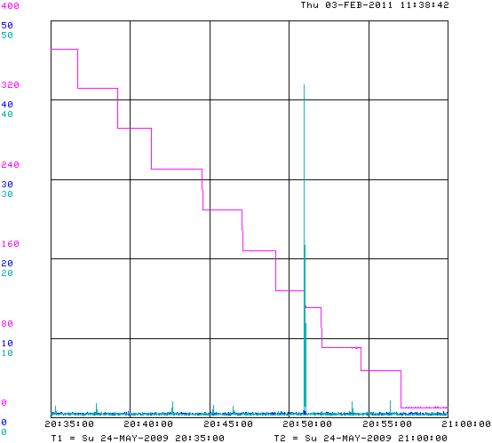
Impedance-driven instability (transverse)
Due to own space charge of pbars when deeply cooled
  Dampers suppressed them very efficiently
  A few were observed during extraction process
    Complicated RF gymnastics
Defined a ‘phase density’ parameter
  Monitored on-line
  Kept far from the calculated (and experimentally
  determined) instability threshold
antiproton ≡ ≡ pbar
# of pbar ×10¹⁰
Emittances in eV∙s & μrad
Vertical damper kick [%]
~20e10 loss
Instability before extracting bunch #7
Vertical damper kick [%]
Vertical emittance
(n, 95%) [π mm mrad]
Number of pbars [e10]
Horizontal emittance (n, 95%) [π mm mrad]
Electron beam current (0.1 A)
Horizontal damper kick [%]
40 min
~10 s

Slide 31
Life time
Life time was always worse with the electron beam on than without it
  Vacuum limit with stochastic cooling: ~1000 hrs
  In operation with electron cooling; 100 – 500 hrs
  No comprehensive explanation, but likely the main effect is related to formation of a cold core
    Life time might be decreasing even when transverse emittance was shrinking
    Strongest correlation was with the peak antiproton beam current
  Some electron beam –induced diffusion is possible as well
    Observation that might be relevant: Life time of protons in RR was dropping from tens of hours to seconds if the electron beam was on
Life time improvements:
  “Off-axis” cooling
  Cooling with a helix trajectory
Example of dependence of the antiproton life time at equilibrium on peak current of the antiproton beam. Dec 2, 2008 – Jan 7, 2009. I_{e} = 0.1A.

Slide 32
Summary of lessons learned
Procedure of the beam line tuning needs to be thought ahead and taken into account while placing components
  Both for initial tuning and operation
Alignment of a 20-m cooling section can be significantly affected by ground motion
Ions need to be carefully cleared from a relativistic electron beam
Life time of the cooled beam may decrease with electron cooling

Slide 33
Final words
Unique electron cooler
  High energy (4 MV), huge beam power (2 MW)
  Low magnetic field in the cooling section with lumped focusing outside
    ‘Non-magnetized’ cooling
    Transport of a beam with large effective emittance
Reliable machine running 24/7
The Recycler Electron Cooler significantly contributed to the success of Run-II
  i.e. property of cooling and overall operation of the cooler satisfied the needs (and maybe beyond expectations)

Slide 34
References
For more information:
  A. Shemyakin and L. R. Prost, The Recycler Electron Cooler, arXiv:1306.3175
  S. Nagaitsev, L. Prost and A. Shemyakin, Fermilab 4.3 MeV electron cooler, JINST 10 T01001 (2015), arXiv:1411.6994

Slide 35
BACK-UP SLIDES

Slide 36
Choice of the scheme (I)
Based on SSC MEB proposal for relativistic cooling
  No longitudinal magnetic field at the gun
  Lumped focusing in the cooling section
Pros
  Use of industrially-manufactured electrostatic accelerator
  Cooling section simpler than for strong continuous focusing
    Significantly cheaper too
Cons
  Low transverse velocities in cooling section ⇒ large value of the β-function ⇒ susceptible to perturbations
    Drift instability from wall image charges
    Ion instability
  Ineffective cooling inside the lenses
    Large azimuthal velocity

Slide 37
Choice of the scheme (II)
Combine advantages from longitudinal magnetic field in the cooling section and lumped focusing in the transport lines
The main reason: the scheme without continuous longitudinal magnetic field looked doable in the time frame useful for the Tevatron Run II.
Also,
  Pelletrons have had the terminal potential up to 25 MV
    Known for being reliable machines
  Cheaper
  Easier to incorporate into the existing MI/RR tunnel

Slide 38
Beam recirculation
Initially, insufficient stability ⇨ main obstacle during R&D and early commissioning
Remedies:
  Increase total length of acceleration tubes
    5 MV nominal → 6 MV nominal
  Fast protection circuitry
Oscillograms of ‘fast’ (red) and ‘slow’ (blue) discharges recorded by the fast capacitive pickup (Fast CPO) that measures the terminal voltage ‘drop’ (the terminal voltage actually becomes more positive)
Oscillograms of a recirculation interruption, showing the effectiveness of the fast gun shut off

Slide 39
Beam recirculation ‘remedies’: Gun and Collector
Developed gun and collector allowed a high beam current with low loss. The best results:
  At a low-energy test bench: 2.6 A, relative beam loss 2·10⁻⁶
  4.3 MeV beam, short beam line: 1.8 A, relative beam loss 1.2·10⁻⁵
  4.3 MeV beam, full beam line: 0.6 A, relative beam loss 1.6·10⁻⁵
    The likely reasons for the higher beam loss with the longer beam lines are interaction with the residual gas and the energy spread increase due to IBS
Pelletron HV Terminal
Collector
Gun
Anode current and changes in the deceleration tube current as functions of the beam current. Full line; ion clearing mode (December 31, 2011.).

Slide 40
Beam recirculation ‘remedies’: Beam optics
Adjust beam envelope in deceleration tube to transport out electrons coming out of the collector
Adjust beam envelope in acceleration tube so that beam core remains far from the tube electrodes when the beam trips
  Big difference in the occurrence of full discharges originating in the acceleration tube.
Protection of deceleration tube from irradiation when the beam trips by using optics with high dispersion in the return line
Simulations of the beam envelope (edge) in the accelerating column for nominal settings (solid curve) and settings representing a partial discharge (dotted curve). The limiting aperture is 12 mm. Vertical dotted lines represent the locations of the magnetic lenses.

Slide 41
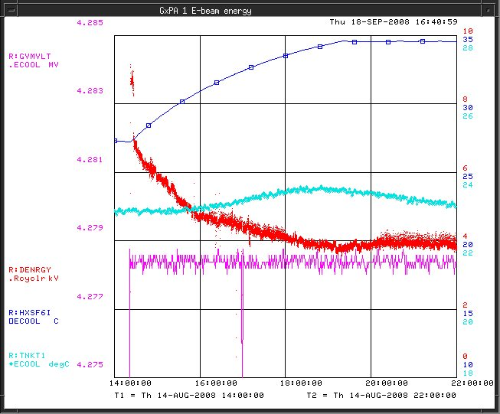
Energy drift
Temperature – related
  Pelletron temperature
  GVM preamplifier temperature
Caused by changing balance of
currents
  Chain current variation
    Was a problem in the time of
    charging efficiency degradation
  Variation of the beam loss or corona current
Changes in GVM reading associated with SF₆ permittivity
  At ~6 atmospheres (abs) ε_{SF6} = 1.012
  The charge generated on GVM at a given voltage increases correspondingly
  1% SF₆ pressure increase results at the same terminal voltage in the GVM reading increase by about 0.01%
    Results in 0.5 keV/psi energy drop
    Was noticed in the time of an SF₆ leak
Example of electron beam energy drift after turning the Pelletron on. Traces: energy deviation (2keV/div); SF6 temperature (5 K/div); GVM reading (2kV/div), and temperature of the GVM preamplifier(2 K/div).

Slide 42
Contribution of residual gas ions
At I_{e} = 0.1A, the potential difference between the beam center and the vacuum pipe is ~ 15 V. It is a deep well for thermal-energy ions
(W_{i} ~ 0.03 eV) created by the primary electrons.
Focusing effect from the ions is higher than the defocusing effect from the beam space charge by ~η_{c}γ² , and can be large with γ² ≈100
  Simulations at optimized focusing: Δα = κ·r·ΔI_{e} with κ ~1 rad/A/m
  Neutralization η_{c} needs to be kept <1% at all relevant currents
  Calculated time to reach η_{c} ~1% is ~0.2s.
    H₂ at 0.3 nTorr
Each BPM is used for ion clearing
  One of the plates is biased at -300V while the other is grounded
    Thermal ions fly ~5m distance between BPMs in the supply line in ~ 3ms
However, there are barriers for ions created by
  Size variations of both the electron beam and the vacuum pipe
  Solenoidal lenses
  BPM clearing removes ions to ~2% (from fitting to measurements)
    Still not good enough

Slide 43
Angles in the cooling section
Estimations of angles in the cooling section for the best case.
  I_{e} = 0.1 A. 1D values are shown.
    Difficult to come up with a defendable procedure of summation
Agrees with cooling force measurements

Slide 44
Example: Oct’07-Oct’08
HV was on 92% of the time
  Part of the downtime was not related to ECool problems
  5 cases of HV regulation–related problems caused ~130 hours of downtime
    Continuing issue with GVM
    Near the end of the run, much less frequent
  The next source of the downtime was the control system
    Interaction between NEC’s ACCELNET and Fermilab’s ACNET
      Eventually, mostly resolved but not 100% free of hang-ups

