Slide 1


Thomas Jefferson National Accelerator Facility is managed by Jefferson Science Associates, LLC, for the U.S. Department of Energy's Office of Science
A fast RF kicker for the MEIC electron cooler
Andrew Kimber
Amy Sy
31st March 2015
Notes:
Blue Title Page

Slide 2

Outline
Kicker requirements for the MEIC
The problem
The kicker concept
The proposed experiment
Initial results
Next steps
MEIC Collaboration Meeting, JLab, March 31st 2015
Andrew Kimber, Fast Kicker LDRD
Slide 2/11
Notes:
Blue Interior Page Design 2

Slide 3
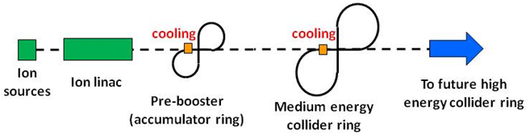
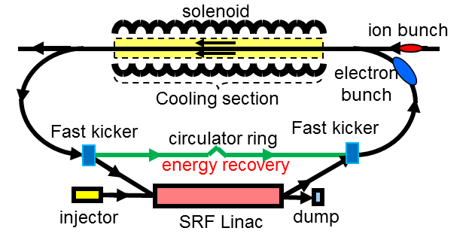
Kicker requirements for the MEIC
Current MEIC proposal includes an electron cooler to attain design luminosity
Cooler requires ~3 nC bunches at 54 MeV and 476 MHz repetition rate
Source current = 1.5 A (!)
Dump power = 81 MW (!)
Use energy recovery and a reused cooling bunch to address these issues
For instance, 100 passes with energy recovery reduces source current to 15 mA and dump power to 75 KW
Requires a very fast kicker operating with ~1 ns rise and fall times at MHz repetition rates
Beyond current driver technology
MEIC Collaboration Meeting, JLab, March 31st 2015
Andrew Kimber, Fast Kicker LDRD
Slide 3/11
Notes:
Blue Interior Page Design 2

Slide 4
The problem
476 MHz pulse train
Few kV
~ns
~ tens of ns
Pulsed power supplies, especially with these characteristics are beyond state of the art.
An alternative driving method is needed…
MEIC Collaboration Meeting, JLab, March 31st 2015
Andrew Kimber, Fast Kicker LDRD
Slide 4/11
Notes:
Blue Interior Page Design 2

Slide 5
The kicker concept
Mathematically, the concept works by summing simple sine waves at sub-frequencies of the final beam repetition frequency* to generate a continuous waveform.
Many ‘theoretical’ solutions exist, I will present one example† that is of particular interest for the ‘real world’ application.
If every n^{th} bunch is kicked then (n-1) harmonics are required.
Gradient of the slope is zero at bunch interaction points.
*Concept originally proposed by Dr. Hutton,
† Based on work by Balsa Terzic
MEIC Collaboration Meeting, JLab, March 31st 2015
Andrew Kimber, Fast Kicker LDRD
Slide 5/11
Notes:
Blue Interior Page Design 2

Slide 6
The kicker concept (2)
Two parts to this LDRD project:
RF Driver
Verification of waveform required
Generation of waveform
Low level signal processing
Phase and amplitude stability
Active feedback required?
Amplification
…
Cavity(s)
Cavity design that can support waveform
Cavity technology
Strip line? (We have one to test)
Cavity layout and configuration
Multiple cavities?
Simulations of real world performance
…
MEIC Collaboration Meeting, JLab, March 31st 2015
Andrew Kimber, Fast Kicker LDRD
Slide 6/11
Notes:
Blue Interior Page Design 2

Slide 7
The proposed experiment
source
~
load matching
/2
/4
/8
broadband
amplifier
/x
stripline kicker cavity
frequency divider
e.g. AD9510
variable
attenuators
combiner
phase shifters
A simple experiment at low power can be setup with parts on hand
The ‘proof of concept’ would include a LLRF board and broadband amplifier that can cover the required range of frequencies
There are many ways this can be demonstrated, one example shown above
MEIC Collaboration Meeting, JLab, March 31st 2015
Andrew Kimber, Fast Kicker LDRD
Slide 7/11
Notes:
Blue Interior Page Design 2

Slide 8
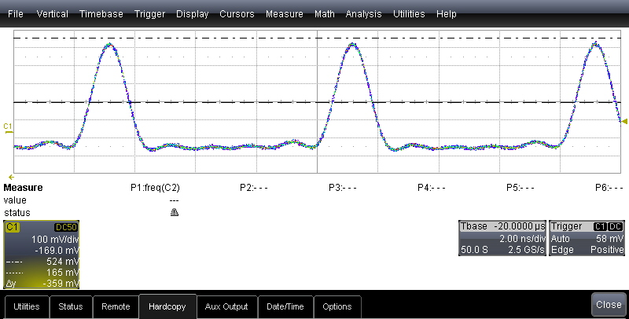
Initial results
Using signal generators allows fine phase and amplitude control
Signal was passed through the amplifier and then attenuated to see the affect (if any) on
the response – looks good, with caveats. Very sensitive to phase.
Signal generator
RF
Combiner
Signal generator
Signal generator
Signal generator
Signal generator
Amplifier
O’Scope
Particle tracking simulations have been initiated and show promising results. More work to do here to show both ideal and real world effects on bunches as they are kicked in and out of the cooler ring.
MEIC Collaboration Meeting, JLab, March 31st 2015
Andrew Kimber, Fast Kicker LDRD
Slide 8/11
Notes:
Blue Interior Page Design 2

Slide 9
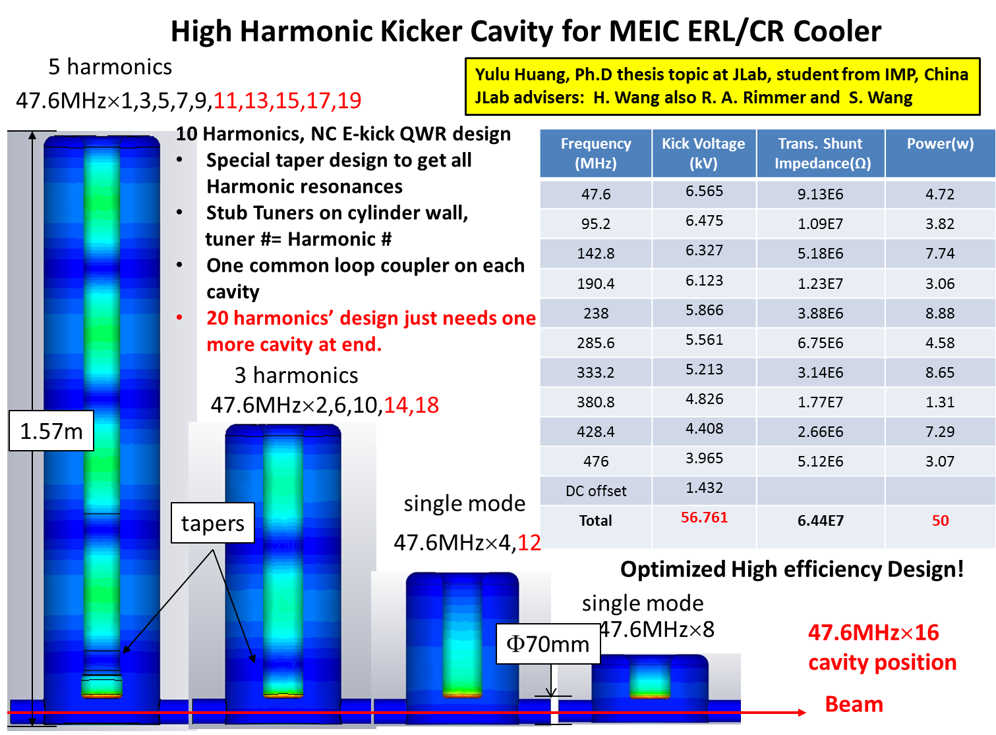
MEIC Collaboration Meeting, JLab, March 31st 2015
Andrew Kimber, Fast Kicker LDRD
Slide 9/11
Notes:
Blue Interior Page Design 2

Slide 10
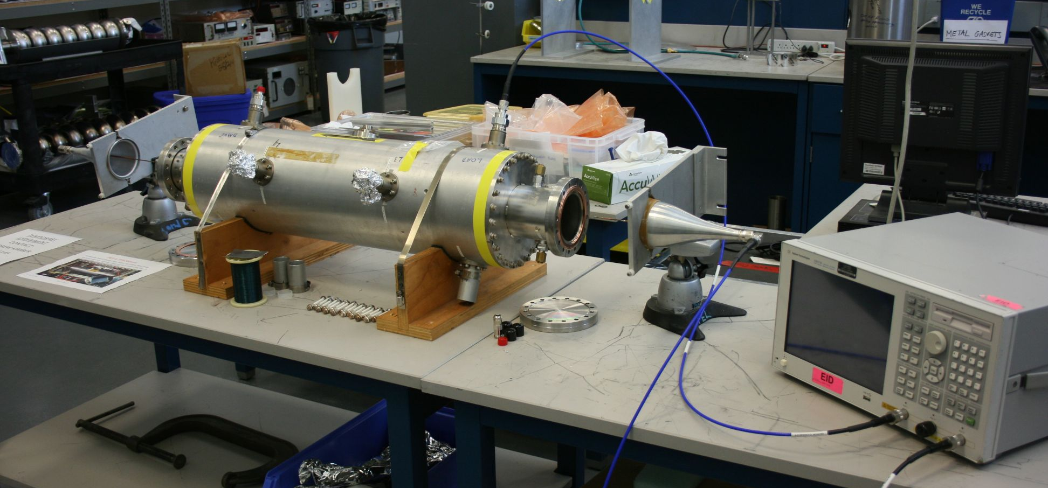
Next steps
Strip line cavity currently on loan from SLAC
0. Repair shipping damage to cavity
Setup a Goubau line experiment to explore driving the cavity with the generated waveform
Simulate both this cavity and an ‘ideal’ cavity for supporting said waveform
Complete simulations on the effects of this kicker on electron bunches in the cooler ring
Establish recommendations for what a fast kicker driver and cavity concept would look like for MEIC
MEIC Collaboration Meeting, JLab, March 31st 2015
Andrew Kimber, Fast Kicker LDRD
Slide 10/11
Notes:
Blue Interior Page Design 2

Slide 11
Questions?
MEIC Collaboration Meeting, JLab, March 31st 2015
Andrew Kimber, Fast Kicker LDRD
Slide 11/11
Notes:
Blue Interior Page Design 2

Slide 12
Thomas Jefferson National Accelerator Facility is managed by Jefferson Science Associates, LLC, for the U.S. Department of Energy's Office of Science
Backup slides
Notes:
Blue Title Page

Slide 13
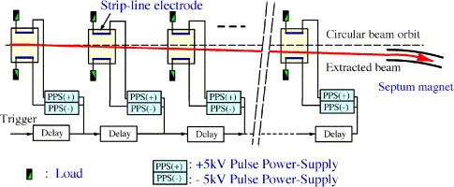
Backup slides (I)
Diagram of a cascade arrangement of stripline kickers for beam extraction.
Image from T. Naito et. al. “Development of a 3 ns rise and fall time strip-line kicker for the International Linear Collider,” [source]
MEIC Collaboration Meeting, March 31st 2015, Fast Kicker LDRD, Andrew Kimber
Backup I (slide 13)
Notes:
Blue Interior Page Design 2

Slide 14
Backup slides (II)
Possible arrangements of multiple stripline kickers.
A. Mikhailichenko “Fast Kicker,” Cornell University, LEPP, Ithaca, New York, U.S.A. CBN 09-03, August 12, 2009
MEIC Collaboration Meeting, March 31st 2015, Fast Kicker LDRD, Andrew Kimber
Backup I (slide 14)
Notes:
Blue Interior Page Design 2

