Slide 1
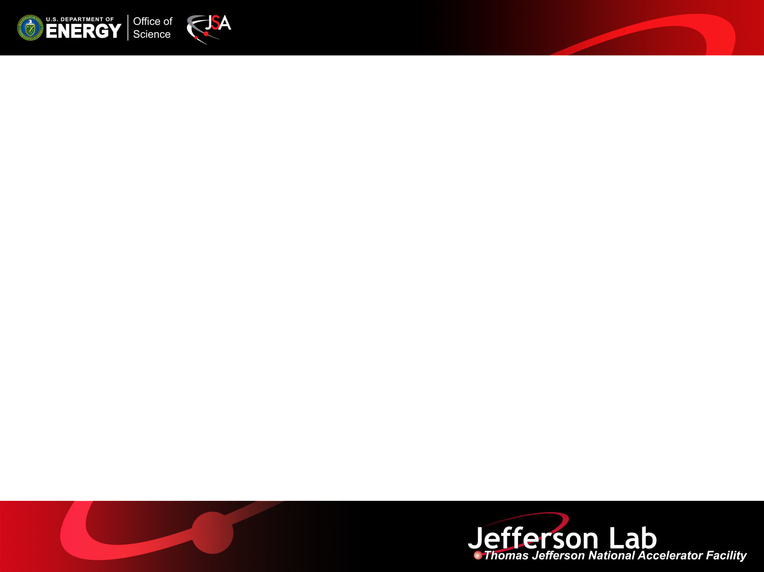
MEIC Electron Cooling
Overview of MEIC Cooling Design
Yuhong Zhang
MEIC Collaboration Meeting Spring 2015
March 30 and 31, 2015

Slide 2
Outline
Introduction
MEIC Electron Cooling Scheme
DC Cooling
Bunched Beam Cooler Design
Summary

Slide 3
Introduction
MEIC relies on conventional electron cooling for delivering high luminosities
MEIC has adopted a multi-step cooling scheme, utilizes a DC cooler in the booster ring and a high energy cooler with a bunched electron beam in the collider ring
A design concept has been developed for a bunched beam electron cooler based an ERL. This cooler is sufficient for the present MEIC baseline
An ultimate cooler design include a circulator ring that will help to deliver an 1+ A current cooling electron beam; it supports a luminosity upgrade (exceeding 10³⁴ cm⁻²s⁻¹)
3

Slide 4
Multi-Step Cooling for High Performance
Cooling of the MEIC protons/ions
achieves a small emittance
achieves a short bunch length of 1 to 2 cm (with strong SRF)
enables ultra strong final focusing and crab crossing
suppresses intra-beam scatterings (IBS), maintaining beam emittance
expands luminosity lifetime
MEIC adopts conventional electron cooling
Well established technology (in the low energy DC regime)
Multi-step scheme
taking advantages of high cooling efficiency at low energy or/and with small emittance
4

Slide 5
MEIC Multi-Step Cooling Scheme
ion linac
DC cooler
BB cooler
ion sources
Booster
(0.285 to 8 GeV)
collider ring
(8 to 100 GeV)
Ring | Cooler | Function | Ion energy | Electron energy
 |  |  | GeV/u | MeV
Booster | DC | Injection/accumulation of positive ions | 0.11 ~ 0.19 (injection) | 0.062 ~ 0.1
 |  | Emittance reduction | 2 | 1.1
Collider | Bunched Beam (BB) | Maintain emittance during stacking | 7.9 (injection) | 4.3
 |  | Maintain emittance | Up to 100 | Up to 55
DC cooling for emittance reduction
BB (bunched beam) cooling for emittance preservation
We anticipate up to 2 orders of magnitude increase of combined cooling rate

Slide 6
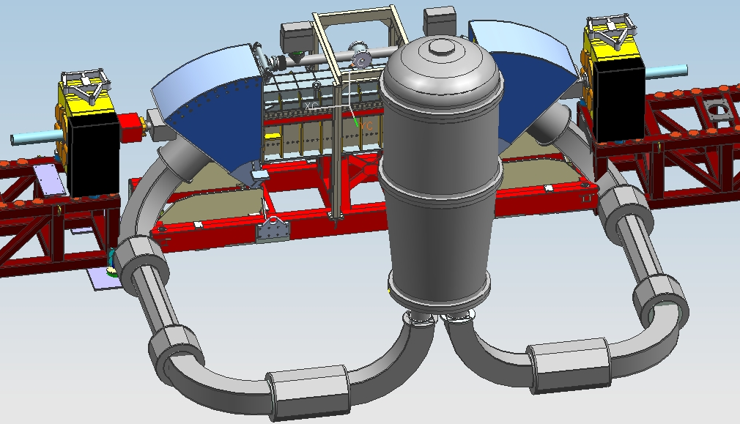
MEIC DC Cooler: Within State-of-Art
Design specifications
Magnetized beam
Energy range: 0.11 to 1.1 MeV
Electron current: 2 A
Cooling section: 10 m
Present status of technology
Well developed and low cost,
The most recent experience is a 2 MeV cooler for COSY built by Budker Institute recently successfully commissioned
We plan to collaborate with Budker Institute to adopt this cooler design for MEIC
COSY Parameter | Unit | Value
Energy range | MeV | 0.1 to 2
High voltage stability |  | < 10⁻⁴
Electron current | A | 0.1 to 2
Cooling section length | m | 2.69
Solenoid field (cooling section) | kG | 0.5 to 2
Electron beam diameter | cm | 1 ~ 3
Toroid radius | m | 1
COSY, IKP, Jülich
6

Slide 7
Bunched Beam Cooler: Baseline & Ultimate
For the present baseline, the designed emittance (0.5 to 1 mm mrad) leads to a much longer IBS growth time, thus requiring a significantly lower electron current
In an anticipated design optimization (or as an option of future luminosity upgrade), we need a higher electron current
 |  | Present baseline | Ultimate
Electron energy | MeV | up to 55 | up to 55
Beam Current and bunch charge | A / nC | 0.2 / 0.42 | 1.5 / 3.15
Bunch repetition | MHz | 476 | 476
Cooling section length | m | 60 | 60
RMS Bunch length | cm | 2 | 2
Electron energy spread | 10⁻⁴ | 3 | 3
Cooling section solenoid field | T | 2 | 2
Normalized drift emittance | mm mrad | 586.3 | 586.3
Normalized Larmor emittance | mm mrad | 1.5 | 1.5
Normalized transverse emittance | mm mrad | 29.7 | 29.7
Notes:
7

Slide 8
Bunched Beam Cooler Design Concept
Utilizes energy-recovery-linac (ERL) (the beam power is up to 11 MW)
Cooling by a bunched electron beam
Cooling section
ion bunch
circulations |  | 25+
Kicker rep rate | MHz | 19.05
Kick duration | ns | 2.1
Angle | mrad
solenoid
electron bunch
Ultra fast kicker
Ultra fast kicker
energy recovery
SRF Linac
injector
dump
Notes:
8

Slide 9
Present Status
ERL cooler design concept
Seems no (?) alternative solution that does not compromise the performance
Has a long history (HERA upgrade@1990s, RHIC/eRHIC@early 2000s)
Technologies (high current e-source, ERL etc.) advanced rapidly, however, are still significantly below what are required.
Technical design
Down-selection of non-magnetized and magnetized beam for cooling
Developed a high level parameter set (based on cooling simulation and beam matching in the cooling section)
Some initial attempt had been made (circulator ring lattice)
Beam physics studies
Some initial studies of CSR-micro-bunching instabilities
Technology development
Some ideas on fast kickers

Slide 10
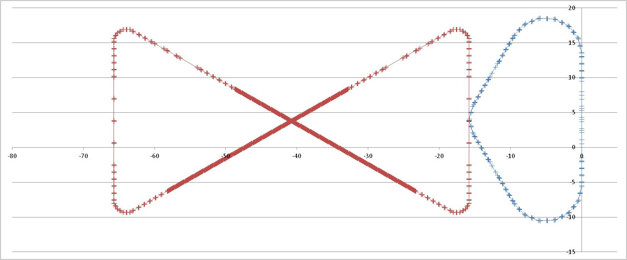
The 1st Design Attempt of ERL-Circulator Cooler
D. Douglas, C. Tennant
decompression
Circulator Cooler Ring
dump
dechirper
beam exchange system
cooling solenoids
ERL
SRF
injector
rechirper
Magnetized source
recompression
Advanced design elements
Magnetized electron beam/source
Round-to-flat transform
Accelerator technologies
High current electron source
Ultra fast kicker
Energy at injection/dump | MeV | 5/5.3
Long. emitt. at injection | keV-ps | 80
RMS length @ injection | ps | 5
Full energy | MeV | 54
Acceleration/recovery phase |  | -13/166º
RMS bunch length at CCR | cm | 1~3

Slide 11
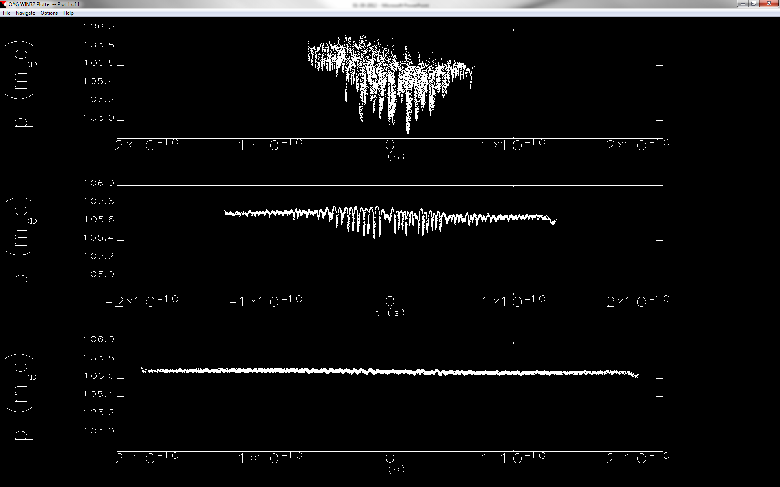
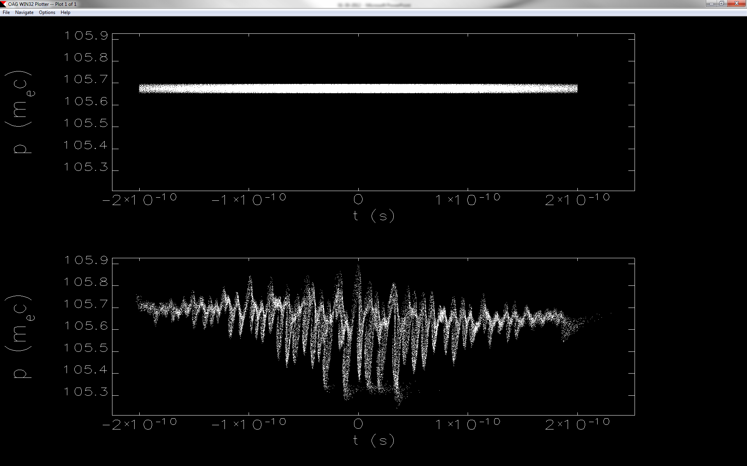
Preliminary Study of Beam Dynamics In a Circulator Ring
Particle tracking (Elegant) simulations of an electron bunch in the circulator cooler ring
  0.5 -- 2 nC bunch charge (2 nC design value)
  1 -- 3 cm bunch length (3 cm design value)
  < 0.1% energy spread (5x10⁻⁴ design value)
Factors limiting number of circulations in CCR
  Beam quality degradation by intra/inter beam scatterings
  Space charge
  Micro-bunching instabilities
Coherent synchrotron radiation (CSR) could induce micro-bunching instabilities,
CSR mitigation
  Magnetized beam (Ya. Derbenev)
  (it also suppresses space charge effect)
  Shielding in beam pipe
  Optical management (D. Douglas)
  (Using longitudinal periodic achromat, simulations show little to no micro-bunching )
2 nC,
After 10 turns
1 cm
2 cm
3 cm
0.5 nC, 3 cm. 100 turns
Δp/p~10⁻⁴
Δp/p~9x10⁻⁴
E. Nissen, C. Tennant

Slide 12
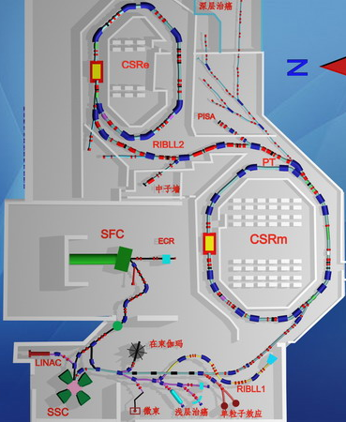
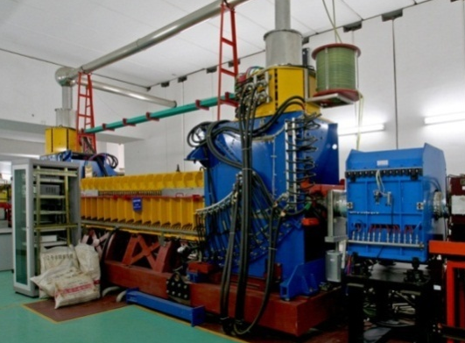
Proposed Experimental Demonstration of Cooling with a Bunched Electron Beam
A collaboration of JLab, IMP (China) and BINP (Russia) currently under discussion
Cooling by a bunched electron beam is considered one (remaining) critical R&D for the MEIC present baseline
IMP has two storage rings, each has a DC cooler for ion coasting beams (built in collaboration with BINP, Russia)
Idea: modulating a DC electron beam into a bunched beam with a high repetition rate by applying a pulsed voltage to the bias-electrode of the electron gun
Non-invasive experiment, supported by IMP leadership
A pilot study supported by a JLab LDRD in progress
A. Hutton (JLab) H. Zhao (IMP)
Institute of Modern Physics (IMP), Chinese Academy of Science (CAS)
BNL LeReC program also utilizes a BB e-cooler
DC cooler
Slide 12

Slide 13
Ultra Fast Kicker
RF kicker
Like an RF separator, a strip-line kicker driven by a waveform which is a superposition of multi harmonic waveforms
Requires a multi-harmonic signal amplifier
RF kicker
A. Kimber
Beam-beam kicker
F
surface charge density
v≈c
D
h
σ_{c}
kicking beam
v₀
L
V. Shiltsev, NIM 1996

Slide 14
Path Forward
The MEIC bunched beam electron cooler study urgently needs a big boost
For reaching a CD1 in two years
A technical (front-to-end) design of an ERL cooler is a must
Significant progress in the beam physics studies
Development (and hopefully proof-of-principle) of key technologies
Technology R&D
200 mA current magnetized electron source
High current ERL
Mitigating the beam instabilities (micro-bunching)
Cooling simulation
How to validate the simulation?

Slide 15
LDRD and SBIR for Cooler R&D
For the present MEIC baseline design
Experiential demo of cooling of ions by a bunched electron beam (LDRD)
Cooling simulations (SBIR)
Cooling software development (LDRD)
For achieving luminosity above 10³⁴ cm⁻²s⁻¹
Improvement of cooling simulation (including code development LDRD)
Development of an RF based fast kicker (LDRD)
Development of high bunch charge/current magnetized electron source (SBIR and pending LDRD)
Demonstration of mitigation of coherent synchrotron radiation/micro-bunching instability (LDRD)

Slide 16
Acknowledgement
The MEIC accelerator design study group, particularly, for those participated electron cooling studies
Yaroslav Derbenev
David Douglas, Rongli Geng, Jiquan Guo, Andrew Hutton, Andrew Kimber, Rui Li, John Musson, Matt Poelker, Robert Rimmer, Yves Roblin, Riad Suleimen, Chris Tennant, Cheng-yin Tsai, Amy Sy, Haipeng Wang, Shaoheng Wang, He Zhang (Jefferson Lab)
Edward Nissen (CERN)
Hongwei Zhao and Lijun Mao (IMP, China)
George Bell and Ilya Pogorelov (Tech-X)
Takeshi Katayama (U. Tokyo)
Peter McIntyre (Texas A & M Univ.)

Slide 17
Backup slides

Slide 18
Circulator Ring for Higher Current/Luminosity
To reach luminosities beyond the present baseline (>10³⁴ cm⁻²s⁻¹)
Requires much smaller emittance (0.35 and 0.07 mm mrad)
Requires much higher electron current for cooling, ~1.5 A (bunch charge 3.15 nC)
A circulator ring will reuse the bunches 25 times, thus, reduce the current from the electron source/injector by a same factor
Beyond state-of-the-art
Require a ultra-fast kicker to switch the bunches in and out of the cooler ring
Require a high bunch charge (~3.15 nC) electron source/injector
Must suppress the collective instabilities
Bunch revolutions in CCR |  | ~25
Current in CCR/ERL | A | 1.5/0.06
Electrons/bunch | 10¹⁰ | 1.25
Bunch repetition rate in CCR/ERL | MHz | 476/30
ion bunch
electron bunch
Cooling section
solenoid
Fast kicker
circulator ring
Fast kicker
injector
energy recovery
recirculating 25+ turns ➔ reduction of current from an ERL by a same factor
SRF Linac
dump
Notes:
18

Slide 19
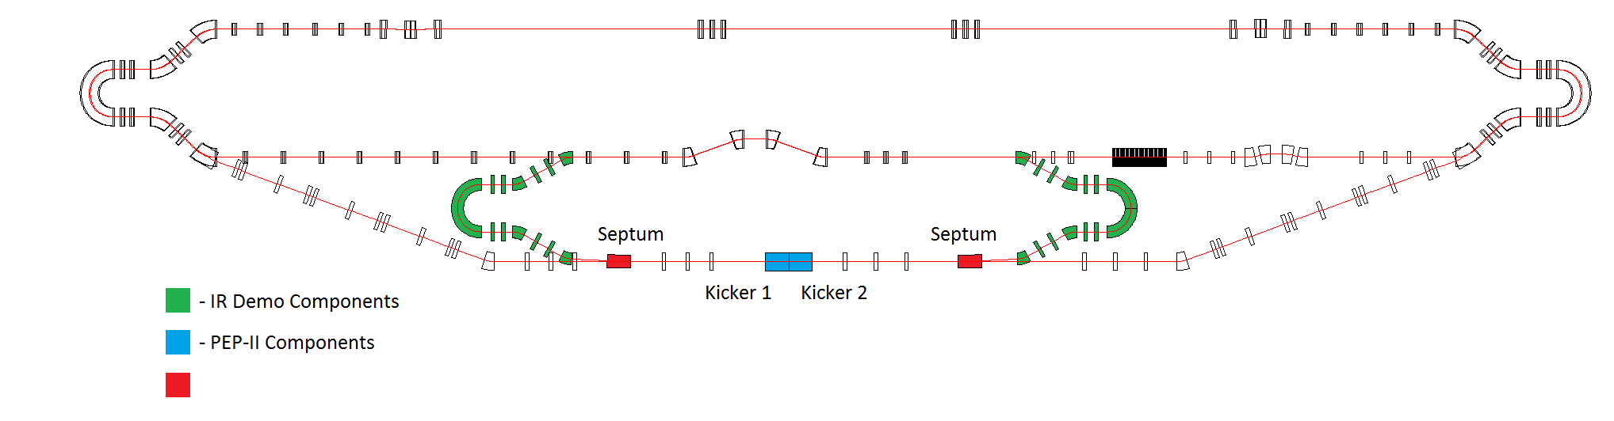
Proposed Beam Studies and Technology Development for an ERL-Circulator Cooler
Dechirper
Rechirper
Cooler Test Facility @ JLab FEL ERL
New Beam-line
  Demonstrate the cooler design concept
  Develop/test key technologies (magnetized gun, fast kickers, etc.)
  Study dynamics of the cooling bunches in a circulator ring
  Using the existing ERL without upgrade, adding two 180°dipoles (available at JLab)
  Supporting MEIC to deliver the high luminosity (10³⁴ 1/cm²/s),

Slide 20
High Current Un-polarized Electron Gun
We propose a three-gun injector, based on the CEBAF injector success
Beam current: 3 x 67 ~ 200 mA (Cornell, 60 mA)
Bunch charge: 0.42 nC, very comfortable for a DC/RF photo-cathode gun
All existing/demonstrated technologies
Steering (BPMs/kickers)
Beams from three individual guns
Gun
Solenoids (emittance compensation)
RF recombiner
One beam
dipole
collimation
buncher
CEBAF injector
dipole
Master slit
Polarized DC gun
Chopper cavity
Chopper cavity
A
Master slit
B
C
One beam
Three beam
One beam
20

