Slide 1
Muon2011
HCC:
Helical Solenoid Development
HTS Coil Progress
J. Tompkins
Fermilab – TD/MSD

Slide 2
Acknowledgements
The ongoing design, fabrication, and test effort for Muon Collider magnets has a large list of contributors – acknowledgements for this presentation include:
Fermilab:
Emanuela Barzi Vadim Kashikhin Vladimir Kashikhin
Mike Lamm Vito Lombardo Mauricio Lopes
Sasha Makarov Mike Tartaglia Katsuya Yonehara
Miao Yu Sasha Zlobin
Muons, Inc.
Gene Flanagan Rolland Johnson Steve Kahn

Slide 3
Outline
Overview
Helical Solenoid Development – HCC
HTS – YBCO Coil Development
Summary

Slide 4
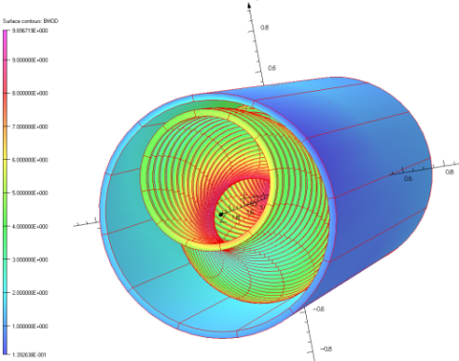
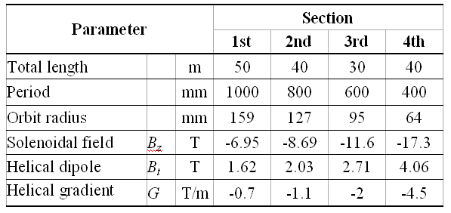
Helical Cooling Channel
The helical solenoid (HS) concept (FNAL/Muons Inc.) :
Coils follow the helical beam orbit generating solenoidal, helical dipole and helical quadrupole fields
Multi-section HCC
Would require 160 meters of magnets
Wide range of fields, helical periods, apertures
Room for RF system
Field tuning is more complicated at high fields
NbTi, Nb3Sn/Nb3Al and HTS in final stage
Early Specs, ca. 2006-K. Yonehara, S. Kahn, R. Johnson et al.

Slide 5
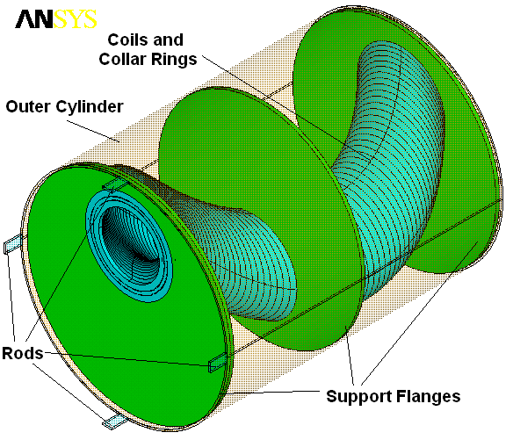
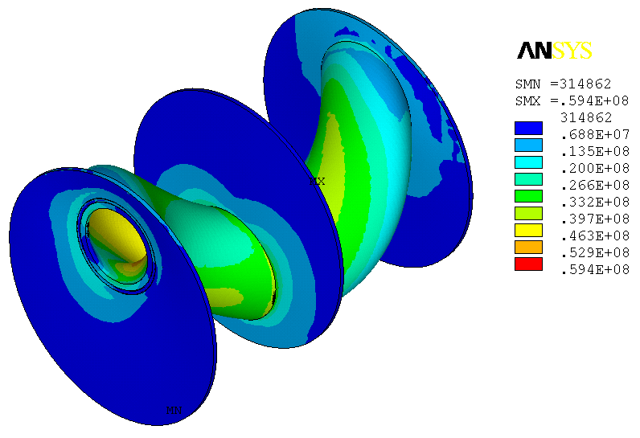
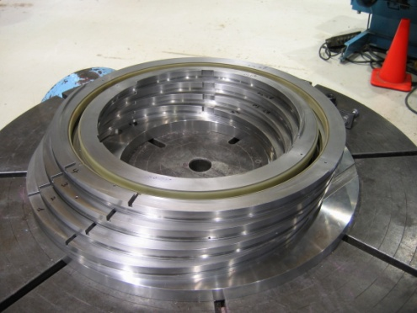
HS Mechanical Concept (FNAL)
Hoop Lorentz forces intercepted by stainless steel rings around the coils
Transverse Lorentz forces intercepted by support flanges
Outer LHe vessel shell provides mechanical rigidity to the structure
The peak stress is ~60 MPa
HSM01

Slide 6
4-Coil NbTi Model Fabrication 2010-11

Slide 7
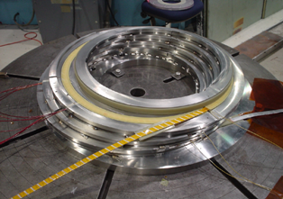
HSM01 – First Helical Solenoid Model
The first helical solenoid model (HSM01) designed, fabricated and tested at Fermilab.
NbTi SSC cable was used for this model. Left picture shows the winding process.

Slide 8
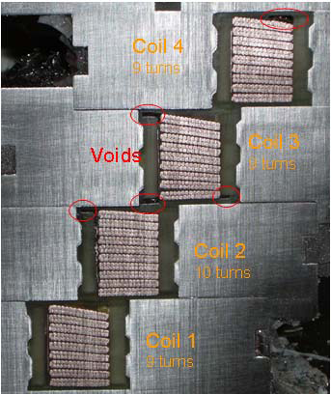
Helical Solenoid Development HSM01 – 1st Model
Solenoid Parameters
Parameter | Units | Value
Coil inner diameter | mm | 426
Coil outer diameter | mm | 455
NbTi SC cable cross section | mm | 12.34 x 1.46
Cable I_{c} (7T,4.2K) | A | 9660
J_{c} (non-Cu) | A/mm² | 1730
Copper to superconductor ratio |  | 1.5:1
Strand diameter | mm | 0.8
Helical Orbit Radius | mm | 255
Number of turns/coil |  | 10
Coil width | mm | 20
HSM01 tested in Nov/Dec 2008 (TD-01-011, PAC09)
Ground insulation issues
Epoxy voids; packing factor
SC lead support
Coordinate system (measurements)

Slide 9
A second model HSM02 was been built to improve the solenoid manufacturing technology and performance.
HSM02 baseline magnetic and mechanical design is the same as for HSM01
Improved:
mechanical structure and insulation
cable geometry and insulation
Additional flattening
coil winding and impregnation procedures
SSC cable re-sized (flattened):
cable test => no degradation
HSM02 was tested at Fermilab MTF at the end of 2010

Slide 10
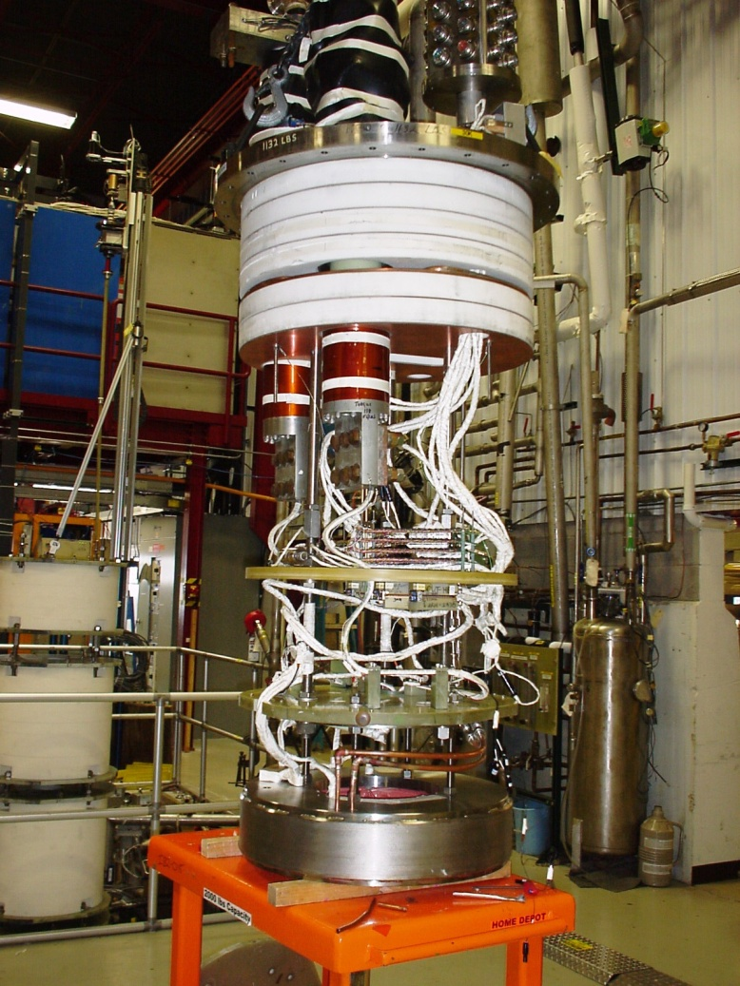
HSM02 Ready for installation in VMTF
30kA power leads
Top plate
Instrumentation ‘tree’
Start: 11/9/2010
 |  | Quench | Quench Total
1 | Initial Check-out | - | -
2 | 4.0K Quench Testing, 20 A/sec nom. | 29 | 29
3 | 4.0K Ramp Rate Studies | 13 | 42
4 | 3.0K Quench Testing, 50A/sec | 13 | 55
5 | 4.0K Quench Testing, 20 A/sec nom. | 2 | 57
6 | 3.0k, 250 A/sec | 16 | 73
7 | 4.5K | 7 | 80
8 | 4.5K Heater Tests | 17
End: 11/22/2010
HSM02

Slide 11
HSM02 Quench Test Results

Slide 12
Comparison of Quench Results with HSM01

Slide 13
HSM01, HSM02 Comparison of Test Results

Slide 14
HSM, the next steps
Further development of outer field coils (NbTi, Nb₃Sn) – depending on resources available, priorities, etc.
HSM03 – same design but with Al rings for coil pre-stress
HSM04 – Nb3Sn design
Needed for inserts in higher field cooling section
Different technology – used in LARP/High Field Magnet Program
Helical solenoid inner coils using HTS (BSSCO wire or YBCO tape) materials
HTS required for inserts in higher field cooling regions
Different technology
Collaboration with Muons, Inc. to design, build, test first model
YBCO coil development under way
Final cooling section >40T fields (but smaller aperture)

Slide 15
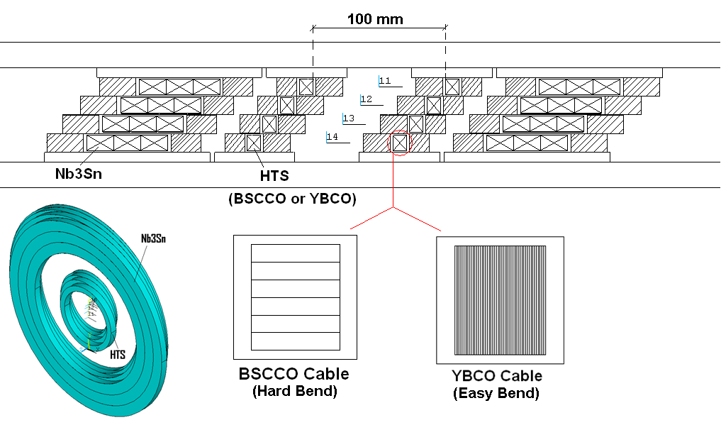
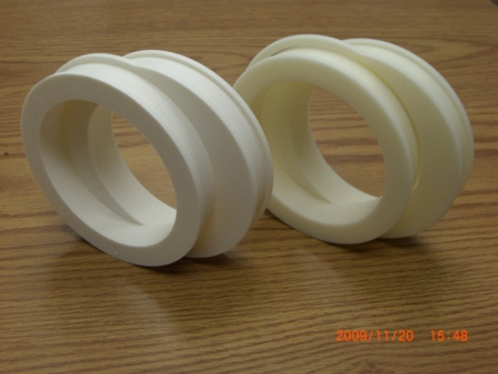
HCC - Hybrid HS Model
This work is partially funded by, and performed in collaboration with, Muons Inc. (SBIR funded)
Conceptual design study shows that a Hybrid HS may be needed for HCC
The goal - develop mechanical design and technology for HTS section based on G2 tape/cable and its assembly with RF and Nb3Sn section
Support structure was designed and prototyped
12-mm YBCO tape procurement has been initiated by Muons Inc.

Slide 16
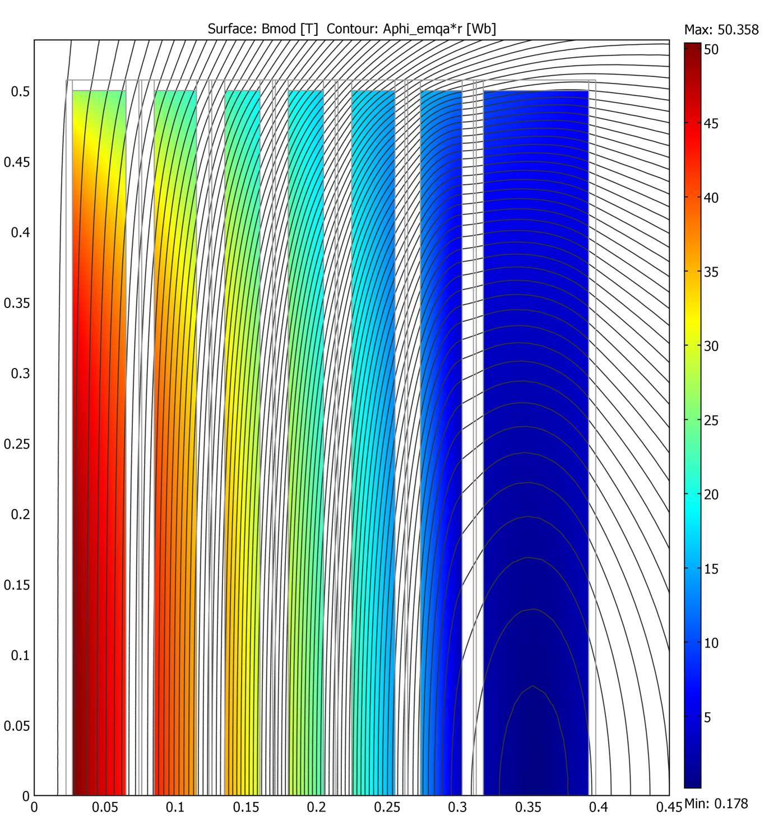
High Field Final Cooling Solenoid ‘Generic’ Design
50T Solenoid Conceptual Design
5
NbTi
Basic Parameters
Inner bore diameter 50 mm
Length 1 meter
Fields 30 T or higher ➔ HTS materials
Key design issues:
Superconductor type
Jc, effect of field direction (in the case of HTS tapes)
Stress management
Quench protection
Cost
Conceptual design:
Hybrid coil design
Coil sections
Nb3Sn
B
YBCO / BSCCO
Coil radius, m

Slide 17
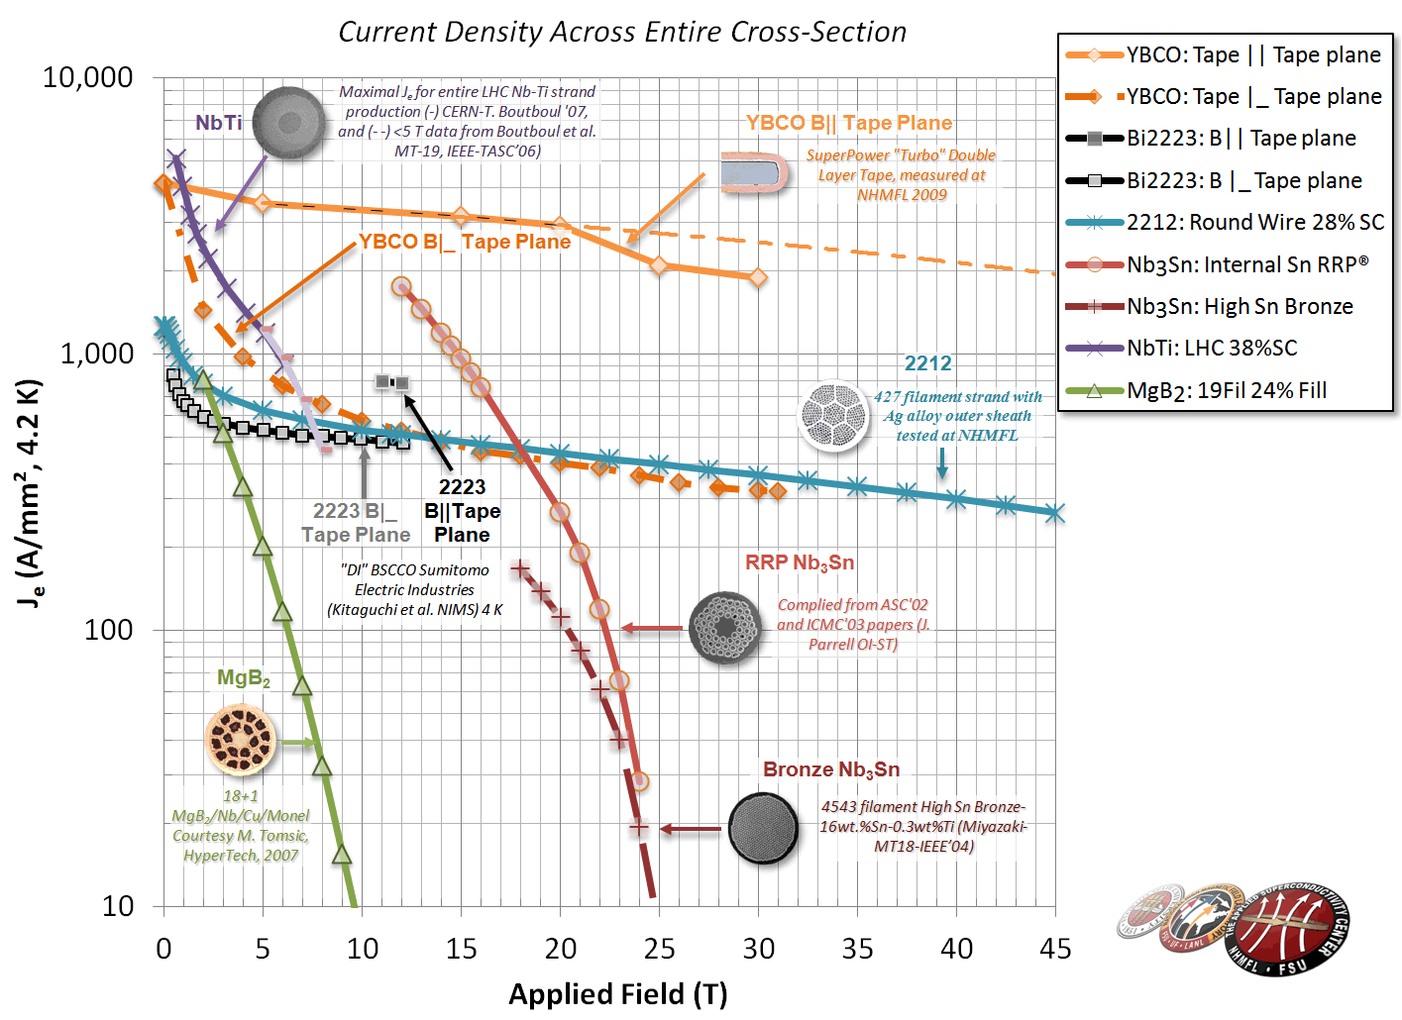
FSU-NHMFL/ASC Superconductors – J_{e} plot
Peter Lee, FSU-NHMFL

Slide 18
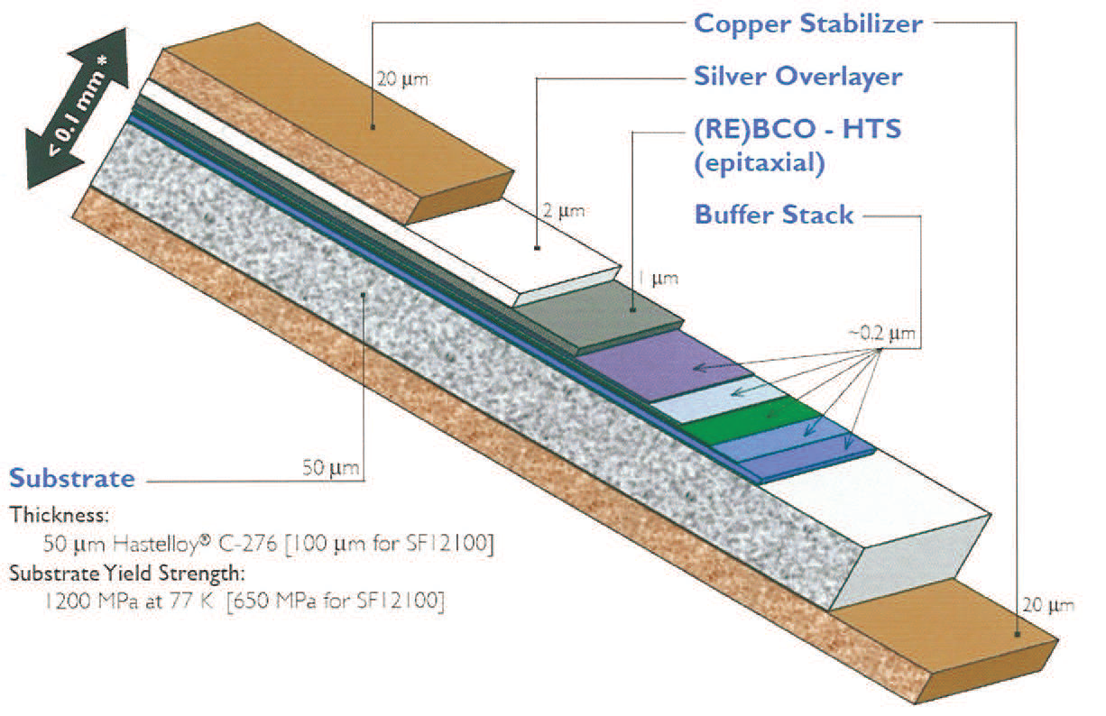
YBCO Tape (from SuperPower)

Slide 19
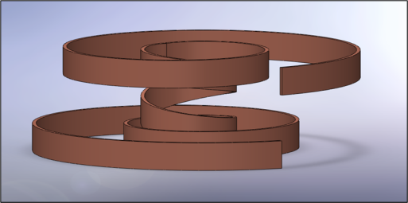
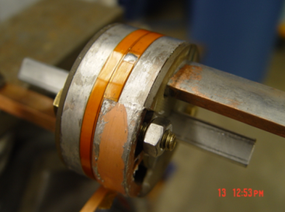
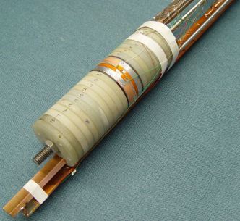
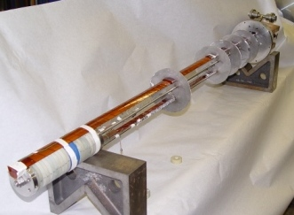
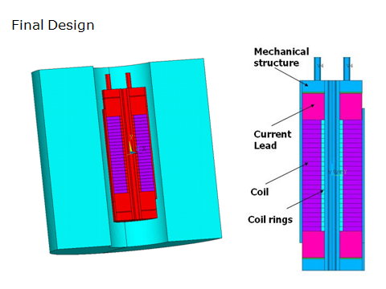
Insert Coil R&D
Present focus on single and double-layer pancake coils based on HTS tapes.
~20 single and double-layer pancake coils (YBCO and Bi-2223) were built and tested in self-field and external solenoid
Study tape splicing techniques, effect of coil impregnation, coil preload
A modular HTS Insert Test Facility to test up to 14 double-layer pancake coils inside the 14T/16T solenoid (B>20 T)
For the second phase of the coil program, larger multi-section HTS coils will be designed, fabricated and tested to achieve higher magnetic field and force levels.

Slide 20
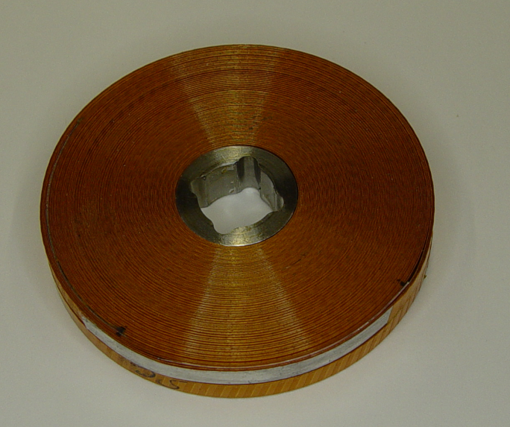
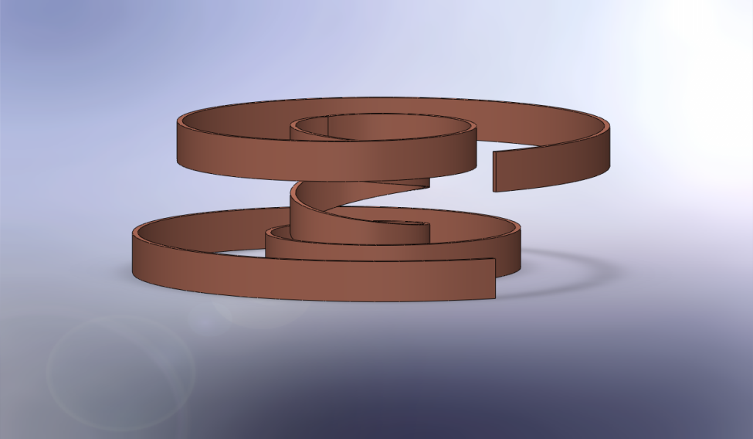
YBCO Coil Parameters
Conductor | SuperPower SCS4050-i
Turn to Turn Insulation | Spiral Wrapped Kapton
Coil Geometry | Double Pancake
Coil ID | 19 mm
Coil OD | 62 mm
Conductor Thickness | 0.1 mm
Conductor + Insulation Thickness | 0.2 mm
Turns per Single Coil | 108
Conductor length per Coil | 13.9 m
Overall Conductor Length | 27.8 m

Slide 21
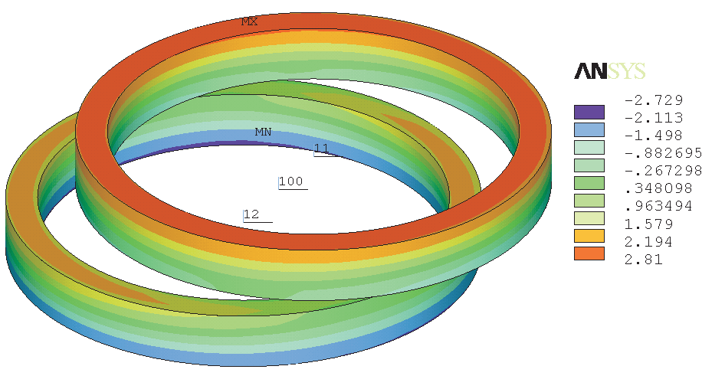
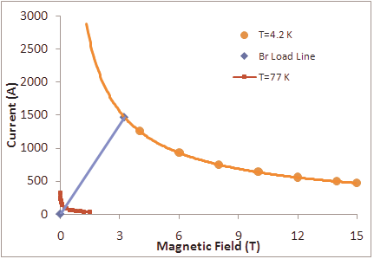
YBCO coil Current vs. Field
Radial Component Distribution (Field ┴ to the Tape)
From: “Test of 1st YBCO Helical Solenoid Double Pancake Model”, M. Yu, et al., FNAL TD-11-001, 2/2011

Slide 22
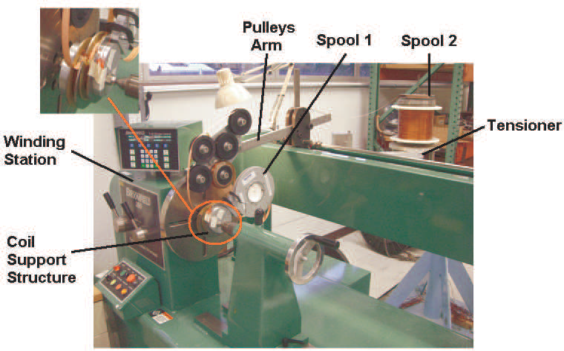
Winding Development

Slide 23
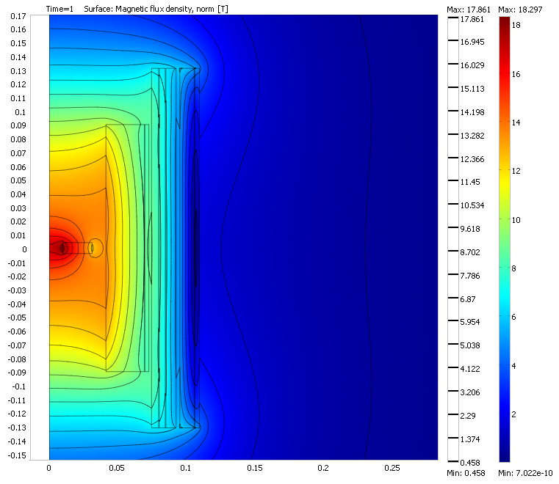
Magnetic Simulations

Slide 24
YBCO coil in 13.5T Background Field
Voltage (μV/cm) vs. Current (A)

Slide 25
Looking ahead
Focus on high field (HTS) solenoids necessary for cooling sections
Conductor development has dominated the R&D path
Quality (Jc, stability, uniformity)
Length
YBCO based solenoid efforts are underway and will continue
PBL/BNL (mostly SBIR funding)
Fermilab/Muons Inc. (SBIR & FNAL/MAP funding)
YBCO is being produced in industry on pilot lines that can yield 100-200 m lengths – the tapes are not optimized for magnets but various projects using the tapes are underway. R&D support would enhance progress for this very promising technology.

Slide 26
Looking ahead, cont.
VHFSMC (an ARRA funded collaboration) is focused on Bi2212 development
Phase I – improvement of strand properties
Phase II – development of small solenoid coils (beginning now) for possible use in MC…
Future – proposal to DOE being developed
A Fermilab Bi2212 solenoid development initiative will be discussed in the next talk by Tengming Shen

Slide 27
Other Fermilab Magnet Efforts
LARP Collaboration – BNL, FNAL, LBNL
2nd generation large aperture IR quadrupoles for LHC upgrade
CERN/Fermilab collaboration to develop 11T Nb3Sn dipoles to replace NbTi before IR collimators
More space in lattice
Mu2e experiment
3 large NbTi solenoids – initial designs, model tests, design, fab, procurement TBD
Ongoing development for ProjX & ILC
SC solenoids, split quads, corrector dipoles

Slide 28
Backup Slides Follow

Slide 29
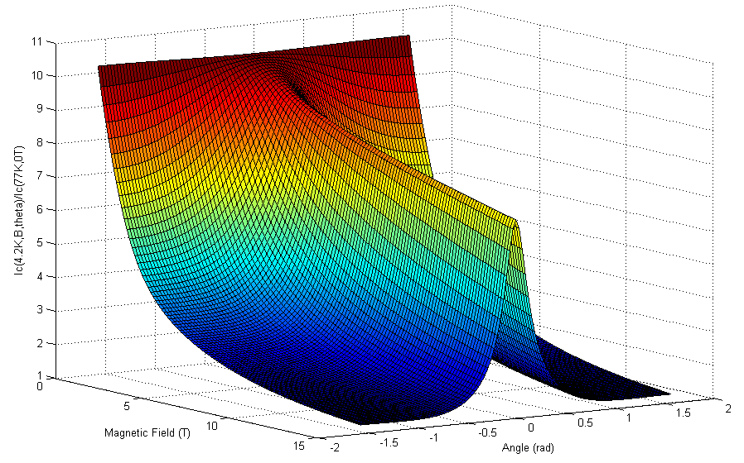
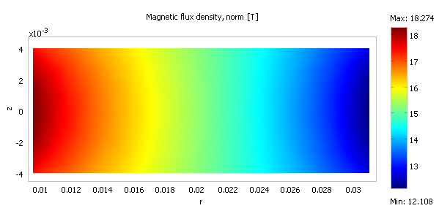
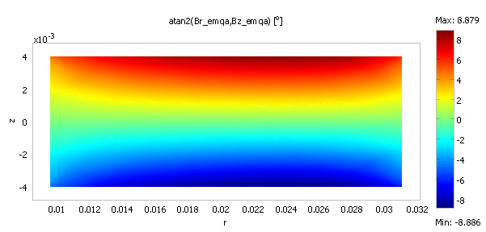
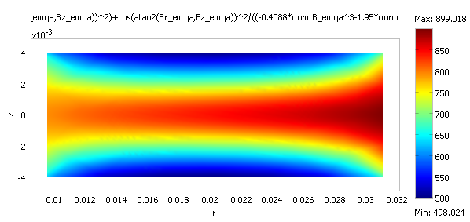

Slide 30
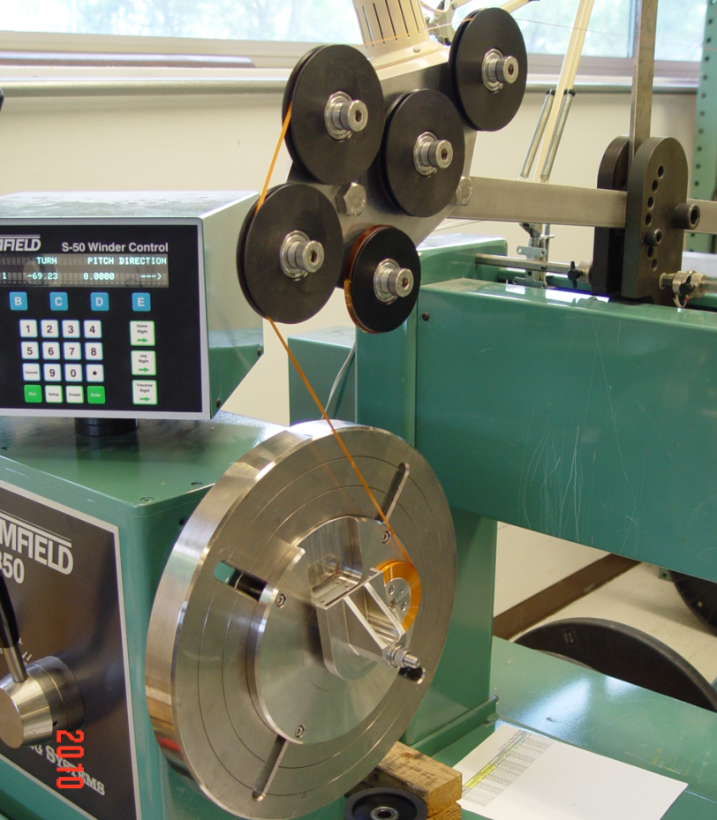
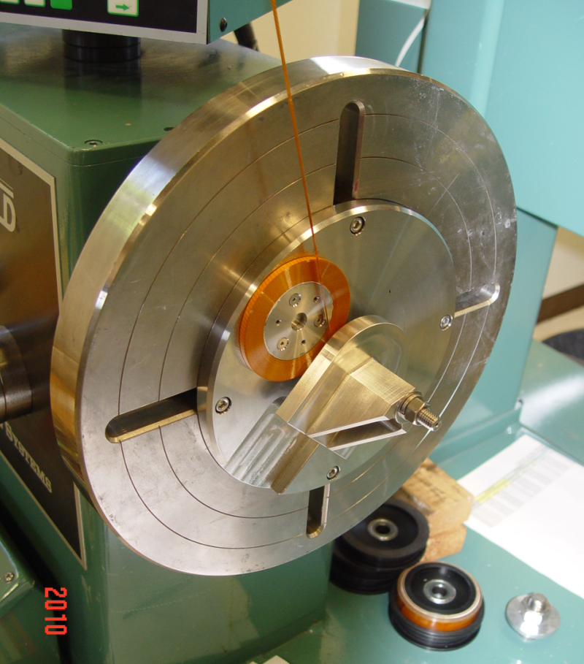
Winding Development, details

Slide 31
Double Pancake Winding

