Slide 1
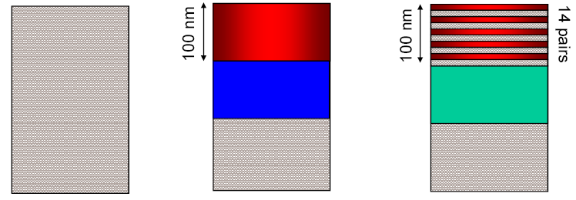
Commissioning of a Nebraska-type Retarding Potential Mott Polarimeter
J. McCarter, M. L. Stutzman, T. J. Gay, K. Trantham, P. Adderley, J. Brittian, J. Clark, A. Cook, J. Grames, J. Hansknecht, M. Poelker
Introduction
Compact retarding field Mott polarimeters are widely used to measure electron beam polarizations without the high beam energies and radiation hazards associated with conventional Mott polarimeters. The Micro-Mott Polarimeter designed at the University of Nebraska -Lincoln operates at voltages up to 30 keV and has been designed for high efficiency and simplicity of machining and assembly. This polarimeter will be used to qualify photocathode material for the CEBAF machine and for photocathode research. Preliminary results from the commissioning of this polarimeter are presented, including measurements of asymmetry and polarimeter efficiency. Efforts to determine the Sherman function by using electron beams of known polarity from three different photocathode materials are also presented.
Commissioning Process
Apparatus
Effective Sherman Function
Determined by comparing measured Mott asymmetries to the known polarizations, as measured in CEBAF, of electron beams from three different GaAs photocathode materials
Efficiency
Defined as the ratio of the current on the detectors to the total current hitting the target
Bias of 300 V applied to target to measure current on target, then HV applied and counts on detectors measured. Current detected did not increase with biases from 300V to 7kV, indicating that the efficiency measured up to 30kV is accurate
Incident current kept low enough to avoid nonlinear dead time issues
Polarized source with load locked system for cathode exchange uses standard CEBAF heating & activation.
Electrostatic lenses in the source chamber bend beam 90º so it strikes the target with transverse polarization
Laser supplies circularly polarized light, while insertable λ/4 plate changes helicity to decrease systematic errors.
Aperture separating source and polarimeter chambers helps collimate beam into electrostatic lenses.
Two concentric hemispheres accelerate electrons to 30keV and decelerate to incident energy after scattering from gold target.
Retarding field grids in front of Channel Electron Multipliers (CEMs) can repel all but elastically scattered electrons.
Output of CEMs capacitively coupled into
data acquisition system (DAQ).
DAQ: Preamp to discriminator to scalars with LabView to control and count
Mott target and lens assembly
Electrostatic lenses
Retarding field grids
CEMs
“Bulk” GaAs
No strain structure
Strained Layer
GaAs on GaAsP
Superlattice of
GaAs and GaAsP
Target
View of the entire lens system. Source is
on the left, target on the right. (SIMION)
Measured CEBAF polarizations
33% 77.5 % at 850 nm 80%
43 % at 773 nm
Isometric cut away view of the cathode and electrostatic lens in the sample chamber (SIMION)
Results
Discussion
Polarimeter commissioning nearing completion
Electronic setup robust in that different DAQ line configurations give same experimental asymmetry
Beam steering effects can diminish polarization; unscattered electrons can overwhelm the signal if certain criteria are not followed
Measured asymmetries and “known” polarization of electron beams coming together toward coherent Sherman function vs. energy
Efficiency and figure of merit (F.O.M.), are larger at low retarding fields. The increase in measured asymmetry does not offset the massive decrease in electrons detected. F.O.M. peaks around 15keV for the same reason. This implies even inelastically scattered electrons still have polarization information.
Average Sherman function of .23 at 30keV is comparable to that measured with gold targets in other designs. The current efficiency and F.O.M. values calculations are roughly a tenth of those reported in the literature.
We show the dependence of F.O.M. on the retarding field for the first time.
We offer a unique and more accurate determination of S_{eff}, using our well characterized electron beam polarizations from different photocathodes
Sample of the effective Sherman function vs retarding potential. Data taken at 30keV incident beam energy from a superlattice cathode.
Maximuim efficiency vs the incident beam energy. Error bars reflect errors in measuring incident current and statistics.
S_{eff} vs incident beam energy for the four electrons beams of different polarization measured is above. Error bars represent statistical and systematic. Asymmetry vs energy for the same samples is below.
Efficiency (defined as I/I₀ ) and the figure of merit, η, (defined as I/I₀*S_{eff}²) vs the retarding potential. Data taken at 15 keV from a superlattice cathode.
Figure of Merit (F.O.M.) vs incident beam energy. Red (top) data set was taken with the maximum values of the Sherman function and efficiency. The blue (bottom) set was obtained from the values measured at 250 V retarding field.
Asymmetry vs incident beam energy for the same samples as above, with the same legend as above.

