Slide 1
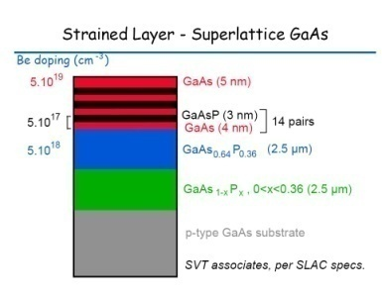
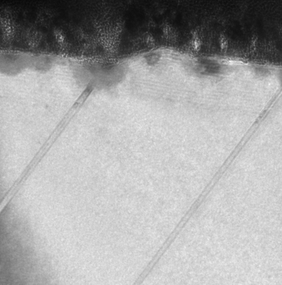
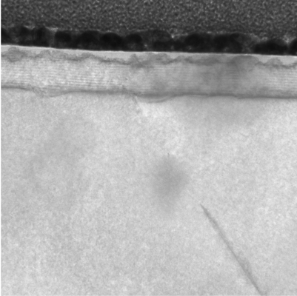
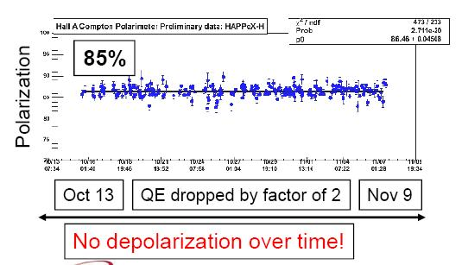
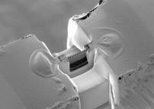
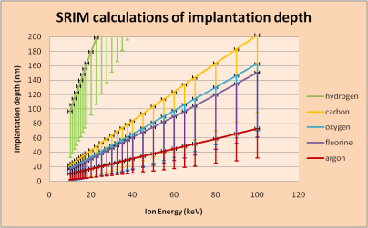
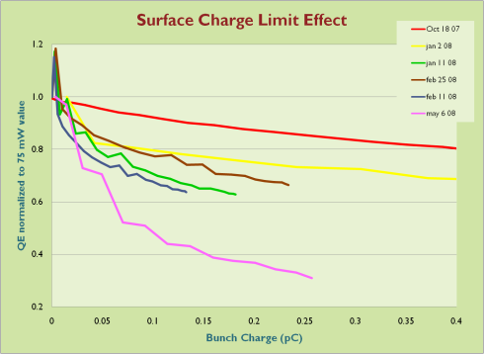
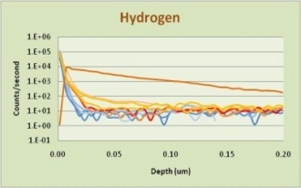
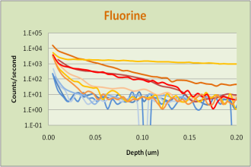
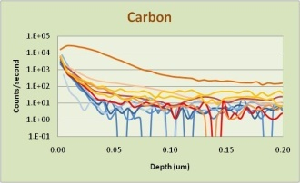
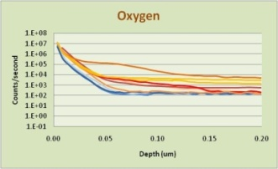
Superlattice Photocathode Damage Marcy Stutzman and the Center for Injectors and Sources
Surface Analysis Goals
Which residual gasses limit photocathode lifetime?
Why do we have surface charge limit?
Why does SCL get worse with photocathode age?
Does Be dopant migrate with heat cycles?
Authored by Jefferson Science Associates, LLC under U.S. DOE Contract No. DE-AC05-06OR23177.
Transmission Electron Microscopy (TEM)
Samples prepared by focused ion beam milling
TEM analysis of structure
Pt
Au-Pd
100 nm superlattice
Defects
Focused Ion Beam mills cross sectional depth profile
Used
Unused
Used
Implantation depth calculations
100 kV: Ar,F,O,C 60-200 nm
<10 kV: H implants 100 nm
Polarization constant through many activations
Fred Stevie NCSU
Secondary Ion Mass Spectrometry
Monitors species as a function of depth
Conclusions
TEM analysis shows dislocations and imperfections in superlattice structure
Defects present in used sample near surface
SRIM depth analysis shows implantation likely
SIMS analysis shows residual gas species in near surface region: Fluorine prevelant
Future Studies
Be dopant and P distribution: Oxygen SIMS
Heating alone vs. ion damage
Reference
F.A. Stevie et al., Surf. Interface Anal. 2001 31 345.
Increasing SCL with use
Install Sept 13, 07
Re-heat 28Dec07, 5Mar08, 18Mar08
Orange data sets: used sample
Blue data: unused sample

