Slide 1
We hope to address/answer some of the following questions: (1) What are the most important scientific questions from generalized TMD and spin physics field? (2) How do the answers to these questions have critical impact in our field, as well as in the broader nuclear science community? (3) Have these questions changed since the publication of the White Paper, "Electron Ion Collider: The Next QCD Frontier - Understanding the glue that binds us all", e-Print: arXiv:1212.1701 (4) Why is an Electron Ion Collider absolutely crucial to study Spin Physics and GTMDS, and why should the broad nuclear science community care about our research? (5) Examples of "so-what" questions are:
(a) An EIC can improve the extraction of \Delta G to much better precision. If we can measure \Delta G up to 1% accuracy, what impact this would have in our understanding of the nucleon? What do we learn from that?
(b) An EIC can measure sea quark/gluon TMDs. If we measure these distributions to a higher accuracy, what do we learn from that? What essential physics comes from such measurements.

Slide 2



Electron Ion Collider:
The next QCD frontier
Understanding the Glue that Binds Us All
Why EIC?
To understand the role of gluons & sea quarks in QCD
QCD Pre-Town Meeting at JLab
August 14, 2014
Acknowledgement: Contribution from many in RHIC/JLab/HERA physics community
and the EIC White Paper Writing Group assembled by the BNL/JLab Managements
Abhay Deshpande

Slide 3
Study of gluons and sea quarks in QCD
Through the precision study of proton structure including its spin
Through precision study of gluons in nuclei both at extremely low “effective x” (high energy) and in modifications in parton distributions in nuclear medium
Precision enabled by the extremely well understood electro-magnetic probe planned for electron-proton and electron-nucleus collisions at the EIC.

Slide 4

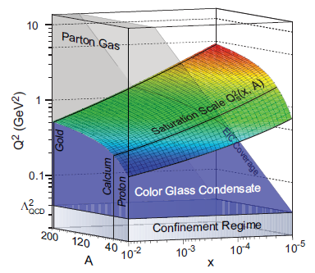
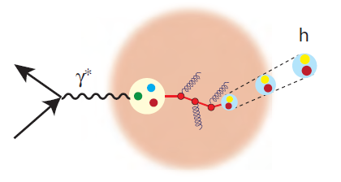
EIC – The Physics Highlights
Explore and image the spin and 3D structure of the nucleon
Needs a machine with high polarized luminosity and variable energy range to cover valence to sea quarks and gluons, excellent acceptance/PID in detectors
Discover the role of gluons in structure and dynamics
Needs a machine capable of high energy capable of accelerating nuclei
Understand the emergence of hadrons from color charge
Needs machine capable of accelerating large & small nuclei & special detectors for nuclear fragments
Investigations of physics beyond the Standard Model
Highest e-p luminosity, highest possible energy and at least one beam polarization

Slide 5
Mass, spin, charge (electric, color, flavor) are fundamental properties of the particles seen in the universe.
Natural to assume that composite particles get their properties from the collective behaviors of the fundamental particles that constitute them.
➔ Charge seems to work, does this apply for mass and spin?
Origin of Mass:
What makes up the mass of the visible universe?
  99.9% of the atomic mass comes from from nuclear mass
  Nuclear Mass comes from the nucleon mass
  Nucleon mass? ➔ energy of massless gluons and almost massless up & down quarks
  Gluon & quark interactions & dynamics make up the entire mass of the visible universe! ➔ “Mass without mass” – John Wheeler

Slide 6
Many interesting and important questions related to gluons: low x physics
But not the focus of this discussion today….

Slide 7
How well do we understand spin?
Spin: Always Surprises
“spin” has killed more theories in physics than any other single observable : E. Leader
If theorists had their way, they would ban all experiments with spin : J.D.Bjorken

Slide 8
Experiments that fundamentally changed the way we think about physics:
Stern and Gehrlach (1921)
  Space quantization associated with the direction
Goudschmidt & Uhlenbeck (1926)
  Atomic fine structure & electron spin magnetic moment
Stern (1933)
  Proton anomalous magnetic moment μ_{N} = 2.79
Kusch (1947)
  Electron anomalous magnetic moment m₀= 1.00119
Yale-SLAC Collaboration (Prescott et al.)
  Electro-Weak interference in polarized e-D DIS: parity non-conservation
European Muon Collaboration (EMC) (1989)
  The Spin Crisis/Puzzle

Slide 9



Our Understanding Of “Nucleon Spin”
Traditionally we treated proton as a 1D object → What are the quark, gluon intrinsic spin contributions to the nucleon’s spin?
Theoretical tools and experiments to view the proton in 3D
What are the position & momentum correlations amongst partons? Do they contribute to nucleon’s spin?
Position & momentum tomography of the nucleon possible??
Prof. M. Morgan-Tracy, UNM
Notes:
Its not just understanding the nucleon spin sum rule. But a deeper quest to understand the nucleon as a many body object in QCD.

Slide 10
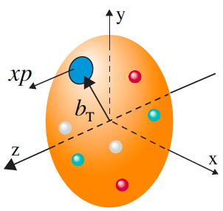
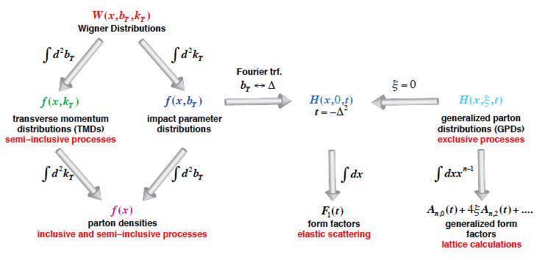
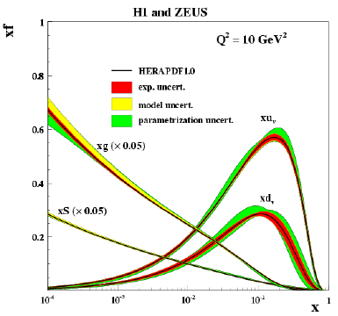
Unified view of the Nucleon Structure
Wigner distributions:
5D
JLab12
COMPASS
for
Valence
HERMES
JLab12
COMPASS
3D
1D
3D imaging of partons: Quarks (fixed target) , Gluons (collider)
TMDs – confined motion in a nucleon (semi-inclusive DIS)
GPDs – Spatial imaging of quarks and gluons (exclusive DIS & diffraction)

Slide 11
WG & GTMDs
qquivalent/
complementary
approaches to
transverse spin
structures and
dynamics of
partons in
nucleons
b : impact parameter
Δ : nucleon mom. transfer
B. Pasquini

Slide 12
Longitudinal spin (helicity contribution)
From ΔΣ and ΔG
Best fits to polarized data from DIS, SIDIS (CERN, DESY, JLab) and polarized p-p (RHIC)
Various studies led by our theory colleagues: De Florian et al, Leader et al, …
We know precisely how to get to ΔΣ and ΔG, what is missing is a broader kinematic range (in x and at moderate to high Q²) to extract these
Only a COLLIDER with polarized beams could do this effectively

Slide 13
Recent global analysis: DSSV
D. deFlorian et al., arXiv:1404.4293
Dramatically makes the statement that, while we have made a huge impact,
We are improving ΔG contributions only in a limited x-region, allowing
large uncertainties to remain in the low-x unmeasured region!
➔ Forward rapidity in jets and π⁰ may be useful but far from “game over”

Slide 14
US EIC: Kinematic reach & properties
For e-N collisions at the EIC:
Polarized beams: e, p, d/³He
e beam 5-10(20) GeV
Luminosity L_{ep} ~ 10³³⁻³⁴ cm⁻²sec⁻¹ ➔ 100-1000 times HERA
Variable center of mass energy

Slide 15
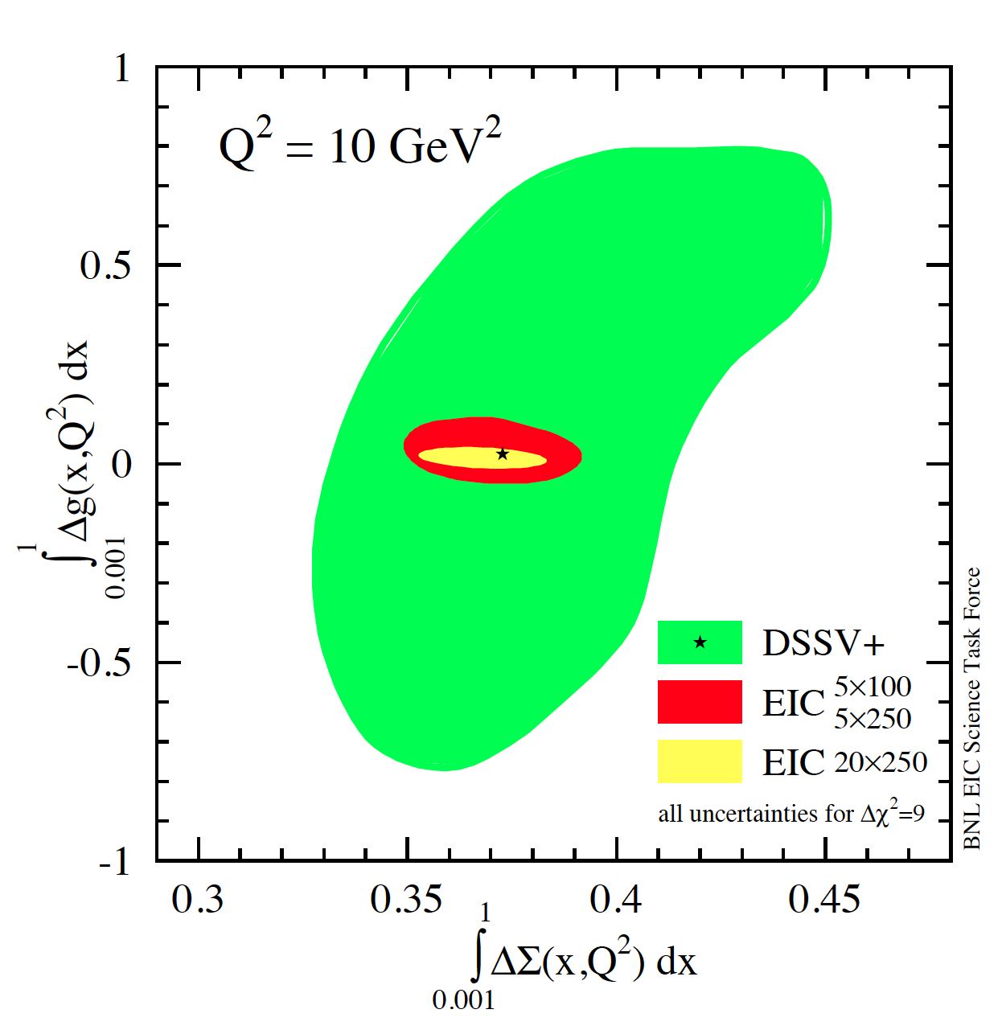
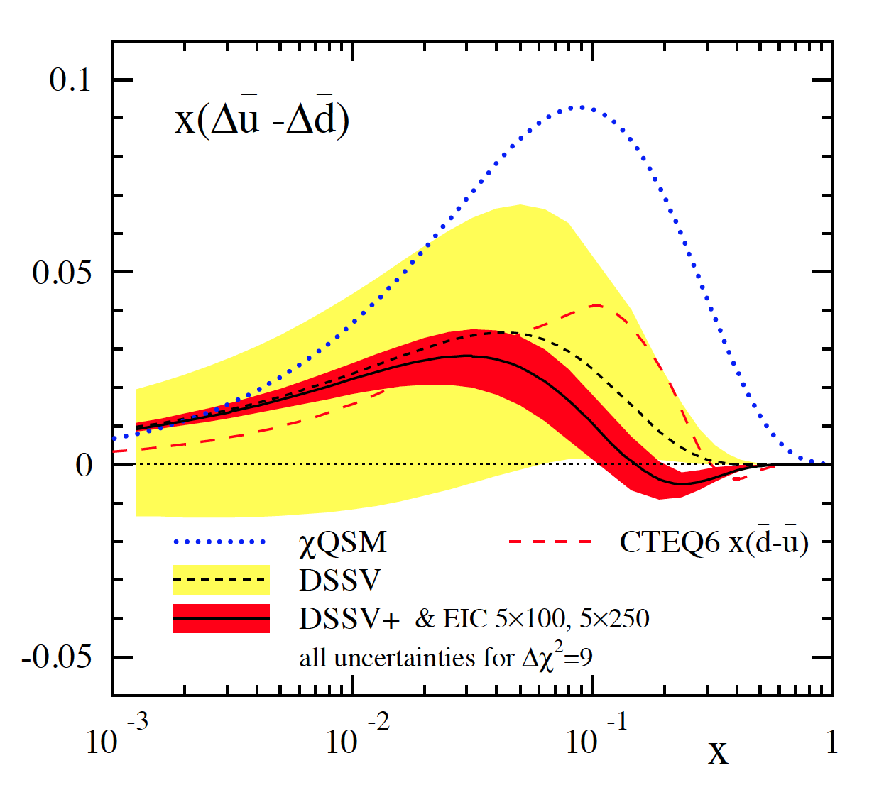
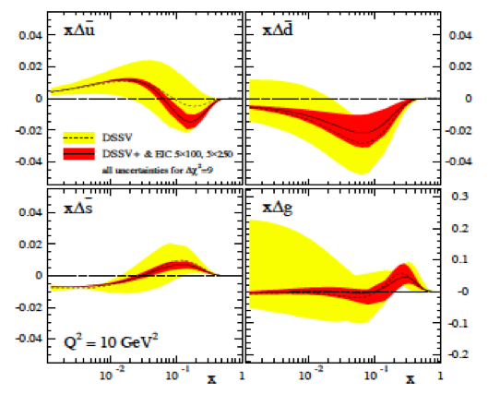
Precision: Gluon & Sea Quark polarization:
--Beyond the current experimental capabilities!
ΔG and ΔΣ in helicity sum
Are the sea quark polarizations different?
current data
w/ EIC data
EIC White Paper: arXive:1212.1701

Slide 16
Current status & what if?
Our best guess at the contributions from ΔΣ and ΔG are at about ~50% of the total contribution to the nucleon spin, with large uncertainty.
  Reduction in uncertainty will require the larger kinematic range i.e. a collider
What if one is able to measure ΔΣ & ΔG to 1%?
The remaining spin has to come then come from the orbital motion of quarks and gluons…. Intimately connected to the transverse/rotational motion of partons in the proton
As most of us now know, transverse dynamics is also fundamental to understanding QCD, not just for understanding the nucleon spin rules

Slide 17
What if based on:
D. deFlorian et al., arXiv:1404.4293
If ΔG = 1 then assuming ΔΣ = 0.3
L_{Q+G} would have to have to bopposite
to N-spin ~ -0.65
If ΔG = 0
L_{Q+G} would will have to be along to N-spin
and ~ +0.35
If ΔG = -0.5
L_{Q+G} would have to be along N-spin
and ~ +0.65
** Above values offset by +0.2 will fix it later
Dramatically makes the statement that, depending on precision values of DS and
DG we will get very different and drastically different scenarios for the internal
Dynamics of the partons in the nucleon

Slide 18
Another important “spin surprise”
In my mind signifies the importance of role theory plays in our perception and outlook to measurements and their interpretation.

Slide 19
Transverse spin
Kane, Pumplin, Repko 1978
Since people starved to measure effects at high p_{T} to interpret them in pQCD frameworks, this was “neglected” as it was expected to be small….. However….
Pion production in single transverse spin collisions showed us something different….

Slide 20

Pion asymmetries: at most CM energies!
ZGS/ANL
√s=4.9 GeV
AGS/BNL
√s=6.6 GeV
FNAL
√s=19.4 GeV
RHIC
√s=62.4 GeV
Suspect soft QCD effects at low scales, but they seem to remain relevant to
perturbative regimes as well

Slide 21
Possible origins for A_{N}
Sivers mechanism: asymmetry in production of forward jet or γ
Collins mechanism: asymmetry in the forward jet fragmentation
S_{P}
S_{P}
k_{T,q}
p
p
p
p
S_{q}
k_{T,π}
Sensitive to proton spin – parton transverse motion correlations
Sensitive to transversity
Need to go beyond inclusive hadron measurements
Possibilities include jets, direct photons, di-hadron correlations, W-production… etc. addressing host of interesting issues including fundamental tests of QCD
2015 and beyond…

Slide 22
Probe & target complex
Soft interactions before collisions can destroy factorization, i.e. nuclear wave function affected
Kinematics imprecisely determined
Probe point like
No soft interactions, factorization preserved
Kinematics precisely determined

Slide 23
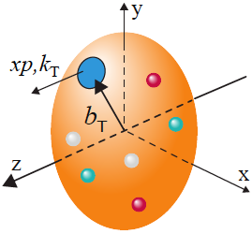
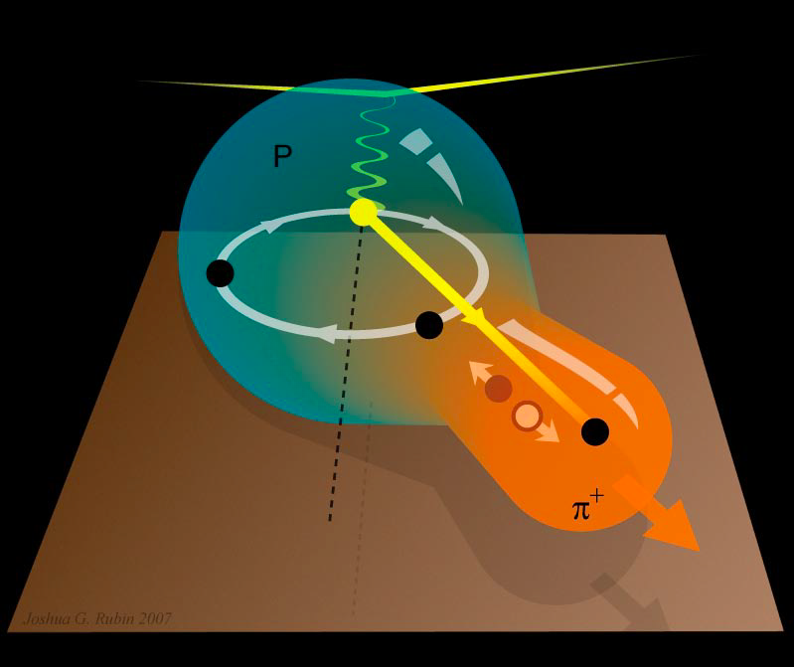
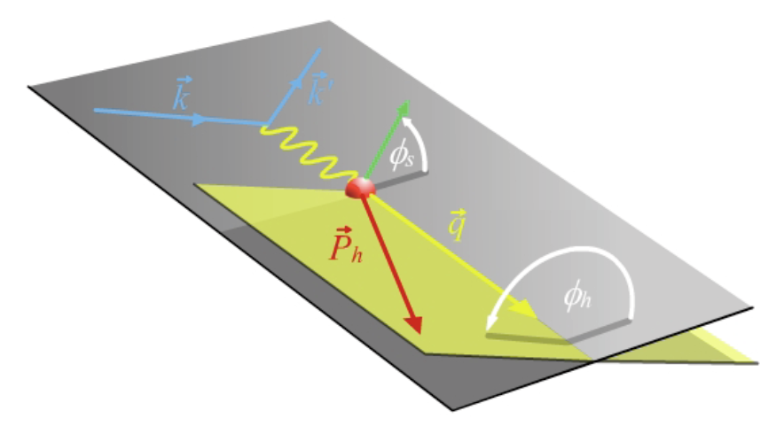
Semi-Inclusive DIS ➔ Best for measuring Transverse Momentum Distributions
Naturally, two scales:
high Q – localized probe
  To “see” quarks and gluons
Low p_{T} – sensitive to confining scale
  To “see” their confined motion
Theory – QCD TMD factorization
Naturally, two planes:

Slide 24
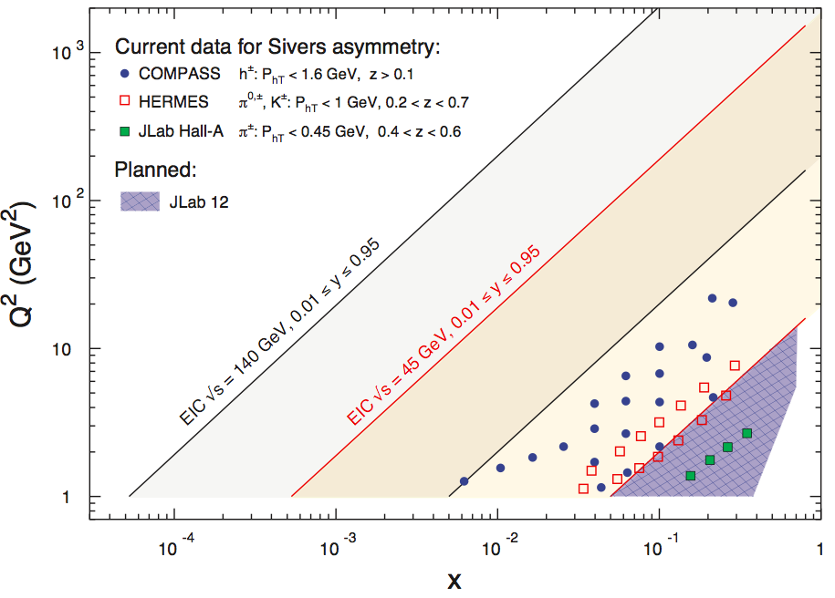
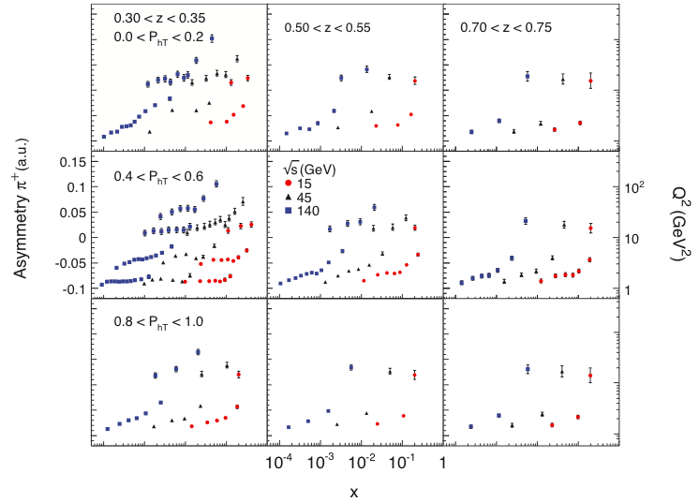
First, maybe the only, measurement of polarized sea and gluon TMDs
High luminosity implies: Single transverse-spin asymmetries: high resolution & multidimensional

Slide 25
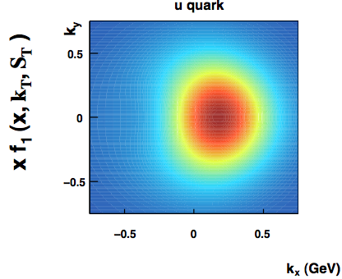
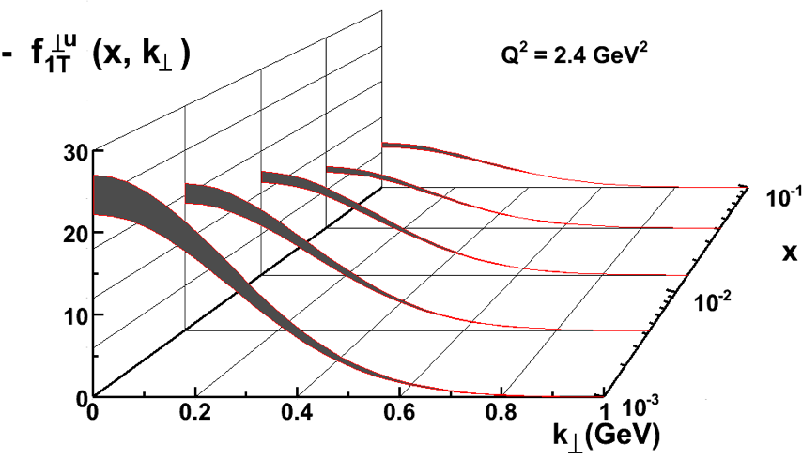
Momentum tomography of the nucleon
Tomographic images of K_{X}/K_{y} of partons as functions of Bjorken-x: u quark distribution for transversely polarized proton.
With EIC: low x partonic plots like these possible!

Slide 26
Exclusive DIS
Measure of resolution power
Kinematics:
e’
γ
Measure of inelasticity
e
γ_{L}*
(Q²)
x+ξ
Measure of momentum fraction of struck quark
x-ξ
~
~
H, H, E, E (x,ξ,t)
p
p’
t
Exclusive events:
e + (p/A) → e’+ (p’/A’)+ γ / J/ψ / ρ / φ
detect all event products in the detector
Allow access to the spatial distribution of partons in the nucleon
Fourier transform of spatial distributions ➔ GPDs
GPDs ➔ Orbital Angular Momenta!

Slide 27
GPDS: Transverse spatial parton distribution from exclusive J/Ψ production
b_{T} is the distance of the sea quarks from the center of the proton
x_{V} determines the parton momentum fraction
E_{e} = 5, 20 GeV
E_{p} = 100, 250 GeV

Slide 28
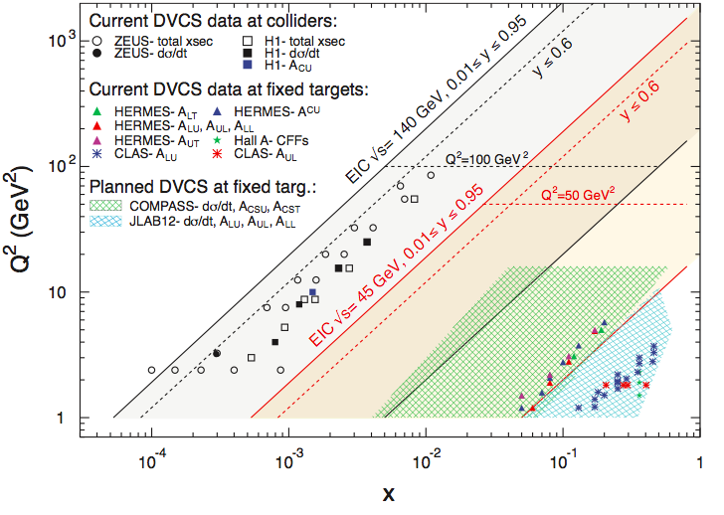
EIC coverage for GPDs
First, maybe the only, measurement of polarized sea and gluon GPDs

Slide 29
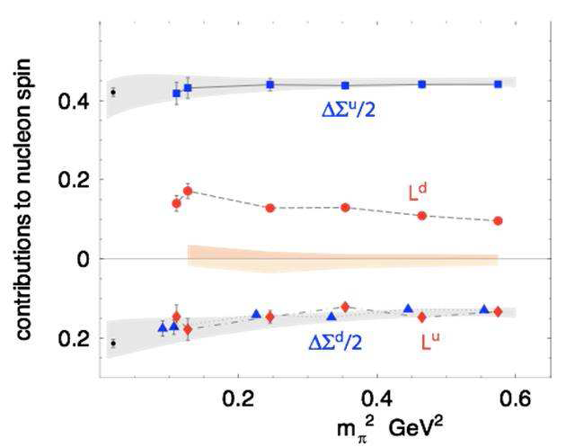
An immediate check:
Quark GPDs and its orbital contribution to proton’s spin:
The first meaningful constraint on quark orbital contribution to proton spin
by combining the sea from the EIC and valence region from JLab 12
This could be checked
by Lattice QCD
L_{u} + L_{d} ~ 0?
There are also more recent ideas
Of calculating parton distribution functions on Lattice:
X. Ji et al. arXiv 1310.4263; 1310.7471; 1402.1462
& Y.-Q. Ma, J.-W. Qiu 1404.6860

Slide 30
Physics Beyond The SM?
Making connections to other subfields of US Nuclear Physics:
Next generation SOLID/PVDIS Experiment at JLab12
Will need the highest possible luminosity for the collider & a great control of systematics…
-- Sin²Θ_{W} (weak mixing angle & its evolution/running)
-- Because of significantly higher CM energy than fixed target experiments and high luminosity (10³⁴ cm⁻²sec⁻¹): Searches of lepto-quarks and other such exotics

Slide 31
Sin²Θ_{W} with the EIC: Physics Beyond SM
Precision parity violating asymmetry measurements e/D or e/p
Deviation from the “curve” may be hints of BSM scenarios including: Lepto-Quarks, RPV SUSY extensions, E₆/Z’ based extensions of the SM
Black: measurements
Blue: near future measurements
Red: US EIC projections
Maroon: LHeC Projection
LHeC

Slide 32
How does EIC compare with HERA?
Private communications: M. Gonderinger
q_{i} q_{j}
Detailed detector studies needed.
About to be initiated.

Slide 33
In summary:
Studying physics with “spin” has always taught us something very fundamental about nature: (understanding the composite particles and using “spin” as a tool to understand something beyond…)
Nucleon spin crisis is now a puzzle:
  We know what the components are, and how to get to some of them with high precision (helicity components). It is imperative that we go after this!
  The TMDs and GPDs are now in coherent formalism➔ 2+1 D tomogrphy a nucleon possible: Quark sector at JLab and COMPASS in the next decade, and in gluon/sea quarks dominated region needs higher energy
  Study of gluon/sea quarks dominated region needs high energy collisions possible at the EIC
The EIC could very well be the machine that addresses all aspects of nucleon spin measurements comprehensively and could enable a meaning full dialogue with lattice QCD

Slide 35
Opportunity for EIC
Limits on LFV(1,3) experimental searches are significantly worse than those for LFV(1,2)
Especially if there are BSM models which specifically allow and enhance LFV(1,3) over LFV(1,2)
  Minimal Super-symmetric Seesaw model
    J. Ellis et al. Phys. Rev. D66 115013 (2002)
  SU(5) GUT with leptoquarks
    I. Dorsner et al., Nucl. Phys. B723 53 (2005)
    P. Fileviez Perez et al., Nucl. Phys. B819 139 (2009)
M. Gonderinger & M.Ramsey Musolf, JHEP 1011 (045) (2010); arXive: 1006.5063 [hep-ph]
  10 fb⁻¹ e-p luminosity @ 90 GeV CM would have potential
  Detector & analysis efficiencies assumed 100%
  HERA experience: effective efficiencies 5-15%
Clearly there is an opportunity for EIC: “icing on the cake”

Slide 36
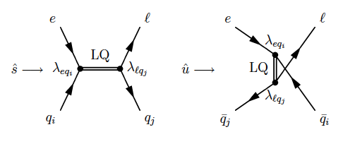
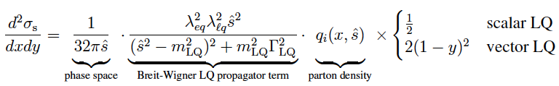
LFV phenomenology
Leptoquark (LQ) event topologies studied with:
  LFV MC generator: LQGENEP (L. Bellagamba, Comp. Phys. Comm. 141, 83 (2001)
  LQ generator for e-p processes using BRW effective model
In this study to increase efficiency: BW-LO propagator replaced with a constant.
  m_{LQ} = 200 GeV, λ = 0.3 (for example one particular LQ…)
  Then go over various values of M_{LQ} i.e. ratios: z = λiλj/M_{LQ}²
τ has a clean characteristic decay signature:
  3π decay in a narrow pencil like jet
  Leptonic decays with neutrinos (missing momentum) with different angular correlations in SM vs. LQ

Slide 37
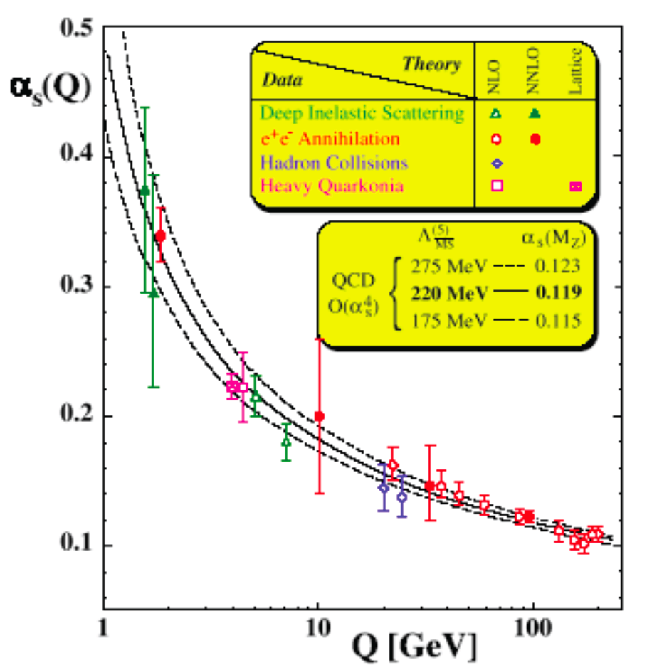

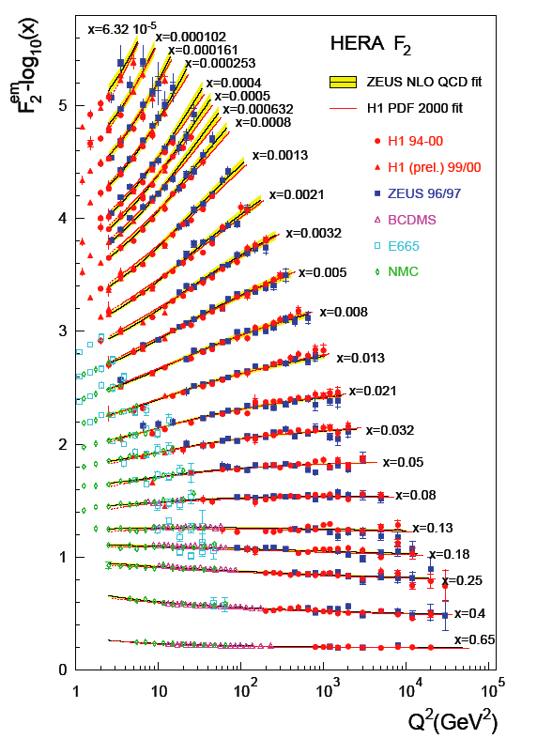
Durr et al. Science 322 (2009) 1224
Successes of
QCD
Measure e-p 0.3 TeV:
➔ Use pQCD Calculate p-p, p-pbar Jet x-sctn at 0.2, 2, 7 TeV

Slide 38
Polarized PDFs: (almost) current status
D. De Florian,
R. Sassott
M. Stratmann
W. Vogelsang
Next-to-Leading Order
pQCD fit to all available
Polarized data:
Pol. DIS fixed target
+
Polarized RHIC

Slide 39
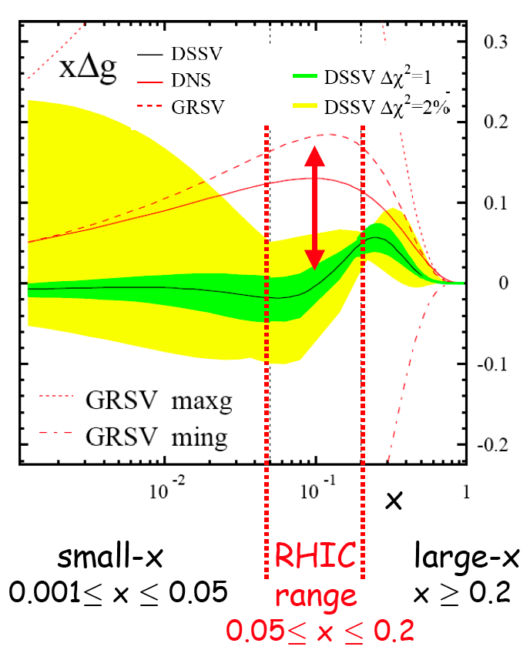
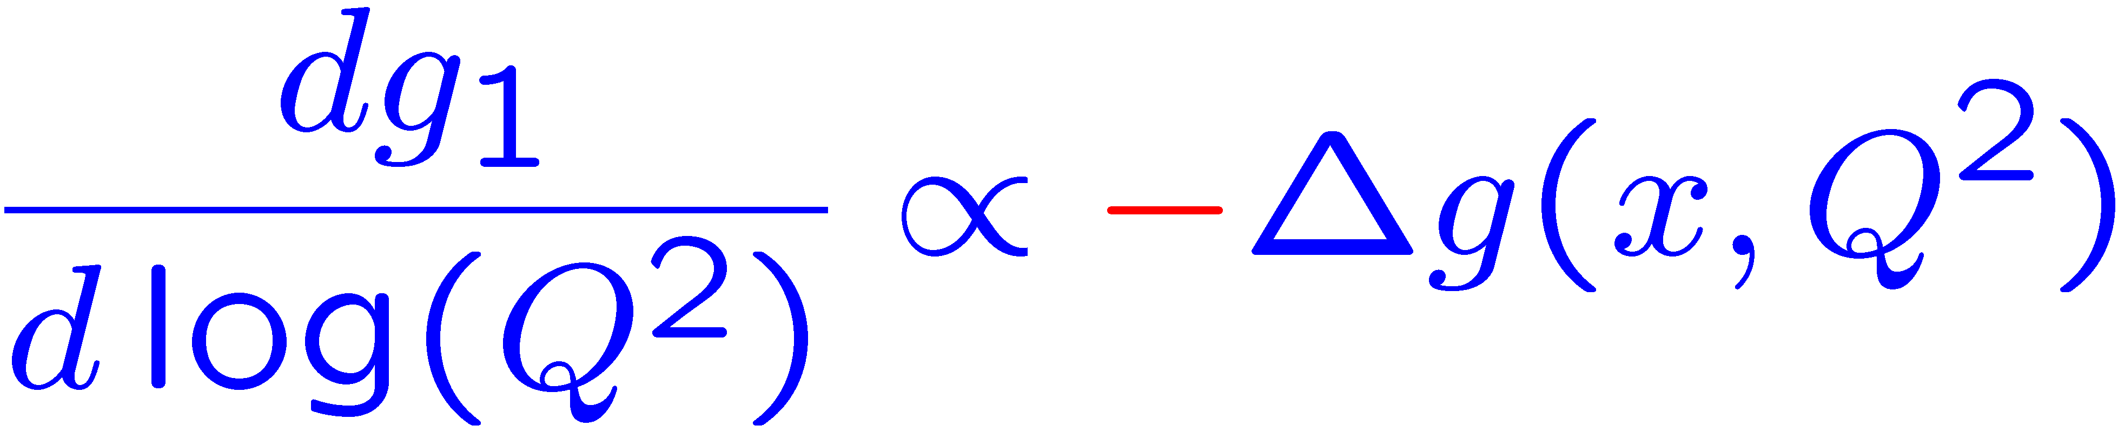
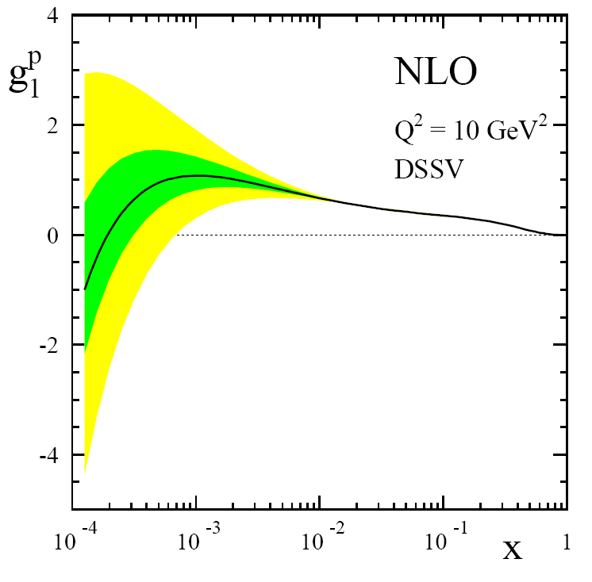
Current knowledge of Polarized Glue:
de Florian, Sassot, Stratmann & Vogelsang
Global analysis: DIS, SIDIS, RHIC-Spin
Uncertainly on ΔG large at low x
positive Δg
Low x measurements
=Opportunity!
Present

Slide 40
Pion: single transverse spin asymmetries!
ZGS/ANL
√s=4.9 GeV
AGS/BNL
√s=6.6 GeV
FNAL
√s=19.4 GeV
RHIC
√s=62.4 GeV

Slide 41
Our Universe:
68% Dark energy
27% Dark matter
5% Visible matter
What makes up the mass of the visible universe?
  Atomic mass (visible matter): 99.9% from nuclear mass
  Nuclear Mass: all of it from nucleon mass
  Nucleon mass? ➔ energy of massless gluons and almost massless up & down quarks
  Gluon & quark interactions & dynamics make up the entire mass of the visible universe!
  ➔ “Mass without mass” – John Wheeler
Planck 2013 Results

Slide 42
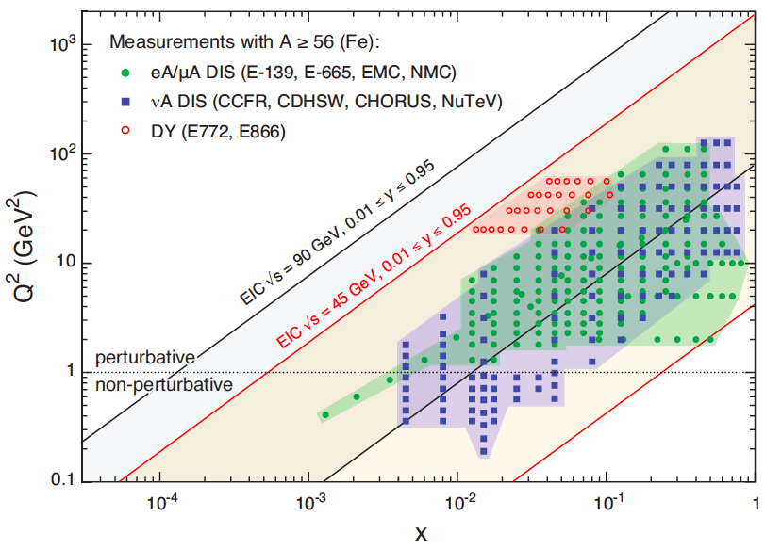
US EIC: Kinematic reach & properties
For e-N collisions at the EIC:
Polarized beams: e, p, d/³He
e beam 5-10(20) GeV
Luminosity L_{ep} ~ 10³³⁻³⁴ cm⁻²sec⁻¹
  100-1000 times HERA
Variable center of mass energy
For e-A collisions at the EIC:
Wide range in nuclei
Luminosity per nucleon same as e-p
Variable center of mass energy

Slide 43
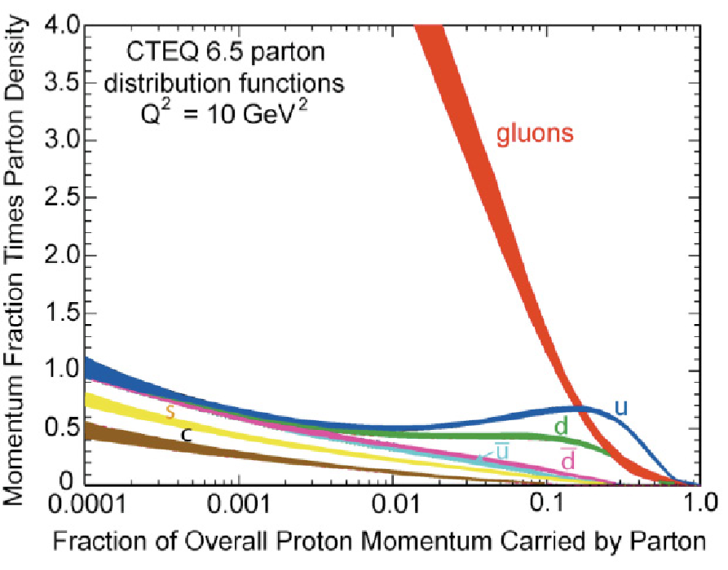
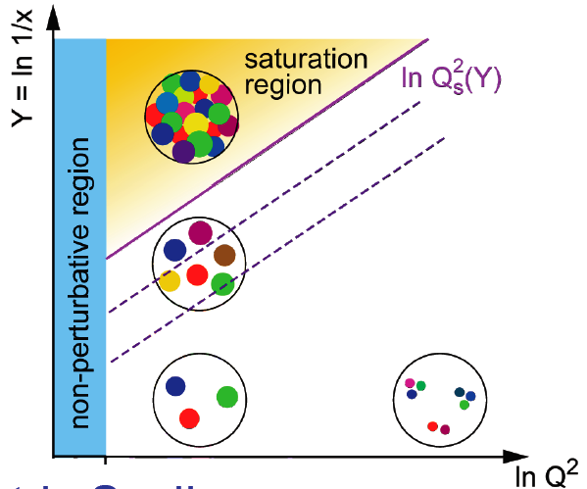
Physics at Low x?
See Ann. Rev. Nucl Part (60) 2010 F. Gelis et al., , arXiv:1002.0333)
Method of including non-linear effects (McLerran, Venugopalan)
Small coupling, high gluon densities
BK/JMWLK equations lead to a Saturation Scale Q_{S}(Y)
BK/JMWLK
Linear QCD
BFKL: gluon
emission
Nonlinear QCD
BK/JMWLK gluon recombination
BFKL
=
At Q_{S}
DGLAP
Strongly correlated gluonic system? Universal? Properties?
Need a higher energy e-p collider than HERA! ➔LHeC
Or ➔ Nuclei: naturally enhance the densities of partonic matter
Why not use Nuclear DIS at high energy?

Slide 44

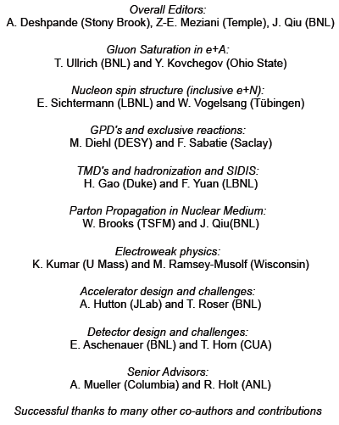
White Paper: EIC Science Case
arXiv:1212.1701
Charged by
R. McKeown (Jlab) & S. Vigdor (BNL)

Slide 45

Deep Inelastic Scattering = Precision + Control
Kinematics:
Measure of resolution power
Measure of inelasticity
Measure of momentum fraction of struck quark
Inclusive events: e+p/A → e’+X
detect only the scattered lepton in the detector
Semi-inclusive events: e+p/A → e’+h(π,K,p,jet)+X
detect the scattered lepton in coincidence with identified hadrons/jets in
the detector
Exclusive events: e+p/A → e’+ p’/A’+ h(π,K,p,jet)
Detect every things including scattered proton/nucleus (or its fragments)
with respect to γ

Slide 46
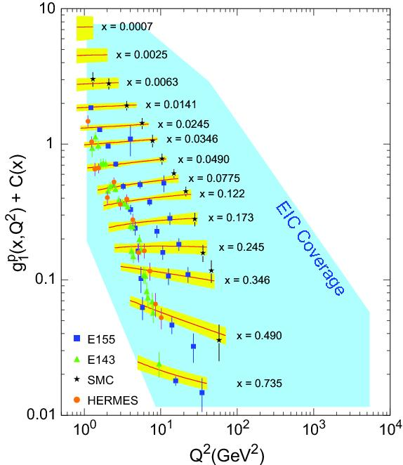
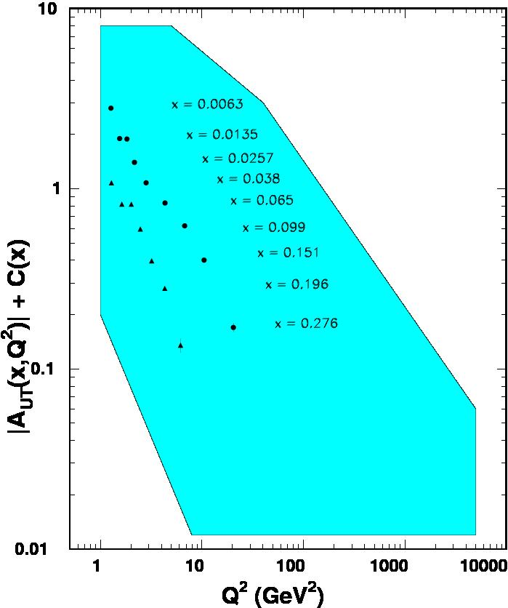

World Data on F₂^{p}
World Data on g₁^{p}
World Data on h₁^{p}
F_{UT}^{sin(φh+φs)}(x,Q²) + C(x) $∝h1$
An EIC makes it possible!
EIC coverage
COMPASS
HERMES
transverse spin ~ angular momentum
momentum
spin
Rolf Ent, DIS2014

Slide 47
Nucleus:
A laboratory for QCD
What do we know about the gluons in nuclei? Very little!
Parton propagation and interaction in nuclei (vs. protons)
Does gluon density saturate? Does it produce a unique and universal state of matter?

Slide 48
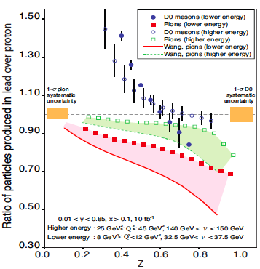
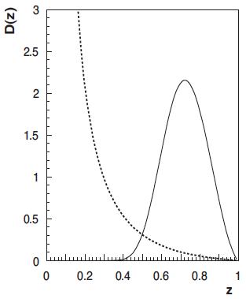
Hadronization & Energy Loss in cold QCD matter
How hadrons emerge from quarks and gluons?
Unprecedented ν range at EIC:
D⁰
Control of ν and
length in the Medium
Heavy quark energy loss:
π
semi-inclusive
DIS
Mass dependence of fragmentation
pion
D⁰
Need the collider energy of EIC
and its control on parton kinematics

Slide 49

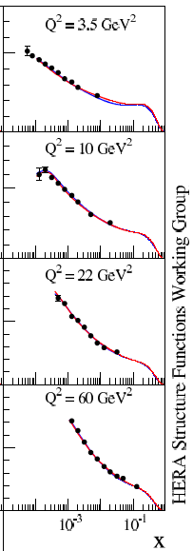
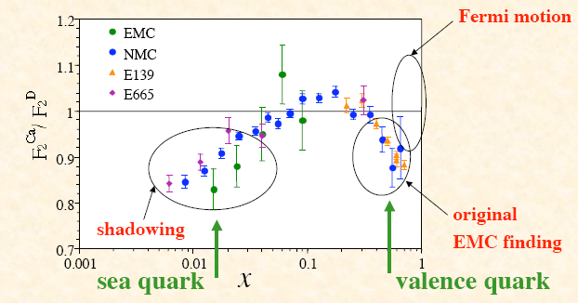
Nuclear Landscape: What do we know at low x?
EMC effect, Shadowing and Saturation:
Saturation in R_{F2}
≠
Saturation in F₂
Saturation in F₂(A) = R_{F2} decreases until saturation in F₂(D)
Questions:
Is (if so why is) nuclear structure function suppressed at small x?
Will the suppression continue fall as x decreases?
Range of color correlation – could impact the center of neutron stars!

Slide 50
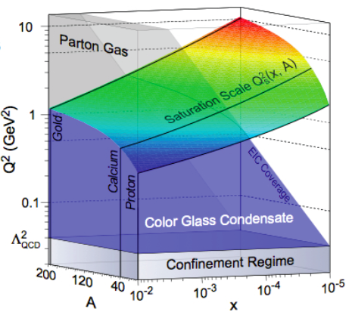
Exploring a new phase of matter:
Probe the NUCLEI with the: Electron Ion Collider (EIC)
Probe high gluonic density
matter, find what “Q_{s”} is!
Balance
between
Kowalski, Teany
PRD 68:114005
Enhancement of Q_{S} with A, not energy

Slide 51
Saturation/CGC: What to measure?
F₂ (quark+ antiquark) & F_{L}(gluons) at low x (classic inclusive measurement)
  F_{L} requires change in the center of mass energy in operation of collider
Diffraction:
At HERA: ep observed 10-15%
If CGC/Saturation: then
Diffraction eA expect ~25-30%
Diffractive to Total cross section ratio for eA/ep
Experimental challenges in diffractive measurements drive the detector and IR design.

Slide 52
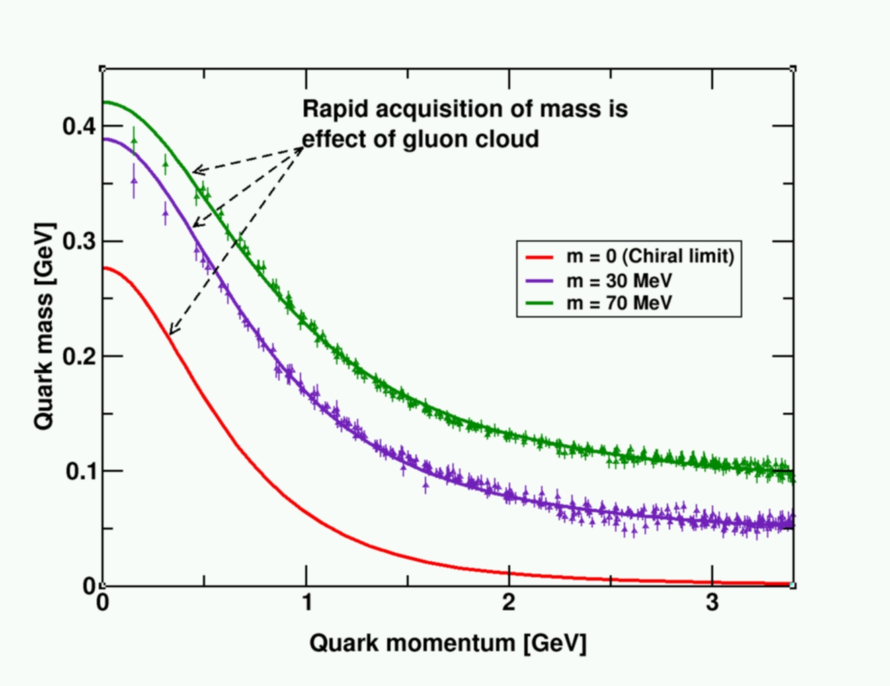

Generation of mass in QCD
99% of the nucleon mass: self-generated gluon fields
Similarity between p, n mass indicates ➔ gluon self interactions are identical & overwhelmingly important:
Bhagwat et al. arXiv:0710.2059 [nucl-th]
Success of QCD!
Higgs boson
plays no role here.
Other successes of QCD: ➔

Slide 53
Successes of
QCD
Durr et al. Science 322 (2009) 1224

Slide 54
QCD is the correct theory of strong interactions, but do we understand it?
“Folks, we should stop testing QCD, and start understanding it.” Yuri Dokshitzer (ICHEP’98, Vancouver)
How well do we understand the role of gluons in QCD?
How well do we understand the sea quarks?

Slide 55
QCD is no doubt correct, but there remain many unsolved, compelling questions!

Slide 56

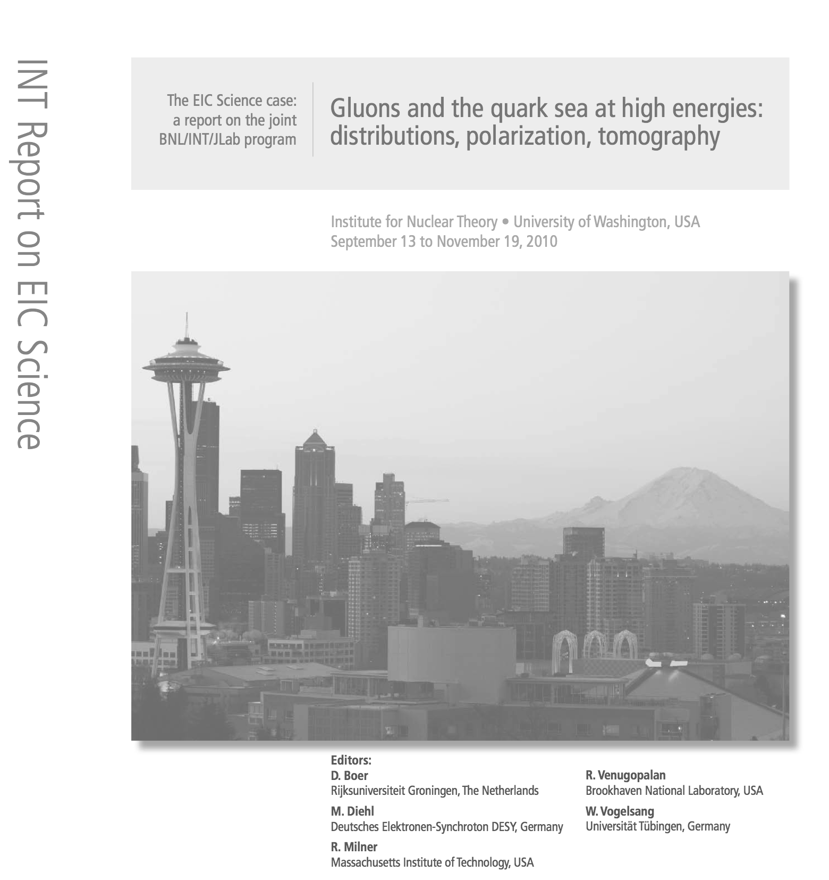
Evolving status of EIC in the US:
NSAC 2007 Long-Range Plan:
“An Electron-Ion Collider (EIC) with polarized beams has been embraced by the U.S. nuclear science community as embodying the vision for reaching the next QCD frontier. EIC would provide unique capabilities for the study of QCD well beyond those available at existing facilities worldwide and complementary to those planned for the next generation of accelerators in Europe and Asia.”
NSAC Facilities Subcommittee (2013):
The Subcommittee ranks an EIC as Absolutely Central in its ability to contribute to world-leading science in the next decade.”
NSAC NEXT Long-Range Process:
Officially started! Final report due on October 15, 2015
EIC needs to be a high recommendation in this report!

Slide 57
Summary & Outlook:
The EIC will profoundly impact our understanding of QCD with its energy variability , high luminosity (e-A) and polarized e-p/D collisions
It will lead to a 2+1 D view of nucleons and nuclei: Color distributions! And study the transition from low to high density QCD matter
EIC: 1st polarized DIS collider, 1st nuclear DIS collider, Focus: QCD
  Precision studies of the role of sea quarks and gluons in QCD
  Precision always leads to discoveries…
Development of the Standard model needed: p-p/p-bar, e-e, e-p collisions →complimentary but essential role
EIC’s will add “spin” and “nuclei” to this list: A-A, p/d-A, e-A
Currently two designs: JLab & BNL both use upgrades of existing facilities.
Next milestones for US EIC: Long Range Plan of the NSAC 2014/5 for support & approval by the US NP community. Its critical that both JLab and RHIC user communities work closely together with our international collaborators to get this through the LRP.

Slide 58
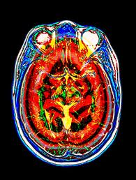
MRI scan of the normal brain
Prof. Dr. Mark Morgan-Tracy
U. Of New Mexico

Slide 59
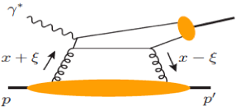
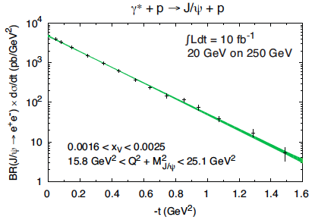
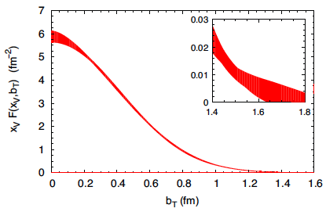
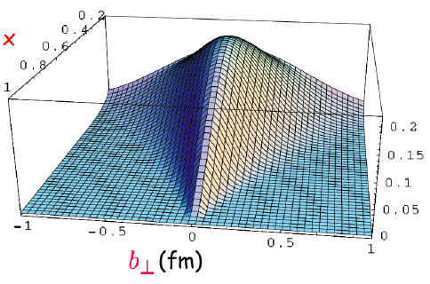
Spatial imaging of gluon density
Exclusive vector meson production:
J/Ψ, Φ, …
Fourier transform of the t-dep
Spatial imaging of glue density
t-dep
Resolution ~ 1/Q or 1/M_{Q}
Gluon imaging from simulation:
Only possible at the EIC
Gluon radius?
How spread
at small-x?

Slide 60
EIC is the best for probing TMDs
Naturally, two planes:
Separation of TMDs:
Collins frag. Func.
from e⁺e⁻ collisions
Hard, if not impossible, to separate TMDs in hadronic collisions

